Slide 1
Enabling Innovation
Inside the Network
Jennifer Rexford
Princeton University
http://www.cs.princeton.edu/~jrex

Slide 2

The Internet: A Remarkable Story
Tremendous success
  From research experiment
  to global infrastructure
Brilliance of under-specifying
  Network: best-effort packet delivery
  Hosts: arbitrary applications
Enables innovation
  Apps: Web, P2P, VoIP, social networks, …
  Links: Ethernet, fiber optics, WiFi, cellular, …

Slide 3
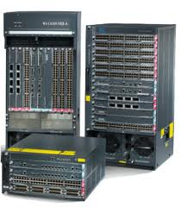
Inside the ‘Net: A Different Story…
Closed equipment
  Software bundled with hardware
  Vendor-specific interfaces
Over specified
  Slow protocol standardization
Few people can innovate
  Equipment vendors write the code
  Long delays to introduce new features

Slide 4
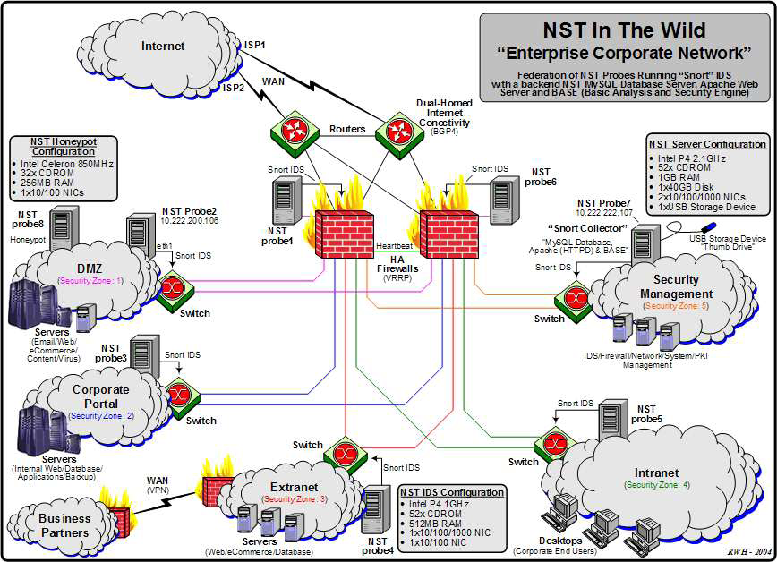
Do We Need Innovation Inside?
Many boxes (routers, switches, firewalls, …), with different interfaces.
Notes:
Enterprise network.

Slide 5
Software Defined Networking (SDN)

Slide 6



Software Defined Networks
control plane: distributed algorithms
data plane: packet processing

Slide 7
Software Defined Networks
decouple control and data planes

Slide 8
Software Defined Networks
decouple control and data planes
by providing open standard API

Slide 9

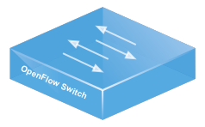
Simple, Open Data-Plane API
Prioritized list of rules
  Pattern: match packet header bits
  Actions: drop, forward, modify, send to controller
  Priority: disambiguate overlapping patterns
  Counters: #bytes and #packets
src=1.2.*.*, dest=3.4.5.* → drop
src = *.*.*.*, dest=3.4.*.* → forward(2)
3. src=10.1.2.3, dest=*.*.*.* → send to controller

Slide 10
(Logically) Centralized Controller
Controller Platform

Slide 11
Protocols ➔ Applications
Controller Application
Controller Platform

Slide 12


Seamless Mobility
See host sending traffic at new location
Modify rules to reroute the traffic

Slide 13
Server Load Balancing
Pre-install load-balancing policy
Split traffic based on source IP
10.0.0.1
src=0*,
dst=1.2.3.4
10.0.0.2
src=1*,
dst=1.2.3.4

Slide 14
Example SDN Applications
Seamless mobility and migration
Server load balancing
Wide-area traffic engineering
Network virtualization
Dynamic access control
Using multiple wireless access points
Energy-efficient networking
Adaptive traffic monitoring
Denial-of-Service attack detection
See http://www.openflow.org/videos/

Slide 15


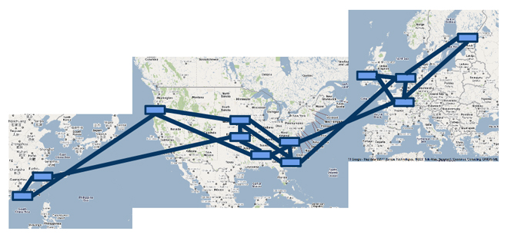

A Major Trend in Networking
Entire backbone
runs on SDN
Bought for $1.2 x 10⁹
(mostly cash)
Notes:
Why now
Merchant silicon chipset vendors enabling new entrants
Cloud computing driving big spend and willingness to program
Research community hungry for a way to do big work with real impact

Slide 16
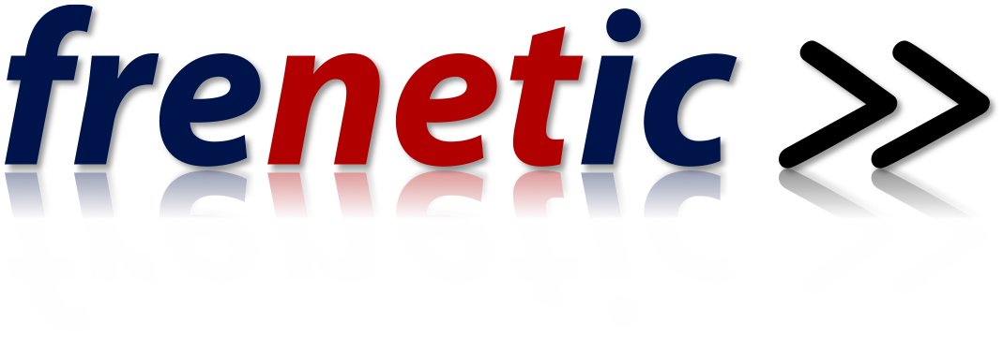
http://frenetic-lang.org

Slide 17



SDN Programming is Hard
The Good
  Network-wide visibility
  Direct control over the switches
  Simple data-plane abstraction
The Bad
  Low-level programming interface
  Functionality tied to hardware
  Explicit resource control
The Ugly
  Non-modular, non-compositional
  Cannot easily combine multiple apps

Slide 18
Network Control Loop
Compute Policy
Read
state
Write
policy
OpenFlow
Switches

Slide 19
Frenetic Language Abstractions
Composition
operators
Query
language
Consistent updates
OpenFlow
Switches
http://www.frenetic-lang.org/

Slide 20
Modular Controller Applications
A module for each task
Monitor
Route
FW
LB
Controller Platform
Easier to program, test, and debug
Notes:
And, a more healthy SDN ecosystem

Slide 21
Network Functions Virtualization (NFV)

Slide 22
OpenFlow Switches are Not Enough
Only simple packet processing
  Reading and writing packet headers
  Multiple stages of match-actions tables
Version | Date | # Headers
OF 1.0 | Dec 2009 | 12
OF 1.1 | Feb 2011 | 15
OF 1.2 | Dec 2011 | 36
OF 1.3 | Jun 2012 | 40
OF 1.4 | Oct 2013 | 41

Slide 23
More General Functionality
Video transcoding
Parental controls
Intrusion detection systems
Firewalls that inspect content
Load balancers that act on URLs
Web proxy caches
Compression/decompression
Encryption/decryption
…

Slide 24
Traditional “Middleboxes”
Dedicated appliances
  Hardware and software bundled together
  Placed at critical junctures (e.g., gateway)
Inefficient solution
  Expensive equipment
  Vendor lock-in
  Single point of failure
  Must process all packets

Slide 25

Network Functions Virtualization
Virtualized network functions (VNFs)
  Separate the software from the hardware
  E.g., run each VNF in a virtual machine (VM)
  Leverage commodity server platforms
  Mix and match VNFs from different vendors
FW
DPI
Hypervisor

Slide 26



Network Functions Virtualization
Service placement
  Decide how many VMs to run
  … and where to place them
FW
DPI
DPI
FW
Hypervisor
Hypervisor
26

Slide 27
Network Functions Virtualization
Service chaining
  Decide which traffic goes through which VNFs
  … and configure the switches to steer traffic
FW
DPI
DPI
FW
Hypervisor
Hypervisor

Slide 28
High-Level Programming
for each flow to port 80:
apply
if DPI triggers an alert:
apply
App
DPI
Controller
Firewall
Place
elements
Install
rules
Application: Map group of
packets to sequence of elements
Element: Perform a virtual network function
Optimize placement, chaining, and routing

Slide 29
Going Forward

Slide 30
Emerging Trends
SDN in more settings
  Data centers and private backbones
  Enterprises, exchange points, cellular core, homes
Greater programmability
  OpenFlow 1.x with increasing flexibility
  Protocol-independence, bare-metal switching, …
Distributed controllers
  Replicated for reliability
  Distributed for scalability
  Across administrative domains

Slide 31
Emerging Trends
Reliable SDN software
  Verifying network invariants
  Automating the testing process
SDN security
  Using SDN to improve network security
  Improving the security of SDN
Software-Defined Infrastructure
  Switches, storage, compute, …

Slide 32
Separate Service from Infrastructure
Industry Trend | Service | Infrastructure
Cloud computing | Applications running in a VM | Physical servers
Software defined networking | Network control software | Switches and routers
Network functions virtualization | Middlebox functions | Dedicated appliances
Managing a fungible pool of heterogeneous resources

Slide 33
Conclusions
Software-defined everything
  Enables innovation
  Broadens who gets to innovate
Key enablers
  Simple, open interfaces to components
  Reusable, high-level programming abstractions
  Platforms for mixing and matching apps
  General distributed-systems solutions
Shaking up the marketplace
  Challenging the dominant vendors
  Enabling new networked services

