Slide 1
Programming Languages for Software Defined Networks
Jennifer Rexford and David Walker
Princeton University
http://frenetic-lang.org
Joint work with the research groups of Nate Foster (Cornell) and Arjun Guha (Umass-Amherst), and several students and post-docs at Princeton

Slide 2
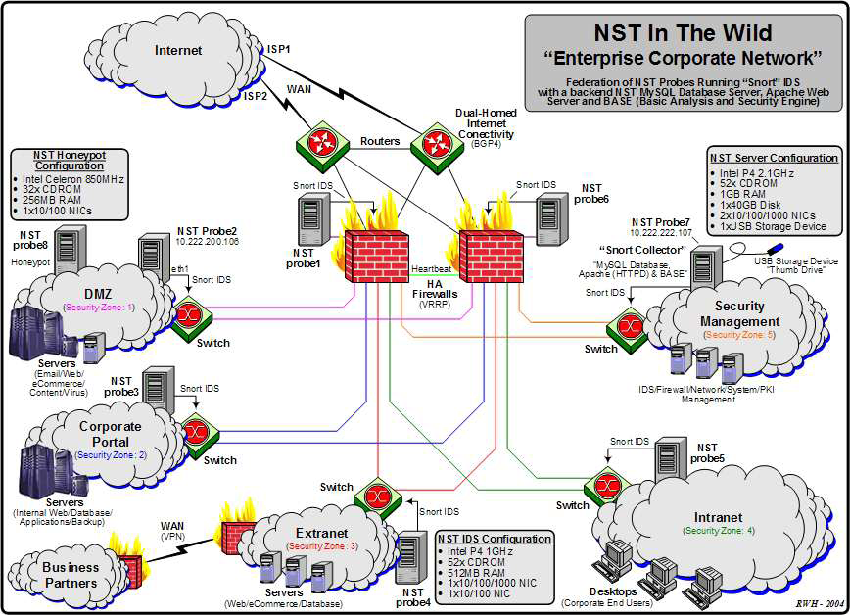
Today’s Networks are a Mess!
Many boxes (routers, switches, firewalls, …), with different interfaces.
Notes:
Enterprise network.

Slide 3



Software Defined Networks
control plane: distributed algorithms
data plane: packet processing

Slide 4
Software Defined Networks
decouple control and data planes

Slide 5
Software Defined Networks
decouple control and data planes
by providing open standard API

Slide 6

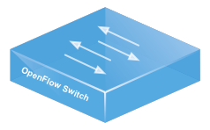
Simple, Open Data-Plane API
Prioritized list of rules
  Pattern: match packet header bits
  Actions: drop, forward, modify, send to controller
  Priority: disambiguate overlapping patterns
  Counters: #bytes and #packets
src=1.2.*.*, dest=3.4.5.* → drop
src = *.*.*.*, dest=3.4.*.* → forward(2)
3. src=10.1.2.3, dest=*.*.*.* → send to controller

Slide 7
(Logically) Centralized Controller
Controller Platform

Slide 8
Protocols ➔ Applications
Controller Application
Controller Platform

Slide 9
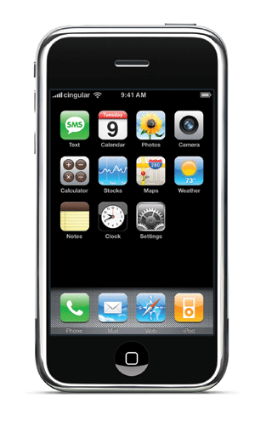

Seamless Mobility
See host sending traffic at new location
Modify rules to reroute the traffic

Slide 10
Server Load Balancing
Pre-install load-balancing policy
Split traffic based on source IP
10.0.0.1
src=0*,
dst=1.2.3.4
10.0.0.2
src=1*,
dst=1.2.3.4

Slide 11
Example SDN Applications
Seamless mobility and migration
Server load balancing
Dynamic access control
Using multiple wireless access points
Energy-efficient networking
Adaptive traffic monitoring
Denial-of-Service attack detection
Network virtualization
See http://www.openflow.org/videos/

Slide 12


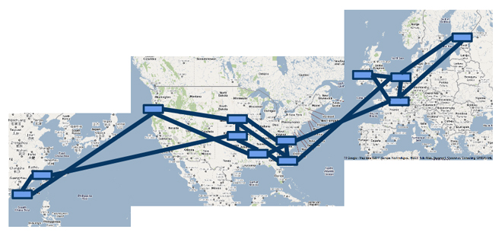

A Major Trend in Networking
Entire backbone
runs on SDN
Bought for $1.2 x 10⁹
(mostly cash)

Slide 13

Programming SDNs
http://frenetic-lang.org

Slide 14



Programming SDNs
The Good
  Network-wide visibility
  Direct control over the switches
  Simple data-plane abstraction
The Bad
  Low-level programming interface
  Functionality tied to hardware
  Explicit resource control
The Ugly
  Non-modular, non-compositional
  Programmer faced with challenging distributed programming problem
Images by Billy Perkins

Slide 15
Network Control Loop
Compute Policy
Read
state
Write
policy
OpenFlow
Switches

Slide 16
Language-Based Abstractions
Module Composition
SQL-like query language
Consistent updates
OpenFlow
Switches

Slide 17
Combining Many Networking Tasks
Monolithic application
Monitor + Route + FW + LB
Controller Platform
Hard to program, test, debug, reuse, port, …
Notes:
But, real networks perform a wide variety of tasks
Routing, network monitoring, firewalls, server load balancing, etc.

Slide 18
Modular Controller Applications
A module for each task
Monitor
Route
FW
LB
Controller Platform
Easier to program, test, and debug
Greater reusability and portability

Slide 19
Beyond Multi-Tenancy
Each module controls a different portion of the traffic
...
Slice 1
Slice 2
Slice n
Controller Platform
Relatively easy to partition rule space, link
bandwidth, and network events across modules
Notes:
Simple case: multi-tenancy
Each module controls a different subset of the traffic
Relatively easy to partition traffic, rule space, and bandwidth resources
We want to write a single application out of modules that affect the handling of same traffic

Slide 20
Modules Affect the Same Traffic
Each module partially specifies the handling of the traffic
Monitor
Route
FW
LB
Controller Platform
How to combine modules into a complete application?

Slide 21
Parallel Composition
dstip = 1.2.3.4 → fwd(1)
dstip = 3.4.5.6 → fwd(2)
srcip = 5.6.7.8 → count
Monitor on source
+
Route on destination
Controller Platform
srcip = 5.6.7.8, dstip = 1.2.3.4 → fwd(1), count
srcip = 5.6.7.8, dstip = 3.4.5.6 → fwd(2), count
srcip = 5.6.7.8 → count
dstip = 1.2.3.4 → fwd(1)
dstip = 3.4.5.6 → fwd(2)
Notes:
From ICFP’11 and POPL’12

Slide 22
Sequential Composition
srcip = 0*, dstip=1.2.3.4 → dstip=10.0.0.1
srcip = 1*, dstip=1.2.3.4 → dstip=10.0.0.2
dstip = 10.0.0.1 → fwd(1)
dstip = 10.0.0.2 → fwd(2)
Load Balancer
>>
Routing
Controller Platform
srcip = 0*, dstip = 1.2.3.4 → dstip = 10.0.0.1, fwd(1)
srcip = 1*, dstip = 1.2.3.4 → dstip = 10.0.0.2, fwd(2)
Notes:
Load balancer splits traffic sent to public IP address over multiple replicas, based on client IP address, and rewrites the IP address

Slide 23
Dividing the Traffic Over Modules
Predicates
  Specify which traffic traverses which modules
  Based on input port and packet-header fields
Web traffic
dstport = 80
Load Balancer
>>
Routing
Non-web
dstport != 80
Monitor
+
Routing

Slide 24

Abstract Topology: Load Balancer
Present an abstract topology
  Information hiding: limit what a module sees
  Protection: limit what a module does
  Abstraction: present a familiar interface
Abstract view
Real network
24

Slide 25
High-Level Architecture
M1
M2
M3
Main
Program
Controller Platform

Slide 26
Reading State: Query Language
Applications read state
  Traffic counters in switches
  Packets sent to the controller
Minimize controller overhead
  Filter using high-level patterns
  Limit the amount of data
Controller platform
  Installs rules
  Reads counters
  Handles packets
Learning Host Location
Select(packets)
GroupBy([srcmac])
SplitWhen([inport])
Limit(1)
Traffic Monitoring
Select(bytes)
Where(inport:2)
GroupBy([dstmac])
Every(60)

Slide 27


Writing Policies: Consistent Updates
Transition from policy P₁ to P₂
  Security: new access control lists
  Routing: new shortest paths
Transient policy violations
  Packets in flight during policy change
  Loops, blackholes, unauthorized traffic
Consistent update semantics
  Packets experience either P₁ or P₂
  … but never a mixture of the two
CHANGE
We Can Believe In

Slide 28
Frenetic Abstractions
Module Composition
Query language
Consistent updates
OpenFlow
Switches

Slide 29
Frenetic Software: Try it Out!
Pyretic
  Python-based language and run-time system
  Software on github under a BSD-style license
  http://www.frenetic-lang.org/pyretic/
  Software development led by Princeton
  Used in SDN MOOC, and PyResonance and SDX projects
Frenetic-OCaml
  OCaml-based language and run-time system
  Software on github under GNU general public license v3
  https://github.com/frenetic-lang/frenetic
  Software development led by Cornell and UMass-Amherst

