Slide 1
Enabling Innovation
Inside the Network
Jennifer Rexford
Princeton University
http://frenetic-lang.org

Slide 2

The Internet: A Remarkable Story
Tremendous success
  From research experiment
  to global infrastructure
Brilliance of under-specifying
  Network: best-effort packet delivery
  Hosts: arbitrary applications
Enables innovation
  Apps: Web, P2P, VoIP, social networks, …
  Links: Ethernet, fiber optics, WiFi, cellular, …

Slide 3
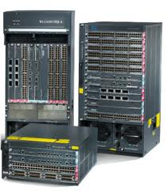
Inside the ‘Net: A Different Story…
Closed equipment
  Software bundled with hardware
  Vendor-specific interfaces
Over specified
  Slow protocol standardization
Few people can innovate
  Equipment vendors write the code
  Long delays to introduce new features

Slide 4
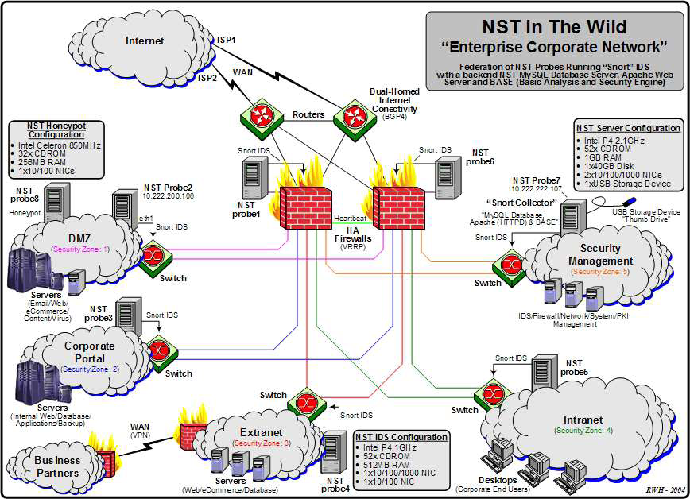
Do We Need Innovation Inside?
Many boxes (routers, switches, firewalls, …), with different interfaces.
Notes:
Enterprise network.

Slide 5



Software Defined Networks
control plane: distributed algorithms
data plane: packet processing

Slide 6
Software Defined Networks
decouple control and data planes

Slide 7
Software Defined Networks
decouple control and data planes
by providing open standard API

Slide 8

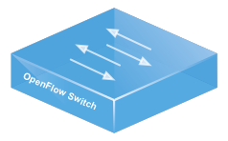
Simple, Open Data-Plane API
Prioritized list of rules
  Pattern: match packet header bits
  Actions: drop, forward, modify, send to controller
  Priority: disambiguate overlapping patterns
  Counters: #bytes and #packets
src=1.2.*.*, dest=3.4.5.* → drop
src = *.*.*.*, dest=3.4.*.* → forward(2)
3. src=10.1.2.3, dest=*.*.*.* → send to controller

Slide 9
(Logically) Centralized Controller
Controller Platform

Slide 10
Protocols ➔ Applications
Controller Application
Controller Platform

Slide 11


Seamless Mobility
See host sending traffic at new location
Modify rules to reroute the traffic

Slide 12
Server Load Balancing
Pre-install load-balancing policy
Split traffic based on source IP
10.0.0.1
src=0*,
dst=1.2.3.4
10.0.0.2
src=1*,
dst=1.2.3.4

Slide 13
Example SDN Applications
Seamless mobility and migration
Server load balancing
Dynamic access control
Using multiple wireless access points
Energy-efficient networking
Adaptive traffic monitoring
Denial-of-Service attack detection
Network virtualization
See http://www.openflow.org/videos/

Slide 14


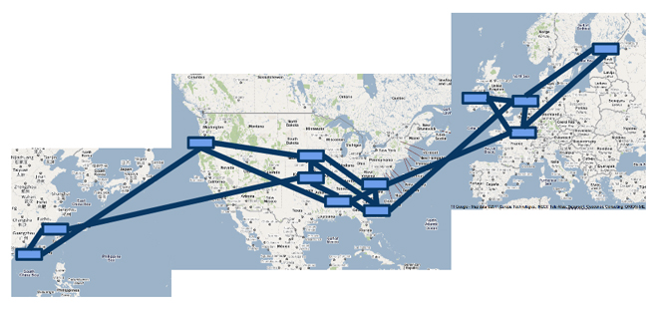

A Major Trend in Networking
Entire backbone
runs on SDN
Bought for $1.2 x 10⁹
(mostly cash)

Slide 15

Programming SDNs
http://frenetic-lang.org

Slide 16



Programming SDNs
The Good
  Network-wide visibility
  Direct control over the switches
  Simple data-plane abstraction
The Bad
  Low-level programming interface
  Functionality tied to hardware
  Explicit resource control
The Ugly
  Non-modular, non-compositional
  Programmer faced with challenging distributed programming problem
Images by Billy Perkins

Slide 17
Network Control Loop
Compute Policy
Read
state
Write
policy
OpenFlow
Switches

Slide 18
Language-Based Abstractions
Module Composition
SQL-like query language
Consistent updates
OpenFlow
Switches

Slide 19
Reading State
SQL-Like Query Language
[ICFP’11]

Slide 20
From Rules to Predicates
Traffic counters
  Each rule counts bytes and packets
  Controller can poll the counters
Multiple rules
  E.g., Web server traffic except for source 1.2.3.4
Solution: predicates
  E.g., (srcip != 1.2.3.4) && (srcport == 80)
  Run-time system translates into switch patterns
1. srcip = 1.2.3.4, srcport = 80
2. srcport = 80

Slide 21
Dynamic Unfolding of Rules
Limited number of rules
  Switches have limited space for rules
  Cannot install all possible patterns
Must add new rules as traffic arrives
  E.g., histogram of traffic by IP address
  … packet arrives from source 5.6.7.8
Solution: dynamic unfolding
  Programmer specifies GroupBy(srcip)
  Run-time system dynamically adds rules
1. srcip = 1.2.3.4
2. srcip = 5.6.7.8
1. srcip = 1.2.3.4

Slide 22
Suppressing Unwanted Events
Common programming idiom
  First packet goes to the controller
  Controller application installs rules
packets

Slide 23
Suppressing Unwanted Events
More packets arrive before rules installed?
  Multiple packets reach the controller
packets

Slide 24
Suppressing Unwanted Events
Solution: suppress extra events
  Programmer specifies “Limit(1)”
  Run-time system hides the extra events
not seen by
application
packets

Slide 25
SQL-Like Query Language
Get what you ask for
  Nothing more, nothing less
SQL-like query language
  Familiar abstraction
  Returns a stream
  Intuitive cost model
Minimize controller overhead
  Filter using high-level patterns
  Limit the # of values returned
  Aggregate by #/size of packets
Traffic Monitoring
Select(bytes) *
Where(in:2 & srcport:80) *
GroupBy([dstmac]) *
Every(60)
Learning Host Location
Select(packets) *
GroupBy([srcmac]) *
SplitWhen([inport]) *
Limit(1)

Slide 26
Computing Policy
Parallel and Sequential Composition
Topology Abstraction
[POPL’12, NSDI’13]

Slide 27
Combining Many Networking Tasks
Monolithic application
Monitor + Route + FW + LB
Controller Platform
Hard to program, test, debug, reuse, port, …
Notes:
But, real networks perform a wide variety of tasks
Routing, network monitoring, firewalls, server load balancing, etc.

Slide 28
Modular Controller Applications
A module for each task
Monitor
Route
FW
LB
Controller Platform
Easier to program, test, and debug
Greater reusability and portability

Slide 29
Beyond Multi-Tenancy
Each module controls a different portion of the traffic
...
Slice 1
Slice 2
Slice n
Controller Platform
Relatively easy to partition rule space, link
bandwidth, and network events across modules
Notes:
Simple case: multi-tenancy
Each module controls a different subset of the traffic
Relatively easy to partition traffic, rule space, and bandwidth resources
We want to write a single application out of modules that affect the handling of same traffic

Slide 30
Modules Affect the Same Traffic
Each module partially specifies the handling of the traffic
Monitor
Route
FW
LB
Controller Platform
How to combine modules into a complete application?

Slide 31
Parallel Composition
dstip = 1.2.3.4 → fwd(1)
dstip = 3.4.5.6 → fwd(2)
srcip = 5.6.7.8 → count
Monitor on source
+
Route on destination
Controller Platform
srcip = 5.6.7.8, dstip = 1.2.3.4 → fwd(1), count
srcip = 5.6.7.8, dstip = 3.4.5.6 → fwd(2), count
srcip = 5.6.7.8 → count
dstip = 1.2.3.4 → fwd(1)
dstip = 3.4.5.6 → fwd(2)
Notes:
From ICFP’11 and POPL’12

Slide 32
Sequential Composition
srcip = 0*, dstip=1.2.3.4 → dstip=10.0.0.1
srcip = 1*, dstip=1.2.3.4 → dstip=10.0.0.2
dstip = 10.0.0.1 → fwd(1)
dstip = 10.0.0.2 → fwd(2)
Load Balancer
>>
Routing
Controller Platform
srcip = 0*, dstip = 1.2.3.4 → dstip = 10.0.0.1, fwd(1)
srcip = 1*, dstip = 1.2.3.4 → dstip = 10.0.0.2, fwd(2)
Notes:
Load balancer splits traffic sent to public IP address over multiple replicas, based on client IP address, and rewrites the IP address

Slide 33
Dividing the Traffic Over Modules
Predicates
  Specify which traffic traverses which modules
  Based on input port and packet-header fields
Web traffic
dstport = 80
Load Balancer
>>
Routing
Non-web
dstport != 80
Monitor
+
Routing

Slide 34

Abstract Topology: Load Balancer
Present an abstract topology
  Information hiding: limit what a module sees
  Protection: limit what a module does
  Abstraction: present a familiar interface
Abstract view
Real network
34

Slide 35
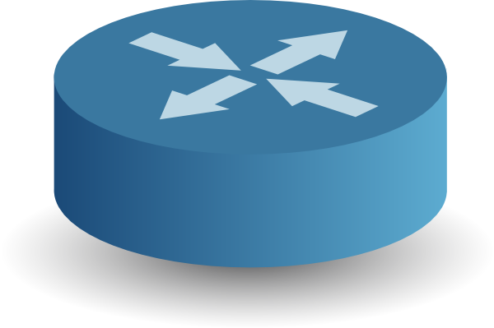

Abstract Topology: Gateway
Ethernet
Gateway
IP Core
Ethernet
IP Core
Left: learning switch on MAC addresses
Middle: ARP on gateway, plus simple repeater
Right: shortest-path forwarding on IP prefixes

Slide 36
High-Level Architecture
M1
M2
M3
Main
Program
Controller Platform

Slide 37
Writing State
Consistent Updates
[SIGCOMM’12]

Slide 38

Avoiding Transient Disruption
Invariants
No forwarding loops
No black holes
Access control
Traffic waypointing

Slide 39
Installing a Path for a New Flow
Rules along a path installed out of order?
  Packets reach a switch before the rules do
packets
Must think about all possible packet and event orderings.

Slide 40
Update Consistency Semantics
Per-packet consistency
  Every packet is processed by
  … policy P1 or policy P2
  E.g., access control, no loops
  or blackholes
Per-flow consistency
  Sets of related packets are processed by
  … policy P1 or policy P2,
  E.g., server load balancer, in-order delivery, …
P1
P2

Slide 41
Policy Update Abstraction
Simple abstraction
  Update entire configuration at once
Cheap verification
  If P1 and P2 satisfy an invariant
  Then the invariant always holds
Run-time system handles the rest
  Constructing schedule of low-level updates
  Using only OpenFlow commands!
P1
P2

Slide 42
Two-Phase Update Algorithm
Version numbers
  Stamp packet with a version number (e.g., VLAN tag)
Unobservable updates
  Add rules for P2 in the interior
  … matching on version # P2
One-touch updates
  Add rules to stamp packets
  with version # P2 at the edge
Remove old rules
  Wait for some time, then
  remove all version # P1 rules

Slide 43
Update Optimizations
Avoid two-phase update
  Naïve version touches every switch
  Doubles rule space requirements
Limit scope
  Portion of the traffic
  Portion of the topology
Simple policy changes
  Strictly adds paths
  Strictly removes paths

Slide 44
Frenetic Abstractions
Policy Composition
Consistent
Updates
SQL-like
queries
OpenFlow
Switches

Slide 45
Related Work
Programming languages
  FRP: Yampa, FrTime, Flask, Nettle
  Streaming: StreamIt, CQL, Esterel, Brooklet, GigaScope
  Network protocols: NDLog
OpenFlow
  Language: FML, SNAC, Resonance
  Controllers: ONIX, POX, Floodlight, Nettle, FlowVisor
  Testing: NICE, FlowChecker, OF-Rewind, OFLOPS
OpenFlow standardization
  http://www.openflow.org/
  https://www.opennetworking.org/

Slide 46
Conclusion
SDN is exciting
  Enables innovation
  Simplifies management
SDN is happening
  Practice: APIs and industry traction
  Principles: higher-level abstractions
Great research opportunity
  Practical impact on future networks
  Placing networking on a strong foundation
Future work
  Higher-level programming abstractions
  Bringing in end hosts and applications

Slide 47
Frenetic Project
Programming languages meets networking
  Cornell: Nate Foster, Gun Sirer, Arjun Guha, Robert Soule, Shrutarshi Basu, Mark Reitblatt, Alec Story
  Princeton: Dave Walker, Jen Rexford, Josh Reich, Rob Harrison, Chris Monsanto, Cole Schlesinger, Praveen Katta, Nayden Nedev
http://frenetic-lang.org

Slide 48
To Learn More
Project surveys
  http://frenetic-lang.org/publications/overview-ieeecoms13.pdf
  http://www.cs.princeton.edu/~jrex/papers/pyretic13.pdf
Main research papers
  http://www.frenetic-lang.org/publications.php
Recent work
  Optimizing rule placement: http://www.cs.princeton.edu/~jrex/papers/rule-place13.pdf
  Cellular core networks: http://www.cs.princeton.edu/~jrex/papers/softcell13.pdf
  Integrating end hosts: http://www.cs.princeton.edu/~jrex/papers/hone.pdf

