Slide 1
Enabling Innovation
Inside the Network
Jennifer Rexford
Princeton University
http://www.cs.princeton.edu/~jrex

Slide 2

The Internet: A Remarkable Story
Tremendous success
  From research experiment
  to global infrastructure
Brilliance of under-specifying
  Network: best-effort packet delivery
  Hosts: arbitrary applications
Enables innovation
  Apps: Web, P2P, VoIP, social networks, …
  Links: Ethernet, fiber optics, WiFi, cellular, …

Slide 3
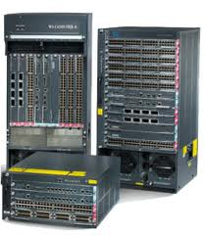
Inside the ‘Net: A Different Story…
Closed equipment
  Software bundled with hardware
  Vendor-specific interfaces
Over specified
  Slow protocol standardization
Few people can innovate
  Equipment vendors write the code
  Long delays to introduce new features

Slide 4
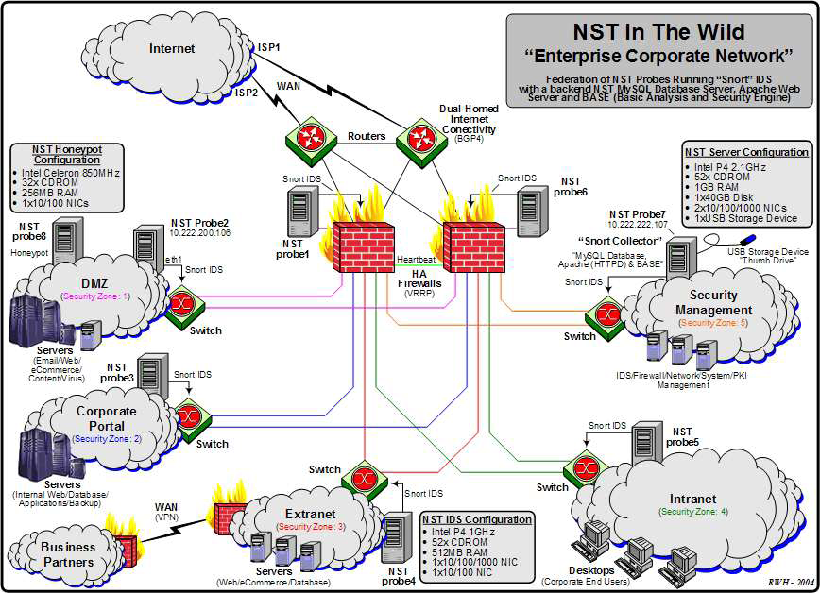
Do We Need Innovation Inside?
Many boxes (routers, switches, firewalls, …), with different interfaces.
Notes:
Enterprise network.

Slide 5



Networks are Hard to Manage
Operating a network is expensive
  More than half the cost of a network
  Yet, operator error causes most outages
Buggy software in the equipment
  Routers with 20+ million lines of code
  Cascading failures, vulnerabilities, etc.
The network is “in the way”
  Especially a problem in data centers
  … and home networks

Slide 6



Software Defined Networks
control plane: distributed algorithms
data plane: packet processing

Slide 7
Software Defined Networks
decouple control and data planes

Slide 8
Software Defined Networks
decouple control and data planes
by providing open standard API

Slide 9
(Logically) Centralized Controller
Controller Platform

Slide 10
Protocols ➔ Applications
Controller Application
Controller Platform

Slide 11
Benefits of SDN
Faster pace of innovation
  Less dependence on vendors and standards
Easier interoperability
  Compatibility only in the “wire” protocol
Simpler management
  Network-wide visibility, and direct control
Simpler, cheaper equipment
  Minimal software, simple forwarding hardware

Slide 12


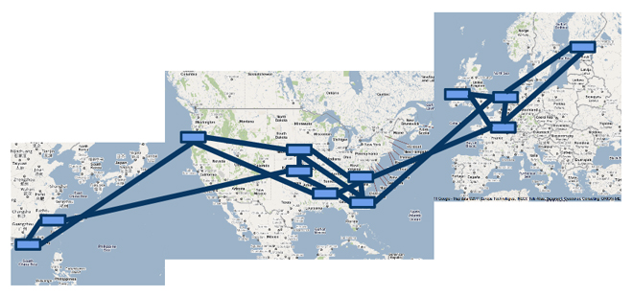

A Major Trend in Networking
Entire backbone
runs on SDN
Bought for $1.2 x 10⁹
(mostly cash)

Slide 13
Creating Foundation for Networking
Today: a domain, not a discipline
  Alphabet soup of protocols
  Header formats and bit twiddling
  Preoccupation with existing artifacts
Tomorrow: from practice, to principles
  Intellectual foundation for networking
  Identify the key abstractions
  … and support them efficiently
To build networks worthy of society’s trust

Slide 14

OpenFlow
http://openflow.org

Slide 15
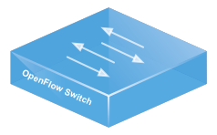
Data Plane: Packet Processing
Simple packet-handling rules
  Pattern: match packet header bits
  Actions: drop, forward, modify, send to controller
  Priority: disambiguate overlapping patterns
  Counters: #bytes and #packets
src=1.2.*.*, dest=3.4.5.* → drop
src = *.*.*.*, dest=3.4.*.* → forward(2)
3. src=10.1.2.3, dest=*.*.*.* → send to controller

Slide 16
Control Plane: Programmability
Controller Application
Controller Platform
Events from switches
Topology changes,
Traffic statistics,
Arriving packets
Commands to switches
(Un)install rules,
Query statistics,
Send packets

Slide 17


Seamless Mobility/Migration
See host sending traffic at new location
Modify rules to reroute the traffic

Slide 18
Server Load Balancing
Pre-install load-balancing policy
Split traffic based on source IP
src=0*
src=1*

Slide 19
Example SDN Applications
Seamless mobility/migration
Server load balancing
Dynamic access control
Using multiple wireless access points
Energy-efficient networking
Adaptive traffic monitoring
Denial-of-Service attack detection
Network virtualization
See http://www.openflow.org/videos/

Slide 20

Programming SDNs
http://frenetic-lang.org

Slide 21



Programming SDNs
The Good
  Network-wide visibility
  Direct control over the switches
  Simple data-plane abstraction
The Bad
  Low-level programming interface
  Functionality tied to hardware
  Explicit resource control
The Ugly
  Non-modular, non-compositional
  Programmer faced with challenging distributed programming problem
Images by Billy Perkins

Slide 22
Network Control Loop
Compute Policy
Read
state
Write
policy
OpenFlow
Switches

Slide 23
Language-Based Abstractions
Module Composition
SQL-like query language
Consistent updates
OpenFlow
Switches

Slide 24
Combining Many Networking Tasks
Monolithic application
Monitor + Route + FW + LB
Controller Platform
Hard to program, test, debug, reuse, port, …
Notes:
But, real networks perform a wide variety of tasks
Routing, network monitoring, firewalls, server load balancing, etc.

Slide 25
Modular Controller Applications
A module for each task
Monitor
Route
FW
LB
Controller Platform
Easier to program, test, and debug
Greater reusability and portability

Slide 26
Beyond Multi-Tenancy
Each module controls a different portion of the traffic
...
Slice 1
Slice 2
Slice n
Controller Platform
Relatively easy to partition rule space, link
bandwidth, and network events across modules

Slide 27
Modules Affect the Same Traffic
Each module partially specifies the handling of the traffic
Monitor
Route
FW
LB
Controller Platform
How to combine modules into a complete application?

Slide 28
Parallel Composition
dstip = 1.2.3.4 → fwd(1)
dstip = 3.4.5.6 → fwd(2)
srcip = 5.6.7.8 → count
Monitor on source
+
Route on destination
Controller Platform
srcip = 5.6.7.8, dstip = 1.2.3.4 → fwd(1), count
srcip = 5.6.7.8, dstip = 3.4.5.6 → fwd(2), count
srcip = 5.6.7.8 → count
dstip = 1.2.3.4 → fwd(1)
dstip = 3.4.5.6 → fwd(2)
Notes:
From ICFP’11 and POPL’12

Slide 29

Example: Server Load Balancer
Spread client traffic over server replicas
  Public IP address for the service
  Split traffic based on client IP
  Rewrite the server IP address
Then, route to the replica
10.0.0.1
10.0.0.2
1.2.3.4
clients
load balancer
10.0.0.3
server replicas

Slide 30
Sequential Composition
srcip = 0*, dstip=1.2.3.4 → dstip=10.0.0.1
srcip = 1*, dstip=1.2.3.4 → dstip=10.0.0.2
dstip = 10.0.0.1 → fwd(1)
dstip = 10.0.0.2 → fwd(2)
Load Balancer
>>
Routing
Controller Platform
srcip = 0*, dstip = 1.2.3.4 → dstip = 10.0.0.1, fwd(1)
srcip = 1*, dstip = 1.2.3.4 → dstip = 10.0.0.2, fwd(2)
Notes:
Load balancer splits traffic sent to public IP address over multiple replicas, based on client IP address, and rewrites the IP address

Slide 31
Dividing the Traffic Over Modules
Predicates
  Specify which traffic traverses which modules
  Based on input port and packet-header fields
Monitor
+
Routing
dstport != 80
Load Balancer
>>
Routing
dstport = 80

Slide 32
Partially Specifying Functionality
A module should not specify everything
  Leave some flexibility to other modules
  Avoid tying the module to a specific setting
Example: load balancer plus routing
  Load balancer spreads traffic over replicas
  … without regard to the network paths
Load Balancer
>>
Routing

Slide 33
Topology Abstraction
Present an abstract topology
  Information hiding: limit what a module sees
  Protection: limit what a module does
  Abstraction: present a familiar interface
Real network
Abstract view
33

Slide 34
High-Level Architecture
M1
M2
M3
Main
Program
Controller Platform

Slide 35
Reading State: Query Language
Applications read state
  Traffic counters in switches
  Packets sent to the controller
Minimize controller overhead
  Filter using high-level patterns
  Limit the amount of data
Controller platform
  Installs rules, reads counters,
  handle packets
Learning Host Location
Select(packets) *
GroupBy([srcmac]) *
SplitWhen([inport]) *
Limit(1)
Traffic Monitoring
Select(bytes) *
Where(inport:2) *
GroupBy([dstmac]) *
Every(60)

Slide 36


Writing Policies: Consistent Updates
Transition from policy P₁ to P₂
  Security: new access control lists
  Routing: new shortest paths
Transient policy violations
  Packets in flight during policy change
  Loops, blackholes, unauthorized traffic
Consistent update semantics
  Packets experience either P₁ or P₂
  … but never a mixture of the two
CHANGE
We Can Believe In

Slide 37
Language-Based Abstractions
Module Composition
SQL-like query language
Consistent updates
OpenFlow
Switches

Slide 38
Many Challenging Questions Remain
Maturing the technology
  Measuring and controlling end hosts
  Heterogeneous switch hardware
  Distributed and replicated controllers
  Multiple administrative domains
Applying SDN in new settings
  Enterprise networks
  Cellular core and radio access networks
  Internet eXchange Points and transit networks

Slide 39
Conclusion
SDN is exciting
  Enables innovation
  Simplifies management
  Rethinks networking
SDN is happening
  Practice: useful APIs and good industry traction
  Principles: start of higher-level abstractions
Great opportunity
  Practical impact on future networks
  Placing networking on a strong foundation

Slide 40
Learn More
SDN and OpenFlow
  www.openflow.org
  www.opennetworking.org
  www.opennetsummit.org
  conferences.sigcomm.org/sigcomm/2012/hotsdn.php
Frenetic language
  www.frenetic-lang.org
  www.cs.princeton.edu/~jrex/papers/frenetic12.pdf
  github.com/frenetic-lang

