Slide 1
Toward Self-Driving Networks
Jennifer Rexford
Princeton University

Slide 2

The Great Success of the Internet
IP network
Arbitrary
applications
Best-effort packet delivery
Programmability: determines who can effect change, and where
Notes:
One lesson is the end-to-end principle (whenever possible

Slide 3
Innovation Above, Below, and Alongside
Applications
Internet
Hosts
Media
Notes:
But, ironically, the Internet did not plant the seeds of its own reinvention

Slide 4
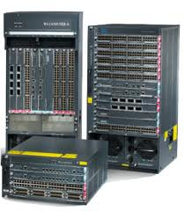
But, Limited Innovation “Inside” the ’Net
Over specified
  Slow protocol standardization
  Standards in fixed-function hardware
Closed equipment
  Software bundled with hardware
  Vendor-specific interfaces
Few people can innovate
  Equipment vendors write the code
  Long delays for new features
But, the inside of the network does need to change
Notes:
Needs to change because of performance, reliability, security, and more. And unique needs in different settings.

Slide 5
Traditional Network Management
2. Analyze
(traffic matrix, route optimization, anomaly detection, fault localization)
1. Measure
(load, performance, traffic, failures)
3. Configure
(reconfigure tunnels, link weights, access control lists)

Slide 6
Limitations of Traditional Network Management
Measurement mismatches
  Overhead of collecting many device-local measurements
  Simplistic statistics (counts, samples) not tailored to the task
Indirect control
  Configuration of complex protocols and mechanisms
  Separate configuration of many distributed devices
Complex reasoning
  Many separate software components and protocols
  Software bugs, configuration errors, and protocol interactions

Slide 7
Closing the Loop
An integrated approach
Efficient measurement
  Measurement tailored to the task
  Data analysis in the data plane
Direct control
  Control actions in the data plane
Correct by construction
  Device-local programs synthesized from network-wide goals
Network-wide goals
(objectives and constraints)
Compiler
Device-local programs
(measure and control)

Slide 8
Protocol Independent Switch Architecture (PISA)
Data plane designed for programmability
  Parsing, match-action tables, actions, registers
  Barefoot/Intel (Arista, NoviFlow, Stordis), Xilinx, Netronome, Pensando, Netcope
  P4 programming language
Parser
Registers
Deparser
Memory
ALU
Match-
Action
Table
Stages

Slide 9
Example Network-Wide Goals
Alleviating microbursts
Performance-aware routing
Denial-of-service attack mitigation
Block hosts with old OSes
<Insert your “app” here>

Slide 10
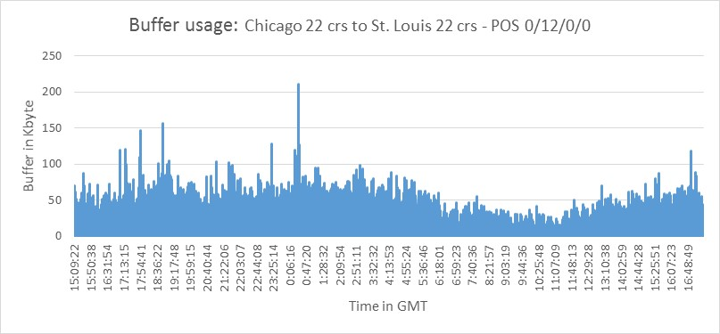
Alleviating Microbursts: ConQuest [CoNext’19]
Small timescale traffic bursts
  Clog the packet queues
  Cause packet delay and loss
Manage microbursts to handle
  Bursty workloads
  Low-cost switches (shallow buffers)
  High link utilization
Goal: penalize the most responsible flows
5x
Microbursts
3x
Queue Length
1x
16:00:00
0:00:00
8:00:00
16:00:00
Time in day (24h)

Slide 11
Microburst Management Policy
Active queue management
  Mark each packet probabilistically
  In proportion to its flow’s contribution to the heavy queue
55%
10%

Slide 12
Detecting Heavy Flows in the Queue
For each flow, how many packets are in the queue?
P4 data structure challenges
  Updating on packet arrival and departure
  Per-flow state (key and count)
Key | Count
 | 1
 | 5
 | 1
 | 1
 | 2
 | 1

Slide 13
ConQuest: Processing Each Packet Only Once
Slice traffic into time windows
Each snapshot records T=4 packets
Why am I waiting?
Egress
Queue
B
B
B
C
B
B
C
A
D
B
B
D
A
B
I enqueued at t=5
I dequeued at t=14
Historical Departures
Flow | ~Count
 | 1
 | 5
 | 1
 | 1
?
S1 | S2 | S3 | S4 | …
A
Memory access
B
C
D

Slide 14
ConQuest: Round-Robin Snapshots
Clean and Reuse the snapshots in the data plane!
Read
Read
Write
Clean
Read
Read
Read

Slide 15
ConQuest: Avoiding Per-Flow State
Compact data structures
  With limited memory and processing
  … at the expense of lower accuracy
Estimate per-flow counts per snapshot
  With accurate estimates for large flows
Count-Min Sketch per snapshot
  C columns indexed by hash functions
  Increment hash_{i}(flowid) in column I
  Estimate is the min of the C counts
Count-Min Sketch [CM ‘05]
+1
B Buckets
+1
+1
f
C columns

Slide 16

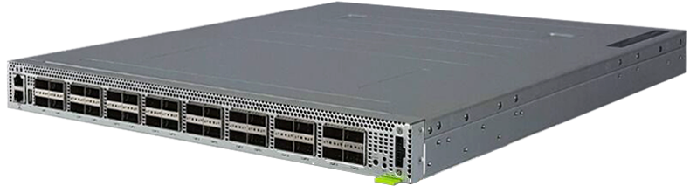
ConQuest in Action on the Princeton Campus
Internet2
Performance symptoms
  Big neuroscience data transfers
  High loss with low average load
  Router with limited measurements
Microburst analytics on Tofino
  Microbursts on a small timescale
  Caused by PerfSONAR active probes
Recent deployment with AT&T
Network TAPs
Mirrored
traffic
Neuroscience
Institute
Tofino
See https://p4campus.cs.princeton.edu/ web site for more details!

Slide 17

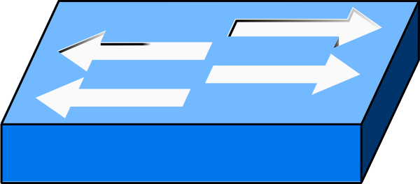

ConQuest: Closing the Control Loop
Testbed with P4-enabled Barefoot Tofino, 4 snapshots
Smart early congestion notification (ECN)
  Baseline: mark all packets when the queue is long
  ConQuest: flow-based ECN to mark flows causing others to wait
Send 1M TCP flows
+ synthetic bursts
100G
10G
Sender
Receiver

Slide 18
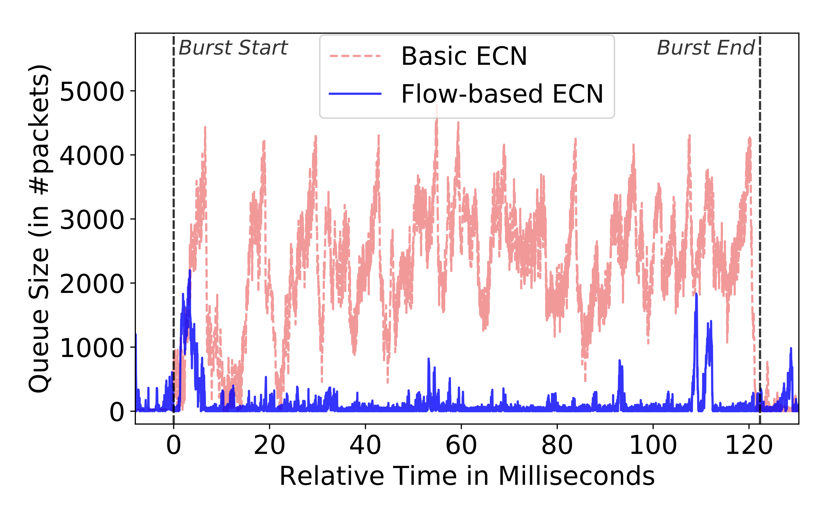
ConQuest: Evaluating the Control Loop
Flow-based ECN reduces Flow Completion Time
Queue remains short, bursty flow effectively suppressed
11%

Slide 19
Performance-Aware Routing: Contra [NSDI’20]
G1: Traffic Engineering
e.g., prefer least utilized paths
G2: Routing Constraints
G3: Fast Adaptation
e.g., middlebox traversal
e.g., update path choices upon performance changes
Notes:
Modern applications send a lot of data over the network. So efficient routing is very important.
Typically, we can think of three common goals
Performance and therefore we need traffic engineering. For example, …
Prefer certain route and therefore we have routing constraints. For example, …
Network condition changes very fast and therefore we need fast adaptation. For example, …

Slide 20


Contra: Performance-Aware Routing
Policy
Switch programs
Topology
Contra compiler
Language + Compiler: Compiles rich, high-level policies
Runtime: Performance-aware routing protocol in the data plane
Notes:
Now, let me give you an overview of Contra.

Slide 21
Contra Policy Language
Routing policy: a function that ranks network paths
  Matching on paths using regular expressions
  Computing and comparing path metrics
Waypoint W with min utilization
Min utilization under light load, otherwise shortest
  if (.* W .*)
  then path.util
  else ∞
  if (path.util < 0.8)
  then (1, 0, path.util)
  else (2, path.len, path.util)
Notes:
Lower scores are better
Infinite mean the path is not used
Regular expressions on path properties is not a new idea

Slide 22
Contra Family of P4 Routing Programs
Distance vector routing
  Flexible path constraints and metrics
  Implementable in modern P4 data planes
path probe: 0.3
0.2
0.3
data packets

Slide 23
Contra P4 Building Blocks
Monitor path performance
  Reverse-path probes collect and accumulate statistics
Enforce path constraints
  Controlling the propagation of probes
Compare and select paths
  Best-path table updated as new probes arrive
Avoid out-of-order packets
  Policy-aware flowlet switching table
Prevent forwarding loops
  Version numbers of probes (like DSDV and Babel)

Slide 24
Contra Prototype and Evaluation
Contra compiler
  Written in 7485 lines of F#
  Generates the switch-local P4 programs
Experimental setup
  Topologies: data centers, random graphs, ISPs
  Performance metric: flow completion time (FCT)
  Comparisons: equal-cost multipath, Hula, and SPAIN
Simulation (in ns-3) and testbed (in CloudLab)
  Outperforms shortest-path routing and static load balancing
Routing Policy
Compiler
P4 code

Slide 25
Toward Verified Closed-Loop Control
Explore more control-loop examples
  DDoS mitigation, blocking unwanted OSes, etc.
Evaluate under realistic conditions
  Hardware switches and operational networks
Identify unifying language constructs
  Traffic queries integrated with control actions
Verify the compiler
  Ensure the P4 programs are “correct by construction”
Pronto project (ONF, Stanford, Princeton, Cornell): https://vimeo.com/447287550

Slide 26
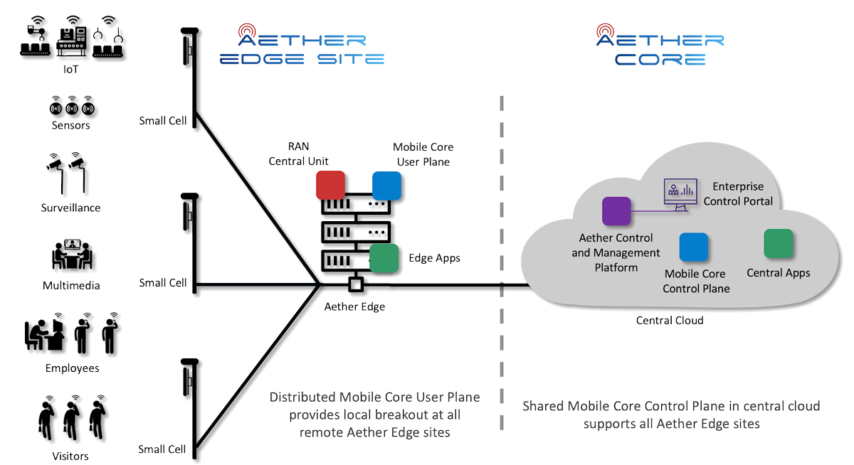
Real Deployments at Princeton
Enterprise: P4 campus
Cellular: ONF Aether platform
Internet2
Neuroscience
Institute
Tofino

Slide 27
Thank you!

