Slide 1

Closing the Loop:
Network Control in the Data Plane
Jennifer Rexford
Princeton University

Slide 2
Traditional Network Management
2. Analyze
(traffic matrix, route optimization, anomaly detection, fault localization)
1. Measure
(load, performance, traffic, failures)
3. Configure
(reconfigure tunnels, link weights, access control lists)

Slide 3
Limitations of Traditional Network Management
Measurement mismatches
  Overhead of collecting many device-local measurements
  Simplistic statistics (counts, samples) not tailored to the task
Indirect control
  Configuration of complex protocols and mechanisms
  Separate configuration of many distributed devices
Complex reasoning
  Many separate software components and protocols
  Software bugs, configuration errors, and protocol interactions

Slide 4
Closing the Loop
An integrated approach
Efficient measurement
  Measurement tailored to the task
  Data analysis in the data plane
Direct control
  Control actions in the data plane
Correct by construction
  Device-local programs synthesized from network-wide goals
Network-wide goals
(objectives and constraints)
Compiler
Device-local programs
(measure and control)

Slide 5
Example Network-Wide Goals
Alleviating microbursts
Performance-aware routing
DDoS mitigation
Block hosts with old OSes
<Insert your “app” here>

Slide 6
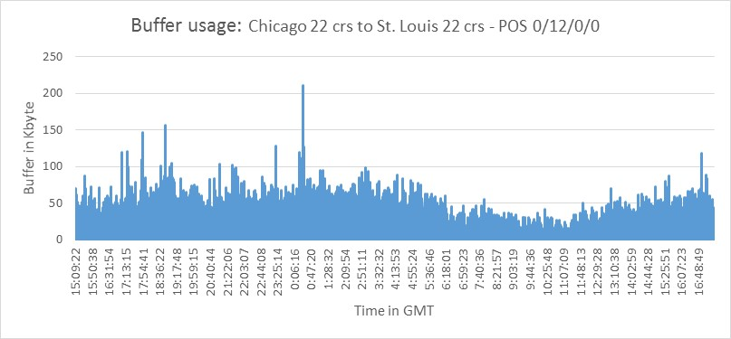
Alleviating Microbursts: ConQuest [CoNext’19]
Small timescale traffic bursts
  Clog the packet queues
  Cause packet delay and loss
Manage microbursts to handle
  Bursty workloads
  Low-cost switches (shallow buffers)
  High link utilization
Goal: penalize the most responsible flows
5x
Microbursts
3x
Queue Length
1x
16:00:00
0:00:00
8:00:00
16:00:00
Time in day (24h)

Slide 7
Microburst Management Policy
Active queue management
  Mark each packet probabilistically
  In proportion to its flow’s contribution to the heavy queue
55%
10%

Slide 8
Detecting Heavy Flows in the Queue
For each flow, how many packets are in the queue?
P4 data structure challenges
  Updating on packet arrival and departure
  Per-flow state (key and count)
Key | Count
 | 1
 | 5
 | 1
 | 1
 | 2
 | 1

Slide 9
ConQuest: Processing Each Packet Only Once
Slice traffic into time windows
Each snapshot records T=4 packets
Why am I waiting?
Egress
Queue
B
B
B
C
B
B
C
A
D
B
B
D
A
B
I enqueued at t=5
I dequeued at t=14
Historical Departures
Flow | ~Count
 | 1
 | 5
 | 1
 | 1
?
S1 | S2 | S3 | S4 | …
A
Memory access
B
C
D

Slide 10
ConQuest: Round-Robin Snapshots
Clean and Reuse the snapshots in the data plane!
Read
Read
Write
Clean
Read
Read
Read

Slide 11
ConQuest: Avoiding Per-Flow State
Compact data structures
  With limited memory and processing
  … at the expense of lower accuracy
Estimate per-flow counts per snapshot
  With accurate estimates for large flows
Count-Min Sketch per snapshot
  C columns indexed by hash functions
  Increment hash_{i}(flowid) in column I
  Estimate is the min of the C counts
Count-Min Sketch [CM ‘05]
+1
B Buckets
+1
+1
f
C columns

Slide 12

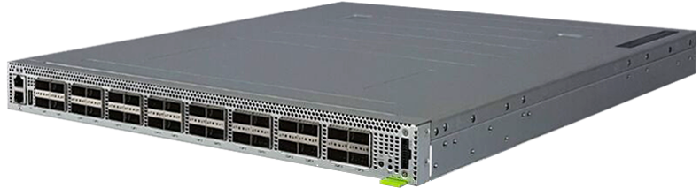
ConQuest in Action on the Princeton Campus
Internet2
Performance symptoms
  Big neuroscience data transfers
  High loss with low average load
  Router with limited measurements
Microburst analytics on Tofino
  Microbursts on a small timescale
  Caused by PerfSONAR active probes
Recent deployment with AT&T
Network TAPs
Mirrored
traffic
Neuroscience
Institute
Tofino
See https://p4campus.cs.princeton.edu/ web site for more details!

Slide 13

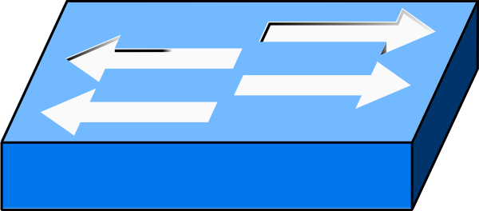
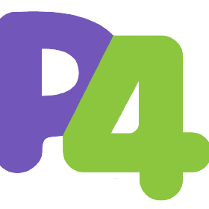
ConQuest: Closing the Control Loop
Testbed with P4-enabled Barefoot Tofino, 4 snapshots
Smart early congestion notification (ECN)
  Baseline: mark all packets when the queue is long
  ConQuest: flow-based ECN to mark flows causing others to wait
Send 1M TCP flows
+ synthetic bursts
100G
10G
Sender
Receiver

Slide 14
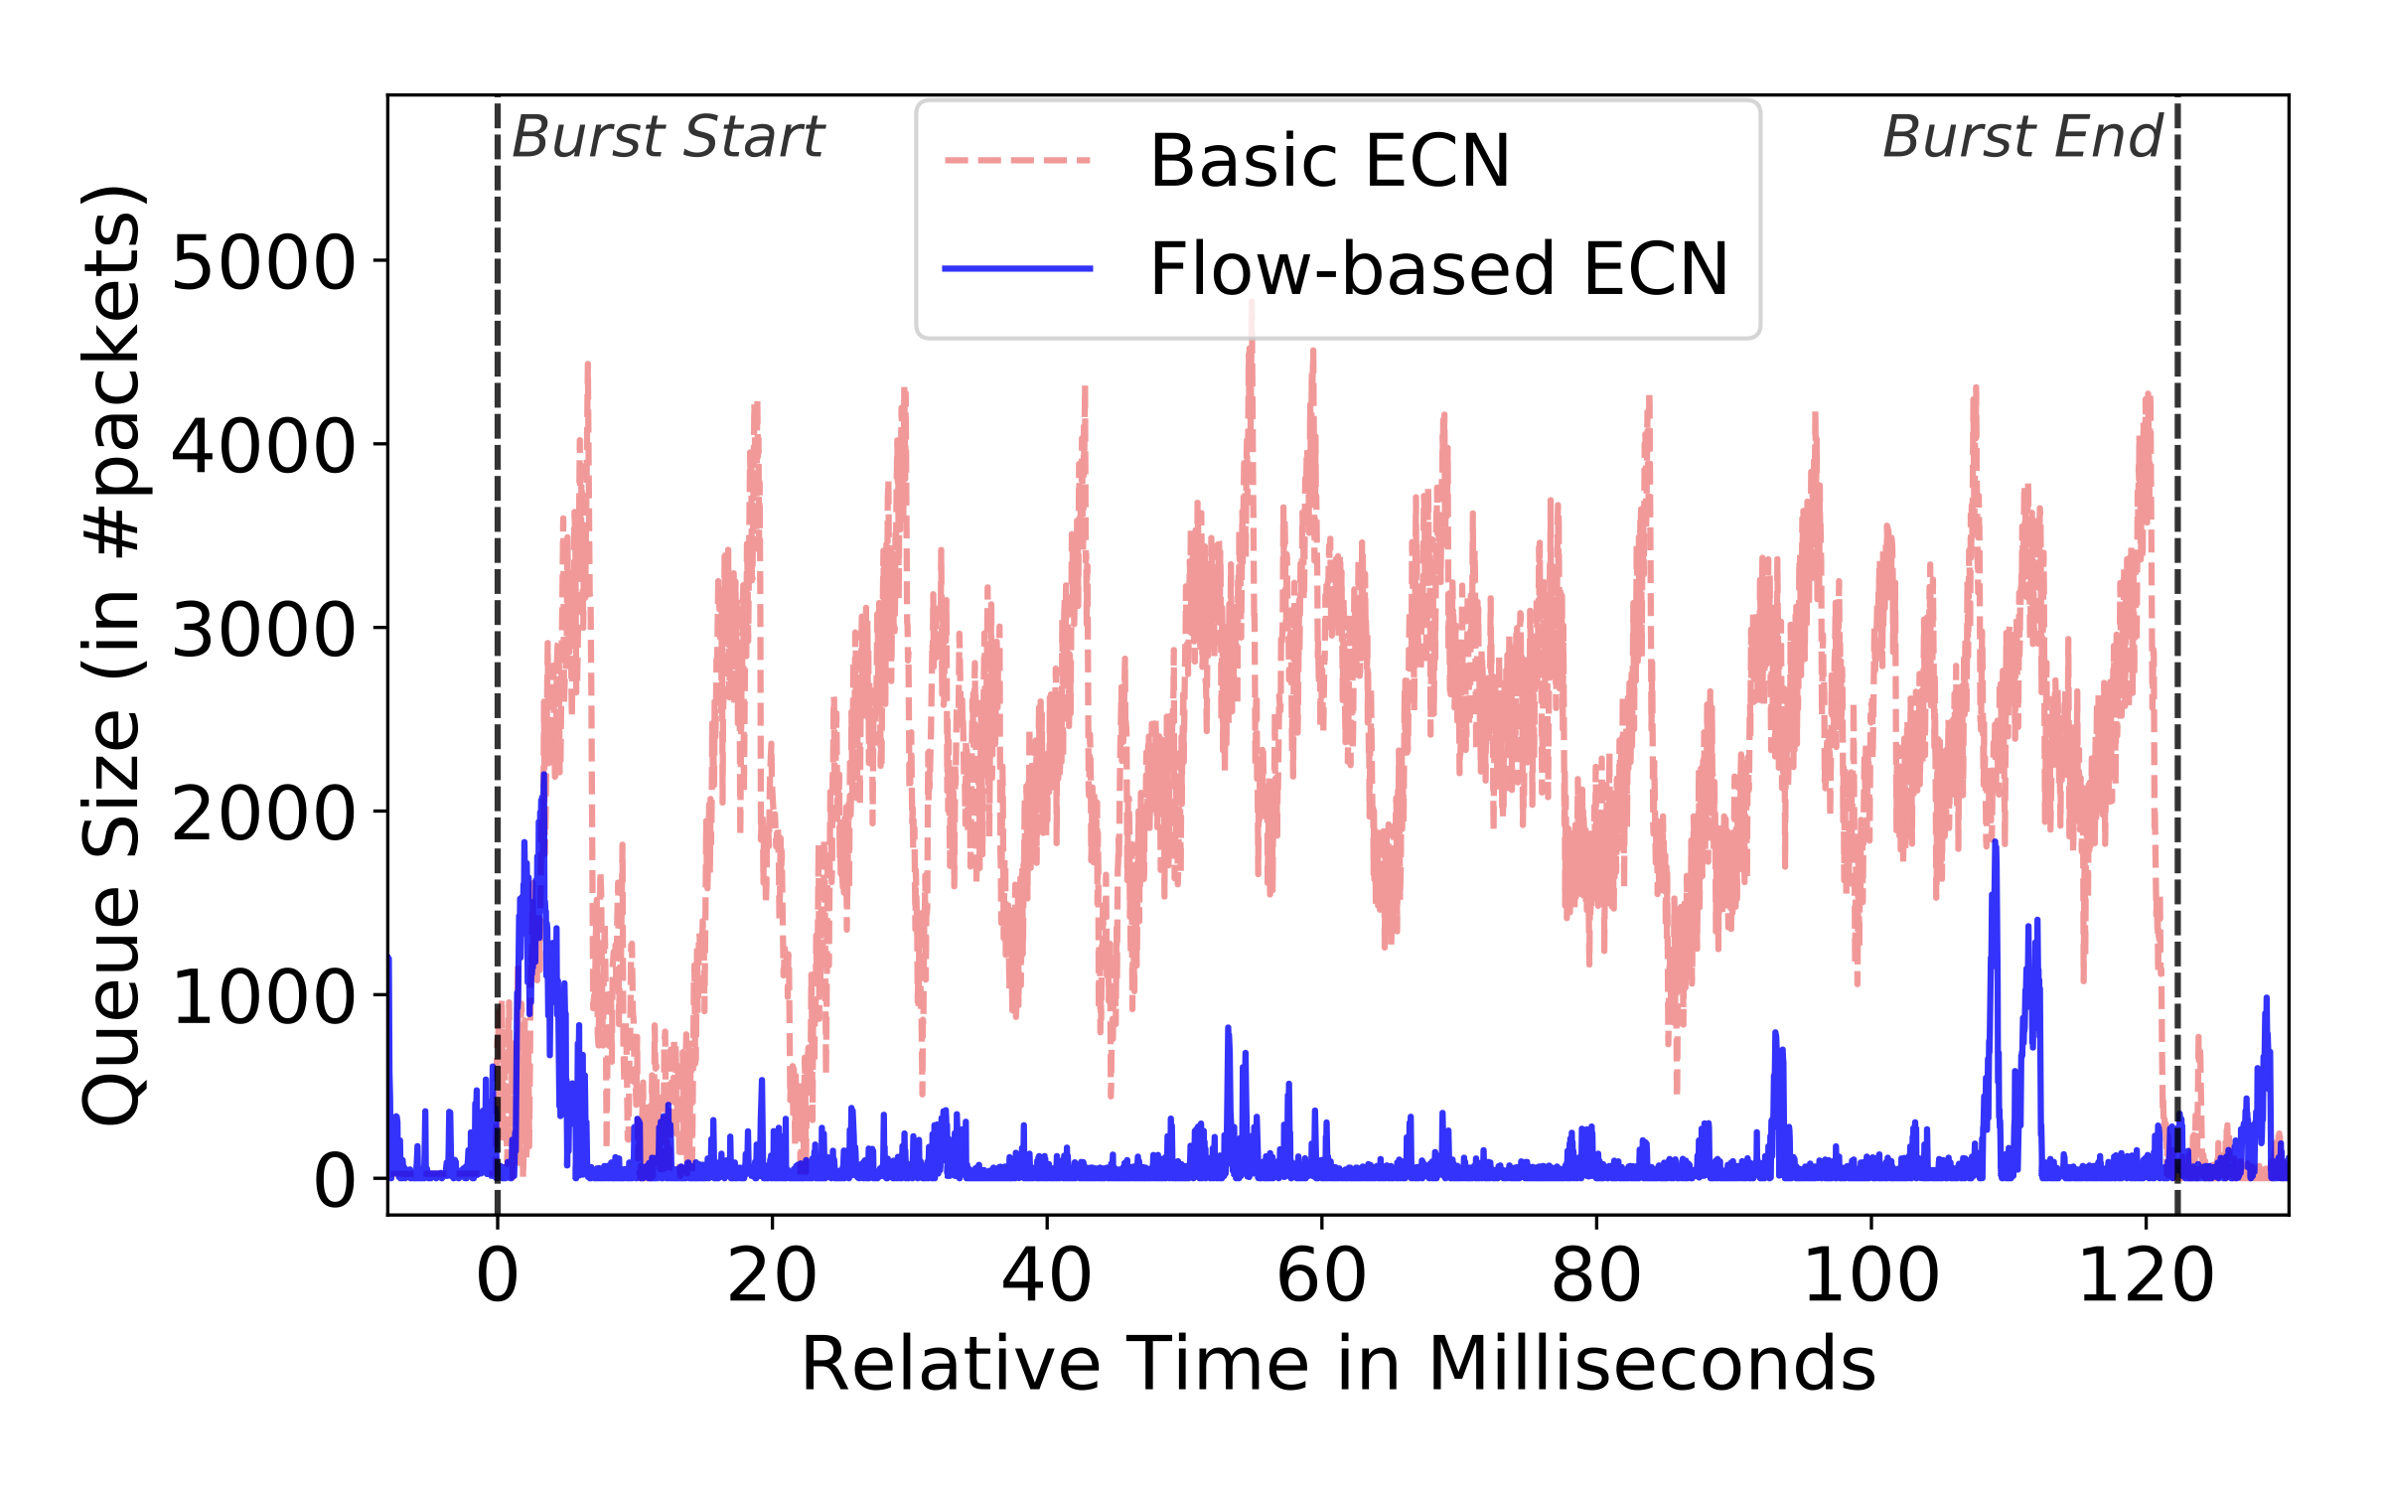
ConQuest: Evaluating the Control Loop
Flow-based ECN reduces Flow Completion Time
Queue remains short, bursty flow effectively suppressed
11%

Slide 15
Performance-Aware Routing: Contra [NSDI’20]
G1: Traffic Engineering
e.g., prefer least utilized paths
"routing constraints" to "flexibility/generality", then it's not very clear
writing “topology + routing”? Then when explaining (e.g., Hula) we can mention that both topology and routing are fixed. And then in the next part the routing constraints would still make sense.
G2: Routing Constraints
G3: Fast Adaptation
e.g., middlebox traversal
e.g., update path choices upon performance changes
Notes:
Modern applications send a lot of data over the network. So efficient routing is very important.
Typically, we can think of three common goals
Performance and therefore we need traffic engineering. For example, …
Prefer certain route and therefore we have routing constraints. For example, …
Network condition changes very fast and therefore we need fast adaptation. For example, …

Slide 16


Contra: Performance-Aware Routing
Policy
Switch programs
Topology
Contra compiler
Language + Compiler: Compiles rich, high-level policies
Runtime: Performance-aware routing protocol in the data plane
Notes:
Now, let me give you an overview of Contra.

Slide 17
Contra Policy Language
Routing policy: a function that ranks network paths
  Matching on paths using regular expressions
  Computing and comparing path metrics
Waypoint W with min utilization
Min utilization under light load, otherwise shortest
  if (.* W .*)
  then path.util
  else ∞
  if (path.util < 0.8)
  then (1, 0, path.util)
  else (2, path.len, path.util)
Notes:
Lower scores are better
Infinite mean the path is not used
Regular expressions on path properties is not a new idea

Slide 18
Contra Family of P4 Routing Programs
Distance vector routing
  Flexible path constraints and metrics
  Implementable in modern P4 data planes
path probe: 0.3
0.2
0.3
data packets

Slide 19
Contra P4 Building Blocks
Monitor path performance
  Reverse-path probes collect and accumulate statistics
Enforce path constraints
  Controlling the propagation of probes
Compare and select paths
  Best-path table updated as new probes arrive
Avoid out-of-order packets
  Policy-aware flowlet switching table
Prevent forwarding loops
  Version numbers of probes (like DSDV and Babel)

Slide 20
Contra Prototype and Evaluation
Contra compiler
  Written in 7485 lines of F#
  Generates the switch-local P4 programs
Experimental setup
  Topologies: data centers, random graphs, ISPs
  Performance metric: flow completion time (FCT)
  Comparisons: equal-cost multipath, Hula, and SPAIN
Simulation (in ns-3) and testbed (in CloudLab)
  Outperforms shortest-path routing and static load balancing
Routing Policy
Compiler
P4 code

Slide 21
Toward Verified Closed-Loop Control
Explore more control-loop examples
  DDoS mitigation, blocking unwanted OSes, etc.
Evaluate under realistic conditions
  Hardware switches and operational networks
Identify unifying language constructs
  Traffic queries integrated with control actions
Verify the compiler
  Ensure the P4 programs are ``correct by construction”

Slide 22
Thank You
https://www.cs.princeton.edu/~jrex
https://p4campus.cs.princeton.edu

