Slide 1
Making the ’Net Work
Jennifer Rexford

Slide 2
Billions of computers and people
100+ billion gigabytes per month
Transforming how we communicate, conduct business, and form and sustain relationships
Notes:
The Internet is a global “network of networks” that interconnects billions of computers and people, delivering more than 100 billion gigabytes of data each month. In our lifetimes, the Internet has transformed how we communicate, conduct business, form and sustain relationships.

Slide 3
Internet outages
Bad performance
Hacked user devices
Configuration errors
Slow video streams
Unreachable sites
Notes:
Yet, we hear nearly every day about serious Internet outages, and we experience the Internet’s frailty so often in our daily lives. From hacked digital cameras launching denial of service attacks, to configuration mistakes taking down entire cloud services. From video streams grinding to a halt, to bank web sites becoming unreachable.

Slide 4
Businesses lose significant revenue due to bad performance and denial-of-service attacks
Users cannot conduct business or reach family,
and worry about data leaks and cyberattacks
Notes:
How much does it matter? Studies show that people will visit a web site less often if the downloads take a quarter of a second longer than a close competitor’s site, causing lost revenue for search engines, news sites, and more. And, some companies lose tens of thousands of dollars for every minute of a denial-of-service attack, with a total cost of multiple billions of dollars per year. And, as individuals we struggle each time our kids can’t watch a video or do their homework or submit their college applications, or when we can’t access our banks or reach our family members, or wonder if our personal data is being leaked or our home Internet connection used to attack others.

Slide 5
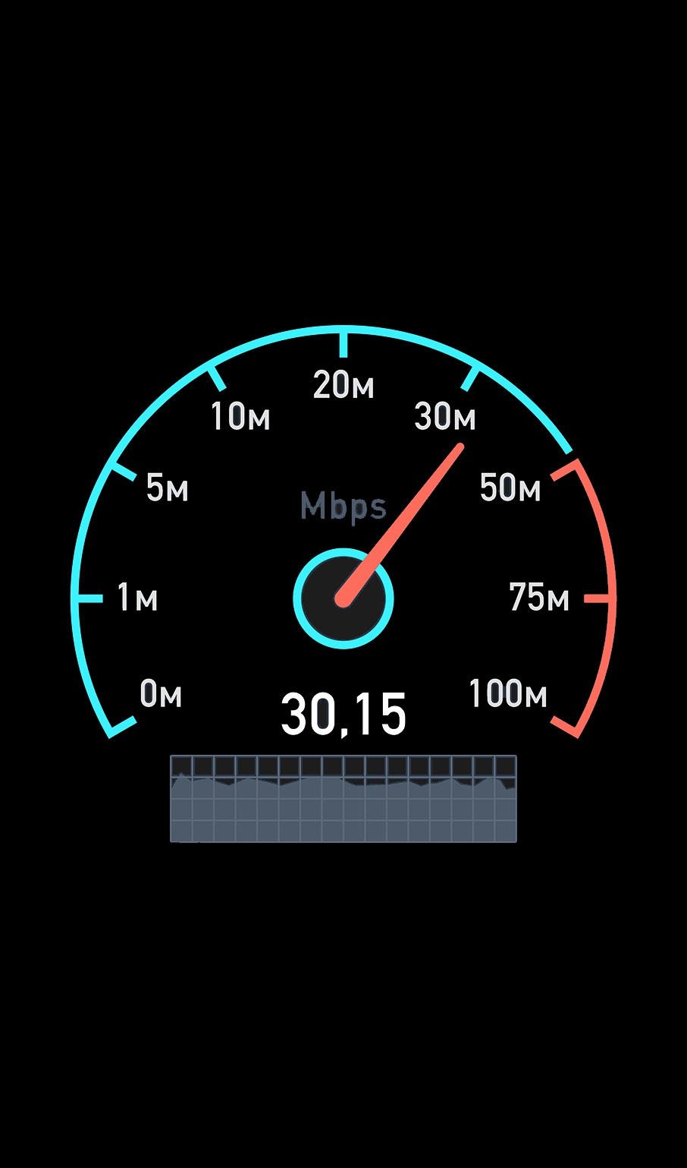

An Internet Worthy of Society’s Trust
security
Performance
Security
Reliability
Notes:
We need a global communications infrastructure that is truly worthy of society’s trust. An Internet that quickly identifies congested links, and routes around them to improve performance. An Internet that detects cyberattacks, and blocks them before they do serious harm and incur significant cost. In short, an Internet with good performance, security, and reliability.

Slide 6
Self-Driving Networks
link
switch
Switches sense and react automatically
Notes:
We need self-driving networks. Computer networks that can “sense” – with network devices (switches) that continuously monitor themselves and the traffic they carry. And computer networks that can “react” – with switches that automatically adapt their operation to improve performance, security, and reliability, without human intervention.

Slide 7
Innovation Inside the Network
Internet
Programmability enables innovation
Notes:
We need the ability to innovate inside the network. That is, we need networks to be programmable.
The Internet itself is a testament to the value of programmability.
Part of the brilliance of the early designers of the Internet was the decision to put a lot of functionality at the end-host computers at its periphery.
That enabled all sorts of innovation. Whoever could write code could change the services the Internet offers.
But only at the edge. Not the inside, not the underlying infrastructure of the Internet.

Slide 8
Programmable Switches are (Finally) Here!
Notes:
Historically, networking equipment has been closed: (i) business reasons and (ii) speed.
Now, just recently, we are starting to have programmable switches.

Slide 9
Toward Self-Driving Networks
+
=
programmable
switch
smart
algorithms
intelligent
switch
Notes:
Self-driving networks are tantalizingly possible, by bringing together two exciting technologies: (i) smart algorithms that can convert measurements of network traffic and performance into true situational awareness and (ii) programmable network switches that can adapt how they collect and analyze data, and how they direct traffic.

Slide 10

Huge Speed
and Scale
packet
transfer
Hundreds of thousands of data transfers
Packet arriving every few nanoseconds
Notes:
Yet, self-driving networks will need to analyze and control network traffic at unprecedented speed and scale. A link in the core of the Internet carries traffic for hundreds of thousands of data transfers at a time. Each transfer is divided into multiple small “packets” of data. On a high-speed link, a new “packet” arrives every few nanoseconds.

Slide 11
Working With Limited Processing and Memory
sketch
packets
Compute statistics as the packets fly by
Do not store information about every transfer
Notes:
To deliver traffic at high speeds, switches perform only limited “processing” (to compute statistics and make decisions) and have limited “memory” (to store results). The switches must compute statistics as the packets fly by, and cannot store information about every “transfer”, shown here by different colors. The switches can only maintain a small “sketch” of the traffic.

Slide 12
Identify and Limit the “Heavy Hitter” Transfers
heavy
hitter
5
With just a few operations per packet, and very little memory
Notes:
My lab invents ways to analyze Internet traffic efficiently on programmable switches. We can identify the “heavy hitter” transfers -- like the green packets contributing half of the traffic -- with just a few operations per packet and very little memory. The switch can then block or slow the offending traffic, to make room for other transfers.

Slide 13
Detect and Block Denial-of-Service Attacks
attack
victim
Identify destinations with many unique senders
Notes:
Similarly, we pinpoint ”distributed denial-of-service” attacks where many computers send traffic to the same unsuspecting victim. Our techniques enable the switches to estimate the number of different senders contacting the same destination, flagging only the outliers, so the switches can automatically block the malicious traffic to protect the victim machine.

Slide 14



Discover and Use the Best-Performing Paths
best path
Faster downloads
Jobs finish sooner
Notes:
And, we enable the switches to continuously monitor the performance of the paths through the network so they can automatically learn which path offers the best performance and automatically use it for each new data transfer. This enables large computational jobs in data centers to finish more quickly, and leads to faster and higher-quality video downloads.

Slide 15
Programming Language for Network Devices
P4 Language Consortium
www.p4.org
70+ industry members (e.g., Alibaba, Baidu, Huawei, TenCent)
Notes:
These and other techniques are a set of “building blocks” for self-driving networks that can sense, and then react, by themselves. We realize these algorithms using a new programming language, called P4, that a group of us designed to enable innovation in network devices. The P4 consortium has more than 70 industry members, and many new networking devices support the language.,

Slide 16
Internet as a “Network of Networks”
Princeton
Tsinghua
Programmability between domains (e.g., Internet exchange points)
Notes:
So far, most deployments of programmable networks are within a single administrative entity, like Google or China Telecom.
Yet, the Internet is a ”network of networks”, and to change how traffic gets from one place to another requires grappling with how networks coordinate with each other. We have been exploring ways to use programmable switches at the juncture points between domains, e.g., at Internet eXchange Points, to enable new ways to delivery traffic (balancing load, blocking attacks, and more).

Slide 17

Pushing Limits: Internet Speed and Scale
sophistication
efficiency
Notes:
Going further, we will push the limits of the techniques that run directly in the switches, so self-driving networks can grow smarter over time. These techniques must strike a careful balance between sophistication and efficiency, to operate at “Internet speed” and “Internet scale”, while continually improving network performance, security, and reliability.

Slide 18
Toward a world where the ‘net simply works
Without tremendous cost and human effort
Without slowdowns, outages, security breaches
Notes:
We envision a future where the Internet is as transparent as the air we breathe. Where the many networks underlying the ‘net simply “work”, without requiring tremendous human effort and without the devastating and expensive slowdowns, outages, and security breaches we see far too often today.

Slide 19
With programmable switches
and smart algorithms,
we can build self-driving networks.
Notes:
We believe that, with smart algorithms running in programmable network switches, we can build and deploy self-driving networks -- and create an Internet truly worthy of society’s trust -- within our lifetimes.

