Slide 1
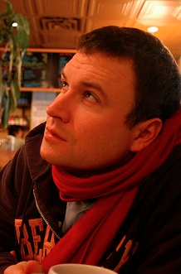
Analysis of Large Scale Visual Recognition
Fei-Fei Li and Olga Russakovsky
Olga Russakovsky, Jia Deng, Zhiheng Huang, Alex Berg, Li Fei-Fei
Detecting avocados to zucchinis: what have we done, and where are we going? ICCV 2013 http://image-net.org/challenges/LSVRC/2012/analysis
Refernce to paper, photos, vision-lab, stanford logos

Slide 2
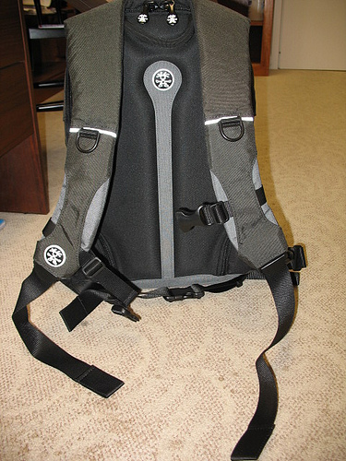
Backpack
Notes:
Want to recognize all objects in the world

Slide 3
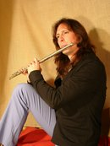
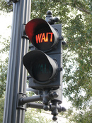
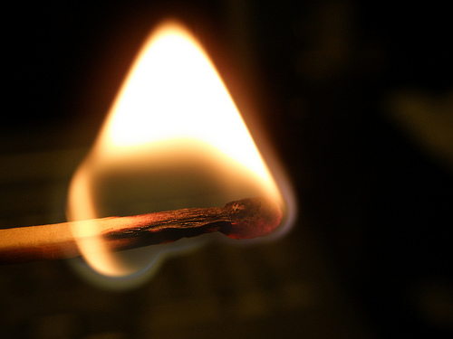
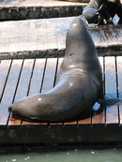
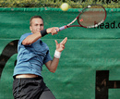
Flute
Strawberry
Traffic light
Backpack
Matchstick
Bathing cap
Sea lion
Racket
Notes:
Want to recognize all objects in the world

Slide 4
Large-scale recognition
Notes:
Want to recognize all objects in the world

Slide 5
Large-scale recognition
Need benchmark datasets
Notes:
Want to recognize all objects in the world

Slide 6
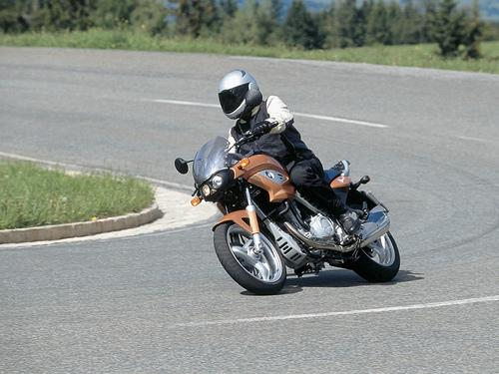
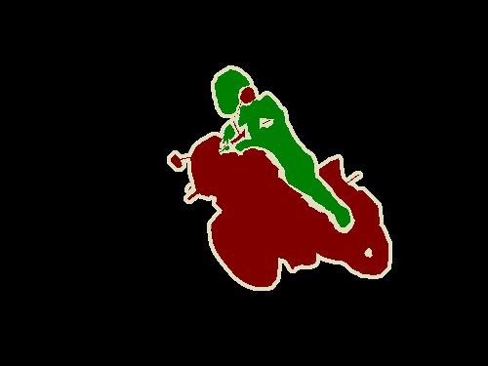
PASCAL VOC 2005-2012
20 object classes 22,591 images
Classification: person, motorcycle
Detection
Segmentation
Person
Motorcycle
Action: riding bicycle
Everingham, Van Gool, Williams, Winn and Zisserman.
The PASCAL Visual Object Classes (VOC) Challenge. IJCV 2010.

Slide 7
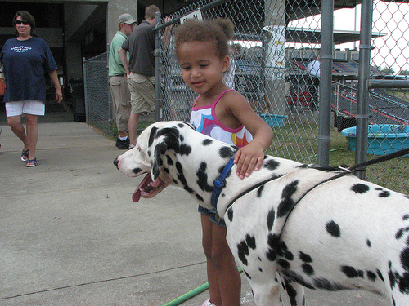
Large Scale Visual Recognition Challenge (ILSVRC) 2010-2012
20 object classes 22,591 images
1000 object classes 1,431,167 images
Dalmatian
http://image-net.org/challenges/LSVRC/{2010,2011,2012}

Slide 8
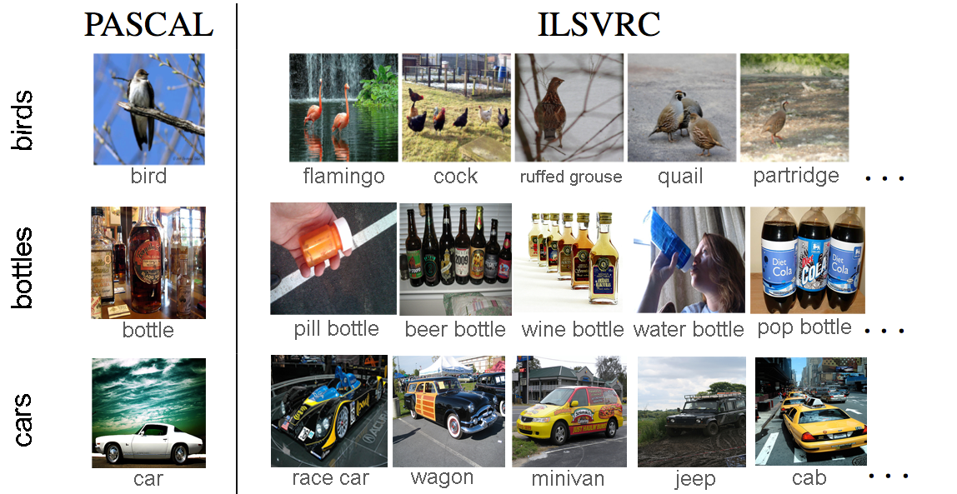
Variety of object classes in ILSVRC

Slide 9
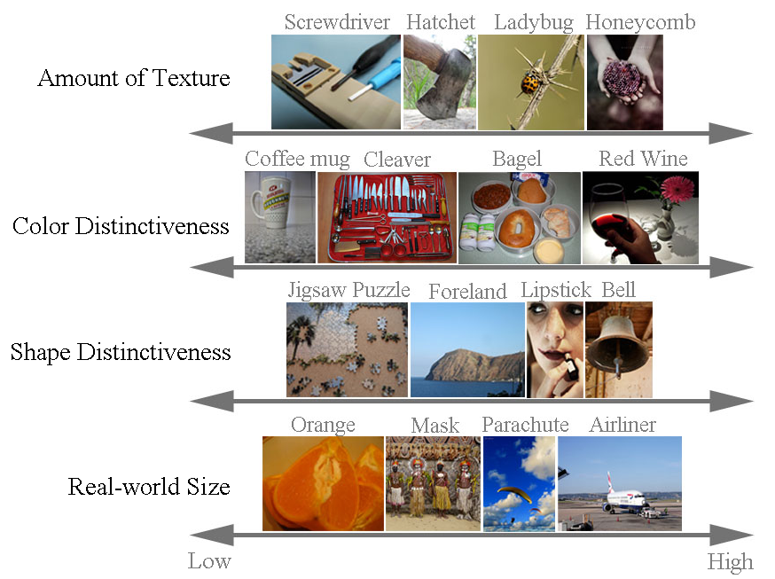
Variety of object classes in ILSVRC

Slide 10
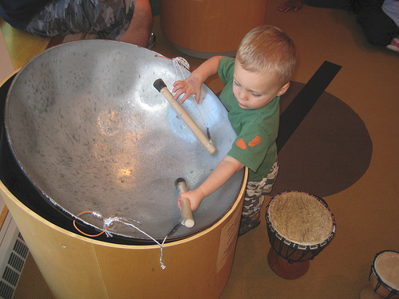
ILSVRC Task 1: Classification
Steel drum
Notes:
At that time was infeasible to label with all objects present

Slide 11
ILSVRC Task 1: Classification
Steel drum
Output:
Scale
T-shirt
Steel drum
Drumstick
Mud turtle
Output:
Scale
T-shirt
Giant panda
Drumstick
Mud turtle
✔
✗

Slide 12
ILSVRC Task 1: Classification
Steel drum
Output:
Scale
T-shirt
Steel drum
Drumstick
Mud turtle
Output:
Scale
T-shirt
Giant panda
Drumstick
Mud turtle
✔
✗
Σ
Accuracy =
1
100,000
1[correct on image i]
100,000
images

Slide 13
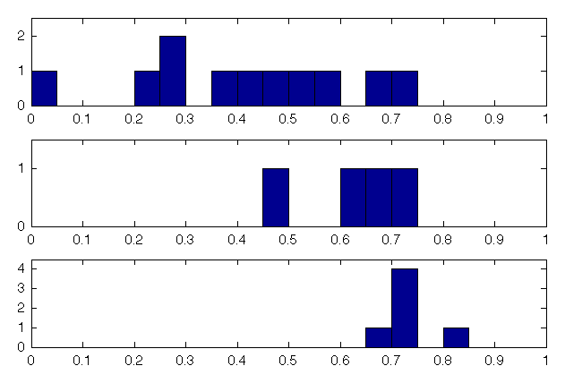
ILSVRC Task 1: Classification
2010
0.72
2011
# Submissions
0.74
2012
0.85
Accuracy (5 predictions/image)

Slide 14
ILSVRC Task 2: Classification + Localization
Steel drum

Slide 15
ILSVRC Task 2: Classification + Localization
Steel drum
Output
Persian cat
Loud speaker
Steel drum
✔
Picket fence
Folding chair

Slide 16
ILSVRC Task 2: Classification + Localization
Steel drum
Output
Persian cat
Loud speaker
Steel drum
✔
Picket fence
Folding chair
Output (bad localization)
Output (bad classification)
Persian cat
Loud speaker
Persian cat
Loud speaker
Steel drum
King penguin
✗
✗
Picket fence
Folding chair
Picket fence
Folding chair

Slide 17
ILSVRC Task 2: Classification + Localization
Steel drum
Output
Persian cat
Loud speaker
Steel drum
✔
Picket fence
Folding chair
Σ
Accuracy =
1
100,000
1[correct on image i]
100,000
images

Slide 18
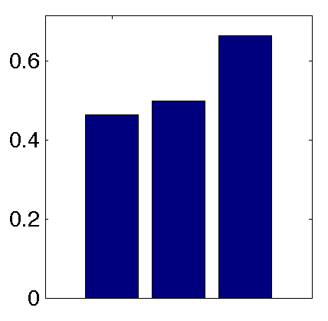
ILSVRC Task 2: Classification + Localization
Accuracy
(5 predictions)
ISI
SuperVision
OXFORD_VGG

Slide 19
What happens under the hood?
Notes:
In order to do this, we need a couple of things first. We begin by introducing a subset of 500 classes of ILSVRC which is suitable for studying localization. We show that is has many of the same challenges as the PASCAL VOC dataset. We’ll use these 500 classes for our analysis. Then we’ll briefly discuss some of the winning algorithms of the 2012 challenge. Given these, we will point out

Slide 20
What happens under the hood
on classification+localization?
Notes:
In order to do this, we need a couple of things first. We begin by introducing a subset of 500 classes of ILSVRC which is suitable for studying localization. We show that is has many of the same challenges as the PASCAL VOC dataset. We’ll use these 500 classes for our analysis. Then we’ll briefly discuss some of the winning algorithms of the 2012 challenge. Given these, we will point out

Slide 21
What happens under the hood
on classification+localization?
Olga Russakovsky, Jia Deng, Zhiheng Huang, Alex Berg, Li Fei-Fei
Detecting avocados to zucchinis: what have we done, and where are we going? ICCV 2013 http://image-net.org/challenges/LSVRC/2012/analysis
Notes:
In order to do this, we need a couple of things first. We begin by introducing a subset of 500 classes of ILSVRC which is suitable for studying localization. We show that is has many of the same challenges as the PASCAL VOC dataset. We’ll use these 500 classes for our analysis. Then we’ll briefly discuss some of the winning algorithms of the 2012 challenge. Given these, we will point out

Slide 22
Preliminaries:
ILSVRC-500 (2012) dataset
Leading algorithms
What happens under the hood
on classification+localization?
Olga Russakovsky, Jia Deng, Zhiheng Huang, Alex Berg, Li Fei-Fei
Detecting avocados to zucchinis: what have we done, and where are we going? ICCV 2013 http://image-net.org/challenges/LSVRC/2012/analysis
Notes:
In order to do this, we need a couple of things first. We begin by introducing a subset of 500 classes of ILSVRC which is suitable for studying localization. We show that is has many of the same challenges as the PASCAL VOC dataset. We’ll use these 500 classes for our analysis. Then we’ll briefly discuss some of the winning algorithms of the 2012 challenge. Given these, we will point out

Slide 23
Preliminaries:
ILSVRC-500 (2012) dataset
Leading algorithms
What happens under the hood
on classification+localization?
A closer look at small objects
A closer look at textured objects
Olga Russakovsky, Jia Deng, Zhiheng Huang, Alex Berg, Li Fei-Fei
Detecting avocados to zucchinis: what have we done, and where are we going? ICCV 2013 http://image-net.org/challenges/LSVRC/2012/analysis
Notes:
In order to do this, we need a couple of things first. We begin by introducing a subset of 500 classes of ILSVRC which is suitable for studying localization. We show that is has many of the same challenges as the PASCAL VOC dataset. We’ll use these 500 classes for our analysis. Then we’ll briefly discuss some of the winning algorithms of the 2012 challenge. Given these, we will point out

Slide 24
Preliminaries:
ILSVRC-500 (2012) dataset
Leading algorithms
What happens under the hood
on classification+localization?
A closer look at small objects
A closer look at textured objects
Olga Russakovsky, Jia Deng, Zhiheng Huang, Alex Berg, Li Fei-Fei
Detecting avocados to zucchinis: what have we done, and where are we going? ICCV 2013 http://image-net.org/challenges/LSVRC/2012/analysis
Notes:
In order to do this, we need a couple of things first. We begin by introducing a subset of 500 classes of ILSVRC which is suitable for studying localization. We show that is has many of the same challenges as the PASCAL VOC dataset. We’ll use these 500 classes for our analysis. Then we’ll briefly discuss some of the winning algorithms of the 2012 challenge

Slide 25
ILSVRC (2012)
1000 object classes
Easy to localize
Hard to localize
Notes:
In this challenge, we focused on 1000 object classes

Slide 26
ILSVRC-500 (2012)
500 classes with smallest objects
Easy to localize
Hard to localize
Notes:
In this challenge, we focused on 1000 object classes

Slide 27
ILSVRC-500 (2012)
500 classes with smallest objects
Easy to localize
Hard to localize
Object scale (fraction of image area occupied by target object)
ILSVRC-500 (2012) | 500 object categories | 25.3%
PASCAL VOC (2012) | 20 object categories | 25.2%
Notes:
In this challenge, we focused on 1000 object classes

Slide 28
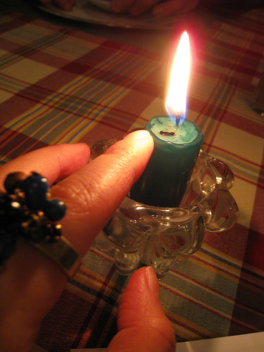
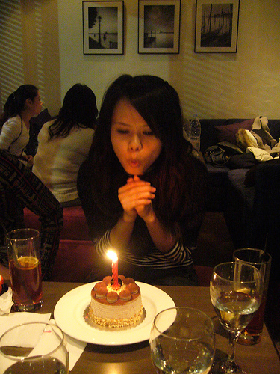
Chance Performance of Localization
Steel drum
B₁
B_{3,4,5,6,…}
B₁
B₂
B₆
B₈
B₉
B₃
B₄
B₅
B₇
B₂
N = 9 here
Notes:
For a single category and the set of corresponding images, can compute as follows. Correlated with object scale, but also takes into account the distribution of locations

Slide 29
Chance Performance of Localization
Steel drum
B₁
B_{3,4,5,6,…}
B₁
B₂
B₆
B₈
B₉
B₃
B₄
B₅
B₇
B₂
N = 9 here
Notes:
For a single category and the set of corresponding images, can compute as follows. Correlated with object scale, but also takes into account the distribution of locations

Slide 30
Chance Performance of Localization
Steel drum
B₁
B_{3,4,5,6,…}
B₁
B₂
B₆
B₈
B₉
B₃
B₄
B₅
B₇
B₂
N = 9 here
ILSVRC-500 (2012) | 500 object categories | 8.4%
PASCAL VOC (2012) | 20 object categories | 8.8%
Notes:
For a single category and the set of corresponding images, can compute as follows. Correlated with object scale, but also takes into account the distribution of locations

Slide 31
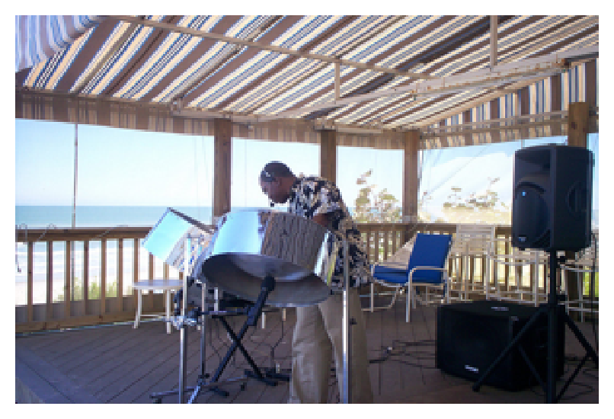
Level of clutter
Steel drum
- Generate candidate object regions using method of
Selective Search for Object Detection
vanDeSande et al. ICCV 2011
- Filter out regions inside object
- Count regions
Notes:
For a single category and the set of corresponding images, can compute as follows. Correlated with object scale, but also takes into account the distribution of locations

Slide 32
Level of clutter
Steel drum
- Generate candidate object regions using method of
Selective Search for Object Detection
vanDeSande et al. ICCV 2011
- Filter out regions inside object
- Count regions
ILSVRC-500 (2012) | 500 object categories | 128 ± 35
PASCAL VOC (2012) | 20 object categories | 130 ± 29
Notes:
For a single category and the set of corresponding images, can compute as follows. Correlated with object scale, but also takes into account the distribution of locations

Slide 33
Preliminaries:
ILSVRC-500 (2012) dataset – similar to PASCAL
Leading algorithms
What happens under the hood
on classification+localization?
A closer look at small objects
A closer look at textured objects
Olga Russakovsky, Jia Deng, Zhiheng Huang, Alex Berg, Li Fei-Fei
Detecting avocados to zucchinis: what have we done, and where are we going? ICCV 2013 http://image-net.org/challenges/LSVRC/2012/analysis
Notes:
In order to do this, we need a couple of things first. We begin by introducing a subset of 500 classes of ILSVRC which is suitable for studying localization. We show that is has many of the same challenges as the PASCAL VOC dataset. We’ll use these 500 classes for our analysis. Then we’ll briefly discuss some of the winning algorithms of the 2012 challenge. Given these, we will point out

Slide 34
SuperVision (SV)
Alex Krizhevsky, Ilya Sutskever, Geoffrey Hinton (Krizhevsky NIPS12)
Image classification: Deep convolutional neural networks
7 hidden “weight” layers, 650K neurons, 60M parameters, 630M connections
Rectified Linear Units, max pooling, dropout trick
Randomly extracted 224x224 patches for more data
Trained with SGD on two GPUs for a week, fully supervised
Localization: Regression on (x,y,w,h)
http://image-net.org/challenges/LSVRC/2012/supervision.pdf
Notes:
Very impressive results given poor localization

Slide 35
SuperVision (SV)
Alex Krizhevsky, Ilya Sutskever, Geoffrey Hinton (Krizhevsky NIPS12)
Image classification: Deep convolutional neural networks
7 hidden “weight” layers, 650K neurons, 60M parameters, 630M connections
Rectified Linear Units, max pooling, dropout trick
Randomly extracted 224x224 patches for more data
Trained with SGD on two GPUs for a week, fully supervised
Localization: Regression on (x,y,w,h)
http://image-net.org/challenges/LSVRC/2012/supervision.pdf
Notes:
Very impressive results given poor localization

Slide 36
OXFORD_VGG (VGG)
Karen Simonyan, Yusuf Aytar, Andrea Vedaldi, Andrew Zisserman
Image classification: Fisher vector + linear SVM (Sanchez CVPR11)
Root-SIFT (Arandjelovic CVPR12), color statistics, augmentation with patch location (x,y) (Sanchez PRL12)
Fisher vectors: 1024 Gaussians, 135K dimensions
No SPM, product quantization to compress
Semi-supervised learning to find additional bounding boxes
1000 one-vs-rest SVM trained with Pegasos SGD
135M parameters!
Localization: Deformable part-based models (Felzenszwalb PAMI10), without parts (root-only)
http://image-net.org/challenges/LSVRC/2012/oxford_vgg.pdf
Notes:
For a single category and the set of corresponding images, can compute as follows. Correlated with object scale, but also takes into account the distribution of locations

Slide 37
Preliminaries:
ILSVRC-500 (2012) dataset – similar to PASCAL
Leading algorithms: SV and VGG
What happens under the hood
on classification+localization?
A closer look at small objects
A closer look at textured objects
Olga Russakovsky, Jia Deng, Zhiheng Huang, Alex Berg, Li Fei-Fei
Detecting avocados to zucchinis: what have we done, and where are we going? ICCV 2013 http://image-net.org/challenges/LSVRC/2012/analysis
Notes:
In order to do this, we need a couple of things first. We begin by introducing a subset of 500 classes of ILSVRC which is suitable for studying localization. We show that is has many of the same challenges as the PASCAL VOC dataset. We’ll use these 500 classes for our analysis. Then we’ll briefly discuss some of the winning algorithms of the 2012 challenge. Given these, we will point out

Slide 38
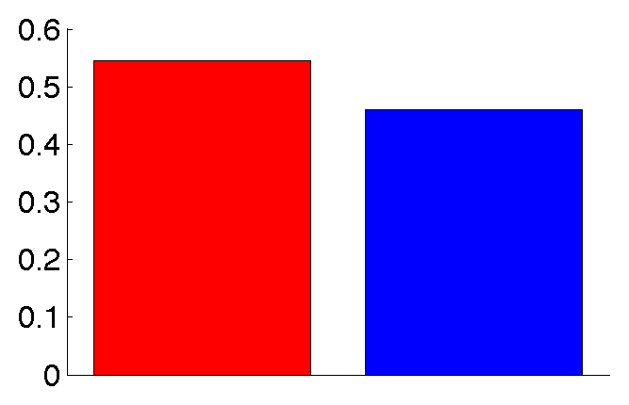
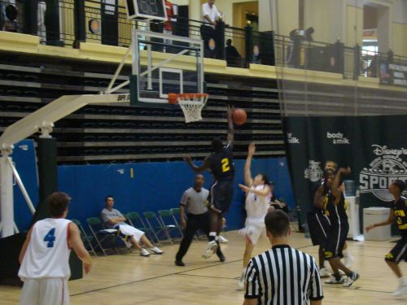
Results on ILSVRC-500
54.3%
45.8%
Cls+loc accuracy
SV
VGG

Slide 39
Difference in accuracy: SV versus VGG
Classification-only
Persian cat
Loud speaker
Steel drum
✔
Picket fence
Folding chair
p < 0.001

Slide 40
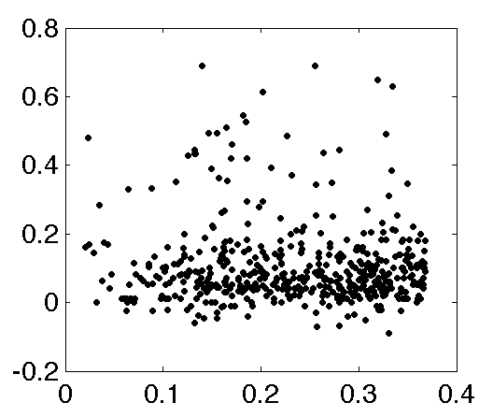
Difference in accuracy: SV versus VGG
Classification-only
Cls. Accuracy: SV - VGG
p < 0.001
Object scale

Slide 41
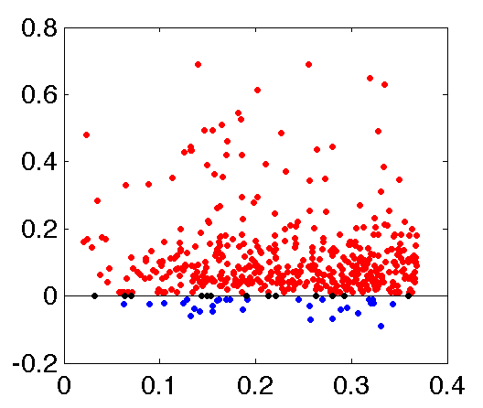
Difference in accuracy: SV versus VGG
Classification-only
SV better
(452 classes)
Cls. Accuracy: SV - VGG
VGG better
(34 classes)
p < 0.001
Object scale

Slide 42
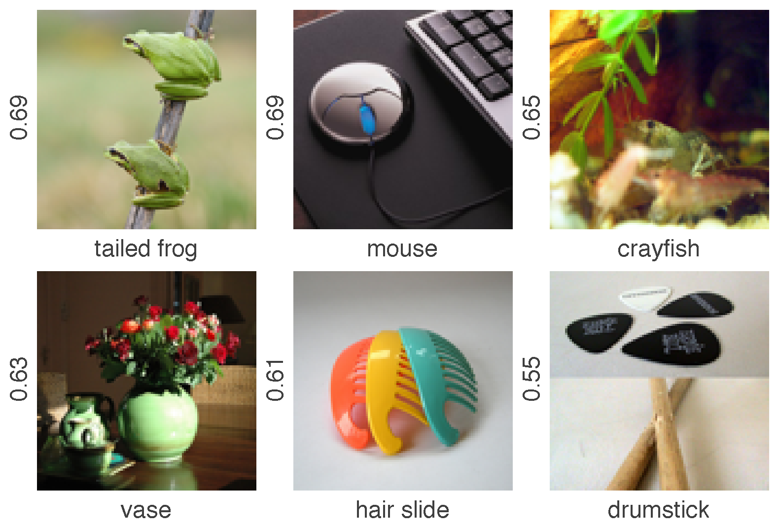
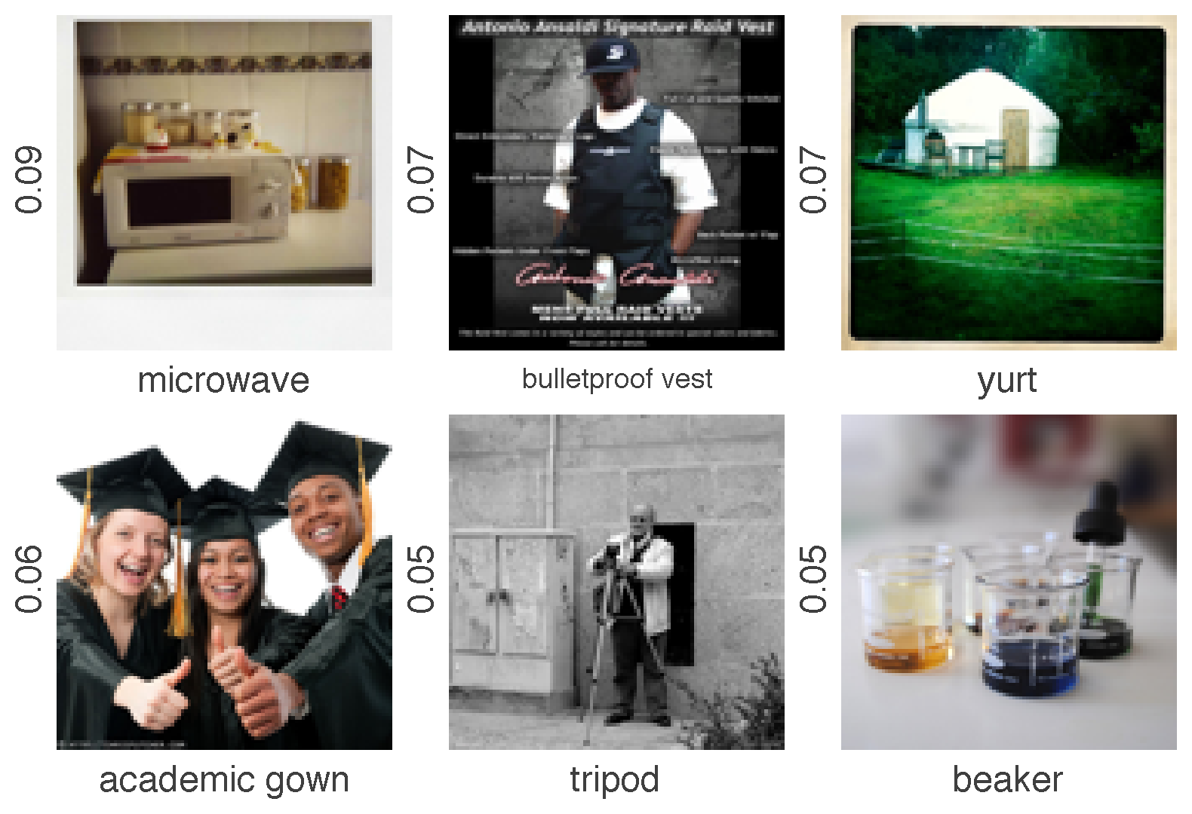
Difference in accuracy: SV versus VGG
SV beats VGG
Classification-only
SV better
(452 classes)
***
***
***
Cls. Accuracy: SV - VGG
***
***
***
VGG beats SV
VGG better
(34 classes)
p < 0.001
Object scale
*

Slide 43
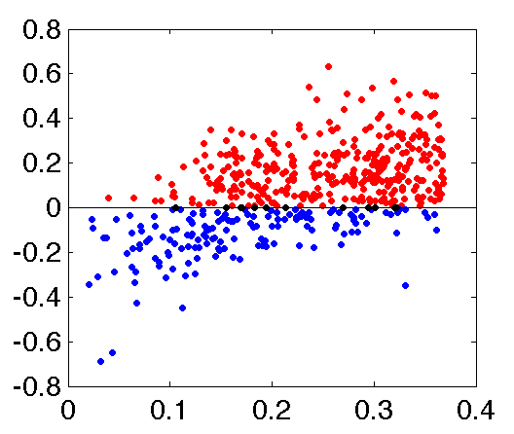
Difference in accuracy: SV versus VGG
Classification-only
Classification+Localiation
SV better
(452 classes)
SV better
(338 classes)
Cls. Accuracy: SV - VGG
Cls+Loc Accuracy: SV - VGG
VGG better
(34 classes)
VGG better
(150 classes)
p < 0.001
Object scale
Object scale

Slide 44
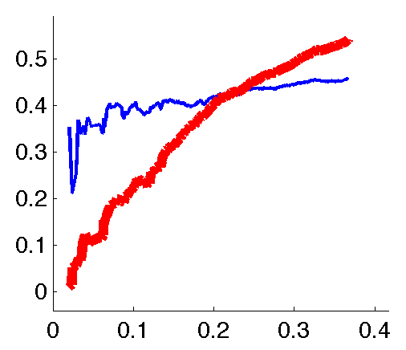
Cumulative accuracy across scales
Classification+Localization
Classification-only
SV
SV
VGG
VGG
Cumulative cls. accuracy
Cumulative cls+loc accuracy
Object scale
Object scale

Slide 45
Cumulative accuracy across scales
Classification+Localization
Classification-only
SV
SV
VGG
VGG
Cumulative cls. accuracy
Cumulative cls+loc accuracy
Object scale
205 smallest object classes
0.24
Object scale
Notes:
40 vs 41% vgg vs sv for boxes
SV not using sliding windows!!

Slide 46
Preliminaries:
ILSVRC-500 (2012) dataset – similar to PASCAL
Leading algorithms: SV and VGG
What happens under the hood
on classification+localization?
SV always great at classification, but VGG does better than SV at localizing small objects
A closer look at textured objects
Olga Russakovsky, Jia Deng, Zhiheng Huang, Alex Berg, Li Fei-Fei
Detecting avocados to zucchinis: what have we done, and where are we going? ICCV 2013 http://image-net.org/challenges/LSVRC/2012/analysis
Notes:
In order to do this, we need a couple of things first. We begin by introducing a subset of 500 classes of ILSVRC which is suitable for studying localization. We show that is has many of the same challenges as the PASCAL VOC dataset. We’ll use these 500 classes for our analysis. Then we’ll briefly discuss some of the winning algorithms of the 2012 challenge. Given these, we will point out

Slide 47
Preliminaries:
ILSVRC-500 (2012) dataset – similar to PASCAL
Leading algorithms: SV and VGG
What happens under the hood
on classification+localization?
SV always great at classification, but VGG does better than SV at localizing small objects
A closer look at textured objects
WHY?
Olga Russakovsky, Jia Deng, Zhiheng Huang, Alex Berg, Li Fei-Fei
Detecting avocados to zucchinis: what have we done, and where are we going? ICCV 2013 http://image-net.org/challenges/LSVRC/2012/analysis
Notes:
In order to do this, we need a couple of things first. We begin by introducing a subset of 500 classes of ILSVRC which is suitable for studying localization. We show that is has many of the same challenges as the PASCAL VOC dataset. We’ll use these 500 classes for our analysis. Then we’ll briefly discuss some of the winning algorithms of the 2012 challenge. Given these, we will point out

Slide 48
Preliminaries:
ILSVRC-500 (2012) dataset – similar to PASCAL
Leading algorithms: SV and VGG
What happens under the hood
on classification+localization?
SV always great at classification, but VGG does better than SV at localizing small objects
A closer look at textured objects
Olga Russakovsky, Jia Deng, Zhiheng Huang, Alex Berg, Li Fei-Fei
Detecting avocados to zucchinis: what have we done, and where are we going? ICCV 2013 http://image-net.org/challenges/LSVRC/2012/analysis
Notes:
In order to do this, we need a couple of things first. We begin by introducing a subset of 500 classes of ILSVRC which is suitable for studying localization. We show that is has many of the same challenges as the PASCAL VOC dataset. We’ll use these 500 classes for our analysis. Then we’ll briefly discuss some of the winning algorithms of the 2012 challenge. Given these, we will point out

Slide 49
Textured objects (ILSVRC-500)
Amount of texture
Low
High
Notes:
156 natural, 344 man-made

Slide 50
Textured objects (ILSVRC-500)
Amount of texture
Low
High
 | No texture | Low texture | Medium texture | High texture
# classes | 116 | 189 | 143 | 52
Notes:
156 natural, 344 man-made

Slide 51
Textured objects (ILSVRC-500)
Amount of texture
Low
High
 | No texture | Low texture | Medium texture | High texture
# classes | 116 | 189 | 143 | 52
Object scale | 20.8% | 23.7% | 23.5% | 25.0%
Notes:
156 natural, 344 man-made

Slide 52
Textured objects (416 classes)
Amount of texture
Low
High
 | No texture | Low texture | Medium texture | High texture
# classes | 116 | 189 149 | 143 115 | 52 35
Object scale | 20.8% | 23.7% 20.8% | 23.5% 20.8% | 25.0% 20.8%
Notes:
156 natural, 344 man-made

Slide 53
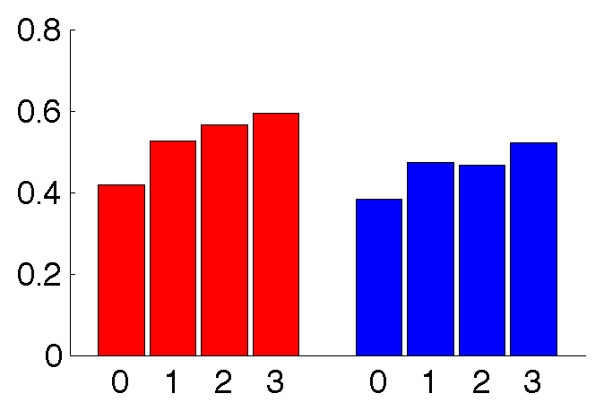
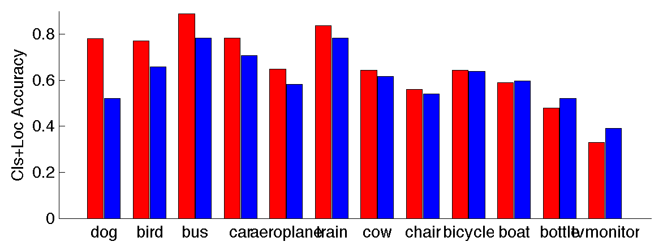
Localizing textured objects (416 classes, same average object scale at each level of texture)
SV
VGG
Localization accuracy
Level of texture
Notes:
156 natural, 344 man-made

Slide 54
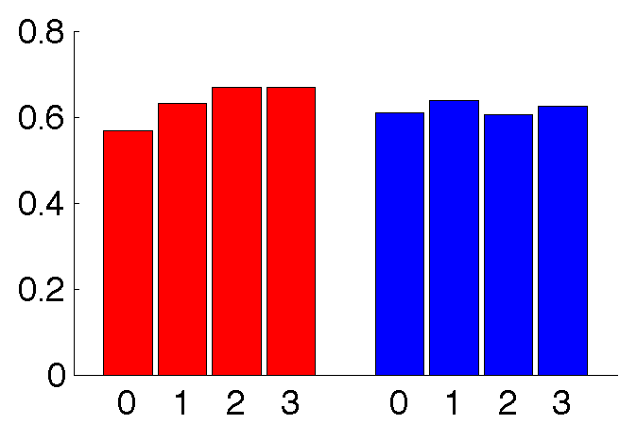
Localizing textured objects (416 classes, same average object scale at each level of texture)
SV
VGG
On correctly classified images
Localization accuracy
Level of texture
Notes:
156 natural, 344 man-made

Slide 55
Localizing textured objects (416 classes, same average object scale at each level of texture)
SV
VGG
On correctly classified images
Localization accuracy
Level of texture
Notes:
156 natural, 344 man-made

Slide 56
Preliminaries:
ILSVRC-500 (2012) dataset – similar to PASCAL
Leading algorithms: SV and VGG
What happens under the hood
on classification+localization?
SV always great at classification, but VGG does better than SV at localizing small objects
Textured objects easier to localize, especially for SV
Olga Russakovsky, Jia Deng, Zhiheng Huang, Alex Berg, Li Fei-Fei
Detecting avocados to zucchinis: what have we done, and where are we going? ICCV 2013 http://image-net.org/challenges/LSVRC/2012/analysis
Notes:
In order to do this, we need a couple of things first. We begin by introducing a subset of 500 classes of ILSVRC which is suitable for studying localization. We show that is has many of the same challenges as the PASCAL VOC dataset. We’ll use these 500 classes for our analysis. Then we’ll briefly discuss some of the winning algorithms of the 2012 challenge. Given these, we will point out

Slide 57
ILSVRC 2013 with large-scale object detection
NEW
Fully annotated 200 object classes across 60,000 images
Person
Car
Motorcycle
Helmet
Allows evaluation of generic object detection in cluttered scenes at scale
http://image-net.org/challenges/LSVRC/2013/
3x
Notes:
In this challenge, we focused on 1000 object classes

Slide 58
ILSVRC 2013 with large-scale object detection
NEW
Statistics |  | PASCAL VOC 2012 | ILSVRC 2013
Object classes |  | 20 | 200
Training | Images | 5.7K | 395K
 | Objects | 13.6K | 345K
Validation | Images | 5.8K | 20.1K
 | Objects | 13.8K | 55.5K
Testing | Images | 11.0K | 40.1K
 | Objects | --- | ---
10x
25x
4x
More than 50,000 person instances annotated
http://image-net.org/challenges/LSVRC/2013/
3x
Notes:
In this challenge, we focused on 1000 object classes

Slide 59
ILSVRC 2013 with large-scale object detection
NEW
159 downloads so far:
http://image-net.org/challenges/LSVRC/2013/
Submission deadline Nov. 15th
ICCV workshop on December 7th, 2013
Fine-Grained Challenge 2013:
https://sites.google.com/site/fgcomp2013/
3x
Notes:
Google, stanford, princeton,

Slide 60
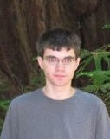
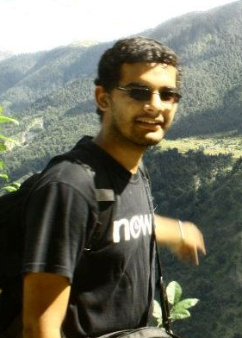
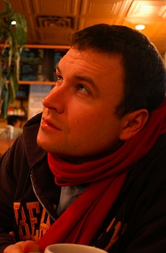
Thank you!
Dr. Jia Deng
Stanford U.
Zhiheng Huang
Stanford U.
Jonathan Krause
Stanford U.
Sanjeev Satheesh
Stanford U.
Hao Su
Stanford U.
Prof. Alex Berg
UNC Chapel Hill

