Slide 1

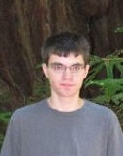
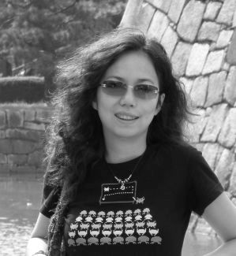

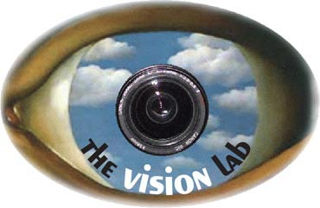
Fine-Grained Crowdsourcing for Fine-Grained Recognition
Jia Deng, Jonathan Krause, Li Fei-Fei
Stanford University
CVPR 2013

Slide 2
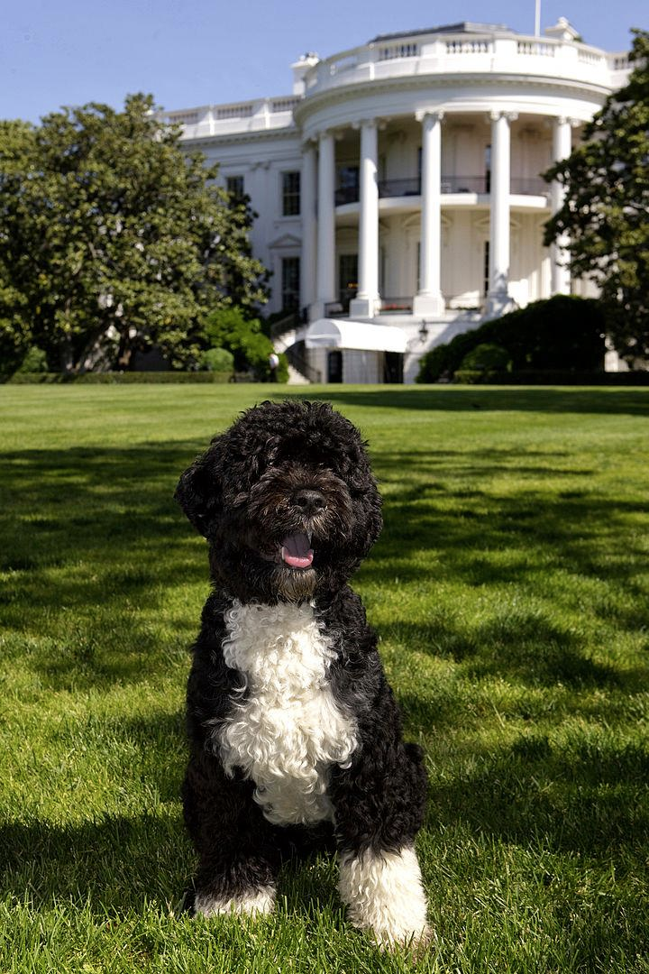
Dog
Portuguese Water Dog
Bo, the First Dog of the U.S.

Slide 3
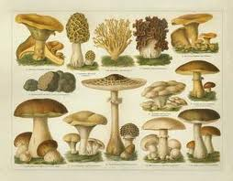
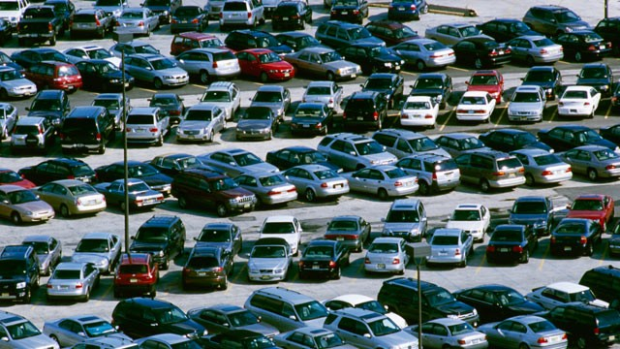
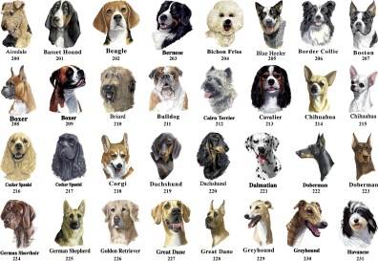
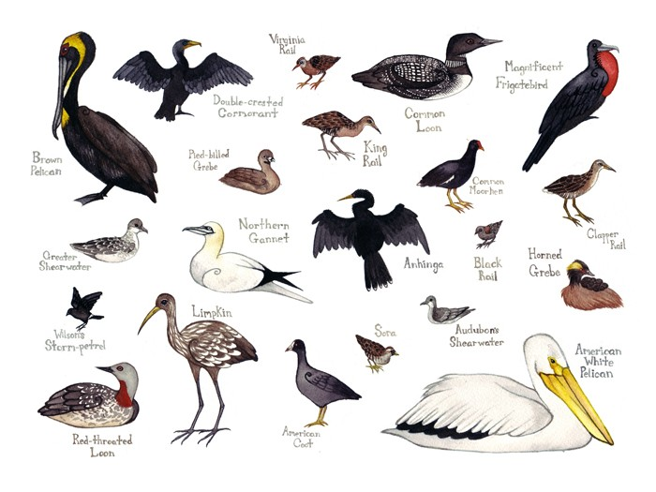
Fine-Grained Recognition

Slide 4
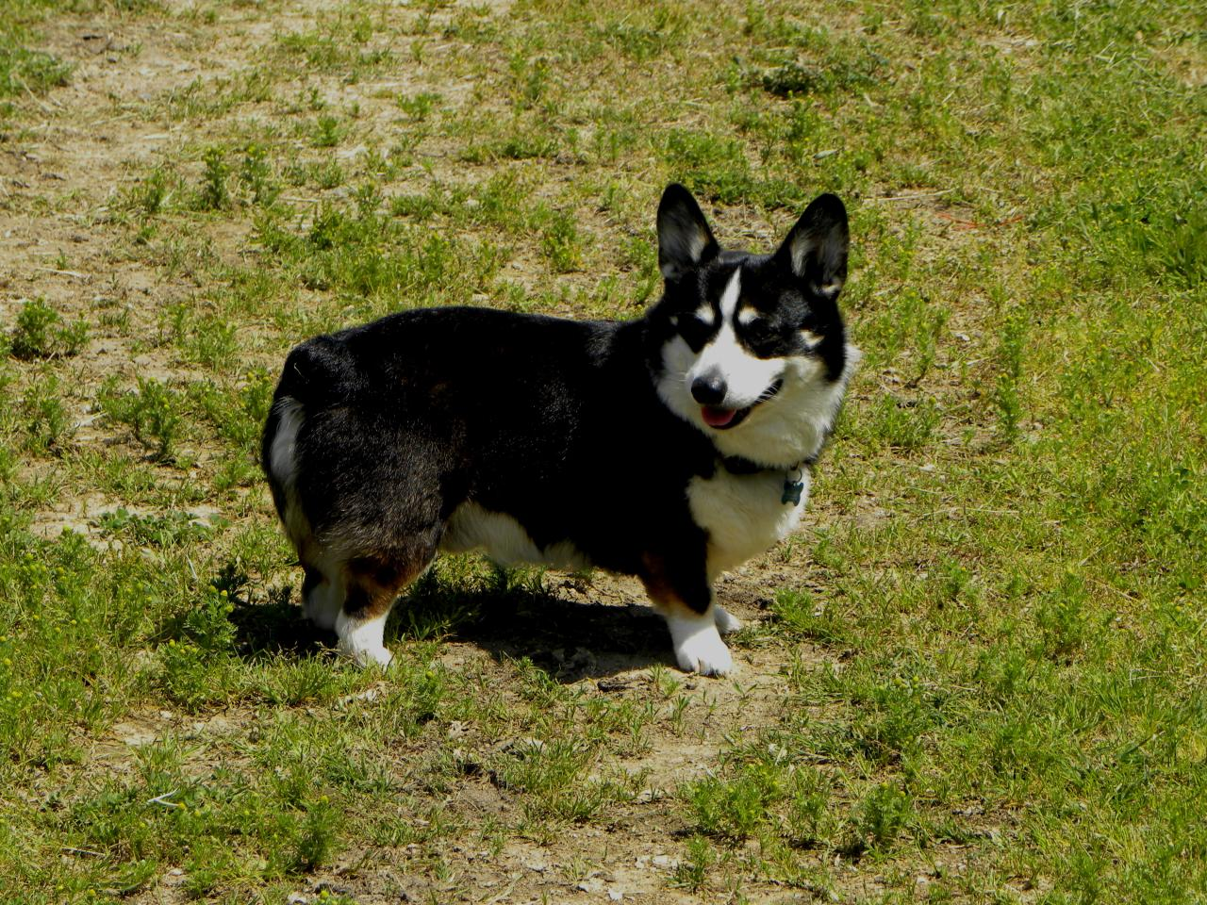
Why is Fine-Grained Recognition Difficult?
?
What breed is this dog?

Slide 5
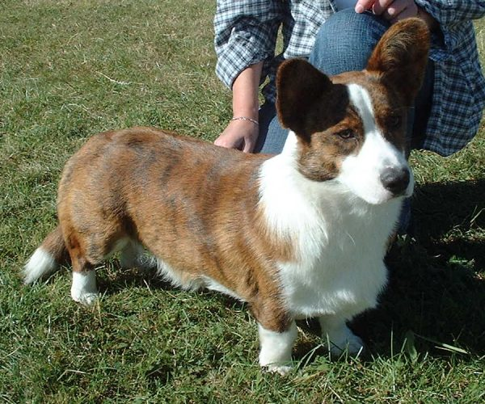
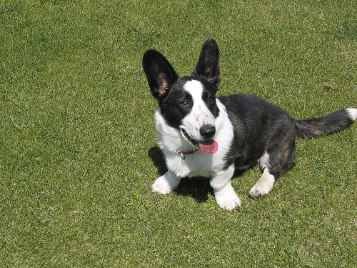
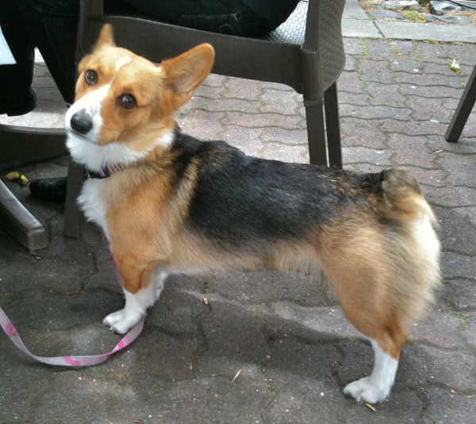
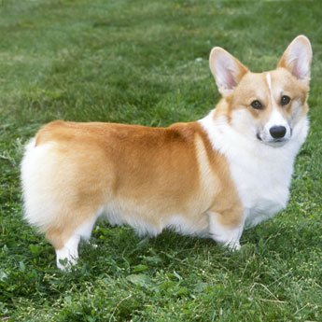
Why is Fine-Grained Recognition Difficult?
…
Cardigan Welsh Corgi
?
…
What breed is this dog?
Pembroke Welsh Corgi
Key: Find the right features.

Slide 6
Why is Fine-Grained Recognition Difficult?
Learning
…
Cardigan Welsh Corgi
…
Existing Work
Pembroke Welsh Corgi
[Branson et al. '10]
[Bo et al. '10]
[Farrell et al. '11]
[Yao et al. ’11]
[Yao et al. ’12]
[Liu et al. ’12]
[Chai et al. ’12]

Slide 7
Why is Fine-Grained Recognition Difficult?
Learning
…
Cardigan Welsh Corgi
…
Existing Work
Pembroke Welsh Corgi
[Branson et al. '10]
[Bo et al. '10]
[Farrell et al. '11]
[Yao et al. ’11]
[Yao et al. ’12]
[Liu et al. ’12]
[Chai et al. ’12]

Slide 8
Why is Fine-Grained Recognition Difficult?
Learning
…
Cardigan Welsh Corgi
…
Pembroke Welsh Corgi
How to help computers select features?

Slide 9
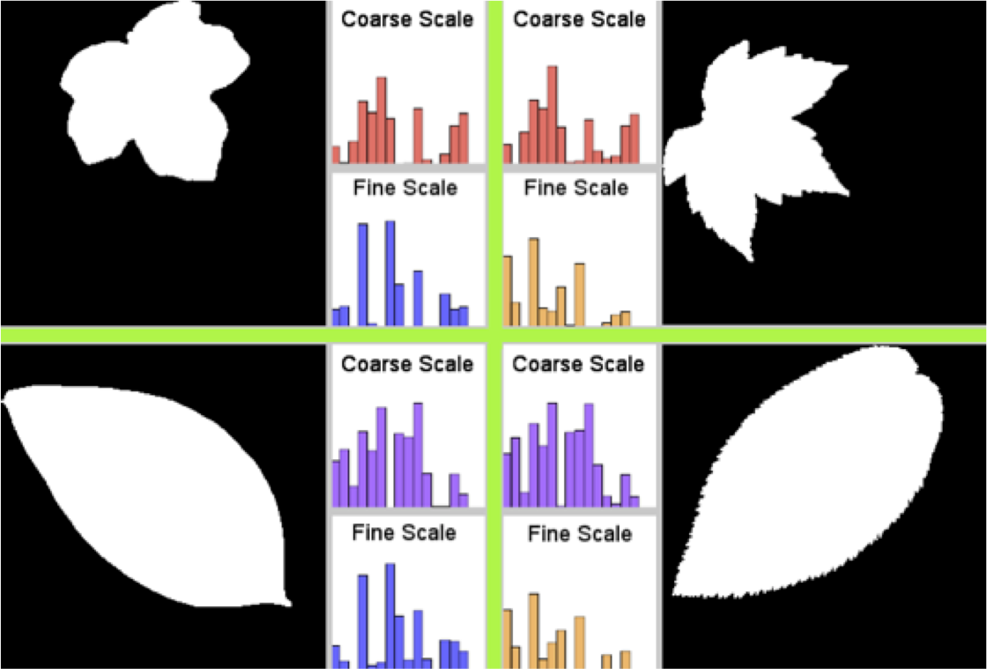
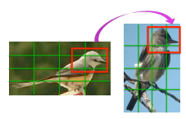
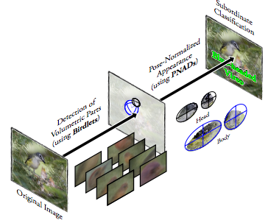
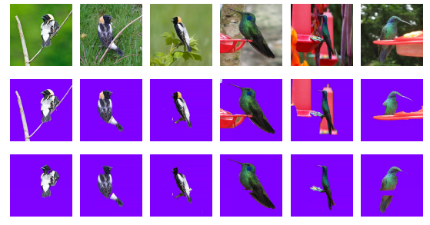
Toward Fine-Grained Recognition
Better Representation
[Kumar et al ’12]
[Yang et al ’12]
Mid-level Vision
[Farrell et al ’11]
[Chai et al ’12]

Slide 10


Machine-Crowd Collaboration
Machine
KNOWLEDGE
Crowd

Slide 11
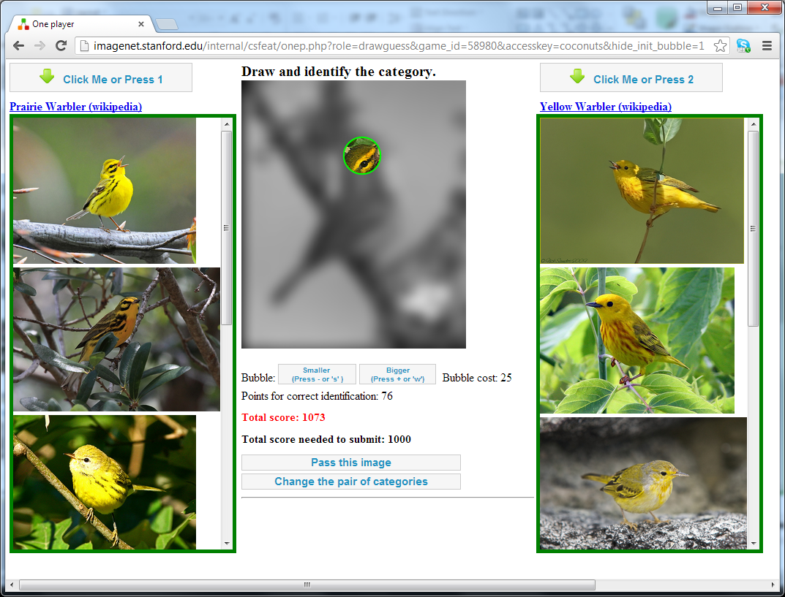
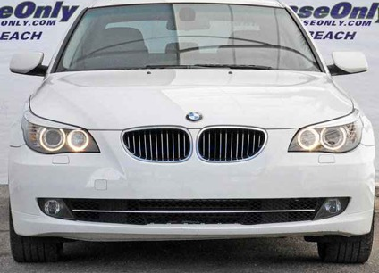
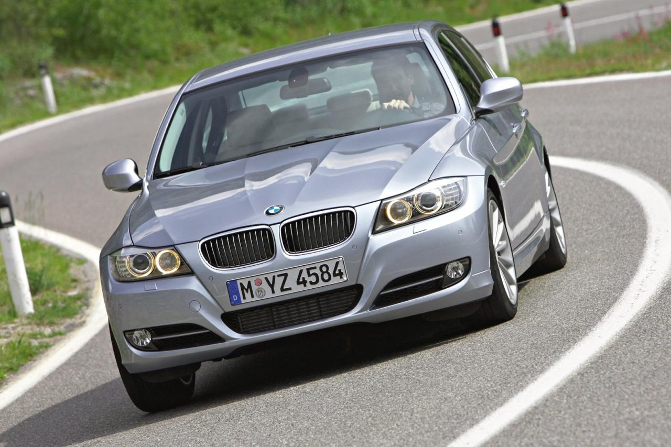
Machine-Crowd Collaboration
Question
VS
VS
VS
Baseline Model
Confusing Class
Pairs
Annotation Task
Learning with New Knowledge
VS
Answer
VS
VS

Slide 12
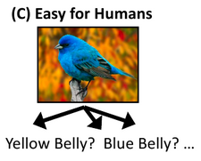
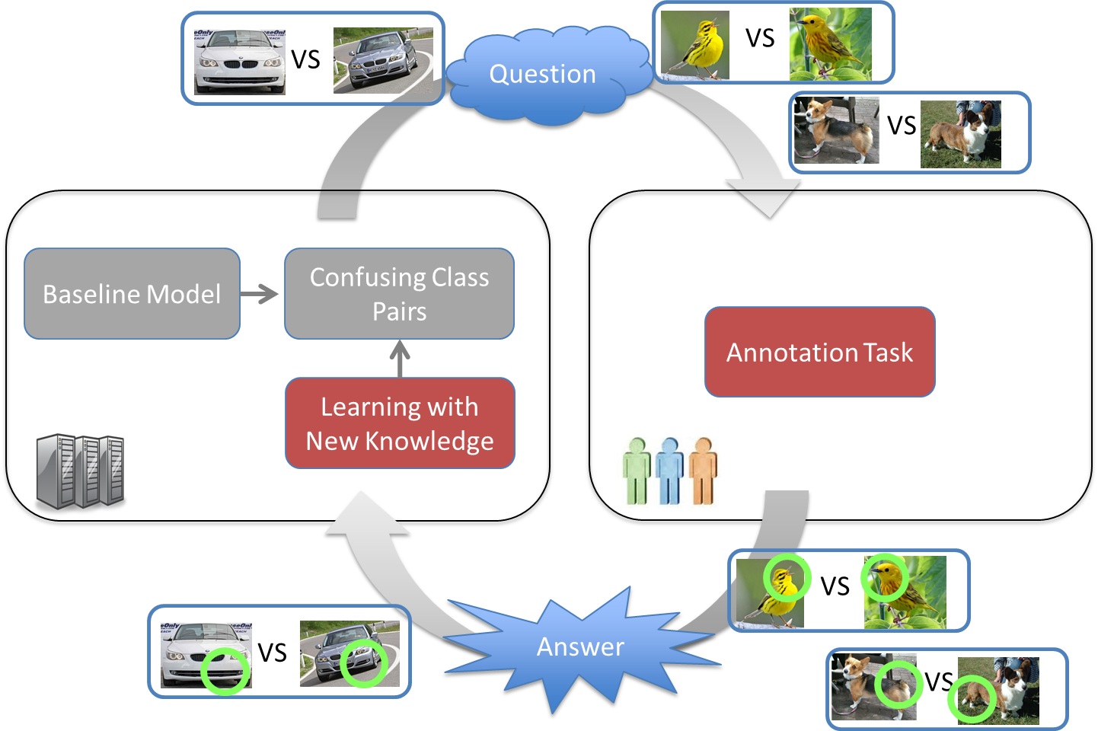
Machine-Crowd Collaboration
[Branson et al. ’10]
[Wah et al. ’11]
[Kovashka et al. ’12]
[Wah & Belongie ’13]
This Talk
Harvesting Knowledge
Interactive Recognition
During Training
During Test

Slide 13
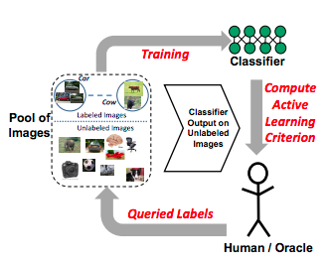
Machine-Crowd Collaboration
[Branson et al. ’10]
[Wah et al. ’11]
[Kovashka et al. ’12]
[Wah & Belongie ’13]
[Kapoor et al ’07]
[Vijayanarasimhan & Grauman ’09]
[Vijayanarasimhan & Grauman ’11]
[Kovashka et al. ’11]
This Talk
Harvesting Knowledge
Interactive Recognition
Active Learning
During Training
During Test

Slide 14
Machine-Crowd Collaboration
[Branson et al. ’10]
[Wah et al. ’11]
[Kovashka et al. ’12]
[Wah & Belongie ’13]
[Kapoor et al ’07]
[Vijayanarasimhan & Grauman ’09]
[Vijayanarasimhan & Grauman ’11]
[Kovashka et al. ’11]
This Talk
Harvesting Knowledge
Interactive Recognition
Active Learning
During Training
During Test
Focus on extracting and leveraging knowledge
Focus on allocating labeling resources

Slide 15
Machine-Crowd Collaboration
Question
VS
VS
VS
Baseline Model
Confusing Class
Pairs
Annotation Task
Learning with New Knowledge
VS
Answer
VS
VS

Slide 16
Machine-Crowd Collaboration
VS
VS
VS
Baseline Model
Confusing Class
Pairs
Annotation Task
Learning with New Knowledge
VS
VS
VS

Slide 17
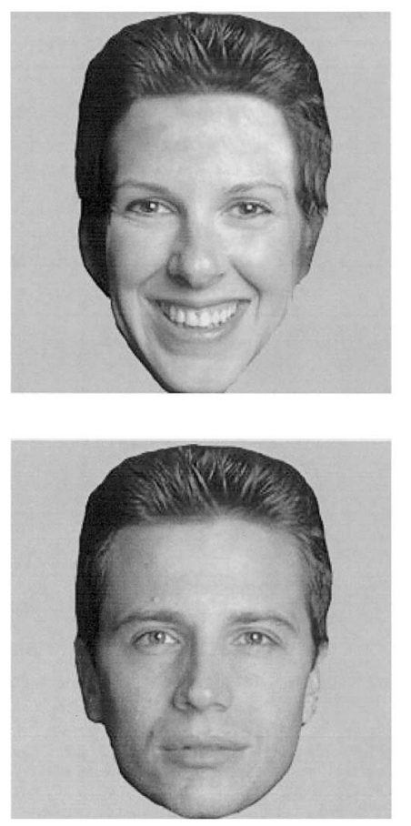
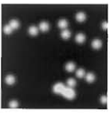
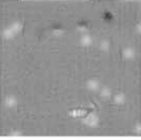
Bubbles [Gosselin & Schyns, ’01]
VS
Smiling
Neutral
+
=
Random Bubble Mask

Slide 18
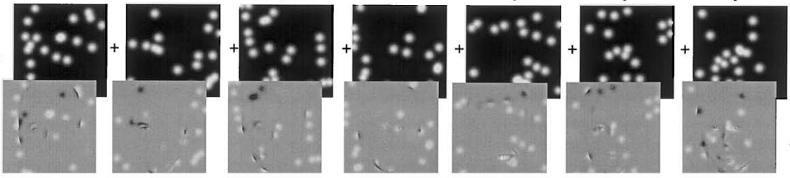
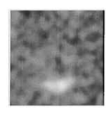
Bubbles [Gosselin & Schyns, ’01]
VS
Too costly
Smiling
Neutral

Slide 19
The Bubbles Game

Slide 20
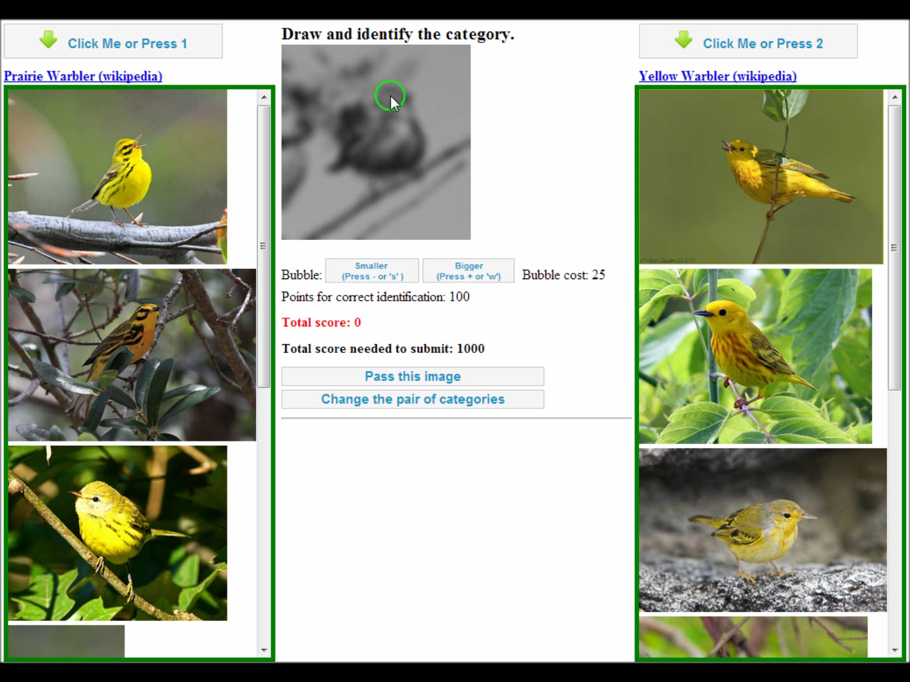
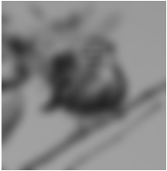
Deng, Krause, & Fei-Fei, CVPR2013

Slide 21
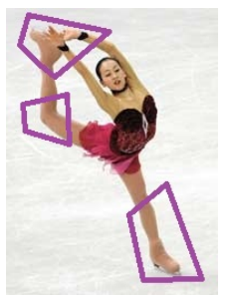
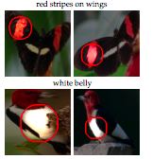
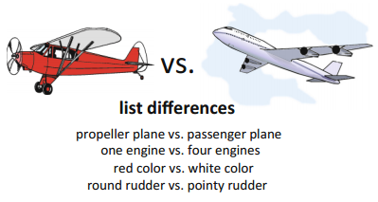
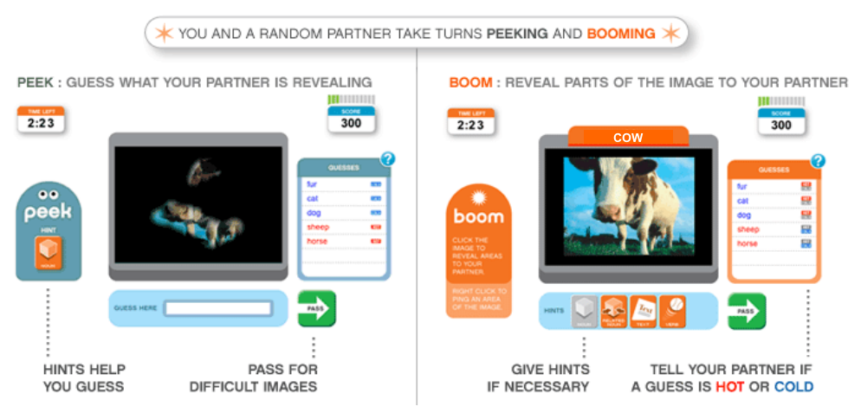
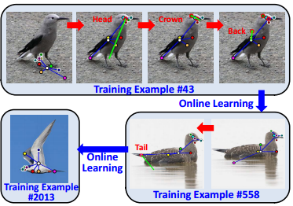
Bubbles versus Related Techniques
Gamified
Automatic quality assurance
Language free
No assumptions about parts/attributes
Domain agnostic
VS
VS
Bubbles
[Donahue & Grauman ’11]
[Duan et al. ’12]
[Maji ’12]
[Ahn, et al. ’06]
[Branson et al. ’11]

Slide 22
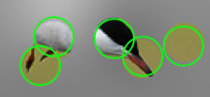
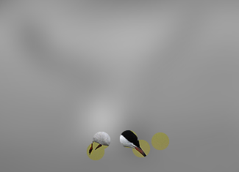
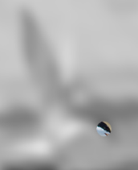
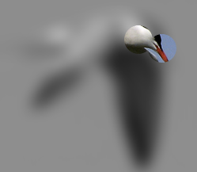




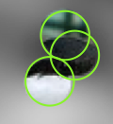
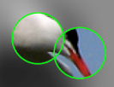
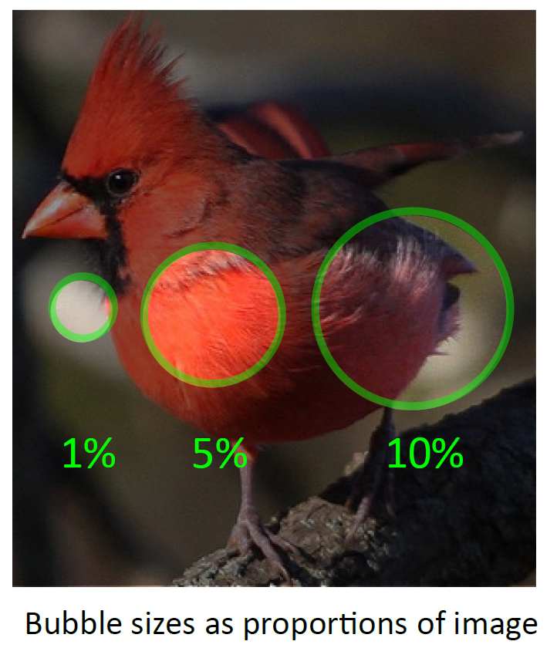
Crowd Picked Bubbles (AMT)
200 classes from Caltech-UCSD-Bird [Welinder et al. 2010]
800 top confusing class pairs (via cross-validation)
90K games on Amazon Mechanical Turk
70% of games are successful
>90% of successful games use <10% of the bounding box
Deng, Krause, & Fei-Fei, CVPR2013

Slide 23
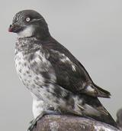
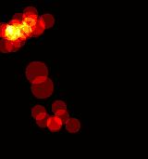
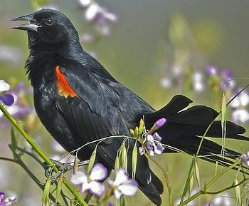
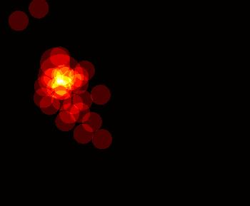
Bubble Heatmaps

Slide 24
Machine-Crowd Collaboration
VS
VS
VS
Baseline Model
Confusing Class
Pairs
Bubbles Game
Learning with New Knowledge
VS
VS
VS

Slide 25
Machine-Crowd Collaboration
Question
VS
VS
VS
Baseline Model
Confusing Class
Pairs
Bubbles Game
Learning with New Knowledge
VS
Answer
VS
VS

Slide 26
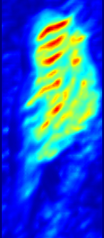
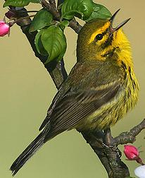
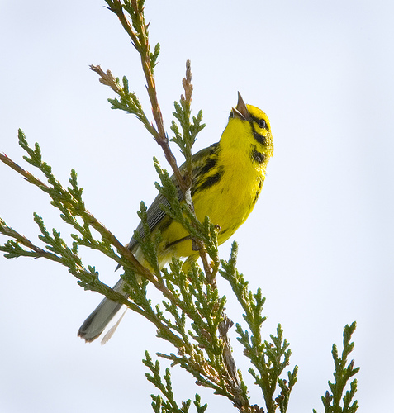
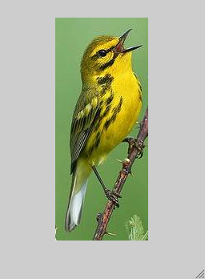



Machine Learning with Crowd-picked Bubbles
The BubbleBank Representation
Training Images
Test Image
?
…
Linear SVM
Deng, Krause, & Fei-Fei, CVPR2013

Slide 27
b
b
MKL [Branson et al. ‘10]
LLC [Wang et al. ‘09]
RF [Yao et al. '11]
MultiCue [Khan et al.'11]
KDES [Bo et al. ’10]
Tricos [Chai ’12]
MKL [Branson et al. '10]
Birdlet [Farrell et al. '11]
CFAF [ Yao et al.'12]
Deng, Krause, & Fei-Fei, CVPR2013

Slide 28
How many bubbles?
3000 random templates per class [Yao et al. 2012]
With ~100 bubbles per class, BubbleBank beats the state of the art.

Slide 29

Top Activated Bubbles (successful predictions)
Deng, Krause, & Fei-Fei, CVPR2013

Slide 30
Top Activated Bubbles (Failure Cases)
Deng, Krause, & Fei-Fei, CVPR2013

Slide 31



Conclusion
- Crowd-Machine Collaboration for Fine-Grained Recognition
- Large improvements over the previous state of the art
BubbleBank
Bubbles Game

