Slide 1

Beyond Ten Blue Links: Enabling User Click Modeling in Federated Web Search
2012 ACM International Conference on Web Search and Data Mining
Danqi Chen^{1,2}, Weizhu Chen², Haixun Wang²,
Zheng Chen², Qiang Yang³
¹Tsinghua University, ²Microsoft Research Asia, ³Hong Kong University of Sci. & Tech.
Notes:
Good afternoon, everyone. Today I will show you our paper – Beyond Ten Blue Links: Enabling User Click Modeling in Federated Web Search. My name is Danqi Chen. I am a senior undergraduate[ju] student from Tsinghua University. This work was done when I was an intern in Microsoft Research Asia.

Slide 2
Outline
Motivation & Background
Data Analysis
Models
Experiments
Conclusion & Future Work
Notes:
I divide my presentation into 5 parts. Motivation & Background, Data Analysis, Models, Experiments, Conclusion & Future Work.

Slide 3
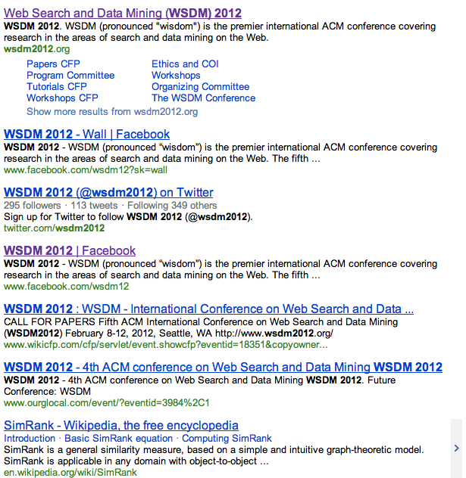
Click Models
Motivation | Data Analysis | Models | Experiments | Conclusion
Search results for “wsdm2012”
Query = “wsdm2012”
Pos | URL | Click
1 | wsdm2012.org | 1
2 | www.facebook.com/wsdm12?sk=wall | 0
3 | twitter.com/wsdm2012 | 0
4 | www.facebook.com/wsdm12 | 1
5 | www.wikicfp.com/cfp/… | 0
6 | www.ourglocal.com/… | 0
7 | en.wikipedia.org/wiki/SimRank | 0
8 | conference.researchbib.com/… | 0
9 | Intelligent-systems.blogspot.com/… | 0
10 | myhuiban.com/… | 0
Notes:
Let’s begin with click model. When a user submits(ә) a query(i) to the search engine, the search engine returns a search result page. Usually it contains 10 results of URLs. The user may click some or none results. We call it a search session.[click] Here is an example, query is “wsdm2012”, the user clicks the first and the fourth result, as shown in the right table. Millions of such tables comprise click log.

Slide 4
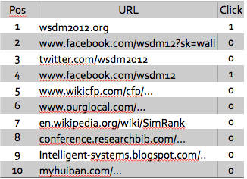
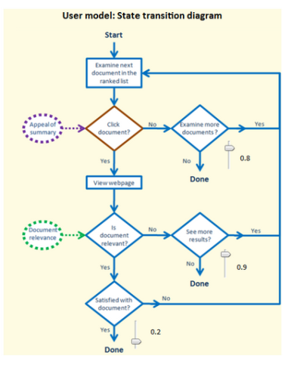
Click Models
Motivation | Data Analysis | Models | Experiments | Conclusion
Given a set of web search click logs
Predict Clicks
Estimate Relevance
Click Logs
Click Model
  Predict Clicks: outputs the probability of click vectors given a new order of URLs.
  Estimate Relevance: measures how good a URL is with regard to the information need of the query.
Notes:
Given a set of web search click logs, we model user’s click behavior into a click model. Usually, click models are used to pre’dict clicks and ‘estimate relevance. Predicting clicks is that given a new order of URLs, it outputs the probability of click vectors. Estimating relevance is to measure how relevant a URL is with regard to the query.

Slide 5
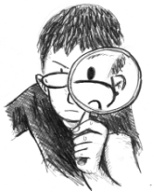




Examination Hypothesis
Motivation | Data Analysis | Models | Experiments | Conclusion
Assume a session has N documents, d1, .., d_{N}.
Binary random variables
  E_{i} = 1: the document at position i is examined.
  C_{i} = 1: the document at position i is clicked.
Examination Hypothesis
P(C_{i} = 1 | E_{i} = 0) = 0
P(C_{i} = 1 | E_{i} = 1) = r_{di}
Document Relevance
Notes:
In click models, we assume that a session has N documents, d1, d2, …, dN. We use N binary random variables Ei to represent whether the document at position i is examined and another N random variables Ci to represent whether the document at position I is clicked. Note that Ei is a hidden random variable and Ci is ob’servable. Next I will introduce the Examination Hypothesis. It is the foundation of most existing click models. It makes 2 assumptions: First, user will never click the document without examining its search results. Second, after user examines a document, whether user clicks the document depends on the document relevance. (click) Here we use rdi to represent the relevance of the document at position i.

Slide 6


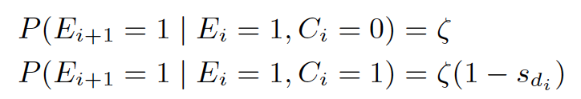
Click Models – UBM & DBN
Motivation | Data Analysis | Models | Experiments | Conclusion
Based on examination hypothesis
User Browsing Model(UBM)
  The examination probability depends on the position and the position of last clicked document.
Dynamic Bayesian Network Model(DBN)
  The examination probability depends on the satisfaction of the last document if it is clicked.
satisfaction
Notes:
Next `I will introduce two popular click models briefly. These will be used later in our paper. They are both based on examination hypothesis. The first one is User Browsing Model, UBM for short. It assumes that the examination probability depends on the position and also the position of last clicked document. The second one is Dynamic Bayesian Network Model, DBN for short. If the document i is not examined, then document i + 1 will not be examined. Otherwise, the examination probability of document i + 1 depends on whether document i is clicked and its degree of satisfaction.

Slide 7
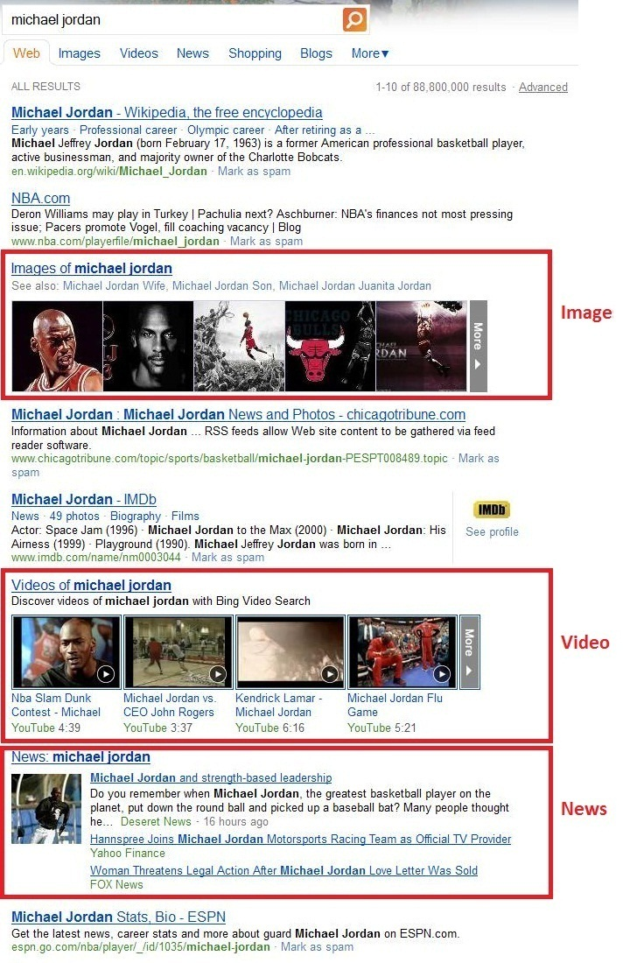
Federated Web Search
Motivation | Data Analysis | Models | Experiments | Conclusion
Previous studies in click models have been demonstrated effective in traditional Web search. However,…
In modern search engines, more and more Web search results are federated from multiple sources and contain non-HTML results returned by other heterogeneous vertical engines such as image, video and news.
Web results vs. Verticals
  Different in layout, presentation
  and attractiveness
What are the user behavior differences between traditional Web search and federated search?
How do verticals affect users’ browsing behavior and their decisions to perform clicks?
Federated Search / Aggregated Search
How to model user behavior and predict clicks in federated search?
Notes:
Many studies in click models have been ‘demonstrated effective in traditional Web search. However, in modern search engines, more and more Web search results are federated from multiple sources and contain non-HTML results returned by other heterogeneous vertical engines such as image, video and news. It is known as federated search or aggregated search. Here is a screenshot of Micrsoft Bing search engine, when the submitted query is “Michael Jordan”. We can see that, besides the ten blue links, the page also contains an image, a video and a news vertical. But all existing click models only assume the availability of ten blue links. The Web results and verticals are highly different in layout, presentation and attractiveness. So we come up with the following questions: What are the user behavior differences between traditional Web search and federated search? How do verticals affect users' browsing behavior and their decisions to perform clicks? How to model user behavior and predict clicks in federated search. These are the problems we try to explore in this paper.

Slide 8
Data Analysis
Motivation | Data Analysis | Models | Experiments | Conclusion
Three-day click log data.
3 kinds of verticals: image(14.23%), video(31.04%) and news(54.73%).
Verticals receive less clicks than Web results.
  Position 1 – Web 53.71%, Vertical 19.09%.
  Position 2 – Web 10.50%, Vertical 3.70%.
Notes:
We start our work from data analysis. We extracted three-day click log data and focus on those sessions with at least one of the three kinds of verticals – image, video and news. First, we find that vertical results always receive less clicks than Web results. Considering average click-through rate, at position 1, the average CTR of Web results is 53.71%, but the CTR of verticals is only 19.09%.

Slide 9
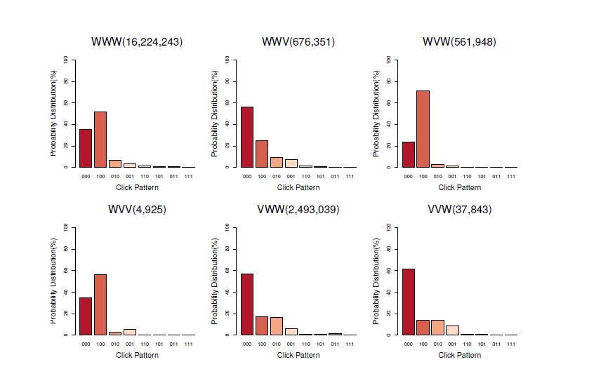
Experiment I
Motivation | Data Analysis | Models | Experiments | Conclusion
We group sessions by the types of top three results and compute probability distribution of click patterns(000, 001, …, 111).
  W – Web, V – Vertical
  “WVW” – the first and the third one are Web results.
  010 – the second document is clicked.
Many users tend to seek the first Web result…
The placed vertical affects the click probability of other Web results.
Notes:
In our first experiment, we group sessions by the types of top three results and compute the probability distribution of click patterns. We use W to represent Web results, V to represent Vertical results. “WVW” means that the first and the third result are Web documents. "010" means that only the second document is clicked. (click) From the result of "VWW" and "VVW", we find that even there is a vertical above it, the click through rate of Web result is not low, we guess that many users always tend to seek the first Web result if there is a vertical above it. (click) From the result of "WWW", "WWV" and "WVW", the distributions are quite different, we guess that the placed vertical greatly affects the click probability of other Web results.

Slide 10
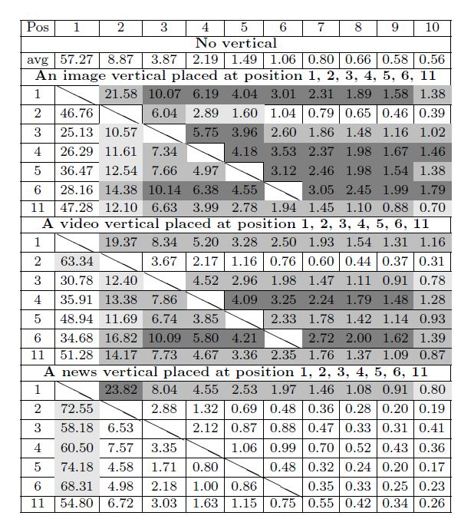
Motivation | Data Analysis | Models | Experiments | Conclusion
Experiment II
CTR when a vertical is placed.
Except for position 1, either image or video vertical has an obvious influence on the CTR of Web documents.
vs.
CTR without verticals.
Notes:
To further explore how verticals affect the Web results, in the second experiment, we compute the average CTR when some vertical is placed, compared with the average CTR when there is no vertical. Here is the result. The more darker the color is, the more significant the click-through rate increases. We can conclude that, except for position 1, either image or video vertical has an obvious influence on the CTR of Web documents. However, for the news vertical, the influence is not clear, since the news vertical is similar with Web documents.

Slide 11
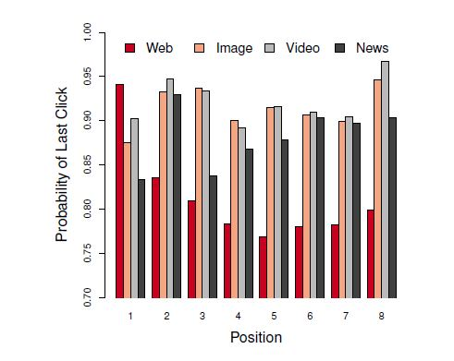
Motivation | Data Analysis | Models | Experiments | Conclusion
Experiment III
The probability of last click.
Except for position 1, vertical results have significantly higher probability of being the last click.
Web Results
snippet – URL, title, short description.
Verticals
thumbnail, hover-to-play video thumbnail, news headline.
Notes:
Finally, we focus on users’ behaviors after clicking a document. We explore the probability of a click being the last click of the session, since last click is believed to be a good indication of user satisfaction. The result shows that except for position 1, vertical results have significantly higher probability of being the last click. We think this is because that, we can only see the URL, title and a short description for Web documents, but for image, video and news documents, search engine can offer an image thum(b)nail, a ho[ɔ]ver-to-play video thumbnail, even the news headline also delivers most information. It is hard for users to examine a snippet and then judge whether it is really relevant or not for Web results. Rather, he can be aware of this from the verticals. After a user clicks a vertical result, he is more likely to not continue exploring other results, since he is already satisfied.

Slide 12
Motivation | Data Analysis | Models | Experiments | Conclusion
Summary
Vertical results can attract more attention and also make the surrounding web documents more prominent.
As a user clicks a vertical, he is more likely to be satisfied with the document.
Many users prefer the default Web results.
Verticals can attract attention but receive less clicks.
Notes:
We summarize three points from the analysis. First, vertical results can attract more attention and also make the surrounding web documents more prominent. Second, as a user clicks a vertical, he is more likely to be satisfied with the document. Third, many users prefer the default Web results instead of verticals. So our viewpoint is, the verticals can attract attention but receive less clicks.

Slide 13
Attention Model
Motivation | Data Analysis | Models | Experiments | Conclusion
Attention Bias If there is a vertical placed in the SERP, users are more likely to examine the vertical as well as the web documents nearby. That is, vertical results play an extra role for attracting users’ attention for other results around.
Introduce a binary random variable A
  A = 1: there exists an attention bias in current session s.
  P(A = 1) = a(s)
Notes:
Next we will focus on developing federated click models. The first proposed model is called Attention Model. We make the first assumption, Attention Bias, if there is a vertical placed in the search result page, users are more likely to examine the vertical as well as the web documents nearby. That is, vertical results play an extra role for attracting users’ attention for other results around. To characterize the attention bias, we introduce a new binary random variable A, if A = 1, then it means there exists an attention bias in current session s. We define P(A = 1) as a(s).

Slide 14
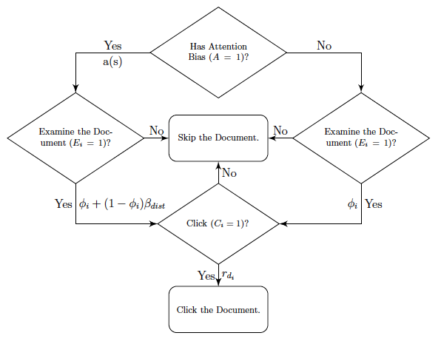

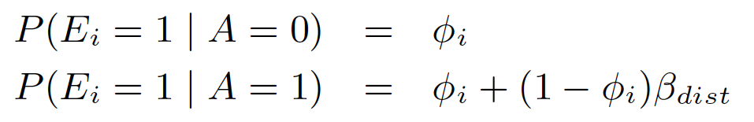

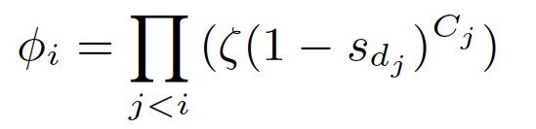
Attention Model
Motivation | Data Analysis | Models | Experiments | Conclusion
How to model a(s)?
  Position-specific a(s) = h_{pos_ver}
  Document-specific a(s) = u_{d}
Examination probability in traditional click models, e.g.,
in UBM, in DBN.
Position effect, where dist is the distance between the document and the vertical.
Notes:
We next assume that if there isn’t an attention bias, the probability that Ei = 1 equals to phi i, otherwise the probability that Ei = 1 equals to phi I plus the multiplication of one minus phi I and beta dist. Here phi I refers to the examination probability in traditional click models such as the two expressions in UBM and DBN. Beta_dist characterizes the position effect where dist is the distance between the document and the vertical. There is a question. How to model a(s)? In our models, we implement it in two ways, position-specific, a(s) depends on the type of the vertical and the position of the vertical. The other is document-specific, a(s) is related with the vertical document.

Slide 15
Exploration Model
Motivation | Data Analysis | Models | Experiments | Conclusion
Exploration Bias As a user clicks a vertical result, he is more likely to be satisfied with the result and end the whole search session.
Introduce a binary random variable D
  D = 1: there exists an exploration bias in current session s.
  C_{v} = 1: there exists a click on a vertical result.
  P(D = 1 | C_{v} = 0) = 0
  P(D = 1 | C_{v} = 1) = e(s)
Notes:
The second model is called Exploration Model. The second assumption, Exploration Bias, says, as a user clicks a vertical result, he is more likely to be satisfied with the result and end the whole session. Similarly, we introduce another random variable D, D is 1 means that there exists an exploration bias. C sub v is one means that there is a click on a vertical result in the session, which is observable. Given that C sub v is 0, the probability of D = 1 is 0; otherwise we define it as e(s).

Slide 16
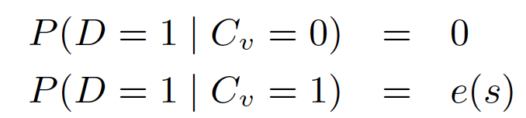
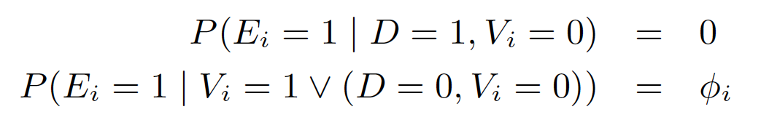
Exploration Model
Motivation | Data Analysis | Models | Experiments | Conclusion
V_{i} = 1: document at position i is a vertical.
e(s): position-specific or document-specific.
Notes:
If there is an exploration bias, the examination probability for a Web document is zero; if there isn’t, the examination probability is phi I as in the traditional click models.
We can also implement e(s) in position-specific or document-specific approaches.

Slide 17

Joint Vertical Model(JVM)
Motivation | Data Analysis | Models | Experiments | Conclusion
Combine Attention Model and Exploration Model.
We will estimate an attention bias a(s), an exploration bias e(s) for each session s.
Notes:
A natural generalization of the above two models is to integrate the attention model and the exploration model into one model. We call this the joint vertical model (JVM).
Given A, D the examination probability equals to the multiplication of the probability that given A and the that given D. So, in our JVM model, we will estimate an attention bias a(s), an exploration bias e(s) for each session s.

Slide 18
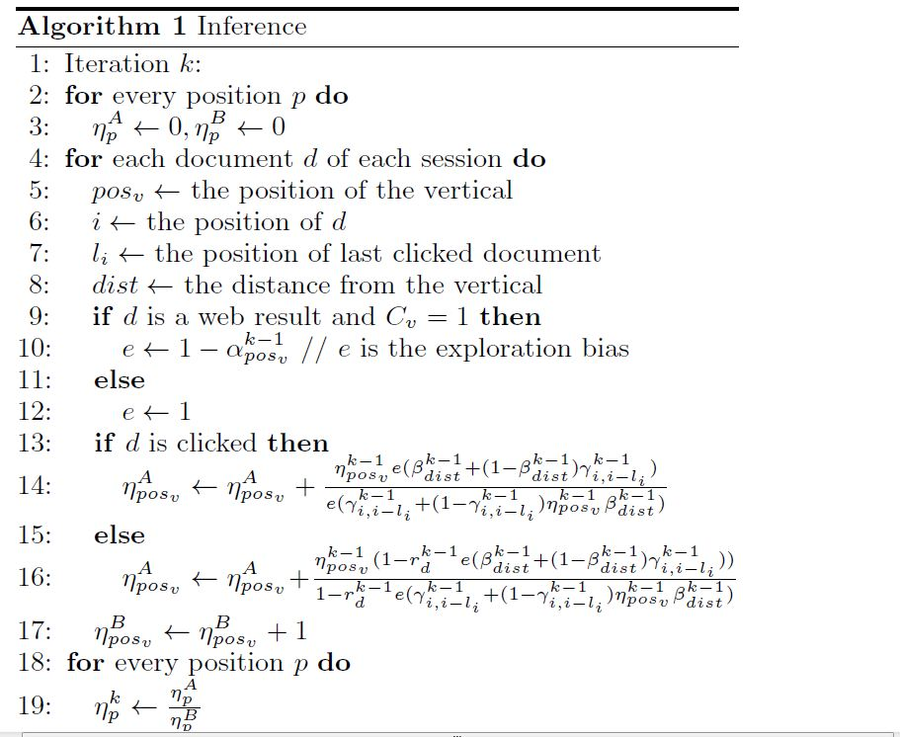
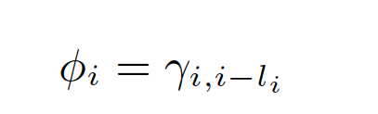

Inference
Motivation | Data Analysis | Models | Experiments | Conclusion
Our models can embrace the assumption of most existing click models dependent on the examination hypothesis.
EM-based inference
For example, ,
Notes:
Our models can embrace the assumption of most existing click models dependent on the examination hypothesis like UBM or DBN. In our paper, we adopt EM algorithm to complete the inference. For example, if we take phi I as in UBM, and e(s) and a(s) in position-specific approaches, the inference of eta is given here. You may refer to my paper.

Slide 19
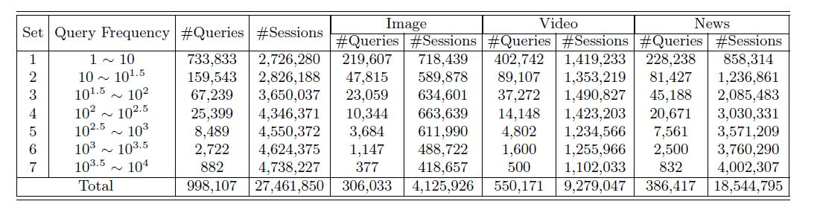
Experimental Setup
Motivation | Data Analysis | Models | Experiments | Conclusion
One week’s click log collected in June 2011
998,107 sampled queries, 27.5 million query sessions
Notes:
In our experiments section, we collected one week’s click log in June 2011, which comprises 998 thousand sampled queries and 27.5 million query sessions. We divide the dataset to 7 subsets by the query frequency.

Slide 20
Experimental Setup
Motivation | Data Analysis | Models | Experiments | Conclusion
Baseline
  UBM & DBN.
Metrics
  Perplexity
  Log-likelihood(LL)
Notes:
In our experiment, we choose UBM and DBN as our baseline and adopt two common evaluation metrics Perplexity and Log-likelihood for our evaluation.

Slide 21
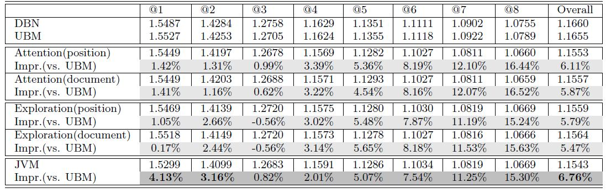
Results
Motivation | Data Analysis | Models | Experiments | Conclusion
Perplexity
JVM > Attention, Exploration Model > DBN, UBM
@1 4.13% impr. @2 3.16% impr. overall 6.76% impr.
Notes:
In perplexity evaluation, we get the following result. It shows that there is a clear ordering that JVM > (attention model or exploration model) > (UBM or DBN). Our JVM model has 4.13% improvement at position 1, 3.16% improvement at position 2 and the overall improvement is 6.76%.

Slide 22
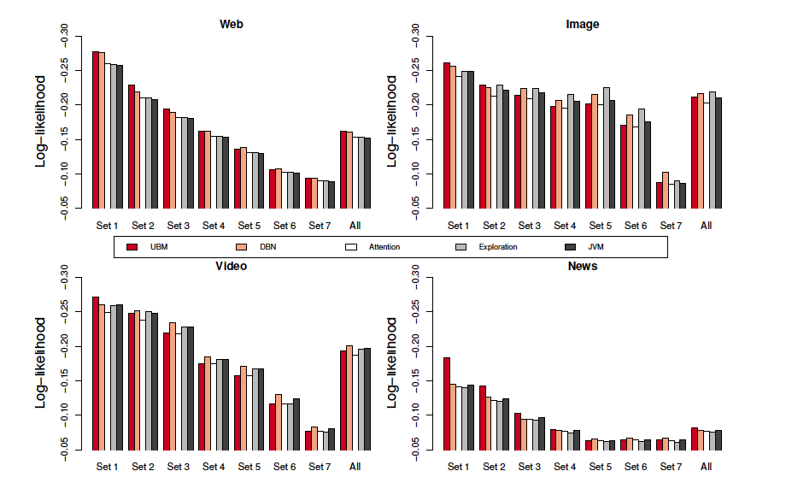
Results
Motivation | Data Analysis | Models | Experiments | Conclusion
Log-likelihood
Web: Impr. Set 1 4%, Set 2 2%.
Image, Video: Impr. 2%
Notes:
In log-likelihood evaluation, we evaluate the results for the Web documents, Image documents, Video documents and News documents respectively. For Web documents, it has an obvious improvement in low-frequency queries, like 4 percent in Set1. For image and video documents, there is also 2% improvement.

Slide 23
Conclusion
Motivation | Data Analysis | Models | Experiments | Conclusion
We have shown the user behavior difference between federated search and traditional Web search.
We have introduced two novel biases and proposed federated click models to characterize user behavior as examining and clicking on vertical results.
Our models are capable of embracing the assumptions in most existing click models and achieve significant improvement in terms of perplexity and log-likelihood.
Notes:
Finally, we reach the conclusion. In our paper, we first show the user behavior difference between federated search and traditional(e) Web search. This is why we should model user behavior in federated search. Next, we introduce two novel biases and propose federated click models to characterize(i) user behavior as examining and clicking on vertical results. Federated Click Models are general, which is capable of embracing the assumptions in most existing click models and achieves significant improvement in terms of perplexity and log-likelihood.

Slide 24
Future Work
Motivation | Data Analysis | Models | Experiments | Conclusion
The challenges
  Layout of the verticals
    Study user behavior by changing the positions of verticals
    Eye-tracking experiments
  User intents when clicking on verticals
Predict clicks of single urls
Notes:
I think our work is a first attempt to consider presentation bias in federated search. But there is still a lot of work to do for improving the results. How to design more effective click models to better understand user click behavior is our future work. There are two main challenges. The first one is the layout of the verticals. We plan to further study user click behavior by changing the positions in which the vertical results are placed. Some eye-tracking experiments may be helpful on it. The other one is user in’tent when clicking on verticals. Even with the same query, different intents will lead to click on different vertical results. Finally, in our work we treat the whole vertical as a document, but, I think how to predict the clicks of each single url is another important but under-explored problem.

Slide 25

Thank you.
Any questions?
Danqi Chen
  Tsinghua University
  Email: cdq10131@gmail.com
Notes:
That’s all my presentation. Thank you for your listening. Do you have any questions about our paper?

