Slide 1
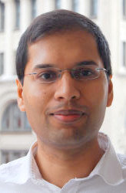
Subhash Khot’s work and its impact
Sanjeev Arora
Computer Science Dept,
Princeton University
ICM 2014 Nevanlinna Prize Laudatio
Notes:
Walk down memory lane
Before 1991:
Main technical advances PCP Thm. Hastad, Khot UGC.
PCP Thm: 3-page overview.
CSPs (example: 3sat, 3-color, max-3sat, max-cut)
Dinur’s gap amplification thm.
AS, ALMSS: alphabet reduction (aka verifier composition)
Side products: property testing, list decoding,locally decodable codes
Next technical advance: Fourier analysis and why it is useful.
Hastad’s thm sketch. Noise operator
Meanwhile, over in algorithms…
SDP, Blossoming of Primal-Dual, Euclidean TSP.
Meeting of algorithms and hardness; optimal results
Khot’s UGC; why useful.
Anatomy of a UGC-based hardness result.
Raghavendra, RS.
SDP ←> hardness
Metric space embeddings
Sparsest cut, sdp based approx, khot-vishnoi-cheeger kleiner
Future: resolve UGC, subexp algorithms, connection with avg case complexity,
Local vs global properties.

Slide 2
Main points from Nevanlinna Prize Citation…
Defined “unique games” problem between P and NP-complete and conjectured it is hard.
Showed how this leads to precise characterization of approximation ratios achievable for various NP-complete problems.
Unconditional new results in isoperimetry, analysis of boolean functions, distortions of metric space embeddings,…
New connections to Math.

Slide 3
Computational complexity
Goal: Characterize computation time needed to
solve a problem
Ideally, should (a) design algorithm running in time T.
(b) show no other algorithm running in << T time solves the problem
Very little progress on (b), so we try to prove (b) modulo famous conjectures.

Slide 4
Example: P vs NP
NP-complete: Every NP problem reducible to instance of this problem in n^{c} time. (e.g Traveling Salesman,MAX-CUT, Satisfiability, Integer Programming, 1000s of others)
NP
P
a good solution can be checked in n^{c} time.
solution can be found in polynomial time i.e. n^{c} (n = “input size”)
P =? NP “Can brilliance/creativity be automated?”
P ≠ NP → NP-complete problems cannot be solved in n^{c} time. (Limits on math/science/social science theories)

Slide 5
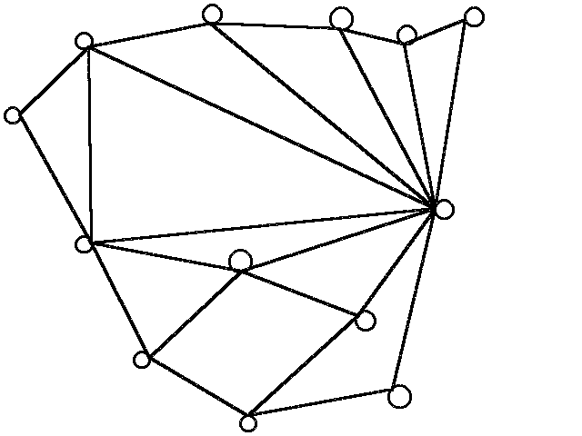
An NP-complete problem: MAX-CUT
Goal: Partition vertices into two sets to maximize number of “cut” edges
Decision version: Given (G, K), does G have a cut with at least K edges?
Qs: What is complexity of finding approximately optimal solutions?? (For this and thousands of other problems)
Of great practical & mathematical interest (“Approximate characterizations”).

Slide 6
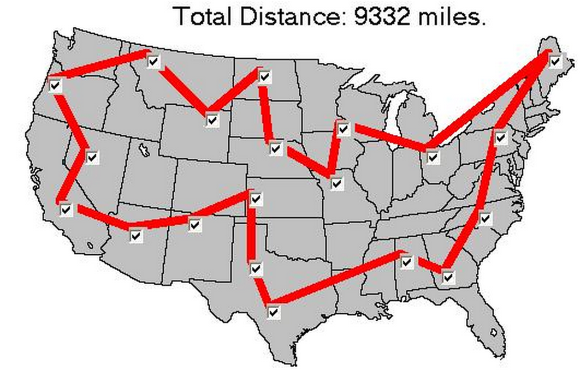
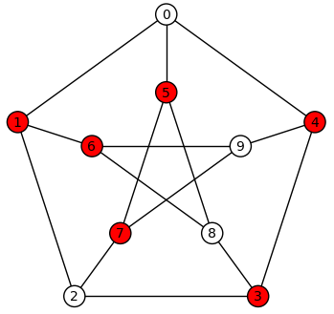
Approximability seems problem-dependent
Traveling salesman: Can find tour of cost ≤ 1.5 OPT. [Christofides’76]
Approximation ratio is 1.5
Vertex Cover: Can find cover of size ≤ 2 OPT [folklore]
Hundreds other such “approximation algorithms.”
(Tremendous effort in last 25 years.)
Are there limits to how well we can approximate?? (Great progress in last 25 years ---modulo conjectures)

Slide 7
Example: Approximability of MAXCUT
MAXCUT: Partition vertices into two sets to maximize number of “cut” edges
[Goemans,Williamson93]: Can find cut s.t. # cut edges > 0.878 MAX-CUT(G)
“Inapproximability result”
[Hastad97] Achieving approx. ratio 0.95 implies P =NP. “ Hastad’s PCP Theorem”.
“Threshold result”
[Khot, Kindler, Mossel, O’Donnell’04, Mossel, O’Donnell, Oleskiewicz’05]
Achieving approx. ratio 0.878 + ε implies unique games conjecture (UGC) of [Khot02] is false.

Slide 8
Story in a nutshell
Interesting approximation algorithms for many NP-complete problems
Vast literature on inapproximability results (“PCP Theorems”; goes back to early 1990s).
Work of Khot + others (post-2002) → For significant group of problems,“threshold of approximability” determined (assuming Unique Games Conjecture)

Slide 9
Unique Game Problem
x-y = 11 (mod 17)
x-z = 13 (mod 17)
…
….
z-w = 15(mod 17)
E2LIN mod p
Given a set of linear equations of the form:
X_{i} – X_{j} = c_{ij} mod p
Find solution that satisfies the maximum number of equations.
Unique Games Conjecture (KKMO’04 version): Given instance in which 0.99 fraction of equations are satisfiable, it is NP-hard to satisfy more than 0.01 fraction.

Slide 10
UGC → standard approximation algorithms (SDP or LP based) optimal for….
Vertex cover [Khot-Regev’03]
Grothendieck Problems [KNS`08, RS`09]
UGC
Kernel Clustering Problems [Khot Naor`08,10]
Constraint Satisfaction Problems [Raghavendra`08]
Max Cut, Max 2Sat
Strictly Monotone CSPs [KMTV`10]
Vertex Cover, Hypergraph Vertex Cover
Metric Labeling Problems [MNRS`08]
Multiway Cut, 0-extension
…
Told ya
In many cases, failure of the standard algorithm (on a single instance) can be converted into an inapproximability result!!
Notes:
Dunce’s proof of P \neq NP: my obvious algorithm doesn’t work, so neither does anybody else’s algorithm.
This can actually be made formal in this context. Stunning!

Slide 11
Efforts to apply/prove/disprove UGC have also yielded a treasure trove of new (unconditional) results in:
Analysis of Boolean Functions, Harmonic Analysis
Isoperimetry, Invariance principles etc.
High dimensional geometry
Embeddability of metric spaces into each other…

Slide 12
Analysis of boolean functions (and why it is relevant) [Kahn-Kalai-Linial’88, Hastad’98,Khot-Kindler-Mossel-O’Donnell’04]
Voting scheme: f : {0,1}^{N} → {0,1}
Collective decision = f(x₁, x₂,.. x_{N})
N voters; i’th one votes x_{i} ε 0/1
Noise stability_{ρ}: Probability this decision doesn’t change if random subset of ρ fraction of voters flip their votes
For Dictatorship (ie f(x₁, x₂,.. x_{N}) = x_{i}): this is 1- ρ.
What is stablest function that is “not close” to dictatorship?
Answer: Majority! ([Mossel, O’Donnell, Oleskiewicz’05]: invariance principles; isoperimetry)

Slide 13
(0.878 + ε)-approx to MAX-CUT →poly-time algorithm for UG [KKMO’04]
“Hard instance” for [GW93] algorithm for MAXCUT!
x-y = 11 (mod 17)
x-z = 13 (mod 17)
…
….
z-w = 15(mod 17)
17
Dimension hypercube
17
Dimensionhypercube
Convert UG instance
into a graph.
17-dimensional hypercube for each variable
Connect point p of x with q of y iff p, q make the angle θ_{GW.} (Coordinate i of x identifies with coordinate
(i+ 11)mod 17 of y.)
If the constraint is, say, x-y =11 (mod 17)
“Majority is stablest” + Harmonic analysis→ approximately optimum cuts in the graph “decodable” to good solution for UG instance (Aside: 0.878.. corresponds to noise stability of majority)
Notes:
A cut in the new graph can be seen as a labeling of the boolean hypercubes. Since edges correspond to vertices with a certain angle, that’s like vectors with a certain hamming distance. So the situation is like the voting system with noise from previous slide, and the cost of the cut turns out to be related to the noise stability.

Slide 14
Low-distortion embeddings of metric spaces
How similar are two metric spaces (X, d₁) and (Y, d₂)?
Important in analysis, also in algorithm design (e.g. if input is from X and our algorithm works for Y).
X
Y
Distortion of f: X → Y is smallest C s.t. d₁(x₁, x₂) ≤ d₂(f(x₁), f(x₂)) ≤ C d₁(x₁, x₂)
f
[Bourgain’85] Every n-point metric space has an embedding into l₂ with distortion O(log n). (Many algorithmic applications after [Linial, London, Rabinovich’94]; big research area )

Slide 15
Goemans-Linial Conjecture
“Every finite metric space of negative type embeds into l₁ with distortion O(1)” (“negative type”: Euclidean and d(x₁, x₂)² + d(x₂, x₃)² ≥ d(x₁, x₃)²)
If true, would yield O(1)-approximation for graph partitioning problems via semidefinite programming. (Also, would disprove UGC [Khot + others])
[Khot-Vishnoi’05] False; Distortion ≥ log log n. (Improved to (log n)^{ε} by [Cheeger, Kleiner, Naor 09] )
(Main idea: Cleverly constructed negative type metric, motivated by insights from UG. Greatly generalized by [Khot-Naor’05] to apply to other metric embedding problems.)
Notes:
So in a duel of two conjectures, UGC came out on top.
In general, there are very few techniques to prove lowerbounds on distortion since we have to make a statement about all possible embeddings. This work is a fundamental new contribution to study of metric spaces. The CKN followup is another stunning contribution.

Slide 16
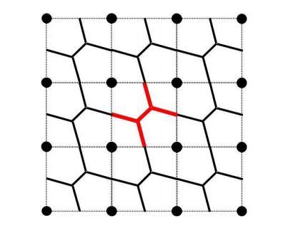
Foams, parallel repetition, unique games
What is smallest surface area of shape Λ in R^{d} such Λ + Z^{d} tiles R^{d}? (“Foam” problem; posed by Kelvin for d=3)
Unit cube → 2d is an upper bound.
d=2
Unit sphere → Ω(√d) is a lower bound.
[Kindler, O’Donnell, Rao, Wigderson’12] Foam construction with area
O(√d); also best construction for d =3. (“Spherical cubes”)
Construction inspired by a counterexample of Raz to
a well-studied approach for proving UGC.

Slide 17
New analyses of Semidefinite programs; Higher-order spectral graph theory.
SDP: subcase of convex programming.
[Khot02] suggested it as a way to try to disprove UGC (i.e., give a good approximation to UG problem)
[Arora, Khot, Kolla, Steurer, Tulsiani, Vishnoi’08]Used SDP to show that UG problem is easy when constraint graph is random or random-like (“expander”);
SDP + eigenvalue methods (“high order spectral graph theory”) lead to subexponential algorithms for UG problem [Arora, Barak, Steurer’10], [Barak,Raghavendra, Steurer ‘11], [Guruswami-Sinop’11].
Many recent results about connection of higher eigenvalues to graph expansion…

Slide 18
Other contributions of Khot
Inapproximability results that don’t rely on UGC (only on P ≠NP): Shortest Vector in Integer Lattice, Max-Clique, Hypergraph Vertex Cover and Coloring, Metric Labeling, Learning parities with noise,…
Lowerbounds for approximation ratios achieved by SDP hierarchies…
Best progress to date on proving UGC (NP-completeness for
a similar problem over R). [Khot-Moshkovitz’11]

Slide 19
In conclusion…
Khot’s 2002 definition of UG problem and UGC proved
very prescient and subsequent work (including his significant
contributions) led to an exciting decade of new discoveries
in theoretical CS and math, with more to come.
(Unanticipated by most experts, certainly by me.).
Congratulations, Subhash!!

