Slide 1
Tying It All Together
COS 316: Principles of Computer System Design
Lecture 20
Wyatt Lloyd

Slide 2
Types of Systems We Covered
Application
Security
Distributed Systems
Networking
Operating Systems
Security
Distributed Systems
Network
Security
Network
OS
OS
Hardware
Hardware

Slide 3
High Level Topics Covered
Systems
Naming
Caching
Layering
Concurrency
Access Control
Notes:
Naming•Systems use names to abstract complexity, abstract differences, isolate applications•Naming choices can dictate system trade-offs

Slide 4
A “Simple” Example – Streaming Video
Record video on phone
Video sent over Internet to service
Web server receives video segments
Web server forwards segments to distributed file system
Web server initiates video processing
Video processing produces streamable versions
Video now streamable – shared w/ other users
User’s app fetches file with metadata about video segments
User’s app runs ABR algorithm to download video segments via CDN

Slide 5
1) Record video on phone
Does app have access to video device?
Interface to video device via OS
Interface to storage via OS

Slide 6
2) Video sent over Internet to the service
Host name -> IP address (e.g., youtube.com -> 172.217.10.14)
Naming!
Global IP routing to 172.217.10.14
Layering!
Sent over a TCP connection to a remote web server
Send whole video, error detection, congestion control, flow control
Applications use socket interface
Assignment 1!

Slide 7
3) Web server receives video segments
Use request routing logic to run handler for video segments
Assignment 2
Is user authorized to create new videos?

Slide 8
4) Web server forwards segments to distributed file system
Durability of video segments
Distributed file system – looks (kinda) like a unix file system
On different machines, accessed over network, running on top of local unix file system
Aside: video segment metadata
Bug: eventual consistency vs. linearizability

Slide 9
5) Web server initiates video processing
Validate video, fix audio alignment, …
Produce many different bitrates
Compress video segments
Generate thumbnails
…
Processing done by a distributed system

Slide 10
6) Video processing in action
Many machines processing different segments of video in parallel
Concurrency!
Durably store resulting video segments
Following grey slides from Qi Huang’s SOSP ‘17 talk on SVE

Slide 11
Speedy: harness parallelism
Users can share videos quickly
Overlap fault tolerance and processing
Overlap upload and processing
Parallel processing

Slide 12
Architectural changes for parallelism
Client
Web Server
Original
Storage
Processing
Final
Storage

Slide 13
Architectural changes for parallelism
Scheduler
Client
Web Server
Preprocessor
Worker
Final
Storage
Worker
Worker
Original
Storage

Slide 14
Overlap fault tolerance and processing
Scheduler
Client
Web Server
Preprocessor
Final
Storage
Write-through
Cache
Worker
Worker
Worker
Original
Storage

Slide 15
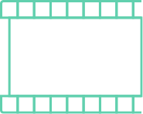





Overlap upload and processing
Scheduler
Client
Web Server
Preprocessor
Worker
Final Storage
Worker
Split into segments
Original
Storage
Worker

Slide 16
Overlap upload and processing
Scheduler
Client
Web Server
Preprocessor
Worker
Final Storage
Worker
...upload in progress
Original
Storage
Worker

Slide 17
Parallel processing w/ many workers
Scheduler
Client
Web Server
Preprocessor
720P Encode
Worker
Final Storage
480P Encode
Worker
...upload in progress
Original
Storage
Worker
Thumbnail

Slide 18
Parallel processing w/ many workers
Scheduler
Client
Web Server
Preprocessor
720P Encode
Final Storage
480P Encode
...upload in progress
Original
Storage
Thumbnail

Slide 19
Parallel processing w/ many workers
Scheduler
Client
Web Server
Preprocessor
720P Encode
Final Storage
480P Encode
...upload in progress
Original
Storage
Thumbnail

Slide 20



Parallel processing w/ many workers
Scheduler
Client
Web Server
Preprocessor
Worker
Final Storage
Worker
Original
Storage
Worker

Slide 21
Three sources of parallelism
Scheduler
Client
Web Server
Preprocessor
Worker
Final Storage
Worker
Overlap fault tolerance
and processing
Overlap upload and processing
Parallel processing
Original
Storage
Worker

Slide 22
Let’s Make This Faster!
Legacy
SVE
Notes:
Draw on slide!

Slide 23
7) Video now shareable with others
Publish information about video segments to database
Assignment 4 – Object Relational Mapper
Assignment 5 – Connection pool
Push information about video to other indexing systems
e.g., newsfeed on Facebook
e.g., subscribers on YouTube

Slide 24
8) User’s app fetches file with metadata about video segments
Host name -> IP address
Global IP routing
TCP connection
Sockets interface
Request routing to handler on web server
Is user authorized to view video?
Web server sends request to in-memory cache for video segment metadata
Assignment 3 – Caching!

Slide 25
9) User’s app runs ABR algorithm to download video segments via CDN
Adaptive BitRate (ABR) algorithm request video segments
Video segment requests via Content Distribution Network
CDNs cache popular video segments

Slide 26



CDN Caching Goal: Minimize WAN Traffic
Requests
Requests
User
Edge cache
Miss
Hit
Wide Area Network (WAN)
traffic is expensive
Key metric hit ratio

Slide 27
Caching Remains Challenging
Heuristic-based algorithms (1965–): LRU, LFU, GDSF, ARC, ...
Work well for some workloads, but work poorly for other
ML-based adaptation of heuristics (2017–): UCB, LeCAR, ...
Also work well for some workloads, but poorly for others
The Belady algorithm (1966)
Offline optimal: requires future knowledge
Large gap in miss ratio between state-of-the-art and Belady:
20–40% on production traces

Slide 28
Edge Cache with Different Algos
Infinite Cache
Clairvoyant (Bélády) shows we can do much better!

Slide 29

Research From Princeton!
Learning Relaxed Belady for Content Distribution Network Caching.
Zhenyu Song, Daniel S. Berger, Kai Li, and Wyatt Lloyd.
In 17th USENIX Symposium on Networked Systems Design and Implementation (NSDI 20), February 2020.

Slide 30
Introducing Learning Relaxed Belady (LRB)
New approach: mimic Belady using machine learning
Machine-Learning-for-Systems (ML-for-Systems)
Enabling technologies
When does it make sense?

Slide 31
General Overview of our Approach
Past information
Now
···
R
R
R
······
R
R
R
R
Training data
Cache
ML architecture
Eviction candidates

Slide 32
Challenge 1: Past Information
Past information
Now
What past information to use?
···
R
R
R
······
R
R
R
R
More data improves training but increases memory overhead
Training data
Cache
ML architecture
Eviction candidates

Slide 33
Challenge 2: Generate Online Training Data
Past information
Now
What past information to use?
···
R
R
R
······
R
R
R
R
Generate online training data?
Training data
Cache
ML architecture
Eviction candidates

Slide 34
Challenge 3: ML Architecture
Past information
Now
What past information to use?
···
R
R
R
······
R
R
R
R
Generate online training data?
Training data
Cache
What ML architecture to select?
Large design space: features, model, prediction target, loss function
ML architecture
Eviction candidates

Slide 35
Challenge 4: Eviction Candidates
Past information
Now
What past information to use?
···
R
R
R
······
R
R
R
R
Generate online training data?
Training data
Cache
What ML architecture to select?
How to select evict candidates?
ML architecture
Eviction candidates

Slide 36
Challenge 5: Quickly Evaluate Design Decisions
Past information
Now
What past information to use?
···
R
R
R
······
R
R
R
R
Generate online training data?
Training data
Cache
What ML architecture to select?
How to select evict candidates?
ML architecture
Eviction candidates
End-to-end evaluation: days

Slide 37
Solutions: Relaxed Belady Algorithm & Good Decision Ratio
What past information to use?
Generate online training data?
Relaxed Belady algorithm
What ML architecture to select?
How to select evict candidates?
End-to-end evaluation: days
Good decision ratio

Slide 38
Solutions: Relaxed Belady Algorithm & Good Decision Ratio
What past information to use?
Generate online training data?
Relaxed Belady algorithm
What ML architecture to select?
How to select evict candidates?
End-to-end evaluation: days
Good decision ratio: mins

Slide 39
Solutions: Relaxed Belady Algorithm & Good Decision Ratio
What past information to use?
Generate online training data?
Relaxed Belady algorithm
What ML architecture to select?
How to select evict candidates?
End-to-end evaluation: days
Good decision ratio: mins

Slide 40
Solution: Relaxed Belady Algorithm
What past information to use?
Generate online training data?
Relaxed Belady algorithm
What ML architecture to select?
How to select evict candidates?

Slide 41
Challenge: Hard to Mimic Belady Algorithm
Belady: evict object with next access farthest in the future
Evict
Cache
(now)
A
B
······
D
B
A
C
C
D
······
······
Time to next request
Mimicking exact Belady is impractical
Need predictions for all objects → prohibitive computational cost
Need exact prediction of next access → further prediction are harder

Slide 42
Introducing the Relaxed Belady Algorithm
Belady boundary
Evict
Cache
(now)
A
B
······
D
B
A
C
C
D
······
······
Time to next request
Observation: many objects are good candidates for eviction
Relaxed Belady evicts a random object beyond boundary
Do not need predictions for all objects → reasonable computation
No need to differentiate beyond boundary → simplifies the prediction

Slide 43
Good Decision Ratio: Directly Measures Eviction Decisions
Belady boundary
Bad eviction decision
evicted obj’s next access < boundary
Good eviction decision
evicted obj’s next access > boundary
Time to next request
Insight: relaxed Belady enables evaluating eviction decisions
Good decision ratio:
# good eviction decisions
# total eviction decisions

Slide 44
Challenge 5: Quickly Evaluate Design Decisions
What past information to use?
Past information
Now
···
R
R
R
······
R
R
R
R
Generate online training data?
What ML architecture to select?
Training data
Cache
How to select evict candidates?
End-to-end evaluation: days
ML architecture
Eviction candidates

Slide 45
Evaluate Design Decisions w/o Simulation
Training data
ML architecture
Eviction candidates
Simulate once,
reuse for many designs
Log
Evaluate designs on log using good decision ratio in minutes

Slide 46
Challenge 1: Past Information
Past information
Now
What past information to use?
···
R
R
R
······
R
R
R
R
More data improves training but increases memory overhead
Training data
Cache
ML architecture
Eviction candidates

Slide 47
Track Objects within a Sliding Memory Window
Sliding memory window mimics Belady boundary
Now
···
R
R
R
······
R
R
R
R
Only track objects within memory window
Window size is LRB’s main hyperparameter
Per object features

Slide 48
Challenge 2: Training Data
Past information
Now
What past information to use?
···
R
R
R
······
R
R
R
R
Generate online training data?
Training data
Cache
ML architecture
Eviction candidates

Slide 49
Sample Training Data & Label on Access or Boundary
Sliding memory window
Now
···
R
R
R
······
R
R
R
R
Per object features
Access
Past memory window
Sample
Unlabeled training data
Labeled training data

Slide 50
Challenge 3: ML Architecture
Past information
Now
What past information to use?
···
R
R
R
······
R
R
R
R
Generate online training data?
Training data
Cache
What ML architecture to select?
Large potential design space
ML architecture
Eviction candidates

Slide 51
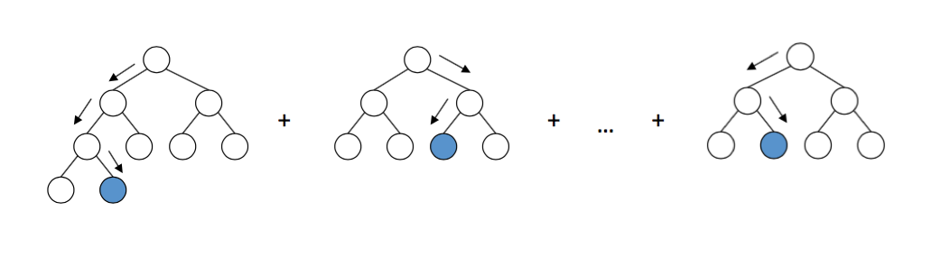
Solution 3: Feature & Model Selection
Use good decision ratio to evaluate new designs
Features
Object size
Object type
Inter-request distances (recency)
Exponential decay counters (long-term frequencies)
Gradient boosting decision trees
Lightweight & high good decision ratio
Training ~300 ms, prediction ~30 us

Slide 52
Challenge 4: Eviction Candidates
Past information
Now
What past information to use?
···
R
R
R
······
R
R
R
R
Generate online training data?
Training data
Cache
What ML architecture to select?
How to select evict candidates?
ML architecture
Eviction candidates

Slide 53
Solution 4: Random Sampling for Eviction
Past information
Now
···
R
R
R
······
R
R
R
R
Cache
Can mimic relaxed Belady if we can find 1 object beyond the boundary
k=64 candidates; more does not improve good decision ratio
Random k candidates

Slide 54
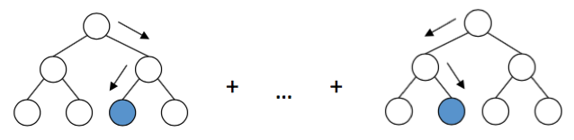
Learning Relaxed Belady
Memory window
Now
···
R
R
R
R
R
···
R
R
R
R
Sample
Label
Cache
Unlabeled dataset
Evict
Train
Sample
Labeled dataset
Eviction Candidates
Model
Predict
···

Slide 55
Implementation
Simulator implementation
LRB + 14 other algorithms
Prototype implementation
C++ on top of production system (Apache Traffic Server)
Many optimizations

Slide 56
Evaluation Setup
Q1: Learning Relaxed Belady (LRB) traffic reduction vs state-of-the-art
Q2: overhead of LRB vs CDN production system
Traces: 6 production traces from 3 CDNs
Hyperparameter (memory window/model/...) tuned on 20% of trace

Slide 57
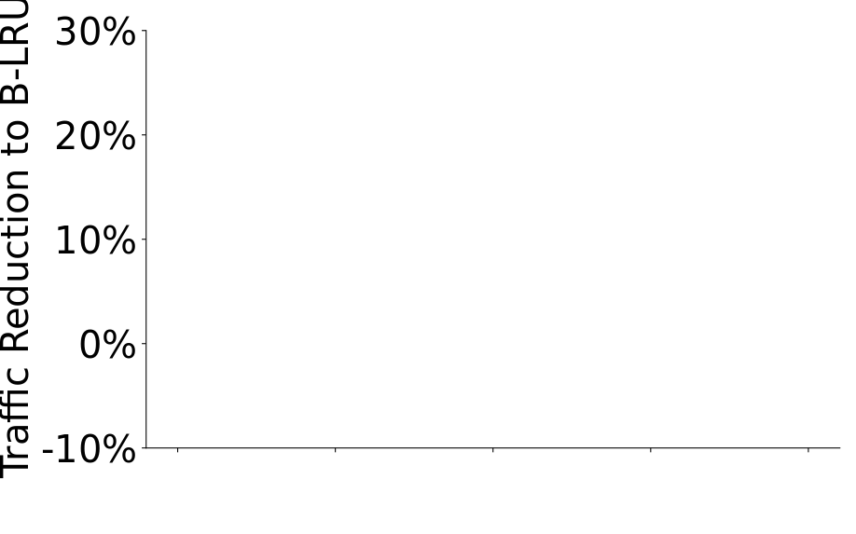
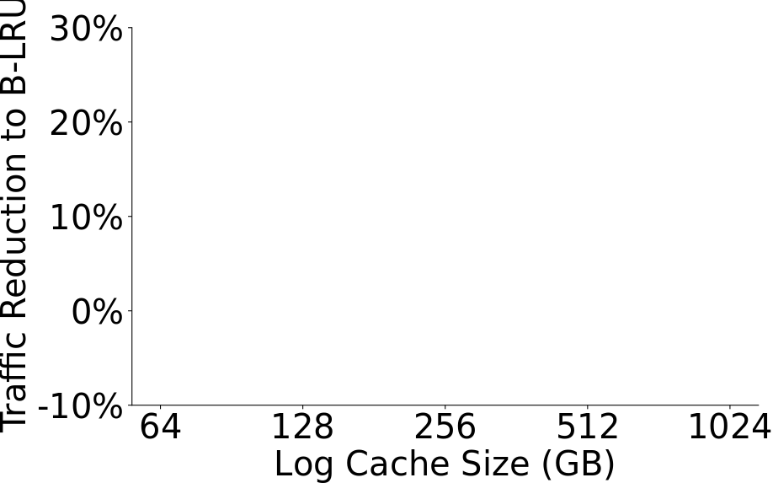
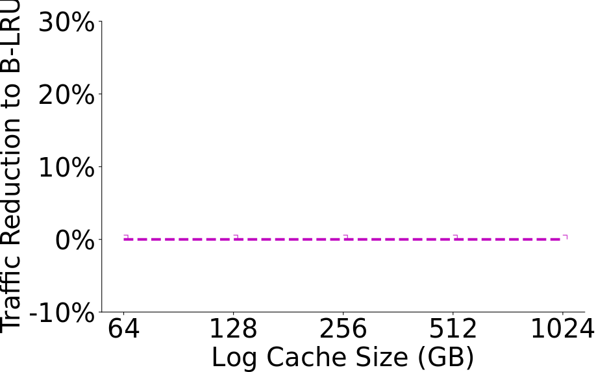
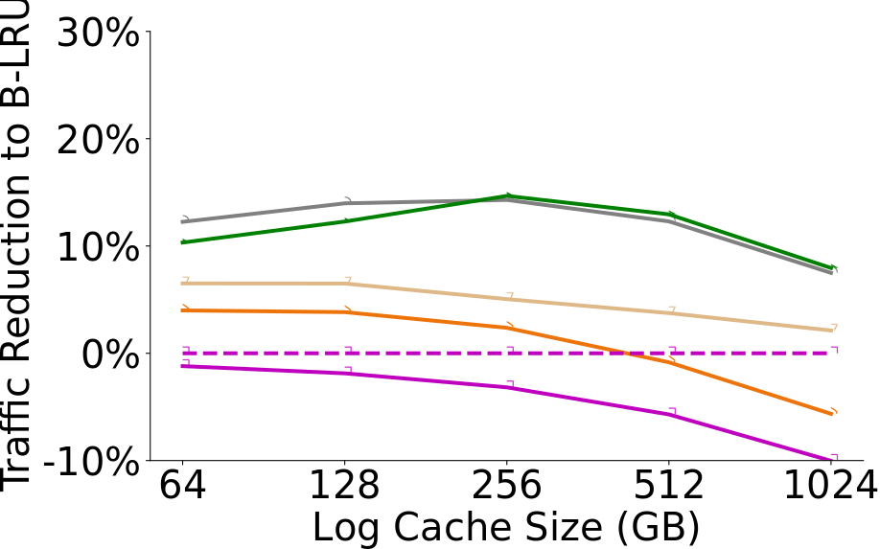
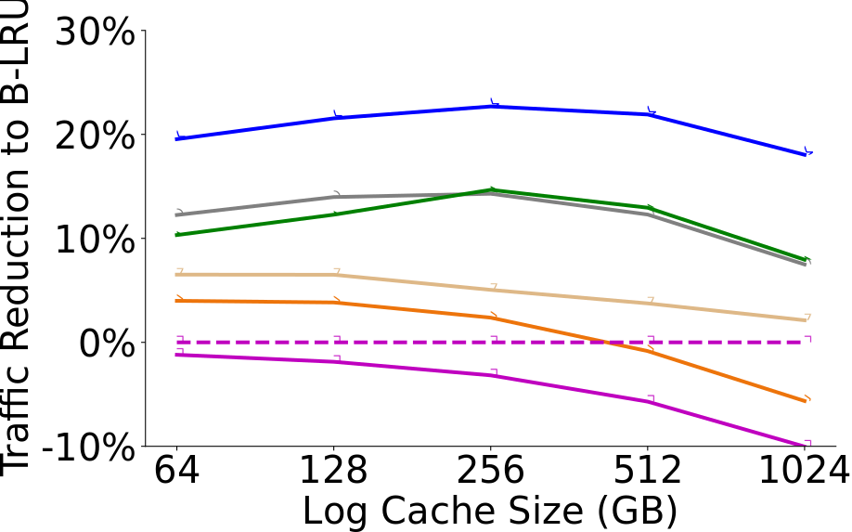
LRB Reduces WAN Traffic
Industry standard
20% traffic reduction over B-LRU
10% reduction over the best SOA
Wikipedia trace

Slide 58
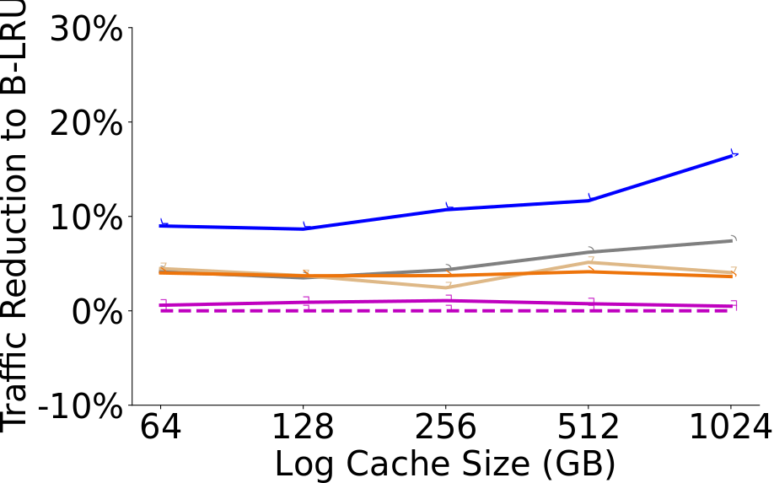
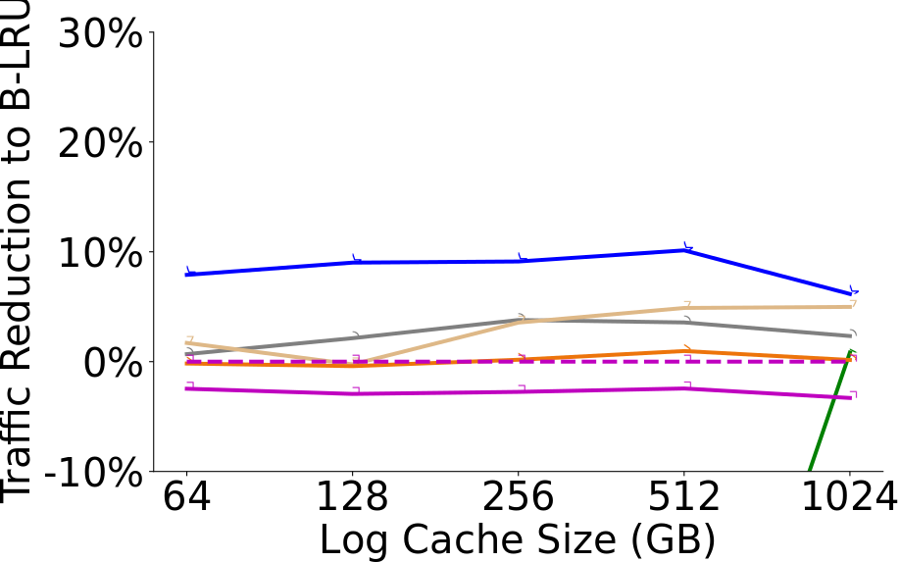
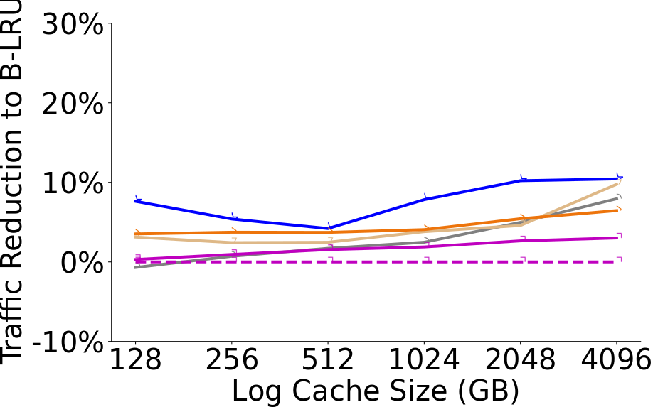
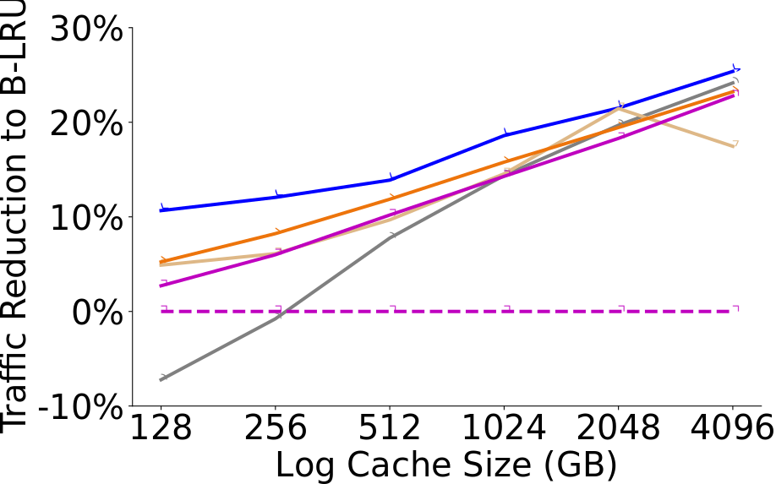
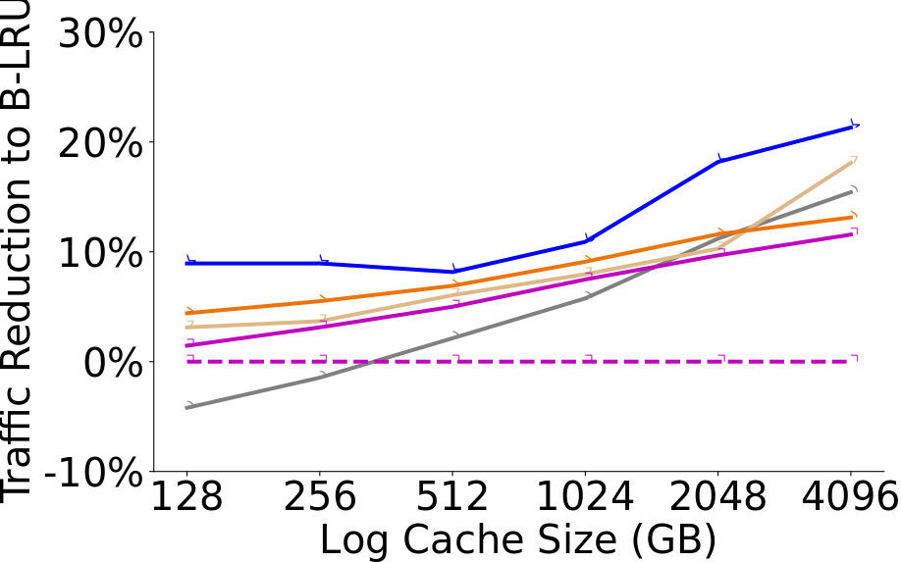
LRB Consistently Improves on the State of the Art
Wikipedia
CDN-A1
CDN-A2
CDN-B1
CDN-B2
CDN-B3

Slide 59
LRB Overhead Is Modest
Requests
User
Edge cache
Memory overhead=1‒3% cache size
Peak CPU: 16% vs 9% (unmodified)
Throughput: 11.7 Gbps vs 11.7 Gbps (unmodified)

Slide 60
Conclusion
LRB reduces WAN traffic with modest overhead
ML-for-systems generally promising to replace heuristics
Key insight: relaxed Belady
→ Simplifies machine learning & reduces system overhead

Slide 61
Systems!
Application
Security
Distributed Systems
Network
Security
Network
Systems abstract underlying resources
Systems are everywhere
Systems are challenging and interesting and cool
This class was about systems
OS
OS
Hardware
Hardware

Slide 62
Systems You Can Learn More About
Application
Security
Application
Distributed Systems
Networking
Operating Systems
Security
Hardware
Distributed Systems
Network
Security
Network
OS
OS
Hardware
Hardware

Slide 63
Systems You Can Learn More About
Application
Security
Distributed Systems
Network
Security
Network
OS
OS
Hardware
Hardware
Applications COS 333 (Every semester)
Distributed Systems COS 418 (Fall ‘26)
Networking COS 461 (Spring ‘27)
Operating Systems COS 417 (Spring ‘27)
Security ECE/COS 432 (Spring ’27)
Hardware (Processors) COS/ECE 375 (Fall ‘26)

Slide 64
Remaining Time: Ask Me Anything!

