Slide 1

Systems Problems in ML Inference
COS 316: Principles of Computer System Design
Lecture 19
Nicolaas Kaashoek

Slide 2
Inference Presents New Challenges
Large language models have two key step:
Training: Creating the model
Inference: Using the model
Training challenges: Parallelism, Fault Tolerance, Storage
Inference challenges? Very different!

Slide 3
What is Inference
Recall: We train LLMs to do prediction
Example: “What day is Dean’s Date? ____”
Inference is the process that gets from input context to response tokens

Slide 4

Inference: Bird’s Eye View
What
Day
Is
Dean’s
Date
Context: Combination of prompt and additional metadata
Previous prompts, source code, etc.
May
5th
2026

Slide 5
Post-Inference Work
Lots of post-inference steps:
Your context gets stored somewhere
Feedback sent to the training/refinement pipeline
Update additional metadata to improve future inferences
Guardrails to check the output

Slide 6
Inference Metrics
Important inference metrics are latency based
Time to First Token (TTFT):
- How long to go from all data to the first output token
Time Between Tokens (TBT):
How long each iteration of the loop takes
End-to-End Latency: Total time from client request to response

Slide 7
Inference: Pre-Fill and Decode
Inference broken into two stages, Pre-Fill and Decode
Pre-Fill: Setup a cache and get the first token (TTFT)
Decode: The loop that generates the next N tokens (TBT)
Pre-Fill and Decode have wildly different performance characteristics!

Slide 8
Pre-Fill
Attention step is highly parallel!
What
Day
Is
Dean’s
Date
Compute Attention
N x N Matrix, N = Len(context)
Model
During attention, produce 3 vectors per token:
Query (Q), Key (K), Value (V)
Reuse them with caching!
KV Cache stores Keys and Values
Previous keys and values used to predict next token
May
KV Cache
Layer 1: K_{0 -> 4} | V_{0 -> 4}
Layer 2: K_{0 -> 4} | V_{0 -> 4}
…
Layer N: K_{0 -> 4} | V_{0 -> 4}

Slide 9
Decode
Only need to compute hidden state for new token!
What
Day
Is
Dean’s
Date
May
Compute Attention
Single Vector Computation
Model
KV Cache
5th
New KV Cache, Contains “May”
Repeat the process until generated tokens “good enough”

Slide 10
LLM with/without KV Cache
Computing the KV cache ahead of time is a huge time saver!
O(N²) matrix multiplication for each new token, to vector
Also frees up GPU cores!
Concrete numbers from DeepSeek R1 on Azure:
Time to First Token (Pre-Fill): 1 second
Time Between Tokens (Decode): 20ms

Slide 11
Inference vs. Training
Training exploits parallelism to make the job computable
Inference has one parallel task, one sequential!
Training: Do it once, then you’re done
Inference: Do it many, many times

Slide 12
Inference at Scale
How many people are doing inference at any one time?
ChatGPT: 30k requests per second (2.5 billion per day)
How many GPUs do we need to support this?
30k? No way!

Slide 13
Systems Challenges for Inference
Challenge 1: Scheduling/Load Balancing
How can we make better use of our GPUs to support necessary throughput?
Challenge 2: GPU Memory Management
How do we properly cache the KV Cache when it gets big and we have lots of them
Challenge 3: Prevent attacks on/with LLMs

Slide 14
Challenge 1 - Scheduling
Inference receives lots and lots of requests, constantly
Pre-Fill eats up GPU cycles (parallelism)
Decode takes the most time (98% of total inference time)
Challenge: Head of line blocking
Need lots of GPUs to do the Pre-Fill step
Can starve the decode step

Slide 15
Solution: Heterogenous Resource Pools
Schedulers are a classic systems problem:
How do I decide what to run, and where?
Insight: Separate pools of resources for pre-fill and decode
ML Schedulers: Complex!
Different GPUs have different models and KV Caches
Inference time is unpredictable
Different workloads have different characteristics (text vs. image)

Slide 16
Solution: Batching
Each decode cycle uses ~1 GPU core, GPUs have 18k cores!
Insight: Batch!
Classic systems solution: merge small jobs into big one
Run decodes from multiple prompts in one batch
Continuous batching: Keep GPUs occupied by constantly sending new decode jobs
Challenge: Multiple KV caches?

Slide 17
Challenge 2: KV Caches Get Big
175 billion parameter model -> Multiple GB KVCache
- 13B parameters: 1.6GB KVCache
Goal: Run many decode jobs on one GPU
Challenge: H100s only have ~80GB of memory!
No way to fit all those KV caches into memory
Moving data from main memory to GPU memory is slow

Slide 18
Solution: PagedAttention
Storing the KV caches for multiple requests is challenging:
Size is unpredictable, and always grows
Laying them out contiguously in memory is a bad idea
How can we manage them all efficiently?
Idea: Split them up into chunks, manage on chunk level
Now Decode has to find the right chunks
Also need to allocate new chunks on the fly
And manage them once they exist
This is a familiar problem…

Slide 19
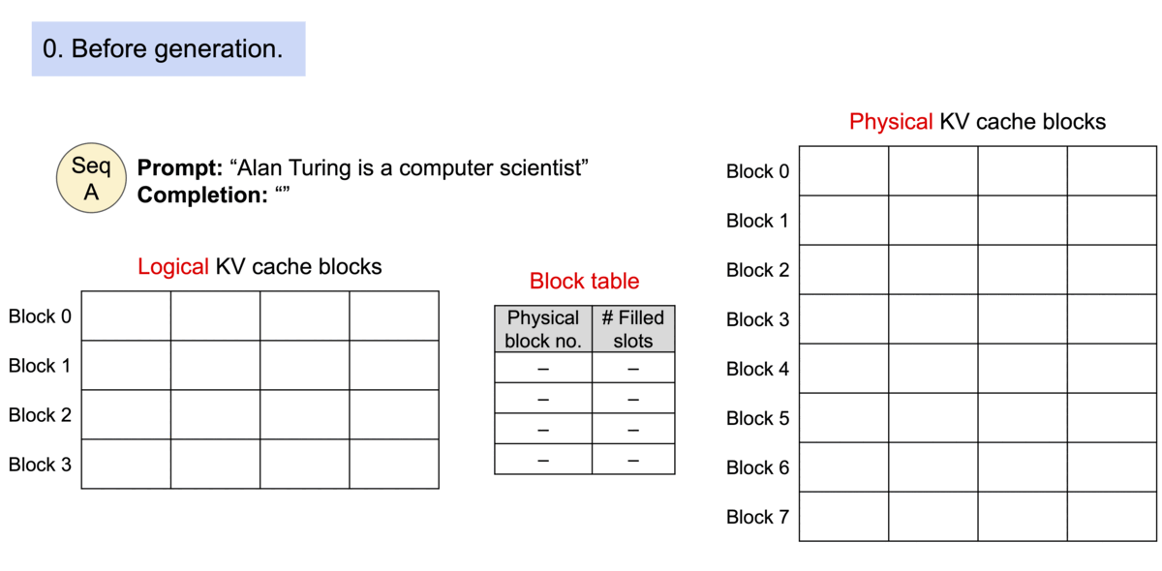
PagedAttention: Memory Management
Source: https://vllm.ai/blog/vllm

Slide 20
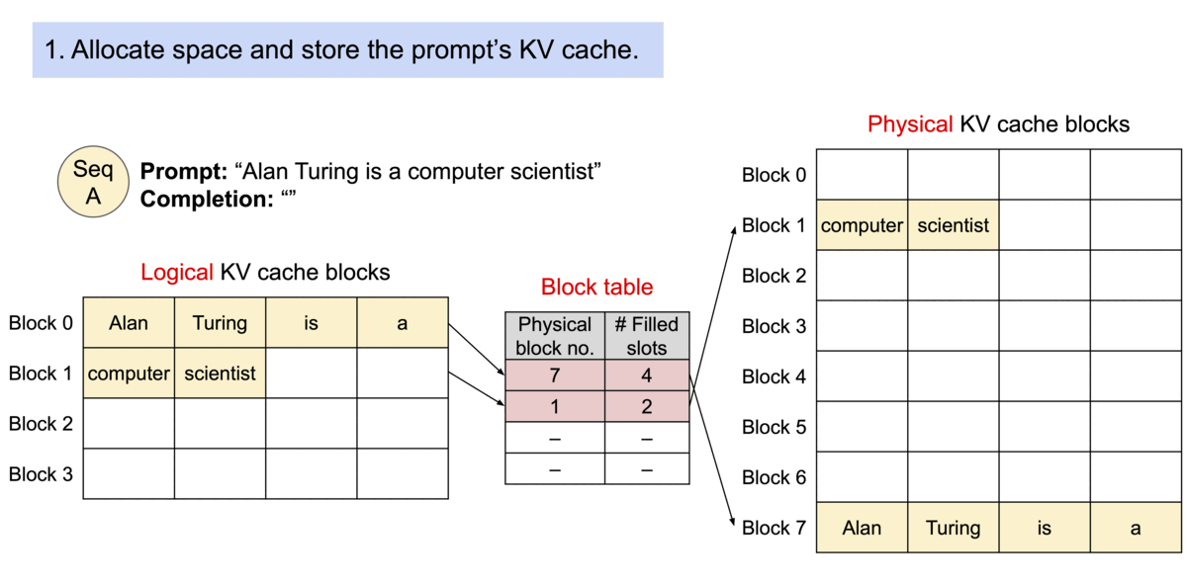
PagedAttention: Memory Management
Source: https://vllm.ai/blog/vllm

Slide 21
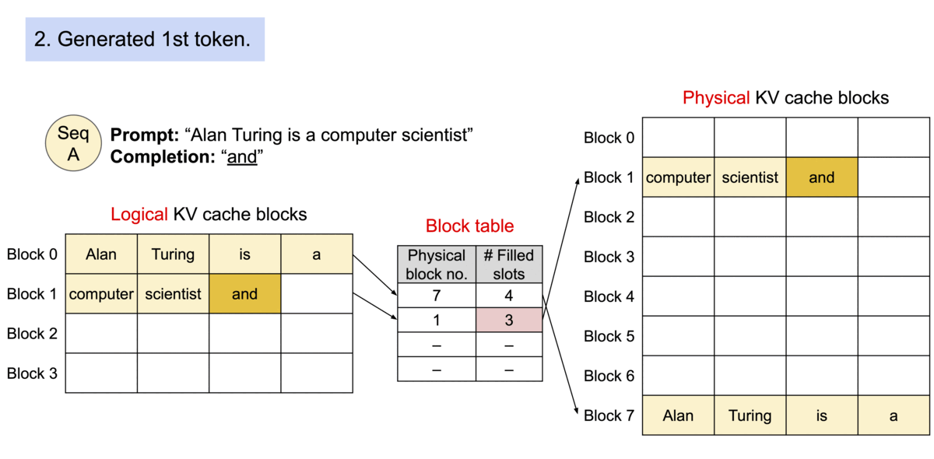
PagedAttention: Memory Management
Source: https://vllm.ai/blog/vllm

Slide 22
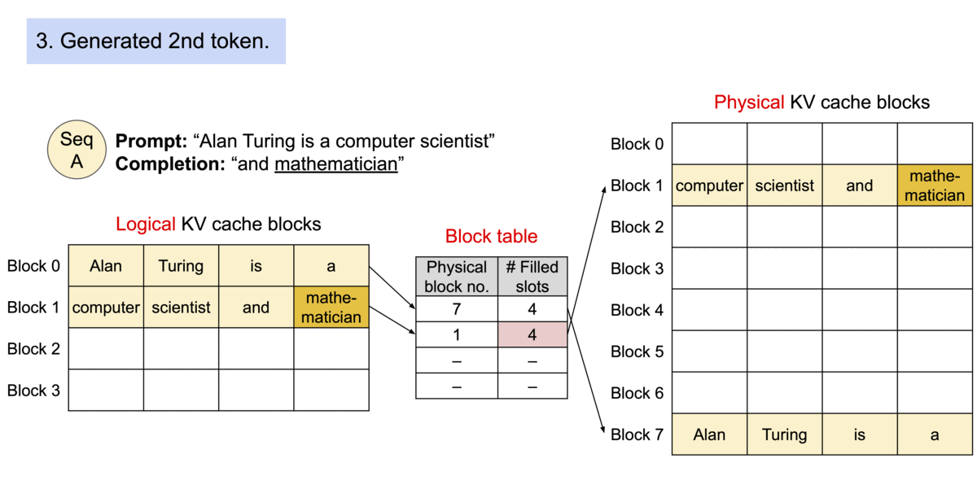
PagedAttention: Memory Management
Source: https://vllm.ai/blog/vllm

Slide 23
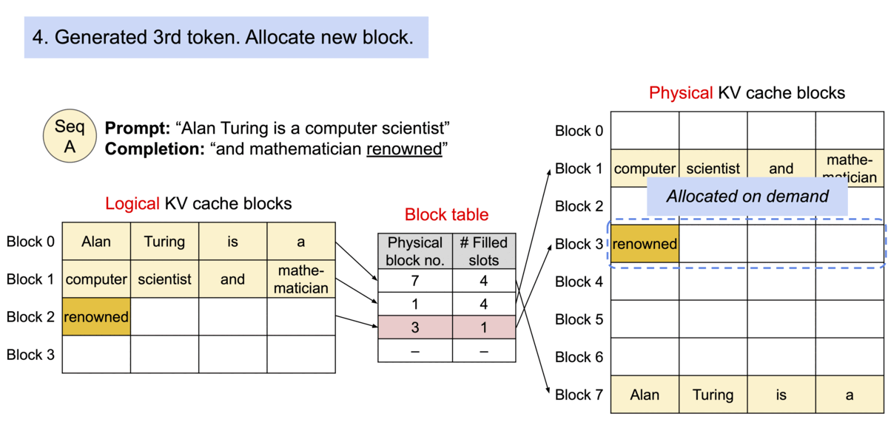
PagedAttention: Memory Management
Source: https://vllm.ai/blog/vllm

Slide 24
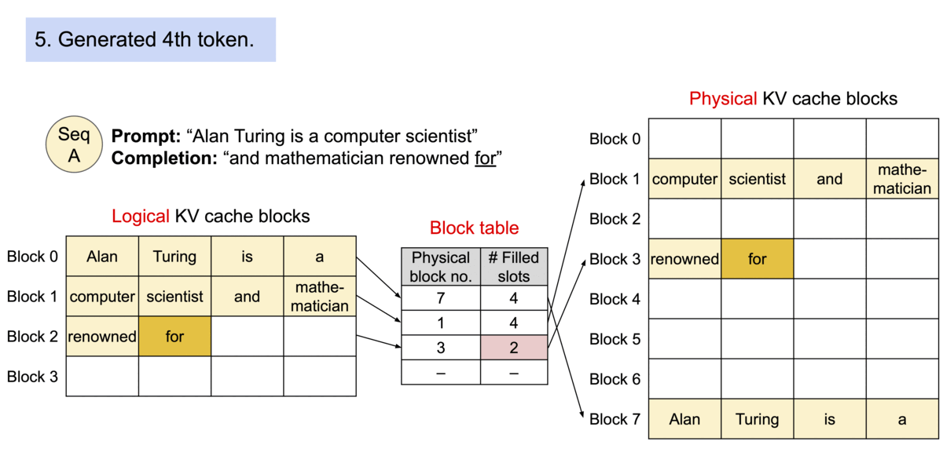
PagedAttention: Memory Management
Source: https://vllm.ai/blog/vllm

Slide 25
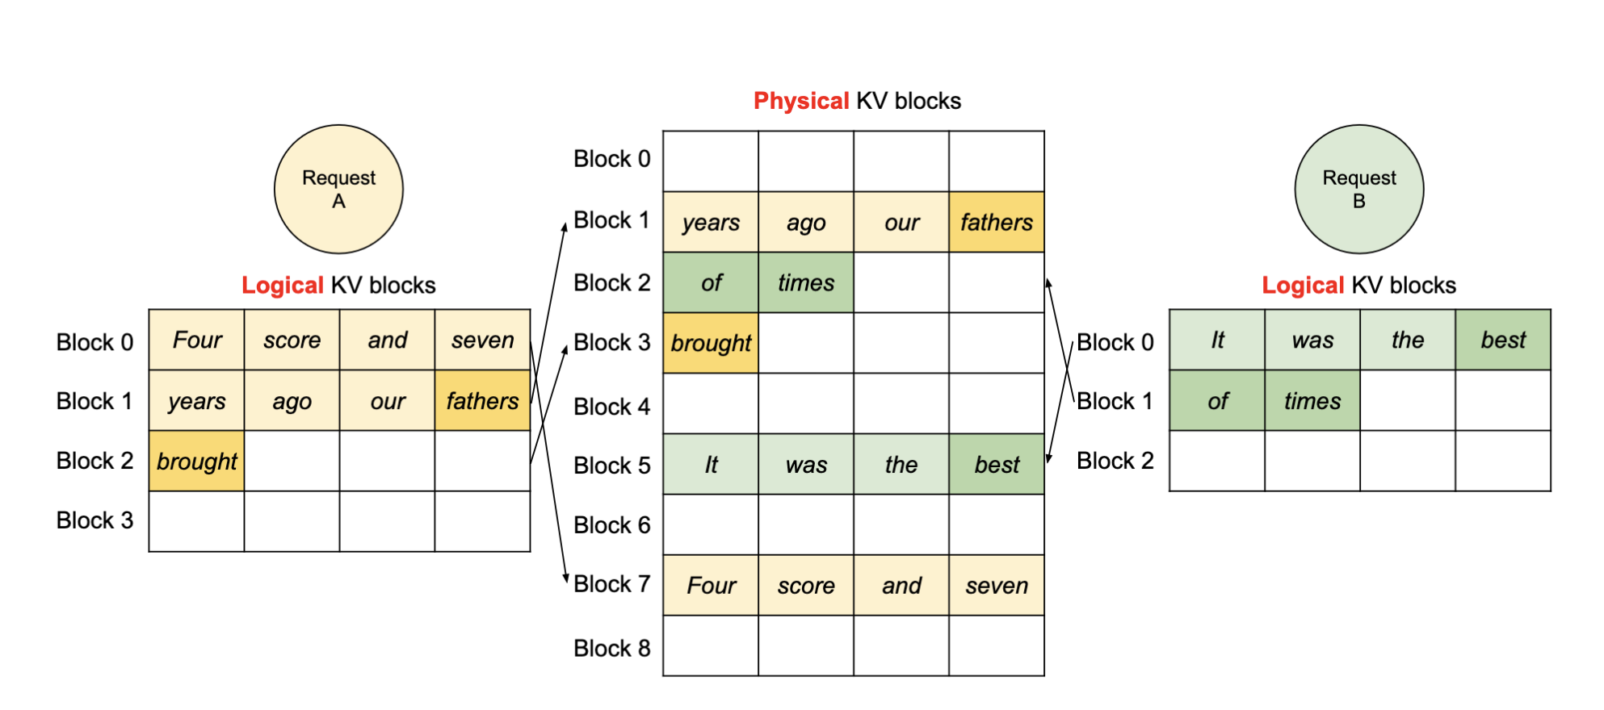
PagedAttention: Efficient Memory Usage
Source: https://arxiv.org/pdf/2309.06180

Slide 26
PagedAttention: Next Steps
PagedAttention doesn’t fully solve our problem, but it enables a whole bunch of other solutions
Operating with blocks rather than full KVCaches is useful:
Can page blocks between CPU and GPU
Share blocks for common parts of prompt
Compress context to evict old blocks
Without PagedAttention, none of the above would be possible!

Slide 27
Challenge 3: Access Control
LLMs are trained on enormous amount of data, designed to be extremely generic
Some tasks should not be doable with LLM:
“How do I build a bomb”
Common term: “AI Alignment”
Challenge: Stop the model from giving up answers that are “bad”

Slide 28
Solution: Guardrails
Put checks in place to prevent the model from returning that to the user if it’s “bad”
Reinforcement during training to incentivize certain kinds of responses
Input sanitization to avoid responding to obvious attacks
Output sanitization to catch harmful responses
Sanitization techniques range from simple (Grep) to complex (Llama-Guard 3)

Slide 29
LLMs Accelerate Attack and Defense!
Every day, new attacks are successfully mounted using LLMs
Yesterday: Lovable (allegedly)
Sunday: Vercel
Saturday: FortiSandbox (CVE-2026-39808)
LLMs are also used to fix vulnerabilities daily ☺
This is an area with huge potential for major research impact!

Slide 30
Aside: Specialized Hardware
GPUs are fantastic at the pre-fill step:
Super parallelizable
Prompts are large, big matrices use all the GPU cores
Decode doesn’t fit this pattern, and there’s an emerging concern over the amount of decode that’s happening
Training new models has diminishing returns
Inference will dominate in the future, and decode dominates inference
Probably need new hardware!

Slide 31
ML Problems Benefit From Systems Solutions
Systems ideas reusable in ML context, with modification
Looked at some today, there are many more!
Speculative execution -> Speculative decoding
Kernel Bypass -> Used all over the place
Copy-on-write -> Active area of research

