Slide 1

Reasoning About Performance in Distributed Systems
COS 316: Principles of Computer System Design
Lecture 14
Nicolaas Kaashoek

Slide 2
Distributed System Scale
Distributed systems operate at varying scales:
Assignment 3: 1 User, 1-10 requests in a second
Canvas: 10s of users, 1-10 requests per second
New Jersey DMV: Millions of users, 1 request per second*
Meta: 100s of Millions of users, billions of requests per second
Performance matters!

Slide 3
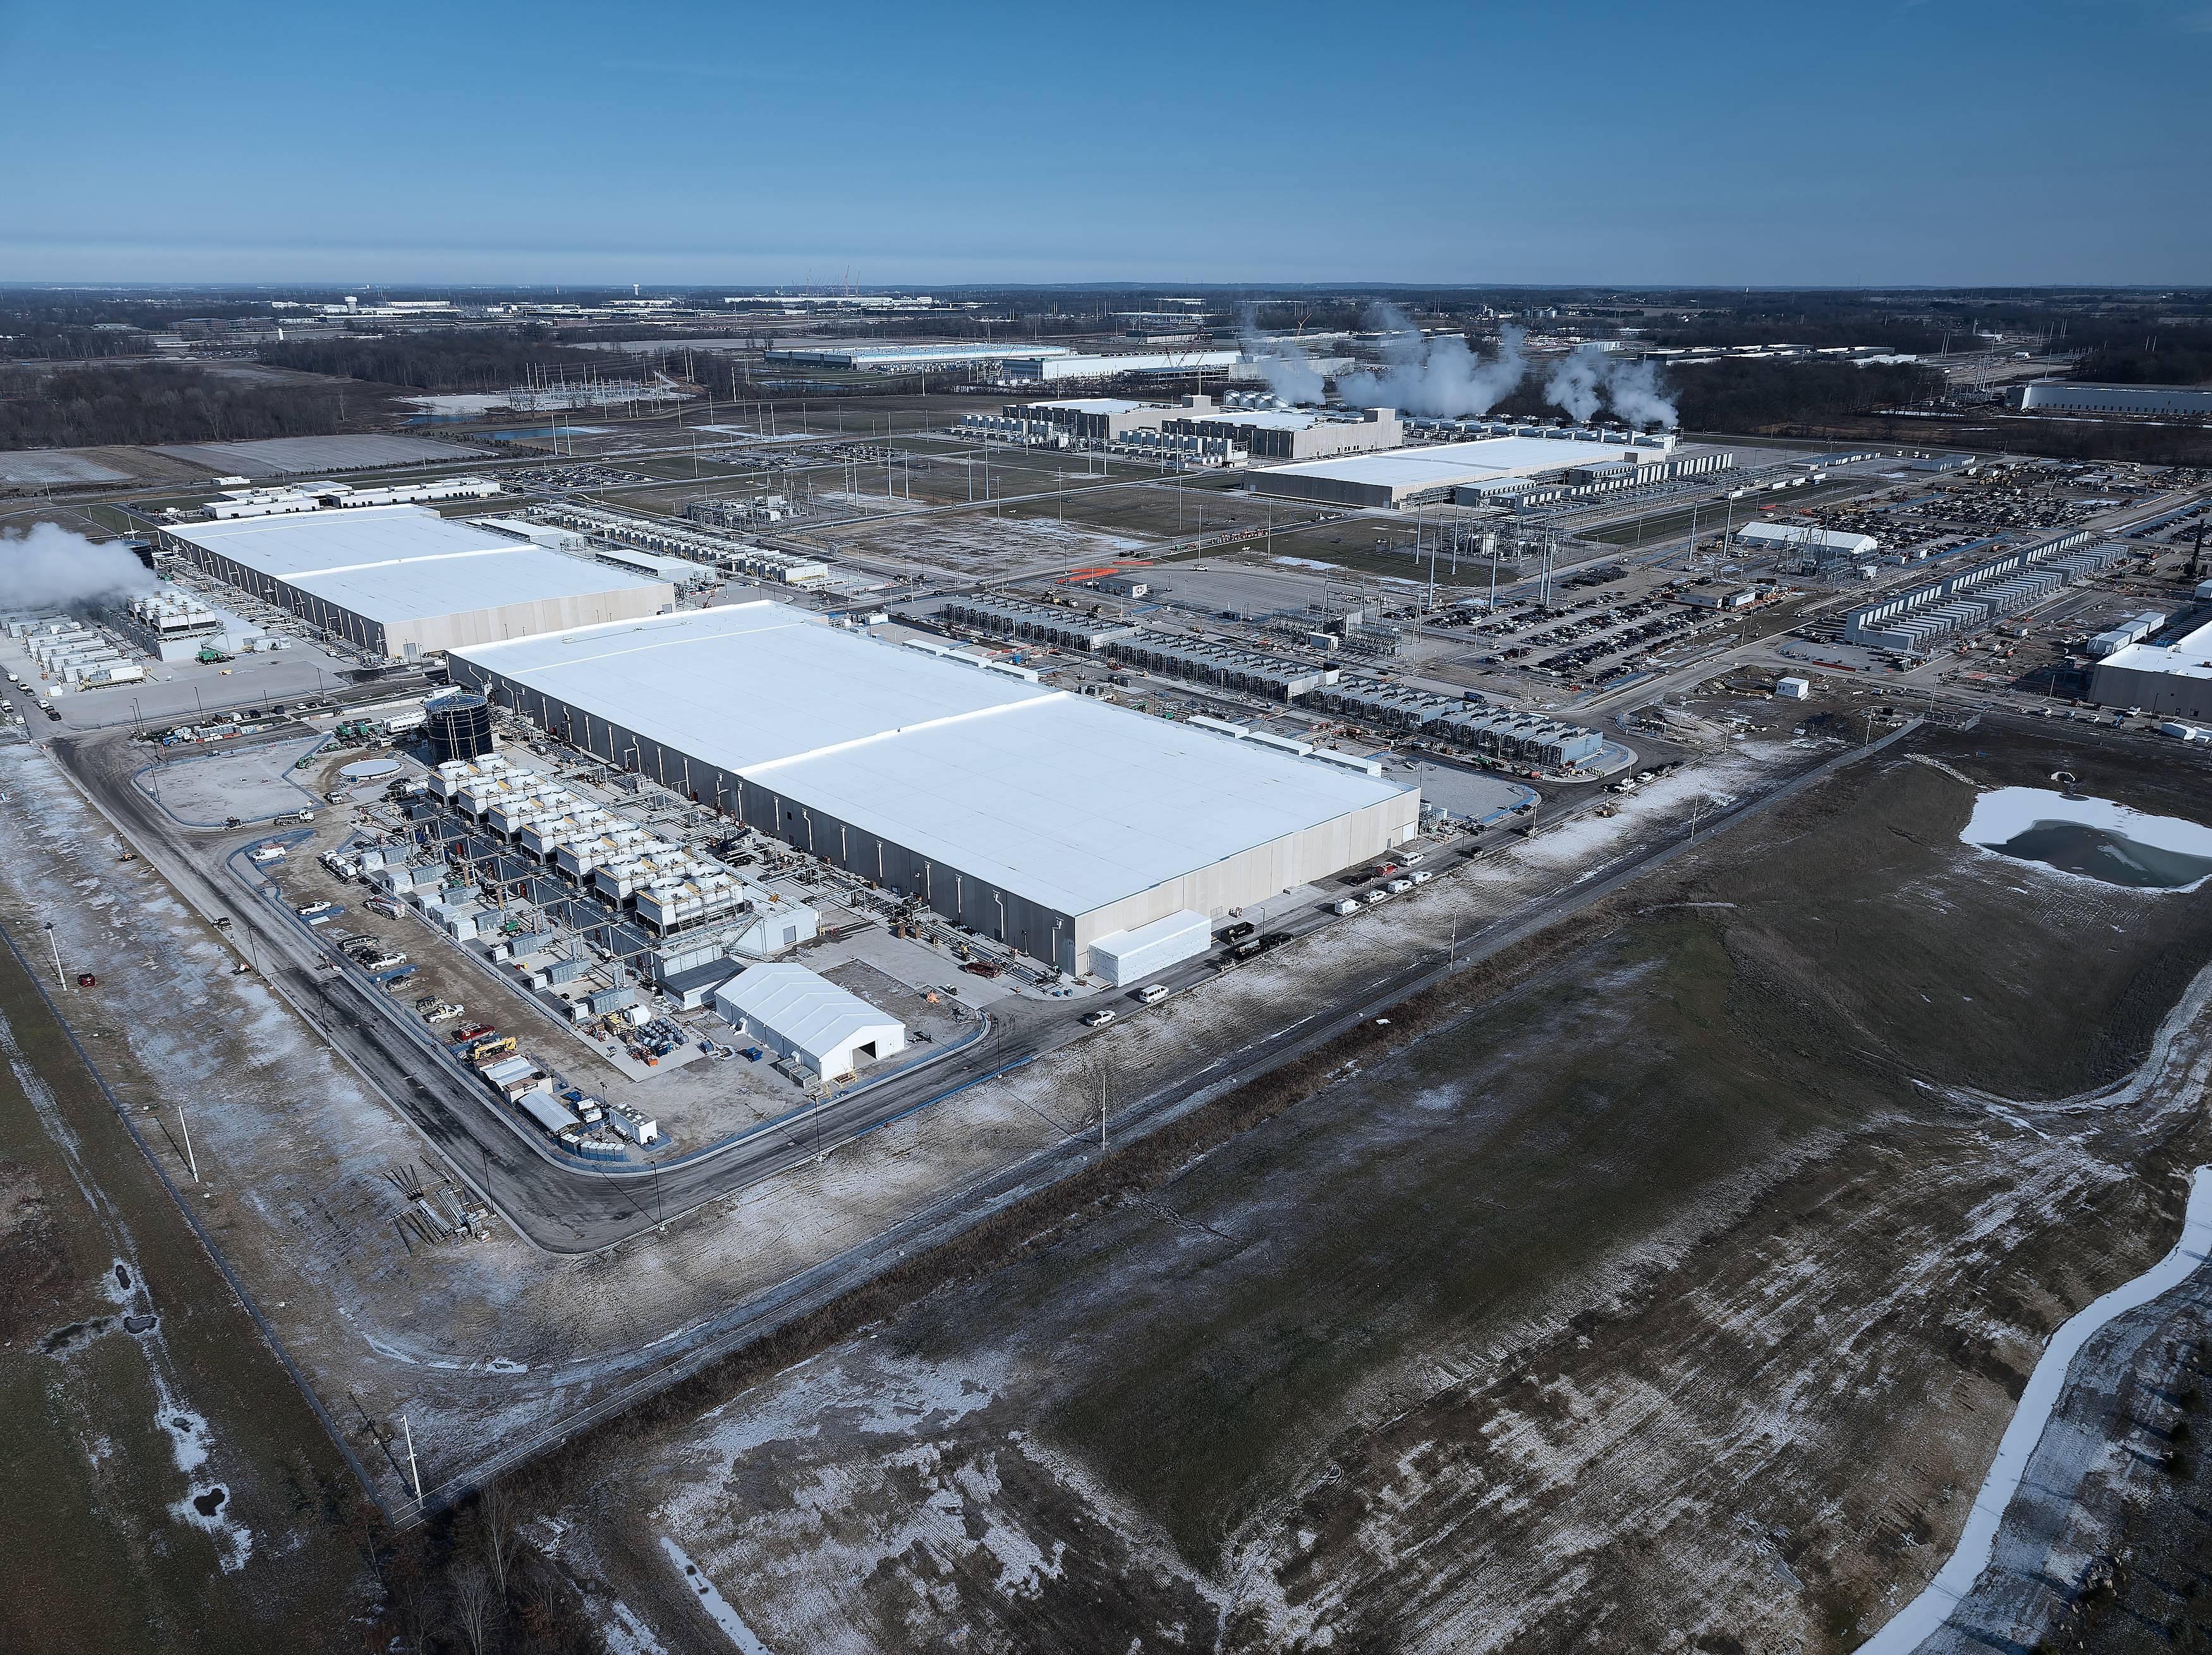
Datacenters
Buildings
with Servers
Cooling
Backup Generators
Electrical Substation

Slide 4
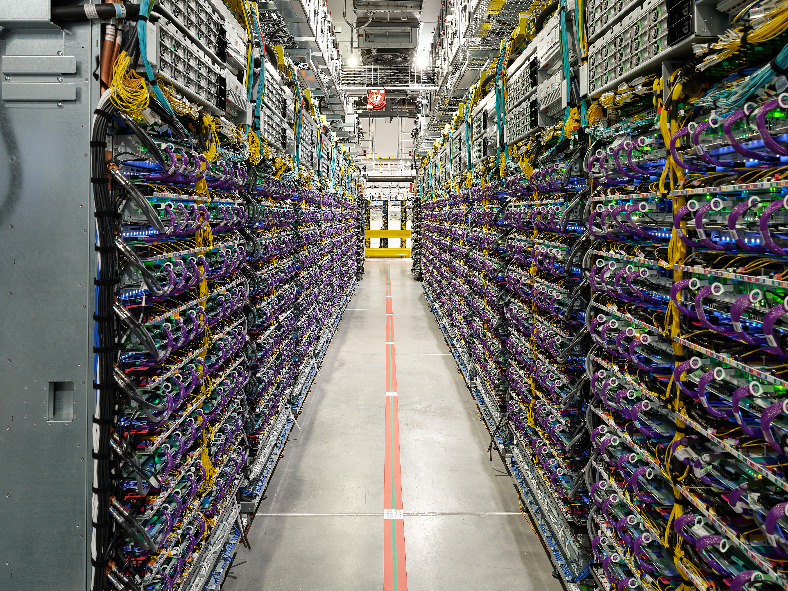
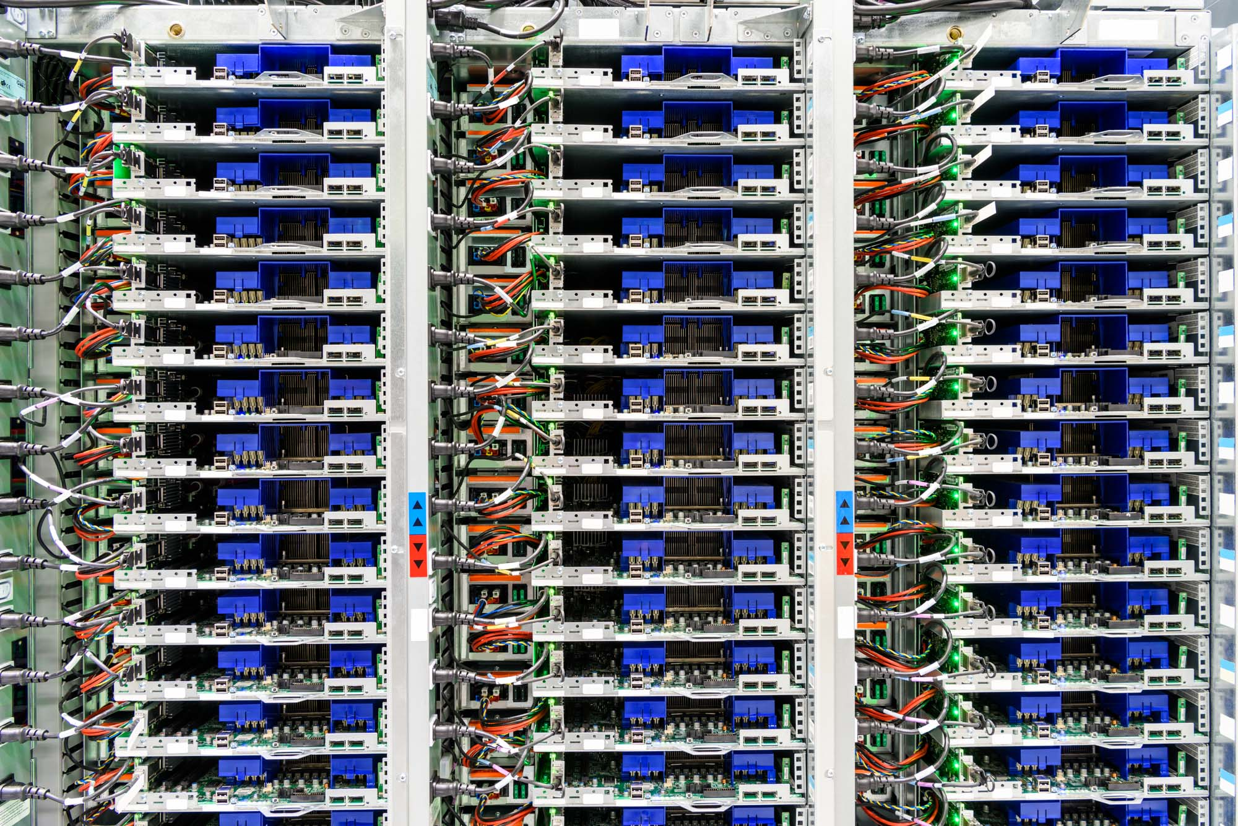
Inside a Datacenter
Central Ohio
Eemshaven

Slide 5
Measuring Distributed Systems
Distributed System
System is a black box to the clients

Slide 6
Metric 1: Latency
Latency measures the time it takes to do something
End-to-end latency measures the time between client request and client response
End-to-end latency captures everything going on inside a system, but misses details
Usual unit: ms

Slide 7
Measuring Latency
Latency measured externally by client
Collect results from many clients!
Distributed System

Slide 8
Breaking Down End-to-End Latency
Client requests routed to a server in the distributed system
Server must do some work to process the request!
1
2
3
Total latency = 1 + 2 + 3

Slide 9
Metric 2: Throughput
How many requests can our system handle in given period if time?
Analogous to link bandwidth in networking!
Measured externally as rate that responses exit system
Usual unit: reqs/sec

Slide 10
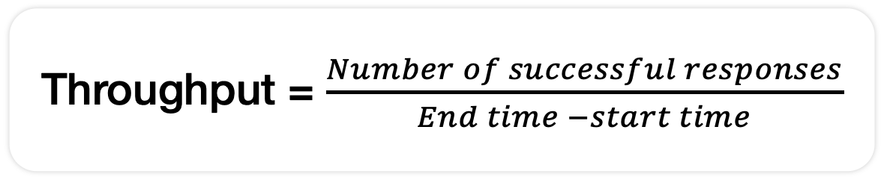
Measuring Throughput
Distributed System
Throughput = $\frac{Number of successful responses}{End time −start time}$

Slide 11
Throughput/Latency Relationship
The more requests we send to the system, the more it has to process
Eventually the system will overload. Two options:
Drop all requests until it can start processing them
Enqueue requests and process as fast as possible
Either way: overload creates higher latencies

Slide 12
Measuring Throughput 2
Blindly hammering a server with requests is not a good idea!
We learn very little by doing this
But, figuring out where a system overloads is important!
Approach:
Start with low load
Increase load
Repeat until observed throughput levels off

Slide 13
Reasoning About Throughput
Network bandwidth can bound the requests that reach server
Server can only process so many requests at a time
1
2
3
Total throughput = min(1, 2, 3)

Slide 14
Throughput Bottlenecks
Bottlenecks to throughput can come from multiple places
Like bandwidth, there’s a bottleneck somewhere
Bottleneck link bandwidth
Server CPU
Server network card
Server’s storage device
Outgoing bottleneck link bandwidth
Many others!

Slide 15
Load Generation
Closed-loop
Each “client” sends one request, waits for the response to come back, and then sends another request
More “clients” => more load
Open-loop
Load is generated independently of the response rate of the system, typically from a probability distribution
More directly control the load on the system
Which one is more realistic?
We’ll reason using closed-loop clients

Slide 16
Important Numbers in Distributed Systems
Latency (Review):
Machines in DC: <1ms
Dorm to Cycles: ~1ms
Dorm to NYC: ~10ms
Dorm to VA: ~20ms
Dorm to CA: ~60ms
Dorm to EU: ~100ms
Dorm to JP: ~150ms
Throughput:
Phone: 100s req/s
Laptop: 1-5k req/s
Desktop: 10-20k req/s
Single Server: 50-100k req/s
High-End Server: 500k+ req/s
Hyperscale System: 10⁶⁻⁹ req/s

Slide 17
Mental Model of an Experiment
Let’s start with 1 closed loop client, and submit requests to a server
What’s our expected latency?
What’s our expected throughput?
Double the number of clients, what happens?
Repeat

Slide 18
Metrics We Need to Know
What do we need to know to do our mental modeling?
How long it takes to get from the client to the system
How many requests the server can handle (how long it takes to overload)
How long it takes the server to process a single request

Slide 19
Throughput-Latency Curves 1
Many distributed systems are benchmarked by a throughput-latency graph
Remember: There’s a coupling between throughput and latency!
Which one goes on the X axis?
- Throughput!

Slide 20
Throughput-Latency Curves 2
Simple Setting:
Single Server
Client-Server RTT 90ms
Server Processing latency 10ms
Single-Threaded Server (100 ops/s)
Latency (ms)
100
10
20
40
100
Throughput (operations/sec)

Slide 21
Throughput-Latency Curves 3
Overload
Latency
Underloaded
Common operating point:
70-80% max load
Throughput

Slide 22
Primary-Backup Performance
Clients talk to primary
Primary talks to backups
Ignore coordinator for now -> assume that client already knows who the primary is, and that no failures occur

Slide 23
PB DC Perf: Latency
What is the latency of a single client talking to the primary?
What steps makeup latency, and how long does each take?
Client sends request to primary (30ms)
Primary adds request to its log (1ms)
Primary replicates operation to all replicas (1ms RTT to backups, 1ms for backups to write to log)
Primary applies request to internal state machine (7ms)
Primary sends response to client (30ms)
Total: 70ms
Note: The numbers are arbitrary, based on realistic values that work out to a nice, round final

Slide 24
PB DC Perf: Throughput
What is our throughput bottleneck going to be?
Almost certainly the primary!
Primary receives messages from client & backups
Each request from client creates n requests from backups
Let’s say 3 backups
If primary can handle 100 requests/sec, how many client requests?
1 client request requires the primary to reach out to 3 backups, for 4 total requests
For simplicity, assume each request takes same processing time: 100/4 = 25 client requests/sec.
Notes:
100 requests in a second, each client request generates 4 messages. Should be able to process 25 client requests per second
Note that this isn’t exact! We’re not doing the same work for each one, etc. But it’s a pretty good approximation

Slide 25
PB DC Perf: Throughput-Latency
25
Setting
Single primary, 2 backups
Client-Server RTT: 60ms
Server Processing latency: 10ms
Server can handle 100 ops/s (25 client req/s)
Latency (ms)
What happens if we change the workload?
70
10
20
Throughput (operations/sec)

Slide 26
PB DC Perf: Read-Only
Does latency change?
Latency decreases slightly because we don’t need to wait for the primary to contact the replicas
For simplicity, we’ll graph with the same latency to make comparing easier
Does throughput change?
It should! Previously, a single client request generated 4 requests the primary had to handle. Now it’s a 1:1 relationship.

Slide 27
PB DC Perf: Throughput-Latency 2
25
100
Setting
Single primary, 3 backups
Client-Server RTT: 60ms
Server Processing latency: 10ms
Server can handle 100 ops/s
All reads
Latency (ms)
70
Workloads matter!
10
20
Throughput (operations/sec)

Slide 28
Primary-Backup WAN Performance
So far, looked at performance when replicas are close by
What happens when replicas are far apart? Why do this?
Better fault tolerance
Replicas closer to users?
Other reasons (power availability, data governance, etc)

Slide 29
PB WAN Perf: Latency
Datacenters: California, Ohio, Virginia
Client to DC: 60ms RTT
Primary in Ohio, how long for a write for a client in:
Ohio: 60ms to Ohio, 50ms from Ohio to CA. 110ms.
California: 60ms to CA, 60ms from CA to VA. 120ms.
How about a read?
- Reads just go to primary, so 110ms for CA and 60 for OH.
Datacenter Pair | CA <-> OH | CA <-> VA | VA <-> OH
RTT Latency | 50 | 60 | 20

Slide 30
PB WAN Perf: Throughput
How does moving to a WAN affect throughput?
Backups are further apart
Primary can still process the same number of req/s
Generally: throughput worse. Network delays, etc.
Never going to be better than in a LAN

Slide 31
Conclusion
Distributed systems can operate at huge scale! This is why both performance and fault tolerance matter
Care about two metrics: throughput and latency
We can reason about throughput and latency with mental models and calculations
Workloads and system deployments matter!

