Slide 1
BBR Congestion Control
COS 316: Principles of Computer System Design
Lecture 8
Wyatt Lloyd

Slide 2
TCP “Sawtooth”
Window
Loss
halved
Time

Slide 3
TCP Sawtooth Misses the Mark
Window
Congesting the network
GOAL:
Underutilizing the network
Time

Slide 4
Can We Do Better?
Yes! Researchers in academia and industry actively working on it for 35+ years and still going!
100s of congestion control schemes proposed…
A couple of papers at every SIGCOMM…

Slide 5
Today: BBR Congestion Control
BBR: bottleneck bandwidth and round-trip propagation time

Slide 6
Bottleneck Bandwidth
Sender
Receiver
Link 1
Link 2
Link 3
Link 4
Bottleneck link

Slide 7
Send at > Bottleneck Bandwidth
Sender
Receiver
Link 1
Link 2
Link 3
Link 4
Queue grows until full and we drop packets
Goal: Sending rate = bottleneck bandwidth

Slide 8
Bandwidth Delay Product (BDP)
Sender
Receiver
Link 2
Round trip propagation delay (RTProp)
Bandwidth Delay Product = RTProp * Bottleneck Bandwidth

Slide 9
Data in Flight vs. Bandwidth Delay Product
Data in flight = un-acknowledged data
If data in flight > bandwidth delay product?
  Queue before bottleneck grows
If data in flight < bandwidth delay product?
  Can’t fill bottleneck at all time => underutilization
Goal: Data in flight = BDP = RTProp * bottleneck bandwidth

Slide 10
BBR’s Two Goals
Sending rate = bottleneck bandwidth
Data in flight = BDP = RTProp * bottleneck bandwidth
High-level technique:
  Estimate bottleneck bandwidth
  Estimate RTProp
  Pace sending to bottleneck bandwidth
  Run experiments to test if bottleneck bandwidth or RTProp change
    Still constrain overall data in flight to be BDP

Slide 11
Estimating Bottleneck Bandwidth
Take a measurement between every send and ack:
  bandwidth_estimate = ∆delivered / ∆t
Can never send faster than bottleneck bandwidth
Bottleneck bandwidth = max estimate in last N seconds
  (N = 10)
Notes:
Measuring ∆delivered accurately is too complex to explain on the slide, but it is possible! The queue article does not describe it, instead it is covered clearly here: https://datatracker.ietf.org/doc/html/draft-cheng-iccrg-delivery-rate-estimation#name-estimating-delivery-rate

Slide 12
Estimating Round Trip Propagation Delay
Take a measurement between every send and ack:
  RTprop_estimate = time_at_ack – time_at_send
Can never receive ack faster than Rtprop
RTprop = min estimate in last N seconds
  (N = 10)

Slide 13
Pacing Sending
Goal: send at bottleneck bandwidth rate
Send a packet every packet_size / bottleneck bandwidth
  e.g., 1500B/40Mbps = 1500B/5MBps = 1 packet / 300µs
if (now >= nextSendTime)
…
nextSendTime = now + packet.size / BtlBw_estimate

Slide 14
Run Experiments
Is there more bandwidth available?
  Try sending extra data
    Same time to ack => no queue => extra bandwidth available!
    Longer to ack => queue grew => no extra bandwidth available
  Compensate by sending less data to keep inflight data < BDP
    Experiment increases queue, compensation drains them
Is RTprop shorter?
  Try sending very little data to avoid queuing

Slide 15
BBR High Level Review
Estimate bottleneck bandwidth with max estimate
Estimate RTProp with min estimate
Pace sending to bottleneck bandwidth rate
Run experiments to test if bottleneck bandwidth or RTProp change
  Still constrain overall data in flight to be BDP

Slide 16
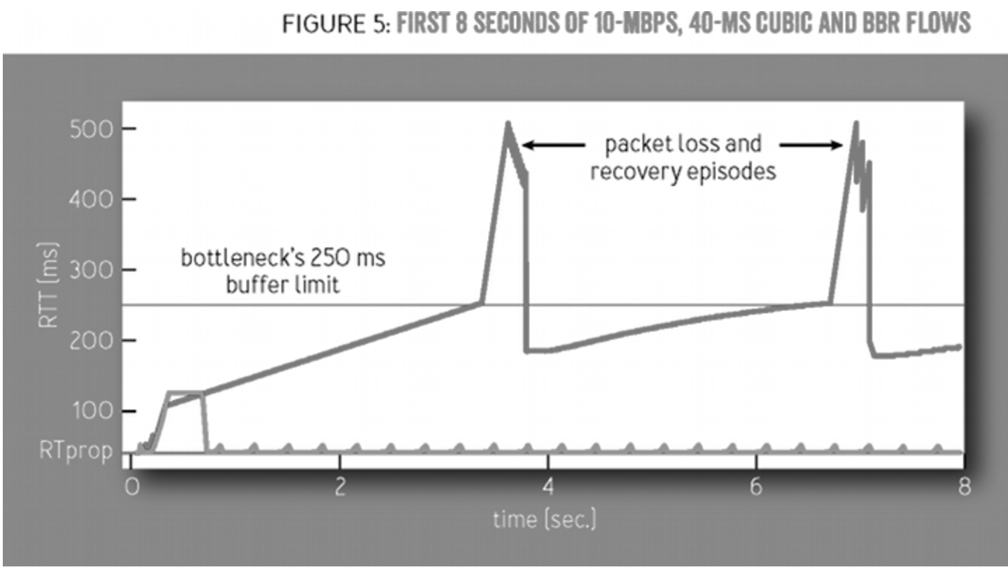
BBR’s Latency? [fig 5 from queue paper]

Slide 17
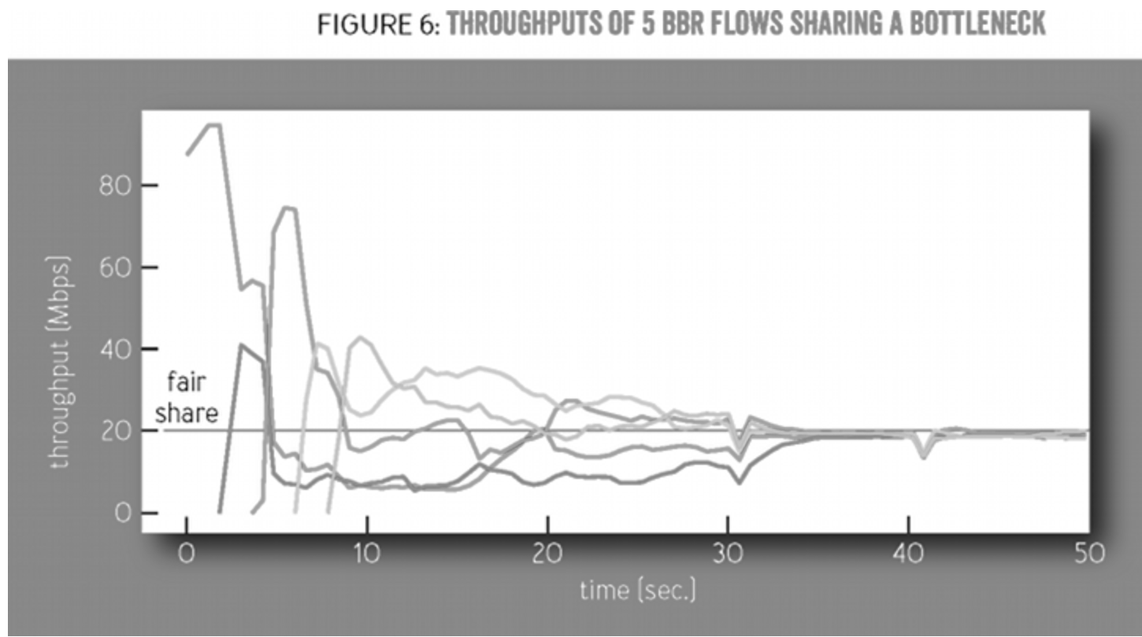
BBR’s Throughput? [fig 5 from queue paper]
Notes:
They end up sending at the same steady rates! Fair sharing! Nearly full utilization!
Takes time to adjust as new flows are added.
Dips are experiments to check for changes to RTprop. (They are synchronized because BBR timeouts after 10 seconds of not getting a lower RTprop value to start this experiment. Shorter queue time synchronize this timeout for everyone, and lead to an even more accurate estimate of RTprop.)

Slide 18
BBR in Practice
In Linux since 2016
  sysctl net.ipv4.tcp_congestion_control=bbr
BBR is used for Google’s internal traffic
  Inside a datacenter
  Between Google datacenters
BBR is used for Google’s external traffic
  Google.com, YouTube
BBR has some adoption outside Google
  8% of most popular 20K websites [Mishra et al. SIGCOMM ‘24]
  e.g., Amazon.com, primevideo
Notes:
Websites != web traffic, BBR runs on > 20% of web traffic
Though lots of different congestion control algos are used in practice, here is top 10 from Nebby paper [Mishra et al. SIGCOMM ‘24]
Websites Traffic CCA
google domains 13.85% BBRv3
netflix.com 13.74% Reno
facebook.com 6.45% CUBIC
apple.com 4.59% AkamaiCC
disneyplus.com 4.49% CUBIC
amazon.com 4.24% BBRv1
tiktok.com 3.93% AkamaiCC
primevideo.com 2.67% BBRv2
hulu.com 2.44% AkamaiCC

Slide 19
BBR Conclusions
Congestion is inevitable
  Internet does not reserve resources in advance
  BBR in TCP estimates the most traffic it can send without increasing congestion
    Runs experiments to push the envelope
Congestion can be handled
  BBR sender limits traffic to the bandwidth delay product (congestion window)
Running in practice!
A
a

