Slide 1
Intro to Networking
Intro to Layering
Network Layering
COS 316: Principles of Computer System Design
Lecture 6
Wyatt Lloyd

Slide 2
Intro to Networking
How do I let two computers talk to each other?
  If they are connected via a physical wire?
  If they are in the same room?
  If they are both on Princeton’s campus?
  If one is in Princeton and the other in Tokyo?
  If one is in Princeton and the other is in Space?

Slide 3
Networking
A series of layers and protocols and systems that allow machines to communicate with each other

Slide 4
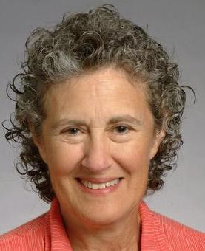
Intro to Layering
“Modularity based on abstraction is the way things get done”
2009 Turing Award Lecture
Barbara Liskov
Notes:
Venus Operating System (1970): Virtual Machines
CLU programming language – modular programming, data abstraction (data types, function, abstract classes with inheritance)
Viewstamped Replication – Collection of machines that fail as single non-failing machine -> datacenter systems – 418!
Practical Byzantine Fault Tolerance – Collection of machines that fail and some are evil as single non-failing machine -> blockchain

Slide 5
Modularity Through Layering
Systems on systems on systems though layering
Each layer hides complexity with abstraction
Network layers today!

Slide 6
The Problem of Communication
Applications
HTTP
Facetime
SSH
FTP
Transmission
media
Coaxial cable
Fiber optic
Wi-Fi
Re-implement every application for every new underlying transmission medium?
Change every application on any change to an underlying transmission medium?
No! But how does the Internet design avoid this?

Slide 7
Solution: Layering
Applications
HTTP
Facetime
SSH
FTP
Intermediate layers
Transmission
media
Coaxial cable
Fiber optic
Wi-Fi
Intermediate layers provide a set of abstractions for applications and media
New applications or media need only implement for intermediate layer’s interface

Slide 8
The Art of Layering
How many layers?
What goes in each layer?
What abstraction (interface) does each layer provide?
Notes:
Discuss, why not too many layers? Often some loss of efficiency with each layer, either implementation or fundamental.

Slide 9
Layering in the Internet
Transport: Provide end-to-end communication between processes on different hosts
Network: Deliver packets to destinations on other (heterogeneous) networks
Link: Enables end hosts to exchange atomic messages with each other
Physical: Moves bits between two hosts connected by a physical link
Host
Applications
Transport layer
Network layer
Link layer
Physical layer

Slide 10
Logical Communication Between Layers
How to forge agreement on the meaning of the bits exchanged between two hosts?
Protocol: Rules that govern the format, contents, and meaning of messages
  Each layer on a host interacts with its peer host’s corresponding layer via the protocol interface
Application
Application
Transport
Transport
Network
Network
Network
Link
Link
Link
Physical
Physical
Physical
Host A
Router
Host B

Slide 11
Physical communication
Communication goes down to the physical network
Then from network peer to peer
Then up to the relevant application
Application
Application
Transport
Transport
Network
Network
Network
Link
Link
Link
Physical
Physical
Physical
Host A
Router
Host B

Slide 12
Communication Between Peers
How do peer protocols coordinate with each other?
Layer attaches its own header (H) to communicate with peer
  Higher layers’ headers, data encapsulated inside message
    Lower layers don’t generally inspect higher layers’ headers
Application
Application message
Transport-layer message body
Transport
H
Network-layer datagram body
Network
H

Slide 13
Internet Protocol Layers
Application
Applications
HTTP …
Transport
Reliable streams
Messages
TCP, UDP
Network
Global packet delivery
IP
Local packet delivery
Ethernet, Optical, WiFi, …
Link
Notes:
Physical layer underneath this too

Slide 14
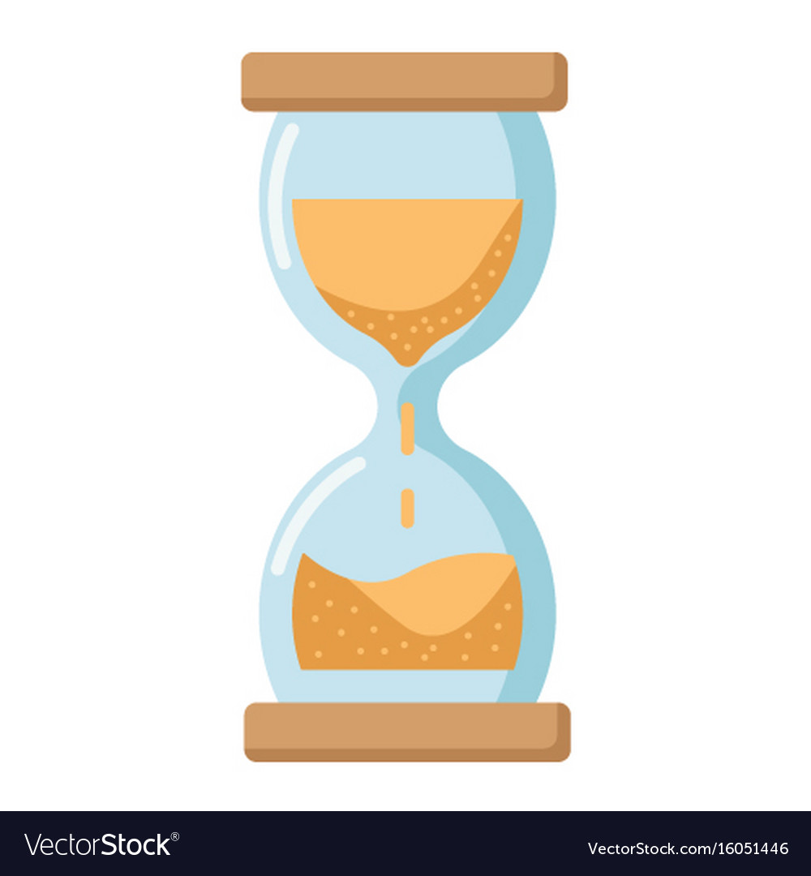
IP is the “Narrow Waist” of the Internet
The network layer protocol
  Enables portability above and below
Lots of link layer protocols underneath
Several transport protocols on top
  TCP, UDP, QUIC

Slide 15
IP: Best-Effort Global Packet Delivery
Never having to say you’re sorry
  Don’t have to reserve bandwidth and memory
  Don’t have to do error detection and correction
  Don’t have to remember anything from one packet to the next
Easier to survive failures
  Transient disruptions are okay during failure recovery
Can run on nearly any link technology
  Greater interoperability and evolution
  RFC 1149…
Data
Notes:
RFC 1149: A Standard for the Transmission of IP Datagrams on Avian Carriers (released April 1, 1990)

Slide 16
Transport: Application to Application
Network layer is host-to-host
Transport layer is port-on-host-to-port-on-host
  think application to application
  demultiplexing
  e.g., port 80 is HTTP, port 443 is HTTPS, port 22 is SSH
Why transport and not network layer?
Notes:
two big reasons:
1) keep network layer simple
2) ports are end-host identifiers ... irrelevant to routers in between the end hosts!

Slide 17
Transport: Application to Application
Network doesn’t have error detection
Transport layer does have error detection
Why transport and not network layer?
Why not both?
Notes:
Errors are rare... (tell them this)
Transport layer: only do once for each global packet delivery
Network layer: would have to do many times for each global packet delivery
Also transport is closer to application, can do fancier error correction

Slide 18
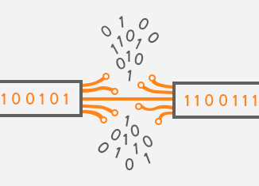
Transport: Transmission Control Protocol (TCP)
Ordered, reliable stream of bytes
  Built on top of best-effort packet delivery at the network layer
Challenges with IP
  Lost or delayed packets
  Corrupted packets
  Out-of-order packet arrivals
  Receiver runs out of space
  Network cannot handle current load

Slide 19
TCP: Lost or Delayed Packets
Problem: Lost or delayed data
Solution: Timeout and retransmit
  Receiver sends acknowledgement of data

Slide 20
TCP: Corrupted Data
Problem: Data corrupted during transmission
Solution: checksums
Sender computes a checksum 134
  Sender sums up all bytes in the payload + 212
  And sends the sum to the receiver = 346
Receiver checks a checksum 134
  Recevier sums up all bytes in the payload + 216
  And compares against the checksum = 350
Then what?
Notes:
Draw on board:
get index.html --→ get indeY.html

Slide 21
TCP: Out-of-Order Packet Arrivals
Problem: Our of order packets:
  Application: GET index.html
  Sent packets: |GET| |inde| |x.ht| |ml|
  Received packets: |ml| |inde| |x.ht| |GET|
Solution: Add sequence numbers
  Received packets at a high level:
    |4|ml| |2|inde| |3|x.ht| |1|GET|
  Received packets a bit more precisely (based on bytes):
    |12|ml| |3|inde| |7|x.ht| |0|GET|
Notes:
Sequence numbers are based on the actual bytes in the byte stream

Slide 22
TCP: Receiver Runs Out of Space
Problem: No more space to receive packets
Solution: Flow control
  Receiver maintains a window size
    Amount of data it can buffer
  Advertises window to the sender
    Amount sender can send without acknowledgement
  Ensures that sender does not send too much

Slide 23
TCP: Network that Cannot Handle the Load
Problem: Too many packets at once
Solution: Congestion control
  Future lectures!

Slide 24
TCP’s Reliable Byte Stream Example
Sender’s application level buffer:
Receiver’s application level buffer:
“What is the best dining hall?”
App ↑
App ↑
OS ↓
OS ↓
Sender’s outgoing TCP buffer:
Receiver’s incoming TCP buffer:
0123456789… 28
What is the best dining hall?
Sender’s outgoing IP buffer:
Receiver’s incoming IP buffer:
0:What is
7: the be
14:st dini
21:ng hall?
Notes:
(This is a simplified description of what really happens)
Animation of:
App sends IP packets:
2nd packet is lost (erase)
3rd packet is corrupted
4th packet is received
2nd packet resent
3rd packet resent
Deliver in order 3->2
Draw them showing up and filling into the contiguous byte stream on the receiver!
App 1 on left
Network in between
App 2 on right

Slide 25
TCP’s Reliable Byte Stream Example
Sender’s application level buffer:
Receiver’s application level buffer:
“What is the best dining hall?”
App ↑
App ↑
“What is”
OS ↓
OS ↓
Sender’s outgoing TCP buffer:
Receiver’s incoming TCP buffer:
0123456789… 28
What is the best dining hall?
0123456789… 28
What is `
Sender’s outgoing IP buffer:
Receiver’s incoming IP buffer:
0:What is
7: the be
14:st dini
21:ng hall?

Slide 26
TCP’s Reliable Byte Stream Example
Sender’s application level buffer:
Receiver’s application level buffer:
“What is the best dining hall?”
App ↑
App ↑
“What is”
OS ↓
OS ↓
Sender’s outgoing TCP buffer:
Receiver’s incoming TCP buffer:
0123456789… 28
What is the best dining hall?
0123456789… 28
What is
Sender’s outgoing IP buffer:
Receiver’s incoming IP buffer:
7: the be
14:st dini
14:st Zini
21:ng hall?

Slide 27
TCP’s Reliable Byte Stream Example
Sender’s application level buffer:
Receiver’s application level buffer:
“What is the best dining hall?”
App ↑
App ↑
“What is”
OS ↓
OS ↓
Sender’s outgoing TCP buffer:
Receiver’s incoming TCP buffer:
0123456789… 28
What is the best dining hall?
0123456789… 28
What is
What is---------------ng hall?
Sender’s outgoing IP buffer:
Receiver’s incoming IP buffer:
14:st Zini
21:ng hall?
Notes:
(This is a simplified description of what really happens)
Draw on board:
App sends IP packets: [_____] [______] [__X____] [_________
2nd packet is lost (erase)
3rd packet is corrupted
4th packet is received
2nd packet resent
3rd packet resent
Deliver in order 3->2
Draw them showing up and filling into the contiguous byte stream on the receiver!
App 1 on left
Network in between
App 2 on right

Slide 28
TCP’s Reliable Byte Stream Example
Sender’s application level buffer:
Receiver’s application level buffer:
“What is the best dining hall?”
App ↑
App ↑
“What is”
OS ↓
OS ↓
Sender’s outgoing TCP buffer:
Receiver’s incoming TCP buffer:
0123456789… 28
What is the best dining hall?
0123456789… 28
What is---------------ng hall?
What is--------st dining hall?
Sender’s outgoing IP buffer:
Receiver’s incoming IP buffer:
7: the be
14:st dini
Notes:
(This is a simplified description of what really happens)
App sends IP packets: [_____] [______] [__X____] [_________
2nd packet is lost (erase)
3rd packet is corrupted
4th packet is received
2nd packet resent
3rd packet resent
Deliver in order 3->2
Draw them showing up and filling into the contiguous byte stream on the receiver!
App 1 on left
Network in between
App 2 on right

Slide 29
TCP’s Reliable Byte Stream Example
Sender’s application level buffer:
Receiver’s application level buffer:
“What is the best dining hall?”
App ↑
App ↑
“What is the best dining hall”
“What is”
OS ↓
OS ↓
Sender’s outgoing TCP buffer:
Receiver’s incoming TCP buffer:
0123456789… 28
What is the best dining hall?
0123456789… 28
What is the best dining hall?
What is-------st dining hall?
Sender’s outgoing IP buffer:
Receiver’s incoming IP buffer:
7: the be
Notes:
(This is a simplified description of what really happens)
App sends IP packets: [_____] [______] [__X____] [_________
2nd packet is lost (erase)
3rd packet is corrupted
4th packet is received
2nd packet resent
3rd packet resent
Deliver in order 3->2
Draw them showing up and filling into the contiguous byte stream on the receiver!
App 1 on left
Network in between
App 2 on right

Slide 30
Transport: User Datagram Protocol (UDP)
Datagram of bytes
  A message
Challenges with IP
  Lost or delayed packets X
  Corrupted packets √
  Out-of-order packet arrivals X
  Receiver runs out of space X
  Network cannot handle current load X
UDP does less than TCP, why do we want UDP too?
Notes:
Transport layer: do

Slide 31
Layering & Network Layers Conclusion
The art of layering
Network layers
  Protocol, headers, encapsulation
IP layer: best-effort global packet delivery between host
TCP layer: ordered, reliable byte stream between applications

