Slide 1

Reasoning about OS Performance
COS 316: Principles of Computer System Design
Lecture 5
Nicolaas Kaashoek

Slide 2
Modeling & Measuring Performance
Why does performance matter?
System performance translates to application performance
Goal: Provide hardware performance
How to think about performance?
Construct a mental model of system design (this lecture)
Hypothesize design performance (this lecture)
Measure Performance using a workload
Revise design and repeat

Slide 3
Hardware Numbers You Be Aware Of
Relative Differences are what matter!
Please don’t memorize!
Storage Capacity
Random Read Latency
64 bits
1 Cycle
Reg
32 KB
L1 Cache
0.5ns (3-5x)
256 KB
L2 Cache
~7ns (14x)
16 GB
Main Memory
~100ns (10x)
500 GB
Solid State Drive (SSD)
150µs (1000x)
2 TB
Magnetic Disk (HDD)
8ms (50x)

Slide 4
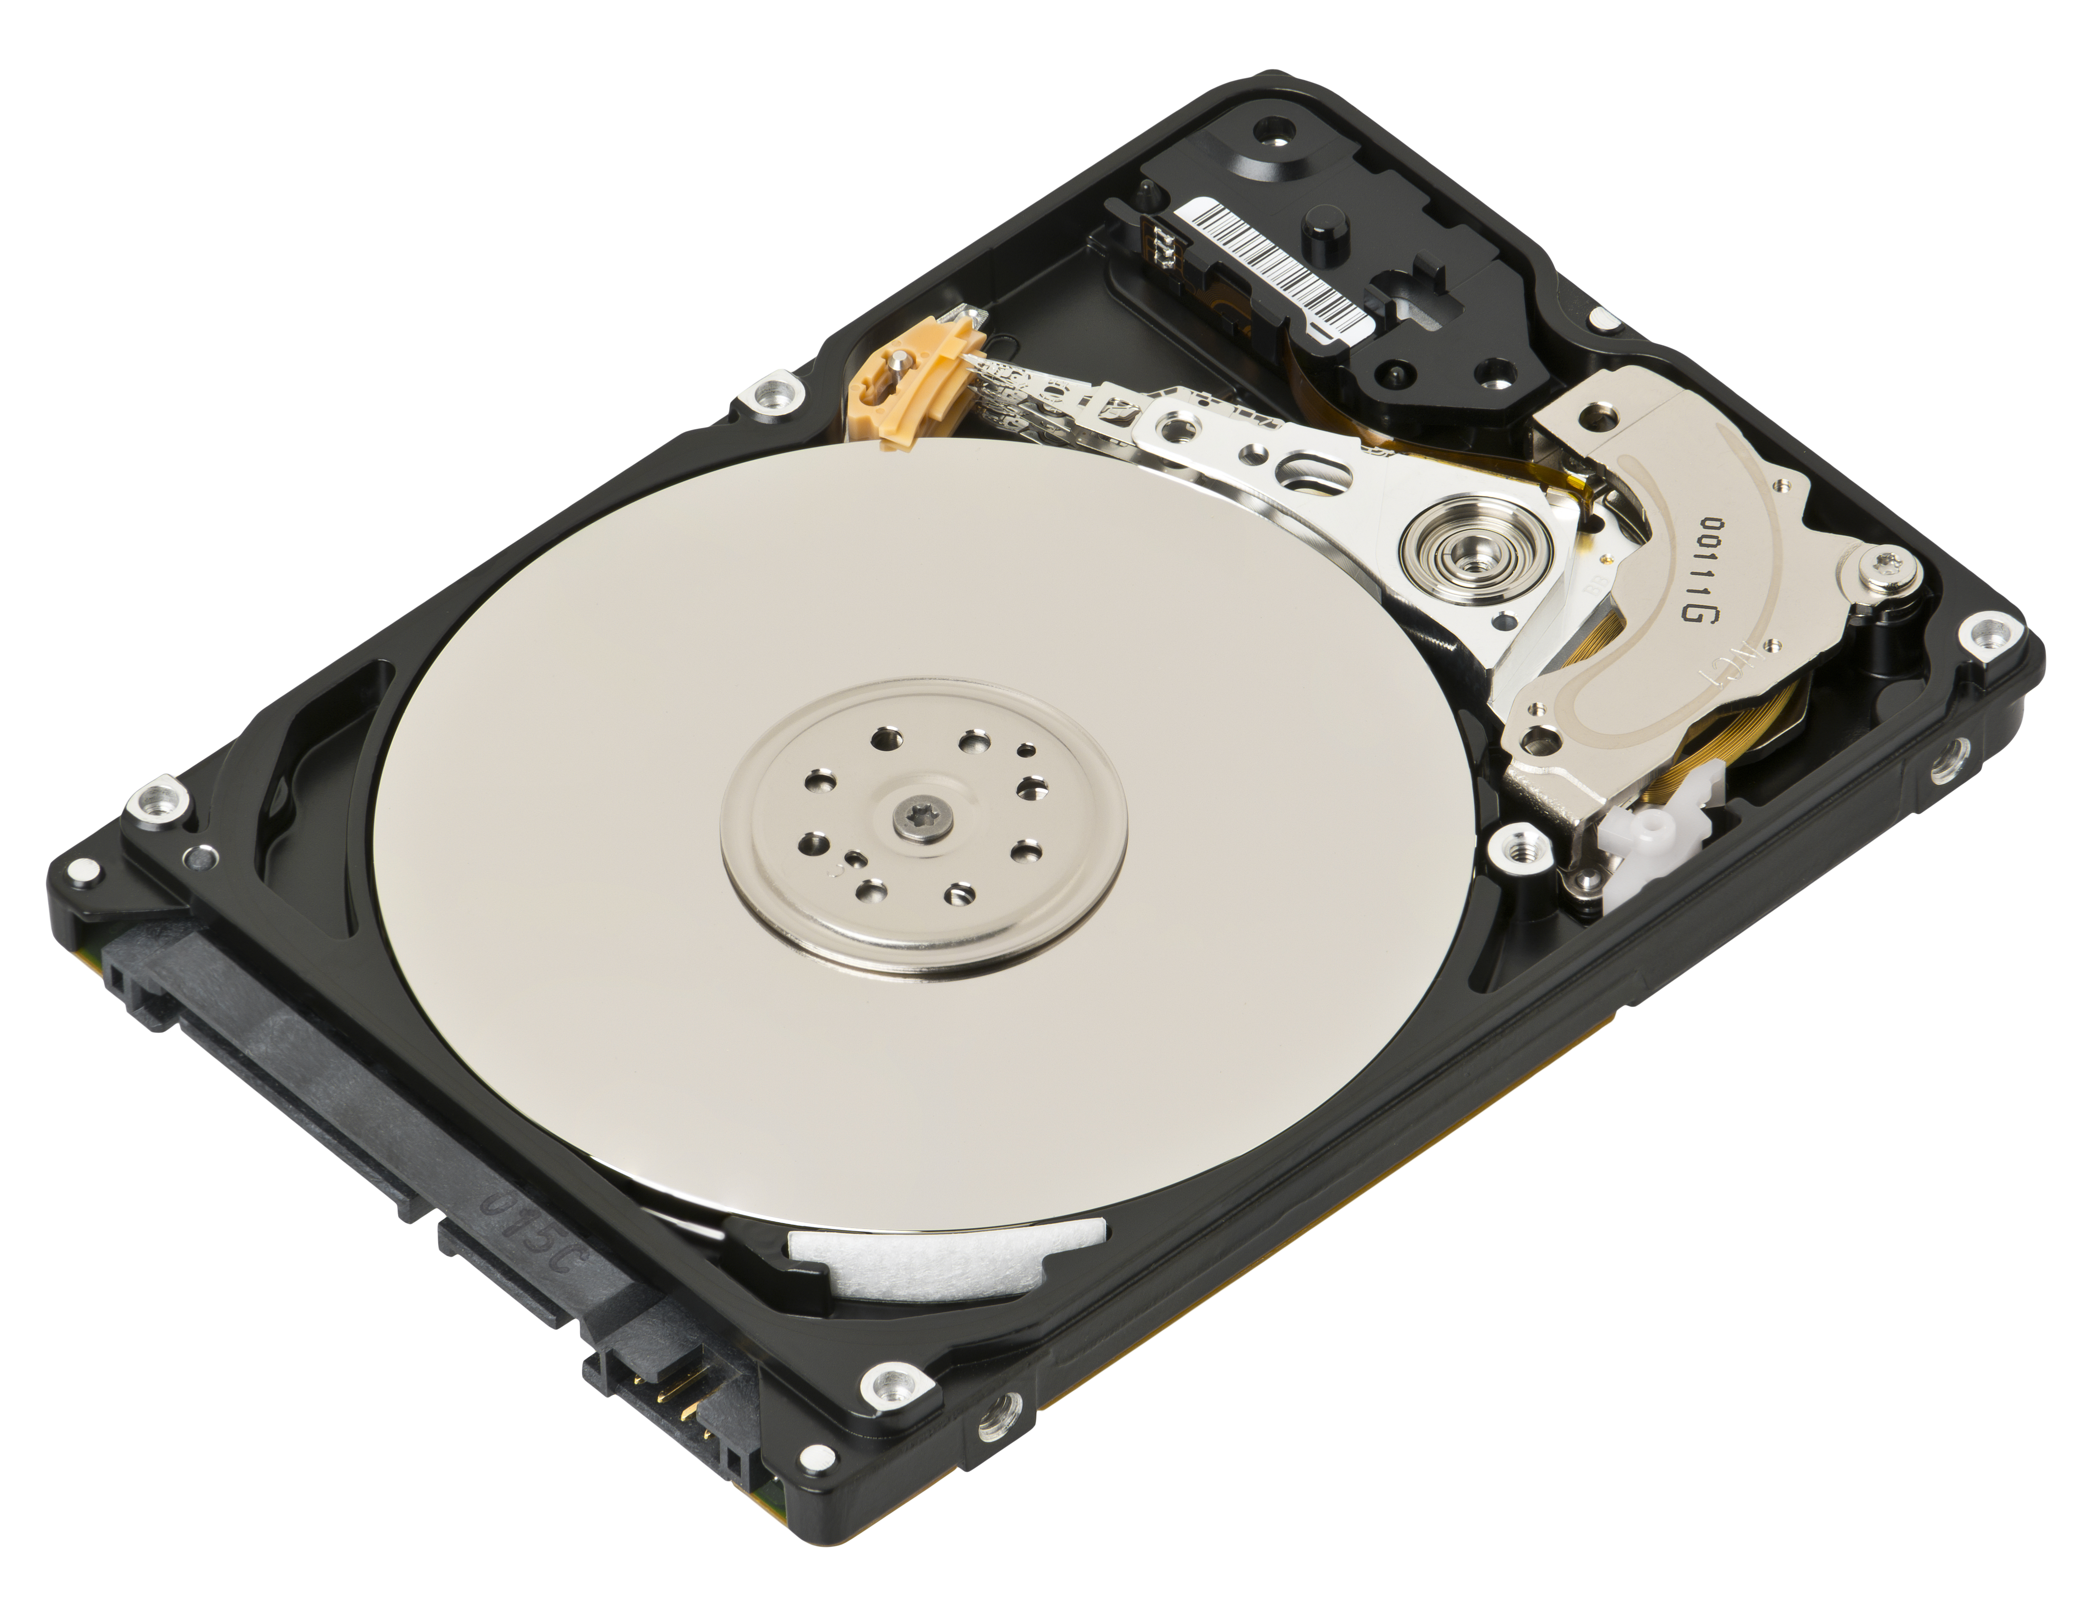
Hardware: Magnetic Disks
3 Parts for Performance:
Seek Speed (Arm to track)
Rotation Speed (Block under arm)
Throughput (bits to blocks)
Modern Disk: 4ms seek,
7200 rpm, ~300 MB/s
Throughput vs. Latency
Random vs. Sequential

Slide 5
Modeling the Unix File System
inode 22
8
15
17
25
0
1
2
3
4
5
Reserved
Super
Free Blocks
Inode List
/
10
11
6
7
8
9
12
13
14
15
16
17
18
19
20
21
22
23
24
25
26
27
28
29

Slide 6
Unix File System Performance - Create
0
1
2
3
4
5
Reserved
Super
Free Blocks
Inode List
/
10
11
6
7
8
9
12
13
14
15
16
17
echo > /foo. What happens?
Allocate an inode for the file
Update the newly created inode
Update the directory entry for “/”
This is a simplification. Demo!
18
19
20
21
22
23
24
25
26
27
28
29

Slide 7
Unix File System Performance - Write
0
1
2
3
4
5
Reserved
Super
Free Blocks
Inode List
foo
/
10
11
6
7
8
9
12
13
14
15
16
17
echo a > /foo. What happens?
Find block from free block list
Zero the allocated block
Write to block
Update inode for file
19
20
21
22
23
18
This is a simplification. Demo!
24
25
26
27
28
29

Slide 8
Unix File System Performance – Delete
What does it take to delete a file from the system?
File can’t be read from or written to anymore
Space can be reclaimed
Anything else?
Work through the steps with your neighbors

Slide 9
Unix File System Performance - Delete
0
1
2
3
4
5
Reserved
Super
Free Blocks
Inode List
/
10
11
6
7
8
9
12
13
14
15
16
17
18
19
20
21
22
23
24
25
26
27
28
29

Slide 10
Demonstration Slide
0
1
2
3
4
5
Reserved
Super
Free Blocks
Inode List
6
7
/ Dir
8
9
10
11
12
13
14
15
16
17
18
19
20
21
22
23
24
25
26
27
28
29
Notes:
7, 8, 12, 15, 17, 25, 28

Slide 11
Log-Structured File System - Intro
Rosenblum & Ousterhout, 1992.
Motivation: turn random writes into sequential ones The Rules:
Replace file/inode layer with a log
Log is made of segments (contiguous blocks)
Log is append-only, all writes to head of log
Reads go to in-memory cache
This lecture: overview. Read the paper if you’re curious for more!

Slide 12
Log-Structured File System – The Log
0
1
2
3
4
5
Segment 1
/
foo
bar
foo
10
11
6
7
8
9
12
13
14
15
16
17
Why are segments a good idea?
Writing to blocks 6, 7, 8, etc
Not 34, 33, 900, etc!
Bottleneck: Disk Throughput
18
19
20
21
22
23
Free Blocks
24
25
26
27
28
29

Slide 13
LFS Performance – Create 1
0
1
2
3
4
5
/
foo
bar
foo
10
baz
11
6
7
8
9
baz
qux
13
14
15
16
17
12
echo > /baz. What happens?
Just need to add to current segment
What if segment is full? Open a new one.
Problem: How do we make sense of blocks?
18
19
20
21
22
23
24
25
26
27
28
29

Slide 14
Log-Structured File System – Lookup 1
0
1
2
3
4
5
Segment 1
/
foo
bar
foo
10
Inodes
11
6
7
8
9
Inode Map Piece
12
13
14
15
16
17
Remember inodes? Let’s reuse those.
LFS adds one additional indirection: inode map
- Map tells us where most recent copy of inode is
Map stored in pieces, in segments. Why?
18
19
20
21
22
23
24
25
26
27
28
29

Slide 15
Log-Structured File System – Lookup 2
Checkpoint Region
Reserved
1
2
3
4
5
0
Super
/
foo
bar
foo
10
Segment 1
Inodes
11
6
7
8
9
Inode Map Piece
Inodes
/Users
File 4
File 4
Inode Map Piece
Segment 2
16
New Inode
12
13
14
15
17
We need some fixed data to tell us about disk
- LFS adds a Checkpoint Region
Region tells us where the map is
To avoid random writes, buffer in memory
Only checkpoint periodically for crash recovery
18
19
20
21
22
23
24
25
26
27
28
29

Slide 16
LFS Performance – Create 2
Checkpoint Region
Reserved
1
2
3
4
5
0
Super
/
foo
bar
foo
10
Segment 1
Inodes
11
6
7
8
9
Inode Map Piece
Inodes
/
Inodes
Inode Map Piece
16
17
Segment 2
12
13
14
15
Complete our example: echo > /baz
Make a new inode for baz
Update / to point to that inode
Update /’s inode to point to newest version
Write new inode map
Wrote to: 12, 13, 14, 15! How many ms?
18
19
20
21
22
23
24
25
26
27
28
29

Slide 17
LFS Performance – Write to File
Checkpoint Region
Reserved
1
2
3
4
5
0
Super
/
foo
bar
foo
10
Segment 1
Inodes
11
6
7
8
9
Inode Map Piece
bar
Inodes
Inode Map Piece
16
17
Segment 2
12
13
14
15
echo a > /bar
Get a new block: in the log!
Update Bar’s inode
Write new piece of the map
Wrote to: 12, 13, 14! How many ms?
18
19
20
21
22
23
24
25
26
27
28
29

Slide 18
LFS – Garbage Collection
Append-only structures only grow, but not infinite space
When can we reclaim space? How can we reuse the space that has been reclaimed?
These are important questions, but we don’t have time.
Insight: Copy live data, reclaim dead segments, treat the log as a linked list

Slide 19
LFS Performance – Delete File
Same idea as before. Work with your neighbors to figure out how to delete a file in a log-structured file system!
Add a number. How many writes to disk, are they random or sequential, and how long does it take in total?

Slide 20
LFS Performance – Write to File
Checkpoint Region
Reserved
1
2
3
4
5
0
Super
/
foo
bar
foo
10
Segment 1
Inodes
11
6
7
8
9
Inode Map Piece
bar
Inodes
Inode Map Piece
16
17
Segment 2
12
13
14
15
18
19
20
21
22
23
24
25
26
27
28
29

Slide 21
LFS vs. Unix File System Tradeoffs
What does a LFS do better than the Unix file system
Create?
Read?
Write?
Delete?
What does the Unix file system do better than an LFS?

Slide 22
Log-Structured File System – Layering
LFS shows why layering is such a powerful concept.
What did we change about the Unix file system? Only the inode/file layer. The rest stayed the same.
The same absolute paths still work, and to the application it looks the same
But we’ll get very different performance
Layers create modularity

Slide 23
Tradeoffs in Systems
Tradeoffs are a fundamental concept in systems
Rare that system is strictly better than competitor
Instead, we build systems that are better in the situations that matter
Critical questions when it comes to evaluating systems!

