Slide 1
Course Overview
COS 316: Principles of Computer System Design
Lecture 2
Wyatt Lloyd

Slide 2
Course Staff: Intros
Kayla Waitman
Nick Kaashoek
Xuyang Cao
Zijian Qin
Wyatt Lloyd

Slide 3
Learning Objectives & Course Components
System Design Principles
  Lectures
  Exams
Skills (Practice)
  Precepts
  Programming Assignments

Slide 4
Learning Objectives:
System Design Principles
Appreciate trade-offs in designing and building systems
  Generality vs. performance, performance vs. security, …
Understand how systems work
  Common high-level techniques in systems
  Reasoning about concurrency
Understand the general systems stack, how it fits together, and some of how it works
  OS, Networking, Distributed Systems, Security

Slide 5
Lectures
Attend!
  Active thinking through concepts (you)
  Active calibration of teaching (us)
  Review each lecture afterwards, ask questions in Office Hours
Explore fundamental concepts,
ways of thinking,
important parts of systems stack,
cutting-edge research

Slide 6
Lectures
Organized into units by type of system
  Operating Systems
  Networking
  Distributed Systems
  Security
Important topics include:
  Naming
  Layering
  Caching
  Concurrency
  Access Control
Notes:
Naming: How do applications manage and manipulate resources? E.g., how do applications access memory?
Layering: Instead of 1 huge system between resources and applications we have many layers. Why? How to choose what goes in each layer? E.g., the layers in the networking stack
Caching: How to use a limited resource to improve performance? E.g., how to best use small amount of storage available near Princeton to provide the best video streaming?
Concurrency: How to reason about many things happening at roughly the same time in many places. And how to build correct systems despite everything that can happen. E.g., what does a distributed system guarantee to its clients?
Access Control: Who is allowed to do what in a system and how that is enforced. E.g., who can read the password file on the CS department servers
[[Scheduling: How to mediate access to resources. E.g., how to schedule many different computations that will each take hours on a cluster of 10K machines.]]

Slide 7
Learning Objectives: Skills
Go programming language, and "Systems" programming
Version control with git
Working in groups (sometimes!)
"Systems programming": sockets programming, concurrency, modular design, unit testing, performance measurement, ...

Slide 8
Precepts
Attend!
Hands on, active learning in small groups
  Bring your laptop!
Coupled primarily with the programming assignments

Slide 9
Programming Assignments
You’re Building a Web Framework!
Set of libraries and tools for building complex web applications
  Abstracts connection and protocol handling
  Routes requests to controllers/handlers
  Caching for common queries and computations
  Multiplexes concurrent access to databases
  Translates database objects into programming language constructs
  User authentication and authorization
Examples: Rails, Django, Express, Apache Struts, Laravel

Slide 10
WARNING
Systems Building is not just Programming
COS 126 & 217 told you how to design & structure your programs.
  This class doesn’t.
If your system is designed poorly, it can be much harder to get right!
Conversely, assignments won't require algorithms or data structures you're not already familiar with.
Your friends:
  Discussing potential solutions before implementing (with TAs or classmates)
  Test-driven development

Slide 11
Assignments: Collaboration & Resources
This slide is really important
You can, and should use general resources available on the Internet to complete assignments:
  Go documentation, Stackoverflow, open source projects
  Mailing lists, chat rooms, etc...
  Cite sources in your README!
You cannot use AI tools like ChatGPT, Copilot, or Claude Code
For partner assignments, you can work with a partner. For solo assignments you can discuss high-level challenges and ideas for addressing them. You cannot talk about or view code with any other students.
  Take-a-walk rule: If you discuss the assignment with other teams, do something else for an hour before returning to your code

Slide 12
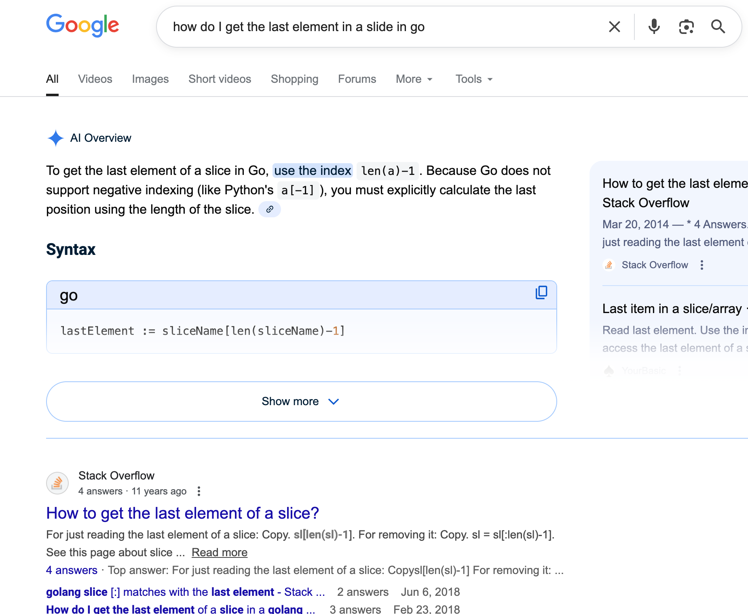
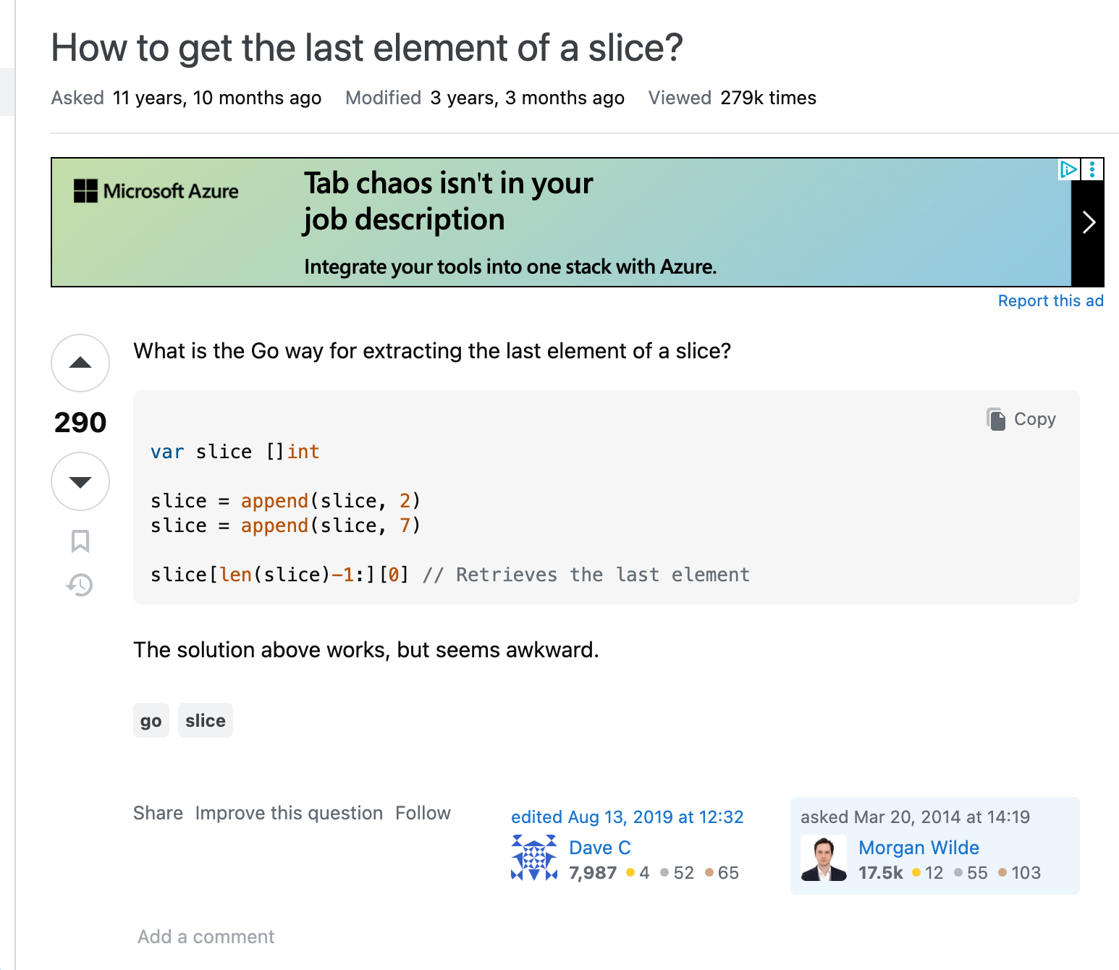
This is encouraged:

Slide 13
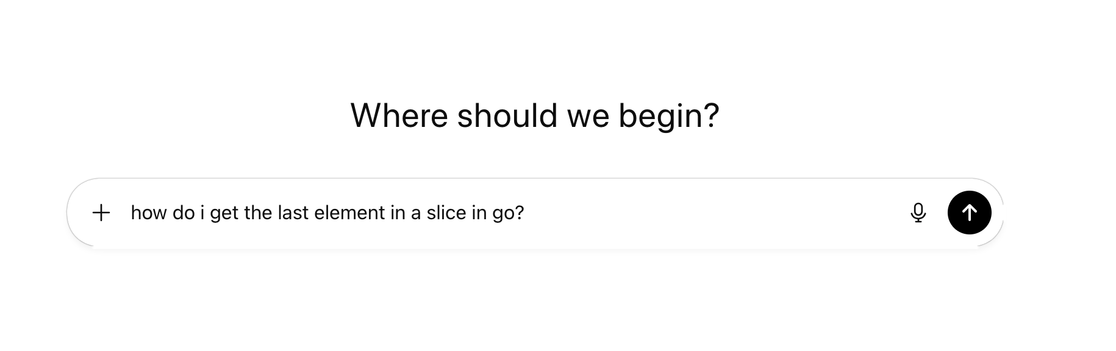
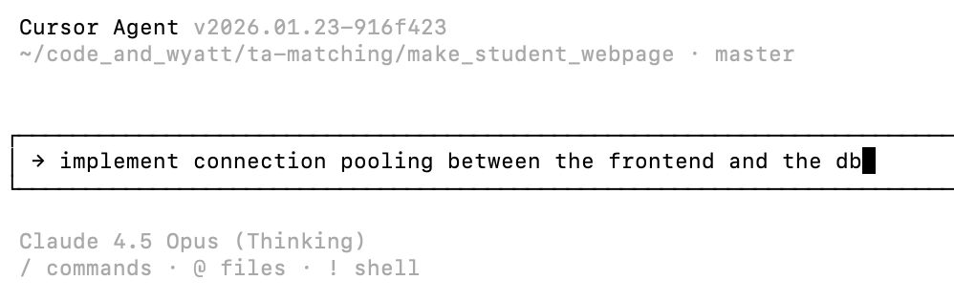
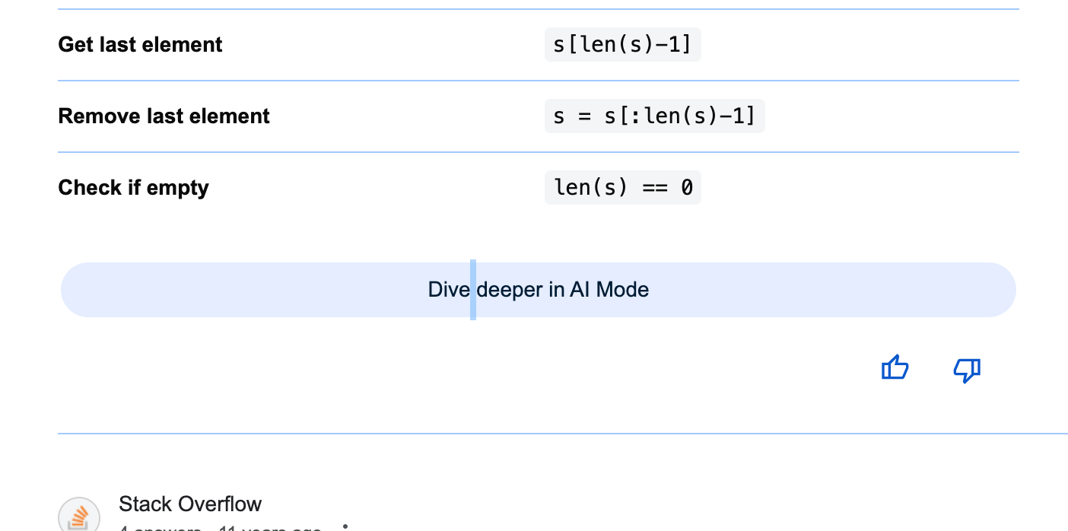
This is not allowed:
Notes:
AI Summaries in search results are a gray area. They are okay, but do not “dive deeper”

Slide 14
Assignments: Collaboration & Resources
https://www.cs.princeton.edu/courses/archive/fall26/cos316/policies.html

Slide 15
Assignment Partners
2 will be with partners
3 will be solo
Notes:
Discuss benefits of both models

Slide 16
Assignments: Submitting and Grading
Submitting happens whenever you "push" to your "master" branch on GitHub
  You can push as many times as you'd like (we encourage you to do so often)
Grading is automatic and immediate
  There is no penalty for multiple submissions. We will use your highest graded submission (push)
  Each automatic grading is posted as a comment to the last commit of each push. It includes a break down of tests cases, including which failed.

Slide 17
Programming Assignment Late Penalties
90% for work submitted up to 24 hours late
80% for work submitted up to 2 days late
70% for work submitted up to 3 days late
60% for work submitted up to 5 days late
50% for work submitted after 5 days late

Slide 18
Programming Assignment Late Days
3 late days total for the semester
  Granularity of 1 day
    1 minute late is 1 day late
    23 hours and 59 minutes late is 1 day late
Assigned retroactively to give you the best possible overall grade
  We do this for you!
Additional late days? No!
  Only w/ involvement of your dean or with a doctor’s note

Slide 19
EdStem
Great place for questions and answers
Use EdStem in lieu of email in almost all cases
  Can send course staff a message using private posts
Post conceptual questions about lecture material or assignments
Not for debugging your code
  Go to office hours to learn how to do that!
Expectations: We will check EdStem and answer questions once a day, on weekdays

Slide 20
Programming Assignment Support
This is a 3xx class: assignments are more challenging and with less direct support
Office hours, office hours, office hours!
TAs will help you learn how to think about and approach solving a problem
They will not debug your code for you
  They are not allowed to touch your laptop!

Slide 21
Exams
Midterm on TBD evening of midterm week
  3 hour “no time pressure” exam
  Midterm review session during week after spring break
    Review OF the midterm not for it
Final on Mon, May 11 07:30 pm - 10:30 pm
  3 hour “no time pressure” exam
  Weakly cumulative (i.e., most questions from 2nd half of course, but some from 1st half)

Slide 22
Grading
50% - Programming Assignments
  5 Assignment, each worth 10%
50% - Exams
  Midterm and final each 25%

Slide 23
Learning Objectives & Course Components
System Design Principles
  Lectures
  Exams
Skills (Practice)
  Precepts
  Programming Assignments
Notes:
Appreciate trade-offs in designing and building systems
Understand how systems work
Understand the general systems stack, how it fits together, and some of how it works

