Slide 1
Peer-to-Peer Systems and Distributed Hash Tables
COS 418: Distributed Systems
Lecture 9
Mike Freedman, Wyatt Lloyd

Slide 2
Today
Peer-to-Peer Systems
Distributed Hash Tables (DHT)
The Chord Lookup Service

Slide 3

Distributed Application Architecture
This lecture
client
Peer
client
Ask for
Nobody.mov
Ask for page
Provide page
Peer
Client
Peer
Provide
Server
Luca.mov
client
www.princeton.edu
Peer
Client-Server
Peer-to-Peer

Slide 4
What is a Peer-to-Peer (P2P) system?
Node
Node
Node
Internet
Node
Node
A distributed system architecture:
  No centralized control
  Nodes are roughly symmetric in function
Large number of unreliable nodes

Slide 5
P2P adoption
Successful adoption in some niche areas
Client-to-client (legal, illegal) file sharing
  Napster (1990s), Gnutella, BitTorrent, etc.
Digital currency: no natural single owner (Bitcoin)
Voice/video telephony: user to user anyway (Skype in old days)
  Issues: Privacy and control

Slide 6
The lookup problem: locate the data
get(“Oppenheimer.mp4”)
N₂
N₃
N₁
N₇
?
Internet
Publisher (N₄)
N₆
put(“Oppenheimer.mp4”, [content])
N₅

Slide 7
Centralized lookup (Napster)
N₂
N₃
N₁
N₇
SetLoc(“Oppenheimer.mp4”, IP address of N₄)
Lookup(“Oppenheimer.mp4”)
DB
Simple, but O(N) state and a single point of failure
Publisher (N₄)
N₆
N₅
key=“Oppenheimer.mp4”, value=[content]

Slide 8
Flooded queries (original Gnutella)
Lookup(“Oppenheimer.mp4”)
N₂
N₃
N₁
N₇
Robust, but O(N = number of peers) messages per lookup
Publisher (N₄)
N₆
N₅
key=“Star Wars.mov”, value=[content]

Slide 9
Tradeoffs in distributed systems
Nearly no state
Many msgs
Gnutella
# msgs
High state
Good performance
Single PoF
Napster
# state

Slide 10
Tradeoffs in distributed systems
Nearly no state
Many msgs
Gnutella
# msgs
High state
Good performance
Single PoF
Ideal
Napster
# state

Slide 11
Tradeoffs in distributed systems
Nearly no state
Many msgs
Gnutella
msgs < Gnutella
state < Napster
DHT
(Chord)
# msgs
High state
Good performance
Single PoF
Napster
# state

Slide 12
What is a DHT (and why)?
Distributed Hash Table: an abstraction of hash table in a distributed setting
  key = hash(data_one)
  lookup(key) → IP addr (Chord lookup service)
  send-RPC(IP address, put, key, data_two)
  send-RPC(IP address, get, key) → data_two
Partitioning data in large-scale distributed systems
  Tuples in a global database engine
  Data blocks in a global file system
  Files in a P2P file-sharing system

Slide 13
Cooperative storage with a DHT
user
user
….
user
upload
download
App
Distributed application
put(key, data)
get (key)
data
Distributed hash table
(DHash)
System
lookup(key)
node IP address
Lookup service
(Chord)
node
node
….
node

Slide 14
DHT is expected to be
Decentralized: no central authority
Scalable: low network traffic overhead
Efficient: find items quickly (latency)
Dynamic: nodes fail, new nodes join

Slide 15
Today
Peer-to-Peer Systems
Distributed Hash Tables (DHT)
The Chord Lookup Service

Slide 16
Chord identifiers
Hashed values (integers) using the same hash function
  Key identifier = SHA-1(key) mod 2^{160}
  Node identifier = SHA-1(IP address) mod 2^{160}
How does Chord partition data?
  i.e., map key IDs to node IDs
Why hash key and address?
  Uniformly distributed in the ID space
  Hashed key → load balancing; hashed address → independent failure

Slide 17
Alternative: mod (n) hashing
System of n nodes: 1…n
  Node that owns key is assigned via hash(key) mod n
  Good load balancing
What if a node fails?
  Instead of n nodes, now n -1 nodes
  Mapping of all keys change, as now hash(key) mod (n-1)
N = 5
  12594 mod 5 = 4
  28527 mod 5 = 2
  816 mod 5 = 1
  716565 mod 5 = 0
N = 4
  12594 mod 4 = 2
  28527 mod 4 = 3
  816 mod 4 = 0
  716565 mod 4 = 1

Slide 18
Consistent hashing [Karger ‘97] – data partition
Identifiers have m = 3 bits
Key space: [0, 2³-1]
0
Identifiers/key space
7
1
Node
3-bit
ID space
6
2
5
3
4

Slide 19
Consistent hashing [Karger ‘97] – data partition
Identifiers have m = 3 bits
Key space: [0, 2³-1]
Stores key 7, 0
0
Stores key 1
Identifiers/key space
7
1
Node
3-bit
ID space
Stores key 6
6
2
5
3
Stores keys 4, 5
Stores keys 2, 3
4
Key is stored at its successor: node with next-higher ID

Slide 20
Consistent hashing [Karger ‘97] – basic lookup
Identifiers have m = 3 bits
Key space: [0, 2³-1]
Stores key 7, 0
0
Stores key 1
Identifiers/key space
7
1
Node 1 has key 1
Node
3-bit
ID space
Stores key 6
6
2
Successor
pointer
5
Key 1 ?
3
Stores keys 4, 5
Stores keys 2, 3
4
Look up key 1
O(N) messages and hops!

Slide 21
Simple lookup algorithm
Lookup(key-id)
succ ← my successor
if my-id < succ < key-id // next hop
call Lookup(key-id) on succ
else // done
return succ
Correctness depends only on successors

Slide 22
Chord – finger tables
Identifiers have m = 3 bits
Key space: [0, 2³-1]
0
Identifiers/key space
7
1
2, [2,3), node 3
3, [3,5), node 3
5, [5,1), node 5
Node
3-bit
ID space
6
2
Each node keeps m states
Key space → m ranges via
(N+2^{k-1}) mod 2^{m}, 1<=k<=m
5
3
Separators
Successors
of separators
4
Key ranges
Example for node N = 1:
1 + 1 => 2
1 + 2 => 3
1 + 4 => 5

Slide 23
Chord – finger tables
Identifiers have m = 3 bits
Key space: [0, 2³-1]
1, [1,2), node 1
2, [2,4), node 3
4, [4,0), node 5
0
Identifiers/key space
7
1
2, [2,3), node 3
3, [3,5), node 3
5, [5,1), node 5
Node
3-bit
ID space
Node 1
6
2
Each node keeps m states
Key space → m ranges via
(N+2^{k-1}) mod 2^{m}, 1<=k<=m
5
3
4
4, [4,5), node 5
5, [5,7), node 5
7, [7,3), node 0
O(logN) messages
and hops!
Look up key 1

Slide 24
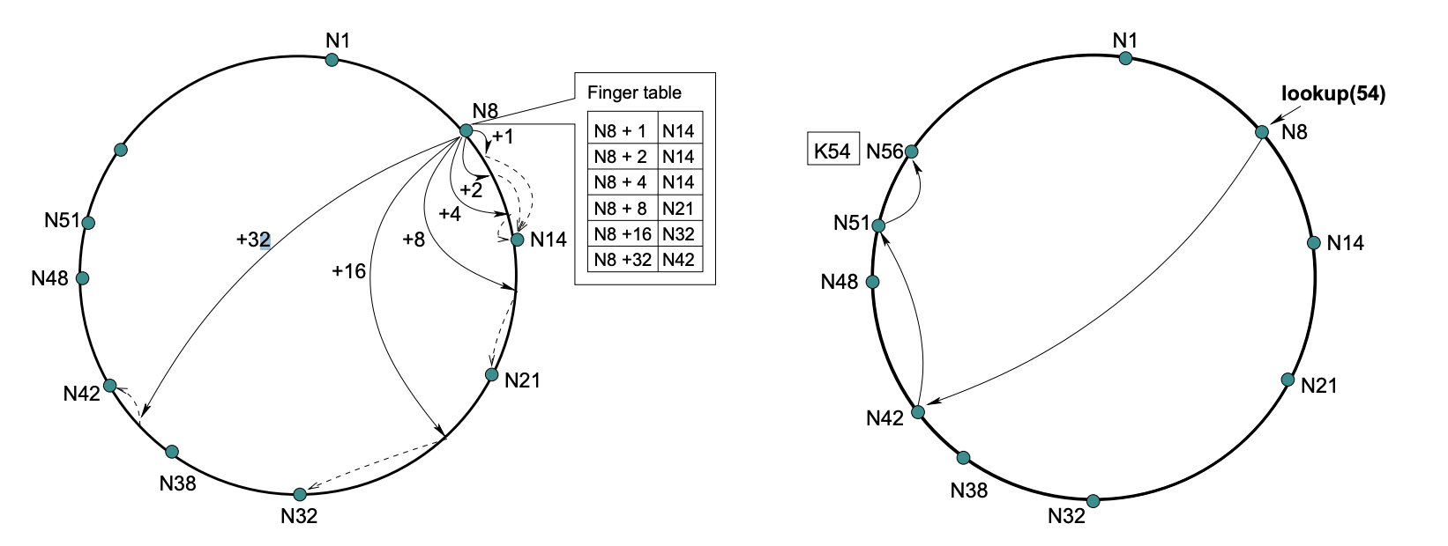
Chord – finger tables
From Chord ToN paper

Slide 25
Lookup with finger table
Lookup(key-id)
look in local finger table for
highest n: my-id < n < key-id
if n exists
call Lookup(key-id) on node n // next hop
else
return my successor // done

Slide 26
Implication of finger tables
A binary lookup tree rooted at every node
  Threaded through other nodes' finger tables
Better than arranging nodes in a single tree
  Every node acts as a root
    So there's no root hotspot
    No single point of failure
    But a lot more state in total

Slide 27
Chord lookup algorithm properties
Interface: lookup(key) → IP address
Efficient: O(log N) messages per lookup
  N is the total number of nodes (peers)
Scalable: O(log N) state per node
Robust: survives massive failures

Slide 28
Chord – Recursive vs. Iterative Lookup
get(key 1)
0
0
7
1
7
1
6
2
6
2
5
3
5
3
4
4
Recursive Lookup
Iterative Lookup

Slide 29
System Dynamics
Handling node joins
Handling node failures
  Rebuilding lookup structures
  Ensure data durability

Slide 30
Chord – finger tables
Identifiers have m = 3 bits
Key space: [0, 2³-1]
1, [1,2), node 1
2, [2,4), node 3
4, [4,0), node 5
0
Identifiers/key space
7
1
2, [2,3), node 3
3, [3,5), node 3
5, [5,1), node 5
Node
3-bit
ID space
6
2
Each node keeps m states
Key space → m ranges via
(N+2^{k-1}) mod 2^{m}, 1<=k<=m
5
3
4
4, [4,5), node 5
5, [5,7), node 5
7, [7,3), node 0
Example for node N = 1:
1 + 1 => 2
1 + 2 => 3
1 + 4 => 5

Slide 31
Chord – node joining
Identifiers have m = 3 bits
Key space: [0, 2³-1]
0
Identifiers/key space
7
1
Lookup id 2
Node
3-bit
ID space
6
2
Node 2 is joining
Node 2 joins by first contacting any known node, e.g., Node 0
5
3
4

Slide 32
Chord – node joining
Identifiers have m = 3 bits
Key space: [0, 2³-1]
0
Your successor = 3
Identifiers/key space
7
1
Node
3-bit
ID space
6
2
Node 2 is joining
5
3
4

Slide 33
Chord – node joining
Identifiers have m = 3 bits
Key space: [0, 2³-1]
0
Your successor = 3
Identifiers/key space
7
1
Node
3-bit
ID space
6
2
Node 2 is joining
5
3
Moves key 2 to node 2
4

Slide 34
Chord – node joining
Identifiers have m = 3 bits
Key space: [0, 2³-1]
Points to successor
0
Points to predecessor
Identifiers/key space
7
1
Node
3-bit
ID space
6
2
Node 2 is joining
5
Periodic stabalization messages
from each node to its successor
maintain node positions
3
4

Slide 35
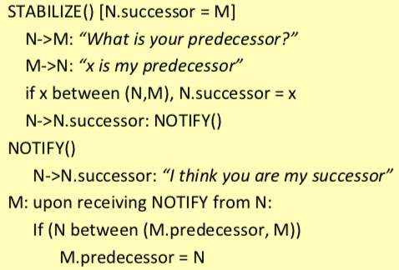
Chord – node joining
Identifiers have m = 3 bits
Key space: [0, 2³-1]
Points to successor
0
Points to predecessor
Identifiers/key space
7
1
Node
3-bit
ID space
6
2
Node 2 is joining
5
3
4
Pseudocode from Rodrigo Fonseca’s lecture notes

Slide 36
Chord – node joining
Identifiers have m = 3 bits
Key space: [0, 2³-1]
Points to successor
0
Points to predecessor
Identifiers/key space
7
1
Node
3-bit
ID space
6
2
Node 2 is joining
5
3
4

Slide 37
Chord – node joining
Identifiers have m = 3 bits
Key space: [0, 2³-1]
Points to successor
0
Points to predecessor
Identifiers/key space
7
1
Node
3-bit
ID space
6
2
Node 2 is joining
5
3
4

Slide 38
Chord – node joining
Identifiers have m = 3 bits
Key space: [0, 2³-1]
Points to successor
0
Points to predecessor
Identifiers/key space
7
1
Node
3-bit
ID space
6
2
Node 2 is joining
5
3
4

Slide 39
Chord – failures and successor list
Identifiers have m = 3 bits
Key space: [0, 2³-1]
1, [1,2), node 1
2, [2,4), node 3
4, [4,0), node 5
0
Identifiers/key space
7
1
2, [2,3), node 3
3, [3,5), node 3
5, [5,1), node 5
Node
3-bit
ID space
6
2
5
3
4
4, [4,5), node 5
5, [5,7), node 5
7, [7,3), node 0
Look up key 1

Slide 40
Chord – failures and successor list
Identifiers have m = 3 bits
Key space: [0, 2³-1]
1, [1,2), node 1
2, [2,4), node 3
4, [4,0), node 5
0
Identifiers/key space
7
1
2, [2,3), node 3
3, [3,5), node 3
5, [5,1), node 5
Node
3-bit
ID space
6
2
5
3
4
4, [4,5), node 5
5, [5,7), node 5
7, [7,3), node 0
Look up key 1

Slide 41
Chord – failures and successor list
Identifiers have m = 3 bits
Key space: [0, 2³-1]
1, [1,2), node 1
2, [2,4), node 3
4, [4,0), node 5
0
Identifiers/key space
7
1
2, [2,3), node 3
3, [3,5), node 3
5, [5,1), node 5
Node
3-bit
ID space
6
2
Points to successor
5
3
4
4, [4,5), node 5
5, [5,7), node 5
7, [7,3), node 0
Look up key 1

Slide 42
Chord – failures and successor list
Identifiers have m = 3 bits
Key space: [0, 2³-1]
1, [1,2), node 1
2, [2,4), node 3
4, [4,0), node 5
0
Identifiers/key space
7
1
2, [2,3), node 3
3, [3,5), node 3
5, [5,1), node 5
Node
3-bit
ID space
6
2
Points to successor
5
3
4
4, [4,5), node 5
5, [5,7), node 5
7, [7,3), node 0
Look up key 1
Succ. of id 7
(Succ. Of node 6)

Slide 43
Chord – failures and successor list
Identifiers have m = 3 bits
Key space: [0, 2³-1]
1, [1,2), node 1
2, [2,4), node 3
4, [4,0), node 5
0
Identifiers/key space
7
1
2, [2,3), node 3
3, [3,5), node 3
5, [5,1), node 5
Node
3-bit
ID space
6
2
Points to successor
5
3
r-nearest successors
(r = logN)
4
4, [4,5), node 5
5, [5,7), node 5
7, [7,3), node 0
Look up key 1
Succ. of id 7
(Succ. Of node 6)

Slide 44
Chord – failures and successor list
Identifiers have m = 3 bits
Key space: [0, 2³-1]
0
Identifiers/key space
7
1
Node
3-bit
ID space
6
2
5
3
r-nearest successors
(r = logN)
4
4, [4,5), node 5
5, [5,7), node 5
7, [7,3), node 0
What if look up key 7?

Slide 45
Chord – failures and successor list
Identifiers have m = 3 bits
Key space: [0, 2³-1]
0
Identifiers/key space
7
1
Node
3-bit
ID space
6
2
5
3
r-nearest successors
(r = logN)
4
4, [4,5), node 5
5, [5,7), node 5
7, [7,3), node 1
What if look up key 7?

Slide 46
DHash replicates data blocks at r successors
Identifiers have m = 3 bits
Key space: [0, 2³-1]
Key 7
0
Key 7
Identifiers/key space
7
1
Node
3-bit
ID space
“Adjacent” nodes in the ring may be far away in the network
→ Independent failures
6
2
5
3
r-nearest successors
(r = logN)
4
Get data under key 7

Slide 47
Today
Peer-to-Peer Systems
Distributed Hash Tables
The Chord Lookup Service
Concluding thoughts on DHT, P2P

Slide 48
Why don’t all services use P2P?
High latency and limited bandwidth between peers (vs. intra/inter-datacenter, client-server model)
  1 M nodes = 20 hops; 50 ms / hop gives 1 sec lookup latency (assuming no failures / slow connections…)
User computers are less reliable than managed servers
Lack of trust in peers’ correct behavior
  Securing DHT routing hard, unsolved in practice

Slide 49
DHTs in retrospective
Seem promising for finding data in large P2P systems
Decentralization seems good for load, fault tolerance
But: the security problems are difficult
But: churn is a problem, particularly if log(n) is big
DHTs have not had the hoped-for impact

Slide 50
What DHTs got right
Consistent hashing
  Elegant way to divide a workload across machines
  Very useful in clusters: actively used today in Amazon Dynamo and other systems
Replication for high availability, efficient recovery
Incremental scalability
  Peers join with capacity, CPU, network, etc.
Self-management: minimal configuration

