Slide 1
Dynamo / Bayou
Feb 23rd & 24th, 2022
[Adapted from Andrew Or’s]
Notes:
Notes to future preceptors:
There’s a lot of material to cover in this precept—all three of us more or less rushed through the slides. Should you find yourself short on time, we would suggest keeping mind what was already extensively covered in class and opt to focus instead on what wasn’t.
The preceptors got some questions on concepts that we surprisingly found intuitive. For example: the math behind the majorities and quorums, virtual nodes vs. physical nodes, Dynamo handling reconciliation (it passes to the client, but I guess the paper’s diagram doesn’t really make that clear for a beginner).

Slide 2
Some context...
Dynamo and Bayou both offer high availability and weak consistency
Most traditional databases offer strong consistency and low availability
Not suitable for modern applications with super high demands
What are some example applications of each?
Flight ticket booking (HA)
Amazon shopping carts (HA)
Offline edits (HA)
Billing services (SC)
Bank accounts (SC)

Slide 3

Availability is important
Tens of millions of customers at peak times
Tens of millions of shopping cart requests, 3 million checkouts per day
Hundreds of thousands of concurrently active sessions
Strict Service-Level Agreements (SLAs) translate to business value

Slide 4
Dynamo
Fully decentralized, highly available key-value store
Always writeable, resolve conflicts during reads --- Eventual Consistency
API for clients to specify requirements (99.9th percentile)
Departure from RDBMS: simpler functionality, fewer guarantees, runs on commodity hardware (low-end, broadly compatible, non-specialized machines)
(Read the original paper, especially Section 4)
Notes:
SLA in terms of latency
NOTE: availability in this context does not simply mean we should always return success to the client. It also means we need to do it within a certain time bound (like 300ms) 99.9% of the time.

Slide 5
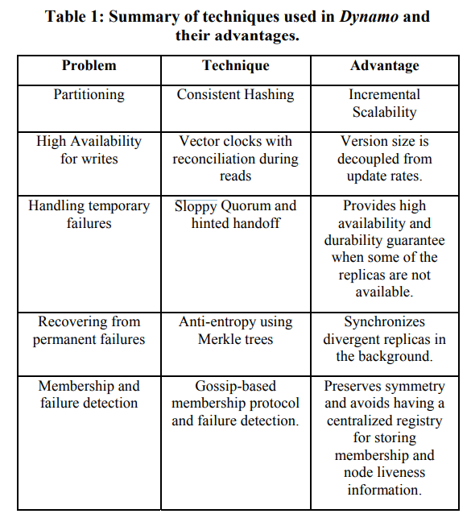
Techniques for achieving availability
Consistent hashing for partitioning key space
Vector clocks for reconciling conflicts during reads
Sloppy quorums for handling temporary failures
Anti-entropy using Merkle trees for syncing key-value pairs
Gossip-based protocol for membership notifications

Slide 6
Techniques for achieving availability
Consistent hashing for partitioning key space
Vector clocks for reconciling conflicts during reads
Sloppy quorums for handling temporary failures
Anti-entropy using Merkle trees for syncing key-value pairs
Gossip-based protocol for membership notifications

Slide 7
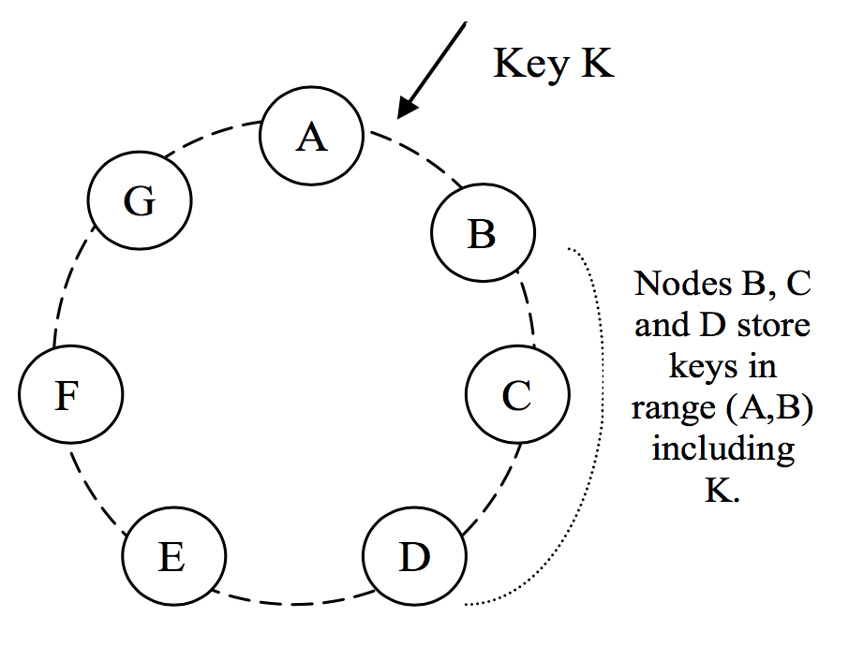
Consistent Hashing
Virtual Nodes
Assign each node a random position on the ring
Node owns the preceding key range
For fault tolerance, replicate each key at N successor nodes in the ring
Virtual nodes: each physical node gets assigned multiple nodes on the ring (e.g. B, D, F)
Notes:
“consistent” here has NOTHING to do with the “consistency” we talked about earlier.
The picture on the right: these are virtual nodes, NOT physical nodes.
What’s the purpose of the virtual nodes?
(From the paper)
If a node becomes unavailable (due to failures or routine maintenance), the load handled by this node is evenly dispersed across the remaining available nodes.
When a node becomes available again, or a new node is added to the system, the newly available node accepts a roughly equivalent amount of load from each of the other available nodes.
The number of virtual nodes that a node is responsible can decided based on its capacity, accounting for heterogeneity in the physical infrastructure.
(TL;DR virtual nodes help you achieve more uniform distribution of load across physical nodes)
Note that virtual nodes has NOTHING to do with replication. That is done by walking the circle clockwise from the key and picking the first N unique nodes.

Slide 8
Consistent Hashing
Desirable properties?
Uniform distribution of load
Minimum object movements when nodes join or leave the ring
Number of virtual nodes can be adjusted for device heterogeneity
Notes:
Primary advantage of consistent hashing:
purely distributed, no centralized lookup
no single point of failure
no extra hop to do lookup
hashing gives uniform distribution in general
nodes joining or leaving the system only affect immediate neighbors
Remember our original goal is to design a system that has high availability. How does this provide that?
Uniform distribution of load helps with load balancing
No overloaded server —> no unavailable server
Zero hop DHT: all nodes know exactly what nodes are responsible for which key range
The zero hop part really helps with latency SLAs

Slide 9
Techniques for achieving availability
Consistent hashing for partitioning key space
Vector clocks for reconciling conflicts during reads
Sloppy quorums for handling temporary failures
Anti-entropy using Merkle trees for syncing key-value pairs
Gossip-based protocol for membership notifications

Slide 10
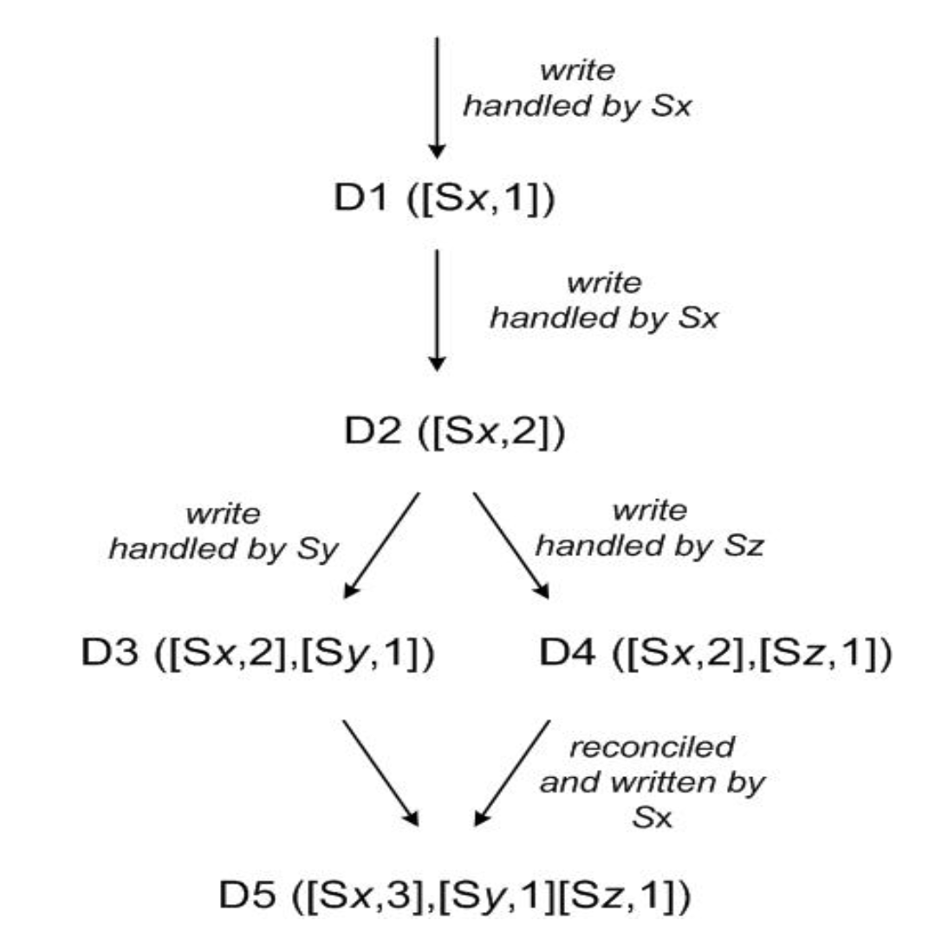
Conflict resolution
Two machines write different values to the same key
Vector clocks: list of (node, count) pairs where count is incremented on write
If one vector clock subsumes another, discard older value
Else, return all conflicting values to client
Notes:
we're only tracking causal dependencies between updates to a single object item, NOT across all items in key-value store.

Slide 11
Context contains vector clocks
Dynamo client API is simple:
get(key) (value, context)
put(key, value, context)
Common pattern: put after get

Slide 12
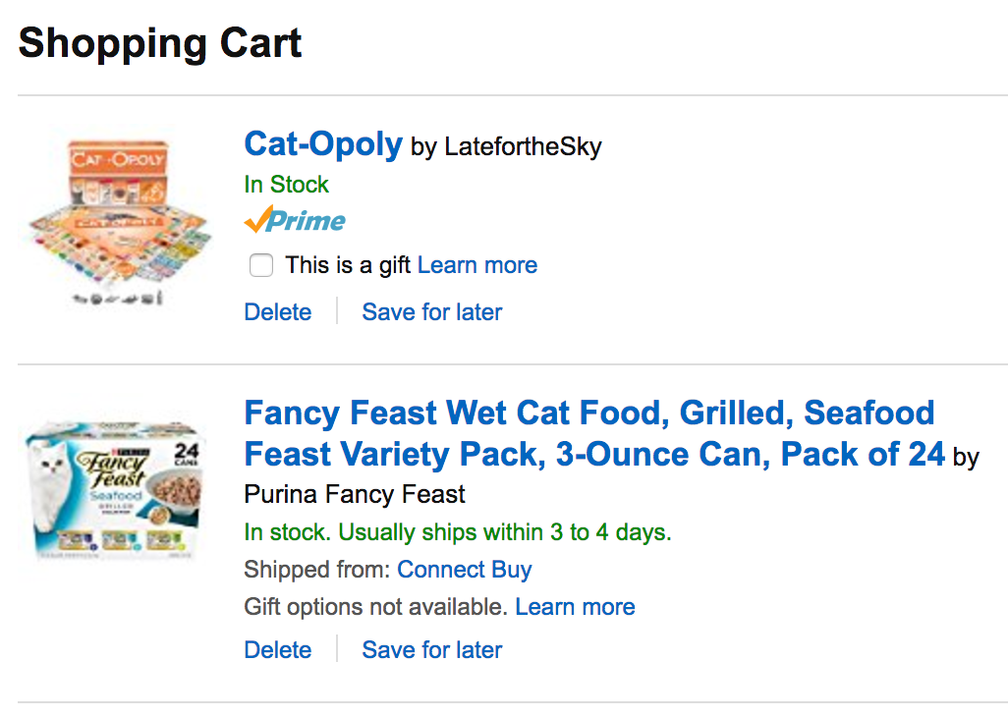



Slide 13

DELETE
Notes:
This kind of conflict resolution is highly specific to the application. In fact, this has some potential unexpected results: deleted items can resurface if we’re just taking the union of the shopping carts. This may be acceptable in some applications but not others. In our case, it’s OK because amazon has a ton of confirmation steps before the user actually buys the things. Also he can cancel at any time.

Slide 14
Conflict resolution
Two machines write different values to the same key
Vector clocks: list of (node, count) pairs where count is incremented on write
If one vector clock subsumes another, discard older value
Else, return all conflicting values to client
Notes:
QUESTION: How is this related to availability?
Writes are now always available, because you don’t check for consistency before writing. You just write
Leave conflict resolution to the reads. This happens so little of the time the extra overhead doesn’t really contribute to the latency even in the 99.9th percentile case.

Slide 15
Techniques for achieving availability
Consistent hashing for partitioning key space
Vector clocks for reconciling conflicts during reads
Sloppy quorums for handling temporary failures
Anti-entropy using Merkle trees for syncing key-value pairs
Gossip-based protocol for membership notifications

Slide 16
Sloppy Quorums
Write to N nodes, return success when W < N nodes respond
Read from N nodes, return value(s) from R < N nodes
Typically, W+R > N means at least one writer and one reader overlap, so values are consistent
Sloppy here means skip nodes that have failed, such that even if W+R > N, the readers and writers may not overlap = not consistent!

Slide 17
Sloppy Quorums
Example:
Typical values are N = 3, W = R = 2
Nodes C and D have failed, so key k is written to E and F instead
Nodes C and D recover, and now client tries to read from C and D = stale value

Slide 18
Hinted Handoff
“Hint” refers to the node the data originally belongs to
Example:
Nodes E and F remember they are writing on behalf of C and D
As soon as C and D recovers, E and F transfer their values for k to C and D
Notes:
Dynamo does this using “hinted handoff”, where the hint refers to the location information of the original data. So hinted handoff is really part of making sloppy quorums work.

Slide 19
Sloppy Quorums
Write to N nodes, return success when W < N nodes respond
Read from N nodes, return value(s) from R < N nodes
Typically, W+R > N means at least one writer and one reader overlap, so values are consistent
Sloppy here means skip nodes that have failed, such that even if W+R > N, the readers and writers may not overlap = not consistent!
Notes:
We saw that sloppy quorums sacrifice consistency when things fail. How does this help with availability?
If we always try to ensure readers and writers overlap, then if enough things fail we might end up waiting for the nodes to come back up. This may take a long time = in the meantime the system is not available.
If we always just pick from N healthy nodes, then we’ll return ASAP without waiting for any failed nodes to come back up

Slide 20
Techniques for achieving availability
Consistent hashing for partitioning key space
Vector clocks for reconciling conflicts during reads
Sloppy quorums for handling temporary failures
Anti-entropy using Merkle trees for syncing key-value pairs
Gossip-based protocol for membership notifications

Slide 21
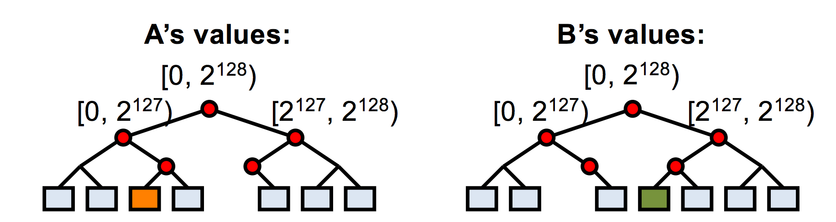
Anti-entropy using Merkle trees
Goal: minimize durability loss from above techniques
Nodes responsible for the same key spaces exchange Merkle trees
Find differences quickly while exchanging little information
Notes:
Anti-entropy means reducing differences between the state stored across the replica nodes (remember we replicate the same partition to N different nodes in the ring).
Dynamo uses this special data structure called Merkle trees. Each leaf node corresponds to an actual key value pair, and all other nodes are hashes of its children.
When exchanging information in an anti-entropy session, nodes start at the root and exchange only the hash in the root. If the hash matches, great, the two nodes agree and the session terminates. Otherwise, the two nodes keep traversing down the tree until they find the value that doesn’t match. In this case the orange and green values are at odds. So A and B will exchange orange and green to each other such that the root hashes become the same.
NOTE: Only leaf nodes correspond to actual key value pairs. The tree itself stores the hashes of the values. Why not just store the hash of the key? (Because values might get updated for the same key, in which case we want the change to be reflected on both nodes).
How does this provide availability?
It doesn’t, really (at least not directly)
It just helps with eventual consistency, which is a level of consistency that can be achieved in a highly available system

Slide 22
Techniques for achieving availability
Consistent hashing for partitioning key space
Vector clocks for reconciling conflicts during reads
Sloppy quorums for handling temporary failures
Anti-entropy using Merkle trees for syncing key-value pairs
Gossip-based protocol for membership notifications

Slide 23
Membership notification
Gossip-based protocol to propagate membership changes
Each node learns the key spaces handled by all other nodes
Result: zero-hop distributed hash table (DHT)
Clearly not infinitely scalable, but storage requirement not a problem in practice
Notes:
In practice the storage requirement has been pretty OK because it only scales with the number of nodes and partitions, NOT the number of key value pairs (which would be prohibitive). As long as you keep your dynamo deployment small enough (fewer nodes, like 10s or 100s) then you should be fine.

Slide 24
Bayou
What is it?
Weakly consistent, replicated storage system
Goals:
Maximize availability, support offline collaboration
Minimize network communication
Agree on all values (eventually)
Notes:
Also tries to achieve availability, but one big difference between bayou and dynamo is that bayou also additionally makes supporting offline collaboration one of its main goals

Slide 25
Bayou Writes
Primary
Versions
P: 0
A: 0
B: 0
W(X, 4)
Client 1
Legend
Commit Timestamp:Write Timestamp:Write Server
A
Versions
B
Versions
P: 0
A: 0
B: 0
P: 0
A: 0
B: 0

Slide 26
Bayou Writes
Primary
Versions
∞:1:P W(X,4)
P: 1
A: 0
B: 0
Client 1
Legend
Commit Timestamp:Write Timestamp:Write Server
A
Versions
B
Versions
P: 0
A: 0
B: 0
P: 0
A: 0
B: 0
Notes:
EXPLAIN THE COLON SYNTAX (Commit timestamp:write timestamp:write server) Commit timestamp is infinity if tentative write.

Slide 27
Bayou Writes
Primary
Versions
∞:1:P W(X,4)
P: 1
A: 0
B: 0
Client 1
W(Y, 8)
Legend
Commit Timestamp:Write Timestamp:Write Server
Client 2
A
B
Versions
Versions
W(X, 3)
P: 0
A: 0
B: 0
P: 0
A: 0
B: 0

Slide 28
Bayou Writes
Primary
Versions
∞:1:P W(X,4)
∞:7:P W(Y,8)
P: 7
A: 0
B: 0
Client 1
W(Z, 8)
Legend
Commit Timestamp:Write Timestamp:Write Server
Client 2
A
B
W(Y, 4)
Versions
Versions
∞:7:A W(X,3)
P: 0
A: 7
B: 0
P: 0
A: 0
B: 0

Slide 29
Bayou Writes
Primary
Versions
∞:1:P W(X,4)
∞:7:P W(Y,8)
P: 7
A: 0
B: 0
Legend
Commit Timestamp:Write Timestamp:Write Server
A
Versions
B
Versions
∞:7:A W(X,3)
∞:12:A W(Y,4)
P: 0
A: 12
B: 0
∞:5:B W(Z,8)
P: 0
A: 0
B: 5

Slide 30
Bayou Anti-Entropy
P
Versions
∞:1:P W(X,4)
∞:7:P W(Y,8)
P: 7
A: 0
B: 0
Anti-Entropy Session
A & B
A
Versions
B
Versions
P: 0
A: 0
B: 5
∞:5:B W(Z,8)
∞:7:A W(X,3)
∞:12:A W(Y,4)
P: 0
A: 12
B: 0
∞:5:B W(Z,8)
P: 0
A: 0
B: 5
P: 0
A: 12
B: 0
∞:7:A W(X,3)
∞:12:A W(Y,4)

Slide 31
Bayou Anti-Entropy
P
Versions
∞:1:P W(X,4)
∞:7:P W(Y,8)
P: 7
A: 0
B: 0
A
Versions
B
Versions
∞:5:B W(Z,8)
∞:7:A W(X,3)
∞:12:A W(Y,4)
P: 0
A: 12
B: 5
∞:5:B W(Z,8)
∞:7:A W(X,3)
∞:12:A W(Y,4)
P: 0
A: 12
B: 5

Slide 32
Bayou Commit
P
Versions
1:1:P W(X,4)
2:7:P W(Y,8)
P: 7
A: 0
B: 0
Primary commits its entries
A
Versions
B
Versions
∞:5:B W(Z,8)
∞:7:A W(X,3)
∞:12:A W(Y,4)
P: 0
A: 12
B: 5
∞:5:B W(Z,8)
∞:7:A W(X,3)
∞:12:A W(Y,4)
P: 0
A: 12
B: 5

Slide 33
Bayou Write
P
Versions
1:1:P W(X,4)
2:7:P W(Y,8)
P: 7
A: 0
B: 0
Write after anti-entropy session
Write timestamp = max(clock, max(TS)+1)
Client 1
D(Y)
A
Versions
B
Versions
∞:5:B W(Z,8)
∞:7:A W(X,3)
∞:12:A W(Y,4)
P: 0
A: 12
B: 5
∞:5:B W(Z,8)
∞:7:A W(X,3)
∞:12:A W(Y,4)
∞:13:B D(Y)
P: 0
A: 12
B: 13
Notes:
D(Y) == delete(Y)

Slide 34
Bayou Anti-Entropy
P
Versions
1:1:P W(X,4)
2:7:P W(Y,8)
P: 7
A: 0
B: 0
Anti-Entropy Session
P & B
P: 0
A: 12
B: 13
∞:5:B W(Z,8)
∞:7:A W(X,3)
∞:12:A W(Y,4)
∞:13:B D(Y)
A
Versions
B
Versions
1:1:P W(X,4)
2:7:P W(Y,8)
∞:5:B W(Z,8)
∞:7:A W(X,3)
∞:12:A W(Y,4)
P: 0
A: 12
B: 5
∞:5:B W(Z,8)
∞:7:A W(X,3)
∞:12:A W(Y,4)
∞:13:B D(Y)
P: 0
A: 12
B: 13
P: 7
A: 0
B: 0

Slide 35
Bayou Anti-Entropy
P
Versions
1:1:P W(X,4)
2:7:P W(Y,8)
∞:5:B W(Z,8)
∞:7:A W(X,3)
∞:12:A W(Y,4)
∞:13:B D(Y)
P: 7
A: 12
B: 13
Anti-Entropy Session
P & B
Primary respects causality
A
Versions
B
Versions
∞:5:B W(Z,8)
∞:7:A W(X,3)
∞:12:A W(Y,4)
P: 0
A: 12
B: 5
1:1:P W(X,4)
2:7:P W(Y,8)
∞:5:B W(Z,8)
∞:7:A W(X,3)
∞:12:A W(Y,4)
∞:13:B D(Y)
P: 7
A: 12
B: 13
Notes:
Since the Primary begins its log at 1 and each commit timestamp is incremented by 1 B knows that it’s tentative write will be committed after those writes with commit timestamps 1 and 2.

Slide 36
Bayou Commit
P
Versions
1:1:P W(X,4)
2:7:P W(Y,8)
3:5:B W(Z,8)
4:7:A W(X,3)
5:12:A W(Y,4)
6:13:B D(Y)
P: 7
A: 12
B: 13
Primary commits Its entries
A
Versions
B
Versions
∞:5:B W(Z,8)
∞:7:A W(X,3)
∞:12:A W(Y,4)
P: 0
A: 12
B: 5
1:1:P W(X,4)
2:7:P W(Y,8)
∞:5:B W(Z,8)
∞:7:A W(X,3)
∞:12:A W(Y,4)
∞:13:B D(Y)
P: 7
A: 12
B: 13

Slide 37
Bayou
P
Versions
1:1:P W(X,4)
2:7:P W(Y,8)
3:5:B W(Z,8)
4:7:A W(X,3)
5:12:A W(Y,4)
6:13:B D(Y)
P: 7
A: 12
B: 13
After a number of commits
and anti-entropy sessions
(without further writes)
A
Versions
B
Versions
1:1:P W(X,4)
2:7:P W(Y,8)
3:5:B W(Z,8)
4:7:A W(X,3)
5:12:A W(Y,4)
6:13:B D(Y)
P: 7
A: 12
B: 13
1:1:P W(X,4)
2:7:P W(Y,8)
3:5:B W(Z,8)
4:7:A W(X,3)
5:12:A W(Y,4)
6:13:B D(Y)
P: 7
A: 12
B: 13

Slide 38
Bayou and Dynamo similarities
Anti-entropy to achieve eventual consistency
Exchange vector clocks to determine order of operations
Expose conflict resolution to application
High availability!
Notes:
Also tries to achieve availability, but one big difference between bayou and dynamo is that bayou also additionally makes supporting offline collaboration one of its main goals

