Slide 1
Wrap Up
COS 418: Distributed Systems
Lecture 24
Mike Freedman

Slide 2
Back in Lecture 1…

Slide 3
Distributed Systems, Why?
Or, why not 1 computer to rule them all?
Failure => Fault Tolerance
Limited computation/storage => Scalability
Physical location => Availability, Low Latency
Notes:
Q: Fault Tolerance Strategies
A: Replicate in time, e.g., try it again like with worker failure in MapReduce
A: Replicate in space, e.g., Raft
Q: Scaling computation/storage/…
A: Have different machines do different work at the same time (MapReduce) for computation
A: Have different machines store different data, w/ sharding, for storage
Q: Physical location
A: Have multiple replicas of data, close to people -> faster, will be available even if offline or network partition

Slide 4
Distributed Systems Goal
Service with higher-level abstractions/interface
e.g., database, programming model, …
Hide complexity - Do “heavy lifting” so app developer doesn’t need to
Reliable (fault-tolerant)
Scalable (scale-out)
Strong guarantees (consistency and transactions)
Efficiently
Lower latency (faster interactions, e.g., page load)
Higher throughput (fewer machines)

Slide 5
What We Learned
(Much of it at least, at a very high level)

Slide 6
Network communication
How can multiple computers communicate?
Networking stack solves this for us!
We use it to build distributed systems, relying on the guarantees it provides.

Slide 7
Remote Procedure Calls
Additional layer on top of networking stack
At least once – dealing with failures!
At most once – ensuring correctness despite concurrency and failures

Slide 8
Time, logical clocks
Concurrency!
Wall-clock time often inadequate for distributed systems
Lamport clocks: A → B => LC(A) < LC(B)
Vector clocks: A → B <=> VC(A) < VC(B)

Slide 9
Eventual Consistency, Bayou
Favor availability above all else
e.g., disconnected dropbox operation
Eventual consistency
Bayou system design
Operation log (logical, not physical, replication)
Causal consistency from log propagation and lamport timestamps

Slide 10
P2P Systems & DHTs
Efficiency of various designs
Goal: scale lookup state, lookup computation, storage; fault tolerant
Scale lookup state, lookup computation w/ Chord
Scale storage with sharding
Fault tolerance through replication, robust protocols
Notes:
How do you build systems that continue to work and scale despite failure?

Slide 11
Dynamo
Favor availability above all + scalable storage
Eventual consistency (really eventual)
Zero-hop DHT on top of data sharded with consistent hashing
Virtual nodes enable better load balancing (improves throughput), but design to still ensure fault tolerance
Notes:
How do you build systems that continue to work and scale despite failure?

Slide 12
So far…
Can build systems that are fault tolerant, scalable, provide low latency, highly available
But…
Weak guarantees

Slide 13
 | Fault Tolerant | Scalable | Highly Available & Low Latency | Guarantees
Bayou | yes | no | yes | causal
Dynamo | yes | yes | yes | eventual

Slide 14
Strong Guarantees + Fault Tolerance
Linearizability: acts just like 1 machine processing requests 1 at a time!
Replicated state machines:
Log of operations, execute in order
Primary-backup (and VM-FT)
Special mechanism for failure detection
React to failure
Paxos, RAFT
Built in failure detection using quorums (f+1 out of 2f+1)
Mask non-leader failure

Slide 15
 | Fault Tolerant | Scalable | Highly Available & Low Latency | Guarantees
Bayou | yes | no | yes | causal
Dynamo | yes | yes | yes | eventual
Paxos/RAFT | yes | no | no | linearizability

Slide 16
Impossibility Results Guide Us
CAP: Must choose either availability of all replicas or consistency between replicas
PRAM: Must choose either low latency of operations or consistency between replicas

Slide 17
Availability + Low Latency + Scalability + Stronger Guarantees
COPS provides causal consistency
Stronger guarantees impossible w/ low latency
Like a scalable Bayou
Sharding to scale storage within a datacenter
Geo-replicate data across datacenters
Replication and sharding!
New protocols for replicating writes between replicas and reading data
Distributed protocols w/ work on only some machines in each replica for scalability
Consistently reading data across shards required transactions

Slide 18
 | Fault Tolerant | Scalable | Highly Available & Low Latency | Guarantees
Bayou | yes | no | yes | causal
Dynamo | yes | yes | yes | eventual
Paxos/RAFT | yes | no | no | linearizability
COPS | yes | yes | yes | causal & read-only txns

Slide 19
Strong Guarantees + Scalability
Strict Serializability: acts just like 1 machine processing requests 1 at a time with transactions across shards
Atomic Commit w/ 2PC
Concurrency control
1 Big Lock: No concurrency ☹
2PL: Growing phase then shrinking phase
OCC: Assume you will succeed, only acquire locks during 2PC

Slide 20
 | Fault Tolerant | Scalable | Highly Available & Low Latency | Guarantees
Bayou | yes | no | yes | causal
Dynamo | yes | yes | yes | eventual
Paxos/RAFT | yes | no | no | linearizability
COPS | yes | yes | yes | causal & read-only txns
2PL | no | yes | - | strict serializability

Slide 21
Strong Guarantees + Scalability + Fault Tolerance
Google’s Spanner
Sharding to scale storage
Paxos for fault tolerance
2PL + 2PC for read-write transactions: Stick serializability, scalable processing (mostly)
So many reads, make read-only txns efficient!
Strictly serializable read-only transactions that block, but do not acquire any locks
Stale read-only transactions that do not even block
Enabled by TrueTime
TrueTime gives bounded wall-clock time interval
Commit wait ensures a transaction completes after its wall-clock commit time

Slide 22
 | Fault Tolerant | Scalable | Highly Available & Low Latency | Guarantees
Bayou | yes | no | yes | causal
Dynamo | yes | yes | yes | eventual
Paxos/RAFT | yes | no | no | linearizability
COPS | yes | yes | yes | causal & read-only txns
2PL | no | yes | - | strict serializability
Spanner (stale-read) | yes | yes | no (yes) | strict serializability (stale)

Slide 23
Strong Guarantees + Scalability + Low Latency?
SNOW is impossible for read-only transactions
Must choose strongest guarantees (Strict Serializability & Write transactions) OR lowest latency (Non-blocking & One Round)
PRAM / CAP are for replication
SNOW / NOCS is for sharding

Slide 24
Now You Can!
Build systems that are fault tolerant, scalable, provide low latency, highly available
+ stronger guarantees, but not the strongest
OR
Build systems that are fault tolerant, scalable, and provide the strongest guarantees

Slide 25
Let’s See It In Action

Slide 26
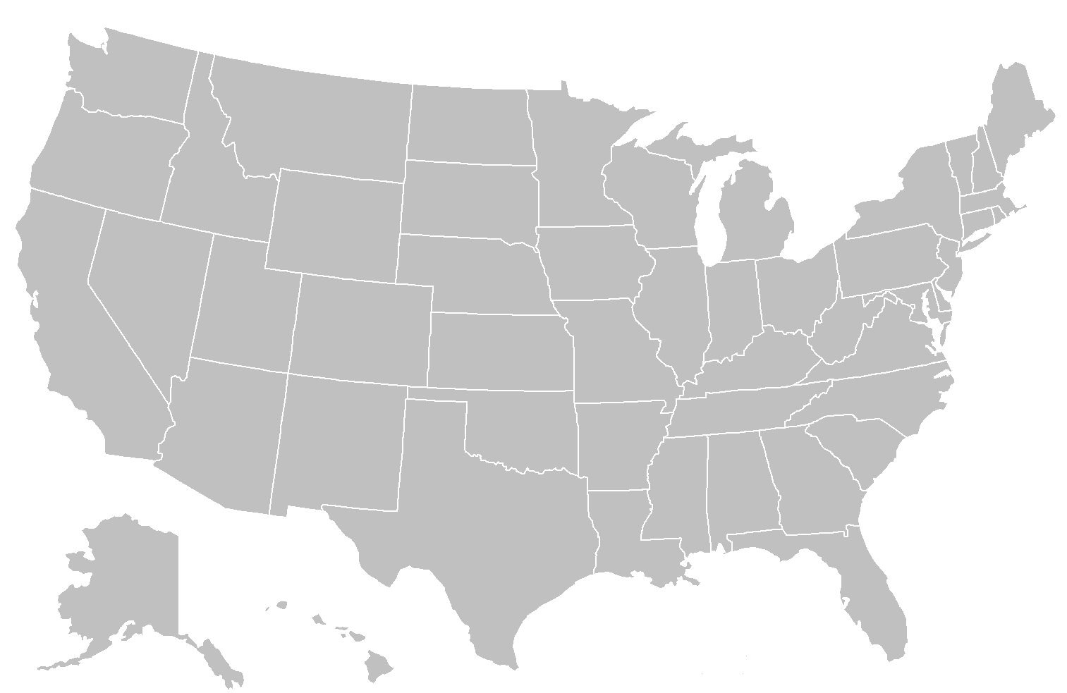
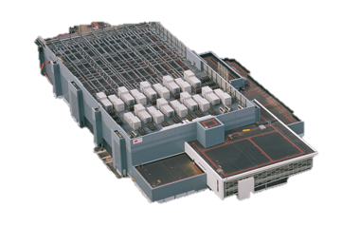
Client → Frontend Server
Notes:
How is this mapping done? Very similar to CDN location load balancing discussion in the last class!

Slide 27
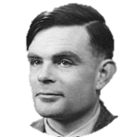
Inside the Datacenter
Web Tier
Storage Tier
Fault Tolerance?
Fault Tolerance?
Scalability?
Scalability?
A-F
G-L
Executes frontend, application code
Stores state, provides …
M-R
S-Z
Notes:
TODO: Switch to world background

Slide 28
App Code Reads/Writes to Storage Tier
Facebook page load has 1000s of reads, chains of sequential reads dozens long [HotOS ‘15]
Application code
Storage
Request
Page

Slide 29
Scalable Storage is Sharded and Geo-Replicated
A-F
G-L
M-R
A-F
S-Z
G-L
M-R
A-F
G-L
S-Z
M-R
S-Z

Slide 30
So Much Concurrency!
A-F
G-L
M-R
A-F
S-Z
G-L
M-R
A-F
G-L
S-Z
M-R
S-Z

Slide 31
So Many Failures!
A-F
G-L
M-R
A-F
S-Z
G-L
M-R
A-F
G-L
S-Z
M-R
S-Z

Slide 32
Not Just One Backend System
[Diagram from Kaushik Veeraraghavan’s OSDI ‘16 Talk]

Slide 33
Each Backend System is a Distributed System
But with different tradeoffs and designs depending on use
LIKE count?
Eventually consistent storage system
User Password?
Strongly consistent storage system

Slide 34
Each Backend System is a Distributed System
Search results
Use precomputed index, precomputed with MapReduce, or a more efficient, specialized system
Trending hashtags
Use a stream processing system to continuously update computation about what is most popular

Slide 35
Distributed Systems on Distributed Systems on …
[Diagram from Malte Schwarzkopf PhD Thesis 2015]
Notes:
Separate out different levels of functionality so they can be reused across systems/applications and optimized

Slide 36
Thanks!

