Slide 1
Distributed Systems for Content Delivery
Mike Freedman
Lecture 21
COS 418: Distributed Systems

Slide 2
Problem Space
Many clients accessing web content
Approach #1: Scale-out web architectures
Use many independent instances of stateless web servers
Scale-out storage backends via sharding
Approach #2: Replicate and cache data closer to users
Much web content is immutable and/or can be slightly stale

Slide 3
Modern Web Architectures
Stateful
Storage Service
Greater fault tolerance
Replication Dimension
A-F
A-F
A-F
Sharding Dimension
G-L
G-L
G-L
M-R
M-R
M-R
Greater scale
System capacity =
Σ individual capacities
S-Z
S-Z
S-Z

Slide 4
Modern Web Architectures
Stateless
Routing Layer
Soft-state
Caching
Layer
Stateful
Storage Service
A-F
A-F
A-F
G-L
G-L
G-L
M-R
M-R
M-R
S-Z
S-Z
S-Z

Slide 5
Modern Web Architectures
Stateless
Routing Layer
Soft-state
Caching
Layer
Stateful
Storage Service
A-F
A-F
A-F
G-L
G-L
G-L
M-R
M-R
M-R
S-Z
S-Z
S-Z

Slide 6
Modern Web Architectures
Stateless
Routing Layer
Soft-state
Caching
Layer
Stateful
Storage Service
A-F
A-F
A-F
G-L
G-L
G-L
M-R
M-R
M-R
A-I
S-Z
S-Z
S-Z
J-P
Q-Z
Caches can also be sharded

Slide 7
Types of State
Soft state – State (information/data) which is used for efficiency, but is not essential for proper operation
Soft state can often be regenerated or replaced if needed
E.g., data caching is example of soft state used for performance improvement: If lost, cached data can be refetched from slower, more durable storage
Hard State – State which is necessary for correctness
To date, most of our discussions in class have focused on hard state
Term introduced by David D. Clark (one of “designers” of Internet): “The design philosophy of the DARPA internet protocols.” SIGCOMM, 1988. http://ccr.sigcomm.org/archive/1995/jan95/ccr-9501-clark.pdf

Slide 8
Sharded vs. Non-Sharded Caching
Pros for sharding
Greater cache capacity (Σ individual capacities)
Adding servers increases both cache capacity and query throughput (although non-sharded can also scale query throughput)
Cons for sharding
Clients need to maintain semi-accurate cache mappings, rather than just random / round-robin selection
Elasticity (adding/removing nodes) more complex, either requiring active moving content or cache misses during passive rebalancing

Slide 9
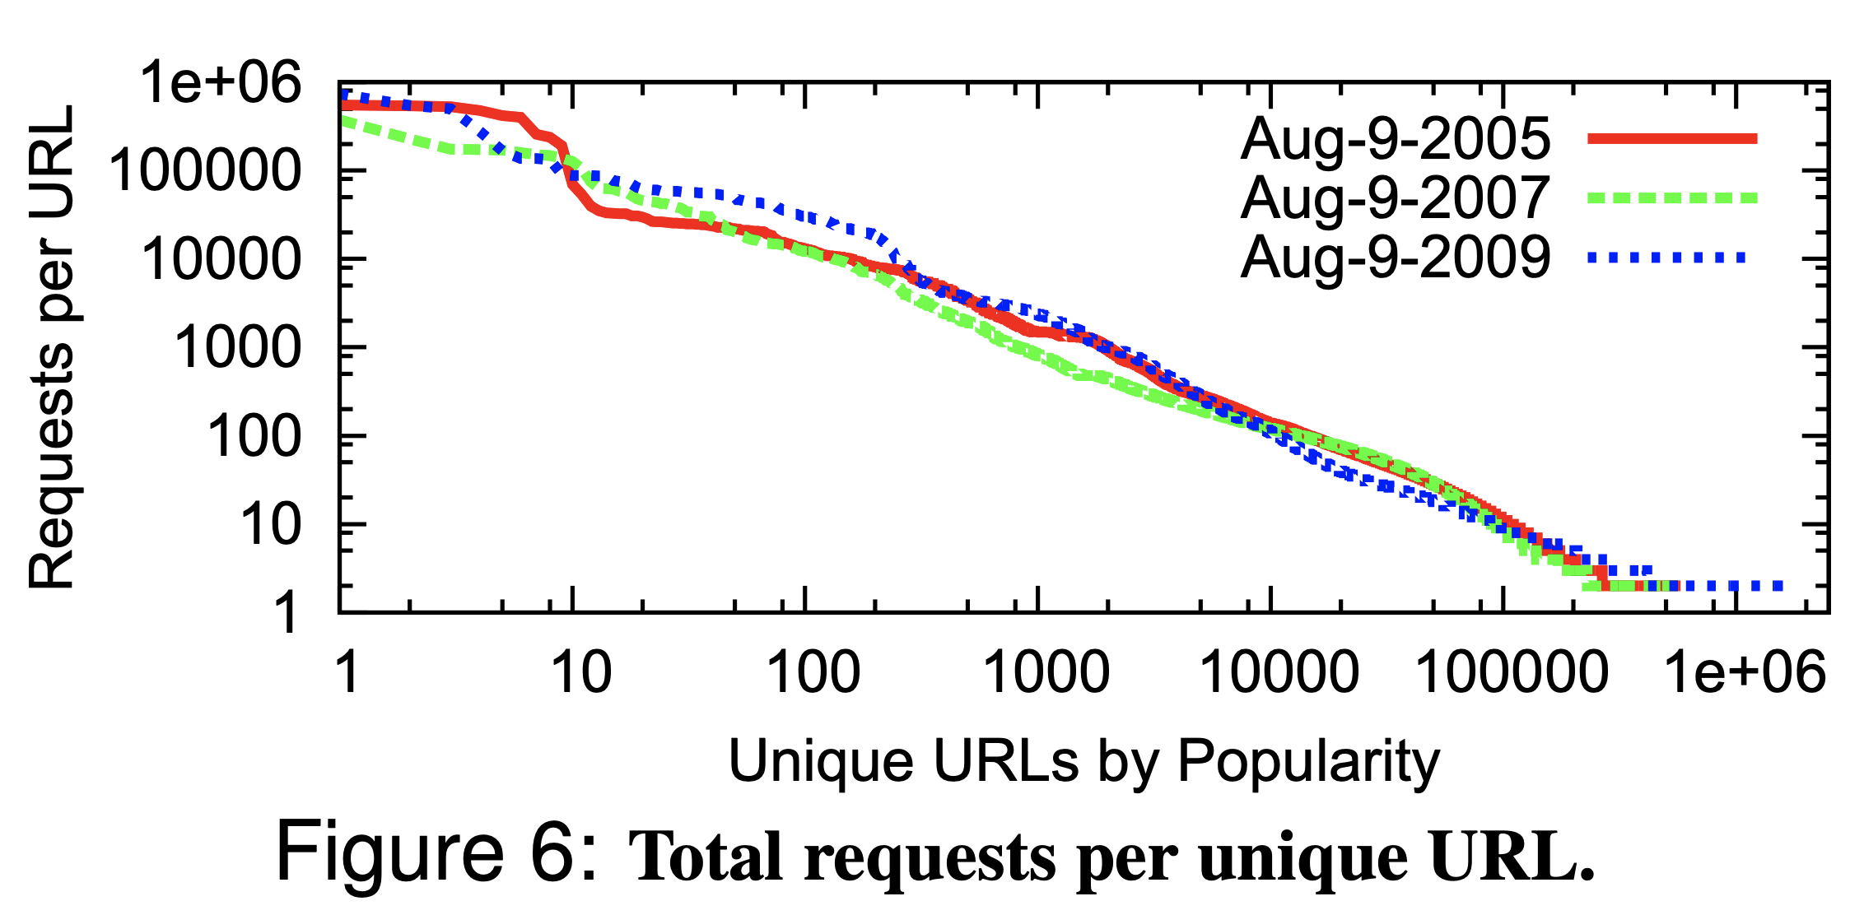
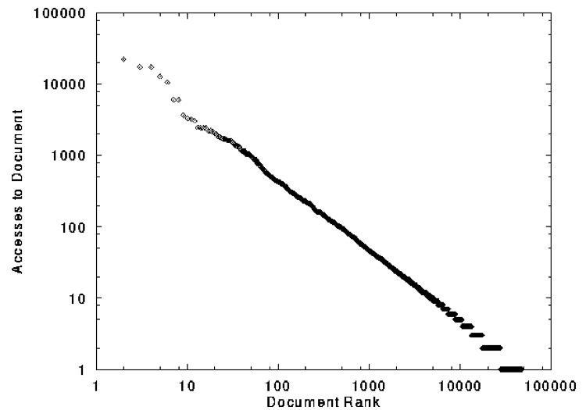
How much to cache? Many Internet workloads have Power law (Zipf) distribution
Characteristics of WWW Client-based Traces. Cunha, Bestavros, Crovella, BU-CS, 1995
Experiences with CoralCDN: A Five-Year Operational View. Freedman. NSDI 2010

Slide 10
How much to cache? Many Internet workloads have Power law (Zipf) distribution
Significant benefits at beginning, but then reduced benefit for cache hit rate as cache size grows

Slide 11
Modern Web Architectures
Stateless
Routing Layer
Soft-state
Caching
Layer
Stateful
Storage Service
A-F
A-F
A-F
G-L
G-L
G-L
M-R
M-R
M-R
A-I
S-Z
S-Z
S-Z
J-P
Q-Z
Caches can also be sharded

Slide 12
Content Delivery Networks
A-I
Stateless
Routing Layer
Soft-state
Caching
Layer
J-P
Q-Z
Downstream
Caching
A-F
G-L
M-R
A-I
A-I
S-Z
J-P
J-P
Q-Z
Q-Z

Slide 13
Content Distribution Network
Proactive content replication
Content provider (e.g., CNN) contracts with a CDN
CDN replicates the content
On many servers spread throughout the Internet
Updating the replicas
Reactive by TTL or updates pushed to replicas when the content changes
origin server
in North America
CDN distribution node
CDN server
in S. America
CDN server
in Asia
CDN server
in Europe

Slide 14
Caching is Complicated
Significant fraction (>50%?) of distinct HTTP objects may be uncacheable
Dynamic data: Stock prices, scores, web cams
CGI scripts: results based on passed parameters
Cookies: results may be based on passed data
Advertising / analytics: want to measure # hits (hint: use random strings)
Yet significant fraction of HTTP bytes are cacheable
Images, video, CSS pages, etc.
Goal: Maximize cachability, while limiting staleness of cached objects
Notes:
14

Slide 15
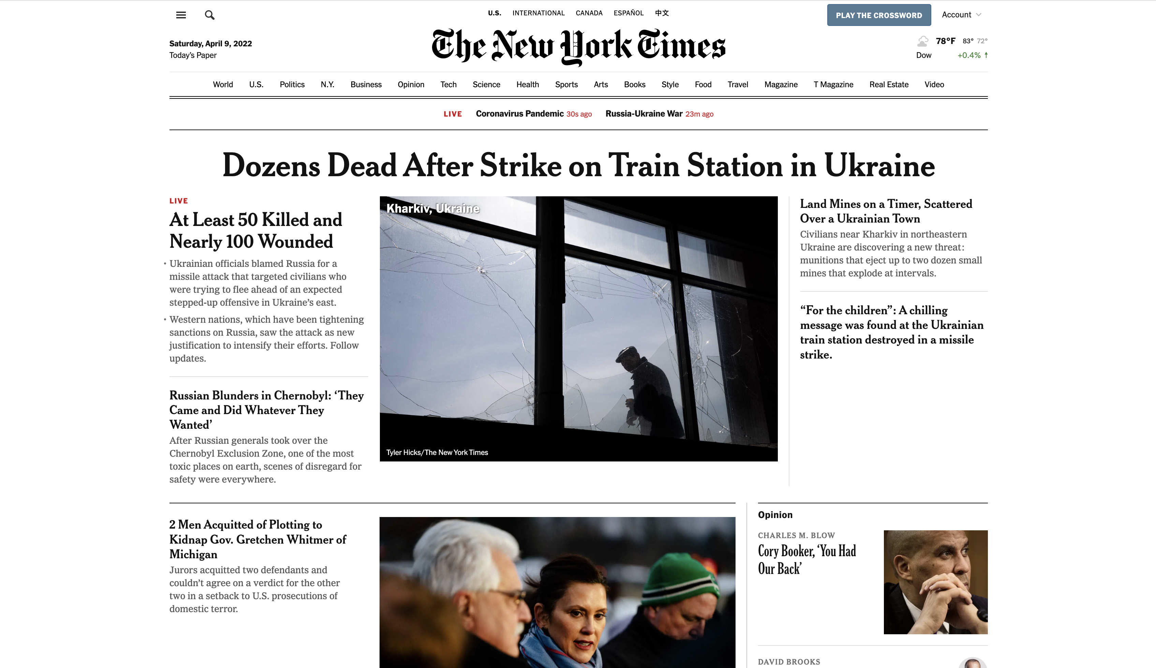

Slide 16
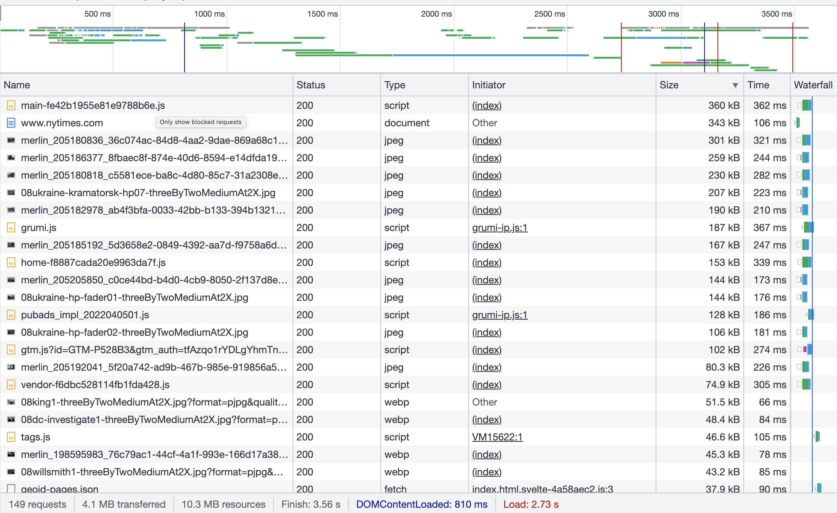

Slide 18
Caching is powerful: Modern HTTP Video-on-Demand
Download “content manifest” from origin server
List of video segments belonging to video
Each segment 1-2 seconds in length
Client can know time offset associated with each
Standard naming for video resolutions/formats: eg, 320dpi, 720dpi, 1040dpi
Client downloads video segment (at certain resolution) using standard HTTP request.
HTTP request can be satisfied by cache: it’s a static object
Client observes download time vs. segment duration, increases/decreases resolution if appropriate

Slide 19
CDN Case Study: How Akamai Works
Akamai Network
Servers: ~365,000
Networks: 1,350
Countries: 135
https://www.akamai.com/company/facts-figures

Slide 20
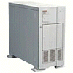
How Akamai Uses DNS
20
cnn.com (content provider)
HTTP
DNS root server
GET index.html
Akamai
cluster
cache.cnn.com/foo.jpg
Akamai global
DNS server
1
2
HTTP
Akamai regional
DNS server
Nearby Akamai
cluster
End user

Slide 21
How Akamai Uses DNS
21
cnn.com (content provider)
HTTP
DNS TLD server
DNS lookup
cache.cnn.com
Akamai
cluster
Akamai global
DNS server
1
2
3
ALIAS:
g.akamai.net
4
Akamai regional
DNS server
Nearby Akamai
cluster
End user

Slide 22
How Akamai Uses DNS
22
cnn.com (content provider)
HTTP
DNS TLD server
DNS lookup
g.akamai.net
Akamai
cluster
Akamai global
DNS server
5
1
2
3
4
6
Akamai regional
DNS server
ALIAS
a73.g.akamai.net
Nearby Akamai
cluster
End user

Slide 23
How Akamai Uses DNS
23
cnn.com (content provider)
HTTP
DNS TLD server
Akamai
cluster
Akamai global
DNS server
5
1
2
3
4
6
Akamai regional
DNS server
7
DNS a73.g.akamai.net
8
Address
1.2.3.4
Nearby Akamai
cluster
End user

Slide 24
How Akamai Uses DNS
24
cnn.com (content provider)
HTTP
DNS TLD server
Akamai
cluster
Akamai global
DNS server
5
1
2
3
4
6
Akamai regional
DNS server
7
8
9
Nearby Akamai
cluster
End user
GET /foo.jpg
Host: cache.cnn.com

Slide 25
How Akamai Uses DNS
25
cnn.com (content provider)
HTTP
DNS TLD server
GET foo.jpg
11
12
Akamai
cluster
Akamai global
DNS server
5
1
2
3
4
6
Akamai regional
DNS server
7
8
9
Nearby Akamai
cluster
End user
GET /foo.jpg
Host: cache.cnn.com

Slide 26
How Akamai Uses DNS
26
cnn.com (content provider)
HTTP
DNS TLD server
11
12
Akamai
cluster
Akamai global
DNS server
5
1
2
3
4
6
Akamai regional
DNS server
7
8
9
Nearby Akamai
cluster
End user
10

Slide 27
How Akamai Works: Cache Hit
27
cnn.com (content provider)
HTTP
DNS TLD server
Akamai
cluster
Akamai global
DNS server
1
2
Akamai regional
DNS server
3
4
5
Nearby Akamai
cluster
End user
6

Slide 28
Routing Client Requests within Map
Mapping system collects data about each “group” of IP addresses, based on network latency, loss, connectivity
Map each IP group to a preferred server cluster
Updated roughly every minute
Short, 60-sec DNS TTLs in Akamai regional DNS accomplish this
Map client request to a server in the cluster
Load balancer selects a specific server
E.g., to maximize the cache hit rate

Slide 29
Selecting server inside cluster
Content 5
CK5
N105
CK20
Server 105
Circular
ID space
N32
Consistent hashing
content_key = hash(URL) mod N
node_key = hash(server ID) mod N
Content belongs to server’s node_key is “closest” to URL’s content_key
N90
CK80

Slide 30
“Consistency”? (and/or limiting the staleness of cached objects)

Slide 31
How long should the client cache for?
Clients (and proxies) cache documents
When should origin be checked for changes?
Every time? Every session? Date?
HTTP includes caching information in headers
HTTP 0.9/1.0 used: “Expires: <date>”; “Pragma: no-cache”
HTTP/1.1 has “Cache-Control”
“No-Cache”, “Max-age: <seconds>”
“ETag: <opaque value>
Notes:
31

Slide 32
Why the changes between 1.0 and 1.1?
Timestamps
Server hints when an object “Expires” (Expires: xxx)
Server provides last modified date, client can check if still valid
Problems
Client and server might not have synchronized clocks
Server replicas might not have synchronized clocks
Max-age solves this: relative seconds, not absolute time

Slide 33
What if cache expires?
Store past expiry time (if room in cache)
Upon request, first revalidate with server
GET / HTTP/1.1
Accept-Language: en-us
If-Modified-Since: Mon, 29 Jan 2001 17:54:18 GMT
Host: www.example.com
Connection: Keep-Alive
HTTP/1.1 304 Not Modified
Date: Tue, 27 Mar 2001 03:50:51 GMT
Connection: Keep-Alive
Notes:
33

Slide 34
Conditional GETs
Revalidate cache content if still valid
Redownload new version if modified
GET / HTTP/1.1
Accept-Language: en-us
If-Modified-Since: Mon, 29 Jan 2001 17:54:18 GMT
Host: www.example.com
Connection: Keep-Alive
HTTP/1.1 304 Not Modified
Date: Tue, 27 Mar 2001 03:50:51 GMT
Connection: Keep-Alive
Notes:
34

Slide 35
Another clock sync problem!
What if server replicas don’t have aligned modification times?
HTTP/1.1 200
Date: Tue, 27 Mar 2001 03:50:51 GMT
ETag: 686897696a7c876b7e
GET / HTTP/1.1
Accept-Language: en-us
If-None-Match: "686897696a7c876b7e”
Host: www.example.com
Connection: Keep-Alive
Notes:
35

Slide 36
Conclusion
Content distribution is hard
Many, diverse, changing objects
Clients distributed all over the world
Moving content towards client is key
Reduces latency, improves throughput, reliability
CDNs evolved into complex distributed systems
Cache controls and revalidation are a key part of managing content freshness with decentralized caching

