Slide 1
Impossibility Results: CAP, PRAM, SNOW, & FLP
COS 418: Distributed Systems
Lecture 20
Mike Freedman

Slide 2
Network Partitions Divide Systems

Slide 3
Network Partitions Divide Systems

Slide 4
How can we handle partitions?
Atomic Multicast?
Bayou?
Dynamo?
Paxos?
RAFT?
COPS?
Spanner?
Notes:
Draw on slide!

Slide 5
How About This Set of Partitions?

Slide 6
Fundamental Tradeoff?
Replicas appear to be a single machine, but lose availability during a network partition
OR
All replicas remain available during a network partition but do not appear to be a single machine

Slide 7
CAP Theorem Preview
You cannot achieve all three of:
Consistency
Availability
Partition-Tolerance
Partition Tolerance => Partitions Can Happen
Availability => All Sides of Partition Continue
Consistency => Replicas Act Like Single Machine
Specifically, Linearizability

Slide 8
Linearizability (refresher)
All replicas execute operations in some total order
That total order preserves the real-time ordering between operations
If operation A completes before operation B begins, then A is ordered before B in real-time
If neither A nor B completes before other begins, then no real-time order. But must be some total order.
Notes:
Local process ordering is a subset of real-time ordering when each process has at-most one operation outstanding at a time

Slide 9
CAP Conjecture [Brewer 00]
From keynote lecture by Eric Brewer (2000)
History: Eric started Inktomi, early Internet search site based around “commodity” clusters of computers
Using CAP to justify “BASE” model: Basically Available, Soft-state services with Eventual consistency
Popular interpretation: 2-out-of-3
Consistency (Linearizability)
Availability
Partition Tolerance: Arbitrary crash/network failures

Slide 10
CAP Theorem [Gilbert Lynch 02]
Assume to contradict that Algorithm A provides all of CAP
Client 1
Client 2

Slide 11
CAP Theorem [Gilbert Lynch 02]
Assume to contradict that Algorithm A provides all of CAP
w(x=1)
Client 1
Client 2
ok
Write eventually returns
(from A)
Partition Possible (from P)

Slide 12
CAP Theorem [Gilbert Lynch 02]
Assume to contradict that Algorithm A provides all of CAP
w(x=1)
r(x)
Client 1
Client 2
ok
x=0
Write eventually returns
(from A)
Read begins after write completes
Read eventually returns (from A)
Partition Possible (from P)

Slide 13
CAP Theorem [Gilbert Lynch 02]
Assume to contradict that Algorithm A provides all of CAP
Not consistent (C) => contradiction!
w(x=1)
r(x)
Client 1
Client 2
ok
x=0
Write eventually returns
(from A)
Read begins after write completes
Read eventually returns (from A)
Partition Possible (from P)

Slide 14
CAP Interpretation Part 1
Cannot “choose” no partitions
2-out-of-3 interpretation doesn’t make sense
Instead, availability OR consistency?
That is: Fundamental tradeoff between availability and consistency
When designing system must choose one or the other, both are not possible

Slide 15
CAP Interpretation Part 2
It is a theorem, with a proof, that you understand!
Cannot “beat” CAP Theorem
Can engineer systems to make partitions extremely rare, however, and then just take the rare hit to availability (or consistency)

Slide 16
Consistency Hierarchy
Strict Serializability
e.g., Spanner
Linearizability
e.g., RAFT
CAP
Sequential Consistency
Causal+ Consistency
e.g., Bayou
Eventual Consistency
e.g., Dynamo

Slide 17
Impossibility Results Useful!!!!
Fundamental tradeoff in design space:
Must make a choice
Avoids wasting effort trying to achieve impossible
Tells us the best-possible systems we can build!

Slide 18
PRAM [Lipton Sandberg 88] [Attiya Welch 94]
d is the worst-case delay in the network over all pairs of processes [datacenters]
Sequentially consistent system
read time + write time ≥ d
Fundamental tradeoff b/w consistency and latency!
(Skipping proof, see presenter notes or papers)
Notes:
(Requires 2 objects.)
Proof intuition:
Let P1 and P2 be the 2 furthest away processes.
Assume to contradict read time + write time < d.
Thus the following executions are possible because P1’s Write can’t be seen at P2 Read:
P1: |--W(x=1)--| |--R(y)=0--|
P2: |--W(y=1)--| |--R(x)=0--|
But there is no total order of these operations, so does not provide sequential consistency.

Slide 19
PRAM Theorem:
Impossible for sequentially consistent system to always provide low latency.

Slide 20
Consistency Hierarchy
Strict Serializability
e.g., Spanner
Linearizability
e.g., RAFT
Sequential Consistency
CAP
PRAM 1988
(Princeton)
Causal+ Consistency
e.g., Bayou
Eventual Consistency
e.g., Dynamo

Slide 21
Sharding vs. Replication
CAP
PRAM
Replication Dimension
A-F
A-F
A-F
Sharding Dimension
G-L
G-L
G-L
M-R
M-R
M-R
SNOW
S-Z
S-Z
S-Z

Slide 22
The SNOW Theorem [Lu et al. 2016]
Focus on read-only transactions
Are the ‘ideal’ read-only transaction possible?
Provide the strongest guarantees, AND
Provide the lowest possible latency?
(Same as eventual consistent non-transactional reads)
No ☹

Slide 23
The SNOW Properties
[S]trict serializability
[N]on-blocking operations
[O]ne response per read
[W]rite transactions that conflict
Strongest Guarantees
Lowest
Latency
Notes:
To study this tradeoff, we looked into 4 properties that characterize the power and latency of read-only transactions. These are the SNOW properties.
The S and W properties represent the highest power, and N and O together represent the lowest latency. I will explain these 4 properties in the next few slides, and show these 4 properties cannot be achieved at the same time.

Slide 24
[S]trict Serializability
Strongest model: real-time + total order
C_{R}
S_{ACL}
S_{Photo}
C_{W}
W starts
Private
“Photo B is private!”
ACL := Private
Upload Photo B
Photo B
W finishes
R starts
R finishes
Notes:
Strict serializability is the strongest consistency, which requires there exists a total order among all the transactions in the system. And the total order respects the real-time order.
Here is an example of what real-time order means. There is a read client CR, 2 servers, and a write client CW. Initially access control is public and the photo server has photo A. Now there is a write W setting the ACL to private and photo to B, and then finishes. After W finishes, a read-only transaction R starts. Because R starts after W finishes, R is in real time after W, so by real-time order requirement, R should return what W just wrote, so in this case it should see photo B is private.

Slide 25
[S]trict Serializability
Strongest model: real-time + total order
C_{R}
S_{ACL}
S_{Photo}
C_{W}
W starts
R starts
Photo B
ACL := Private
Upload Photo B
“Public + Photo A”
“Photo B is private!”
“Public + Photo B”
“Photo A is private!”
Private
W finishes
R finishes
Notes:
Here is another example where read is concurrent with the write. The write W is also updating both servers. But R starts before W finishes. In this case, R and W are concurrent as their executions overlap. So there is no real-time order, That means it’s okay to make either transaction first. However, we should still satisfy the total order requirement, which means R should not observe the partial effect of W.
For instance, it’s okay for R to return public and photo A, or photo B is private, but not public with photo B or photo A is private.
Strict serializability is desirable because it’s the strongest so it eliminates the most anomalies, and makes the system very easy to program

Slide 26
[N]on-blocking Operations
Do not wait on external events
Locks, timeouts, messages, etc.
Lower latency
Save the time spent blocking
Notes:
Non-blocking means the read-only transactions do not wait on external events, such as waiting on locks, timeouts, or other messages.
This is a latency related property as it saves at least the time spent blocking.

Slide 27
[O]ne Response
One round-trip
No message redirection
Centralized components: coordinator, etc.
No retries
Save the time for extra round-trips
One value per response
Less time for transmitting, marshaling, etc.
Notes:
The one-response property means there is only one round-trip between the client and the servers, and there is only one value in each response from the server.
This is also a latency related property, as it saves the time for extra round-trips and also the time for processing extra copies of data.

Slide 28
[W]rite Transactions That Conflict
Compatible with write transactions
Richer system model
Easier to program
Spanner has W
COPS does not have W
Notes:
The property W means it’s okay for the system not only have read-only transactions but also write transactions, and the read-only transactions still work correctly when the data is concurrently being updated by write transactions. Write transaction means any transaction that modifies the data, so it includes general read-write transactions and write-only transactions. Having different types of transactions provides a richer system model and makes programming easier.

Slide 29
The SNOW Theorem:
Impossible for read-only transaction
algorithms to have all SNOW properties Must choose strongest guarantees OR lowest latency for read-only transactions
Notes:
By studying those 4 properties, we prove the SNOW Theorem, which is an impossibility result. It says there is no read-only transaction algorithm that can achieve all of the SNOW properties.

Slide 30
Why SNOW Is Impossible [Intuition]
C_{R}
S_{A}
S_{B}
C_{W}
W starts
A := new
B := new
Assume
SNOW
→
R
W
invisible
Violates
property S
T
W
visible
R_{A} = new
R_{B} = old
W finishes
Notes:
Now I will talk about the proof intuition with a simplified example. We prove by contradiction.
R is a read-only transaction and we assume it has all SNOW properties and later we will derive a contradiction.
W is a conflicting write transaction writing new values to server A and B, these 2 servers initially have value old. R and W can conflict because of the SNOW property -- write transactions that conflict. The execution of W on servers take time, and we proved that there exists time T, before T, W is invisible to concurrent read transactions, and it becomes visible after T. The reads incurred by R at those 2 servers have to return immediately because of the non-blocking property. Due to the asynchronous nature of the network, a part of R may arrive before t and observes the old value, and the other part of R arrives after T and observes the new value. This violates strict serializability, and R cannot retry for consistent results because of the one-response property. This contradicts that R has all SNOW properties since it’s not strictly serializable.

Slide 31
SNOW Is Tight
S
N
O
W
S+N+O
: COPS-DW
S+N+W
: Eiger
S+O+W
: Spanner-RO
N+O+W
: Spanner-Snap
Spanner’s read-only transaction interfaces provide both sides of tradeoff!
Notes:
Other than just proving the SNOW theorem, we also show the Theorem is tight by showing that any combination of 3 properties is possible.
For instance, COPS-DW is a new algorithm we designed, which has the 3 properties: strict serializability, non-blocking and one-response. Eiger is an existing system, the only property eiger’s read-only transaction doesn’t have is one-response, because it needs 3 round-trips in worst case for returning strictly serializable results. Spanner is google’s distributed database system, it provides 2 read-only transaction APIs, Spanner-RO provides strictly serializable reads, but it requires blocking. Spanner-Snap is non-blocking, but only returns snapshot reads, which is weaker than strict serializability.
We say a read-only transaction is snow-optimal if it has any 3 of the properties, because this is the most it can have. And latency-optimal if it has the properties non-blocking and one-response, because this is the fastest it can be.

Slide 32
Consistency Hierarchy
Strict Serializability
e.g., Spanner
SNOW
Linearizability
e.g., RAFT
Sequential Consistency
CAP
PRAM
Causal+ Consistency
e.g., Bayou
Eventual Consistency
e.g., Dynamo

Slide 33
Latency vs. Throughput
Latency: How long operations take
All results so far about latency/availability
Throughput: How many operations/sec

Slide 34
The NOCS Theorem [Lu et al. 2020]
Focus on read-only transaction’s latency and throughput
Are the ‘ideal’ read-only transaction possible?
Provide the strongest guarantees, AND
Provide the lowest possible latency? AND
Provide the highest possible throughput?
No ☹

Slide 35
The NOCS Properties
[N]on-blocking operations
[O]ne response per read
[C]onstant metadata
[S]trict serializability
Same
As
Simple
Reads
Notes:
Simple reads are eventually consistent non-transactional reads.
No “W” here, applies even in systems without write transactions, thus is more restrictive.

Slide 36
The NOCS Theorem:
Impossible for read-only transaction
algorithms to have all NOCS properties Must choose strongest consistency OR best performance for read-only transactions

Slide 37
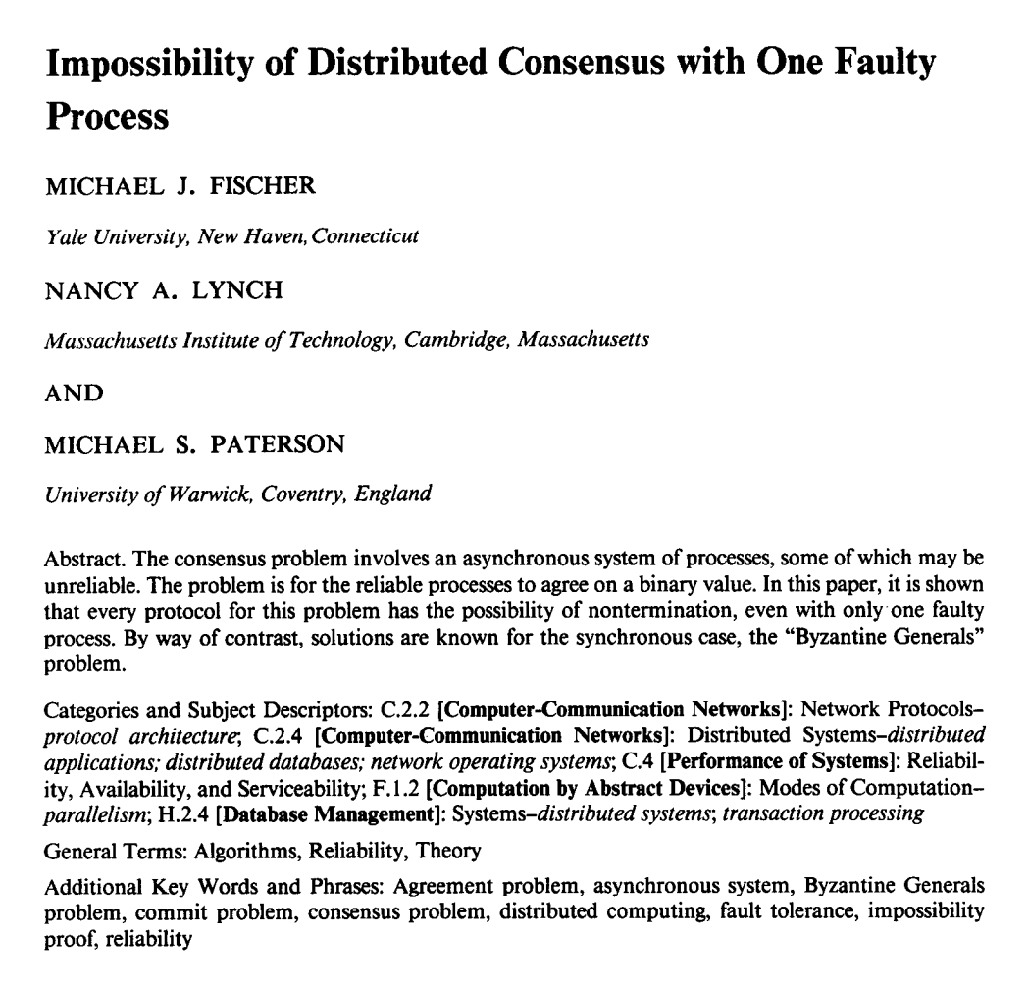
“FLP” Result
No deterministic one-crash-robust consensus algorithm exists with asynchronous communication

Slide 38
FLP is the original impossibility result for distributed systems!
Useful interpretation: no consensus algorithm can always reach consensus with an asynchronous network
Do not believe such claims!
Led to lots and lots of theoretical work
(Consensus is possible when the network is reasonably well-behaved)

Slide 39
Conclusion
Impossibility results tell you choices you must make in the design of your systems
CAP: Fundamental tradeoff b/w availability and strong consistency (for replication)
PRAM: Fundamental tradeoff b/w latency and strong consistency (for replication)
SNOW: Fundamental tradeoff b/w latency and strong guarantees (for sharding)
NOCS: Fundamental tradeoff b/w performance (latency and throughput) and strong guarantees (for sharding)

