Slide 1
Distributed Systems Intro
COS 418
Distributed Systems
Lecture 1
Mike Freedman

Slide 2

Strict Mask Policy, Zero Tolerance
Good, properly-fit masks required 100% of time
No eating or drinking. No removing masks.
Students not abiding will be asked to leave immediately

Slide 3
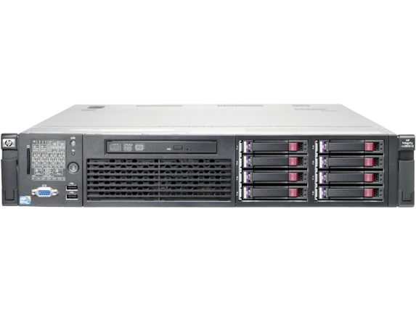
Distributed Systems, What?
Multiple computers
Connected by a network
Doing something together

Slide 4
Distributed Systems, Why?
Or, why not 1 computer to rule them all?
Failure
Limited computation/storage/…
Physical location
Notes:
[Student chat me their answers here]

Slide 5
Distributed Systems, Where?
Web Search (e.g., Google, Bing)
Shopping (e.g., Amazon, Shopify)
File Sync (e.g., Dropbox, iCloud)
Social Networks (e.g., Facebook, Twitter, TikTok)
Music (e.g., Spotify, Apple Music)
Ride Sharing (e.g., Uber, Lyft)
Video (e.g., Youtube, Netflix)
Online gaming (e.g., Fortnite, Roblox)
…

Slide 6
Backrub (Google) 1997

Slide 7
Google 2012

Slide 8
“The Cloud” is not amorphous

Slide 9
Microsoft

Slide 10
Google

Slide 11
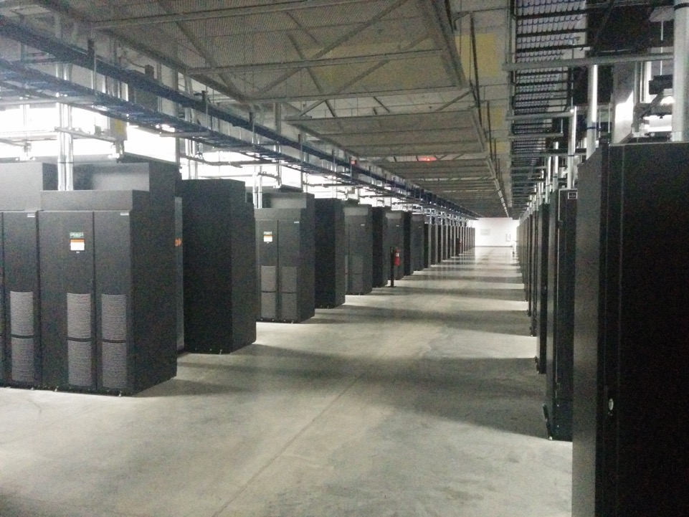
Facebook

Slide 12
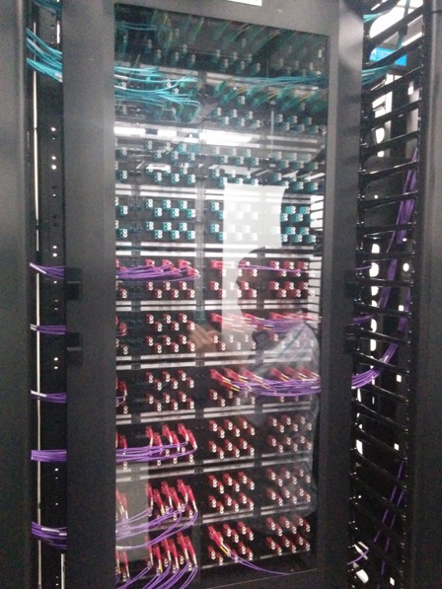
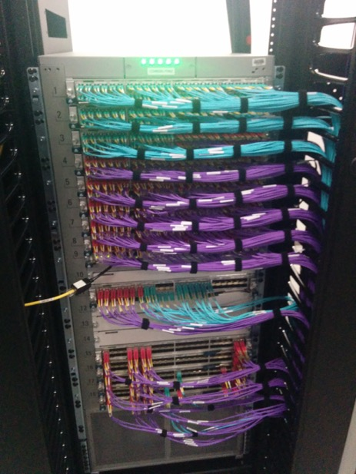
Facebook
Facebook

Slide 13
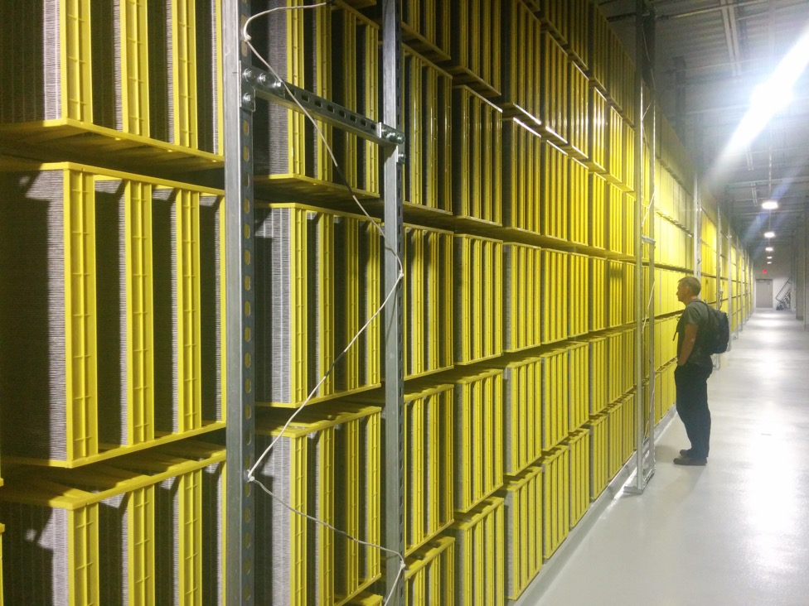
Facebook

Slide 14
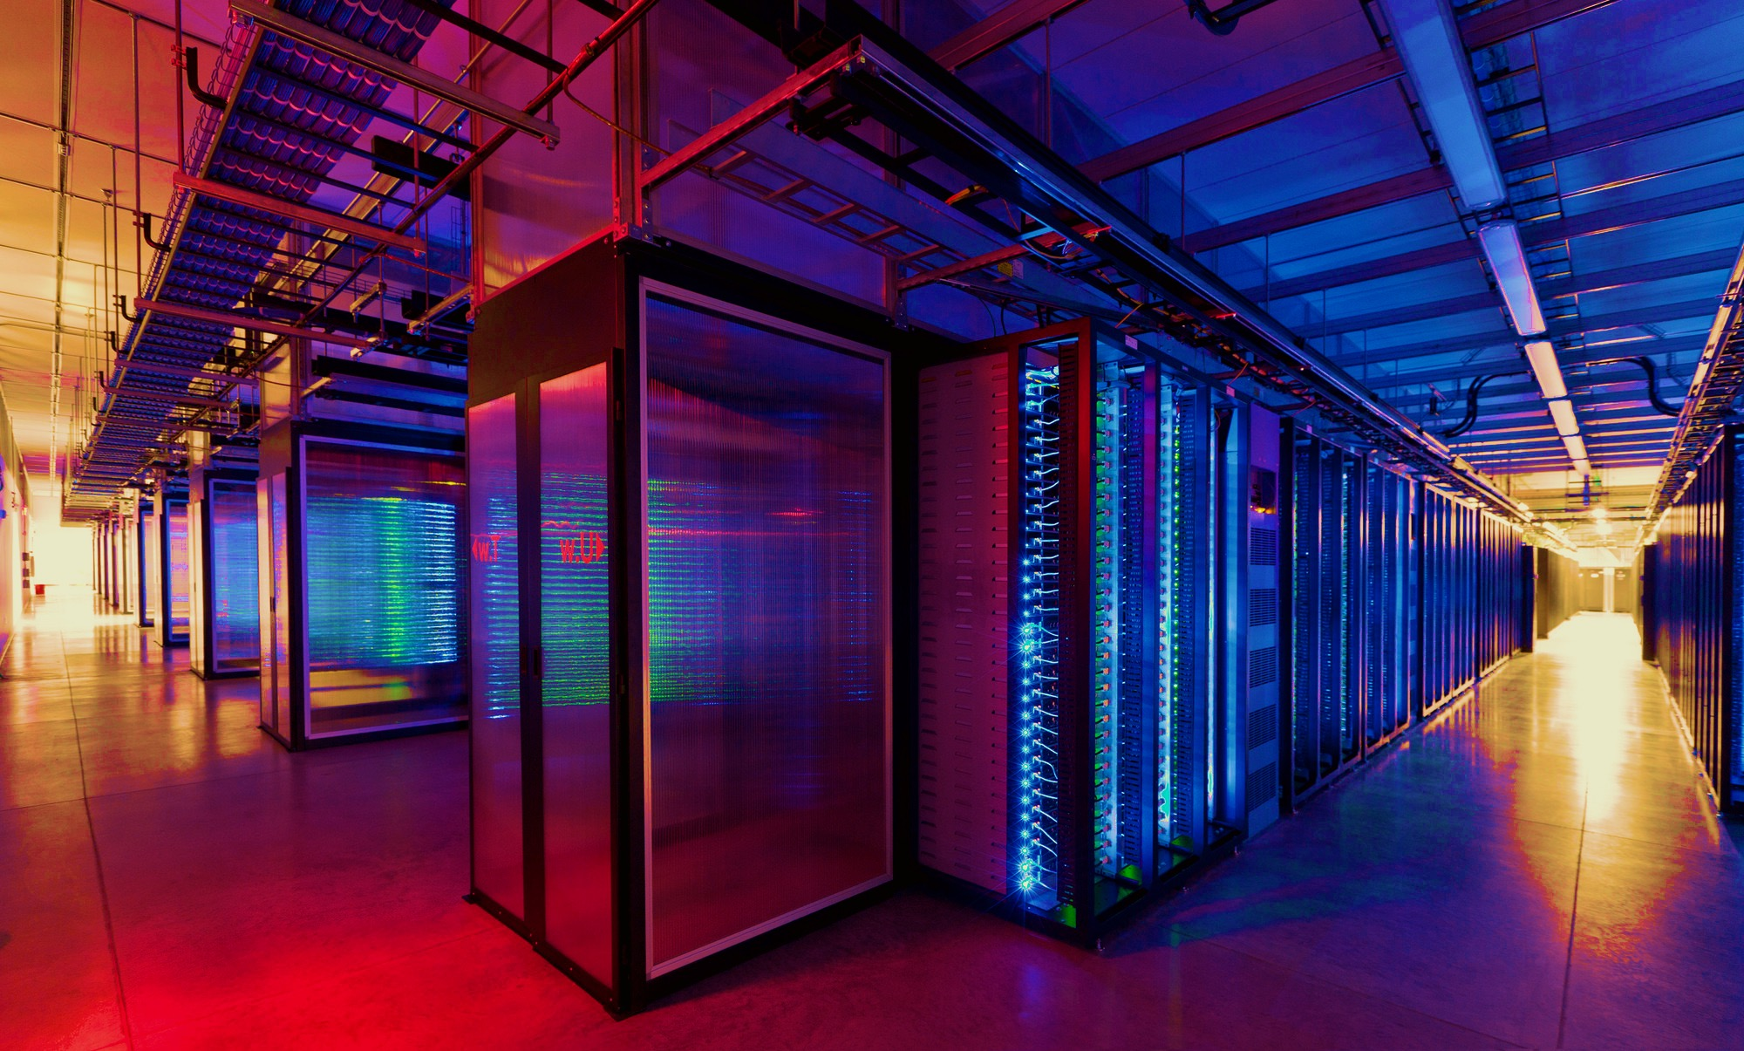
100,000s of physical servers
10s MW energy consumption
Facebook Prineville:
$250M physical infro, $1B IT infra

Slide 15
Everything changes at scale
“Pods provide 7.68Tbps to backplane”

Slide 16
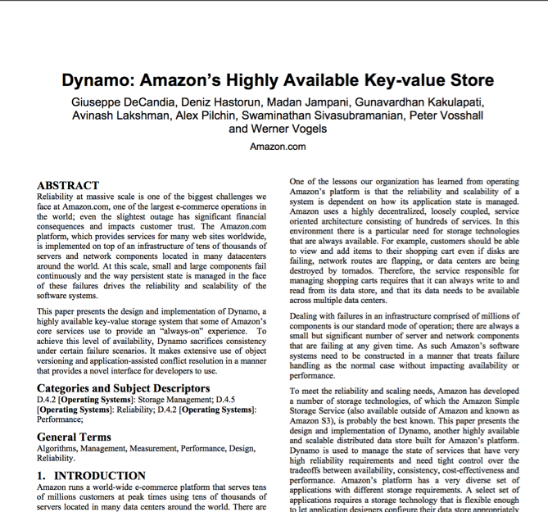
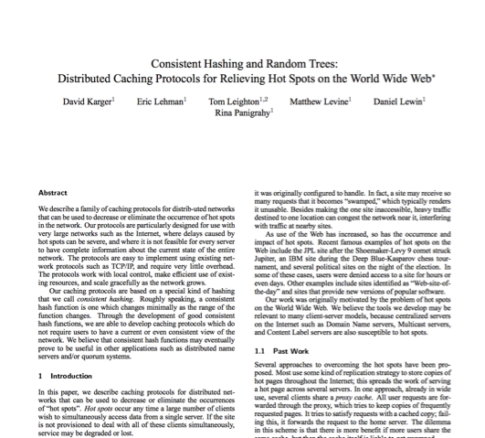
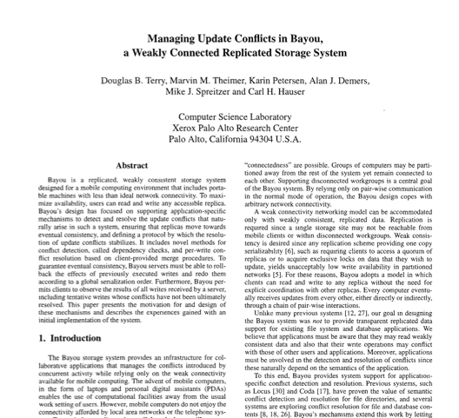
Research results matter: NoSQL
Notes:
NoSQL:
Consistent hash tables
+ consistency tradeoffs (e.g., eventual)
Amazon Dynamo popularized (published SOSP 2007), CTO was faculty at Cornell on distributed systems

Slide 17
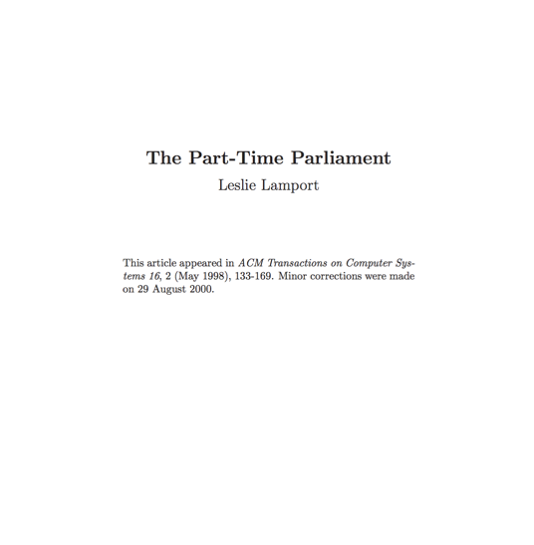
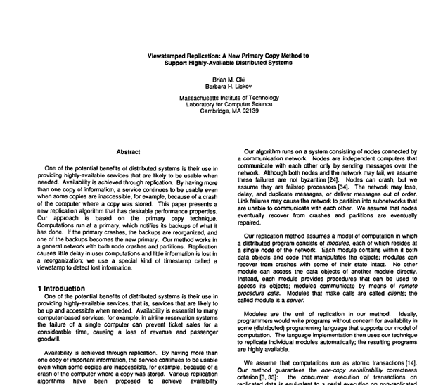
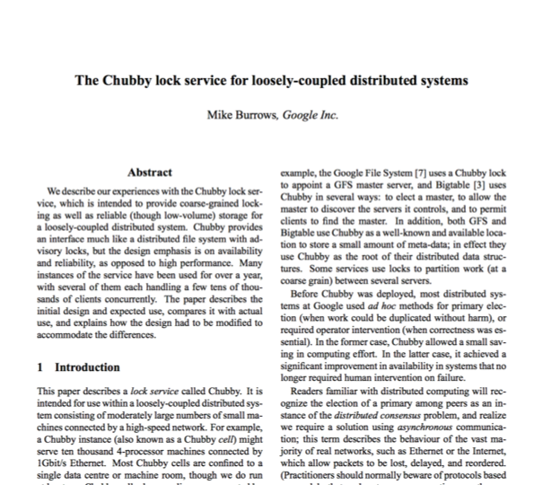
Research results matter: Paxos
Notes:
Paxos
Long history starting in early 1990s on “reaching consensus in distributed systems”
Google Chubby
Coordinate datacenters at scale
When a file server fails, who takes over?
Authors for industrial research labs and academia (DEC SRC, Cambridge/UW, etc.)
Led to open-source Apache Zookeeper

Slide 18
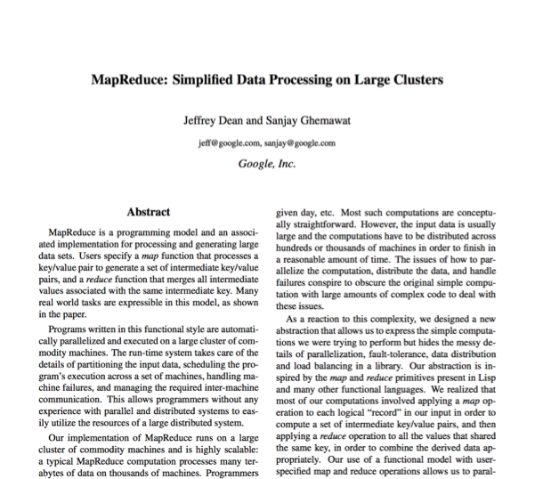
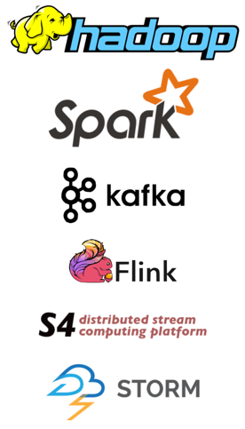
Research results matter: MapReduce
Notes:
Google MapReduce
How to process large volumes of data over 1000s of servers, even in face of failures
Authors for industrial research labs and academia (DEC WRL, MIT/UW, etc.)
Led to open-source Apache Hadoop
Created Big Data industry…

Slide 19
Course Logistics

Slide 20
Instructors & Grading
Lecture
  Professor Mike Freedman
  Slides available on course website
Precept:
  TAs Anja Kalaba, Nanqinqin Li, Dongsheng Yang
Grading
  Midterm (25%) and final (25%)
  Programming Assignments: 50%

Slide 21
418 assignment 1 (in three parts)
Learn how to program in Go
  Basic Go assignment (due Feb 3)
  “Simple” Map Reduce (due Feb 8)
  Distributed Map Reduce (due Feb 10)

Slide 22
Topics

Slide 23
Distributed Systems Goal
Service with higher-level abstractions/interface
  e.g., file system, database, key-value store, programming model, …
Hide complexity
  Scalable (scale-out)
  Reliable (fault-tolerant)
  Well-defined semantics (consistent)
Do “heavy lifting” so app developer doesn’t need to

Slide 24
Scalable Systems in this Class
Scale computation across many machines
  MapReduce, TensorFlow
Scale storage across many machines
  Dynamo, COPS, Spanner

Slide 25
Fault Tolerant Systems in this Class
Retry on another machine
  MapReduce, TensorFlow
Maintain replicas on multiple machines
  Primary-backup replication
  Paxos
  RAFT
  Bayou
  Dynamo, COPS, Spanner

Slide 26
Range of Abstractions and Guarantees
Eventual Consistency
  Dynamo
Causal Consistency
  Bayou, COPS
Linearizability
  Paxos, RAFT, Primary-backup replication
Strict Serializability
  2PL, Spanner

Slide 27
Learning Objectives
Reasoning about concurrency
Reasoning about failure
Reasoning about performance
Building systems that correctly handle concurrency and failure
Knowing specific system designs and design components
Notes:
[Also mention art of abstraction design]

Slide 28
Conclusion
Distributed Systems
  Multiple machines doing something together
  Pretty much everywhere and everything computing now
“Systems”
  Hide complexity and do the heavy lifting (i.e., interesting!)
  Scalability, fault tolerance, guarantees

