Slide 1
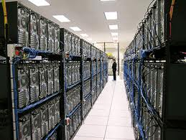
Datacenter Networks
Mike Freedman
COS 461: Computer Networks
http://www.cs.princeton.edu/courses/archive/spr20/cos461/

Slide 2

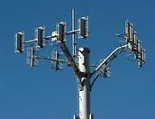

Networking Case Studies
Datacenter
Backbone
Enterprise
Cellular
Wireless

Slide 3
Cloud Computing
3

Slide 4
Cloud Computing
Elastic resources
  Expand and contract resources
  Pay-per-use
  Infrastructure on demand
Multi-tenancy
  Multiple independent users
  Security and resource isolation
  Amortize the cost of the (shared) infrastructure
Flexible service management
4

Slide 5
Cloud Service Models
Software as a Service
  Provider licenses applications to users as a service
  E.g., customer relationship management, e-mail, ..
  Avoid costs of installation, maintenance, patches, …
Platform as a Service
  Provider offers platform for building applications
  E.g., Google’s App-Engine, Amazon S3 storage
  Avoid worrying about scalability of platform
5

Slide 6
Cloud Service Models
Infrastructure as a Service
  Provider offers raw computing, storage, and network
  E.g., Amazon’s Elastic Computing Cloud (EC2)
  Avoid buying servers and estimating resource needs
6

Slide 7
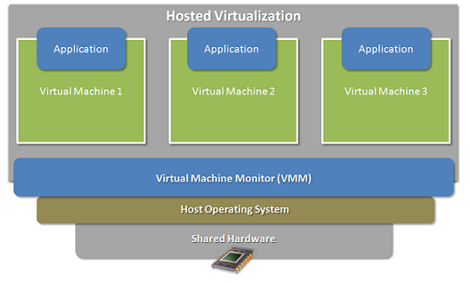
Enabling Technology: Virtualization
Multiple virtual machines on one physical machine
Applications run unmodified as on real machine
Recently: Lighter-weight virtualization through “containers”
Can migrate from one machine to another
Autoscale by spinning up/down VMs & containers
7

Slide 8
Multi-Tier Applications
Applications consist of tasks
  Many separate components
  Running on different machines
Commodity computers
  Many general-purpose computers
  Not one big mainframe
  Easier scaling

Slide 9
Componentization leads to different types of network traffic
“North-South traffic”
  Traffic to/from external clients (outside of datacenter)
  Handled by front-end (web) servers, mid-tier application servers, and back-end databases
  Traffic patterns fairly stable, though diurnal variations
“East-West traffic”
  Traffic within data-parallel computations within datacenter (e.g. “Partition/Aggregate” programs like Map Reduce)
  Data in distributed storage, partitions transferred to compute nodes, results joined at aggregation points, stored back into FS
  Traffic may shift on small timescales (e.g., minutes)

Slide 10
North-South Traffic
Router
Front-End
Proxy
Front-End
Proxy
Web Server
Web
Server
Web Server
Data
Cache
Data
Cache
Database
Database

Slide 11
East-West Traffic
Distributed
Storage
Map
Tasks
Reduce
Tasks
Distributed
Storage

Slide 12
Datacenter Network

Slide 13
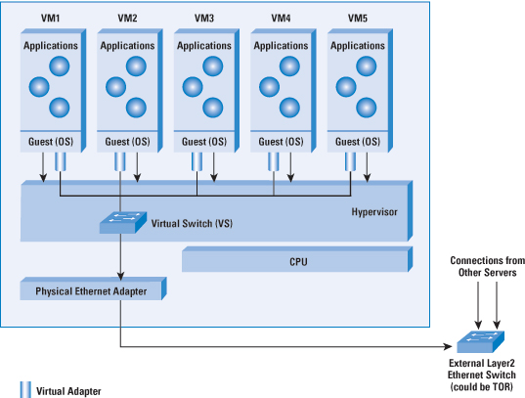
Virtual Switch in Server
13

Slide 14
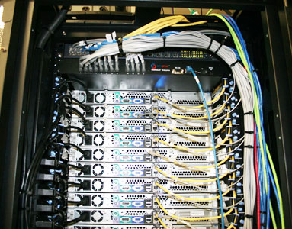
Top-of-Rack Architecture
Rack of servers
  Commodity servers
  And top-of-rack switch
Modular design
  Preconfigured racks
  Power, network, and
  storage cabling
14

Slide 15
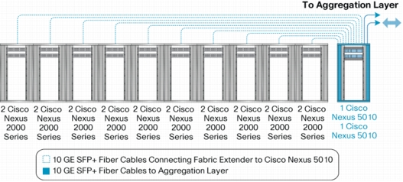
Aggregate to the Next Level
15

Slide 16
Datacenter Network Topology
Internet
CR
CR
. . .
AR
AR
AR
AR
S
S
S
S
S
S
. . .
A
A
…
A
A
A
…
A
Key
CR = Core Router
AR = Access Router
S = Ethernet Switch
A = Rack of app. servers
~ 1,000 servers/pod
16

Slide 17
Capacity Mismatch?
CR
CR
1
AR
AR
AR
AR
S
2
S
S
S
3
S
S
S
S
. . .
S
S
S
S
A
A
…
A
A
A
…
A
A
A
…
A
A
A
…
A
“Oversubscription”:
Much more demand vs. supply for higher links
17

Slide 18
Capacity Mismatch!
CR
CR
~ 200:1
AR
AR
AR
AR
S
S
S
S
~ 40:1
S
S
S
S
. . .
S
S
S
S
~ 5:1
A
A
…
A
A
A
…
A
A
A
…
A
A
A
…
A
Particularly bad for east-west traffic
18

Slide 19
Layer 2 vs. Layer 3?
Ethernet switching (layer 2)
  Cheaper switch equipment
  Fixed addresses and auto-configuration
  Seamless mobility, migration, and failover
IP routing (layer 3)
  Scalability through hierarchical addressing
  Efficiency through shortest-path routing
  Multipath routing through equal-cost multipath
19

Slide 20
Datacenter Routing
Internet
CR
CR
DC-Layer 3
. . .
AR
AR
AR
AR
DC-Layer 2
S
S
S
S
S
S
S
S
. . .
S
S
S
S
A
A
…
A
A
A
…
A
Key
CR = Core Router (L3)
AR = Access Router (L3)
S = Ethernet Switch (L2)
A = Rack of app. servers
~ 1,000 servers/pod == IP subnet
20

Slide 21
New datacenter networking problems have emerged...

Slide 22
Network Incast
Web
Server
Data
Cache
Data
Cache
Data
Cache
Data
Cache
Incast arises from synchronized parallel requests
  Web server sends out parallel request (“which friends of Johnny are online?”
  Nodes reply at same time, cause traffic burst
  Replies potential exceed switch’s buffer, causing drops

Slide 23
Network Incast
Web
Server
Data
Cache
Data
Cache
Data
Cache
Data
Cache
Solutions mitigating network incast
  Reduce TCP’s min RTO (often use 200ms >> DC RTT)
  Increase buffer size
  Add small randomized delay at node before reply
  Use ECN with instantaneous queue size
  All of above
Notes:
E – all of the above

Slide 24
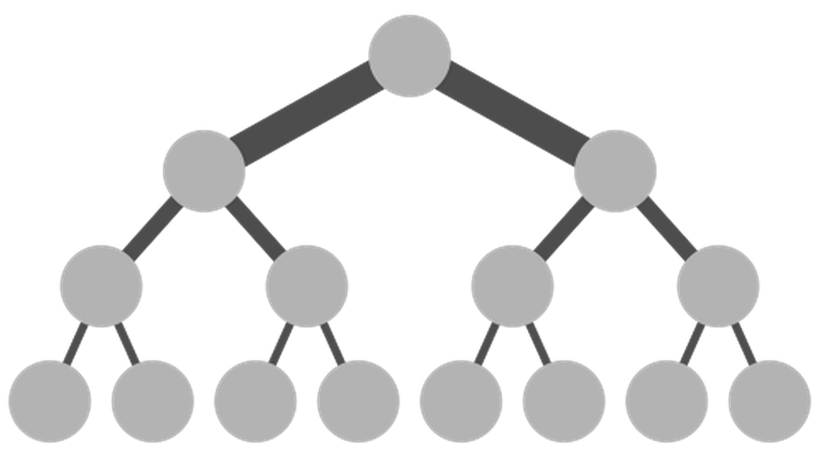
Full Bisection Bandwidth
Eliminate oversubscription?
  Enter FatTrees
  Provide static capacity
  Heterogeneous Links
    1-10 GB in racks
    40-100GB to core

Slide 25
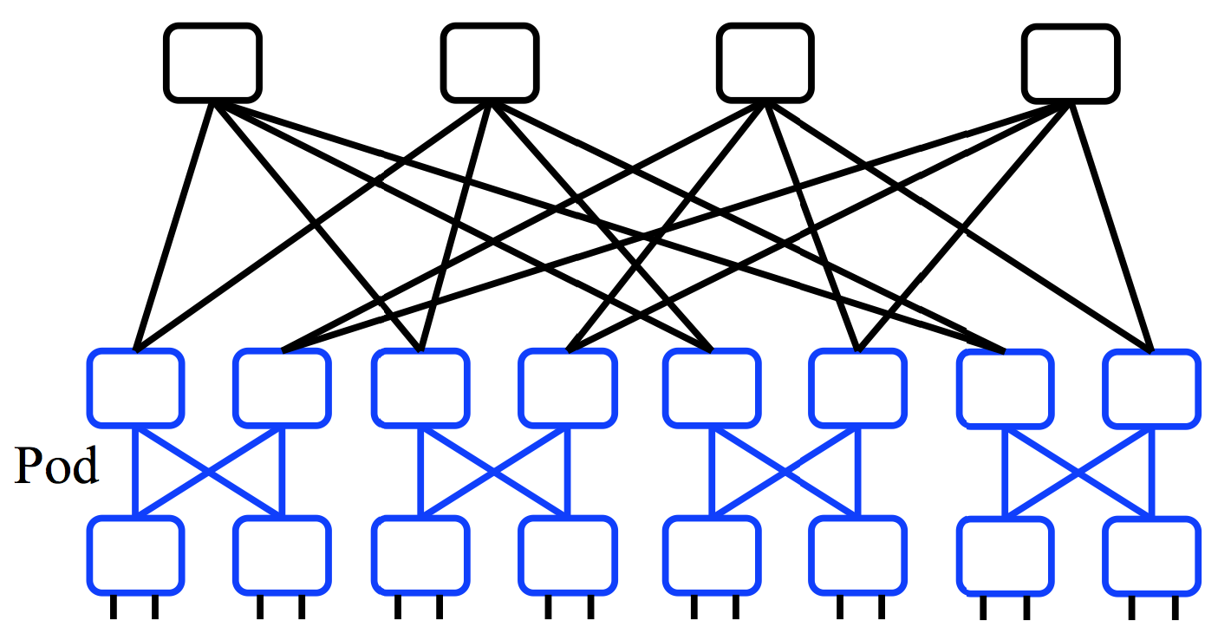
Full Bisection Bandwidth
But “scale up” link capacity has limits
New scale out architectures
  Build multi-stage FatTree out of k–port switches
  k/2 ports up, k/2 down
  Supports k³/4 hosts: 48 ports, 27,648 hosts

Slide 26
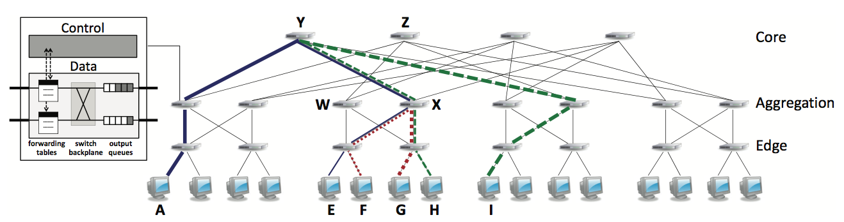
Full Bisection Bandwidth Not Sufficient
Must choose good paths for full bisectional throughput
Load-agnostic routing
  Use ECMP across multiple potential paths
  Can collide, but ephemeral? Not if long-lived, large elephants
Load-aware routing
  Centralized flow scheduling, end-host congestion feedback, switch local algorithms

Slide 27
Conclusion
Cloud computing
  Major trend in IT industry
  Today’s equivalent of factories
Datacenter networking
  Regular topologies interconnecting VMs
  Mix of Ethernet and IP networking
Modular, multi-tier applications
  New ways of building applications
  New performance challenges

