Slide 1
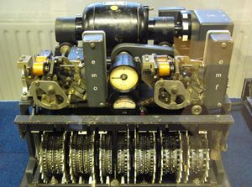
Naming Security
Mike Freedman
COS 461: Computer Networks
http://www.cs.princeton.edu/courses/archive/spr20/cos461/

Slide 2
Network Security
Application layer
E-mail: PGP, using a web-of-trust
Web: HTTP-S, using a certificate hierarchy
Transport layer
Transport Layer Security/ Secure Socket Layer
Network layer
IP Sec
Network infrastructure
DNS-Sec and BGP-Sec

Slide 3
Continuation of Lec 18

Slide 4
Transport Layer Security (TLS)
Based on the earlier Secure Socket Layer (SSL) originally developed by Netscape

Slide 5
TLS Handshake Protocol
Send new random value, list of supported ciphers
Send pre-secret, encrypted under PK
Create shared secret key from pre-secret and random
Switch to new symmetric-key cipher using shared key
Send new random value, digital certificate with PK
Create shared secret key from pre-secret and random
Switch to new symmetric-key cipher using shared key

Slide 6
TLS Record Protocol
Messages from application layer are:
Fragmented or coalesced into blocks
Optionally compressed
Integrity-protected using an HMAC
Encrypted using symmetric-key cipher
Passed to the transport layer (usually TCP)
Sequence #s on record-protocol messages
Prevents replays and reorderings of messages

Slide 7
Comments on HTTPS
HTTPS authenticates server, not content
If CDN (Akamai) serves content over HTTPS, customer must trust Akamai not to change content
Symmetric-key crypto after public-key ops
Handshake protocol using public key crypto
Symmetric-key crypto much faster (100-1000x)
HTTPS on top of TCP, so reliable byte stream
Can leverage fact that transmission is reliable to ensure: each data segment received exactly once
Adversary can’t successfully drop or replay packets

Slide 8
IP Security

Slide 9
IP Security
There are range of app-specific security mechanisms
eg. TLS/HTTPS, S/MIME, PGP, Kerberos, …
But security concerns that cut across protocol layers
Implement by the network for all applications?
Enter IPSec!

Slide 10
IPSec
General IP Security framework
Allows one to provide
Access control, integrity, authentication, originality, and confidentiality
Applicable to different settings
Narrow streams: Specific TCP connections
Wide streams: All packets between two gateways

Slide 11
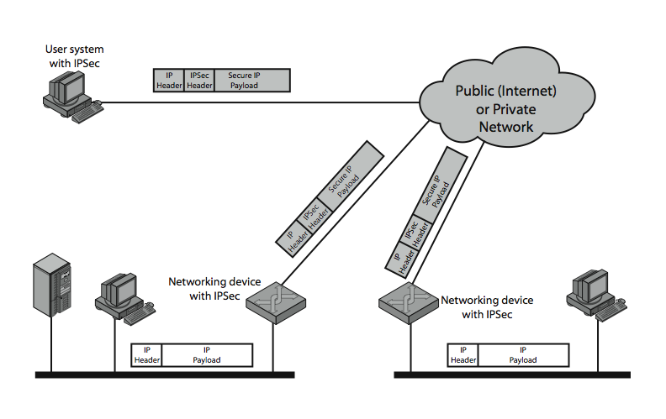
IPSec Uses

Slide 12
Benefits of IPSec
If in a firewall/router:
Strong security to all traffic crossing perimeter
Resistant to bypass
Below transport layer
Transparent to applications
Can be transparent to end users
Can provide security for individual users

Slide 13
IP Security Architecture
Specification quite complex
Mandatory in IPv6, optional in IPv4
Two security header extensions:
Authentication Header (AH)
Connectionless integrity, origin authentication
MAC over most header fields and packet body
Anti-replay protection
Encapsulating Security Payload (ESP)
These properties, plus confidentiality
Notes:
Not as robust: Can detect duplicates, but not lost or re-ordered…
• RFC 2401: An overview of a security architecture
• RFC 2402: Description of a packet authentication extension to IPv4 and IPv6
• RFC 2406: Description of a packet encryption extension to IPv4 and IPv6
• RFC 2408: Specification of key management capabilities

Slide 14
Encapsulating Security Payload (ESP)
Transport mode: Data encrypted, but not header
After all, network headers needed for routing!
Can still do traffic analysis, but is efficient
Good for host-to-host traffic
Tunnel mode (“IP-in-IP”)
Encrypts entire IP packet
Add new header for next hop
Good for VPNs, gateway-to-gateway security

Slide 15
Replay Protection is Hard
Goal: Eavesdropper can’t capture encrypted packet and duplicate later
Easy with TLS/HTTP on TCP: Reliable byte stream
But IP Sec at packet layer; transport may not be reliable
IP Sec solution: Sliding window on sequence #’s
All IPSec packets have a 64-bit monotonic sequence number
Receiver keeps track of which seqno’s seen before
[lastest – windowsize + 1 , latest] ; windowsize typically 64 packets
Accept packet if
seqno > latest (and update latest)
Within window but has not been seen before
If reliable, could just remember last, and accept iff last + 1

Slide 16
DNS Security

Slide 17
Hierarchical Naming in DNS
unnamed root
com
edu
org
ac
uk
zw
arpa
generic domains
country domains
bar
ac
in-
addr
west
east
cam
12
foo
my
usr
34
my.east.bar.edu
usr.cam.ac.uk
56
12.34.56.0/24

Slide 18
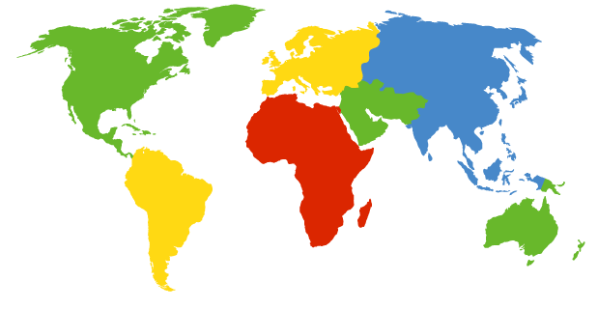
DNS Root Servers
13 root servers (see http://www.root-servers.org/)
Labeled A through M
A Verisign, Dulles, VA
C Cogent, Herndon, VA (also Los Angeles)
D U Maryland College Park, MD
G US DoD Vienna, VA
H ARL Aberdeen, MD
J Verisign, ( 11 locations)
K RIPE London (+ Amsterdam, Frankfurt)
I Autonomica, Stockholm (plus 3 other locations)
E NASA Mt View, CA
F Internet Software C. Palo Alto, CA (and 17 other locations)
m WIDE Tokyo
B USC-ISI Marina del Rey, CA
L ICANN Los Angeles, CA

Slide 19
DoS attacks on DNS Availability
Feb. 6, 2007
Botnet attack on the 13 Internet DNS root servers
Lasted 2.5 hours
None crashed, but two performed badly:
g-root (DoD), l-root (ICANN)
Most other root servers use anycast

Slide 20
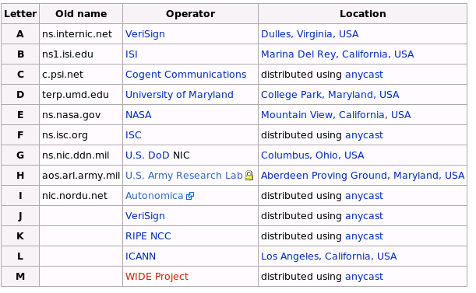
Defense: Replication and Caching
source: wikipedia

Slide 21
Denial-of-Service Attacks on Hosts
×40 amplification
DNS Query SrcIP: DoS Target
(60 bytes)
DNS Response
(3000 bytes)
DNS Server
DoS Source
DoS Target
580,000 open resolvers on Internet (Kaminsky-Shiffman’06)

Slide 22

Preventing Amplification Attacks
attacker
ip spoofed packets
open
amplifier
replies
prevent
ip spoofing
disable
open amplifiers
victim

Slide 23
DNS Integrity and the TLD Operators
If domain name doesn’t exist, DNS should return NXDOMAIN (non-existant domain) msg
Verisign instead creates wildcard records for all .com and .net names not yet registered
September 15 – October 4, 2003
Redirection for these domain names to Verisign web portal: “to help you search”
And serve you ads…and get “sponsored” search
Verisign and online advertising companies make $$

Slide 24
DNS Integrity: Cache Poisoning
Was answer from an authoritative server?
Or from somebody else?
DNS cache poisoning
Client asks for www.evil.com
Nameserver authoritative for www.evil.com returns additional section for (www.cnn.com, 1.2.3.4, A)
Thanks! I won’t bother check what I asked for

Slide 25
DNS Integrity: DNS Hijacking
To prevent cache poisoning, client remembers:
The domain name in the request
A 16-bit request ID (used to demux UDP response)
DNS hijacking
16 bits: 65K possible IDs
What rate to enumerate all in 1 sec? 64B/packet
64*65536*8 / 1024 / 1024 = 32 Mbps
Prevention: also randomize DNS source port
Kaminsky attack: this source port… wasn’t random
http://unixwiz.net/techtips/iguide-kaminsky-dns-vuln.html

Slide 26
Let’s strongly believe the answer! Enter DNSSEC
DNSSEC protects against data spoofing and corruption
DNSSEC also provides mechanisms to authenticate servers and requests
DNSSEC provides mechanisms to establish authenticity and integrity

Slide 27
PK-DNSSEC (Public Key)
The DNS servers sign the hash of resource record set with its private (signature) keys
Public keys can be used to verify the SIGs
Leverages hierarchy:
Authenticity of name server’s public keys is established by a signature over the keys by the parent’s private key
In ideal case, only roots’ public keys need to be distributed out-of-band

Slide 28
Verifying the Tree
Question: www.cnn.com ?
. (root)
dns.cs.princeton.edu
www.cnn.com A ?
src.cs.princeton.edu
ask .com server
SIG (ip addr and PK of .com server)
resolver
stub
resolver
www.cnn.com A ?
xxx.xxx.xxx.xxx
www.cnn.com A ?
.com
transaction
signatures
ask cnn.com server
SIG (ip addr and PK of cnn.com server)
add to cache
www.cnn.com A ?
SIG (xxx.xxx.xxx.xxx)
cnn.com

Slide 29
Conclusions
Security at many layers
Application, transport, and network layers
Customized to the properties and requirements
Exchanging keys
Public key certificates
Certificate authorities vs. Web of trust
Next time
Interdomain routing security
Learn more: take COS 432 next year!

