Slide 1

Communication Security
Mike Freedman
COS 461: Computer Networks
http://www.cs.princeton.edu/courses/archive/spr20/cos461/

Slide 2
Internet’s Design: Insecure
Designed for simplicity
“On by default” design
Readily available zombie machines
Attacks look like normal traffic
Internet’s federated operation obstructs cooperation for diagnosis/mitigation

Slide 3
Eavesdropping - Message Interception (Attack on Confidentiality)
Unauthorized access to information
Packet sniffers and wiretappers (e.g. tcpdump)
Illicit copying of files and programs
A
B
Eavesdropper

Slide 4
Integrity Attack - Tampering
Stop the flow of the message
Delay and optionally modify the message
Release the message again
A
B
Perpetrator

Slide 5
Authenticity Attack - Fabrication
Unauthorized assumption of other’s identity
Generate and distribute objects under identity
A
B
Masquerader: from A

Slide 6
Attack on Availability
Destroy hardware (cutting fiber) or software
Modify software in a subtle way
Corrupt packets in transit
Blatant denial of service (DoS):
Crashing the server
Overwhelm the server (use up its resource)
A
B

Slide 7
Basic Security Properties
Confidentiality:
Authenticity:
Integrity:
Availability:
Non-repudiation:
Access control:
Concealment of information or resources
Identification and assurance of origin of info
Trustworthiness of data/resources; preventing improper and unauthorized changes
Ability to use desired information or resource
Offer of evidence that a party indeed is sender or a receiver of certain information
Facilities to determine and enforce who is allowed access to what resources (host, software, network, …)

Slide 8
Security protocols at many layers
Application layer
E-mail: PGP, using a web-of-trust
Web: HTTP-S, using a certificate hierarchy
Transport layer
Transport Layer Security/ Secure Socket Layer
Network layer
IP Sec
Network infrastructure
DNS-Sec and BGP-Sec

Slide 9
Introduction to Cryptography

Slide 10
Cryptographic Algorithms: Goal
One-way functions: cryptographic hash
Easy to compute hash
Hard to invert
“Trapdoor” functions: encryption/signatures
Given ciphertext alone, hard to compute plaintext (invert)
Given ciphertext and key (the “trapdoor”), relatively easy to compute plaintext
“Level” of security often based on “length” of key

Slide 11
Encryption and MAC/Signatures
Confidentiality (Encryption)
Sender:
Compute C = Enc_{K}(M)
Send C
Receiver:
Recover M = Dec_{K}(C)
Auth/Integrity (MAC / Signature)
Sender:
Compute s = Sig_{K}(Hash (M))
Send <M, s>
Receiver:
Compute s’ = Ver_{K}(Hash (M))
Check s’ == s
These are simplified forms of the actual algorithms

Slide 12
Symmetric vs. Asymmetric Crypto a.k.a. Secret vs. Public Key Crypto
Symmetric crypto (all crypto pre 1970s)
Sender and recipient share a common key
All classical encryption algorithms are private-key
Dual use: confidentiality or authentication/integrity
Encryption vs. msg authentication code (MAC)
Public-key crypto
(Public, private) key associated with each entity (“Alice”)
Anybody can encrypt to Alice, anybody can verify Alice’s msg
Only Alice can decrypt, only Alice can “sign”
Developed to address “key distribution” problem and “digital signatures” (w/o prior establishment)

Slide 13
Why still both?
Symmetric Pros and Cons
Simple and very fast (1000-10000x faster than asymmetric)
Must agree/distribute the key beforehand
AES/CBC (256-bit) → 80 MB/s (for 2048 bits, that’s .003 ms)
Public Key Pros and Cons
Easier key pre-distribution: “Public Key Infrastructure” (PKI)
Much slower
2048-RSA → 6.1ms Decrypt, 0.16ms Encrypt
Common “engineering” approach:
Best of both worlds via “hybrid” scheme: Use public key to distribute a new random ”session” key b/w sender and recipient, then symmetric crypto for remainder of session

Slide 14
Email Security: Pretty Good Privacy (PGP)

Slide 15


Sender and Receiver Keys
If the sender knows the receiver’s public key
Confidentiality
Receiver authentication
If the receiver knows the sender’s public key
Sender authentication
Sender non-repudiation

Slide 16
Sending an E-Mail Securely
Sender digitally signs the message
Using the sender’s private key
Sender encrypts the data
Using a one-time session key
Sending the session key, encrypted with the receiver’s public key
Sender converts to an ASCII format
Converting the message to base64 encoding
(Email messages must be sent in ASCII)

Slide 17

Public Key Certificate
Binding between identity and a public key
“Identity” is, for example, an e-mail address
“Binding” ensured using a digital signature
Contents of a certificate
Identity of the entity being certified
Public key of the entity being certified
Identity of the signer
Digital signature
Digital signature algorithm id

Slide 18
Web of Trust for PGP
Decentralized solution
Protection against government intrusion
No central certificate authorities
Customized solution
Individual decides whom to trust, and how much
Multiple certificates with different confidence levels
Key-signing parties!
Collect and provide public keys in person
Sign other’s keys, and get your key signed by others

Slide 19
HTTP Security

Slide 20
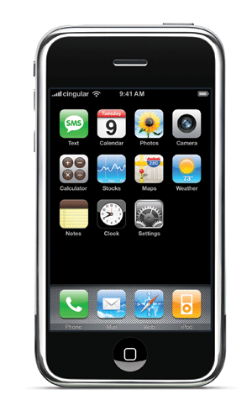

HTTP Threat Model
Eavesdropper
Listening on conversation (confidentiality)
Man-in-the-middle
Modifying content (integrity)
Impersonation
Bogus website (authentication, confidentiality)

Slide 21
HTTP-S: Securing HTTP
HTTP sits on top of secure channel (SSL/TLS)
https:// vs. http://
TCP port 443 vs. 80
All (HTTP) bytes encrypted and authenticated
No change to HTTP itself!
Where to get the key???
HTTP
Secure Transport Layer
TCP
IP
Link layer

Slide 22
Learning a Valid Public Key
What is that lock?
Securely binds domain name to public key (PK)
If PK is authenticated, then any message signed by that PK cannot be forged by non-authorized party
Believable only if you trust the attesting body
Bootstrapping problem: Who to trust, and how to tell if this message is actually from them?

Slide 23
Hierarchical Public Key Infrastructure
Public key certificate
Binding between identity and a public key
“Identity” is, for example, a domain name
Digital signature to ensure integrity
Certificate authority
Issues public key certificates and verifies identities
Trusted parties (e.g., VeriSign, GoDaddy, Comodo)
Preconfigured certificates in Web browsers

Slide 24
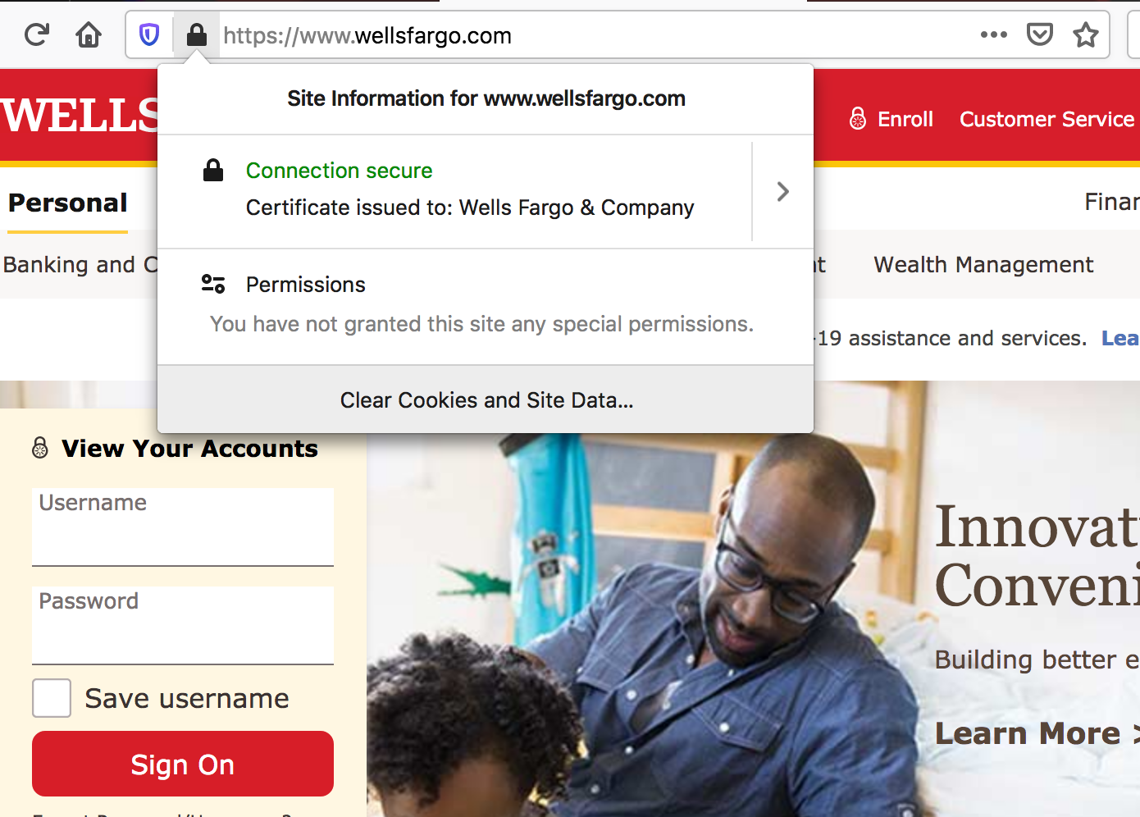
Public Key Certificate

Slide 25
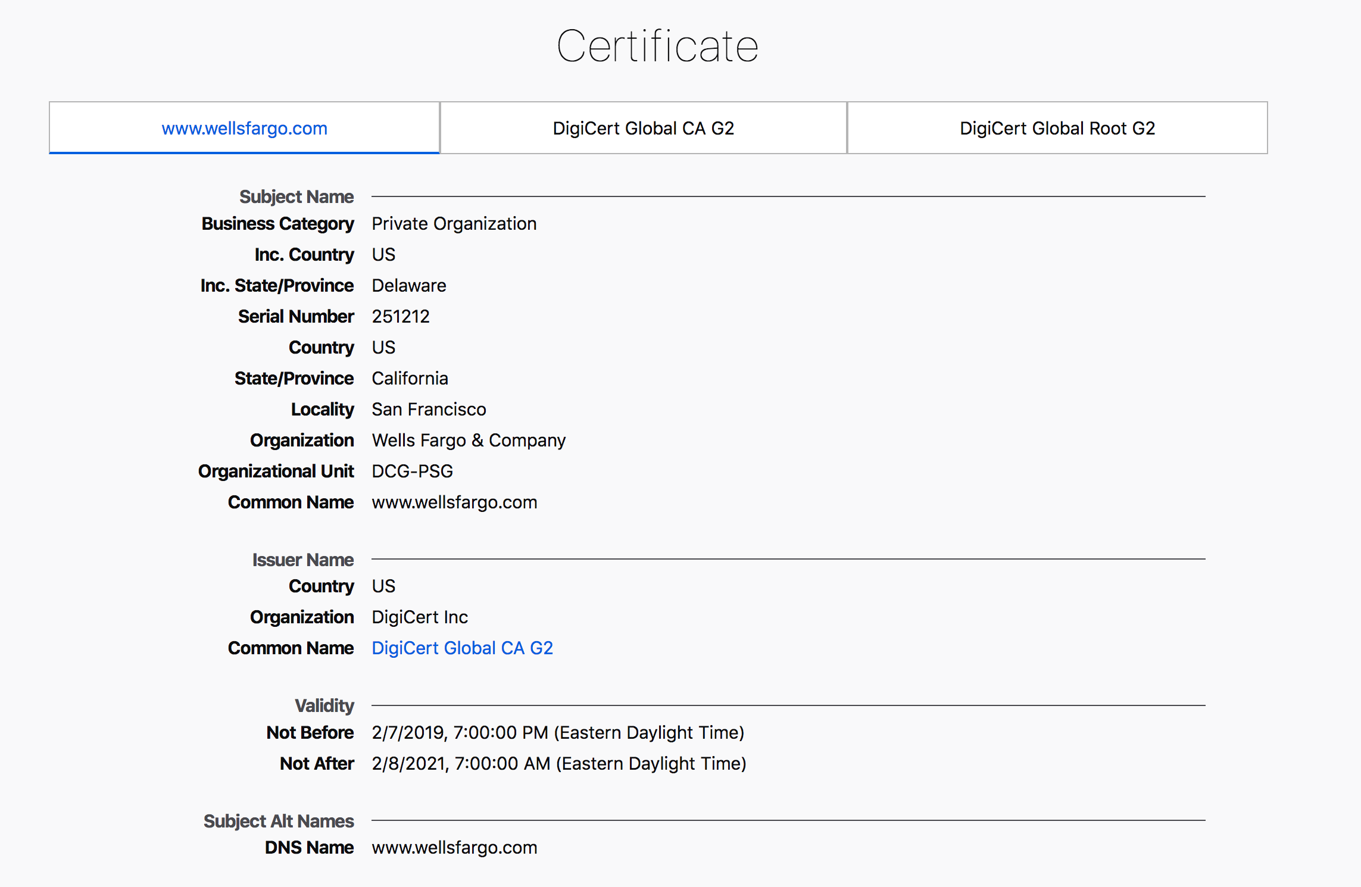

Slide 26
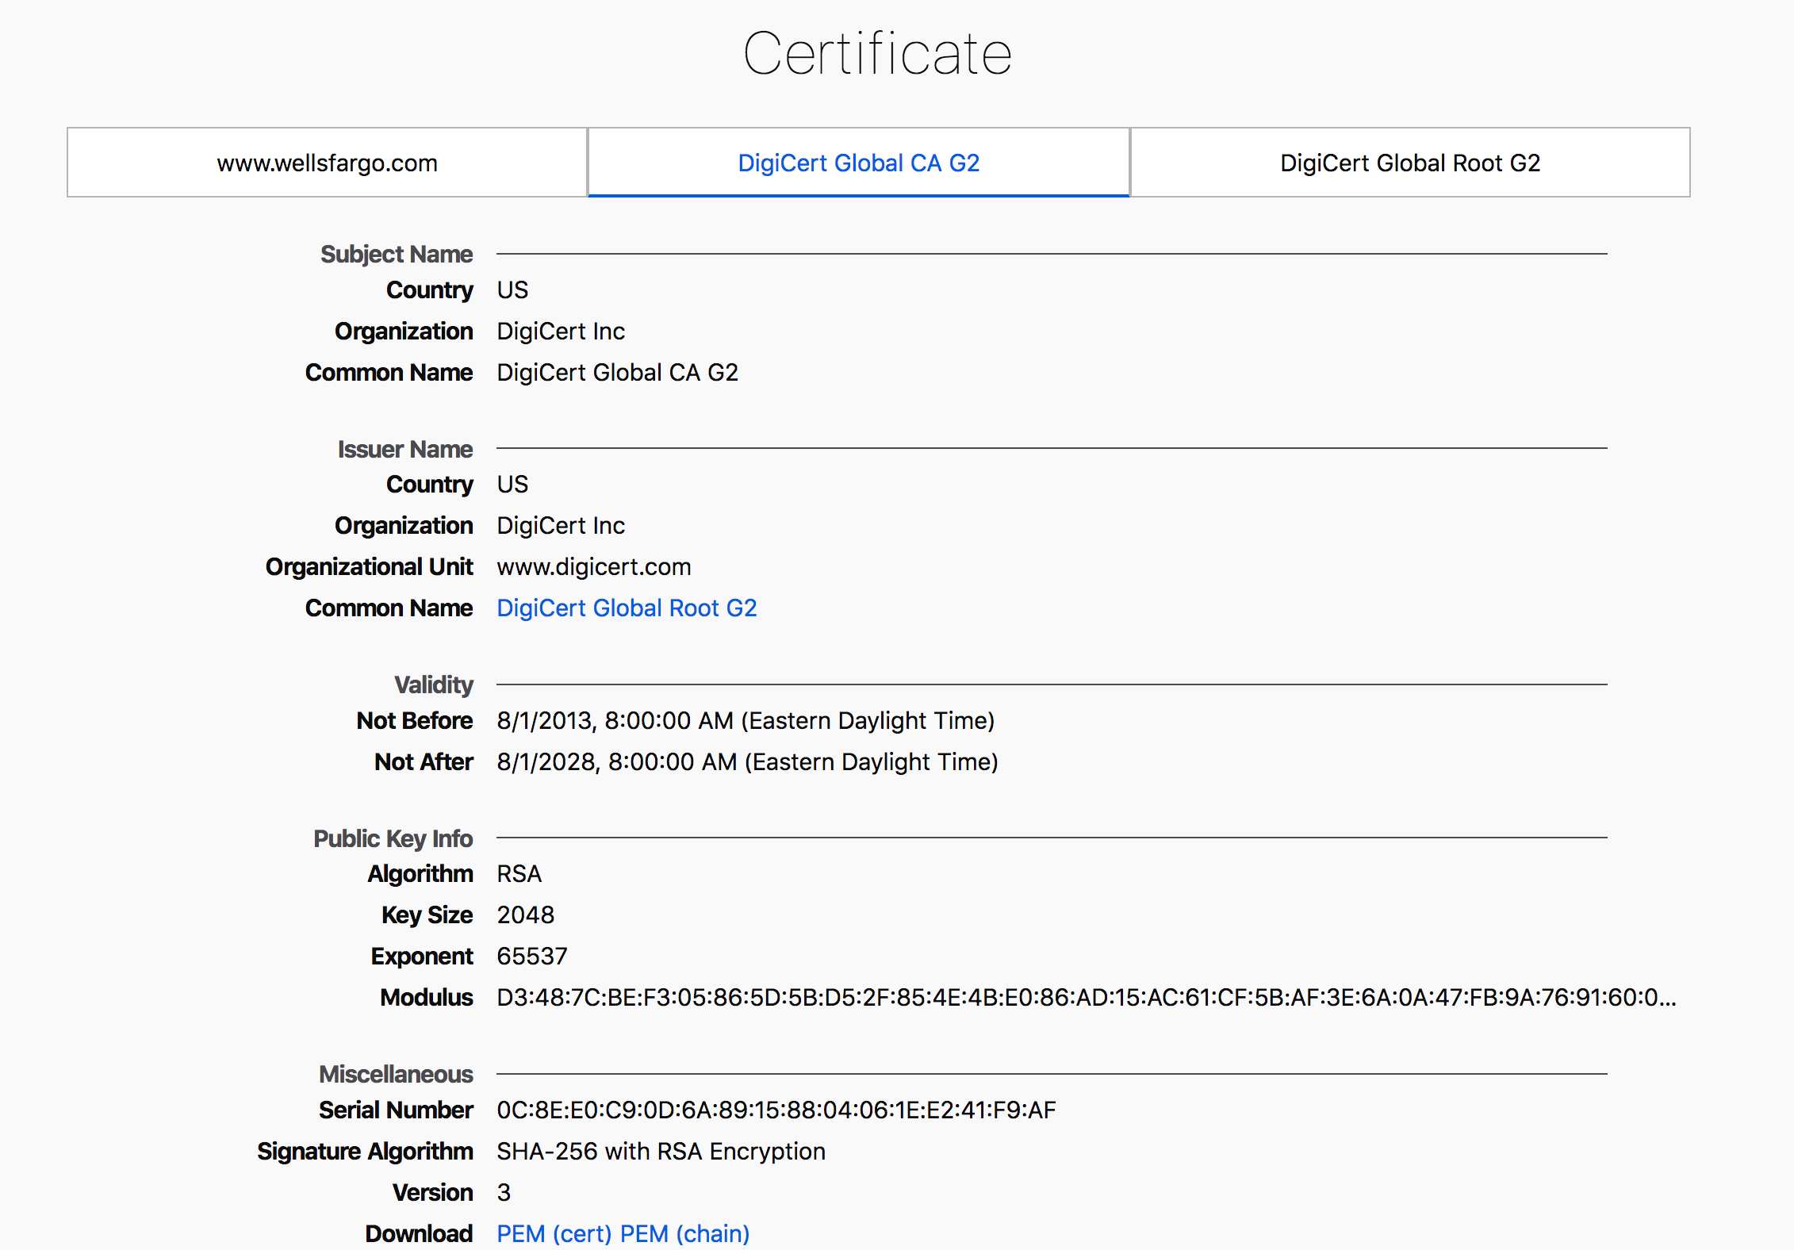

Slide 27
Transport Layer Security (TLS)
Based on the earlier Secure Socket Layer (SSL) originally developed by Netscape

Slide 28
TLS Handshake Protocol
Send new random value, list of supported ciphers
Send pre-secret, encrypted under PK
Create shared secret key from pre-secret and random
Switch to new symmetric-key cipher using shared key
Send new random value, digital certificate with PK
Create shared secret key from pre-secret and random
Switch to new symmetric-key cipher using shared key

Slide 29
TLS Record Protocol
Messages from application layer are:
Fragmented or coalesced into blocks
Optionally compressed
Integrity-protected using an HMAC
Encrypted using symmetric-key cipher
Passed to the transport layer (usually TCP)
Sequence #s on record-protocol messages
Prevents replays and reorderings of messages

Slide 30
Comments on HTTPS
HTTPS authenticates server, not content
If CDN (Akamai) serves content over HTTPS, customer must trust Akamai not to change content
Symmetric-key crypto after public-key ops
Handshake protocol using public key crypto
Symmetric-key crypto much faster (100-1000x)
HTTPS on top of TCP, so reliable byte stream
Can leverage fact that transmission is reliable to ensure: each data segment received exactly once
Adversary can’t successfully drop or replay packets

Slide 31
IP Security

Slide 32
IP Security
There are range of app-specific security mechanisms
eg. TLS/HTTPS, S/MIME, PGP, Kerberos, …
But security concerns that cut across protocol layers
Implement by the network for all applications?
Enter IPSec!

Slide 33
IPSec
General IP Security framework
Allows one to provide
Access control, integrity, authentication, originality, and confidentiality
Applicable to different settings
Narrow streams: Specific TCP connections
Wide streams: All packets between two gateways

Slide 34
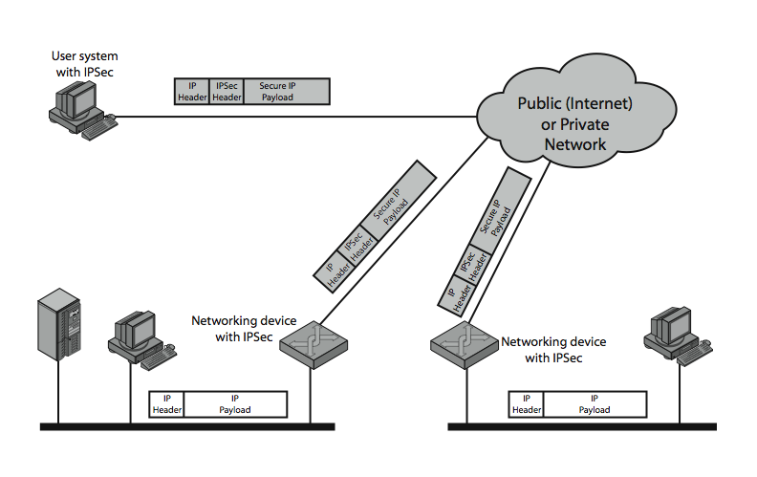
IPSec Uses

Slide 35
Benefits of IPSec
If in a firewall/router:
Strong security to all traffic crossing perimeter
Resistant to bypass
Below transport layer
Transparent to applications
Can be transparent to end users
Can provide security for individual users

Slide 36
IP Security Architecture
Specification quite complex
Mandatory in IPv6, optional in IPv4
Two security header extensions:
Authentication Header (AH)
Connectionless integrity, origin authentication
MAC over most header fields and packet body
Anti-replay protection
Encapsulating Security Payload (ESP)
These properties, plus confidentiality
Notes:
Not as robust: Can detect duplicates, but not lost or re-ordered…
• RFC 2401: An overview of a security architecture
• RFC 2402: Description of a packet authentication extension to IPv4 and IPv6
• RFC 2406: Description of a packet encryption extension to IPv4 and IPv6
• RFC 2408: Specification of key management capabilities

Slide 37
Encapsulating Security Payload (ESP)
Transport mode: Data encrypted, but not header
After all, network headers needed for routing!
Can still do traffic analysis, but is efficient
Good for host-to-host traffic
Tunnel mode (“IP-in-IP”)
Encrypts entire IP packet
Add new header for next hop
Good for VPNs, gateway-to-gateway security

Slide 38
Replay Protection is Hard
Goal: Eavesdropper can’t capture encrypted packet and duplicate later
Easy with TLS/HTTP on TCP: Reliable byte stream
But IP Sec at packet layer; transport may not be reliable
IP Sec solution: Sliding window on sequence #’s
All IPSec packets have a 64-bit monotonic sequence number
Receiver keeps track of which seqno’s seen before
[lastest – windowsize + 1 , latest] ; windowsize typically 64 packets
Accept packet if
seqno > latest (and update latest)
Within window but has not been seen before
If reliable, could just remember last, and accept iff last + 1

Slide 39
Conclusions
Security at many layers
Application, transport, and network layers
Customized to the properties and requirements
Exchanging keys
Public key certificates
Certificate authorities vs. Web of trust
Next time
Naming security
Learn more: take COS 432 next year!

