Slide 1

Wireless Networks
Mike Freedman
COS 461: Computer Networks
http://www.cs.princeton.edu/courses/archive/spring20/cos461/

Slide 2
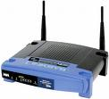

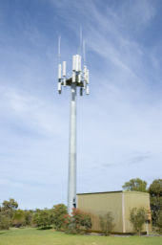
Widespread Deployment
Worldwide cellular subscribers
  1993: 34 million
  2005: more than 2 billion
  2012: 6.8 billion
      (2.1B with mobile broadband)
  >> 1.2B landline subscribers
Wireless local area networks
  Wireless adapters built into laptops, tablets, & phones
  More ubiquitous than wired broadband? 700M in 2012

Slide 3
Wireless Links

Slide 4
Wireless Properties
Interference / bit errors
  More sources of corruption compared to wired
Multipath propagation
  Signal does not travel in a straight line
Broadcast medium
  All traffic to everyone
Power trade-offs
  Important for power constrained devices

Slide 5
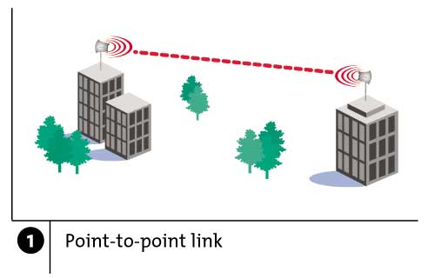
Wireless Links: High Bit Error Rate
Decreasing signal strength
  Disperses as it travels greater distance
  Attenuates as it passes through matter

Slide 6
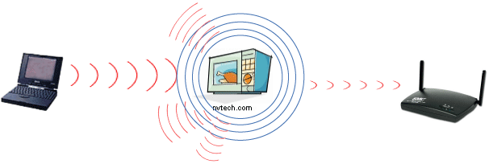
Wireless Links: High Bit Error Rate
Interference from other sources
  Radio sources in same frequency band
  E.g., 2.4 GHz wireless phone interferes with 802.11b wireless LAN
  Electromagnetic noise (e.g., microwave oven)

Slide 7
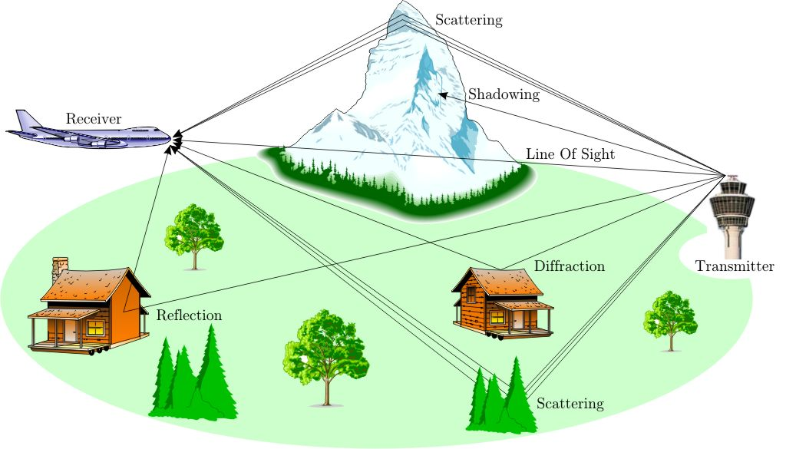
Wireless Links: High Bit Error Rate
Multi-path propagation
  Electromagnetic waves reflect off objects
  Taking many paths of different lengths
  Causing blurring of signal at the receiver
receiver
transmitter

Slide 8
Dealing With Bit Errors
Wireless vs. wired links
  Wired: most loss is due to congestion
  Wireless: higher, time-varying bit-error rate
Dealing with high bit-error rates
  Sender could increase transmission power
    Requires more energy (bad for battery-powered hosts)
    Creates more interference with other senders
  Stronger error detection and recovery
    More powerful error detection/correction codes
    Link-layer retransmission of corrupted frames

Slide 9
Wireless Links: Broadcast Limitations
Wired broadcast links
  E.g., Ethernet bridging, in wired LANs
  All nodes receive transmissions from all other nodes
Wireless broadcast: hidden terminal problem
C
A and B hear each other
B and C hear each other
But, A and C do not
So, A and C are unaware of their interference at B
B
A

Slide 10
Wireless Links: Broadcast Limitations
Wired broadcast links
  E.g., Ethernet bridging, in wired LANs
  All nodes receive transmissions from all other nodes
Wireless broadcast: fading over distance
A
B
C
A and B hear each other
B and C hear each other
But, A and C do not
So, A and C are unaware of their interference at B
A’s signal
strength
C’s signal
strength
space

Slide 11
Example Wireless Link Technologies
Data networks
  802.15.1 (Bluetooth): 2.1 Mbps – 10 m
  802.11b (WiFi): 5-11 Mbps – 100 m
  802.11a and g (WiFi): 54 Mbps – 100 m
  802.11n (WiFi): 200 Mbps – 100 m
  802.16 (WiMax): 70 Mbps – 10 km
Cellular networks, outdoors
  2G: 56 Kbps
  3G: 384 Kbps
  3G enhanced (“4G”): 4 Mbps
  LTE: 10-100 Mbps

Slide 12
Wireless Network: Wireless Link
Wireless link
Typically used to connect mobile(s) to base station
Also used as backbone link
Multiple access protocol coordinates link access
network
infrastructure

Slide 13
Wireless Network: Wireless Hosts
Wireless host
Laptop, smartphone
Run applications
May be stationary (non-mobile) or mobile
network
infrastructure

Slide 14
Wireless Network: Base Station
Base station
Typically connected to wired network
Relay responsible for sending packets between wired network and wireless host(s) in its “area”
E.g., cell towers, 802.11 access points
network
infrastructure

Slide 15
Wireless Network: Infrastructure
Network infrastructure
Larger network with which a wireless host wants to communicate
Typically a wired network
Provides traditional network services
May not always exist
network
infrastructure

Slide 16
Infrastructure Mode (APs)
Infrastructure mode
Base station connects mobiles into wired network
Network provides services (addressing, routing, DNS)
Handoff: mobile changes base station providing connection to wired network
network
infrastructure

Slide 17
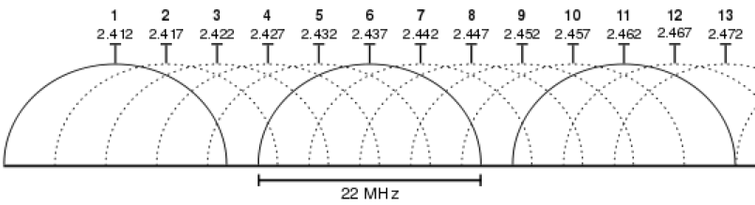
Channels and Association
Multiple channels at different frequencies
  Network administrator chooses frequency for AP
  Interference if channel is same as neighboring AP

Slide 18
Channels and Association
Multiple channels at different frequencies
  Network administrator chooses frequency for AP
  Interference if channel is same as neighboring AP
Access points send periodic beacon frames
  Containing AP’s name (SSID) and MAC address
  Host scans channels, listening for beacon frames
  Host selects an access point: association request/response protocol between host and AP

Slide 19
Mobility Within the Same Subnet
H1 remains in same IP subnet
  IP address of the host can remain same
  Ongoing data transfers can continue uninterrupted
H1 recognizes the need to change
  H1 detects a weakening signal
  Starts scanning for stronger one
Changes APs with same SSID
  H1 disassociates from one
  And associates with other
Switch learns new location
  Self-learning mechanism
router
hub or
switch
BBS 1
AP 1
AP 2
H1
BBS 2

Slide 20
Questions
Loss is primary caused by bit errors
  (Y) Ethernet (Wired)
  (M) 802.11 (Wireless)
  (C) Both
  Neither
All hosts on subnet see all communication
  (Y) Ethernet (Wired)
  (M) 802.11 (Wireless)
  (C) Both
  Neither

Slide 21
Questions
Loss is primary caused by bit errors
  (Y) Ethernet (Wired)
  (M) 802.11 (Wireless)
  (C) Both
  Neither
All hosts on subnet see all communication
  (Y) Ethernet (Wired)
  (M) 802.11 (Wireless)
  (C) Both
  Neither
Notes:
Loss is primary caused by bit errors: B
All hosts on subset see all communication: A

Slide 22
WiFi: 802.11 Wireless LANs

Slide 23
802.11 LAN Architecture
Access Point (AP)
  Base station that communicates with the wireless hosts
Basic Service Set (BSS)
  Coverage of one AP
  AP acts as the master
  Identified by an “network name” known as an SSID
Internet
hub, switch
or router
AP
BSS 1
AP
BSS 2
SSID: Service Set Identifier

Slide 24
CSMA: Carrier Sense, Multiple Access
Multiple access: channel is shared medium
  Station: wireless host or access point
  Multiple stations may want to transmit at same time
Carrier sense: sense channel before sending
  Station doesn’t send when channel is busy
  To prevent collisions with ongoing transfers
  But, detecting ongoing transfers isn’t always possible
A
B
C
C
A’s signal
strength
C’s signal
strength
B
A
space

Slide 25
CA: Collision Avoidance, Not Detection
Collision detection in wired Ethernet
  Station listens while transmitting
  Detects collision with other transmission
  Aborts transmission and tries sending again
Problem #1: cannot detect all collisions
  Hidden terminal problem
  Fading

Slide 26
CA: Collision Avoidance, Not Detection
Collision detection in wired Ethernet
  Station listens while transmitting
  Detects collision with other transmission
  Aborts transmission and tries sending again
Problem #1: cannot detect all collisions
  Hidden terminal problem
  Fading
Problem #2: listening while sending
  Strength of received signal is much smaller
  Expensive to build hardware that detects collisions
So, 802.11 does collision avoidance, not detection

Slide 27
Hidden Terminal Problem
A
B
C
A and C can’t see each other, both send to B
Occurs b/c 802.11 relies on physical carrier sensing, which is susceptible to hidden terminal problem

Slide 28
Virtual carrier sensing
First exchange control frames before transmitting data
  Sender issues “Request to Send” (RTS), incl. length of data
  Receiver responds with “Clear to Send” (CTS)
If sender sees CTS, transmits data (of specified length)
If other node sees CTS, will idle for specified period
If other node sees RTS but not CTS, free to send

Slide 29
Hidden Terminal Problem
A
B
C
A and C can’t see each other, both send to B
RTS/CTS can help
  Both A and C would send RTS that B would see first
  B only responds with one CTS (say, echoing A’s RTS)
  C detects that CTS doesn’t match and won’t send

Slide 30
Exposed Terminal Problem
A
B
C
D
B sending to A, C wants to send to D
As C receives packets, carrier sense would prevent it from sending to D, even though wouldn’t interfere
RTS/CTS can help
  C hears RTS from B, but not CTS from A
  C knows it’s transmission will not interfere with A
  C is safe to transmit to D

Slide 31
Impact on Higher-Layer Protocols
Wireless and mobility change path properties
  Wireless: higher packet loss, not from congestion
  Mobility: transient disruptions, and changes in RTT
Logically, impact should be minimal …
  Best-effort service model remains unchanged
  TCP and UDP can (and do) run over wireless, mobile
But, performance definitely is affected
  TCP treats packet loss as a sign of congestion
  TCP tries to estimate the RTT to drive retransmissions
  TCP does not perform well under out-of-order packets
Internet not designed with these issues in mind

Slide 32
Questions
RTS/CTS more like:
  (Y) Statistical multiplexing
  (M) Time-division multiplexing
  (C) Frequency-division multiplexing
Which of following is NOT true?
(Y) Collisions are minimized when RTS/CTS used.
(M) Sender can always detect a collision without feedback from receiver.
(C) TCP congestion control works poorly in wireless without link-layer retransmission.
(A) Wireless generally has higher loss rates than wired.

Slide 33
Questions
RTS/CTS more like:
  (Y) Statistical multiplexing
  (M) Time-division multiplexing
  (C) Frequency-division multiplexing
Which of following is NOT true?
(Y) Collisions are minimized when RTS/CTS used.
(M) Sender can always detect a collision without feedback from receiver.
(C) TCP congestion control works poorly in wireless without link-layer retransmission.
(A) Wireless generally has higher loss rates than wired.

Slide 34
Bluetooth: 802.15.1
“personal-area-networks”

Slide 35
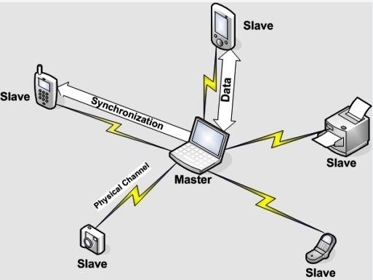
Bluetooth piconets
Up to 7 “slave devices and 225 “parked” devices
Operates on unlicensed wireless spectrum
  How to prevent interference?

Slide 36
PHY: Spread Spectrum – Frequency Hopping
Nodes rapidly jump between frequencies
Sender and receiver coordinated in jumps
  How coordinate? Pseudorandom number generator, with shared input known to sender/receiver
If randomly collide with other transmitted, only for short period before jump again
Bluetooth
  79 frequencies, on each frequency for 625 microseconds
  Each channel also uses TDMA, with each frame taking 1/3/5 consecutive slots.
  Only master can start in odd slot, slave only in response
Notes:
Question: why bluetooth use this approach of TDMA, rather than CSMA?

Slide 37
Infrastructure vs. Ad Hoc
Infrastructure mode
  Wireless hosts are associated with a base station
  Traditional services provided by the connected network
  E.g., address assignment, routing, and DNS resolution
Ad hoc networks
  Wireless hosts have no infrastructure to connect to
  Hosts themselves must provide network services
Similar in spirit to the difference between
  Client-server communication
  Peer-to-peer communication

Slide 38
Conclusions
Wireless
  Already a major way people connect to the Internet
  Gradually becoming more than just an access network
Mobility (not discussed)
  Today’s users tolerate disruptions as they move
  … and applications try to hide the effects
  Tomorrow’s users expect seamless mobility
Challenges the design of network protocols
  Wireless breaks the abstraction of a link, and the assumption that packet loss implies congestion
  Mobility breaks association of address and location
  Higher-layer protocols don’t perform as well

Slide 39
The Upside to Interference
Some systems leverage interference
If packets collide once, likely will again
  Can use both collisions to construct original packets
  Reduce effective error rate significantly
If two hosts send to each other through an AP, and collide, AP can broadcast collision to both
  Both know what they sent, can “subtract” that from collision to get the other
  Improves throughput of system!

