Slide 1
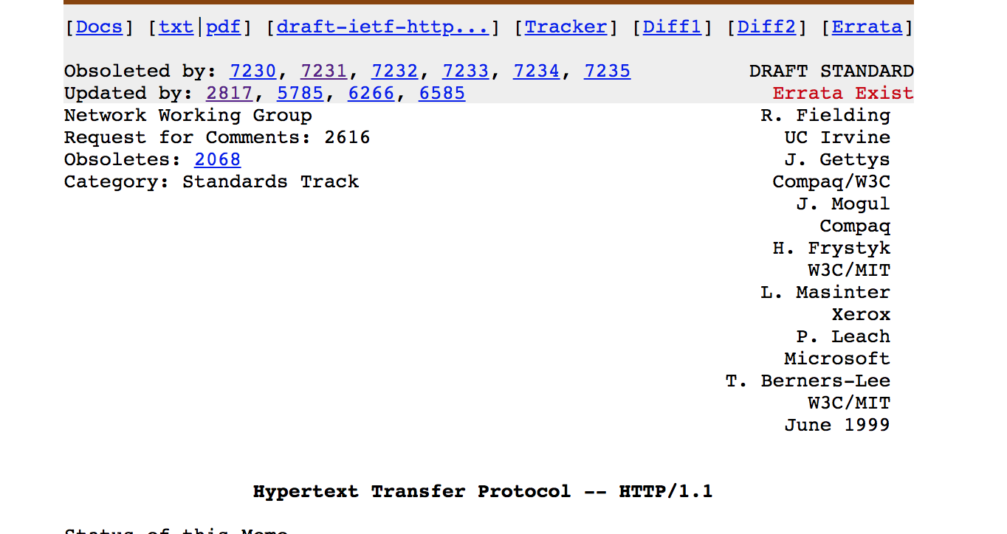
HTTP and the Web
Mike Freedman
https://www.cs.princeton.edu/courses/archive/spr20/cos461/
1
Notes:
1

Slide 2
Two Forms of Header Formats
Fixed: Every field (type, length) defined
Fast parsing (good for hardware implementations)
Not human readable
Fairly static (IPv6 ~20 years to deploy)
E.g., Ethernet, IP, TCP headers
Variable length headers
Slower parsing (hard to implement in hardware)
Human readable
Extensible
E.g., HTTP (Web), SMTP (Email), XML
2
Notes:
Incremental because you just add a new header label and those that support it will use it
2

Slide 3
HTTP Basics (Overview)
HTTP over bidirectional byte stream (e.g. TCP)
Interaction
Client looks up host (DNS)
Client sends request to server
Server responds with data or error
Requests/responses are encoded in text
Stateless
HTTP maintains no info about past client requests
HTTP “Cookies” allow server to identify client and associate requests into a client session
3
Notes:
3
Why TCP?
- don’t want to have holes in our web page – won’t render correctly
Encoded in text would be “human readable”
Stateless – simplifies the server, reduces resources / client

Slide 4
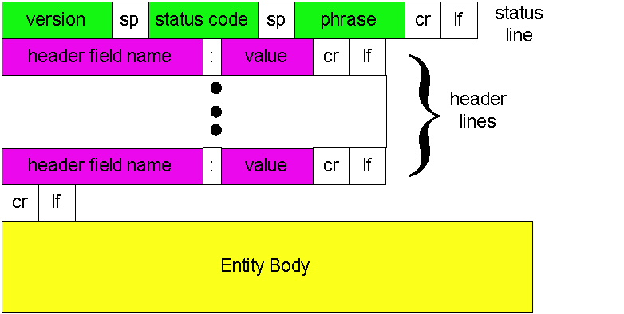
HTTP Response
“cr” is \r “lf” is \n
4
Notes:
Entity Body for 200 is typically the HTML or data for img/js/etc
4

Slide 5
HTTP Request
Request line
Method
GET – return URI
HEAD – return headers only of GET response
POST – send data to the server (forms, etc.)
URL (relative)
E.g., /index.html
HTTP version
5
Notes:
5
Why is it relative?
Rest of URL is implied by what you connect to
Can use Host: header if different

Slide 6
HTTP Request (cont.)
Request headers
Variable length, human-readable
Uses:
Authorization – authentication info
Acceptable document types/encodings
From – user email
If-Modified-Since
Referrer – what caused this page to be requested
User-Agent – client software
Blank-line
Body
6
Notes:
6

Slide 7
HTTP Request Example
GET /index.html HTTP/1.1
Host: www.example.com
Accept-Language: en-us
Accept-Encoding: gzip, deflate
User-Agent: Mozilla/4.0 (compatible; MSIE 5.5; Windows NT 5.0)
Connection: Keep-Alive
7
Notes:
7
Can add more headers easily. Each on their own line

Slide 8
HTTP Response
Status-line
HTTP version (now “1.1”)
3 digit response code
1XX – informational
2XX – success
200 OK
3XX – redirection
301 Moved Permanently
303 Moved Temporarily
304 Not Modified
4XX – client error
404 Not Found
5XX – server error
505 HTTP Version Not Supported
Reason phrase
8
Notes:
8

Slide 9
HTTP Response (cont.)
Headers
Variable length, human-readable
Uses:
Location – for redirection
Server – server software
WWW-Authenticate – request for authentication
Allow – list of methods supported (get, head, etc)
Content-Encoding – E.g x-gzip
Content-Length
Content-Type
Expires (caching)
Last-Modified (caching)
Blank-line
Body
9
Notes:
9
The body contains all the HTML and/or data for images, etc

Slide 10
HTTP Response Example
HTTP/1.1 200 OK
Date: Tue, 27 Mar 2001 03:49:38 GMT
Server: Apache/1.3.14 (Unix) (Red-Hat/Linux) mod_ssl/2.7.1 OpenSSL/0.9.5a DAV/1.0.2 PHP/4.0.1pl2 mod_perl/1.24
Last-Modified: Mon, 29 Jan 2001 17:54:18 GMT
Accept-Ranges: bytes
Content-Length: 4333
Keep-Alive: timeout=15, max=100
Connection: Keep-Alive
Content-Type: text/html
…..
10
Notes:
10

Slide 11
How to Mark End of Message?
Close connection
Only server can do this
One request per TCP connection. Hurts performance.
Content-Length
Must know size of transfer in advance
No body content. Double CRLF marks end
E.g., 304 never have body content
Transfer-Encoding: chunked (HTTP/1.1)
After headers, each chunk is content length in hex, CRLF, then body. Final chunk is length 0.
11
Notes:
11
Server implicitly tells us by closing the connection
Server either explicitly tells us the content length with header field, but problem is that you need to know a priori which, if you have dynamic content, it gets very complicated
304 and other errors / directives have implied lengths of nothing
Chunked encoding, using for dynamic

Slide 12
Example: Chunked Encoding
HTTP/1.1 200 OK <CRLF>
Transfer-Encoding: chunked <CRLF>
<CRLF>
25 <CRLF>
This is the data in the first chunk <CRLF>
1A <CRLF>
and this is the second one <CRLF>
0 <CRLF>
Especially useful for dynamically-generated content, as length is not a priori known
Server would otherwise need to cache data until done generating, and then go back and fill-in length header before transmitting
12
Notes:
Length, then data, length, then data, etc
12

Slide 13
Proxies

Slide 14
Proxies
End host that acts a broker between client and server
Speaks to server on client’s behalf
Why?
Privacy
Content filtering
Caching!!!
14
Notes:
Privacy – server doesn’t know the actual originating addr, just proxy’s
Content filtering – can selectively block requests and instead server up other pages
Caching – Multiple people want the same thing, cache it on proxy and save a request to server
14

Slide 15
Proxies (Cont.)
origin
server
Accept requests from multiple clients
Takes request and reissues it to server
Takes response and forwards to client
Proxy
server
HTTP request
HTTP request
client
HTTP response
HTTP response
HTTP request
HTTP response
client
origin
server
15

Slide 16
HTTP Caching
Why cache?
Lot of objects don’t change (images, js, css)
Reduce # of client connections
Reduce server load
Reduce overall network traffic; save $$$
16

Slide 17
Caching is Hard
Significant fraction (>50%?) of distinct HTTP objects may be uncacheable
Dynamic data: Stock prices, scores, web cams
CGI scripts: results based on passed parameters
Cookies: results may be based on passed data
SSL: encrypted data is not cacheable
Advertising / analytics: owner wants to measure # hits
Random strings in content to ensure unique counting
Yet significant fraction of HTTP bytes are cacheable
Images, video, CSS pages, etc.
Want to limit staleness of cached objects
17
Notes:
17

Slide 18
How long should the client cache for?
Clients (and proxies) cache documents
When should origin be checked for changes?
Every time? Every session? Date?
HTTP includes caching information in headers
HTTP 0.9/1.0 used: “Expires: <date>”; “Pragma: no-cache”
HTTP/1.1 has “Cache-Control”
“No-Cache”, “Max-age: <seconds>”
“ETag: <opaque value>
18
Notes:
18

Slide 19
Why the changes between 1.0 and 1.1?
Timestamps
Server hints when an object “Expires” (Expires: xxx)
Server provides last modified date, client can check if that’s still valid
Problems
Client and server might not have synchronized clocks
Server replicas might not have synchronized clocks
Max-age solves this: relative seconds, not abs time
19

Slide 20
What if cache expires?
Store past expiry time (if room in cache)
Upon request, first revalidate with server
GET / HTTP/1.1
Accept-Language: en-us
If-Modified-Since: Mon, 29 Jan 2001 17:54:18 GMT
Host: www.example.com
Connection: Keep-Alive
HTTP/1.1 304 Not Modified
Date: Tue, 27 Mar 2001 03:50:51 GMT
Connection: Keep-Alive
20
Notes:
20

Slide 21
Another problem!
What if server replicas don’t have aligned modification times?
HTTP/1.1 200
Date: Tue, 27 Mar 2001 03:50:51 GMT
ETag: 686897696a7c876b7e
GET / HTTP/1.1
Accept-Language: en-us
If-None-Match: "686897696a7c876b7e”
Host: www.example.com
Connection: Keep-Alive
21
Notes:
21

Slide 22
HTTP xfer = single object Web pages = many objects

Slide 23
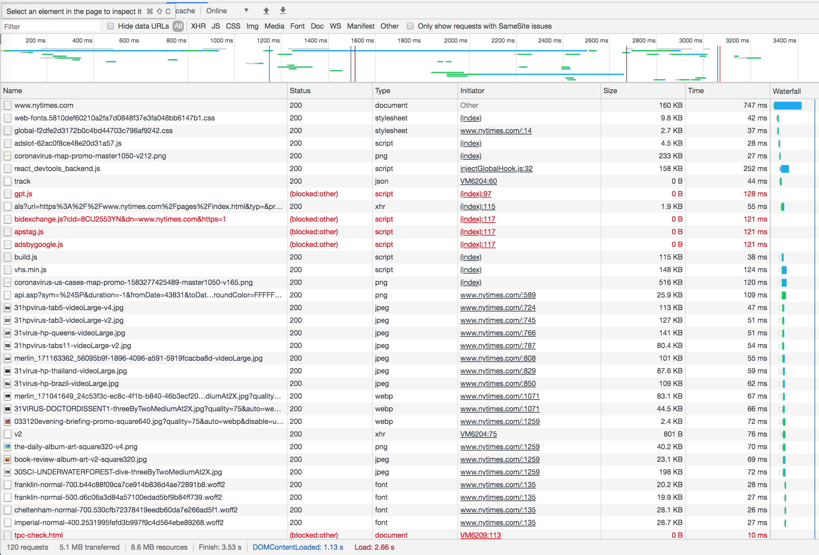
nytimes.com

Slide 24
How to handle many requests?
Maximize goodput by reusing connections
Avoid connection (TCP) setup
Avoid TCP slow-start
Client-server will maintain existing TCP connection for up to K idle seconds
GET / HTTP/1.1
Host: www.example.com
Connection: Keep-Alive
HTTP/1.1 200 OK
Date: Tue, 27 Mar 2001 03:50:51 GMT
Connection: Keep-Alive
24

Slide 25
Three approaches to multiple requests
Parallel
Connections
Persistent
Connections
Pipelined
Connections
Conn 1:
Request 1
Response 1
Conn 2:
Request 2
Response 2
Conn 1:
Request 1
Response 1
Request 2
Response 2
Request 3
Response 3
Conn 1:
Request 1
Request 2
Request 3
Response 1
Response 2
Response 3

Slide 26
What are challenges with pipelining?
Head-of-line blocking
Small xfers can “block” behind large xfer
No reordering
HTTP response does not “identify” which request it’s in response to; obvious in simple request/response
Can behave worse than parallel + persistent
Can send expensive query 1 on conn 1, while sending many cheap queries on conn 2
26

Slide 27
Google’s SPDY -> HTTP/2
Server “push” for content
One client request, multiple responses
After all, server knows that after parsing HTML, client will immediately request embedded URLs
Better pipelining and xfer
Multiplexing multiple xfers w/o HOL blocking
Request prioritization
Header compression
https://developers.google.com/web/fundamentals/performance/http2

Slide 28
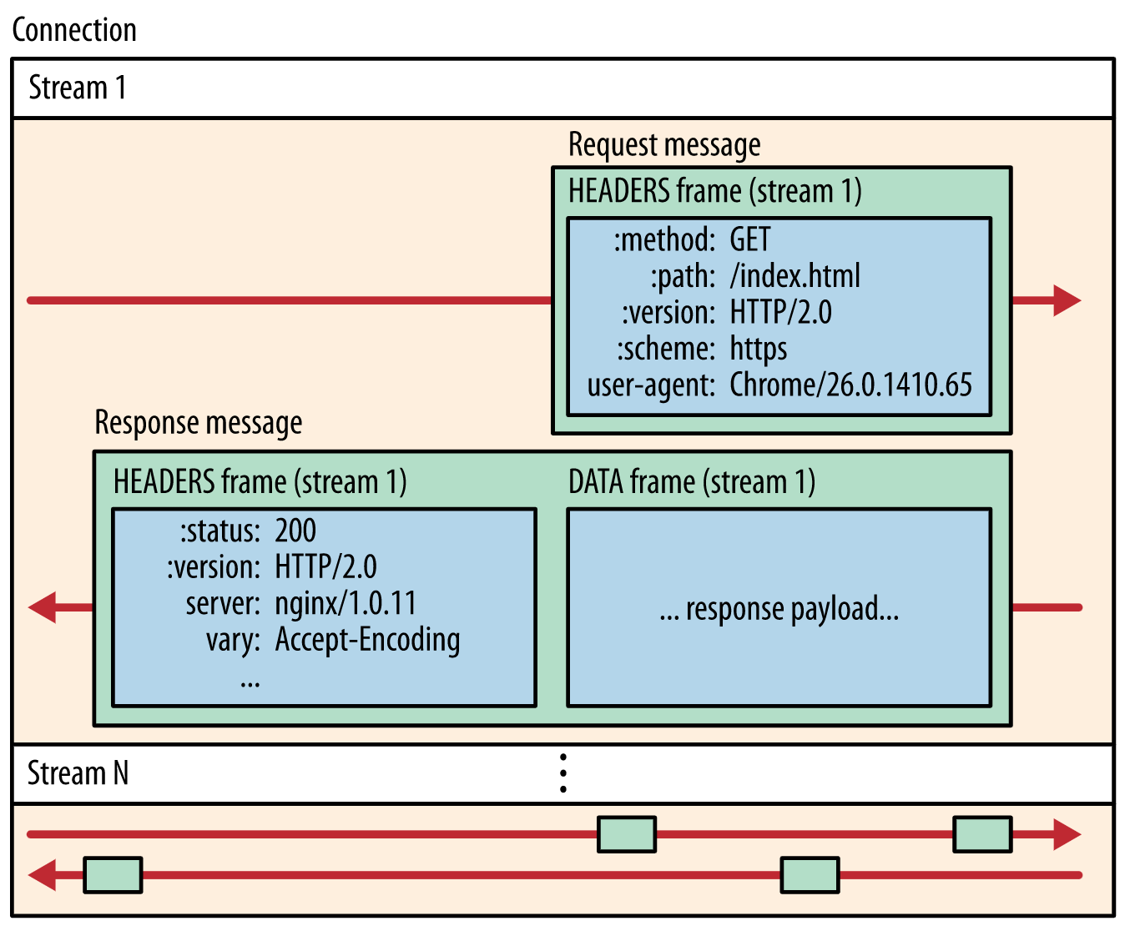

Slide 29
