Slide 1
Queue Management
Mike Freedman
COS 461: Computer Networks
http://www.cs.princeton.edu/courses/archive/spr20/cos461/

Slide 2
Last lecture: Congestion Control
What can end-points do to collectively to make
good use of shared underlying resources?
logical link
name
?
?
physical
path
address
Notes:
This week, we’ll talk about how to share resources. Today we’ll talk about what the end-points can do in a distributed fashion, from the edge of the network. On Wednesday, we’ll talk about what the lower-level elements can do.

Slide 3
Today: Queue Management
What can individual links do to make good use of shared underlying resources?
logical link
name
physical
path
?
address
Notes:
This week, we’ll talk about how to share resources. Today we’ll talk about what the end-points can do in a distributed fashion, from the edge of the network. On Wednesday, we’ll talk about what the lower-level elements can do.

Slide 4
Packet Queues

Slide 5
Router
Processor
control plane
data plane
Switching
Fabric
Line card
Line card
Line card
Line card
Line card
Line card

Slide 6
Line Cards (Interface Cards, Adaptors)
Packet handling
Packet forwarding
Buffer management
Link scheduling
Packet filtering
Rate limiting
Packet marking
Measurement
to/from link
Receive
lookup
Transmit
to/from switch

Slide 7
Queue Management Issues
Scheduling discipline
Which packet to send?
Some notion of fairness? Priority?
Drop policy
When should you discard a packet?
Which packet to discard?
Goal: balance throughput and delay
Huge buffers minimize drops, but add to queuing delay (thus higher RTT, longer slow start, …)

Slide 8
FIFO Scheduling and Drop-Tail
Access to the bandwidth: first-in first-out queue
Packets only differentiated when they arrive
Access to the buffer space: drop-tail queuing
If the queue is full, drop the incoming packet
✗

Slide 9
Early Detection of Congestion

Slide 10
Bursty Loss From Drop-Tail Queuing
TCP depends on packet loss
Packet loss is indication of congestion
TCP additive increase drives network into loss
Drop-tail leads to bursty loss
Congested link: many packets encounter full queue
Synchronization: many connections lose packets at once

Slide 11
Slow Feedback from Drop Tail
Feedback comes when buffer is completely full
… even though the buffer has been filling for a while
Plus, the filling buffer is increasing RTT
… making detection even slower
Better to give early feedback
Get 1-2 connections to slow down before it’s too late!

Slide 12
Random Early Detection (RED)
Router notices that queue is getting full
… and randomly drops packets to signal congestion
Packet drop probability
Drop probability increases as queue length increases
Else, set drop probability f(avg queue length)
Drop
Probability
0 1
Average Queue Length

Slide 13
Properties of RED
Drops packets before queue is full
In the hope of reducing the rates of some flows
Tolerant of burstiness in the traffic
By basing the decisions on average queue length
Which of the following are true?
(Y) Drops packet in proportion to each flow’s rate
(M) High-rate flows selected more often
(C) Helps desynchronize the TCP senders
(A) All of the above
Notes:
D: All of the above

Slide 14
Properties of RED
Drops packets before queue is full
In the hope of reducing the rates of some flows
Tolerant of burstiness in the traffic
By basing the decisions on average queue length
Which of the following are true?
(Y) Drops packet in proportion to each flow’s rate
(M) High-rate flows selected more often
(C) Helps desynchronize the TCP senders
(A) All of the above
Notes:
D: All of the above

Slide 15
Problems With RED
Hard to get tunable parameters just right
How early to start dropping packets?
What slope for increase in drop probability?
What time scale for averaging queue length?
RED has mixed adoption in practice
If parameters aren’t set right, RED doesn’t help
Many other variations in research community
Names like “Blue” (self-tuning), “FRED”…

Slide 16
From Loss to Notification

Slide 17
Feedback: From loss to notification
Early dropping of packets
Good: gives early feedback
Bad: has to drop the packet to give the feedback
Explicit Congestion Notification
Router marks the packet with an ECN bit
Sending host interprets as a sign of congestion

Slide 18
Explicit Congestion Notification
Needs support by router, sender, AND receiver
End-hosts check ECN-capable during TCP handshake
ECN protocol (repurposes 4 header bits)
Sender marks “ECN-capable” when sending
If router sees “ECN-capable” and congested, marks packet as “ECN congestion experienced”
If receiver sees “congestion experienced”, marks “ECN echo” flag in responses until congestion ACK’d
If sender sees “ECN echo”, reduces cwnd and marks “congestion window reduced” flag in next packet
Notes:
Why extra ECN flag? Congestion could happen in either direction, want sender to react to forward direction
Why CRW ACK? ECN-echo could be lost, but we ideally only respond to congestion in forward direction

Slide 19
ECN Questions
Why separate ECN experienced and echo flags?
(Y) Detect reverse path congestion with “experienced”
(M) Congestion could happen in either direction, want sender to react to forward direction
(C) Both of the above

Slide 20
ECN Questions
Why separate ECN experienced and echo flags?
(Y) Detect reverse path congestion with “experienced”
(M) Congestion could happen in either direction, want sender to react to forward direction
(C) Both of the above
Why “echo” resent & “congestion window reduced” ACK?
(Y) Congestion in reverse path can lose ECN-echo, still want to respond to congestion in forward path
(M) Only should apply backoff once per cwnd
(C) Both of the above

Slide 21
ECN Questions
Why separate ECN experienced and echo flags?
(Y) Detect reverse path congestion with “experienced”
(M) Congestion could happen in either direction, want sender to react to forward direction
(C) Both of the above
Why “echo” resent & “congestion window reduced” ACK?
(Y) Congestion in reverse path can lose ECN-echo, still want to respond to congestion in forward path
(M) Only should apply backoff once per cwnd
(C) Both of the above

Slide 22
Link Scheduling

Slide 23

First-In First-Out Scheduling
First-in first-out scheduling
Simple, but restrictive
Example: two kinds of traffic
Voice over IP needs low delay
E-mail is not that sensitive about delay
Voice traffic waits behind e-mail
23

Slide 24
Strict Priority
Multiple levels of priority
Always transmit high-priority traffic, when present
Isolation for the high-priority traffic
Almost like it has a dedicated link
Except for (small) delay for packet transmission
But, lower priority traffic may starve ☹
24

Slide 25
Weighted Fair Scheduling
Weighted fair scheduling
Assign each queue a fraction of the link bandwidth
Rotate across queues on a small time scale
50% red, 25% blue, 25% green
25

Slide 26
Weighted Fair Scheduling
If non-work conserving (resources can go idle)
Each flow gets at most its allocated weight
WFQ is work-conserving
Send extra traffic from one queue if others are idle
Results in (Y) higher or (M) lower utilization than non-work conserving?
WFQ results in max-min fairness
Maximize the minimum rate of each flow
26
Notes:
Results in higher

Slide 27
Max-Min Fairness
Maximize the minimum rate of each flow
Allocate in order of increasing demand
No flow gets more than demand
The excess, if any, is equally shared
8
10
10
10
2
8
Rate Demanded/Allocated
2
Total = 6
2
2
2
Flows sorted by demand
27
Notes:
Results in higher

Slide 28
Max-Min Fairness
Maximize the minimum rate of each flow
Allocate in order of increasing demand
No flow gets more than demand
The excess, if any, is equally shared
8
10
4
10
4
10
2
2
8
Rate Demanded/Allocated
f = 4:
min(8, 4) = 4
min(10, 4) = 4
min(2, 4) = 2
Total = 10
2
4
4
2
2
2
Flows sorted by demand
28
Notes:
Results in higher

Slide 29
Weighted Fair Queueing
Link 1, ingress
Link 1, egress
Link 2, ingress
Link 2, egress
flow 1
Classifier
flow 2
Scheduler
Link 3, ingress
Link 3, egress
flow n
WFQ slides credit: Nick McKeown (Stanford)

Slide 30
Bit-by-Bit Fair Queueing
Question: What is a “flow”?
Flow 5-tuple: protocol, IP source/dest, port src/dest
Question: How can we give weights?
Protocol class, bit markings, prefixes, etc.
Flow 1
Bit-by-bit round robin
Classification
Flow N
Notes:
One connection: IP source/dest, TCP port/dest
Aggregate of traffic called a class; members have same requirements (all video, bit-torrent, traffic to a particular domain, etc)

Slide 31
Bit-by-Bit Weighted Fair Queueing
Flows allocated different rates by servicing different number of bits for each flow during each round.
w₁ = 0.1
1
w₂ = 0.3
R₁
C
w₃ = 0.3
w₄ = 0.3
Order of service for the four queues:
… f_{1,} f_{2,} f_{2,} f_{2,} f_{3,} f_{3,} f_{3,} f_{4,} f_{4,} f_{4,} f₁,…

Slide 32
Packet vs. “Fluid” System
Bit-by-bit FQ is not implementable:
…In real packet-based systems:
One queue is served at any given time
Packet transmission cannot be preempted
Goal: A packet scheme close to fluid system
Bound performance w.r.t. fluid system

Slide 33
First Cut: Simple Round Robin
Serve a packet from non-empty queues in turn
Lets assume all flows have equal weight
Variable packet length → get more service by sending bigger packets
Unfair instantaneous service rate (esp. with variable weights)
E.g. 500 flows: 250 with weight 1, 250 with weight 10
Each round takes 2,750 packet times
What if a packet arrives right after its “turn”?
Notes:
Q1: What about different packet sizes? How might you mitigate the problem? What if you knew mean pkt size?

Slide 34
Packet-by-packet Fair Queuing (Weighted Fair Queuing)
Deals better with variable size packets and weights
Key Idea:
Determine the finish time of packets in bit-by-bit system, assuming no more arrivals
Serve packets in order of finish times

Slide 35
Implementing WFQ
Challenge: Determining finish time is hard
Idea: Don’t need finish time. Need finish order.
The finish order is a lot easier to calculate.

Slide 36
Finish order
Increasing L_{i}/w_{i}
In what order do the packets finish?
w₁ = 0.1
L₁
1
w₂ = 0.3
L₂
R₁
C
w₃ = 0.3
L₃
w₄ = 0.3
Order of service for the four queues:
… f_{1,} f_{2,} f_{2,} f_{2,} f_{3,} f_{3,} f_{3,} f_{4,} f_{4,} f_{4,} f₁,…
L₄
Does not change with future packet arrivals!

Slide 37
Bit-by-bit System Round
w₁ = 0.1
L₁
w₁ = 1
1
w₂ = 0.3
L₂
w₂ = 3
R₁
C
w₃ = 0.3
w₃ = 3
L₃
w₄ = 0.3
Order of service for the four queues:
… f_{1,} f_{2,} f_{2,} f_{2,} f_{3,} f_{3,} f_{3,} f_{4,} f_{4,} f_{4,} f₁,…
w₄ = 3
L₄
Round – One complete cycle through all the queues sending w_{i} bits per queue
Question: How long does a round take?
Notes:
Makes sense that this is doable because we saw that the GPS order does not depend on future events

Slide 38
Bit-by-bit System Round
w₁ = 0.1
L₁
w₁ = 1
1
w₂ = 0.3
L₂
w₂ = 3
R₁
C
w₃ = 0.3
w₃ = 3
L₃
w₄ = 0.3
Order of service for the four queues:
… f_{1,} f_{2,} f_{2,} f_{2,} f_{3,} f_{3,} f_{3,} f_{4,} f_{4,} f_{4,} f₁,…
w₄ = 3
L₄
Round – One complete cycle through all the queues sending w_{i} bits per queue
R(t) = # of rounds at time t
C = link rate
B(t) = set of backlogged flows
Notes:
Makes sense that this is doable because we saw that the GPS order does not depend on future events

Slide 39
Bit-by-bit System Round
w₁ = 0.1
L₁
w₁ = 1
1
w₂ = 0.3
L₂
w₂ = 3
R₁
C
w₃ = 0.3
w₃ = 3
L₃
w₄ = 0.3
Order of service for the four queues:
… f_{1,} f_{2,} f_{2,} f_{2,} f_{3,} f_{3,} f_{3,} f_{4,} f_{4,} f_{4,} f₁,…
w₄ = 3
L₄
Round – One complete cycle through all the queues sending w_{i} bits per queue
Question: How many rounds does it take to serve a packet of length L from flow i?
Notes:
Makes sense that this is doable because we saw that the GPS order does not depend on future events

Slide 40
Bit-by-bit System Round
w₁ = 0.1
L₁
w₁ = 1
1
w₂ = 0.3
L₂
w₂ = 3
R₁
C
w₃ = 0.3
w₃ = 3
L₃
w₄ = 0.3
Order of service for the four queues:
… f_{1,} f_{2,} f_{2,} f_{2,} f_{3,} f_{3,} f_{3,} f_{4,} f_{4,} f_{4,} f₁,…
w₄ = 3
L₄
Round – One complete cycle through all the queues sending w_{i} bits per queue
Packet of length L takes L/w_{i} rounds to serve
Notes:
Makes sense that this is doable because we saw that the GPS order does not depend on future events

Slide 41
Round (aka. “Virtual Time”) Implementation of WFQ
Question: What is finish round of kth packet – F_{i}^{k}?

Slide 42
Round (aka. “Virtual Time”) Implementation of WFQ
Assign a start/finish round to each packet at arrival
→ serve packets in order of finish rounds
Suppose kth packet of flow i arrives at time a
Finish round
of (k-1)th packet
Start round
of kth packet
k
k-1
……
(Flow i backlogged)
k
Round number
at time a
(Flow i empty)

Slide 43
Putting it All Together
For k^{th} packet of flow i arriving at time a:
Question: How to compute R(a)?
Simple approximation:
Set R(a) to start or finish round of packet currently in service

Slide 44
Implementation Trade-Offs
FIFO
One queue, trivial scheduler
Strict priority
One queue per priority level, simple scheduler
Weighted fair scheduling
One queue per class, and more complex scheduler
44

Slide 45
Quality of Service Guarantees

Slide 46
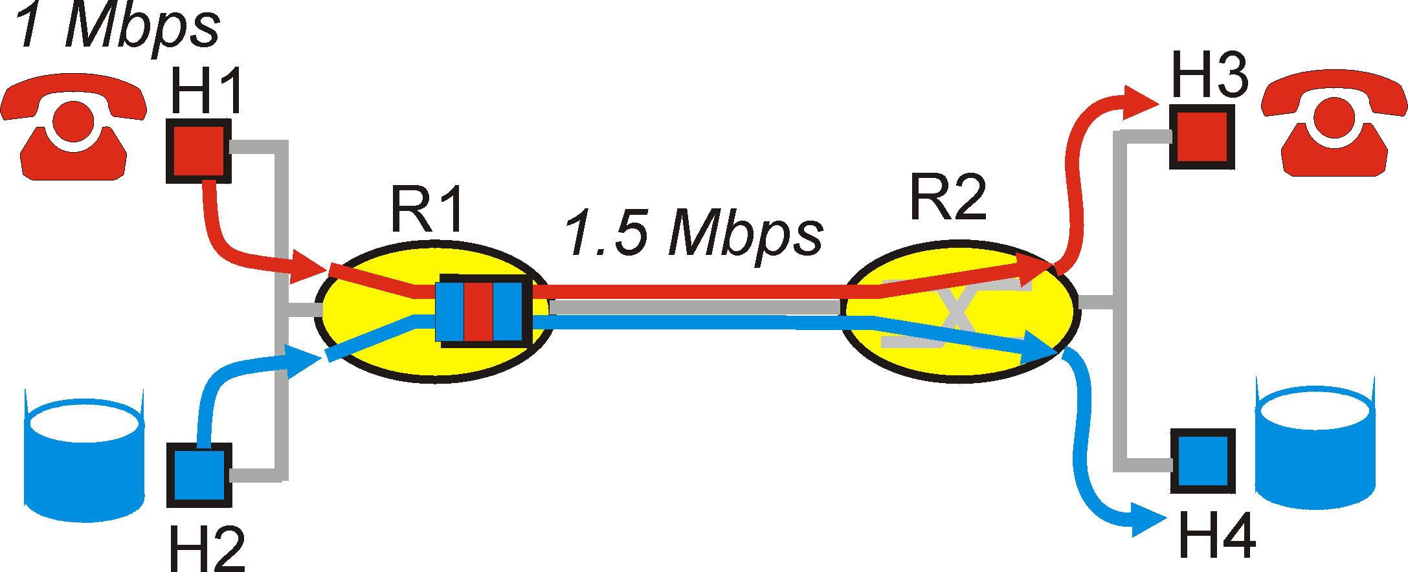
Distinguishing Traffic
Applications compete for bandwidth
E-mail traffic can cause congestion/losses for VoIP
Principle 1: Packet marking
So router can distinguish between classes
E.g., Type of Service (ToS) bits in IP header
46

Slide 47
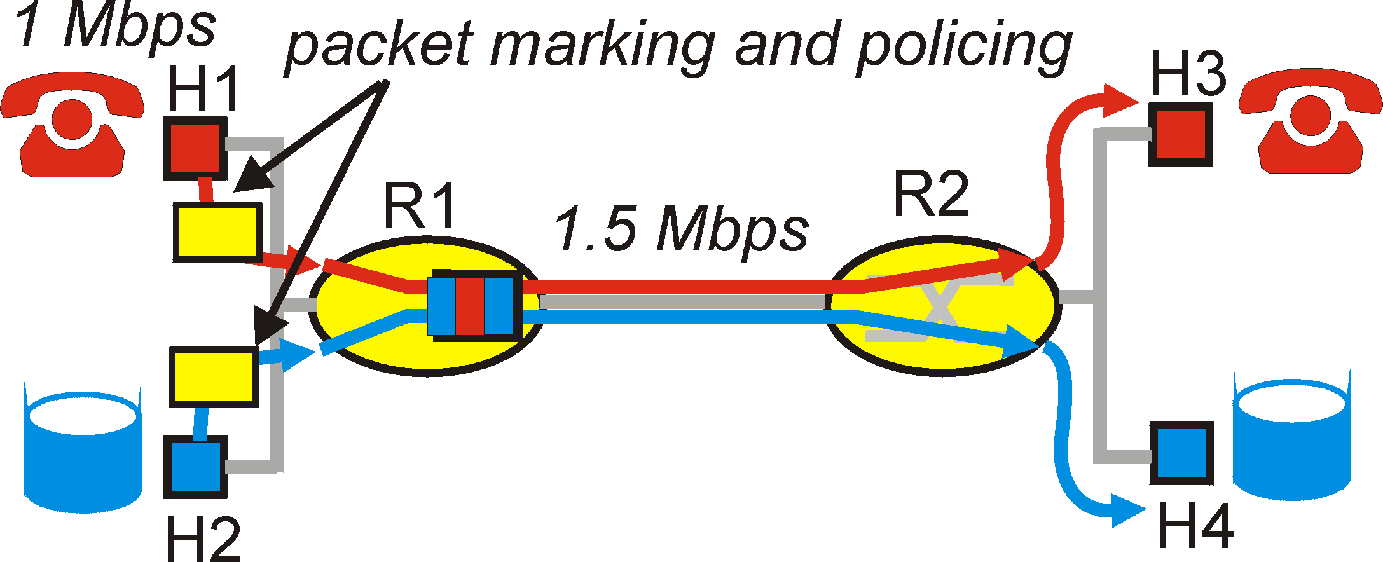
Preventing Misbehavior
Applications misbehave
VoIP sends packets faster than 1 Mbps
Principle 2: Policing
Protect one traffic class from another
By enforcing a rate limit on the traffic
47

Slide 48
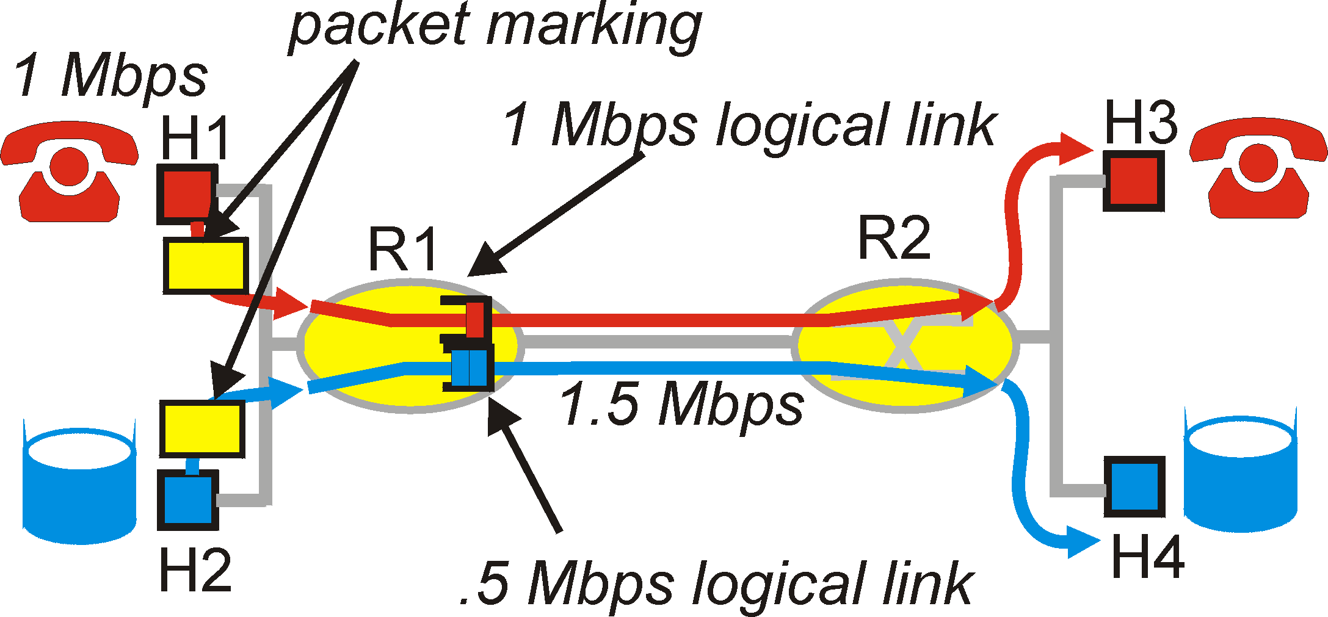
Subdividing Link Resources
Principle 3: Link scheduling
Ensure each application gets its share
… while (optionally) using any extra bandwidth
E.g., weighted fair queuing
48

Slide 49
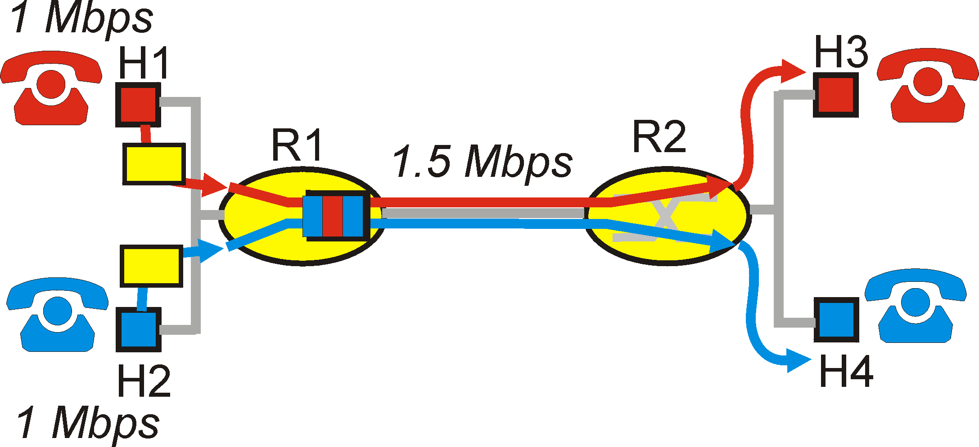
Reserving Resources, and Saying No
Traffic cannot exceed link capacity
Deny access, rather than degrade performance
Principle 4: Admission control
Application declares its needs in advance
Application denied if insufficient resources available
49

Slide 50
Quality of Service (QoS)
Guaranteed performance
Alternative to best-effort delivery model
QoS protocols and mechanisms
Packet classification and marking
Traffic shaping
Link scheduling
Resource reservation and admission control
Identifying paths with sufficient resources
50

