Slide 1
Bitcoin and the Blockchain
COS 518: Advanced Computer Systems
Lecture 19
Mike Freedman

Slide 2
Bitcoin: 10,000 foot view
New bitcoins are “created” every ~10 min, owned by “miner” (more on this later)
Thereafter, just keep record of transfers
e.g., Alice pays Bob 1 BTC
Basic protocol:
Alice signs transaction: txn = Sign_{Alice} (BTC, PK_{Bob})
Alice shows transaction to others…
Notes:
So that motivates the 2PL algorithm.

Slide 3
Problem: Equivocation!
Can Alice “pay” both Bob and Charlie with same bitcoin ?
( Known as “double spending” )

Slide 4
How traditional e-cash handled problem
Bank
Alice
Bob
When Alice pays Bob with a coin, Bob validates that coin hasn’t been spend with trusted third party
Introduced “blind signatures” and “zero-knowledge protocols” so bank can’t link withdrawals and deposits
Notes:
So that motivates the 2PL algorithm.

Slide 5
How traditional e-cash handled problem
Bank
Alice
Bob
When Alice pays Bob with a coin, Bob validates that coin hasn’t been spend with trusted third party
Introduced “blind signatures” and “zero-knowledge protocols” so bank can’t link withdrawals and deposits
Bank maintains linearizable log of transactions
Notes:
So that motivates the 2PL algorithm.

Slide 6
Problem: Equivocation!
Goal: No double-spending in decentralized environment
Approach: Make transaction log
public
append-only
strongly consistent

Slide 7
Bitcoin: 10,000 foot view
Public
Transactions are signed: txn = Sign_{Alice} (BTC, PK_{Bob})
All transactions are sent to all network participants
No equivocation: Log append-only and consistent
All transactions part of a hash chain
Consensus on set/order of operations in hash chain
Notes:
So that motivates the 2PL algorithm.

Slide 8
Recall Cryptography Hash Functions
Take message m of arbitrary length and produces fixed-size (short) number H(m)
One-way function
Efficient: Easy to compute H(m)
Hiding property: Hard to find an m, given H(m)
Collision resistance:
Strong resistance: Find any m != m’ such that H(m) == H(m’)
Weak resistance: Given m, find m’ such that H(m) == H(m’)
Notes:
Balls and bins analogy: weak collision is finding a collision on a SPECIFIC bin (the "m"), strong collision is finding a collision on ANY bin.

Slide 9
Tamper-evident logging

Slide 10
Blockchain: Append-only hash chain
prev: H( )
prev: H( )
prev: H( )
txn 5
txn 6
txn 7
Hash chain creates “tamper-evident” log of txns
Security based on collision-resistance of hash function
Given m and h = hash(m), difficult to find m’ such that h = hash(m’) and m != m’

Slide 11
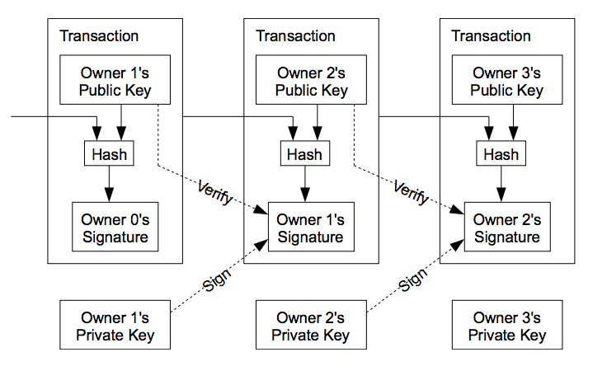
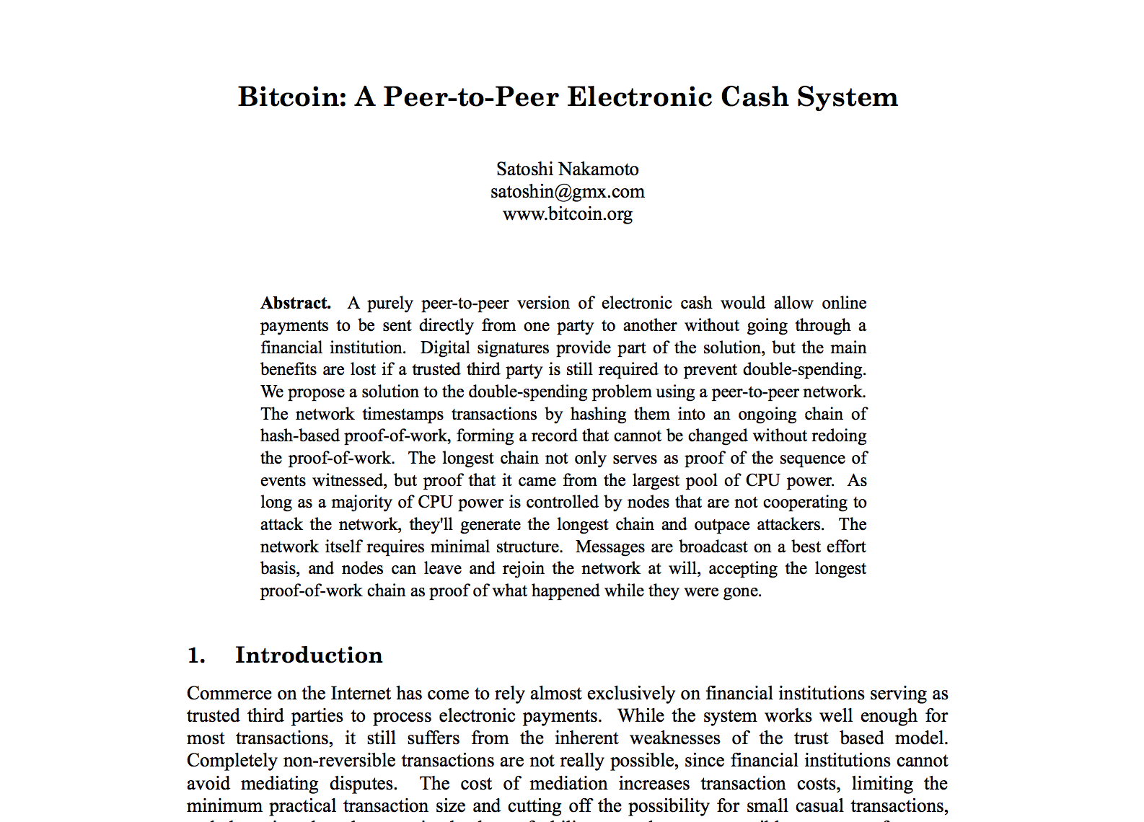
Blockchain: Append-only hash chain

Slide 12
Problem remains: forking
prev: H( )
prev: H( )
prev: H( )
txn 5
txn 6
txn 7
prev: H( )
prev: H( )
txn 6’
txn 7’

Slide 13
Goal: Consensus
Recall Byzantine fault-tolerant protocols to achieve consensus of replicated log
Requires: n >= 3f + 1 nodes, at most f faulty
Problem
Communication complexity is n²
Requires strong view of network participants

Slide 14
Consensus susceptible to Sybils
All consensus protocols based on membership…
… assume independent failures …
… which implies strong notion of identity
“Sybil attack” (p2p literature ~2002)
Idea: one entity can create many “identities” in system
Typical defense: 1 IP address = 1 identity
Problem: IP addresses aren’t difficult / expensive to get, esp. in world of botnets & cloud services

Slide 15
Consensus based on “work”
Rather than “count” IP addresses, bitcoin “counts” the amount of CPU time / electricity that is expended
Proof-of-work: Cryptographic “proof” that certain amount of CPU work was performed
“The system is secure as long as honest nodes collectively control more CPU power than any cooperating group of attacker nodes.” - Satoshi Nakamoto

Slide 16
Key idea: Chain length requires work
prev: H( )
prev: H( )
prev: H( )
prev: H( )
prev: H( )
txn 5
txn 6
txn 7
txn 8
txn 9
prev: H( )
txn 6’
Generating a new block requires “proof of work”
“Correct” nodes accept longest chain
Creating fork requires rate of malicious work >> rate of correct
So, the older the block, the “safer” it is from being deleted

Slide 17
Use hashing to determine work!
Recall hash functions are one-way / collision resistant
Given h, hard to find m such that h = hash(m)
But what about finding partial collision?
m whose hash has most significant bit = 0?
m whose hash has most significant bit = 00?
Assuming output is randomly distributed, complexity grows exponentially with # bits to match

Slide 18
Bitcoin proof of work
Find nonce such that
hash (nonce || prev_hash || block data) < target
i.e., hash has certain number of leading 0’s
What about changes in total system hashing rate?
Target is recalculated every 2 weeks
Goal: One new block every 10 minutes

Slide 19
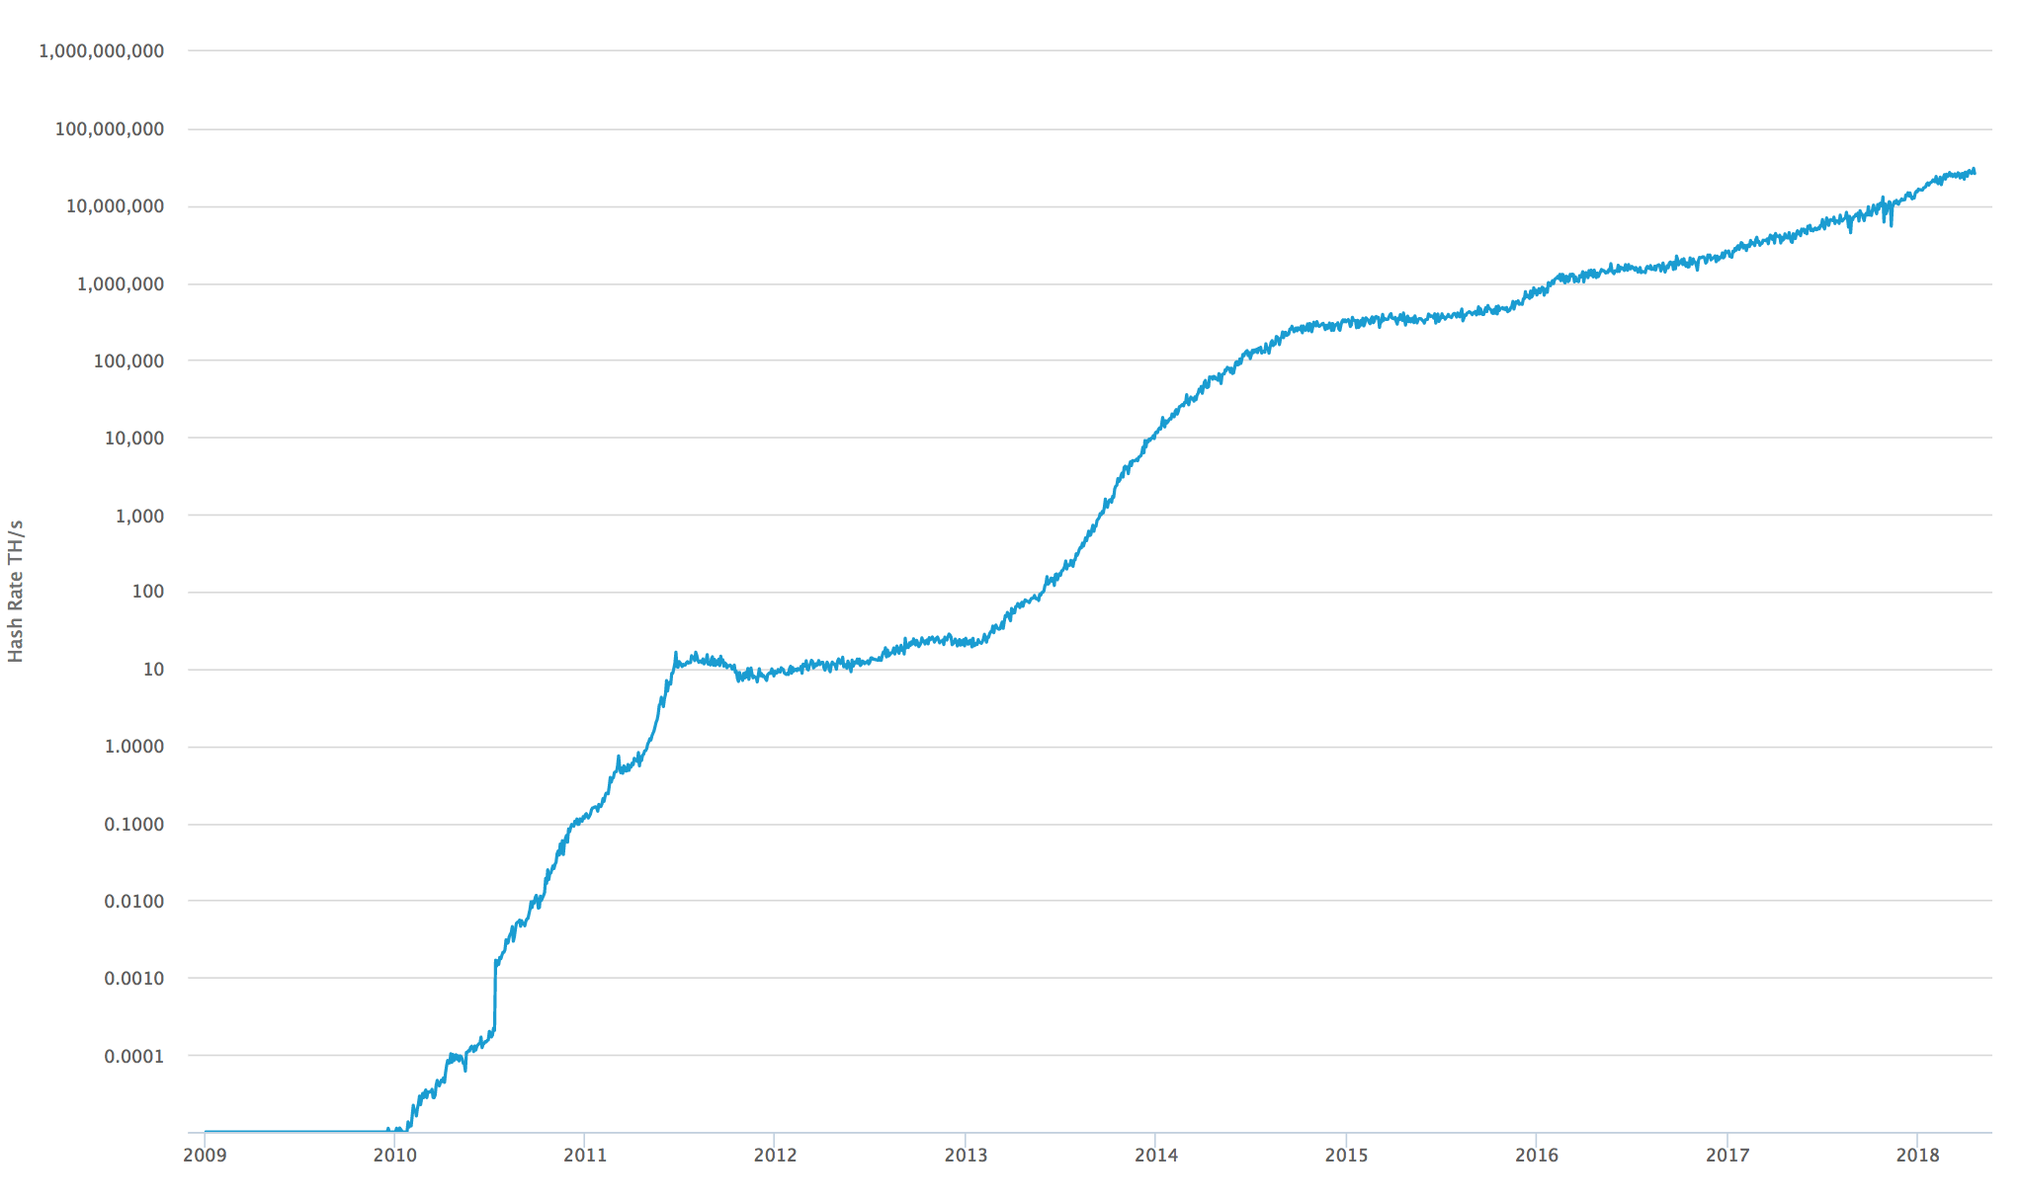
Historical hash rate trends of bitcoin
Currently: 25 Exahash/s
25 x 10¹⁸
Tech: CPU → GPU → FPGA → ASICs

Slide 20
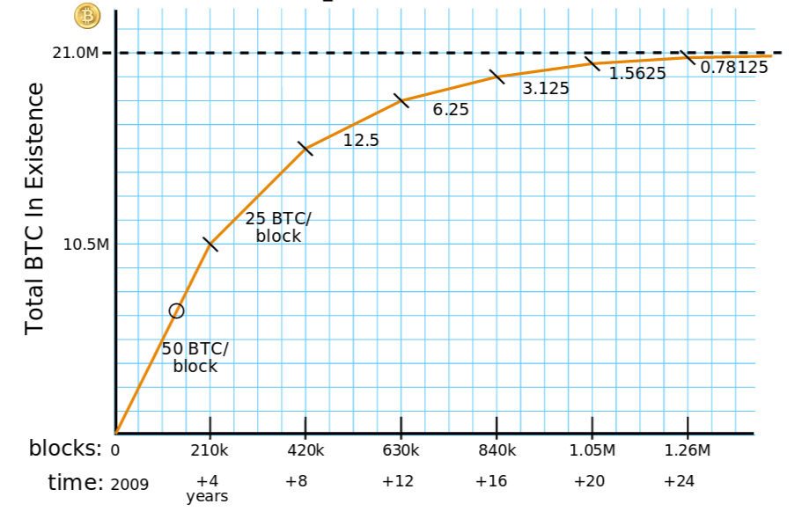
Why consume all this energy?
Creating a new block creates bitcoin!
Initially 50 BTC, decreases over time, currently 12.5
Next halving in ~2021
Block height is ~572K as of 4-23-2019
New bitcoin assigned to party named in new block
Called “mining” as you search for gold/coins

Slide 21
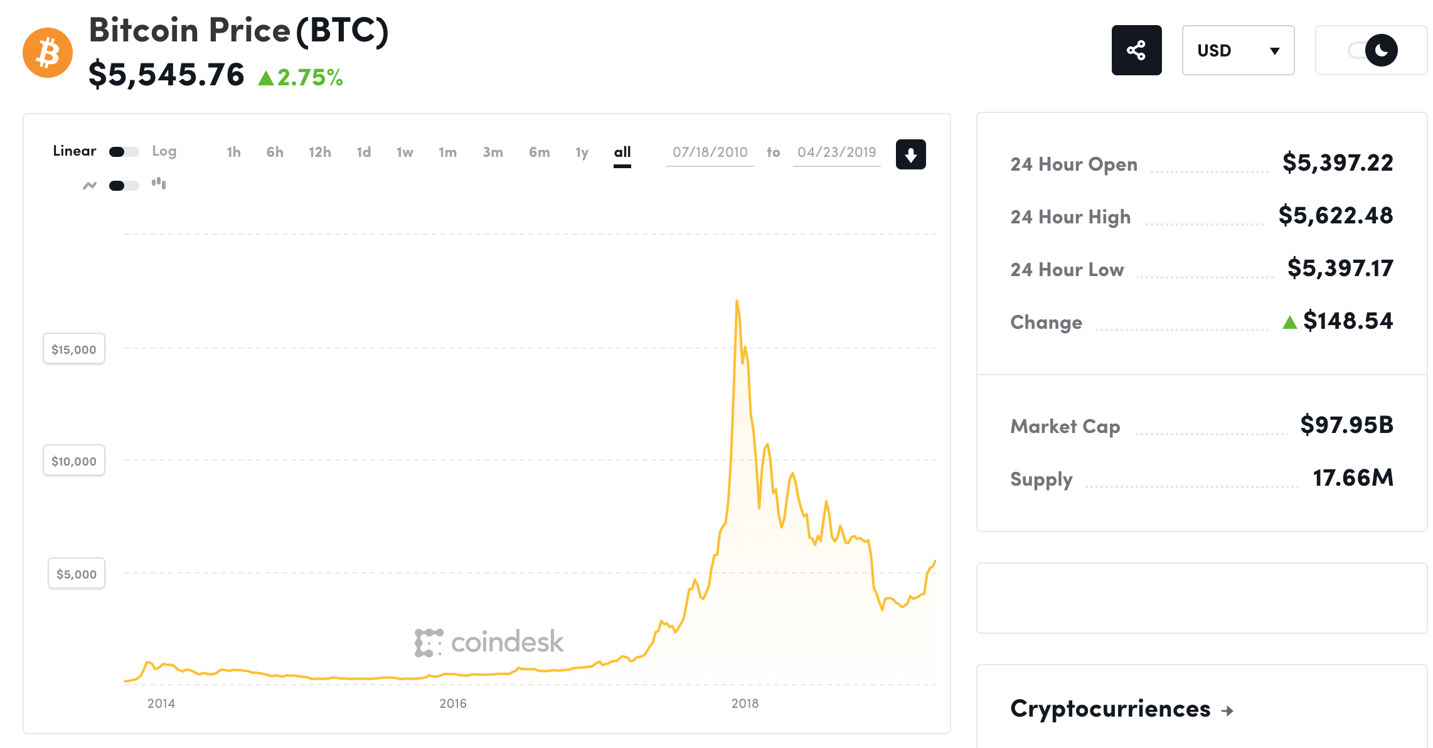
Bitcoin is worth (LOTS OF) money!
4-23-19
12.5 BTC = $69,300 today

Slide 22
Incentivizing correct behavior?
Race to find nonce and claim block reward, at which time race starts again for next block
hash (nonce || prev_hash || block data)
As solution has prev_hash, corresponds to particular chain
Correct behavior is to accept longest chain
“Length” determined by aggregate work, not # blocks
So miners incentivized only to work on longest chain, as otherwise solution not accepted
Remember blocks on other forks still “create” bitcoin, but only matters if chain in collective conscious (majority)

Slide 23
Form of randomized leader election
Each time a nonce is found:
New leader elected for past epoch (~10 min)
Leader elected randomly, probability of selection proportional to leader’s % of global hashing power
Leader decides which transactions comprise block

Slide 24
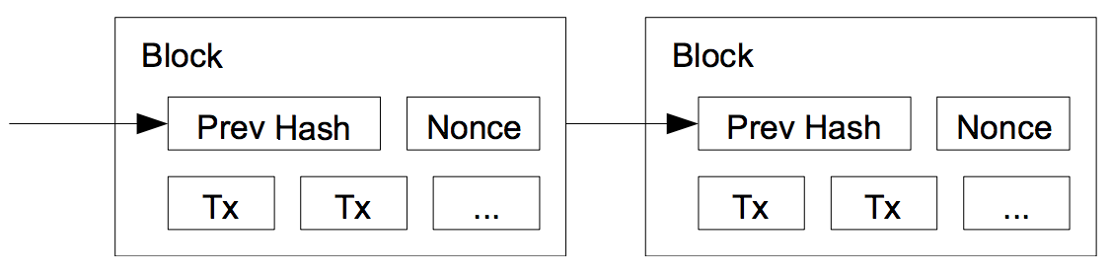
One block = many transactions
Each miner picks a set of transactions for block
Builds “block header”: prevhash, version, timestamp, txns, …
Until hash < target OR another node wins:
Pick nonce for header, compute hash = SHA256(SHA256(header))

Slide 25
Transactions are delayed
At some time T, block header constructed
Those transactions had been received [ T – 10 min, T]
Block will be generated at time T + 10 min (on average)
So transactions are from 10 - 20 min before block creation
Can be much longer if “backlog” of transactions are long

Slide 26
Commitments further delayed
When do you trust a transaction?
After we know it is “stable” on the hash chain
Recall that the longer the chain, the hard to “revert”
Common practice: transaction “committed” when 6 blocks deep
i.e., Takes another ~1 hour for txn to become committed

Slide 27
Transaction format: strawman
Create 12.5 coins, credit to Alice
Transfer 3 coins from Alice to Bob _{SIGNED(Alice)}
Transfer 8 coins from Bob to Carol _{SIGNED(Bob)}
Transfer 1 coins from Carol to Alice _{SIGNED(Carol)}
How do you determine if Alice has balance?
Scan backwards to time 0 !

Slide 28
Transaction format
Inputs: Ø // Coinbase reward
Outputs: 25.0→PK_Alice
Inputs: H(prevtxn, 0) // 25 BTC from Alice
Outputs: 25.0→PK_Bob _{SIGNED(Alice)}
Inputs: H (prevtxn, 0) // 25 BTC From Alice
Outputs: 5.0→PK_Bob, 20.0 →PK_Alice2 _{SIGNED(Alice)}
Inputs: H (prevtxn1, 1), H(prevtxn2, 0) // 10+5 BTC
Outputs: 14.9→PK_Bob _{SIGNED(Alice)}
Transaction typically has 1+ inputs, 1+ outputs
Making change: 1st output payee, 2nd output self
Output can appear in single later input (avoids scan back)

Slide 29
Transaction format
Inputs: Ø // Coinbase reward
Outputs: 25.0→PK_Alice
Inputs: H(prevtxn, 0) // 25 BTC from Alice
Outputs: 25.0→PK_Bob _{SIGNED(Alice)}
Inputs: H (prevtxn, 0) // 25 BTC From Alice
Outputs: 5.0→PK_Bob, 20.0 →PK_Alice _{SIGNED(Alice)}
Inputs: H (prevtxn1, 1), H(prevtxn2, 0) // 10+5 BTC
Outputs: 14.9→PK_Bob _{SIGNED(Alice)}
Unspent portion of inputs is “transaction fee” to miner
In fact, “outputs” are stack-based scripts
1 Block = 1MB max

Slide 30
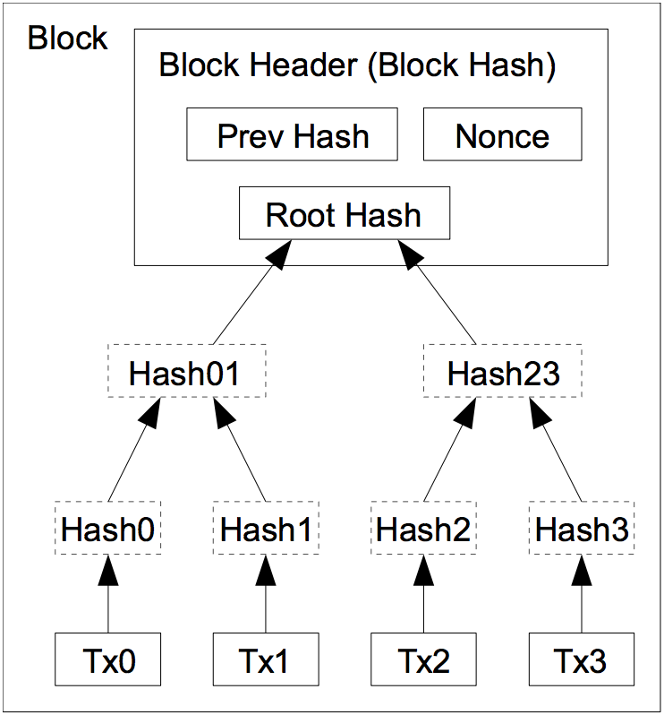
Storage / verification efficiency
Merkle tree
Binary tree of hashes
Root hash “binds” leaves given collision resistance
Using a root hash
Block header now constant size for hashing
Can prune tree to reduce storage needs over time

Slide 31
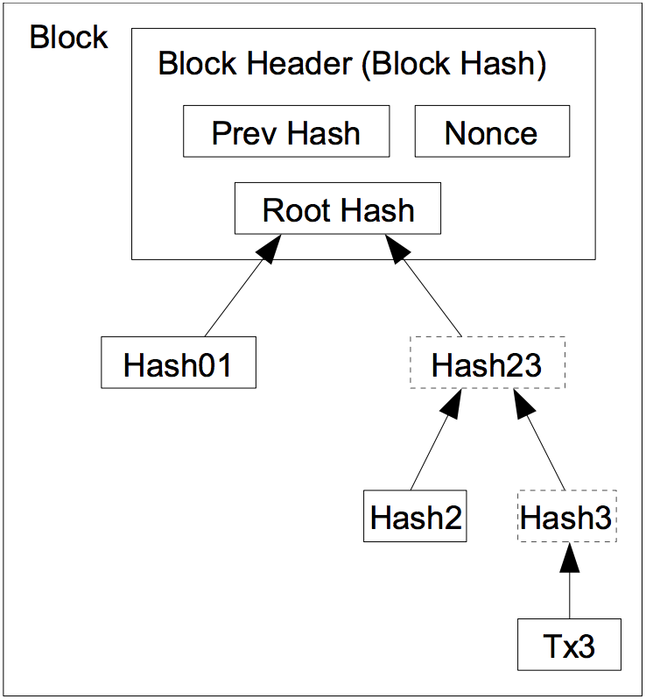
Storage / verification efficiency
Merkle tree
Binary tree of hashes
Root hash “binds” leaves given collision resistance
Using a root hash
Block header now constant size for hashing
Can prune tree to reduce storage needs over time
Can prune when all txn outputs are spent
Now: 80GB pruned, 300GB unpruned

Slide 32
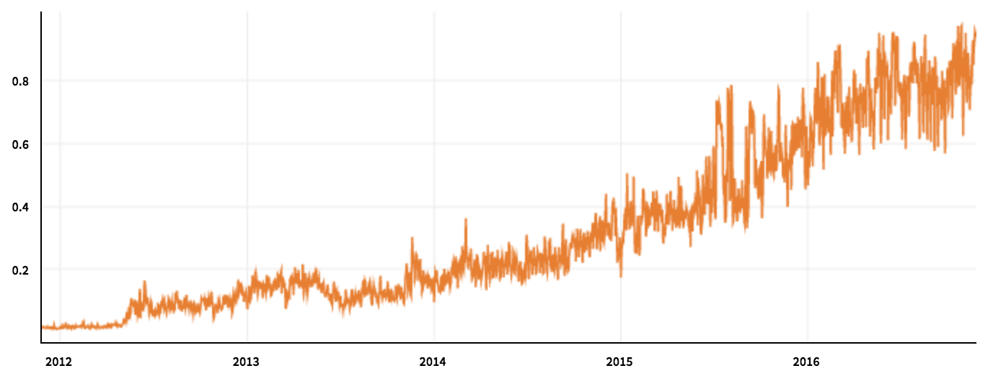
Not panacea of scale as some claim
Scaling limitations
1 block = 1 MB max
1 block ~ 2000 txns
1 block ~ 10 min
So, 3-4 txns / sec
Log grows linearly, joining requires full dload and verification
Visa peak load comparison
Typically 2,000 txns / sec
Peak load in 2013: 47,000 txns / sec
block size

Slide 33
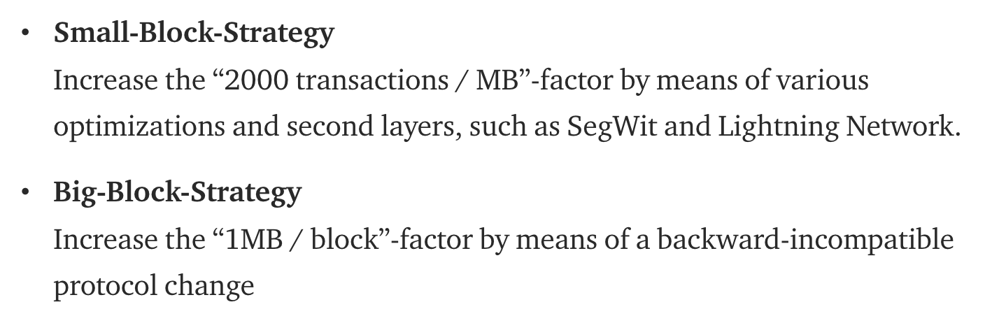

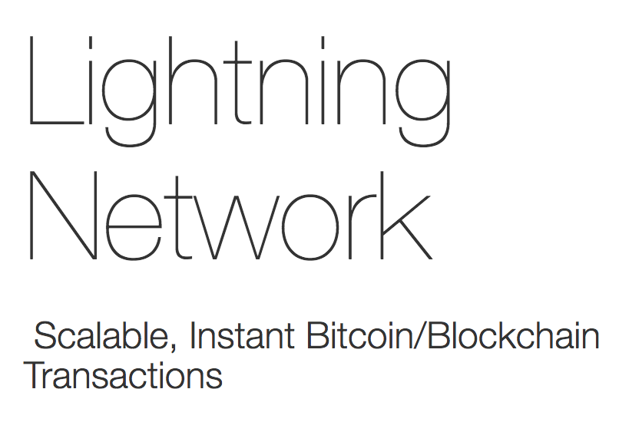
Huge debates over how to scale

Slide 34
Summary
Coins xfer/split between “addresses” (PK) in txns
Blockchain: Global ordered, append-only log of txns
Reached through decentralized consensus
Each epoch, “random” node selected to batch transactions into block and append block to log
Nodes incentivized to perform work and act correctly
When “solve” block, get block rewards + txn fees
Reward: 12.5 BTC @ ~730 USD/BTC (11-25-16) = $9125 / 10 min
Only “keep” reward if block persists on main chain
Notes:
So that motivates the 2PL algorithm.

Slide 35
Bitcoin & blockchain intrinsically linked
security of block chain
health of mining ecosystem
value of currency
Notes:
So that motivates the 2PL algorithm.

Slide 36
Rich ecosystem: Mining pools
health of mining ecosystem
Mining == gambling:
Electricity costs $, huge payout, low probability of winning
Development of mining pools to amortize risk
Pool computational resources, participants “paid” to mine e.g., rewards “split” as a fraction of work, etc
Verification? Demonstrate “easier” proofs of work to admins
Prevent theft? Block header (coinbase txn) given by pool
Notes:
So that motivates the 2PL algorithm.

Slide 37
More than just currency…

Slide 38
