Slide 1
MIMO III: Channel Capacity,
Interference Alignment
COS 463: Wireless Networks
Lecture 18
Kyle Jamieson
[Parts adapted from D. Tse]

Slide 2
Today
Interference Channel Capacity
  Single-Antenna Context
MIMO Channel Capacity
Interference Alignment

Slide 3
Two-User Interference Channel
Sender 1
AP
Sender 2
On the same frequency channel at the same time:
  Sender 1 sends signal x₁ with power P₁
  Sender 2 sends signal x₂ with power P₂
AP receives: y[m] = x₁[m] + x₂[m] + w[m]
  w[m] is background Gaussian Noise with variance σ²
What are the fundamental limits of communication here?

Slide 4
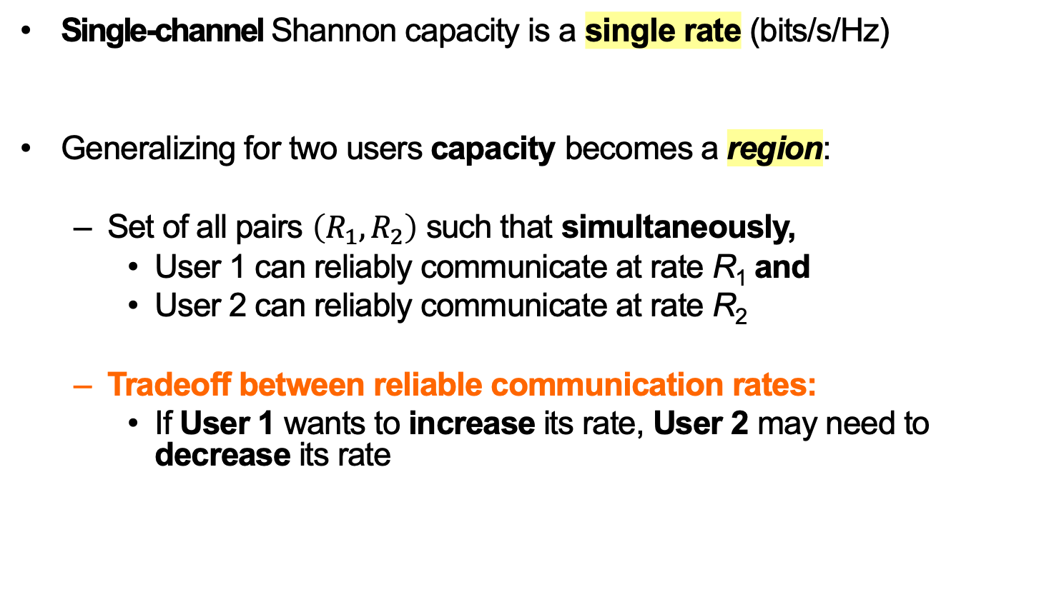
Extension of Capacity to Multiple Users
Single-channel Shannon capacity is a single rate (bits/s/Hz)
Generalizing for two users capacity becomes a region:
  Set of all pairs $\left(R_{1}, R_{2}\right)$ such that simultaneously,
    User 1 can reliably communicate at rate R₁ and
    User 2 can reliably communicate at rate R₂
  Tradeoff between reliable communication rates:
    If User 1 wants to increase its rate, User 2 may need to decrease its rate

Slide 5

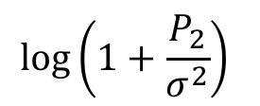
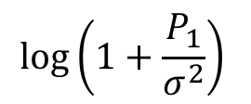

Two-User Interference Channel:
Single-User Bounds
User 2’s rate $R_{2}$
User 2 sending alone
$$\log\left(1+\frac{P_{2}}{σ^{2}}\right)$$
User 1 sending alone
$$\log\left(1+\frac{P_{1}}{σ^{2}}\right)$$
User 1’s rate $R_{2}$

Slide 6
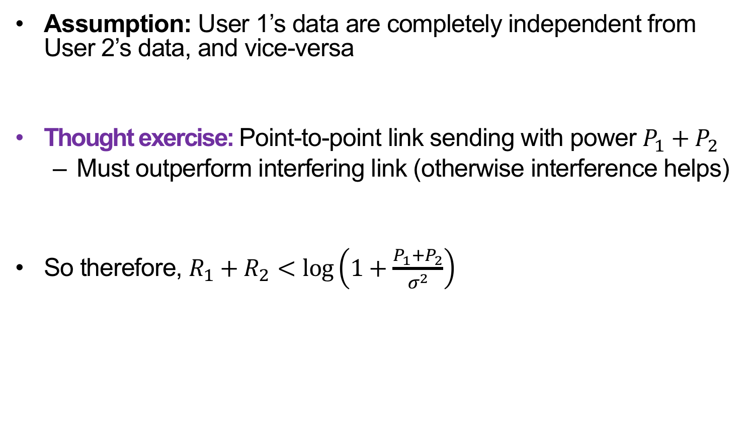
Interference Doesn’t Help
Assumption: User 1’s data are completely independent from User 2’s data, and vice-versa
Thought exercise: Point-to-point link sending with power $P_{1}+P_{2}$
  Must outperform interfering link (otherwise interference helps)
So therefore, $R_{1}+R_{2}<\log\left(1+\frac{P_{1}+P_{2}}{σ^{2}}\right)$

Slide 7
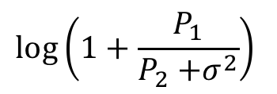
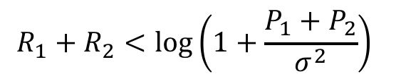
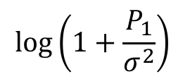

Two-User Interference Channel:
Capacity Region
User 2’s rate $R_{2}$
$$\log\left(1+\frac{P_{2}}{σ^{2}}\right)$$
$$R_{1}+R_{2}<\log\left(1+\frac{P_{1}+P_{2}}{σ^{2}}\right)$$
$$\log\left(1+\frac{P_{1}}{P_{2}{+σ}^{2}}\right)$$
User 1’s rate $R_{1}$
$$\log\left(1+\frac{P_{1}}{σ^{2}}\right)$$

Slide 8
Successive Interference Cancellation (SIC)
Receiver decodes information from both senders in three stages:
Decode data of user 1, treating signal from user 2 as noise
Reconstruct user 1’s signal (x’₁[m]) from decoded data and subtract from aggregate received signal y[m], cancelling it:
  y’ [m] = y [m] − x’₁[m]
  = x₂[m] + (x₁[m] – x’₁[m]) + w[m]
Decode user 2’s signal from y’[m]

Slide 9
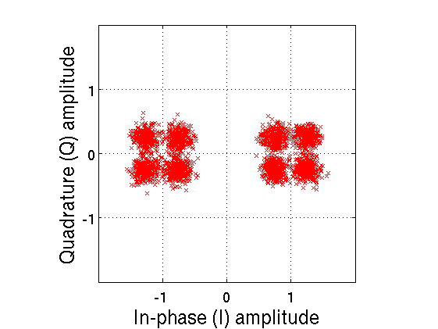
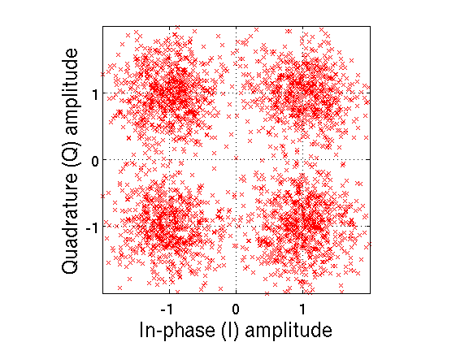
Decoding Strong BPSK with weak QPSK
“1”
“0”
BPSK decoding
BPSK bit
decisions
Received r(t)
BPSK model
Interference-cancelled QPSK
−
=
Q
“10”
“00”
Input bit=“1”
Input bit=“0”
−
I
=
−1
+1
“11”
“01”

Slide 10
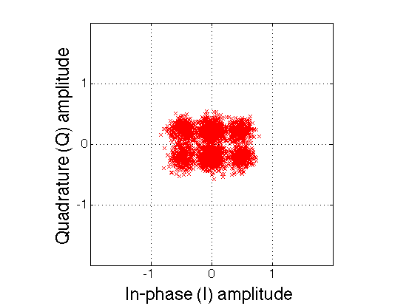
Power Difference Helps Superposition Coding
Q
Input bit=“1”
Input bit=“0”
−
I
−1
+1

Slide 11
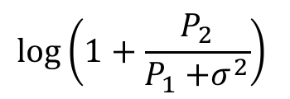
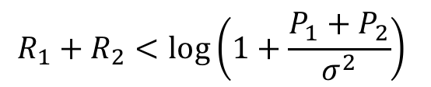
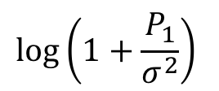
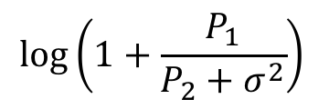
SIC: Choice of User Order
User 2’s rate $R_{2}$
$$\log\left(1+\frac{P_{2}}{σ^{2}}\right)$$
$$\log\left(1+\frac{P_{2}}{P_{1}{+σ}^{2}}\right)$$
$$R_{1}+R_{2}<\log\left(1+\frac{P_{1}+P_{2}}{σ^{2}}\right)$$
$$\log\left(1+\frac{P_{1}}{P_{2}+σ^{2}}\right)$$
User 1’s rate $R_{1}$
$$\log\left(1+\frac{P_{1}}{σ^{2}}\right)$$

Slide 12
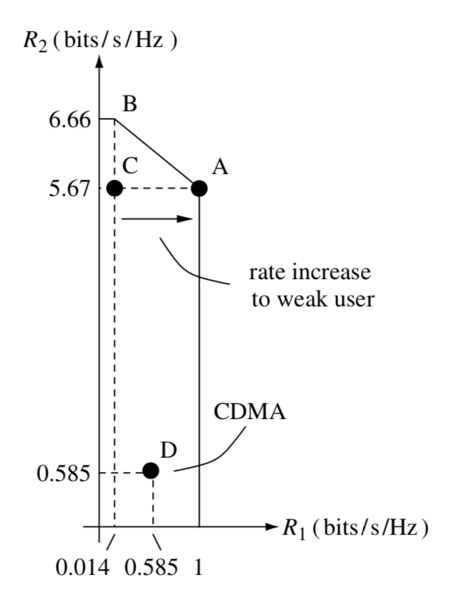
Comparison with CDMA
CDMA: Every user decoded treating the other users as noise
  Achieves Point C
    But, User 1 starves
CDMA power control: Reduce power of the strong user
  Achieves Point D

Slide 13
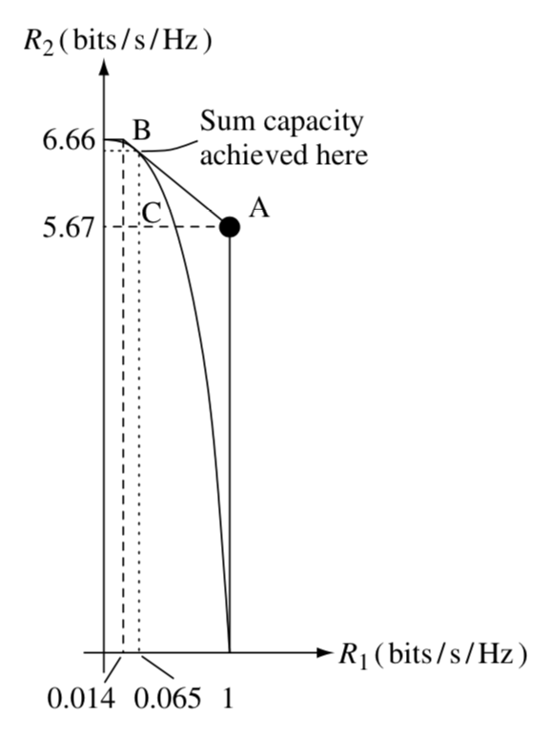
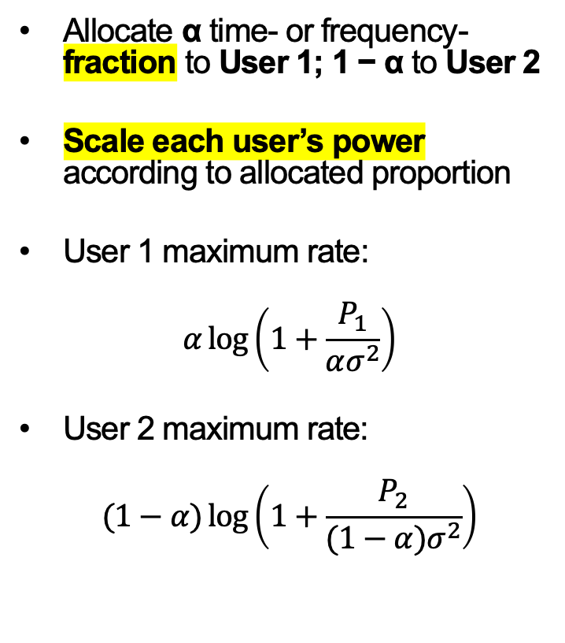
Comparison with TDMA/FDMA + Power Control
Allocate α time- or frequency-fraction to User 1; 1 − α to User 2
Scale each user’s power according to allocated proportion
User 1 maximum rate:
$$α\log\left(1+\frac{P_{1}}{ασ^{2}}\right)$$
User 2 maximum rate:
$$(1−α)\log\left(1+\frac{P_{2}}{(1−α)σ^{2}}\right)$$

Slide 14
Comparison with TDMA/FDMA + Power Control
Allocate as follows:
  α time- or frequency-fraction to User 1; 1 − α to User 2
Tuning α, the users can achieve a point on the (optimal) A-B line

Slide 15
Today
Interference Channel Capacity
MIMO Channel Capacity
Interference Alignment

Slide 16

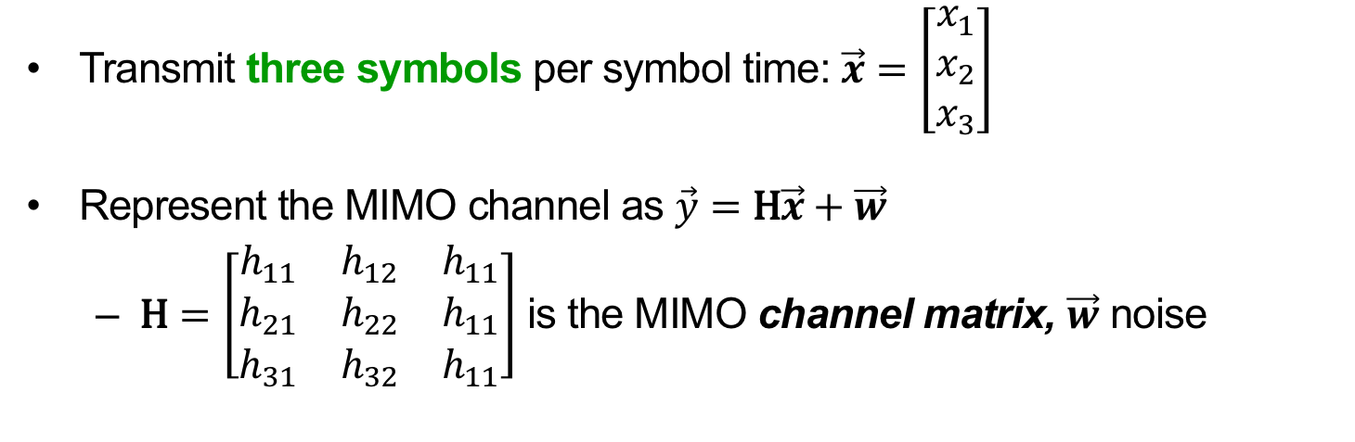


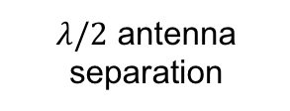

Review: The MIMO Channel
Send x₁, x₂, x₃
$$φ$$
$$λ/2$$
1
1
2
2
$λ/2$ antenna separation
3
3
$$θ$$
$$d≫λ$$
Receive y₁, y₂, y₃
Transmit three symbols per symbol time: $\vec{x}=\left[\begin{matrix}x_{1} \\ x_{2} \\ x_{3}\end{matrix}\right]$
Represent the MIMO channel as $\vec{y}=\text{H}\vec{x}+\vec{w}$
  $\text{H}=\left[\begin{matrix}h_{11} & h_{12} & h_{11} \\ h_{21} & h_{22} & h_{11} \\ h_{31} & h_{32} & h_{11}\end{matrix}\right]$ is the MIMO channel matrix, $\vec{w}$ noise

Slide 17
Recap: MIMO Radio Channel
MIMO link with n_{t} transmit, n_{r} receive antennas
MIMO radio channel itself:

Slide 18
Recap: Zero-Forcing MIMO
Sender
Receiver
Transmitter does not know H (channel)
Each symbol time:
  Sends n_{t} symbols (original Data), one per transmit antenna
Data arrives mixed together at receiver antennas y

Slide 19
Recap: Zero-Forcing MIMO
Receiver knows H (channel)
Each symbol time:
  Receive n_{r} mixed-up signals y
  For each of the n_{t} transmitted symbols:
    Zero-Forcing Receiver nulls all but that symbol

Slide 20
Today
Interference Channel Capacity
MIMO Channel Capacity
  Vector Space Intuition
  Eigenmode Forcing via Singular Value Decomposition
Interference Alignment

Slide 21
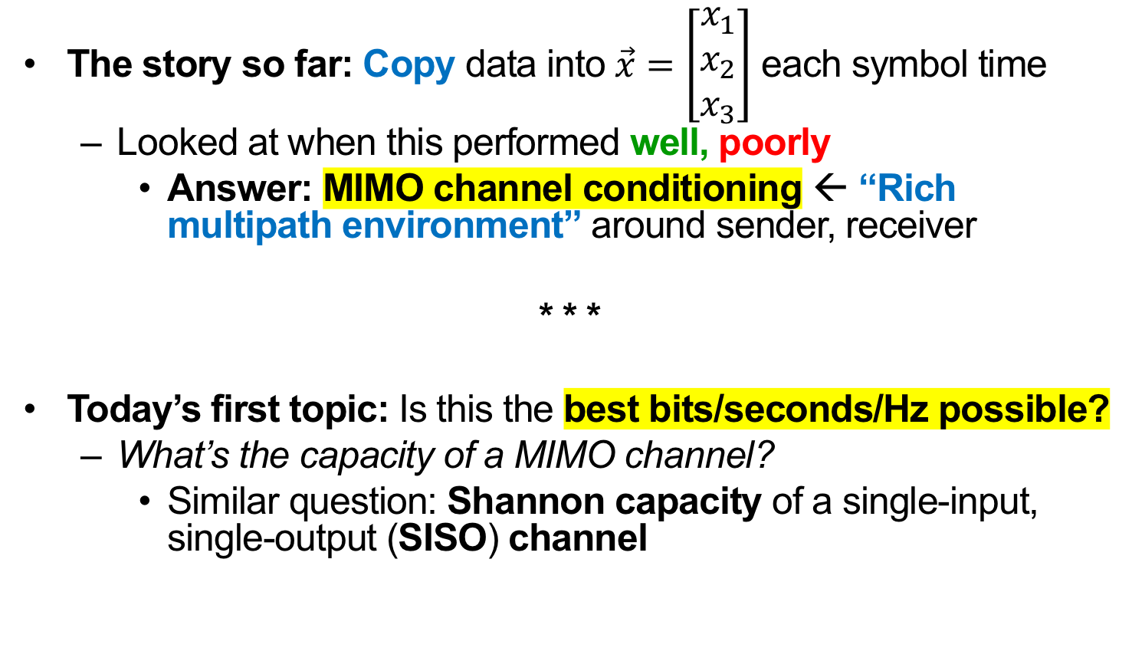
MIMO Channel Capacity: Motivation
The story so far: Copy data into $\vec{x}=\left[\begin{matrix}x_{1} \\ x_{2} \\ x_{3}\end{matrix}\right]$ each symbol time
  Looked at when this performed well, poorly
    Answer: MIMO channel conditioning ← “Rich multipath environment” around sender, receiver
* * *
Today’s first topic: Is this the best bits/seconds/Hz possible?
  What’s the capacity of a MIMO channel?
    Similar question: Shannon capacity of a single-input, single-output (SISO) channel

Slide 22
Where’s the Room for Improvement?
Suppose the transmitter knows H (channel)
Zero-forcing receiver heard h₁, h₂, h₃
  Power loss at receiver (due to Proj⟘) for h₃
Idea: Use transmit antennas 2 and 3 to send the ideal direction
  No longer simply one symbol, one transmit antenna
h₁
h₂
h₃
Send this instead of h₃

Slide 23
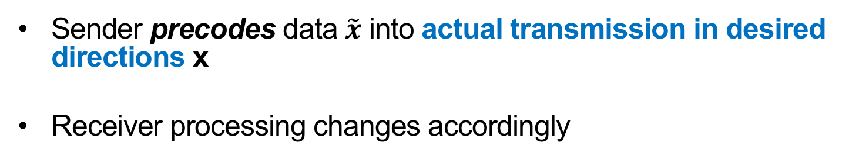
How Might We Control Directions?
Sender precodes data $\tilde{x}$ into actual transmission in desired directions x
Receiver processing changes accordingly
Sender
Receiver

Slide 24
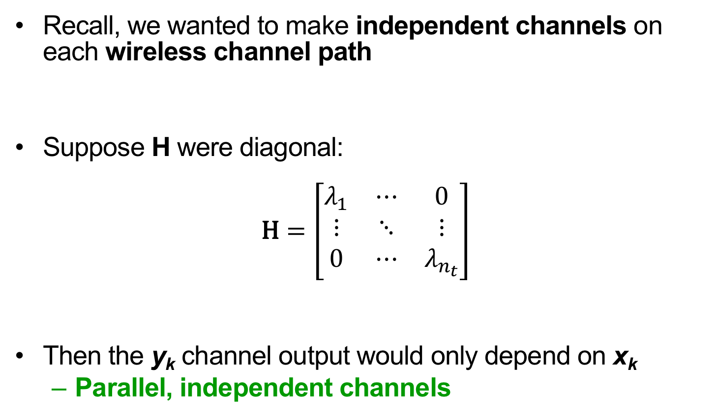
What Kind of Precoding?
Recall, we wanted to make independent channels on each wireless channel path
Suppose H were diagonal:
$$\text{H}=\left[\begin{matrix}λ_{1} & ⋯ & 0 \\ ⋮ & ⋱ & ⋮ \\ 0 & ⋯ & λ_{n_{t}}\end{matrix}\right]$$
Then the y_{k} channel output would only depend on x_{k}
  Parallel, independent channels

Slide 25
Today
Interference Channel Capacity
MIMO Channel Capacity
  Vector Space Intuition
  Eigenmode Transmission
Interference Alignment

Slide 26
Singular Value Decomposition (SVD)
The insight lies in a special way of “factoring” matrix H
Any matrix H has an SVD: H → UΛV*
  Λ is a diagonal matrix (contains zeroes off-diagonal)
  U and V are unitary (UU* = U*U = VV* = V*V = I)
n_{t}
n_{r}
n_{t}
n_{t}
H
U
Λ
V*
n_{r}
=
n_{r}
×
×
n_{t}
n_{r}

Slide 27
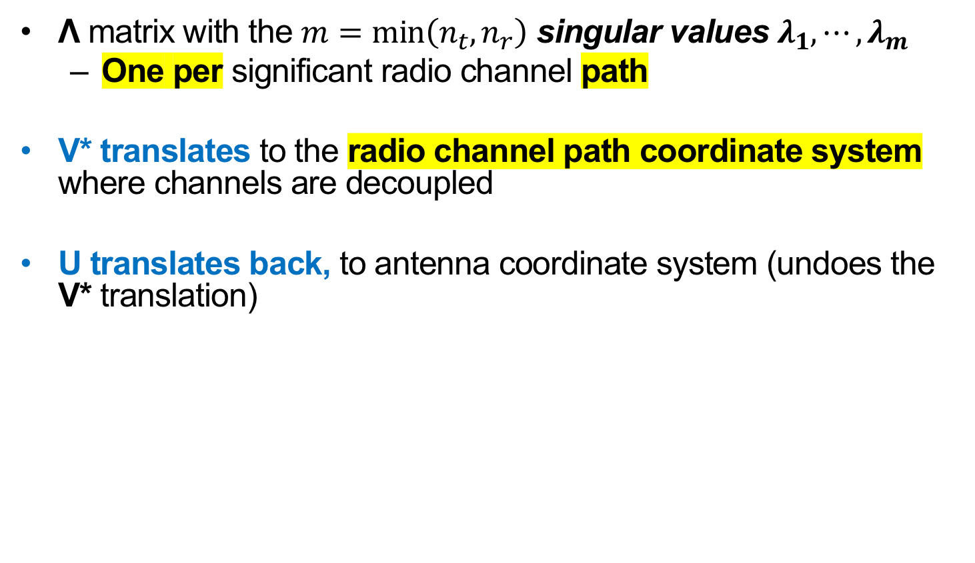
Interpreting the SVD Steps
Λ matrix with the $m=\min\left(n_{t}, n_{r}\right)$ singular values $λ_{1}, ⋯, λ_{m}$
  One per significant radio channel path
V* translates to the radio channel path coordinate system where channels are decoupled
U translates back, to antenna coordinate system (undoes the V* translation)
n_{t}
n_{r}
n_{t}
n_{t}
H
U
Λ
V*
n_{r}
=
n_{r}
×
×
n_{t}
n_{r}

Slide 28

Leveraging the SVD in a Practical System
  Alone, SVD does nothing (just analyzes what H does)
  Want to put data into the radio channel coordinate system
Insight: VV* = I (Unitary property)
Want $\tilde{x}$ here →

Slide 29
Leveraging the SVD in a Practical System
  Sender precodes with V, receiver “post-codes” with U*
    V is unitary, so V*V = I (same for U)
      So data sees independent channels
  This is called MIMO eigenmode transmission
No effect
Sender
Receiver

Slide 30
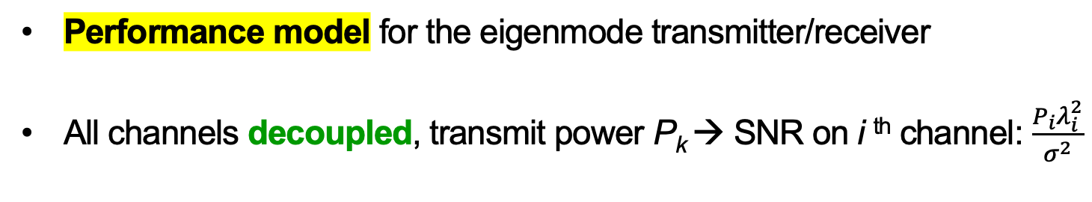
A Model for Eigenmode Transmission
Performance model for the eigenmode transmitter/receiver
All channels decoupled, transmit power P_{k} → SNR on i ^{th} channel: $\frac{P_{i}λ_{i}^{2}}{σ^{2}}$
Sender
Receiver

Slide 31
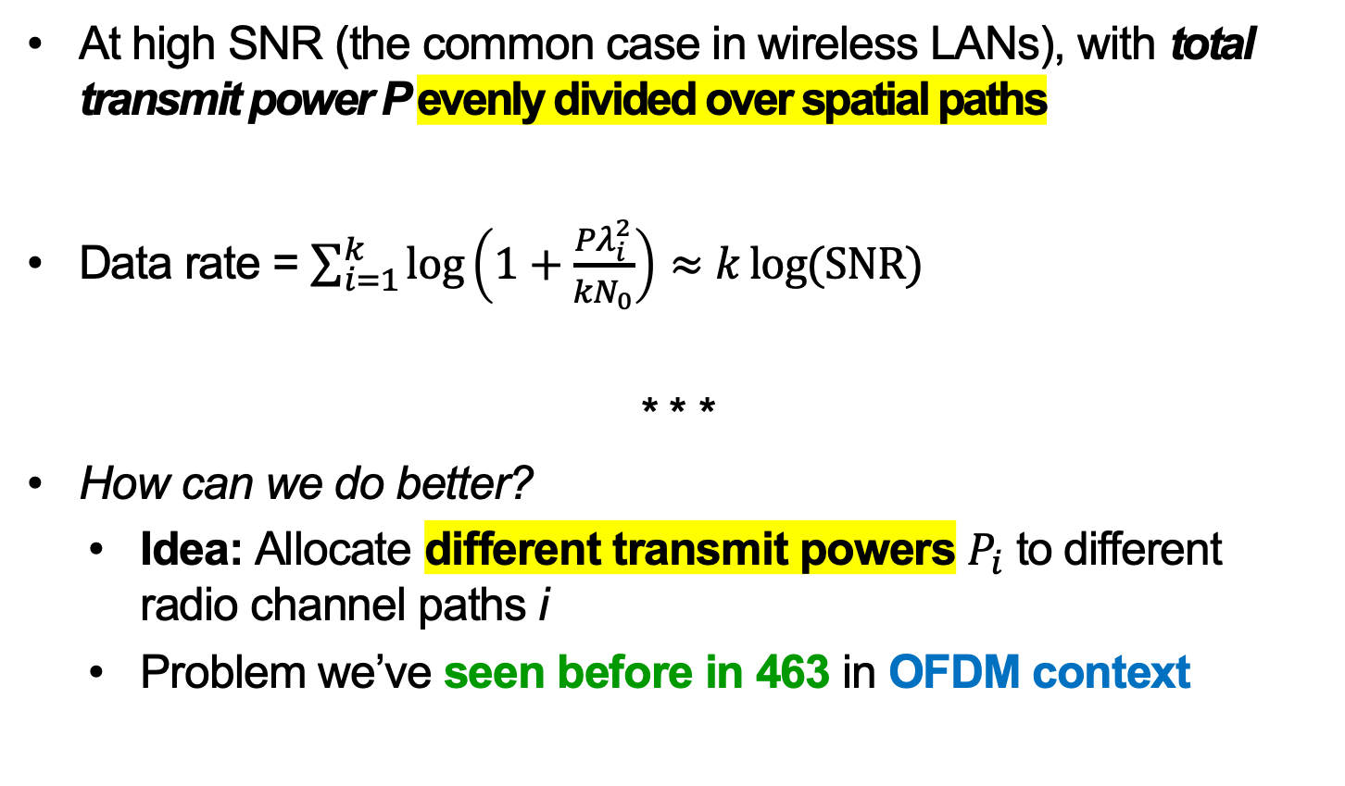
Performance: Uniform Power Division
  At high SNR (the common case in wireless LANs), with total transmit power P evenly divided over spatial paths
  Data rate = $\sum_{i=1}^{k}{\log\left(1+\frac{Pλ_{i}^{2}}{kN_{0}}\right)}≈k\log{(\text{SNR})}$
  * * *
  How can we do better?
    Idea: Allocate different transmit powers $P_{i}$ to different radio channel paths i
    Problem we’ve seen before in 463 in OFDM context

Slide 32
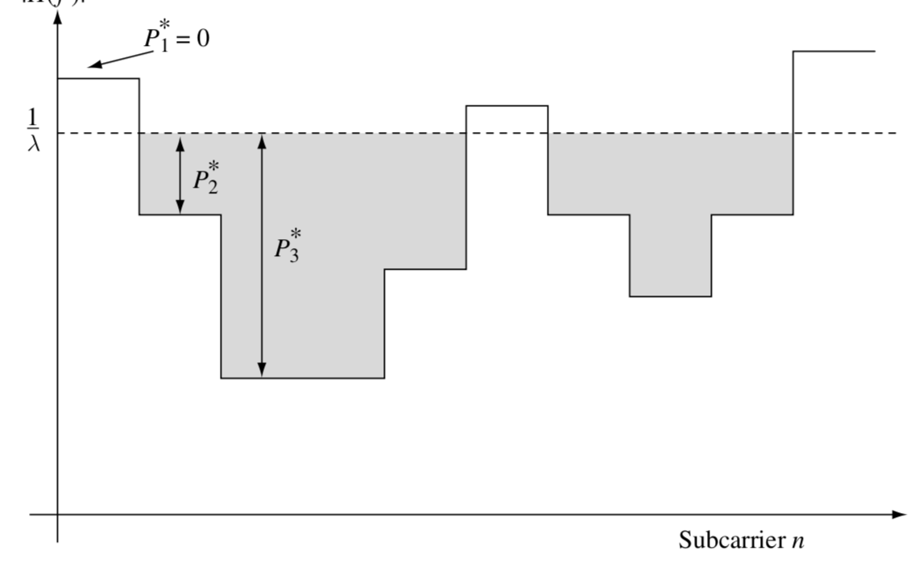

Waterfilling for MIMO Power Allocation
Allocated transmit power P_{i}
μ
$$\frac{σ^{2}}{λ_{i}^{2}}$$
Physical Channel Path / Eigenmode i

Slide 33
MIMO Capacity: Takeaways
OFDM – MIMO analogy:
  A transformation (OFDM: FFT, MIMO: SVD)
  renders interfering channels in
  (OFDM: frequency, MIMO: space) independent
MIMO Eigenmode transmission:
  Transmitter sends directionally, along spatial paths of the radio channel
  Receiver listens directionally, along same spatial paths
  Achieves the MIMO channel capacity

Slide 34
Today
Interference Channel Capacity
MIMO Channel Capacity
Interference Alignment

Slide 35
Interference Alignment (IA)
Number of concurrent MIMO streams a client can send is limited by the number of antennas
  Sending more streams results in interference between streams
  Also limited by the amount of multipath in the environment
New Idea: Use MIMO precoding techniques to align interference at receivers to advantage
Requires APs cooperating via a wired backhaul
  e.g. APs owned by one organization

Slide 36
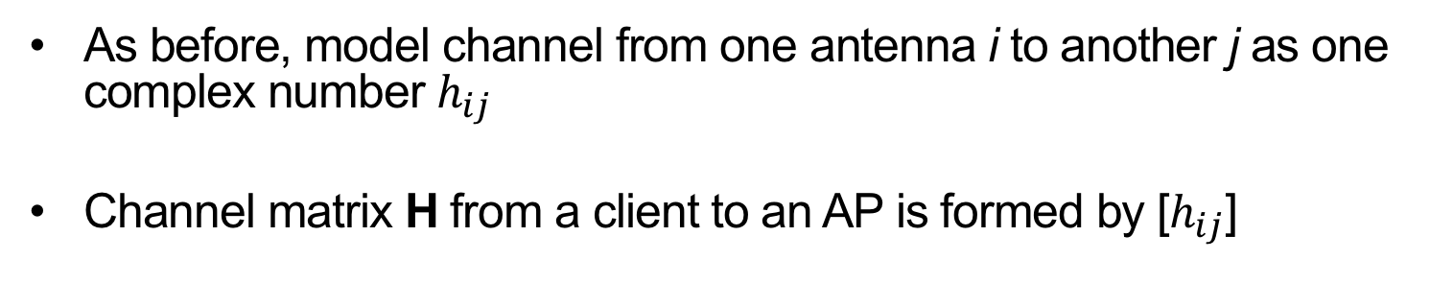
MIMO channel representation
As before, model channel from one antenna i to another j as one complex number $h_{ij}$
Channel matrix H from a client to an AP is formed by [$h_{ij}$]

Slide 37
Uplink: Interference Between Networks
Client 1 has 2 packets for AP 1; Client 2 has a packet for AP 2
  Two-antenna APs, so each decoding in a 2-D space
Three packets form three vectors in the 2-D space at each AP
  Therefore, the APs can’t decode these 3 packets
1
1
2
2

Slide 38
Interference alignment: Basic idea (1)
Clients transmit p₂ and p₃ aligned at access point (AP) 1
  They add up in their one direction
AP 1 zero-forces to decode p₁, sends it over backhaul to AP 2
AP 2 subtracts p₁ from the signal it receives, cancelling it
1
1
2
2

Slide 39
Interference alignment: Basic idea (2)
AP 2 uses zero-forcing receiver to decode p₂, p₃
AP 2 sends p₂ to AP 1 (or onward on behalf of client 1)
1
1
2
2

Slide 40
Uplink: Sketching a Practical Protocol
Transmit precoding: client multiplies packet by vector v
  Changes alignment at receiver
Client 1 picks random precoding vectors v₁ and v₂
Client 1 begins transmission
1
1
2
2
Client 2 chooses v₃ so that H₁₁v₂ = H₂₁v₃
  How does client 2 know H₁₁ and H₂₁?
    Client 1 can include in its packet header

Slide 41
Uplink: Four Concurrent Packets?
All packets but one (p₁) must align at AP 1, so AP 1 can decode
Subtract p₁ from the four packets at AP 2, leaving three packets
AP 2 can only decode two packets at a time (2-d space)
  Can’t decode p₃ and p₄ at AP 2: Can only decode p₁ and p₂
1
2

Slide 42
Downlink Interference Alignment
Clients can’t exchange frames over backhaul
Instead, align neighboring APs’ interference at each client
p₂, p₃ aligned:
p₁, p₃ aligned:
p₁, p₂ aligned:

Slide 43
Thursday Topic:
Ripple II: Faster Communication
through Physical Vibration
(Download & Pre-read paper!)

