Slide 1
MIMO II: Physical Channel
Modeling, Spatial Multiplexing
COS 463: Wireless Networks
Lecture 17
Kyle Jamieson

Slide 2
Today
Graphical intuition in the I-Q plane
Physical modeling of the SIMO channel
Physical modeling of the MIMO channel

Slide 3

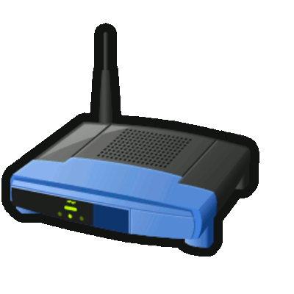

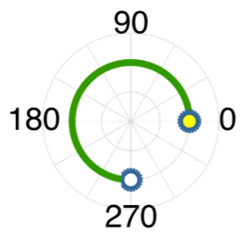
The problem of wireless interference
User A
Channel
Access Point (AP)
I-Q plot:
A send
AP receive
Channel
AP can estimate the channel, so can decode User A’s signal ( )

Slide 4
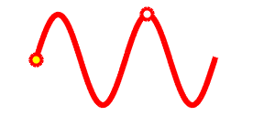
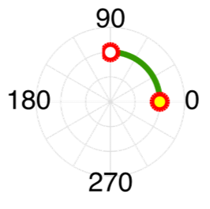
The problem of wireless interference
User B
I-Q plot:
B send
AP receive
Channel
AP can estimate the channel, so can decode User B’s signal ( )

Slide 5
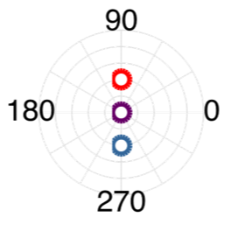
The problem of wireless interference
User B
User A
I-Q plot:
AP receive from A alone
AP receive from B alone
AP receive (A + B)
One received signal ( ), two sent ( , ), so AP can’t decode

Slide 6
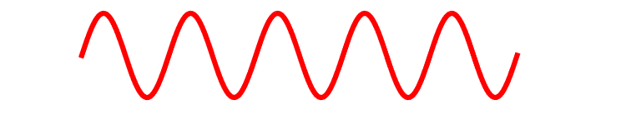

Leveraging Multiple Antennas
Now, the AP hears two received signals, one on each antenna:
Antenna 1
2
User A
Access Point
User A
Antenna 2
Send
Antenna 1

Slide 7
Leveraging Multiple Antennas
User B
Antenna 1
User A
2
User A
User B
Mixture of A and B
A2
+
=
Antenna 2
A2
A1
A1
Antenna 1

Slide 8
Intuition: Zero-Forcing Receiver
MIMO zero-forcing receiver
Rotate one antenna’s signal ( )
Sum the two antennas’ signals together ( + )
User A
User B
Sum
A2
Sum
A2
Rotate
A1
Rotate
A1
Zero-forcing cancels B, revealing A
Can re-run to cancel A, revealing B

Slide 9
Spatial Multiplexing: More “Streams”
Send multiple streams of information over each of the spatial paths between sender and receiver
  This is called spatial multiplexing
Potential for increased capacity by a factor of N (minimum number of send or receive antennas):
Potential for a multiplicative rate speed-up

Slide 10
Today
Graphical intuition in the I-Q plane
Physical modeling of the SIMO channel
Physical modeling of the MIMO channel

Slide 11
Physical Modeling of Multi-Antenna Channels
Gain intuition as to how the RF channel (ambient environment) impacts capacity
Many physical antenna arrangement geometries possible
Limit discussion today to linear antenna arrays, half-wavelength antenna spacing
  Details vary with more sophisticated antenna arrangements, but concepts do not

Slide 12
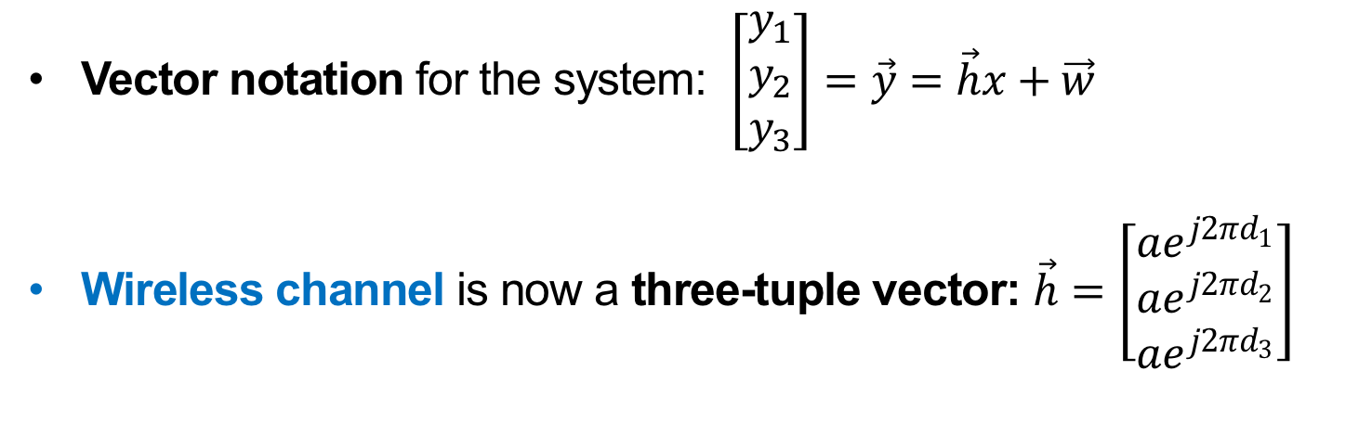

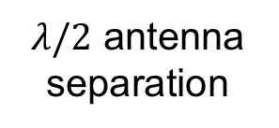

Line-of-Sight SIMO Channel: A Second Look
$$φ$$
$$d≫λ$$
$λ/2$ antenna separation
Send x
1
2
3
Receive y₁, y₂, y₃
Vector notation for the system: $\left[\begin{matrix}y_{1} \\ y_{2} \\ y_{3}\end{matrix}\right]=\vec{y}=\vec{h}x+\vec{w}$
Wireless channel is now a three-tuple vector: $\vec{h}=\left[\begin{matrix}ae^{j2πd_{1}} \\ ae^{j2πd_{2}} \\ ae^{j2πd_{3}}\end{matrix}\right]$

Slide 13
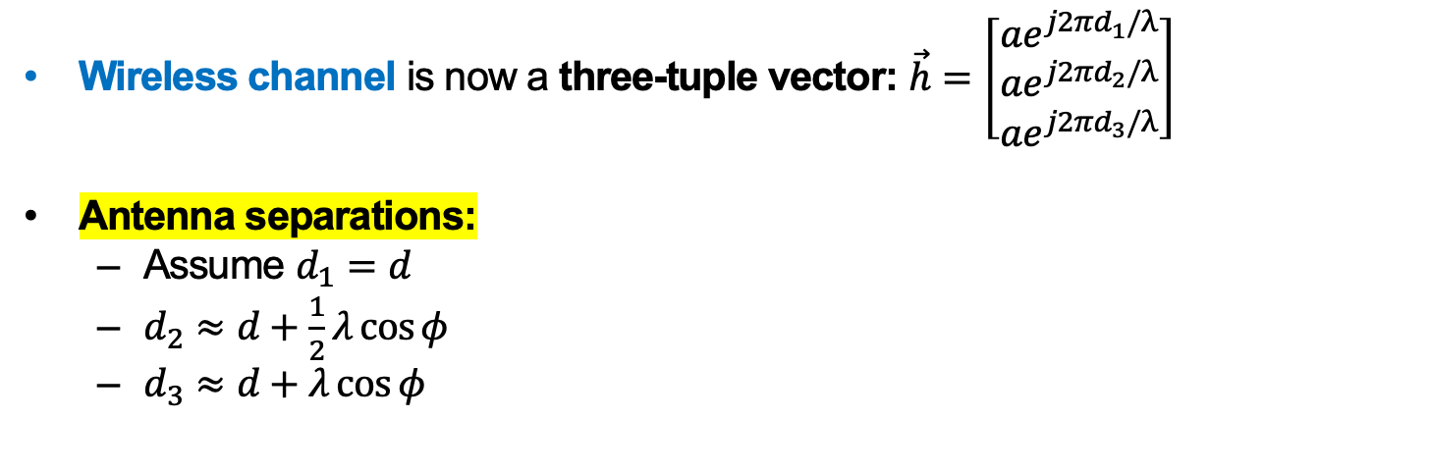
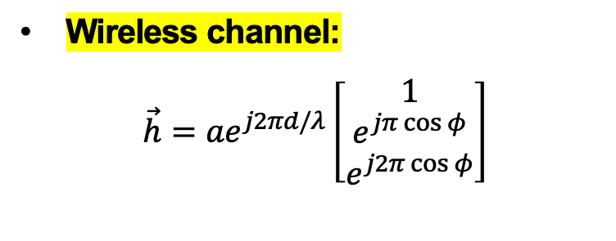
Line-of-Sight SIMO Channel: A Second Look
$$φ$$
$$d≫λ$$
$λ/2$ antenna separation
Send x
1
2
3
Receive y₁, y₂, y₃
Wireless channel is now a three-tuple vector: $\vec{h}=\left[\begin{matrix}ae^{j2πd_{1}/λ} \\ ae^{j2πd_{2}/λ} \\ ae^{j2πd_{3}/λ}\end{matrix}\right]$
Antenna separations:
  Assume $d_{1}=d$
  $d_{2}≈d+\frac{1}{2}λ\cos{φ}$
  $d_{3}≈d+λ\cos{φ}$
Wireless channel:
$$\vec{h}=ae^{j2πd/λ}\left[\begin{matrix}1 \\ e^{jπ\cos{φ}} \\ e^{j2π\cos{φ}}\end{matrix}\right]$$

Slide 14
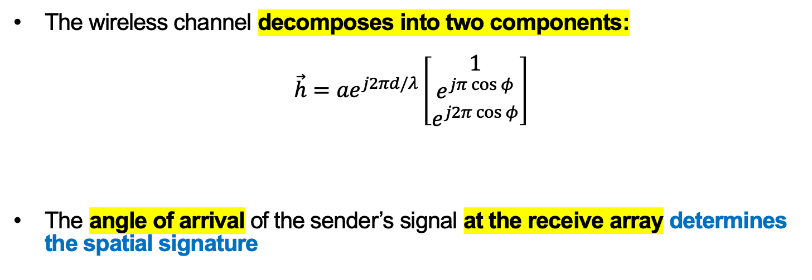
Line-of-Sight SIMO Channel: Spatial Signature
$$φ$$
$$d≫λ$$
$λ/2$ antenna separation
Send x
1
2
3
Receive y₁, y₂, y₃
The wireless channel decomposes into two components:
$$\vec{h}=ae^{j2πd/λ}\left[\begin{matrix}1 \\ e^{jπ\cos{φ}} \\ e^{j2π\cos{φ}}\end{matrix}\right]$$
The angle of arrival of the sender’s signal at the receive array determines the spatial signature
Path
component
Spatial Signature

Slide 15
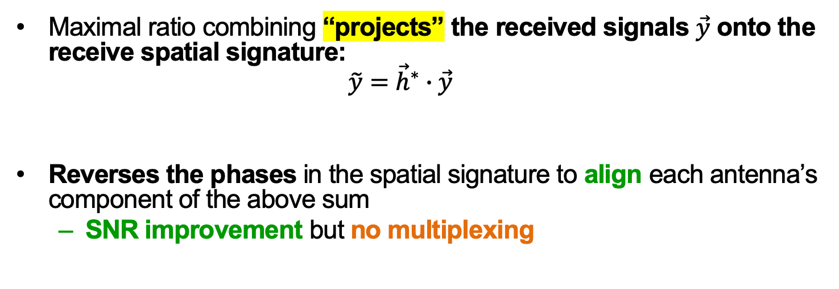
Line-of-Sight SIMO Channel:
Maximal Ratio Combining (Review)
$$φ$$
$$d≫λ$$
$λ/2$ antenna separation
Send x
1
2
3
Receive y₁, y₂, y₃
Maximal ratio combining “projects” the received signals $\vec{y}$ onto the receive spatial signature:
  $$\tilde{y}={\vec{h}}^{∗}∙\vec{y}$$
Reverses the phases in the spatial signature to align each antenna’s component of the above sum
  SNR improvement but no multiplexing

Slide 16
Today
Graphical intuition in the I-Q plane
Physical modeling of the SIMO channel
Physical modeling of the MIMO channel
  Line-of-Sight MIMO Channel
  Geographically-Separated Transmit Antennas
  Geographically-Separated Receive Antennas
  MIMO Link in Multipath

Slide 17

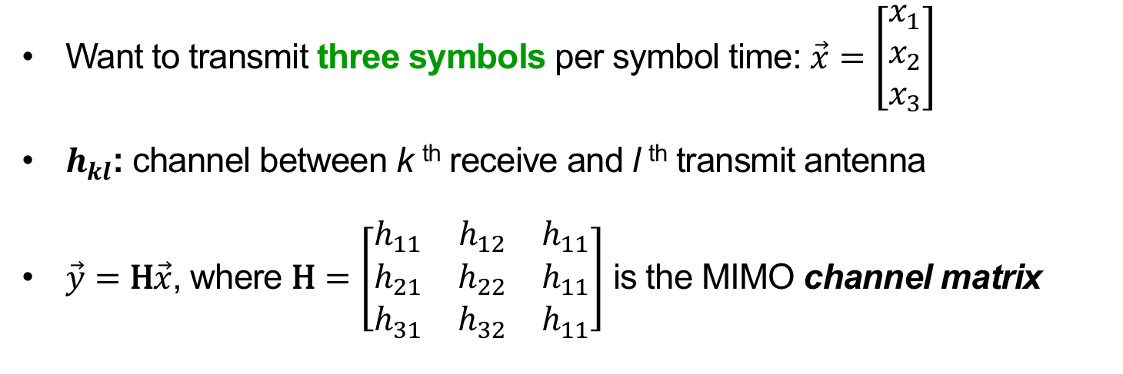


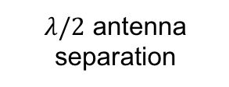

The Line-of-Sight MIMO Channel
Send x₁, x₂, x₃
$$φ$$
$$λ/2$$
1
1
2
2
$λ/2$ antenna separation
3
3
$$θ$$
$$d≫λ$$
Receive y₁, y₂, y₃
Want to transmit three symbols per symbol time: $\vec{x}=\left[\begin{matrix}x_{1} \\ x_{2} \\ x_{3}\end{matrix}\right]$
$h_{kl}$: channel between k ^{th} receive and l ^{th} transmit antenna
$\vec{y}=\text{H}\vec{x}$, where $\text{H}=\left[\begin{matrix}h_{11} & h_{12} & h_{11} \\ h_{21} & h_{22} & h_{11} \\ h_{31} & h_{32} & h_{11}\end{matrix}\right]$ is the MIMO channel matrix

Slide 18
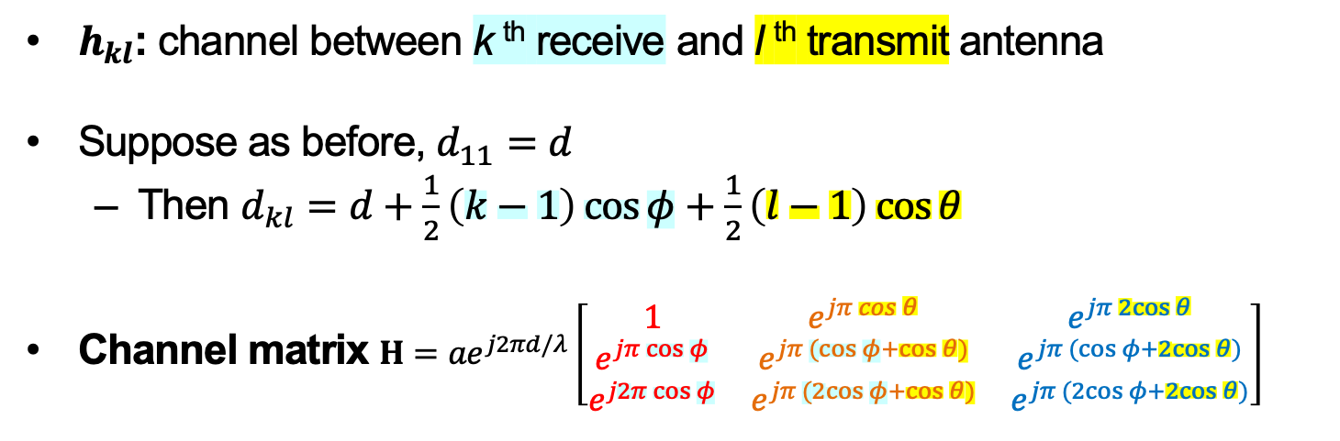
The Line-of-Sight MIMO Channel:
Channel Matrix
Send x₁, x₂, x₃
$$φ$$
$$λ/2$$
1
1
2
2
$λ/2$ antenna separation
3
3
$$θ$$
$$d≫λ$$
Receive y₁, y₂, y₃
$h_{kl}$: channel between k ^{th} receive and l ^{th} transmit antenna
Suppose as before, $d_{11}=d$
  Then $d_{kl}=d+\frac{1}{2}\left(k−1\right)\cos{φ}+\frac{1}{2}\left(l−1\right)\cos{θ}$
Channel matrix $H=ae^{j2πd/λ}\left[\begin{matrix}1 & e^{jπ\cos{θ}} & e^{jπ2cos{θ}} \\ e^{jπ\cos{φ}} & e^{jπ(cos{φ}+\cos{θ)}} & e^{jπ(\cos{φ}+2cos{θ)}} \\ e^{j2π\cos{φ}} & e^{jπ(2cos{φ}+\cos{θ)}} & e^{jπ(2cos{φ}+2cos{θ)}}\end{matrix}\right]$
Tx 1:
Tx 2:
Tx 3:

Slide 19
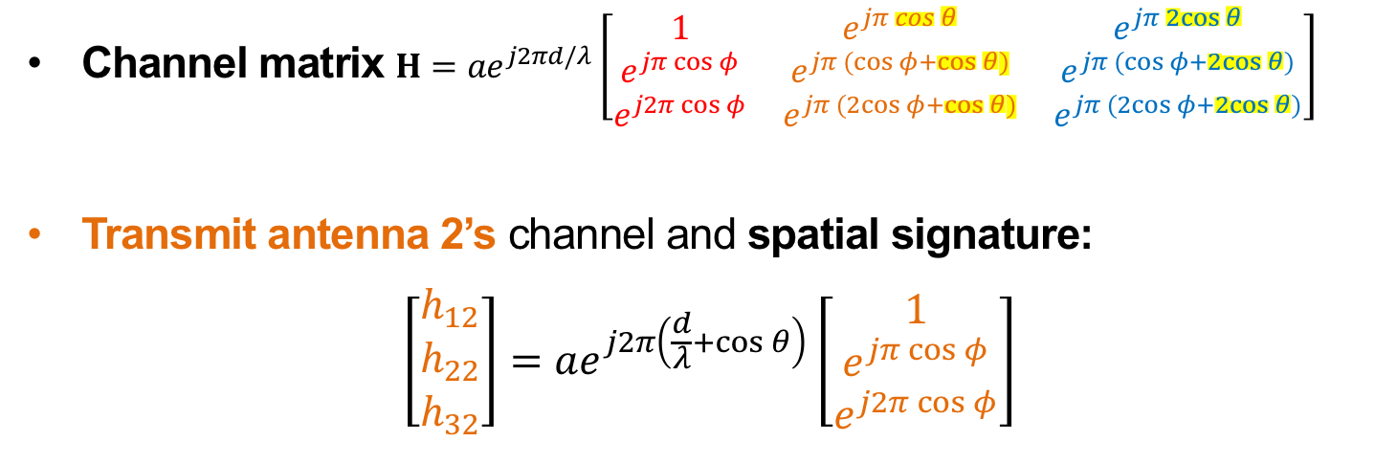
The Line-of-Sight MIMO Channel:
Identical Spatial Signatures
Send x₁, x₂, x₃
$$φ$$
$$λ/2$$
1
1
2
2
$λ/2$ antenna separation
3
3
$$θ$$
$$d≫λ$$
Receive y₁, y₂, y₃
Tx 1:
Tx 2:
Tx 3:
Channel matrix $H=ae^{j2πd/λ}\left[\begin{matrix}1 & e^{jπ\cos{θ}} & e^{jπ2cos{θ}} \\ e^{jπ\cos{φ}} & e^{jπ(cos{φ}+\cos{θ)}} & e^{jπ(\cos{φ}+2cos{θ)}} \\ e^{j2π\cos{φ}} & e^{jπ(2cos{φ}+\cos{θ)}} & e^{jπ(2cos{φ}+2cos{θ)}}\end{matrix}\right]$
Transmit antenna 2’s channel and spatial signature:
$$\left[\begin{matrix}h_{12} \\ h_{22} \\ h_{32}\end{matrix}\right]=ae^{j2π\left(\frac{d}{λ}+\cos{θ}\right)}\left[\begin{matrix}1 \\ e^{jπ\cos{φ}} \\ e^{j2π\cos{φ}}\end{matrix}\right]$$

Slide 20
The Line-of-Sight MIMO Channel: Takeaways
Spatial signature: How to phase-shift received signals to align them
Spatial signature of Transmit antenna 1
  Equals spatial signature of Tx antenna 2, Tx antenna 3
So any receiver attempt to align signal from Transmit antenna 1
  Also aligns transmit antennas 2 and 3
Result is interference between x₁, x₂, x₃
  Can send same single symbol x on all transmit antennas
    Results in same power gain as MRC
Spatial mux fail

Slide 21
Today
Graphical intuition in the I-Q plane
Physical modeling of the SIMO channel
Physical modeling of the MIMO channel
  Line-of-Sight MIMO Channel
  Geographically-Separated Transmit Antennas
  Geographically-Separated Receive Antennas
  MIMO Link in Multipath

Slide 22

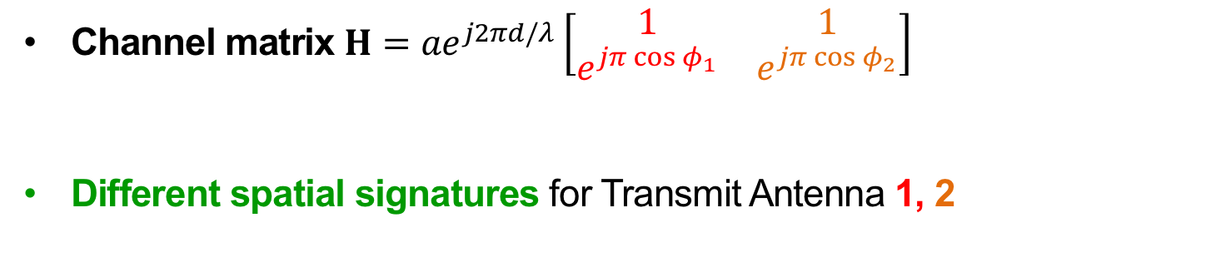


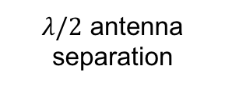


Geographically-Separated Transmit Antennas:
Space-Division Multiple Access (SDMA)
Send x₁, x₂
1
$$d≫λ$$
1
$λ/2$ antenna separation
$$∆ ≈d$$
$$d≫λ$$
$$φ_{2}$$
$$φ_{1}$$
2
2
Receive y₁, y₂
Tx 1:
Tx 2:
Channel matrix $H=ae^{j2πd/λ}\left[\begin{matrix}1 & 1 \\ e^{jπ\cos{φ_{1}}} & e^{jπ\cos{φ_{2}}}\end{matrix}\right]$
Different spatial signatures for Transmit Antenna 1, 2
Sig. 1
Sig. 2

Slide 23


Spatial Signature =
Series of Phase Differences
Tx 1:
Tx 2:
Channel matrix $H=ae^{j2πd/λ}\left[\begin{matrix}1 & 1 \\ e^{jπ\cos{φ_{1}}} & e^{jπ\cos{φ_{2}}}\end{matrix}\right]$
Sig. 1, $h_{φ_{1}}$
Sig. 2, $h_{φ_{2}}$
From Transmit Antenna 1:
From Transmit Antenna 2:
At Receive Antenna 1
At Receive Antenna 1
+
Sig. 1
Sig. 2
At Receive Antenna 2
At Receive Antenna 2

Slide 24
The Zero-Forcing Receiver
(via Spatial Signatures)
Suppose want to receive from Transmit Antenna 1
  (Recall:) Rotate Receive Antenna 2’s signal so that Signature 2 cancels itself
From Transmit Antenna 1:
From Transmit Antenna 2:
At Receive Antenna 1
At Receive Antenna 1
+
Cancelled!
Sig. 1
Sig. 2
At Receive Antenna 2
At Receive Antenna 2

Slide 25
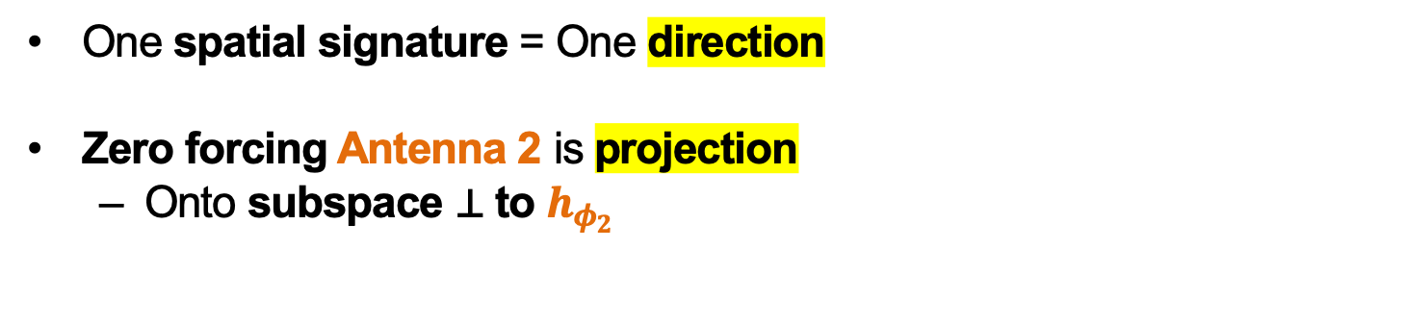



The Zero-Forcing Receiver
(via Spatial Signatures)
$$h_{φ_{2}}$$
$$\vec{y}$$
One spatial signature = One direction
Zero forcing Antenna 2 is projection
  Onto subspace ⊥ to $h_{φ_{2}}$
$$h_{φ_{1}}$$
From Transmit Antenna 1:
From Transmit Antenna 2:
At Receive Antenna 1
At Receive Antenna 1
+
Cancelled!
Sig. 1
Sig. 2
At Receive Antenna 2
At Receive Antenna 2

Slide 26






MIMO Separability: Discussion
Transmit antenna separation →
  Spatial signature separation →
    Better projection,
    Better performance
MIMO antenna array without multipath
  No transmit antenna separation
  No spatial signature separation
    Cancel Tx Ant 2: cancels Tx Ant 1
  No spatial multiplexing
$$h_{φ_{2}}$$
$$\vec{y}$$
$$h_{φ_{1}}$$
$$h_{φ_{2}}$$
$$\vec{y}$$
$$h_{φ_{1}}$$

Slide 27
Today
Graphical intuition in the I-Q plane
Physical modeling of the SIMO channel
Physical modeling of the MIMO channel
  Line-of-Sight MIMO Channel
  Geographically-Separated Transmit Antennas
  Geographically-Separated Receive Antennas
  MIMO Link in Multipath

Slide 28
Geographically-Separated Receive Antennas:
SDMA Downlink
Different spatial signatures for Receive Antennas 1, 2
  Rows, instead of columns in the MIMO matrix

Slide 29
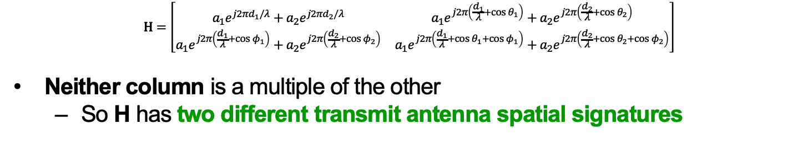
MIMO in Multipath
Tx antenna 1:
Tx antenna 2:
$$\text{H}=\left[\begin{matrix}a_{1}e^{j2πd_{1}/λ}+a_{2}e^{j2πd_{2}/λ} & a_{1}e^{j2π\left(\frac{d_{1}}{λ}+\cos{θ_{1}}\right)}+a_{2}e^{j2π\left(\frac{d_{2}}{λ}+\cos{θ_{2}}\right)} \\ a_{1}e^{j2π\left(\frac{d_{1}}{λ}+\cos{φ_{1}}\right)}+a_{2}e^{j2π\left(\frac{d_{2}}{λ}+\cos{φ_{2}}\right)} & a_{1}e^{j2π\left(\frac{d_{1}}{λ}+\cos{θ_{1}}+\cos{φ_{1}}\right)}+a_{2}e^{j2π\left(\frac{d_{2}}{λ}+\cos{θ_{2}}+\cos{φ_{2}}\right)}\end{matrix}\right]$$
Neither column is a multiple of the other
  So H has two different transmit antenna spatial signatures

Slide 30
Different Spatial Signatures: Intuition
A
B
Channel matrix H has two different spatial signatures
Imagine perfect signal “relays” A, B
  This H is the product of:
    Geographically-separated receive antenna channel
    Geographically-separated transmit antenna channel

Slide 31
“Poorly-Conditioned” MIMO channels
Only reflectors
near receiver: ϕ₁ ≈ ϕ₂
Only reflectors near
transmitter: θ₁ ≈ θ₂
h₁
h₂
When channel is poorly conditioned, spatial signatures are closer aligned

Slide 32
How Many Streams are Possible?
Received signals live in an n_{r}-dimensional vector space
  e.g. n_{r} = 3 receive antennas → 3-D vector space:
Cancel by projection. Therefore, at most n_{r} streams possible

Slide 33
How Many Streams are Possible?
One spatial signature per transmit antenna
  e.g. n_{r} = 3 receive, n_{t} = 2 transmit antennas:
Therefore, at most n_{t} streams possible
h₂
h₁

Slide 34
How Many Streams are Possible?
Need enough strong physical paths in the wireless channel
  e.g. n_{r} = 3, n_{t} = 3 but two physical paths confines { h_{i} } to a plane
At most # physical paths possible streams
h₂
h₁
h₃

Slide 35

How Many Streams are Possible?
Need enough strong physical paths in the wireless channel
  e.g. n_{r} = 3, n_{t} = 3 and three physical paths
At most # physical paths possible streams
h₁
$${\text{Proj}}_{⊥\left\langle h_{2}, h_{3}\right\rangle }h_{1}$$
h₂
h₁
h₃

Slide 36
Degrees of Freedom
The figure of merit that summarizes the number of streams possible is called the number of degrees of freedom of H
Degrees of freedom = min { n_{t} , n_{r} , # strong paths }
h₁
h₂
h₃

Slide 37
Summary
Spatial multiplexing requires either:
  Spatially-separated receivers / transmitters (SDMA), or
  Multiple antennas at both ends of a link (MIMO), and
    Enough physical channel propagation paths
Degrees of freedom quantify spatial multiplexing potential

Slide 38
Tuesday Topic:
MIMO III: Channel Capacity,
Interference Alignment

