Slide 1
MIMO I: Spatial Diversity
COS 463: Wireless Networks
Lecture 16
Kyle Jamieson
[Parts adapted from D. Halperin et al., T. Rappaport]

Slide 2
What is MIMO, and why?
Multiple-Input, Multiple-Output (MIMO) communications
  Send/receive > 1 signal on different transmit and receive antennas
We’ve already seen frequency, time, spatial multiplexing in 463:
  MIMO is a more powerful way to multiplex wireless medium in space
  Transforms multipath propagation from impediment to advantage

Slide 3
Many Uses of MIMO
At least three different ways to leverage space:
Spatial diversity: Send or receive redundant streams of information in parallel along multiple spatial paths
  Increase reliability and range (unlikely all paths are degraded simultaneously)
Spatial multiplexing: Send independent streams of information in parallel along multiple spatial paths
  Increases rate, if we can avoid interference
Interference alignment: “Align” two streams of interference at receiver, resulting in impact of just one interference stream

Slide 4
MIMO-OFDM
subcarriers
Symbols
Multipath fading: different effects on different frequencies
  OFDM: Orthogonal Frequency Domain Multiplexing
  Different subcarriers are independent of each other
Channel model for OFDM: y = h∙x + w
  A single complex number h captures the effect of the channel on data in a particular subcarrier
For MIMO: Think about each subcarrier, independent of other subcarriers

Slide 5
Plan
Today: Diversity in Space
  Receive Diversity
  Transmit Diversity
Next time: Multiplexing in Space
Next time: Interference Alignment

Slide 6
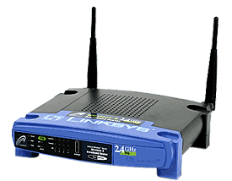
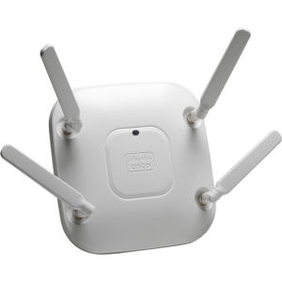
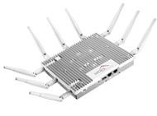
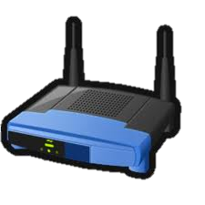
Path Diversity: Motivation
Multi-Antenna Access Points (APs), especially 802.11n,ac:
Multiple APs cooperating with each other:
Distributed Antenna systems, separating antenna from AP:
Wired backhaul

Slide 7
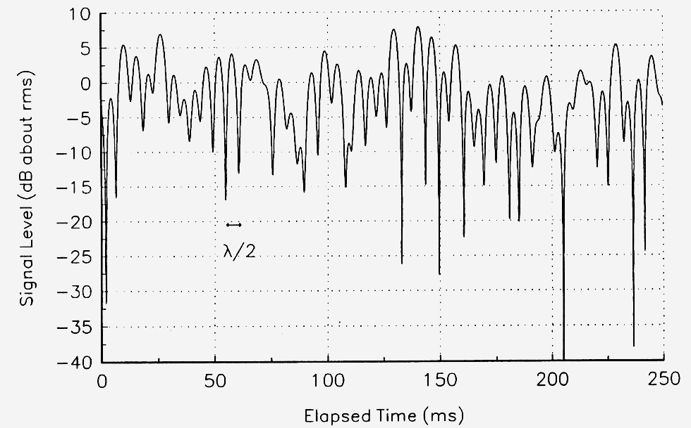
Review: Fast Fading
Typical outdoor multipath propagation environment, channel h
On one link each subcarrier’s power level experiences Rayleigh fading:
$${\left|h\right|}^{2}$$

Slide 8
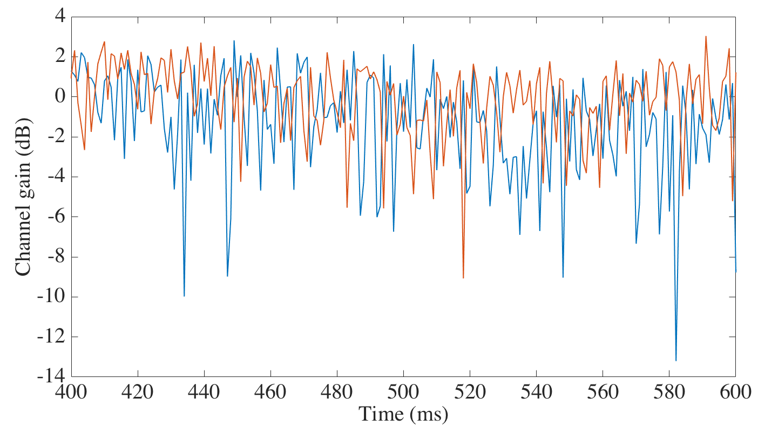
Uncorrelated Rayleigh Fading
Suppose two antennas, separated by distance d₁₂
Channels from each to a distant third antenna (h₁₃, h₂₃) can be uncorrelated
  Fading happens at different times with no bias for a simultaneous fade
$${\left|h_{1}\right|}^{2},{\left|h_{2}\right|}^{2}$$

Slide 9
When is Fading Uncorrelated, and Why?
$$≫λ$$
$$d_{12}$$
Channels from each antenna (h₁₃, h₂₃) to a third antenna
  Channels are uncorrelated when $d_{12}> ≈1.5λ$
  Channels correlated, fade together when $d_{12}< ≈λ$
This correlation distance depends on the radio environment around the pair of antennas
  Increases, e.g., atop cellular phone tower

Slide 10
Plan
Today: Diversity in Space
  Receive Diversity
    Selection Diversity
    Maximal Ratio Combining
  Transmit Diversity
Next time: Multiplexing in Space
Next time: Interference Alignment

Slide 11
Channel Model for Receive Diversity
One transmit antenna sends a symbol to two receive antennas
  Receive diversity, or Single-Input, Multi-Output (SIMO)
Each receive antenna gets own copy of transmitted signal via:
  A different path
  A (likely) different channel
h₁
Receive antenna 1
x
h₂
Receive antenna 2

Slide 12
Selection Diversity
h₁
Rx 1
x
Select stronger
h₂
Radio
Rx 2
Two receive antennas share one receiving radio via a switch
Receiver selects antenna with stronger signal to connect to the radio
  Helps reliability (both unlikely bad)
  Wastes received signal from other antenna(s)

Slide 13
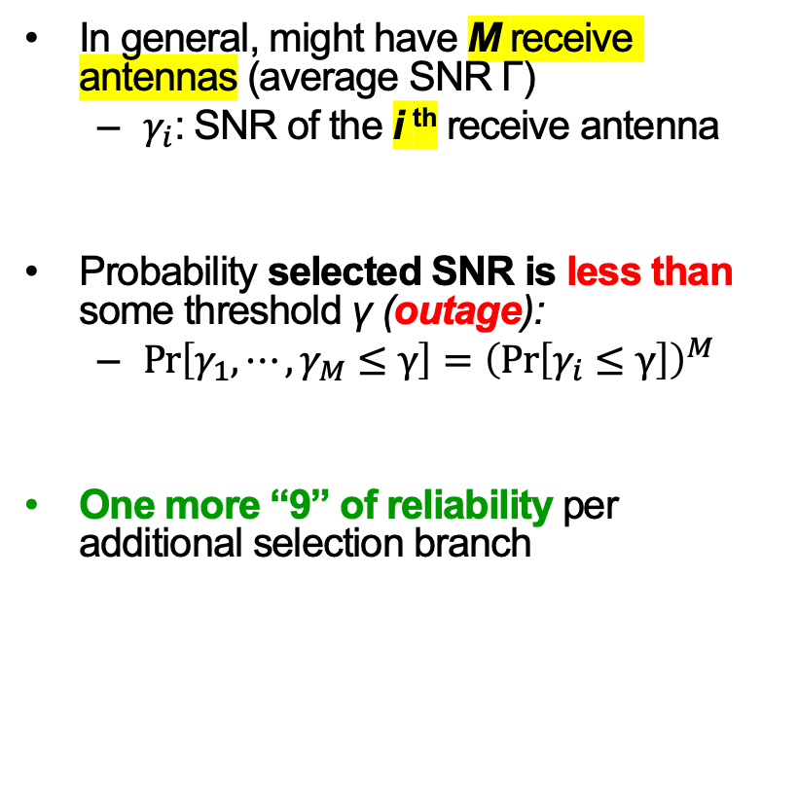
Selection Diversity:
Performance Improvement in Uncorrelated Rayleigh Fading
In general, might have M receive antennas (average SNR Γ)
  $γ_{i}$: SNR of the i ^{th} receive antenna
Probability selected SNR is less than some threshold γ (outage):
  $\operatorname{Pr}\left[γ_{1}, ⋯,γ_{M}≤γ\right]={\left(\operatorname{Pr}\left[γ_{i}≤γ\right]\right)}^{M}$
One more “9” of reliability per additional selection branch
Probability (%) that Selected Antenna’s SNR Exceeds Threshold γ
Higher probability (better) ↓
← lower threshold SNR

Slide 14
Leveraging All Receive Antennas
h₁
Rx 1
x
h₂
Rx 2
Want to just add the two received signals together
  But if we did the signals would often cancel out
Solution: Receive M radios, align signal phases, then add
  Requires M receive radios, in general

Slide 15
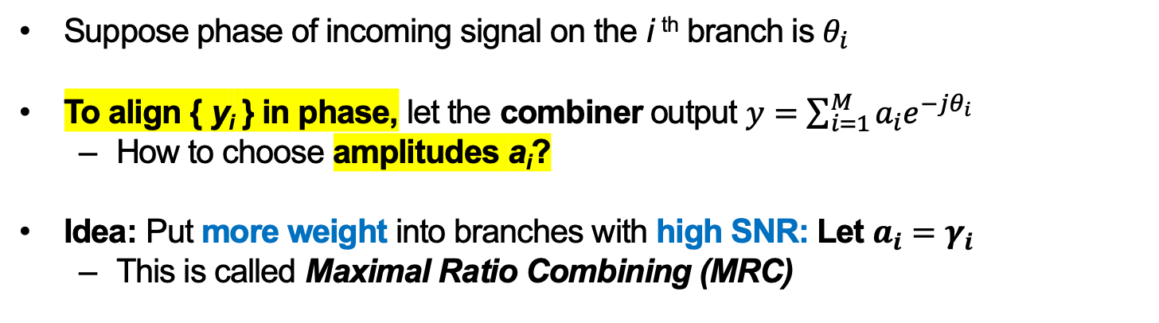
How to Choose Weights?
h₁
Rx 1
Combiner
x
h₂
y
Rx 2
Suppose phase of incoming signal on the i ^{th} branch is $θ_{i}$
To align { y_{i} } in phase, let the combiner output $y=\sum_{i=1}^{M}{a_{i}e^{−jθ_{i}}}$
  How to choose amplitudes a_{i}?
Idea: Put more weight into branches with high SNR: Let $a_{i}=γ_{i}$
  This is called Maximal Ratio Combining (MRC)

Slide 16

MRC: Performance Improvement
Probability that MRC’s SNR is Under Threshold γ
Lower probability (better) ↓
$$10{\text{log}}_{10}\left(Γ/γ\right)$$
Lower threshold SNR →
Two “9”s of reliability improvement between one (i.e., no MRC) and two MRC branches

Slide 17
Selection Diversity, in Frequency
Antennas A and C experience different fades on different subcarriers
Selection Combining (“SEL”) improves but certain subcarriers still experience fading
MRC increases power and flattens nulls, leading to fewer bit errors

Slide 18
MRC’s Capacity Increase
MRC with M branches increases SNR
  Increased Shannon capacity
Sub-linear (logarithmic) capacity increase in M:
  $C_{MRC}=BW∙log⁡\left(1+M∙SNR\right)$ bits/second/Hz

Slide 19
Plan
Today: Diversity in Space
  Receive Diversity
  Transmit Diversity
    Transmit beamforming
    Introduction to Space-Time Coding: Alamouti’s Scheme
Next time: Multiplexing in Space
Next time: Interference Alignment

Slide 20
Transmit Diversity: Motivation
More space, power, processing capability available at the transmitter?
  Yes, likely! e.g. Cell tower, Wi-Fi AP sending downlink traffic to mobile
But, a possible requirement: Transmitter may need to know radio channel before transmission commences
  cf. receive diversity: receiver knows channel from preamble
So, a tension: Want to separate transmit antennas for path diversity
  Need to move timely radio channel measurements between locations
    Introduces overhead and design complexity

Slide 21
Transmit Beamforming: Motivation
“receiver”
Suppose transmitter knows the channel to receivers
Transmitters align their signals so that constructive interference occurs at the single receive antenna
  Align before transmission, not after reception (receive beamforming)

Slide 22
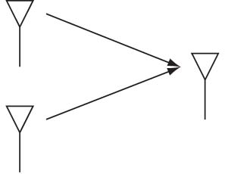
Transmit Beamforming
Leverage channel reciprocity, receive beamforming “in reverse”
Send one data symbol x from two antennas
$$a_{1}e^{−jθ_{1}}$$
$$h_{1}=a_{1}e^{jθ_{1}}$$
Tx 1
Receive
$$h_{2}{=a}_{1}e^{jθ_{2}}$$
Tx 2
$$a_{2}e^{−jθ_{2}}$$
At each transmit antenna, multiply (pre-code) x by the complex conjugate of the respective channel to the receive antenna

Slide 23
Plan
Today: Diversity in Space
  Receive Diversity
  Transmit Diversity
    Transmit beamforming
    Introduction to Space-Time Coding: Alamouti’s Scheme
Next time: Multiplexing in Space
Next time: Interference Alignment

Slide 24
Alamouti Scheme: Motivation
Suppose transmitters don’t know channel to receiver: what to do?
Naïve (“blind”) beamforming (just send same signals)
  Signals would often cancel out
Repetition in time
  Each antenna takes turns transmitting same symbol
    Receiver combines coherently
  Uses M symbol times
    Increases diversity (“SNR” term in Shannon capacity)
    Cuts Shannon rate by 1/M factor

Slide 25
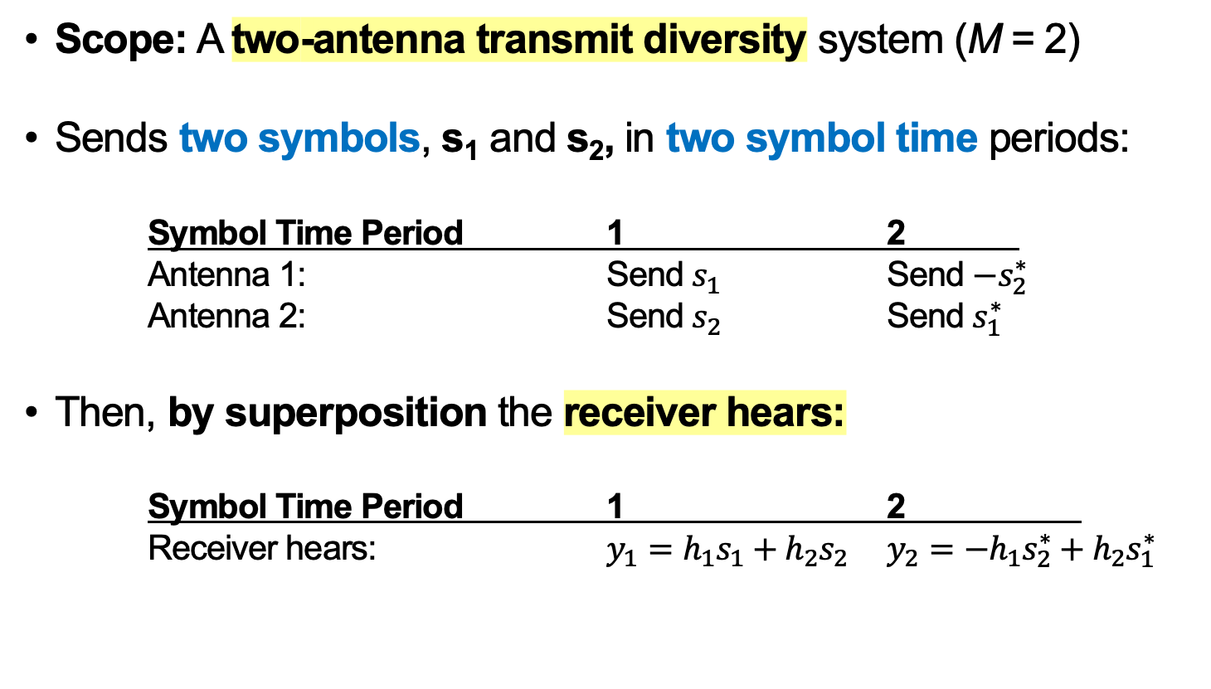
Alamouti Scheme
Scope: A two-antenna transmit diversity system (M = 2)
Sends two symbols, s₁ and s₂, in two symbol time periods:
Symbol Time Period 1 2
Antenna 1: Send $s_{1}$ Send $−s_{2}^{∗}$
Antenna 2: Send $s_{2}$ Send $s_{1}^{∗}$
Then, by superposition the receiver hears:
Symbol Time Period 1 2
Receiver hears: $y_{1}=h_{1}s_{1}+h_{2}s_{2}$ $y_{2}=−h_{1}s_{2}^{∗}+h_{2}s_{1}^{∗}$

Slide 26
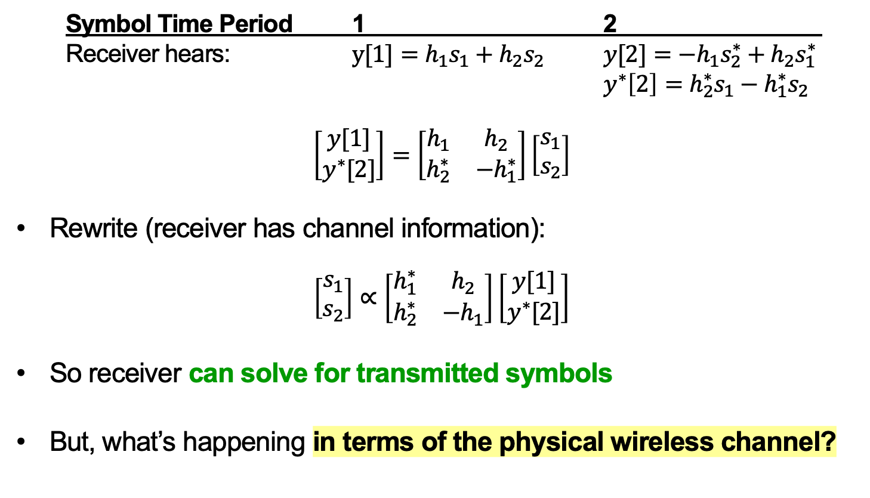
Alamouti Receiver Processing
Symbol Time Period 1 2
Receiver hears: $y[1]=h_{1}s_{1}+h_{2}s_{2}$ $y[2]=−h_{1}s_{2}^{∗}+h_{2}s_{1}^{∗}$
$y^{∗}\left[2\right]=h_{2}^{∗}s_{1}−h_{1}^{∗}s_{2}$
$$\left[\begin{matrix}y[1] \\ y^{∗}[2]\end{matrix}\right]=\left[\begin{matrix}h_{1} & h_{2} \\ h_{2}^{∗} & −h_{1}^{∗}\end{matrix}\right]\left[\begin{matrix}s_{1} \\ s_{2}\end{matrix}\right]$$
Rewrite (receiver has channel information):
$$\left[\begin{matrix}s_{1} \\ s_{2}\end{matrix}\right]∝\left[\begin{matrix}h_{1}^{∗} & h_{2} \\ h_{2}^{∗} & −h_{1}\end{matrix}\right]\left[\begin{matrix}y[1] \\ y^{∗}[2]\end{matrix}\right]$$
So receiver can solve for transmitted symbols
But, what’s happening in terms of the physical wireless channel?

Slide 27
Intuition for Alamouti Receiver Processing
Start with the inverted channel matrix:
$$\left[\begin{matrix}s_{1} \\ s_{2}\end{matrix}\right]∝\left[\begin{matrix}h_{1}^{∗} & h_{2} \\ h_{2}^{∗} & −h_{1}\end{matrix}\right]\left[\begin{matrix}y[1] \\ y^{∗}[2]\end{matrix}\right]$$
Consider the computation for s₁:
  Rotate $y[1]$ by $−θ_{1}$
  Rotate $y^{∗}[2]$ by $θ_{2}$
  Sum the result

Slide 28
Alamouti: Impact of Phase Rotations
Consider the computation for s₁:
  Rotate $y[1]$ by $−θ_{1}$
  Rotate $y^{∗}[2]$ by $θ_{2}$
  Sum the result
Symbol Time Period 1 2
Receiver hears: $y[1]=h_{1}s_{1}+h_{2}s_{2}$ $y^{∗}\left[2\right]=h_{2}^{∗}s_{1}−h_{1}^{∗}s_{2}$
↓ ↓ ↓ ↓
Phase after rotation: $0$ $θ_{2}−θ_{1}$ $0$ $θ_{2}−θ_{1}$

Slide 29
Alamouti: Receiver-Side Picture
Symbol Time Period 1 2
Receiver hears: $y[1]=h_{1}s_{1}+h_{2}s_{2}$ $y^{∗}\left[2\right]=h_{2}^{∗}s_{1}−h_{1}^{∗}s_{2}$
↓ ↓ ↓ ↓
Phase after rotation: $0$ $θ_{2}−θ_{1}$ $0$ $θ_{2}−θ_{1}$
Receiver then sums all terms above:
Received signal:
Q
$$∡θ_{2}−θ_{1}$$
s₂
s₂
s₁
s₁
I

Slide 30
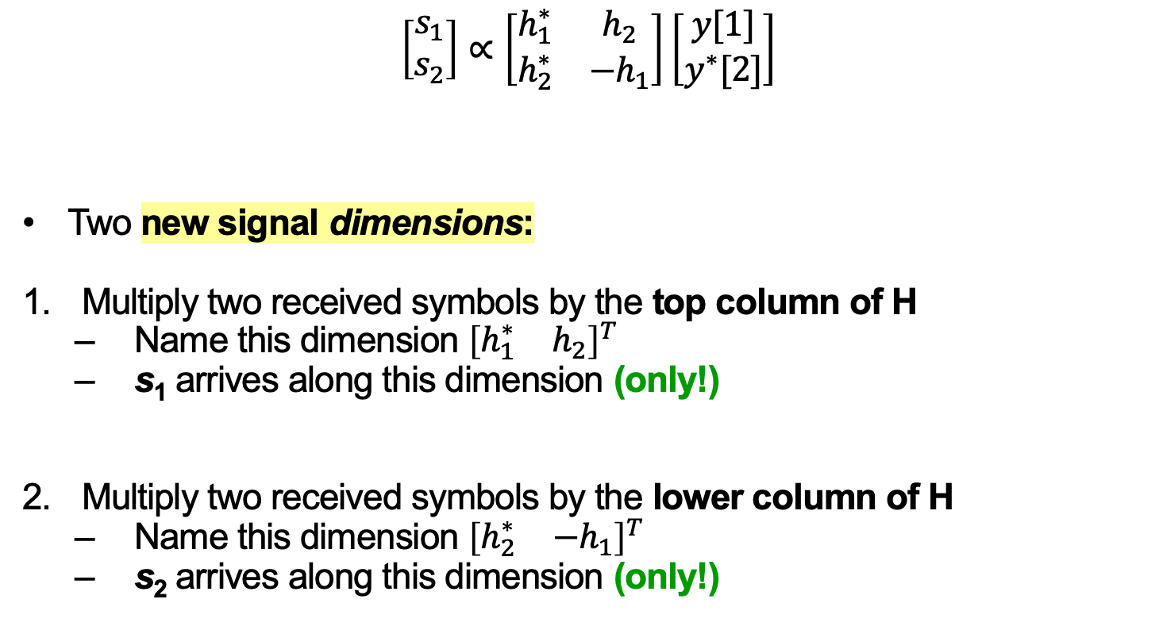
Alamouti: Interpretation
$$\left[\begin{matrix}s_{1} \\ s_{2}\end{matrix}\right]∝\left[\begin{matrix}h_{1}^{∗} & h_{2} \\ h_{2}^{∗} & −h_{1}\end{matrix}\right]\left[\begin{matrix}y[1] \\ y^{∗}[2]\end{matrix}\right]$$
Two new signal dimensions:
Multiply two received symbols by the top column of H
  Name this dimension ${\left[\begin{matrix}h_{1}^{∗} & h_{2}\end{matrix}\right]}^{T}$
  s₁ arrives along this dimension (only!)
Multiply two received symbols by the lower column of H
  Name this dimension ${\left[\begin{matrix}h_{2}^{∗} & {−h}_{1}\end{matrix}\right]}^{T}$
  s₂ arrives along this dimension (only!)
H

Slide 31
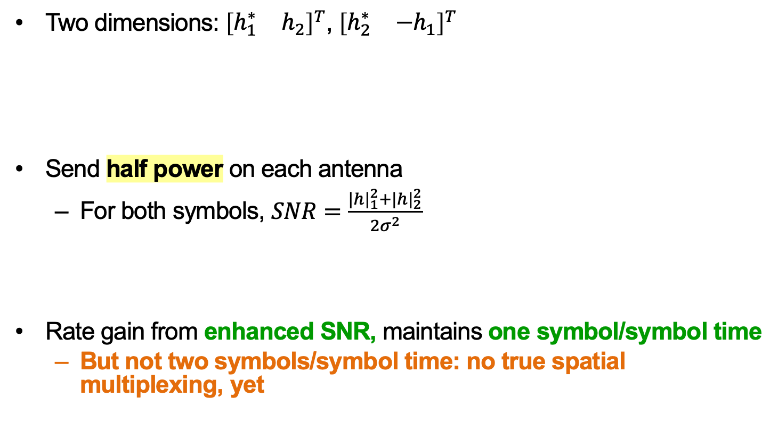
Alamouti: Performance
Two dimensions: ${\left[\begin{matrix}h_{1}^{∗} & h_{2}\end{matrix}\right]}^{T}$, ${\left[\begin{matrix}h_{2}^{∗} & {−h}_{1}\end{matrix}\right]}^{T}$
Send half power on each antenna
  For both symbols, $SNR=\frac{{|h|}_{1}^{2}+{|h|}_{2}^{2}}{2σ^{2}}$
Rate gain from enhanced SNR, maintains one symbol/symbol time
  But not two symbols/symbol time: no true spatial multiplexing, yet
Received
signal:
Q
s₁
s₁
I

Slide 32
Multi-Antenna Diversity: Summary
Leverage path diversity
  Decrease probability of “falling into” to deep Rayleigh fade on a single link
Defined new “dimensions” of independent communication channels based on space
  Segue to spatial multiplexing next time

Slide 33
Thursday Topic:
MIMO II: Spatial Multiplexing

