Slide 1
Receiver Designs for the
Radio Channel
COS 463: Wireless Networks
Lecture 15
Kyle Jamieson
[Parts adapted from C. Sodini, W. Ozan, J. Tan]

Slide 2
Today
Delay Spread and Frequency-Selective Fading
Time-Domain Equalization
Orthogonal Frequency Division Multiplexing

Slide 3
Last Time: Multipath causes Delay Spread
a₂,τ₂
Transmitter
a₁,τ₁
Receiver
Power Delay Profile P(t)
a₁
a₂
Channel delay spread T_{d}
τ₁
τ₂
t

Slide 4
Last Time: Multipath causes Frequency Selectivity
Interference between reflected and line-of-sight radio waves results in frequency dependent fading

Slide 5
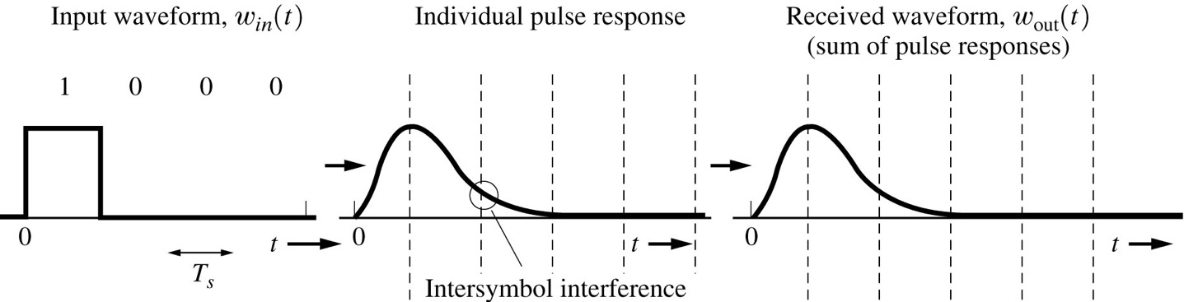
Problem: Inter-symbol interference (ISI)
Transmitted signal
Received signal with ISI

Slide 6
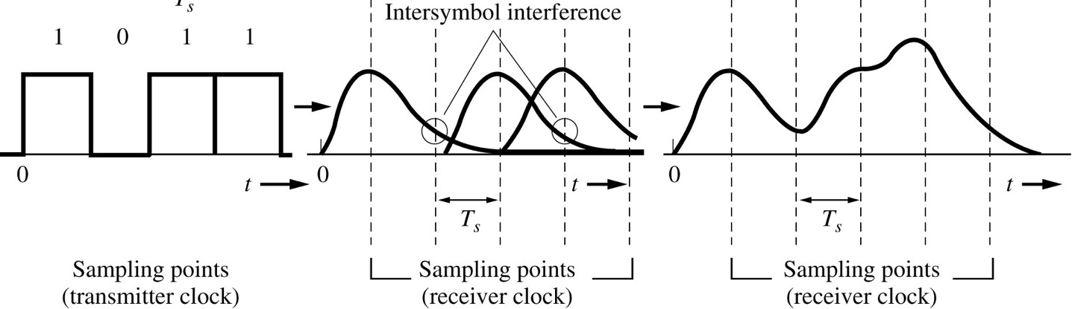
Problem: Inter-symbol interference (ISI)
Transmitted signal
Received signal with ISI
ISI at one symbol depends on the value of other symbols

Slide 7
Today
Delay Spread and Frequency-Selective Fading
Time-Domain Equalization
Orthogonal Frequency Division Multiplexing

Slide 8


Wideband System Design
Transmitter
Data d_{k}
p(t)
Transmit pulse filter
Channel
h(t)
Receiver
y_{t}
y[n]
p*(−t)
h_{eq}(t)
Received data $\hat{dk}$
Matched filter
Equalizer
$$f\left(t\right)=\left(p∗h\right)\left(t\right)∗p^{∗}(−t)$$
Composite channel f between data and received signal y[n] is made up of the transmit pulse shape, radio channel, and matched filter

Slide 9
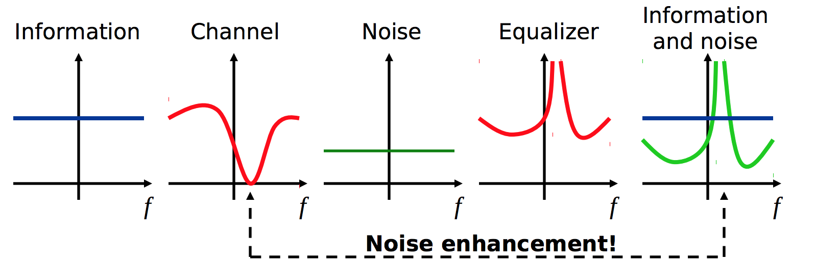
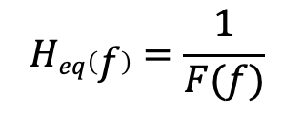

Zero-Forcing Equalizer
Receiver:
Receiver front-end noise: n_{k}
y_{t}
y[n]
+
p*(−t)
h_{eq}(t)
$$\hat{dk}$$
Matched filter
Equalizer
$$Heq\left(f\right)=\frac{1}{F(f)}$$
Received
Received
Information
Noise

Slide 10
Today
Delay Spread and Frequency-Selective Fading
Time-Domain Equalization
Orthogonal Frequency Division Multiplexing

Slide 11
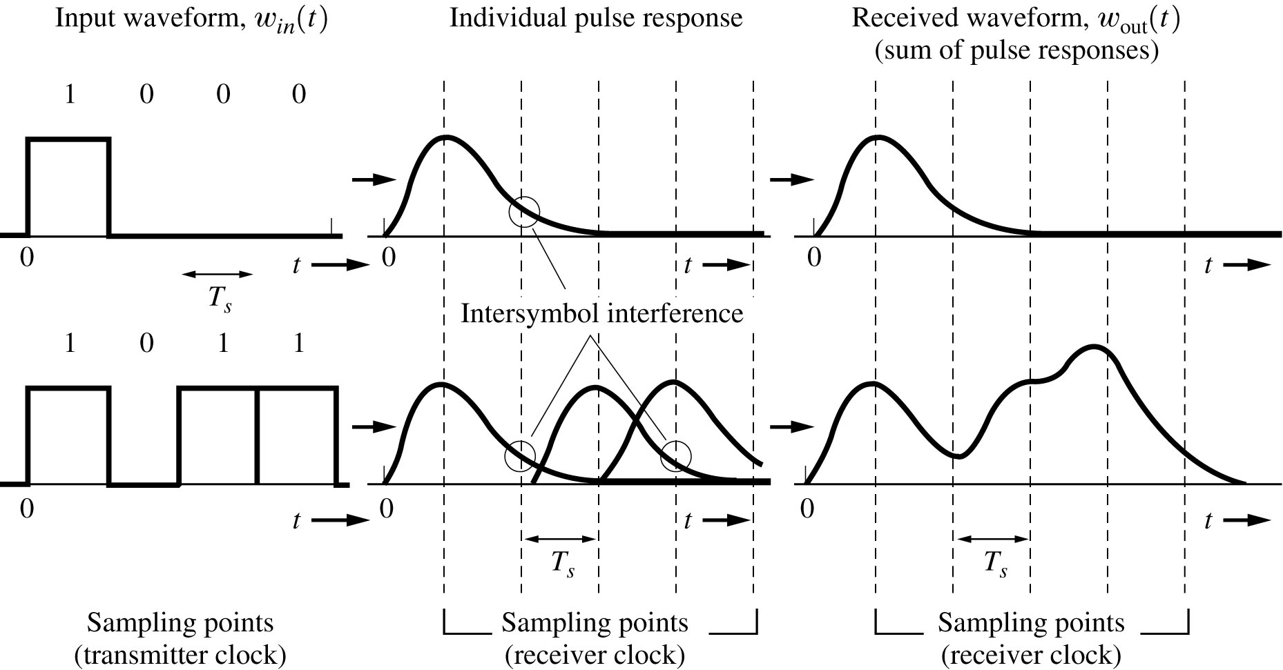
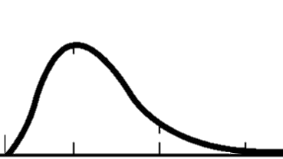
Simple Solution: Increase symbol time
(at receiver)
1
(double) T_{s}
No ISI
Transmitted signal Received signal
Choose symbol time T_{s} ≫ channel delay spread T_{d}

Slide 12
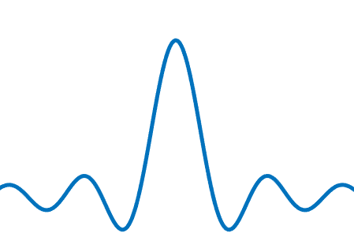
Symbol time determines frequency bandwidth
Symbol time
T
W
t
f
2T
W/2
t
f
Slowing down by a factor of two halves the frequency bandwidth of the sender’s signal

Slide 13

A narrowband signal “fits into” the coherence bandwidth
Over what frequency range is the channel approximately the same? This is the coherence bandwidth$W_{c}≈\frac{1}{2T_{d}}$
Coherence bandwidth W_{c}

Slide 14
Wideband versus OFDM
Wideband Signal
Frequency
Frequency selective fading
distorts wide-band signals
Multipath causes ISI
Time
Frequency
OFDM Signal
Narrowband
signals
Longer symbol time T_{s}
Time

Slide 15
FDMA: Frequency Division Multiple Access
Channel frequency bandwidth divided into smaller sub-bands
Each data gets own frequency sub-band (sinusoidal carrier)
But need to add quiet guard sub-bands in between each sub-band
  To mitigate inter-sub band interference
time
(guard)
FDM signal
frequency bands
(guard)
(guard)

Slide 16
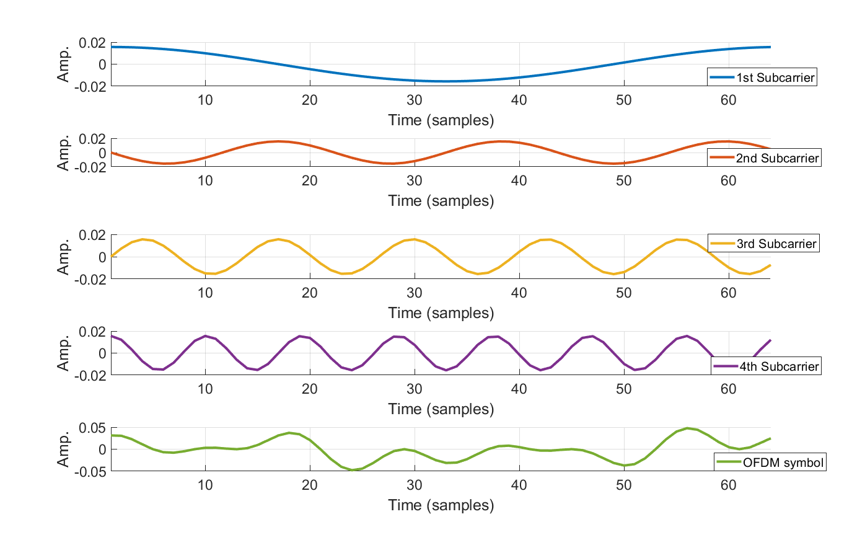
Long sinusoids, different frequencies
Baseband signal (In-Phase part)
Symbol time T_{s}
Modulate amplitude/phase of each above subcarrier to send information
Different frequencies on different subcarriers don’t mutually interfere

Slide 17
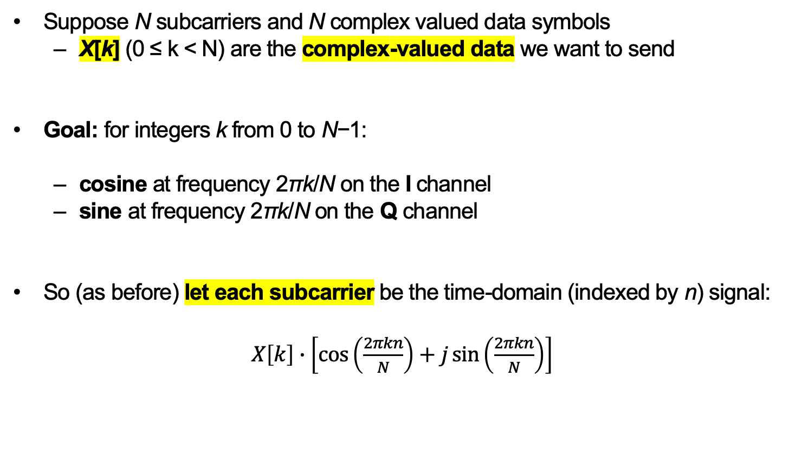
Integer-Multiple Frequencies
Suppose N subcarriers and N complex valued data symbols
  X[k] (0 ≤ k < N) are the complex-valued data we want to send
Goal: for integers k from 0 to N−1:
  cosine at frequency 2πk/N on the I channel
  sine at frequency 2πk/N on the Q channel
So (as before) let each subcarrier be the time-domain (indexed by n) signal:
$X\left[k\right]∙\left[\cos\left(\frac{2πkn}{N}\right)+j\sin\left(\frac{2πkn}{N}\right)\right]$

Slide 18
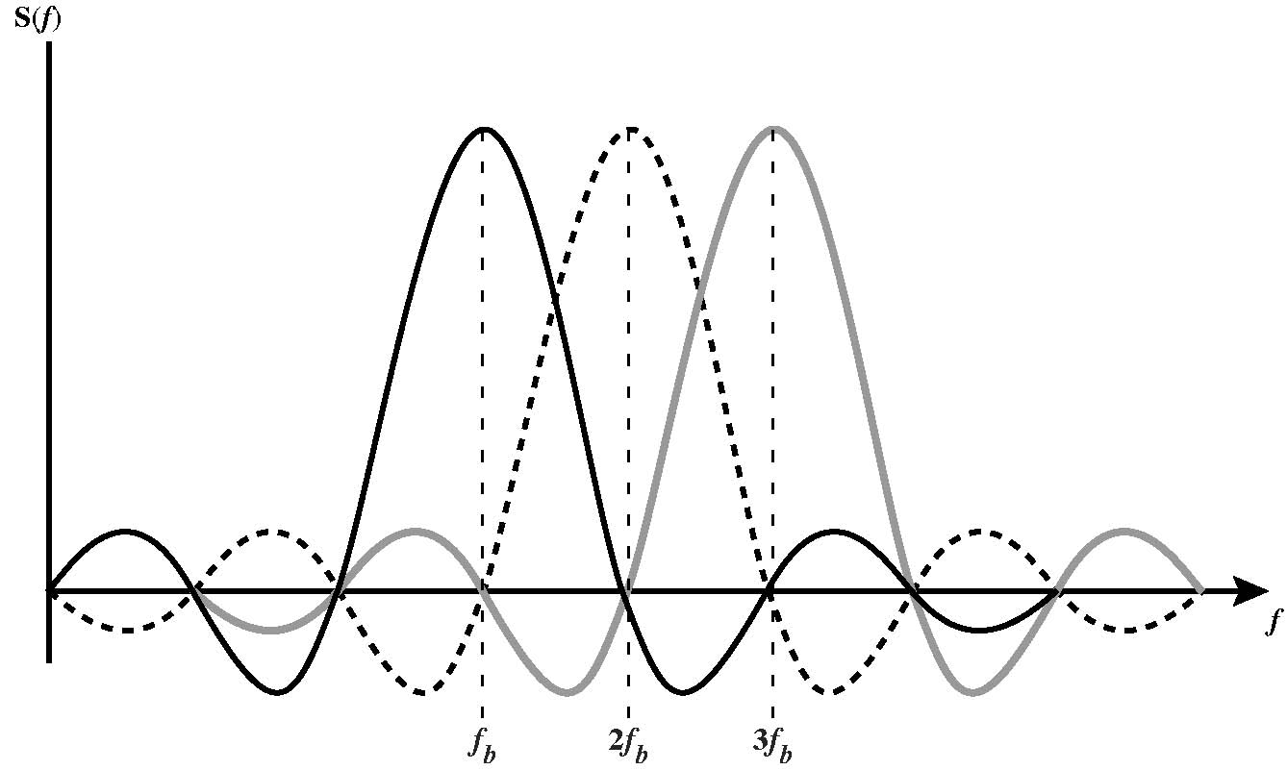
OFDM Subcarriers are “Orthogonal”
Integer-multiple frequencies so peaks of each subcarrier coincide in frequency with zeros of other subcarriers
  No guard bands required!

Slide 19
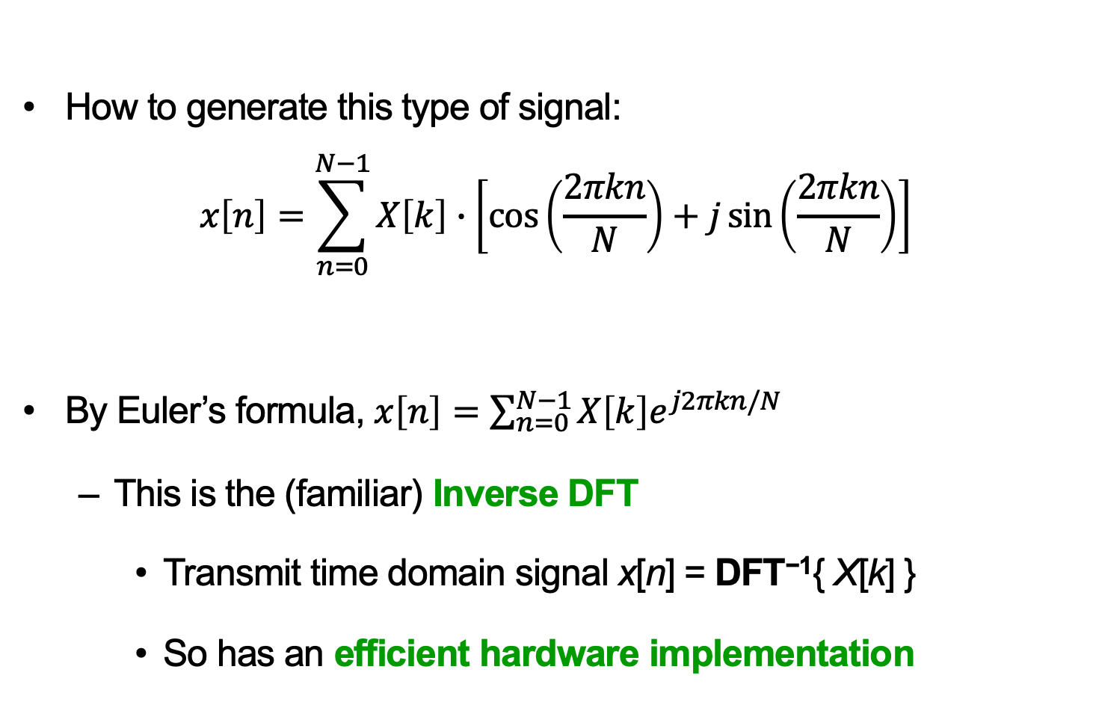
Generating an OFDM Signal
How to generate this type of signal:
$$x\left[n\right]=\sum_{n=0}^{N−1}{X\left[k\right]∙\left[\cos\left(\frac{2πkn}{N}\right)+j\sin\left(\frac{2πkn}{N}\right)\right]}$$
By Euler’s formula, $x\left[n\right]=\sum_{n=0}^{N−1}{X\left[k\right]e^{j2πkn/N}}$
  This is the (familiar) Inverse DFT
    Transmit time domain signal x[n] = DFT⁻¹{ X[k] }
    So has an efficient hardware implementation

Slide 20
Transmitting one OFDM symbol in time
OFDM symbol time T_{s}

Slide 21
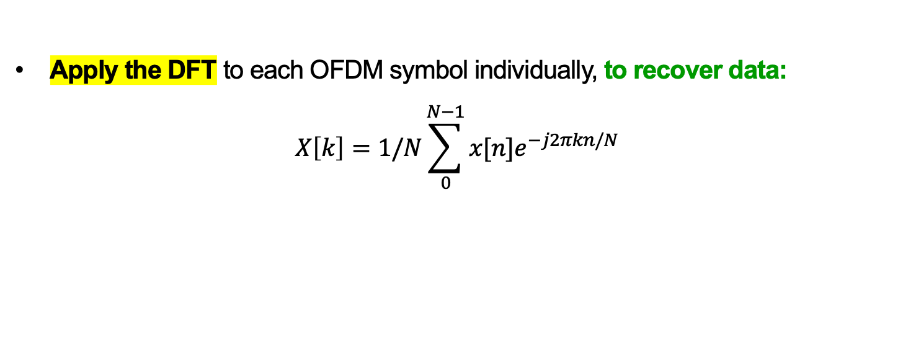
Receiving an OFDM signal
Apply the DFT to each OFDM symbol individually, to recover data:
$$X\left[k\right]=1/N\sum_{0}^{N−1}{x[n]e^{−j2πkn/N}}$$
Frequency
Time
One OFDM symbol
x[0]…x[N−1]

Slide 22
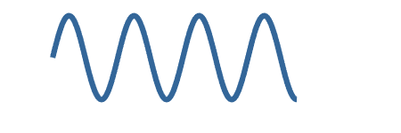

What about the wireless channel?
Channel impulse response h(t) is a function of time
  Impulse has an infinite bandwidth
Effect of a very narrowband channel is one complex number h
  Subcarrier eventually arrives on all paths, e.g. h = h₁+h₂:
Channel impulse response h(t)
a₁
a₂
Delay spread T_{d}
τ₁
τ₂
t
h₂
Transmitter
h₁
Receiver

Slide 23
What about the wireless channel?
Channel used at each subcarrier’s discrete frequency location
e.g. with three subcarriers:
k=1
k=2
k=3

Slide 24
Estimating the Channel
Transmit known a OFDM preamble symbol p[n]
  In frequency domain on frequency k denote preamble P[k]
After DFT on the preamble, the receiver hears frequency domain value Y[k]
Receiver computes channel estimate on kth subcarrier: H[k] = Y[k] / P[k]
Aside: To compute channel impulse response: DFT⁻¹{ H[k] } = h[n]

Slide 25
Problem: Inter-OFDM Symbol Interference

Slide 26
Problem: Receiver synchronization
1
2
3
Receiver:
1
2
3
Receiver’s view of Symbol 1 contains actual Symbols 1 and 2

Slide 27
Interference solution:
Inter-symbol guard interval
Guard interval between adjacent symbols mitigates adjacent symbol interference

Slide 28
Synchronization solution: Cyclic prefix
N_{fft}, T_{fft}
N_{s}, T_{s}
Receiver:
Symbol OK!

Slide 29
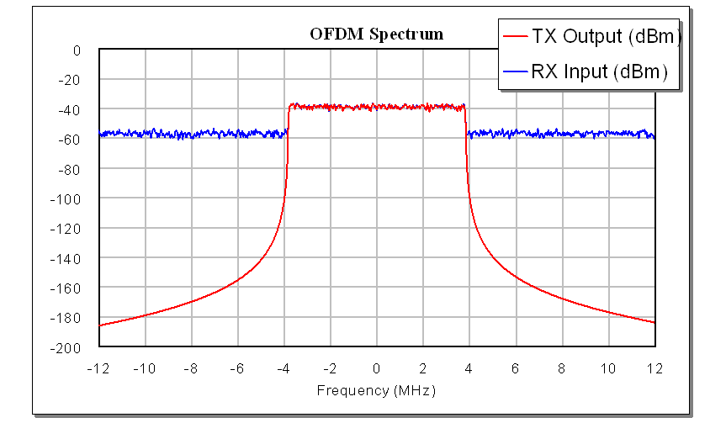
OFDM signal: Frequency-Domain view
Uniform power in the frequency domain over the OFDM signal bandwidth

Slide 30
OFDM signal: Time Domain View
Many low-frequency sinusoids in the time domain
Occasionally in time, many will all constructively interfere
  Result: High ratio of peak power / average power

Slide 31
Peak to Average Power & Transmit Amplifiers
Transmit power amplifier sits just before the transmit antenna
Peak power in non-linear region causes signal distortion
  So lower input signal level:
Typical Transmit Power Amplifier Response (V_{out} / V_{in})
Put peak power here
High peak to average power ratio (PAPR) → Low average power level →
    Signal mostly uses fewer levels in discrete representation, so high quantization error (another form of distortion)

Slide 32
An OFDM Modem
N complex samples
N subchannels
S/P
quadrature amplitude modulation (QAM) encoder
N-IFFT
add cyclic prefix
P/S
D/A +
transmit filter
Bits
00110
TRANSMITTER
multipath channel
RECEIVER
N complex samples
N subchannels
P/S
QAM
decoder
invert channel
=
frequency
domain
equalizer
N-FFT
S/P
remove cyclic prefix
Receive filter
+
A/D

Slide 33
Packet detection
OFDM uses two identical, repeated symbols s₁, s₂ in the preamble for packet detection:
Receiver radio is always listening, receiving samples
  Call this received sample stream r[n]
s₁
s₂
Preamble
Packet body

Slide 34
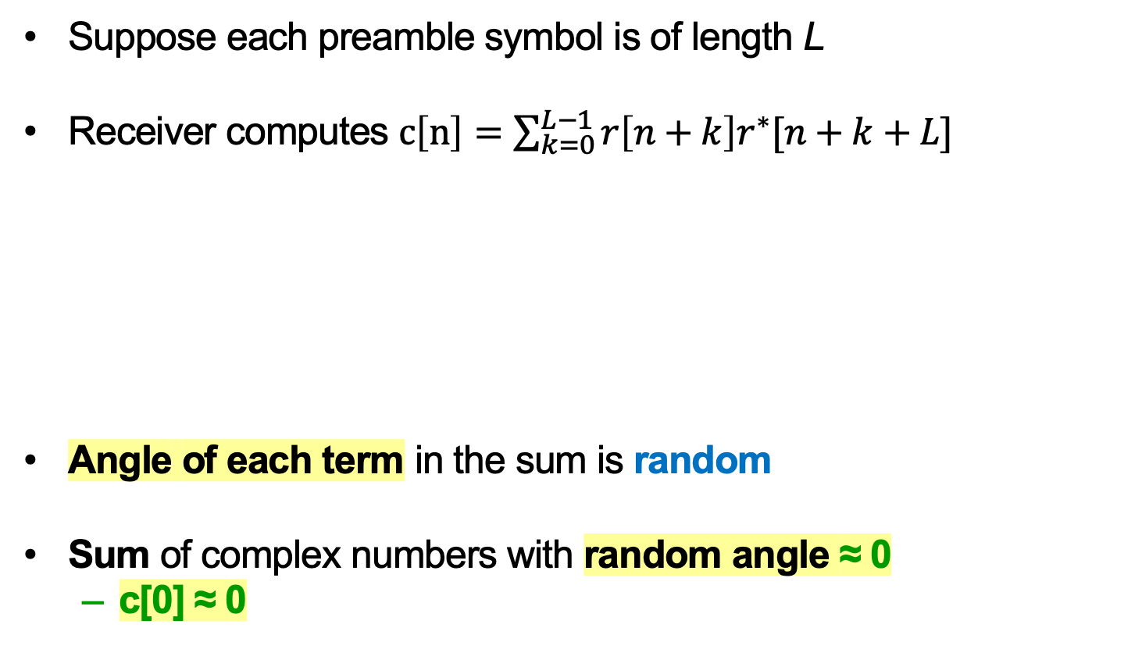
Searching for the preamble in noise
Suppose each preamble symbol is of length L
Receiver computes $c\left[n\right]=\sum_{k=0}^{L−1}{r\left[n+k\right]r^{∗}[n+k+L]}$
Angle of each term in the sum is random
Sum of complex numbers with random angle ≈ 0
  c[0] ≈ 0
Computing c[0]:
L
r[n]:
background noise
s₁
s₂
Packet body

Slide 35
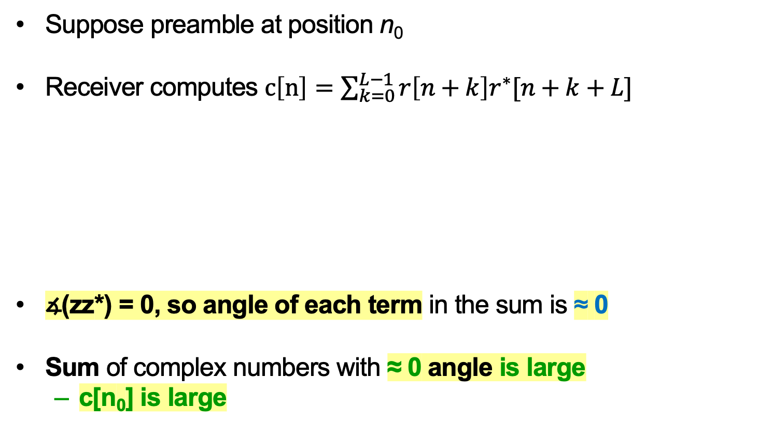
Search window encounters preamble
Suppose preamble at position n₀
Receiver computes $c\left[n\right]=\sum_{k=0}^{L−1}{r\left[n+k\right]r^{∗}[n+k+L]}$
∡(zz*) = 0, so angle of each term in the sum is ≈ 0
Sum of complex numbers with ≈ 0 angle is large
  c[n₀] is large
Computing c[n₀]:
L
r[n]:
background noise
s₁
s₂
Packet body
n₀

Slide 36
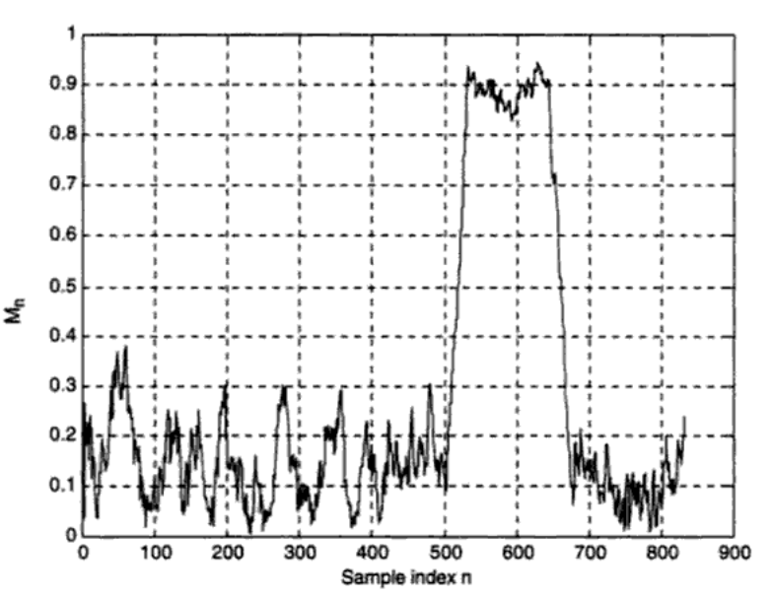
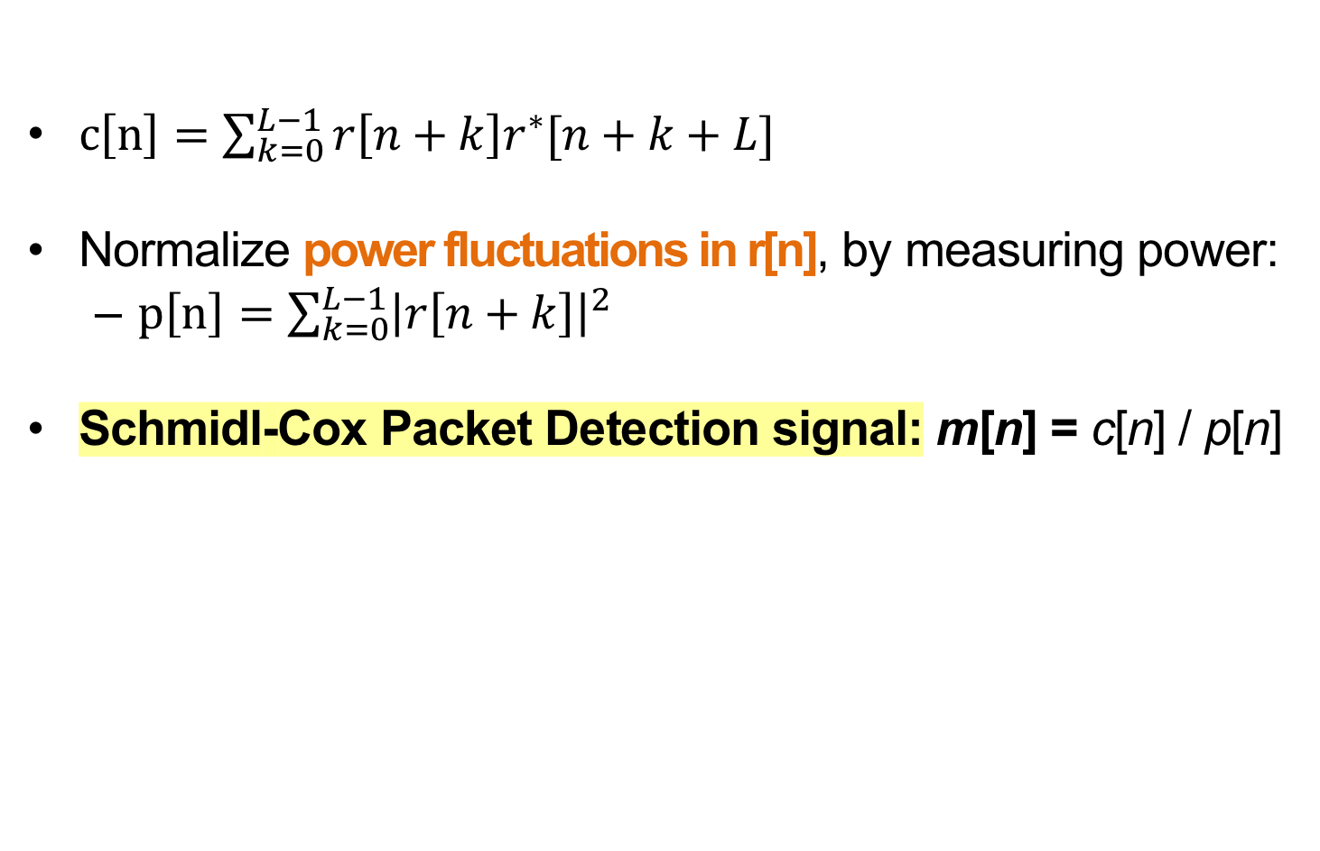
Schmidl-Cox Packet Detection
$c\left[n\right]=\sum_{k=0}^{L−1}{r\left[n+k\right]r^{∗}[n+k+L]}$
Normalize power fluctuations in r[n], by measuring power:
  $p\left[n\right]=\sum_{k=0}^{L−1}{{\left|r\left[n+k\right]\right|}^{2}}$
Schmidl-Cox Packet Detection signal: m[n] = c[n] / p[n]
Packet detection metric m[n]
Time samples n

Slide 37
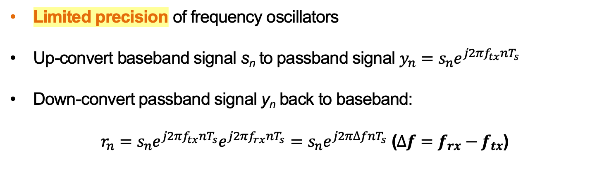
A Closer Look at Carrier Frequency Offset
Limited precision of frequency oscillators
Up-convert baseband signal s_{n} to passband signal $y_{n}=s_{n}e^{j2πf_{tx}nT_{s}}$
Down-convert passband signal y_{n} back to baseband:
$r_{n}=s_{n}e^{j2πf_{tx}nT_{s}}e^{j2πf_{rx}nT_{s}}=s_{n}e^{j2π∆fnT_{s}}$ ($∆f=f_{rx}−f_{tx}$)

Slide 38
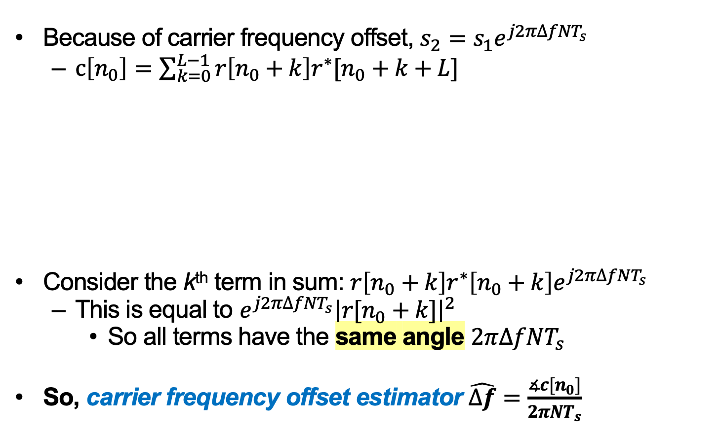
Estimating Carrier Frequency Offset
Because of carrier frequency offset, $s_{2}=s_{1}e^{j2π∆fNT_{s}}$
  $c\left[n_{0}\right]=\sum_{k=0}^{L−1}{r\left[n_{0}+k\right]r^{∗}[n_{0}+k+L]}$
Consider the k^{th} term in sum: $r\left[n_{0}+k\right]r^{∗}\left[n_{0}+k\right]e^{j2π∆fNT_{s}}$
  This is equal to $e^{j2π∆fNT_{s}}{\left|r[n_{0}+k]\right|}^{2}$
    So all terms have the same angle $2π∆fNT_{s}$
So, carrier frequency offset estimator $\hat{∆f}=\frac{∡c[n_{0}]}{2πNT_{s}}$
Computing c[n₀]:
L
r[n]:
background noise
s₁
s₂
Packet body
n₀

Slide 39
Sample Clock Offset
The transmitter and receiver may sample the signal at slightly different rates, leading to a sample time offset ζ
All subcarriers experience the same sampling delay, but travel over different frequencies

Slide 40
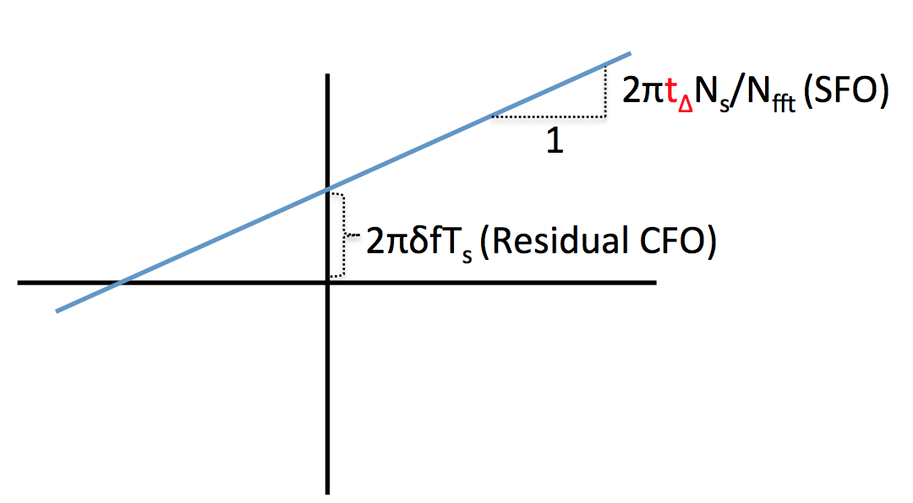

Correcting Sample Clock Offset in the Frequency Domain
$$2πζ\left(\frac{N_{s}}{N_{FFT}}\right)$$
⦟ H
f
Sample clock offset : slope
Residual CFO: intersection with y-axis

Slide 41
Example: IEEE 802.11a, 802.11g
OFDM with up to 48 subcarriers
  Subcarrier spacing is 312.5 KHz
  Subcarriers modulated: BPSK, QPSK, 16-QAM, or 64-QAM
Uses a convolutional code at a rate of ½, 2/3, ¾ , or 5/6 to provide forward error correction
Results in data rates of 6, 9, 12, 18, 24, 36, 48, and 54 MBps
Cyclic prefix is 25% of a symbol time (16 vs 64)

Slide 42
Per-subcarrier Bit Rate Choice

Slide 43
Tuesday Topic:
MIMO I: Spatial Diversity
Friday Precept:
Lab 4: Single-carrier transceiver
on the HackRF hardware

