Slide 1
The Radio Channel
COS 463: Wireless Networks
Lecture 14
Kyle Jamieson
[Parts adapted from I. Darwazeh, A. Goldsmith, T. Rappaport, P. Steenkiste]

Slide 2
Radio Channel: Motivation
The radio channel is what limits most communications systems – the main challenge!
  Understanding its properties is therefore key to understanding radio systems’ design
There is variation in many different properties
  Carrier frequency, environment (e.g. indoors, outdoors, satellite, space)
Many different models covering many different scenarios

Slide 3
Channel and Propagation Models
A channel model describes what happens
  Gives channel output power for a particular input power
  “Black Box” – no explanation of mechanism
  Requires appropriate statistical parameters (e.g. loss, fading)
A propagation model describes how it happens
  How signal gets from transmitter to receiver
  How energy is redistributed in time and frequency
  Can inform channel model parameters

Slide 4
Today
Large scale channel model
  Friis Free space model
    How much power delivered from omnidirectional transmitter to omnidirectional receiver, in free space?
Small-scale channel models

Slide 5
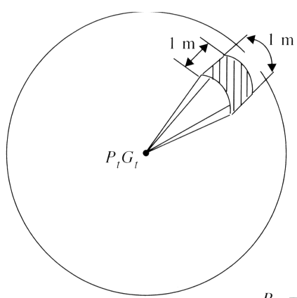
Transmitting in Free Space
unit area
$$P_{t}$$
$$d$$
Total spherical surface area: $4πd^{2}$
Deliver $P_{t}$ Watts to an omnidirectional transmitting antenna
So then power density (Watts per unit area) at range d is $p=\frac{P_{t}}{4πd^{2}}$ W/m²
  Independent of wavelength (frequency)

Slide 6
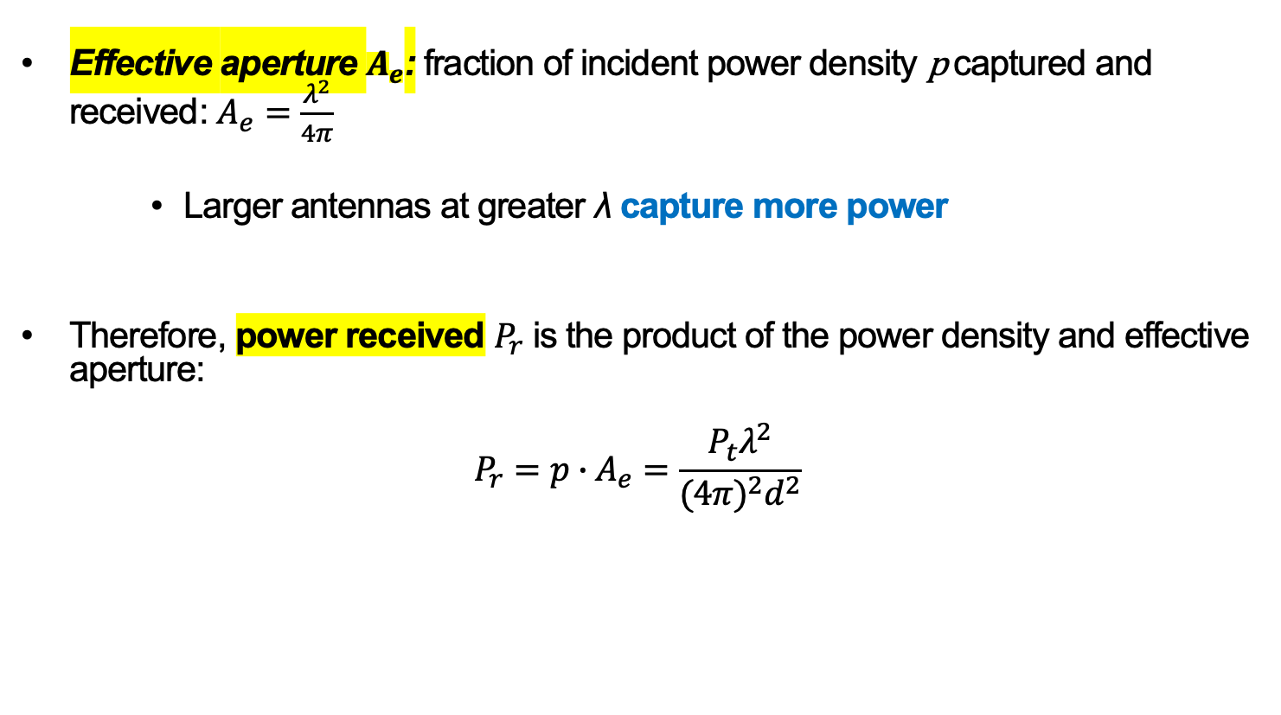
Idealized Receive Antenna
Effective aperture $A_{e}$: fraction of incident power density p captured and received: $A_{e}=\frac{λ^{2}}{4π}$
    Larger antennas at greater λ capture more power
Therefore, power received $P_{r}$ is the product of the power density and effective aperture:
$$P_{r}=p∙A_{e}=\frac{P_{t}λ^{2}}{{(4π)}^{2}d^{2}}$$

Slide 7
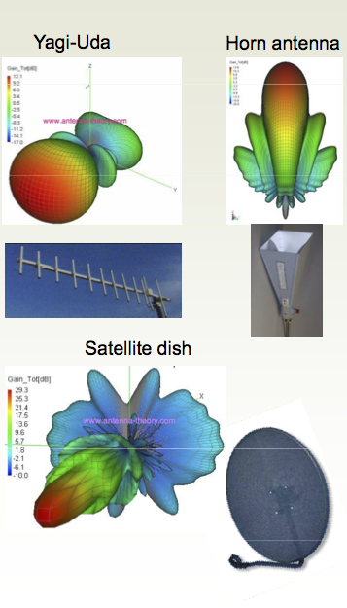
Antenna Gain
Antennas don’t radiate power equally in all directions
  Specific to the antenna design
Model these gains in the directions of interest between transmitter, receiver:
  Transmit antenna gain G_{t}
  Receive antenna gain G_{r}

Slide 8
Friis Free Space Channel Model
Power received $P_{r}$ is the product of the power received by idealized antennas, times transmit and receive antenna gains:
$$P_{r}=\frac{P_{t}G_{t}G_{r}λ^{2}}{{(4π)}^{2}d^{2}}$$

Slide 9
Today
Large scale channel models
Small-scale channel models
  Multi-path propagation
  Motion and channel coherence time

Slide 10
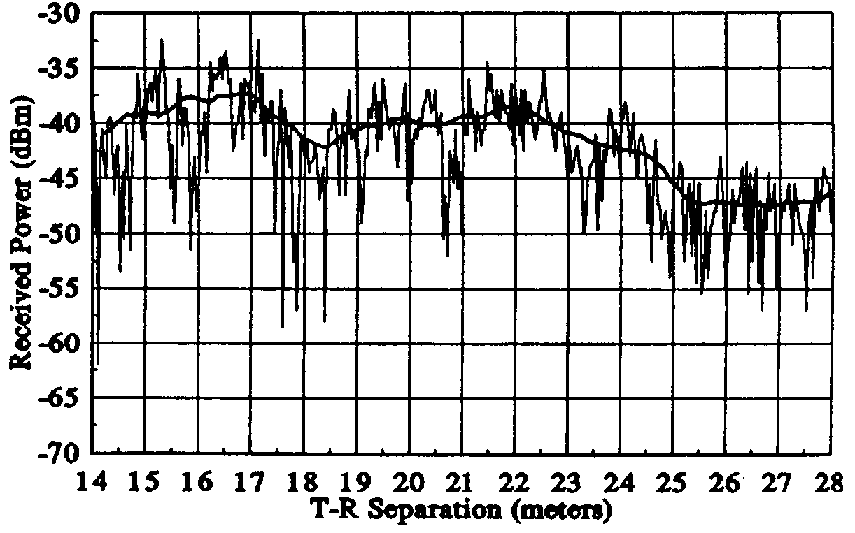
Small-scale versus large-scale modeling
Small-scale models: Characterize the channel over at most a few wavelengths or a few seconds

Slide 11
Multipath Radio Propagation
Receiver gets multiple copies of signal
  Each copy follows different path, with different path length
  Copies can either strengthen or weaken each other
    Depends on whether they are in or out of phase
Enables communication even when transmitter and receiver are not in “line of sight”
  Allows radio waves effectively to propagate around obstacles, thereby increasing the radio coverage area
Transmitter, receiver, or environment object movement on the order of λ significantly affects the outcome
  e.g. 2.4 GHz → λ = 12 cm, 900 MHz → ≈ 1 ft

Slide 12
Radio Propagation Mechanisms
Refraction
Reflection
Scattering
Diffraction
Refraction
  Propagation wave changes direction when impinging on different medium
Reflection
  Propagation wave impinges on large object (compared to λ)
Scattering
  Objects smaller than λ (i.e. foliage, street signs etc.)
Diffraction
  Transmission path obstructed by surface with sharp irregular edges
  Waves bend around obstacle, even when line of sight does not exist

Slide 13
Today
Large scale channel models
Small-scale channel models
  Multi-path propagation
    Frequency-domain view
    Time-domain view
  Motion and channel coherence time

Slide 14

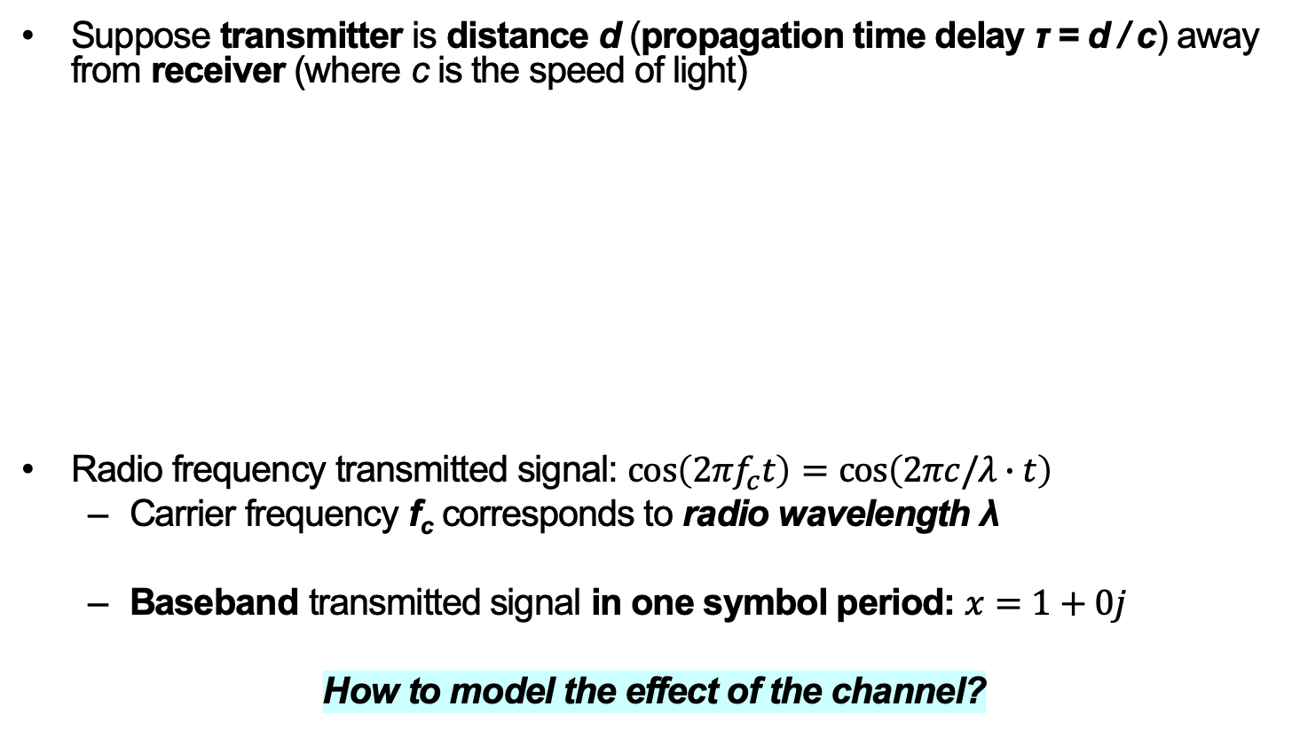
Sinusoidal carrier, line of sight only
Suppose transmitter is distance d (propagation time delay τ = d / c) away from receiver (where c is the speed of light)
Radio frequency transmitted signal: $\cos\left(2πf_{c}t\right)=\cos\left(2πc/λ∙t\right)$
  Carrier frequency f_{c} corresponds to radio wavelength λ
  Baseband transmitted signal in one symbol period: $x=1+0j$
How to model the effect of the channel?
λ
Transmitter
d, τ
Receiver

Slide 15
Sinusoidal carrier, line of sight only:
Signal Attenuation
Represent channel’s amplitude attenuation with a real number a
Models, e.g. attenuation due to two refractions and partial reflection as the signal passes through an indoor wall
Transmitter
a, d, τ
Receiver

Slide 16
Sinusoidal carrier, line of sight only:
Signal Phase Shift
Received signal travels distance d
One wavelength corresponds to a 360˚ (2π radian) phase shift
Represent path’s phase shift with an angle (real number) θ = 2π⋅ d / λ
  “Abstract away” distance and wavelength into (one) phase shift θ
λ
Transmitter
a, θ
Receiver

Slide 17

Sinusoidal carrier, line of sight only:
Channel Model
Wireless channel h attenuates by a, phase-shifts by θ
  Therefore, $h=ae^{jθ}$
Received baseband signal: $y=h∙x$ (no noise)
Q
y
Scale by a
Rotate by θ
x
I
x
Transmitter
a, θ
Receiver
y

Slide 18
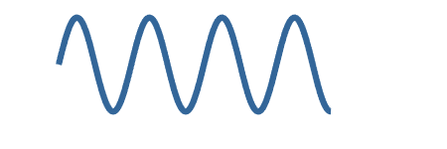
Line-of-sight plus reflecting path: Motivation
h₂ (a₂, θ₂)
Transmitter
h₁ (a₁, θ₁)
Receiver
What if reflections (e.g., indoor walls) introduce a second path?
Wireless channel becomes the superposition of the direct path’s channel h₁ and the reflection path’s channel h₂

Slide 19
Line-of-sight plus reflecting path:
Channel Model
h₂ (a₂, θ₂)
Transmitter
h₁ (a₁, θ₁)
Receiver
Channel is now $h=h_{1}+h_{2}{=a}_{1}e^{jθ_{1}}+a_{2}e^{jθ_{2}}$
h₂
Q
h
h₁
h₂
I

Slide 20
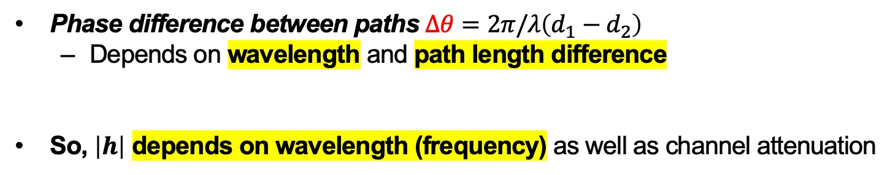
Line-of-sight plus reflecting path:
Channel Model
h₂ (a₂, θ₂)
Transmitter
h₁ (a₁, θ₁)
Receiver
Q
h₁
Δθ
h₂
I
Phase difference between paths $∆θ=2π/λ\left(d_{1}−d_{2}\right)$
  Depends on wavelength and path length difference
So, $\left|h\right|$ depends on wavelength (frequency) as well as channel attenuation

Slide 21
Reflections cause frequency selectivity
Interference between reflected and line-of-sight radio waves results in frequency dependent fading
Coherence bandwidth B_{c}: Frequency range over which the channel is roughly the same (“flat”)

Slide 22
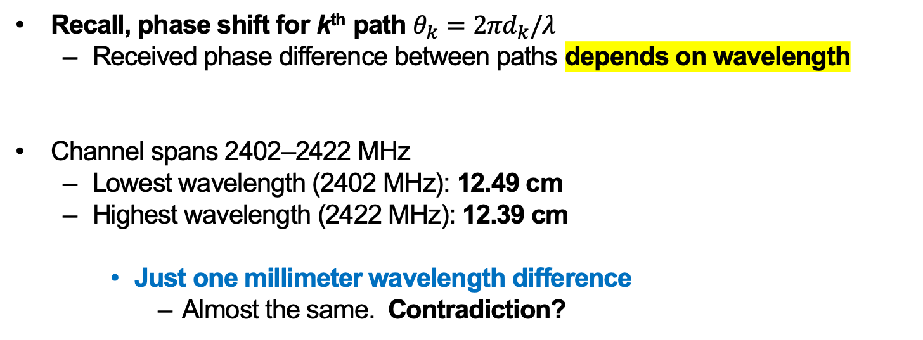
Practical Frequency-Selective Fading
One 2.4 GHz Wi-Fi channel is centered at 2412 MHz and spans a 20 MHz bandwidth
Observe: Frequency-selective fading
[D. Halperin]
Recall, phase shift for k^{th} path $θ_{k}=2πd_{k}/λ$
  Received phase difference between paths depends on wavelength
Channel spans 2402–2422 MHz
  Lowest wavelength (2402 MHz): 12.49 cm
  Highest wavelength (2422 MHz): 12.39 cm
    Just one millimeter wavelength difference
      Almost the same. Contradiction?

Slide 23
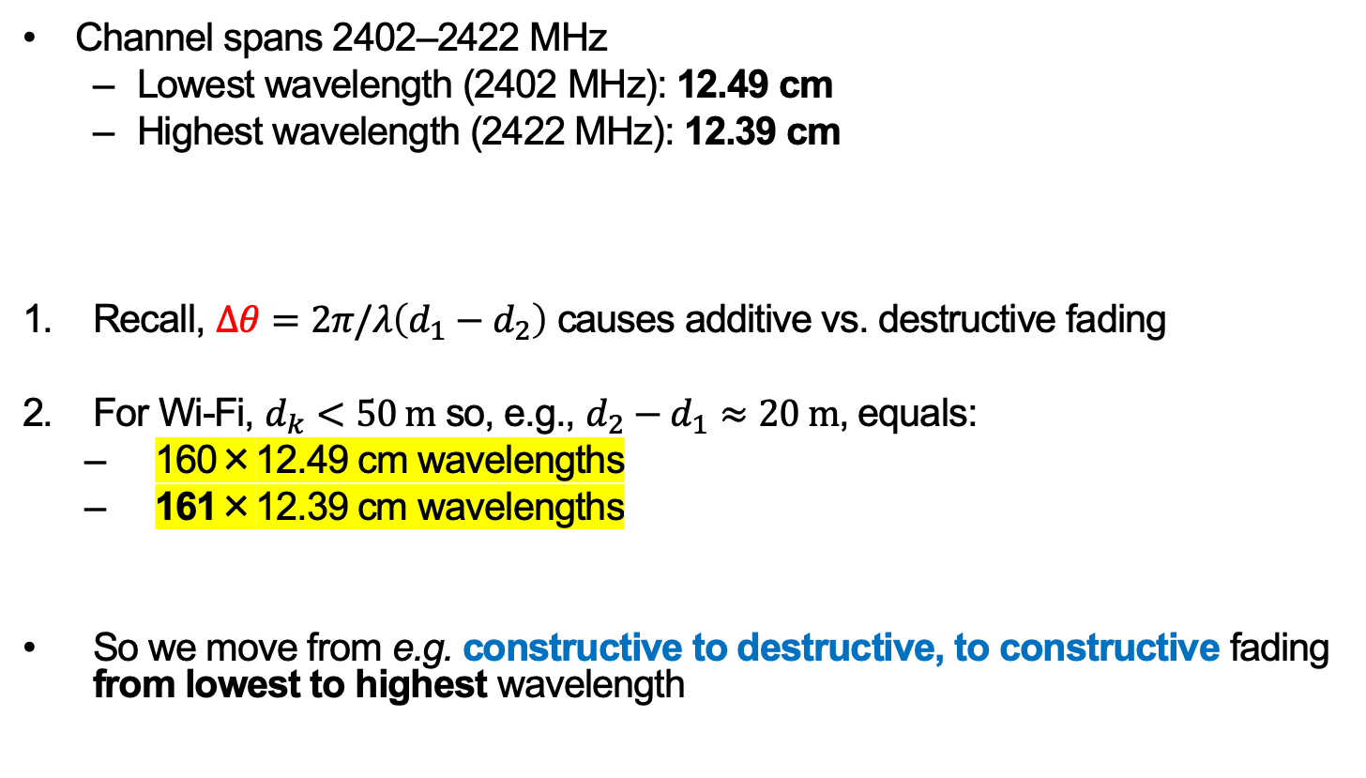
Practical Frequency-Selective Fading
Channel spans 2402–2422 MHz
  Lowest wavelength (2402 MHz): 12.49 cm
  Highest wavelength (2422 MHz): 12.39 cm
Recall, $∆θ=2π/λ\left(d_{1}−d_{2}\right)$ causes additive vs. destructive fading
For Wi-Fi, $d_{k}<50 \text{m}$ so, e.g., $d_{2}−d_{1}≈20 \text{m}$, equals:
  160×12.49 cm wavelengths
  161×12.39 cm wavelengths
So we move from e.g. constructive to destructive, to constructive fading from lowest to highest wavelength
[D. Halperin]

Slide 24
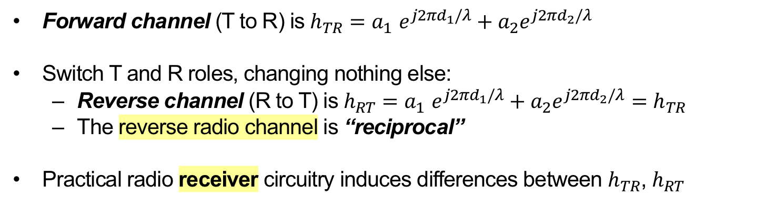
Radio Channels are “Reciprocal”
a₂,d₂,τ₂
Transmitter T
a₁,d₁,τ₁
Receiver R
Forward channel (T to R) is $h_{TR}{=a}_{1}e^{j2πd_{1}/λ}+a_{2}e^{j2πd_{2}/λ}$
Switch T and R roles, changing nothing else:
  Reverse channel (R to T) is $h_{RT}{=a}_{1}e^{j2πd_{1}/λ}+a_{2}e^{j2πd_{2}/λ}=h_{TR}$
  The reverse radio channel is “reciprocal”
Practical radio receiver circuitry induces differences between $h_{TR}$, $h_{RT}$

Slide 25
Putting it all Together: Ray Tracing
Approximate solutions to Maxwell’s electromagnetic equations by instead representing wavefronts as particles, traveling along rays
  Apply geometric reflection, diffraction, scattering rules
    Compute angle of reflection, angle of diffraction
Error is smallest when receiver is many λ from nearest scatterer, and all scatterers are large relative to λ
Good match to empirical data in rural areas, along city streets (radios close to ground), and indoors
Completely site-specific
  Changes to site may invalidate model

Slide 26
Today
Large scale channel models
Small-scale channel models
  Multi-path propagation
    Frequency-domain view
    Time-domain view
  Motion and channel coherence time

Slide 27
What does the channel look like in time?
a₂,d₂,τ₂
Transmitter
a₁,d₁,τ₁
Receiver
a₁
Channel impulse response h(t)
a₁
a₂
Delay spread T_{d}
τ₁
τ₂
t

Slide 28
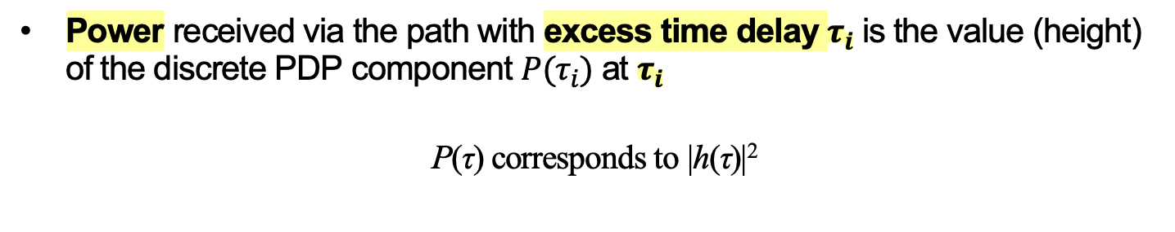
Power delay profile (PDP)
Power received via the path with excess time delay $τ_{i}$ is the value (height) of the discrete PDP component $P(τ_{i})$ at $τ_{i}$
P(τ) corresponds to |h(τ)|²
P(τ)
τ
0
$$τ_{1}$$
$$τ_{2}$$
$$τ_{3}$$
$$τ_{4}$$
$$τ_{5}$$

Slide 29
Characterizing a power delay profile
Given a PDP $P\left(τ_{k}\right)$ sampled at time steps $τ_{k}$:
Mean excess delay $\overline{τ}$: Expected value of $P\left(τ_{k}\right):$
$$\overline{τ}=\frac{\sum_{k}{P(τ_{k})}τ_{k}}{\sum_{k}{P(τ_{k})}}$$
Root mean squared (RMS) delay spread $σ_{τ}$ measures the spread of the power’s arrival in time
  RMS delay spread is the variance of $P\left(τ_{k}\right):$
$σ_{τ}=\sqrt{\overline{τ^{2}}−{\left(\overline{τ}\right)}^{2}}$, where $\overline{τ^{2}}=\frac{\sum_{k}{P(τ_{k})τ_{k}^{2}}}{\sum_{k}{P(τ_{k})}}$
Maximum excess delay < X dB $τ_{<X}$ is the greatest delay at which the PDP is greater than X dB below the strongest arrival in the PDP

Slide 30
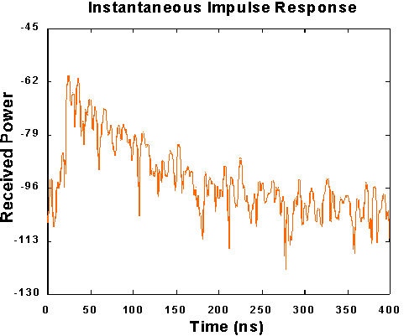
Example Indoor PDP Estimation
Typical RMS delay spreads
Environment | RMS delay spread
Indoor cell | 10 – 50 ns
Satellite mobile | 40 – 50 ns
Open area (rural) | < 0.2 𝛍s
Suburban macrocell | < 1 𝛍s
Urban macrocell | 1 – 3 𝛍s
Hilly macrocell | 3 – 10 𝛍s
Finite bandwidth of measurement normally results in continuous PDP
PDP typically has a decaying exponential form

Slide 31
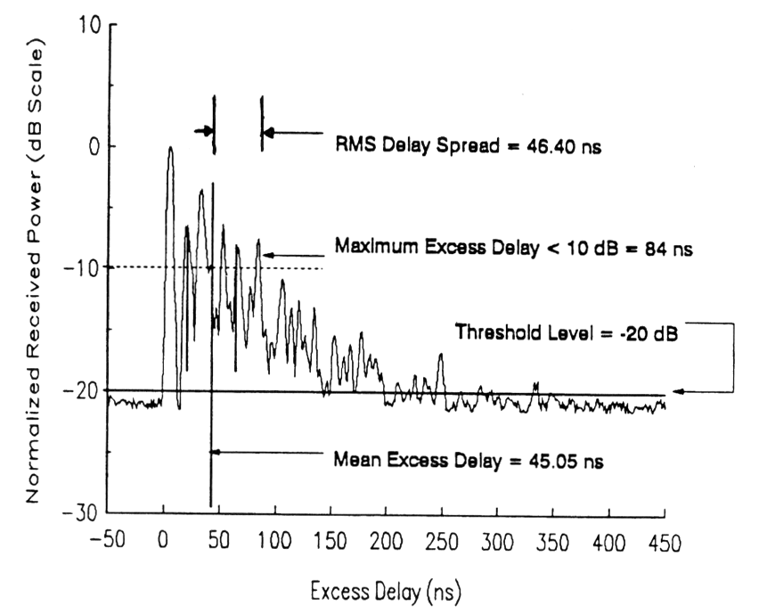
Indoor power delay profile

Slide 32
Flat Fading
Channel
Not shown above!
Slow down → sending data over a narrow bandwidth channel
  Channel is constant over its bandwidth
  Multipath is still present, so channel strength fluctuates over time
    How to model this fluctuation?

Slide 33
Rayleigh Fading Model
Channel impulse response h(t)
a₁
a₂
a₃
τ₁
τ₂
τ₃
t
Random gain of k^{th} arriving path: $a_{k}=a_{k}^{I}+ja_{k}^{Q}$
Therefore, the I and Q channel components $h_{I}, h_{Q}$ are zero-mean Gaussian distributed
So $\left|h\right|= \sqrt{h_{I}^{2}+h_{Q}^{2}}$ is Rayleigh-distributed
Rayleigh PDF
$$σ$$

Slide 34
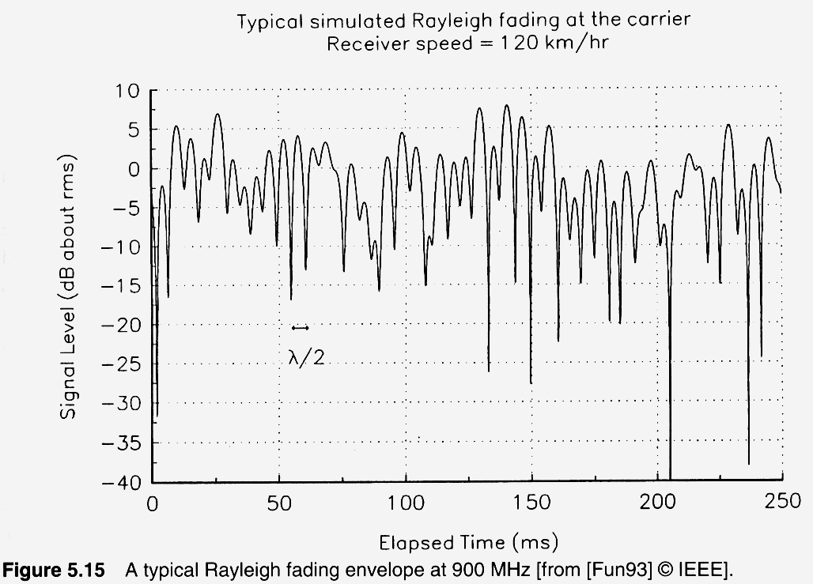
Rayleigh fading example

Slide 35
Today
Large scale channel models
Small-scale channel models
  Multi-path propagation
  Motion and channel coherence time

Slide 36
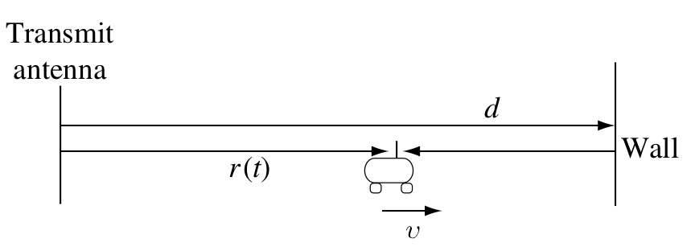
Stationary transmitter, moving receiver
Receiver
antenna
Suppose reflecting wall, fixed transmit antenna, no other objects
  Receive antenna moving rightwards at velocity v
Two arriving signals at receiver antenna with a path length difference of 2(d − r(t))

Slide 37
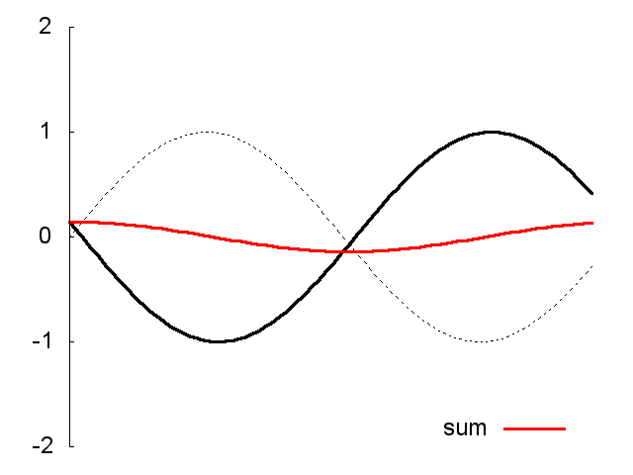
How does fading in time arise?
Receiver
antenna
Path length difference $∆ =2(d−r\left(t\right))$
If $∆ \left(\text{mod} λ\right)=\frac{λ}{2}$ → receive ≈ 0
  Destructive interference
If $∆ \left(\text{mod} λ\right)=0$ → receive ≈ 2
  Constructive interference
λ/2
λ
sum

Slide 38
Stretch Break and In-Class Question
In the preceding example, the reflected wave and direct wave travel in opposite directions
  What happens if we move the reflecting wall to the left side of the transmitter?
    What is the nature of the multipath fading, both over time and over frequency?
Transmit antenna
Wall
d
r(t)
v

Slide 39
Channel Coherence Time
A change in path length difference of λ / 2 transitions from constructive to destructive interference
  Receiver movement of λ/4: coherence distance
  Duration of time that transmitter, receiver, or objects in environment take to move a coherence distance: channel coherence time T_{c}
    Walking speed (2 mph) @ 2.4 GHz: ≈ 15 milliseconds
    Driving speed (20 mph) @ 1.9 GHz: ≈ 2.5 milliseconds
    Train/freeway speed (75 mph) @ 1.9 GHz: < 1 millisecond

Slide 40
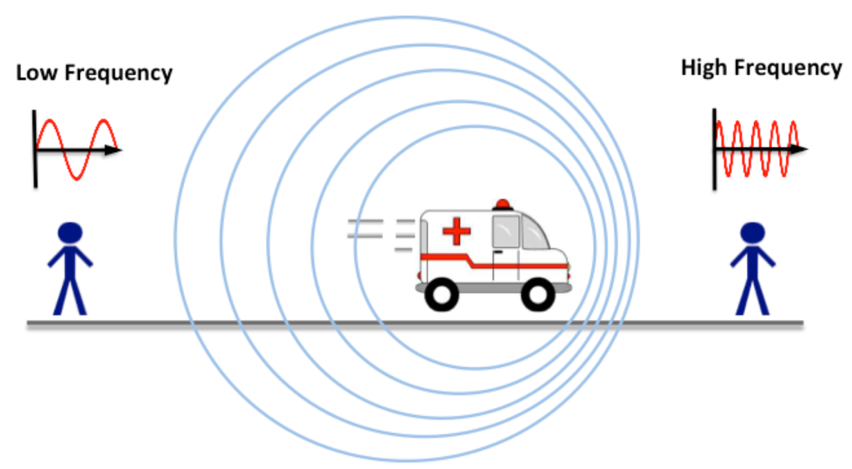
Another perspective: Doppler Effect
Movement by the transmitter, receiver, or objects in the environment creates a Doppler Shift
$$∆f=\left(\frac{v}{c}\right)f$$
v →

Slide 41
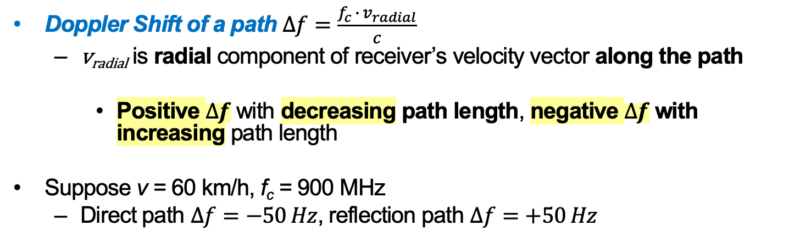
Stationary transmitter, moving receiver:
From a Doppler Perspective
Receiver
antenna
Doppler Shift of a path $∆f=\frac{f_{c}{ ∙ v}_{radial}}{c}$
  v_{radial} is radial component of receiver’s velocity vector along the path
    Positive $∆f$ with decreasing path length, negative $∆f$ with increasing path length
Suppose v = 60 km/h, f_{c} = 900 MHz
  Direct path $∆f=−50 Hz$, reflection path $∆f=+50 Hz$

Slide 42
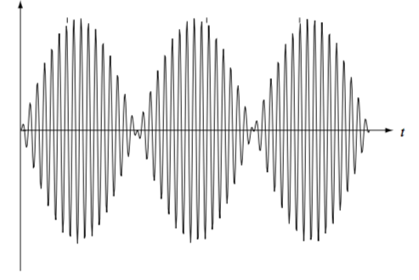
Stationary transmitter, moving receiver:
From a Doppler Perspective
Channel Doppler Spread D_{s}: maximum path Doppler shift, minus minimum path Doppler shift
Suppose v = 60 km/h, f_{c} = 900 MHz
  Direct path $∆f=−50 Hz$, reflection path $∆f=+50 Hz$
  Doppler Spread: 100 Hz
Results in sinusoidal “envelope” at frequency D_{s} / 2:
Received signal
5 ms
Receiver
antenna

Slide 43
Channel Coherence Time:
From a Doppler Perspective
Sinusoidal “envelope” at frequency $\frac{D_{s}}{2}$:
Transition from 0 to peak in $\frac{1}{2D_{s}}$
  So qualitatively significant change in time $T_{c}=\frac{1}{4D_{s}}$
    Alternate definition of channel coherence time
Received signal
$$\frac{D_{s}}{2}$$

Slide 44
Thursday Topic:
Receiver Designs for
the Wireless Channel

