Slide 1
Receiver Design and Performance; Shannon Capacity
COS 463: Wireless Networks
Lecture 13
Kyle Jamieson
[Parts adapted from M. Perrott, C. Terman]

Slide 2
Plan
Today
Receiver architecture
  Tradeoffs between ISI and Noise
  Transmit/receive filter design: Raised Cosine Matched Filter
Bit error rate and Shannon Capacity
Coming up
Realistic wireless channel
Using multiple antennas (MIMO)

Slide 3
Review of Digital I/Q Modulation
Leverage analog communication channel to send discrete-valued symbols
  e.g. send symbol from {-3,-1,1,3} on both I and Q channels every symbol period
At receiver, sample I/Q waveforms every symbol period
  Associate each sampled I/Q value with symbol from set, on both I and Q channels

Slide 4
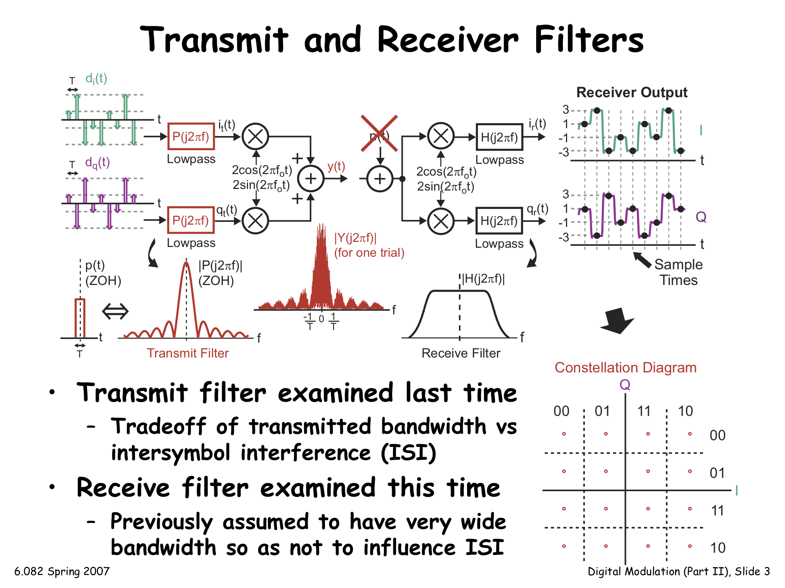
Review of Transmit and Receive Filters
Last time: Transmit pulse-shaping filter
  Tradeoff between transmitted bandwidth and intersymbol interference (ISI)
This time: Receive filter (previously assumed very wide bandwidth so as not to influence ISI)

Slide 5
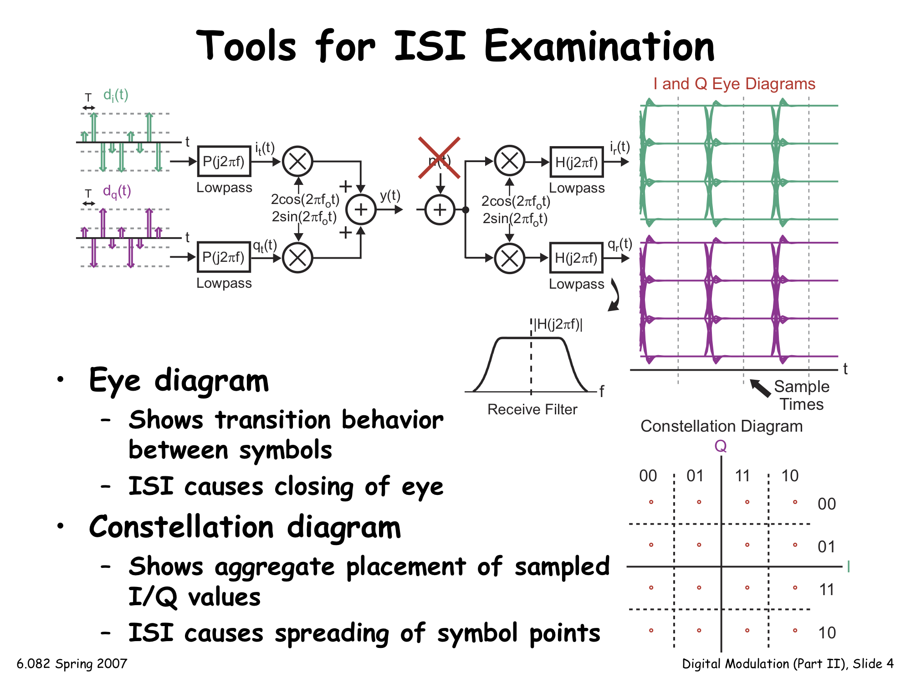
Review of Tools for Examining ISI
Eye Diagram
  For transition behavior between symbols
  ISI causes eye to close
Constellation Diagram
  Shows aggregate placement of sampled I/Q values
  ISI spreads the constellation points

Slide 6
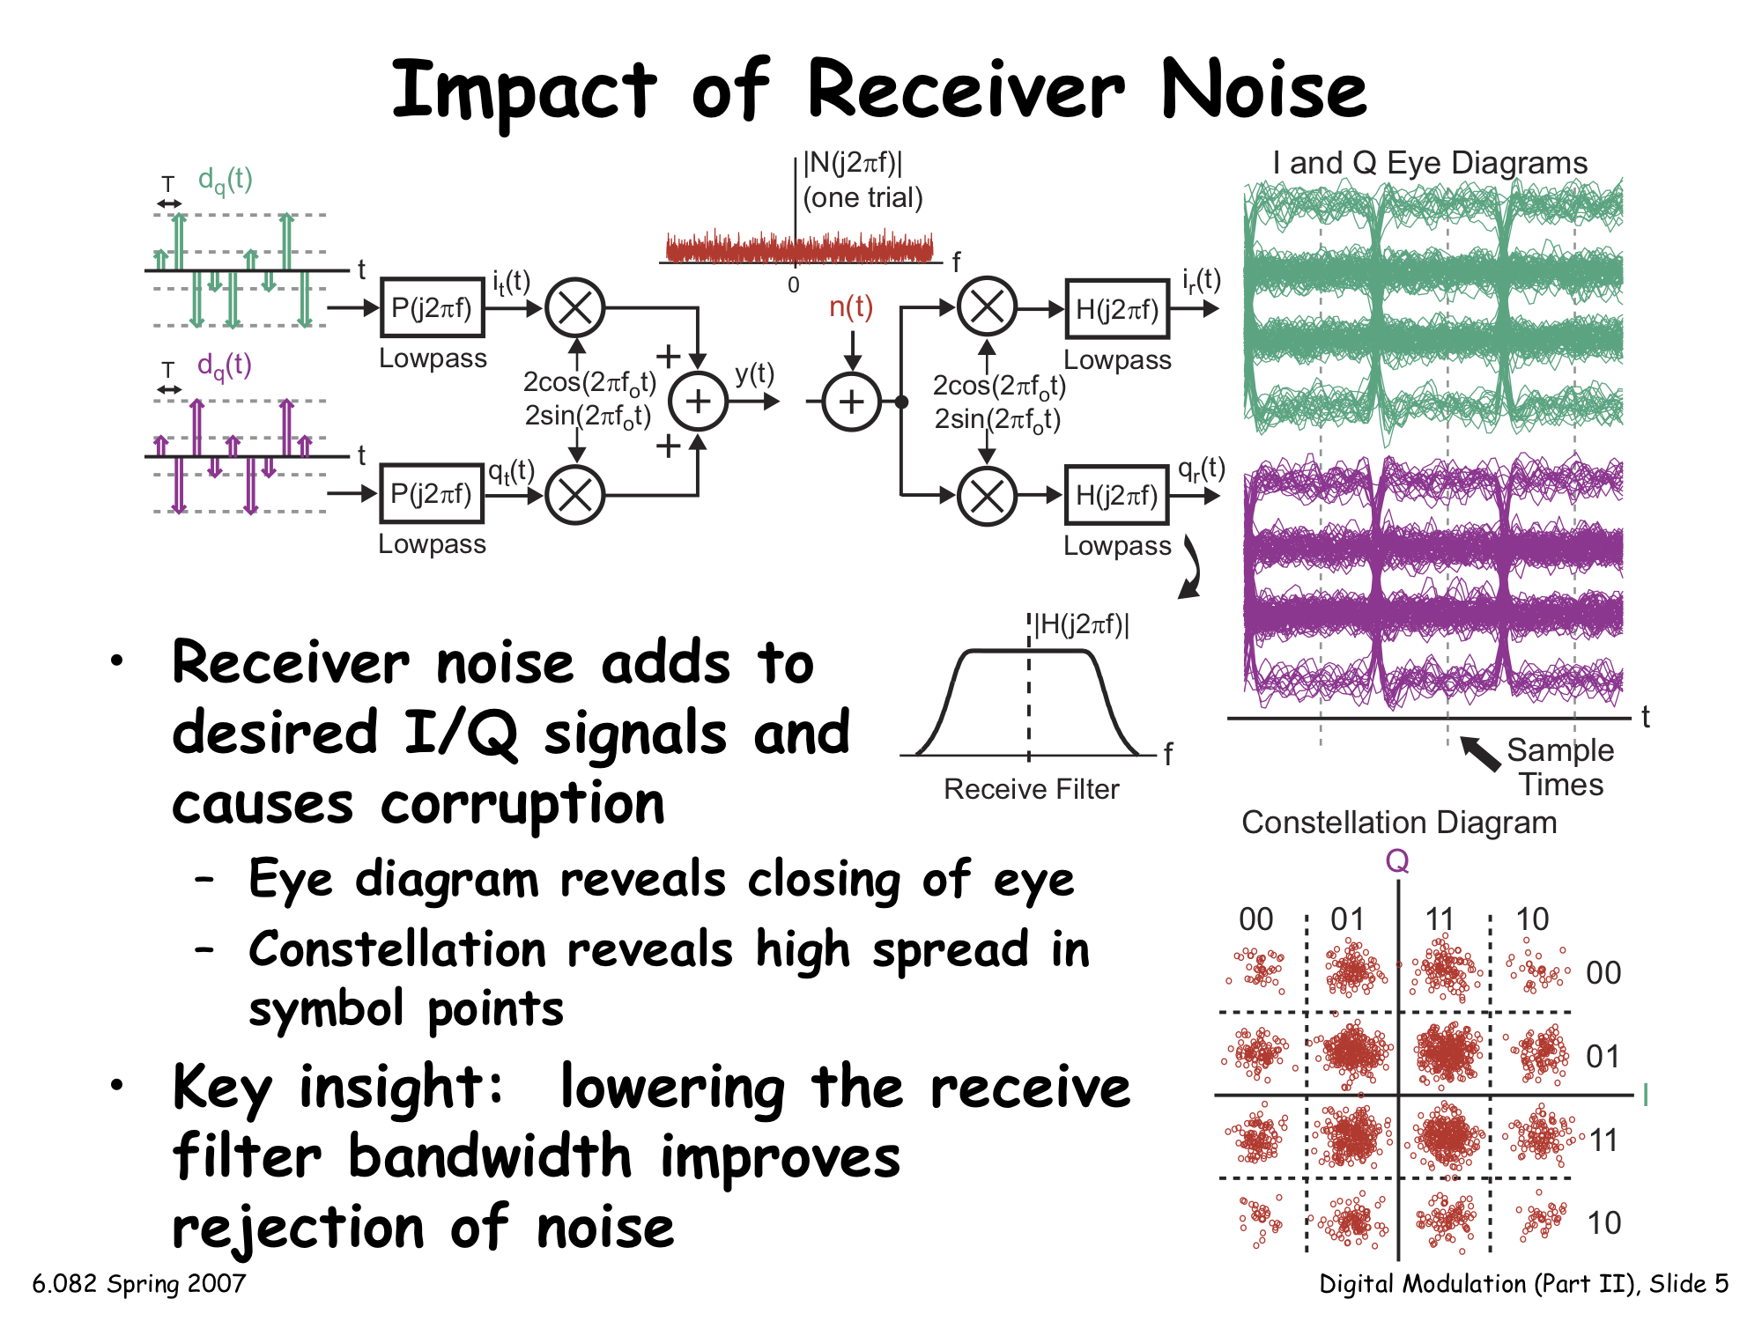
Impact of Receiver Noise
Receiver noise adds to desired I/Q signals, causes corruption
  Eye closes further
  Constellation points spread out

Slide 7
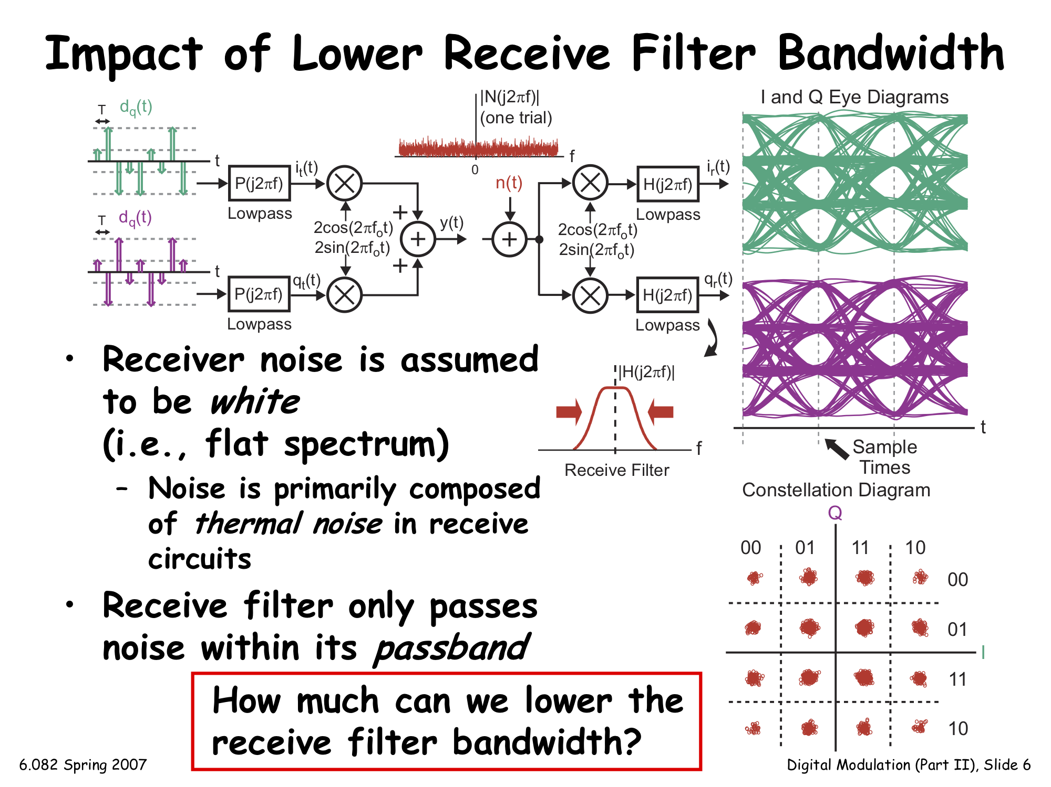
Benefit of Lower Receiver Filter Bandwidth
Primary noise source: Thermal noise in receive circuits
Receive filter only passes noise within its passband
  Lowering receive filter bandwidth improves the rejection of background noise
How much can we lower receive filter bandwidth?

Slide 8
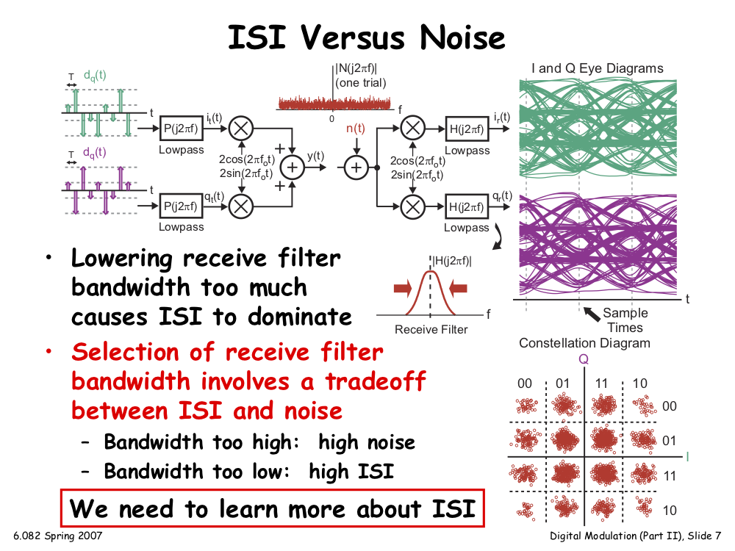
Tradeoff: ISI Versus Noise
Lowering receive filter bandwidth too much again causes ISI to dominate
Selection of receive filter bandwidth involves a tradeoff between ISI, noise:
  Bandwidth too high: High Noise
  Bandwidth too low: High ISI

Slide 9
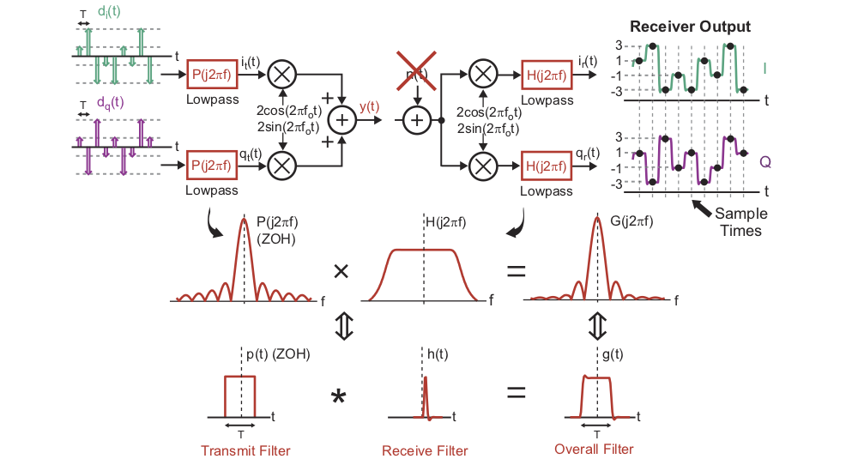
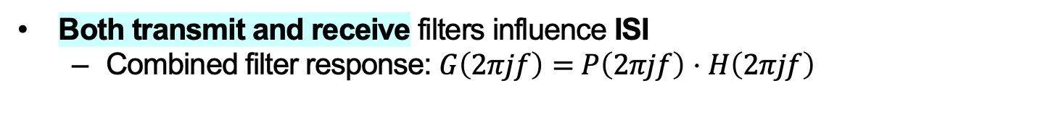
Joint Transmit/Receive ISI Analysis
Both transmit and receive filters influence ISI
  Combined filter response: $G\left(2πjf\right)=$ $P\left(2πjf\right)$ ⋅ $H\left(2πjf\right)$

Slide 10
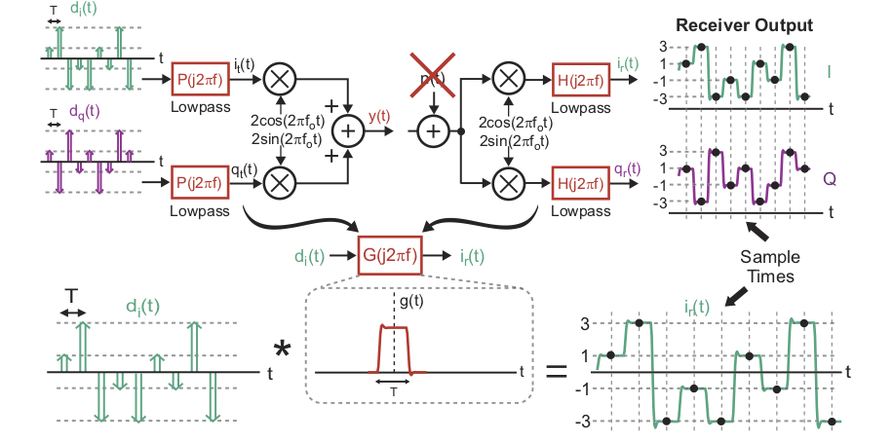
Viewing Filtering in the Time Domain
Combined filter G corresponds to convolution in the time domain with G’s impulse response (inverse Fourier Transform of G)
Time domain view allows us to more clearly see impact of overall filter on ISI

Slide 11
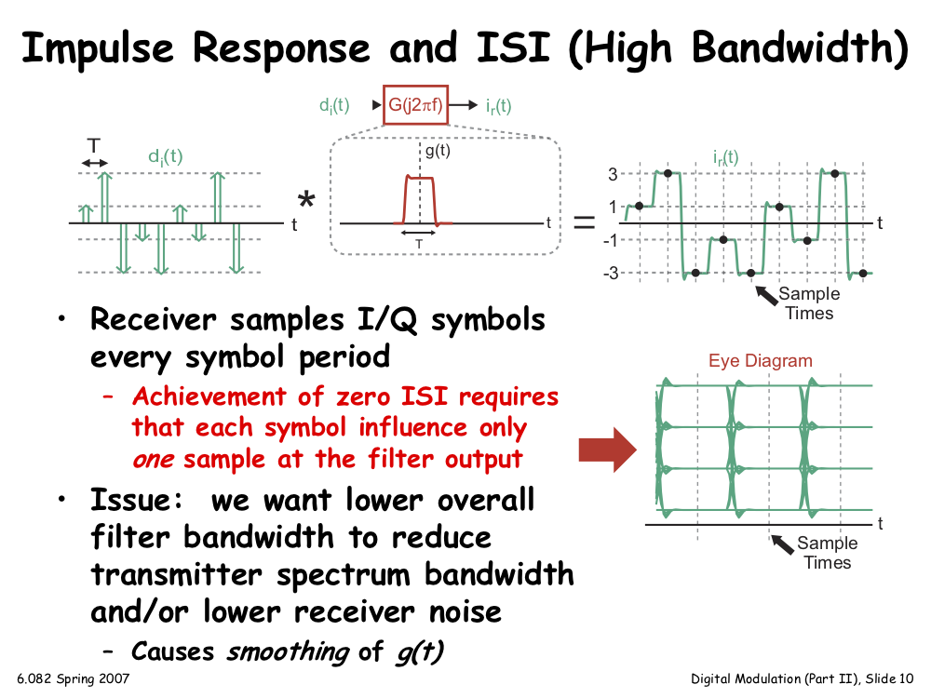
Impulse Response and ISI: High Bandwidth
Receiver samples I/Q every symbol period
  Achieving zero ISI requires that each symbol influence only one sample at the combined filter output
Issue: Want lower overall filter bandwidth to reduce spectrum bandwidth and lower noise
  But this causes smoothing of g(t)

Slide 12
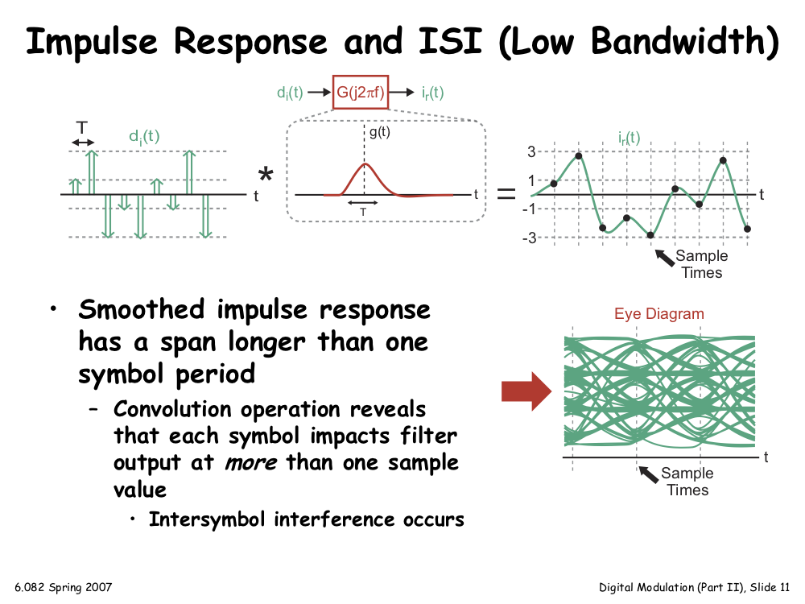
Impulse Response and ISI: Low Bandwidth
Smoothed impulse response has a span longer than one symbol period
  Convolution reveals that each symbol impacts filter output at > 1 sample value
    Inter-symbol interference occurs

Slide 13
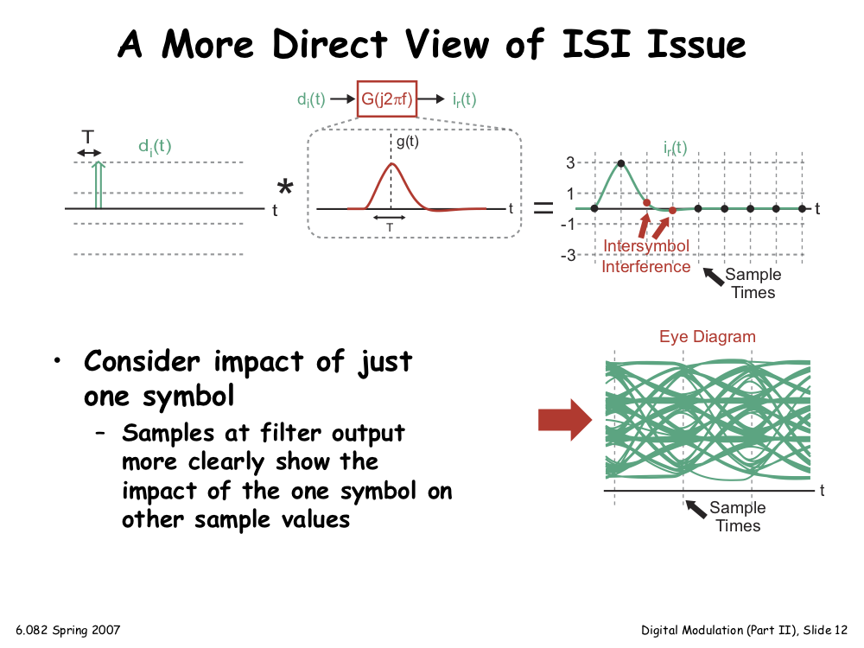
A More Direct View of the ISI Issue
Consider impact of just one symbol on received signal
  Samples at filter output more clearly show the impact of the one symbol on other sample values

Slide 14
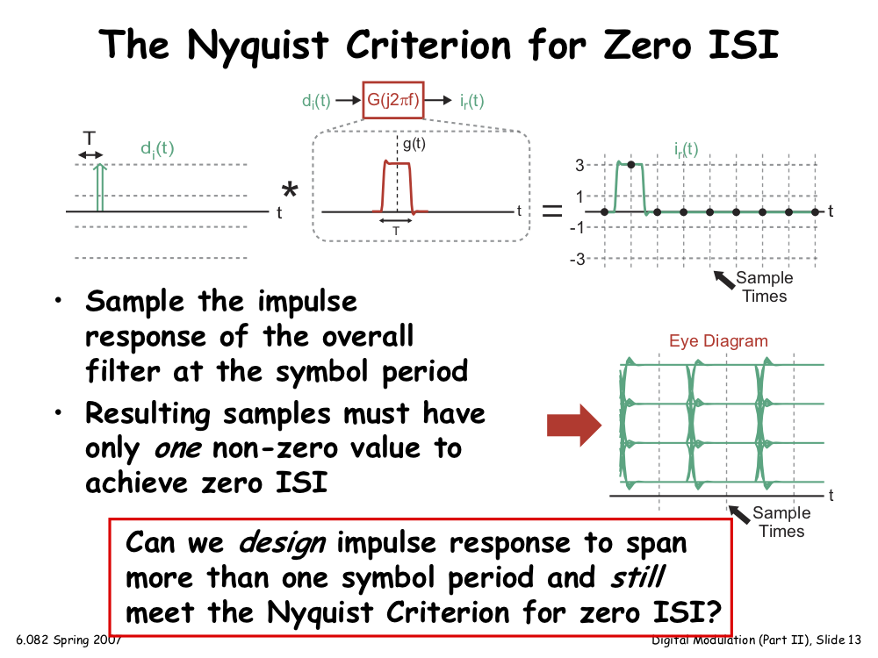
The Nyquist Criterion for Zero ISI
Sample g(t) at the symbol period
  Nyquist Criterion: Samples must have only one non-zero value to achieve zero ISI
Can g(t) span >1 symbol period (low bandwidth) and still meet Nyquist Criterion?
Sample Times

Slide 15
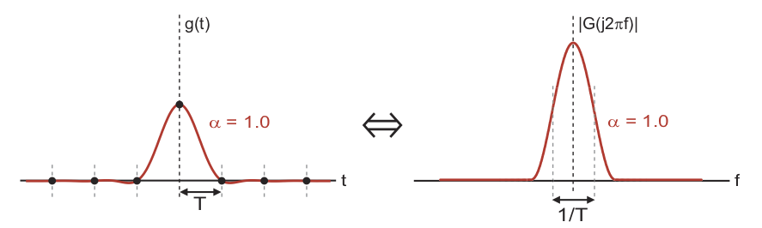
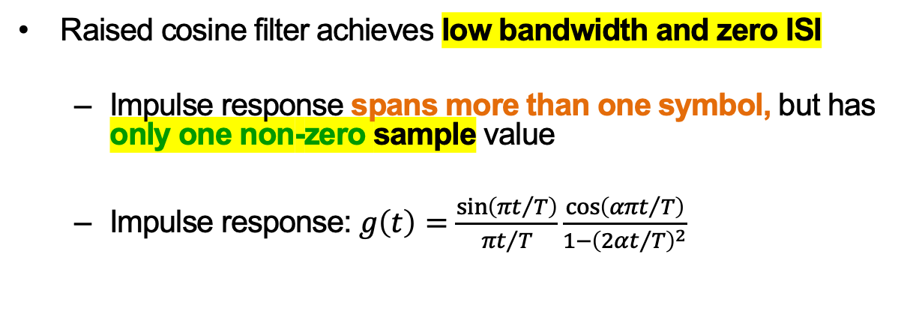
Raised Cosine Filter
Raised cosine filter achieves low bandwidth and zero ISI
  Impulse response spans more than one symbol, but has only one non-zero sample value
  Impulse response: $g\left(t\right)=\frac{sin⁡\left({πt}/T\right)}{{πt}/T}\frac{\cos\left({απt}/T\right)}{1−{\left(2αt/T\right)}^{2}}$

Slide 16
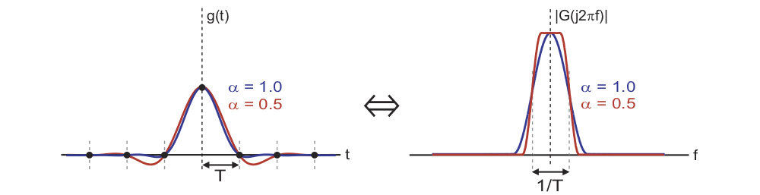
Raised Cosine Filter: Roll-off factor
Parameter α (0 ≤ α ≤ 1) is referred to as the roll-off factor of the filter
  Smaller values of α lead to:
    Reduced filter bandwidth
    Increased duration of the filter impulse response
Regardless of α, the raised cosine filter achieves zero ISI

Slide 17
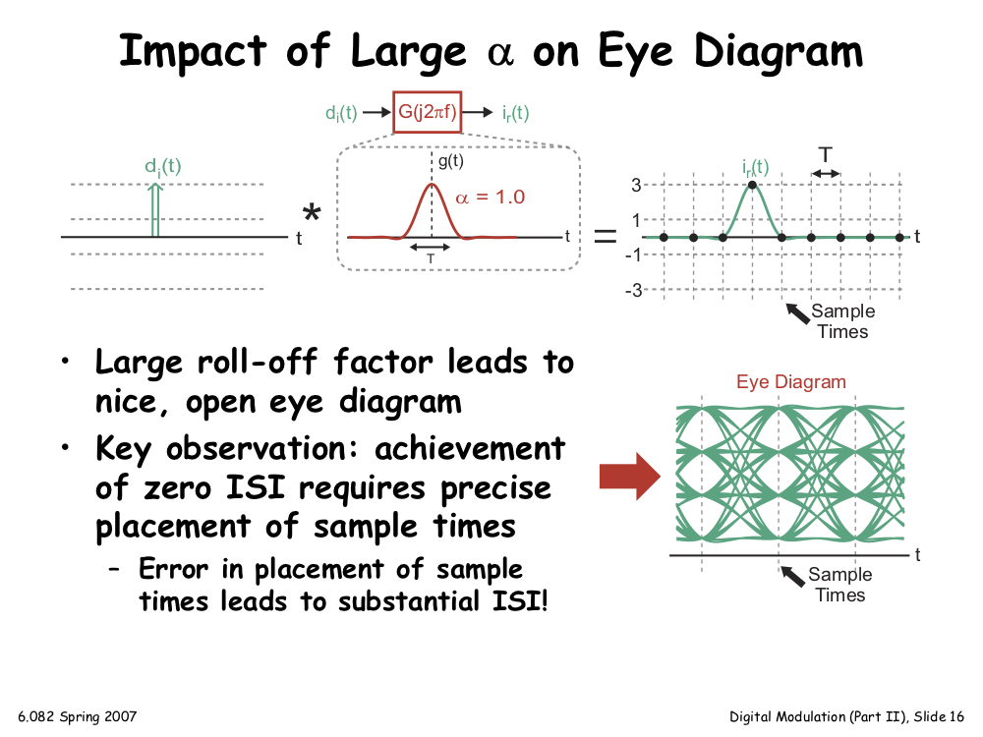
Impact of Large α on Eye Diagram
Large roll-off factor leads to nice, open eye diagram
Key observation: Achieving zero ISI requires precise placement of sample times
  Error in placement of sample times leads to substantial ISI

Slide 18
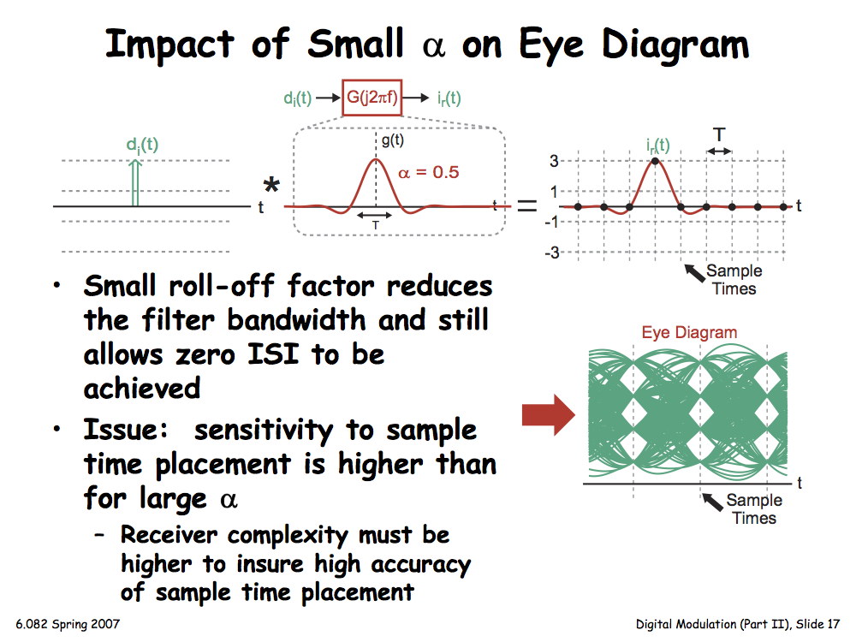
Impact of Small α on Eye Diagram
Small roll-off factor reduces the filter bandwidth and still allows zero ISI to be achieved
Issue: Greater sensitivity to sample time placement than for large α
  Needs greater receiver complexity to ensure precise sample time placement

Slide 19
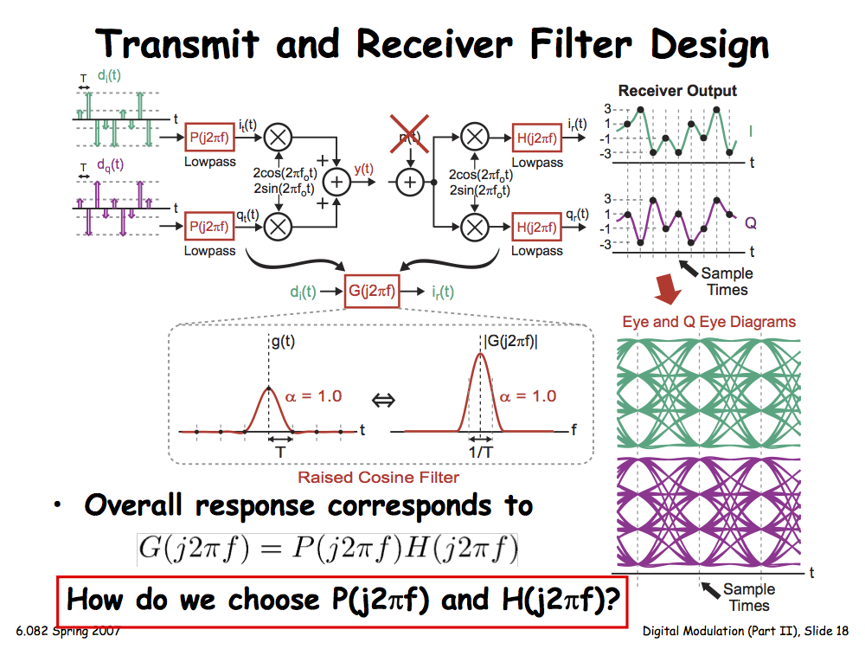
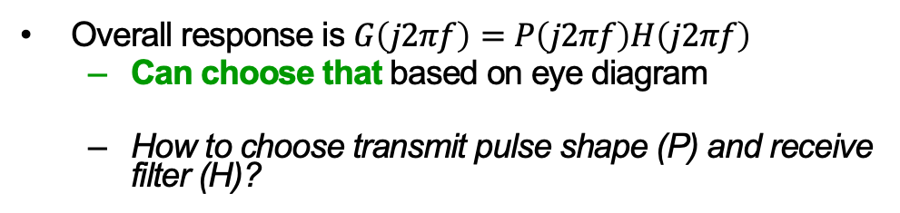
Transmitter and Receiver Filter Design
Overall response is $G\left(j2πf\right)=P\left(j2πf\right)H\left(j2πf\right)$
  Can choose that based on eye diagram
  How to choose transmit pulse shape (P) and receive filter (H)?

Slide 20
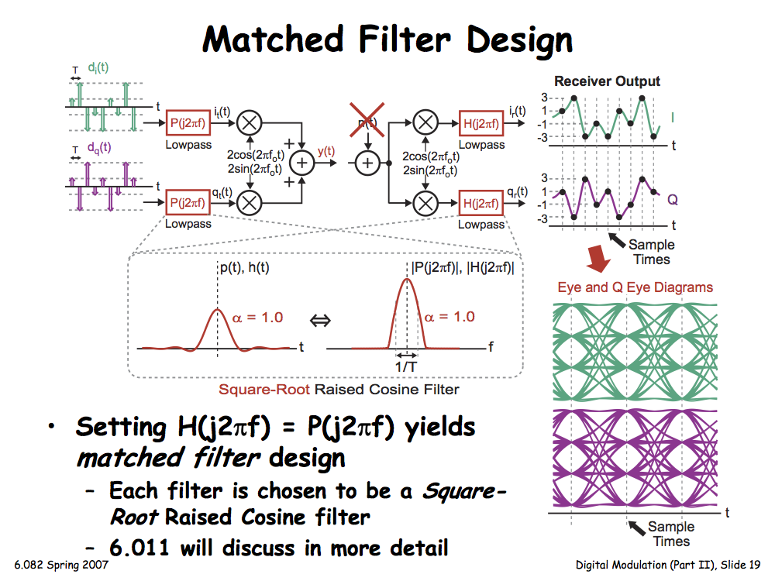
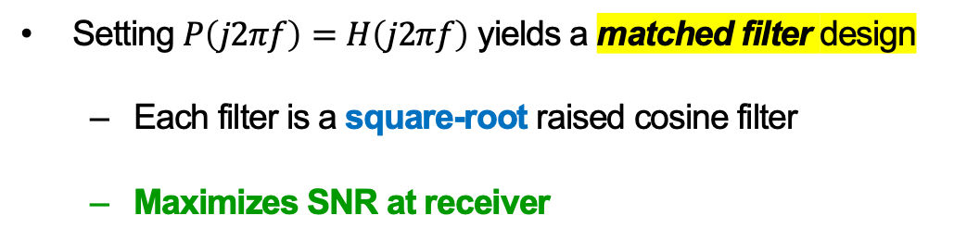
Matched Filter Design
Setting $P\left(j2πf\right)=H\left(j2πf\right)$ yields a matched filter design
  Each filter is a square-root raised cosine filter
  Maximizes SNR at receiver

Slide 21
Today
Receiver architecture
  Tradeoffs between ISI and Noise
  Transmit/receive filter design: Raised Cosine
Bit error rate and Shannon Capacity

Slide 22
Review of Digital Modulation
Transmitter sends discrete-value signals over analog communication channel
Receiver samples recovered baseband signal
  Noise and ISI corrupt received signal
Key techniques:
  Properly design transmit and receive filters for low ISI
  Sample and slice received signals to detect symbols

Slide 23
A Closer Look at the Transmitter
Amplitude of I/Q transmit signals impact power of transmitted output
  Output power limited within a given spectral band
  Low output power desirable for portable applications (battery life)

Slide 24
A Constellation View of the Transmitter
Provides intuitive view of the relationship between symbol separation and transmitted power

Slide 25
A Constellation View of the Receiver
Provides an intuitive view of relationship between symbol separation, received signal power, noise

Slide 26
Impact of SNR on Receiver Constellation
SNR (in signal frequency band) is influenced by transmitted power, distance between transmitter & receiver, and background noise

Slide 27
Impact of Increased signal on Constellation
Increase in received signal power leads to increased separation between symbols
  SNR improved if and when noise level unchanged

Slide 28
Quantifying the Impact of Noise
Distribution of noise: zero-mean Gaussian distribution
  Variance of noise determines the width of the Gaussian
Minimum separation between symbols: d_{min}
  Bit errors occur when noise moves a symbol by more than ½ d_{min}

Slide 29
Impact of Reduced SNR
Lower signal power leads to reduced value for d_{min}
Leads to a higher bit error rate
  Assuming noise variance unchanged
  Assuming received signal power reduced

Slide 30
Impact of Constellation Size Reduction
Reducing the number of symbols leads to an increased value for d_{min}
Leads to a lower bit error rate
  Assuming signal power, noise variance constant

Slide 31
Can we Estimate Bit Error Rate?
Bit Error Rate depends on two factors:
SNR (ratio of received signal power to noise variance)
# constellation points, which sets d_{min}, given a received signal power level

Slide 32
Let’s Start with a Detailed System View
Assumptions: No ISI, four-point constellation

Slide 33
A Closer Examination of Signal and Noise

Slide 34
The Binary Symmetric Channel Model
Provides a succinct model of the wireless channel

Slide 35
Computation of SNR

Slide 36

Resulting Bit Error Rate Versus SNR
Bit error rate P_{e}
SNR (dB) = $10\log_{10}\left(\frac{{\left(\frac{d_{min}}{2}\right)}^{2}}{σ^{2}}\right)$
Gaussian distribution of noise

Slide 37
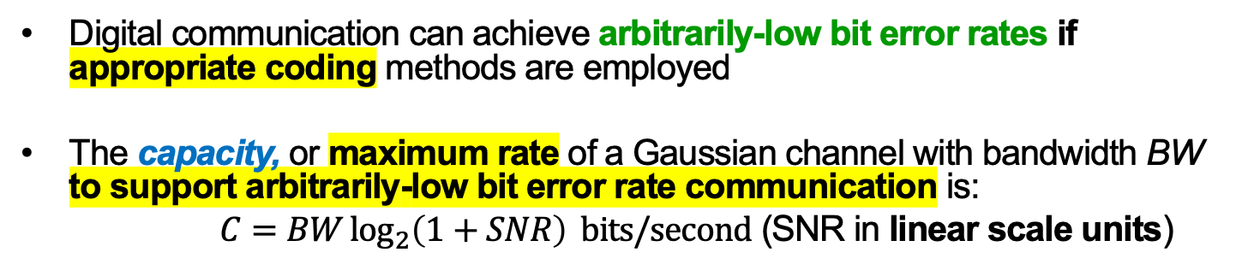
Shannon Capacity
Digital communication can achieve arbitrarily-low bit error rates if appropriate coding methods are employed
The capacity, or maximum rate of a Gaussian channel with bandwidth BW to support arbitrarily-low bit error rate communication is:
    $C=BW\log_{2}\left(1+SNR\right) bits/second$ (SNR in linear scale units)

Slide 38
Impact of Channel Bandwidth on Capacity
A doubling of bandwidth allows twice the number of bits to be sent in time T
  Capacity (bits/second) increases linearly with bandwidth

Slide 39
Impact of SNR on Capacity
A higher SNR allows more bits to be sent per symbol
  Adding n bits adds 2^{n} constellation points, but reduces d_{min}
High SNR (>> 1): Capacity increases linearly with SNR (dB, log scale)

Slide 40
Summary
Constellation diagrams allow intuitive approach of quantifying uncoded bit error rate of a channel
  Function of SNR and number of constellation points
A digital communication channel can be viewed in terms of a binary signaling model
  Focuses attention on key issue of bit error rate
Coding theoretically allows arbitrarily low bit error rate performance of a practical digital communication link

Slide 41
Tuesday Topic:
The Wireless Channel

