Slide 1
From AM Radio to
Digital I/Q Modulation
COS 463: Wireless Networks
Lecture 12
Kyle Jamieson
[Parts adapted from H. Balakrishnan, M. Perrott, C. Terman]

Slide 2
Roadmap
Analog I/Q modulation
Discrete-time processing of continuous signals
  The Digital Abstraction
  Quantization: Discretizing values
  Sequences: Discretizing time
Digital I/Q Modulation

Slide 3
Review: AM Modulation & Demodulation
Transmitter:
Receiver:
Multiplication (i.e. mixing) operation shifts in frequency
Low-pass filtering passes only the desired baseband signal at the receiver
Works with cos or sin carrier signal

Slide 4
Impact of a 90º phase shift
Transmitter:
Receiver:
∿
∿
Local oscillator
Suppose receiver uses sine, instead of cosine: no output
  sin(2πf₀t)×cos(2πf₀t) = ½ sin(4πf₀t)
Need to synchronize phase of transmitter and receiver local oscillators (coherent demodulation)

Slide 5
Coherent Demodulation:
Frequency-domain analysis
∿
∿
Transmitter and receiver oscillators phase-synchronized
Demodulated copies add constructively at baseband (close to f = 0)

Slide 6
90º Phase Shift:
Frequency-domain analysis
Transmitter, receiver oscillators are offset in phase by 90º
Demodulated copies add destructively at baseband (close to f = 0)
  Zero output from receiver
But: Opportunity to create two separate channels!

Slide 7
In-Phase/Quadrature Modulation
Modulate each with a cosine & sine, then sum the result
In-Phase (I) component (real)
Quadrature (Q) component (imaginary)
I, Q signals occupy the same frequency band
  One is real (for cos), one is imaginary (for sin)

Slide 8
In-Phase/Quadrature Demodulation
Transmitter:
Receiver:
Demodulate with both a sine and a cosine
  Both I and Q channels are recovered!

Slide 9
I/Q Demodulation: 90º Phase Shift
Transmitter:
Receiver:
I and Q channels get swapped at receiver
  Key observation: No information is lost!

Slide 10
Summary of Analog I/Q modulation

Slide 11
I/Q modulation: Wrap-up
I/Q modulation allows twice the amount of information to be sent compared to basic AM
Impact of phase offset is to swap I/Q
Impact of frequency offset is I/Q swapping (small offset)
  Or catastrophic corruption (large offset) of received signal

Slide 12
Roadmap
Analog I/Q modulation
Discrete-time processing of continuous signals
  The Digital Abstraction
  Quantization: Discretizing values
  Sequences: Discretizing time
Digital I/Q Modulation

Slide 13
Representing information with voltage
Encoding of pixel at location (x, y) in a Black & White picture:
  0 Volts = Black
  1 Volt = White
  0.37 V = 37% Gray
  etc...
Encoding of a picture:
  Scan points in prescribed order
  Generate a continuous voltage waveform (baseband signal)

Slide 14
Let’s build a P2P television network
One hop:
Encode
x(t)
Decode
×
×
∿
∿
Many hops:
Encode
Decode

Slide 15
Why did our network fail?
Transmitter doesn’t work right
Receiver doesn’t work right
Theory is imperfect
System architecture isn’t right
Answer: All of the above!
Noise, transmitter/receiver imperfections inevitable, so must design system to tolerate some amount of error

Slide 16
Analog communications issues
Problem: It’s hard to distinguish legitimate analog waveforms from corrupted ones
  Every waveform is potentially legitimate!
Small errors accumulate at each hop
Endpoints can’t help, so need to eliminate errors at each hop

Slide 17
Plan: Mixed Signal Architecture

Slide 18
Discrete time, Discrete values
Continuous-time, continuous-valued waveform is being converted into a discrete-valued sequence
  Only certain values are ”allowed” to be used
Questions yet to be answered:
How many discrete values should we use?
How rapidly in time should we sample the waveform?

Slide 19
Roadmap
Analog I/Q modulation
Discrete-time processing of continuous signals
  The Digital Abstraction
  Quantization: Discretizing values
  Sequences: Discretizing time
Digital I/Q Modulation

Slide 20
Encoding Information Digitally
First encoding attempt:
But, what happens in the presence of noise?

Slide 21
Big Idea: Noise Margins

Slide 22
Roadmap
Analog I/Q modulation
Discrete-time processing of continuous signals
  The Digital Abstraction
  Quantization: Discretizing values
  Sequences: Discretizing time
Digital I/Q Modulation

Slide 23
Quantization: How many discrete values?

Slide 24
Quantization Error
Introduce at most ½ interval length of quantization error

Slide 25
Roadmap
Analog I/Q modulation
Discrete-time processing of continuous signals
  The Digital Abstraction
  Quantization: Discretizing values
  Sequences: Discretizing time
Digital I/Q Modulation

Slide 26
Need for Continuous-to-Discrete Conversion
Real world (Hack RF)
Computer (Python)
Continuous-time signal
Discrete-time sequence
The boundary between analog and digital
  Real world filled with continuous-time signals
  Computers operate on discrete-time sequences
Crossing analog to digital boundary requires conversion between the two

Slide 27
How Fast to Sample?
Real world (Hack RF)
Computer (Python)
Continuous-time (CT) signal
Discrete-time (DT) sequence
Too slow (undersampling):
  DT sequence loses information about CT signal
Too fast (oversampling):
  DT sequence contains redundant, useless information

Slide 28
Modelling Continuous-to-Discrete Conversion
Two-step process:
Sample continuous-time signal every T seconds
  Model as multiplication of signal with impulse train
Create sequence from amplitude of scaled impulses
  Model as rescaling of time axis (T → 1)

Slide 29
Fourier Transform of Impulse Train
Impulse train in time corresponds to impulse train in frequency
  Spacing in time of T seconds corresponds to 1/T Hz spacing in frequency

Slide 30
Frequency Domain view of Sampling
Sampling in time leads to a periodic Fourier Transform, with period 1/T

Slide 31
Frequency Domain View of a Sequence
Conversion to a sequence amounts to setting T = 1
Resulting Fourier Transform is now periodic with a period of one

Slide 32
Summary: Continuous-to-Discrete Conversion
Sampling leads to periodicity in frequency domain

Slide 33
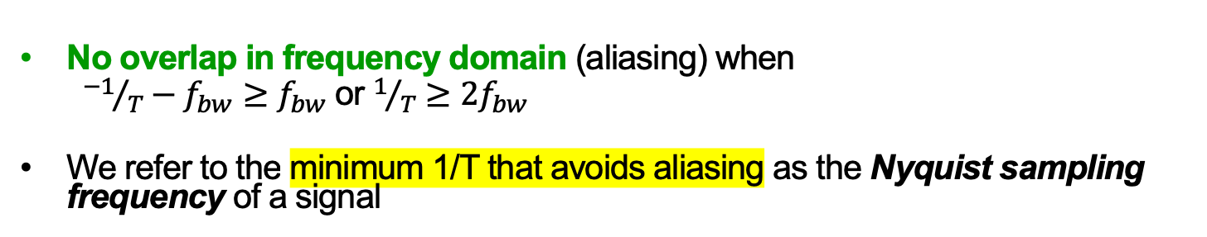
The Sampling Theorem
No overlap in frequency domain (aliasing) when
  ${−1}/T−f_{bw}≥f_{bw}$ or $1/T≥2f_{bw}$
We refer to the minimum 1/T that avoids aliasing as the Nyquist sampling frequency of a signal

Slide 34
Sine Wave Example:
Sampling Above Nyquist Rate
Time domain: Resulting sequence maintains same period as input signal

Slide 35
Sine Wave Example:
Sampling at Nyquist Rate
Time Domain: Resulting sequence maintains same period as input signal

Slide 36
Sine Wave Example:
Sampling at Half the Nyquist Rate
Sequence now appears as constant (zero frequency) signal
Frequency domain: Aliasing to 0

Slide 37
Sine Wave Example:
Sampling Below the Nyquist Rate
Resulting sequence now a sine wave with a different period than the input
Frequency domain: Aliasing to a lower frequency

Slide 38
The Issue of High Frequency Noise
Typically set sample rate to exceed desired signal’s bandwidth
Real systems can introduce noise/other interference at high frequencies
  Sampling causes noise to alias into desired frequency band

Slide 39
Anti-Alias Filtering
Practical systems use a continuous-time filter before the sampling operation
  Removes noise/interference >1/2T in frequency, prevents aliasing

Slide 40
Summary: Advantages of Going Digital
Allows error correction to be achieved
  Less sensitivity to radio channel imperfections
Enables compression of information
  More efficient use of the channel
Supports a wide variety of information content
  Voice, text, video can all be represented as digital bit streams

Slide 41
Roadmap
Analog I/Q modulation
Discrete-time processing of continuous signals
Digital I/Q Modulation

Slide 42
Digital I/Q modulation
Leverage analog communication channel to send discrete-valued symbols
  Example: Send symbol from set { -3, -1, 1, 3 } on both I and Q channels
At receiver, sample I/Q waveforms every symbol period
  Associate each sampled I/Q value with symbols from same set on both I and Q channels

Slide 43
Constellation Diagrams
Plot I/Q samples on x-y axis
  As samples are plotted, constellation diagram eventually displays all possible symbol values
Provides a sense of how easy it is to distinguish between different symbols

Slide 44
Sending Digital Bits
Assign bits to each I/Q symbol
  Example: I/Q = {1, 3} translates to bits 1110
  Gray coding minimizes bit errors when symbol errors are made
    Example: I/Q = {3, 3} translates to bits 1010 (one bit flip from {1, 3})

Slide 45
The Impact of Noise
At receiver, noise perturbs sampled I/Q values
  Constellation points no longer consist of single points for each symbol
Issue: What’s the best way of matching received I/Q samples with their corresponding transmitted symbols?

Slide 46
Symbol Selection based on Slicing
Receiver matches I/Q samples to corresponding symbols based on decision boundaries
Decision boundaries are also called slicing levels

Slide 47
Transitioning Between Symbols
Transition behavior influenced by transmit I/Q input waveforms and receive filter
  Today: Focus on what the transmitter does
  Ignore impact of noise for this analysis

Slide 48
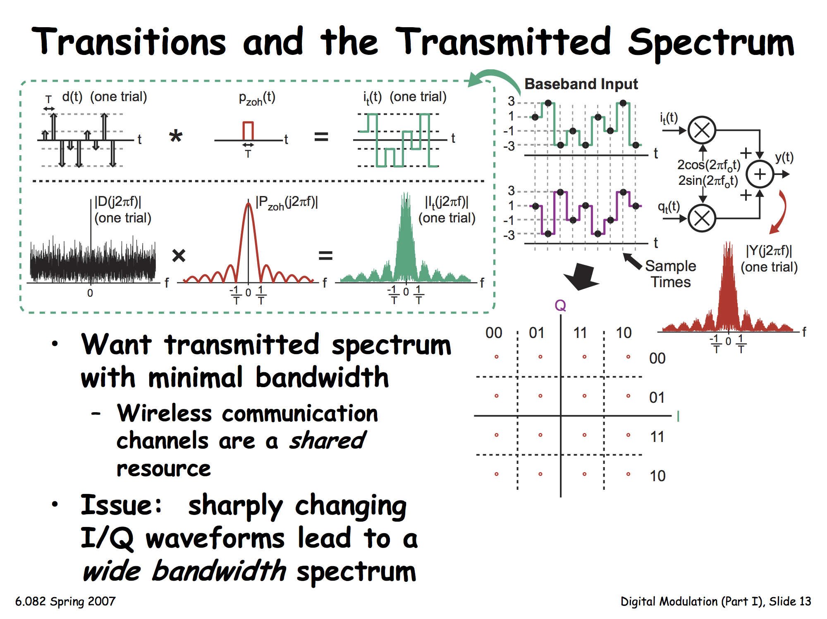
Transitions and the Transmitted Spectrum
Want transmitted spectrum with minimal bandwidth
Issue: Sharply changing I/Q leads to very wide bandwidth spectrum

Slide 49
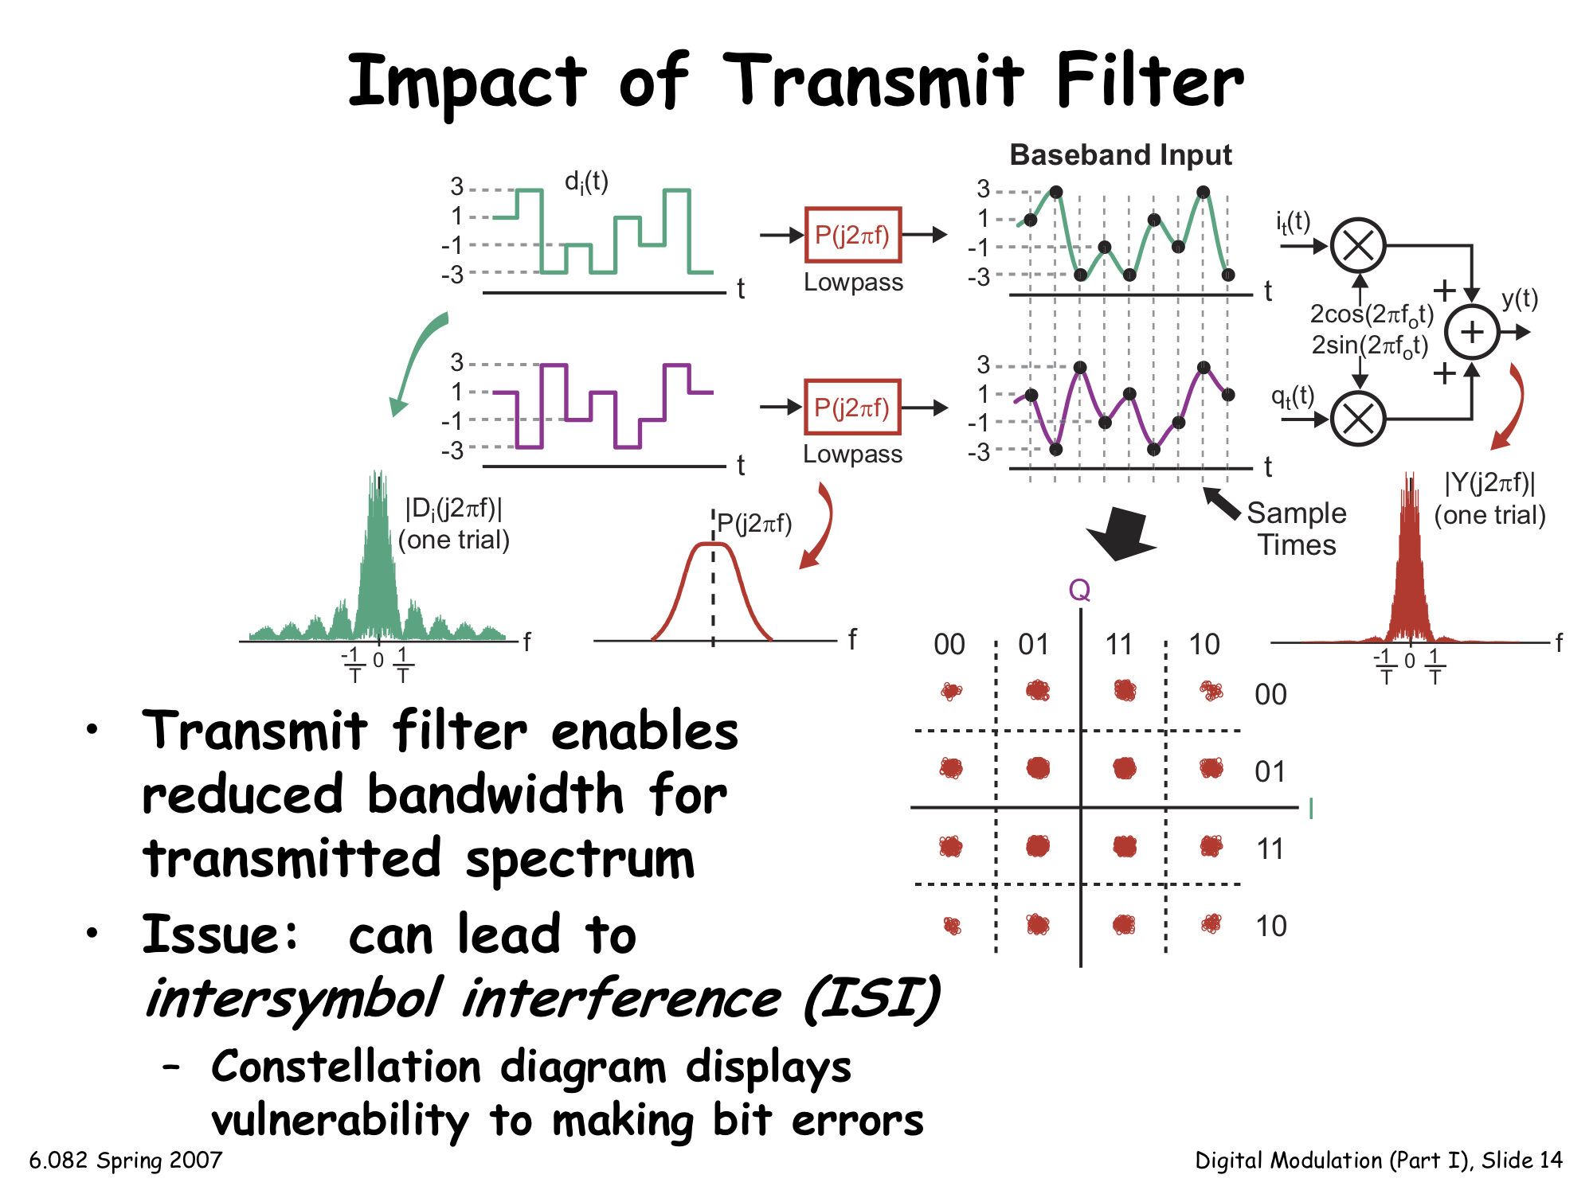
Impact of Transmit Filter
Transmit filter shapes the pulses, enables reduced bandwidth for transmitted spectrum
Next Issue: Can lead to bit errors

Slide 50
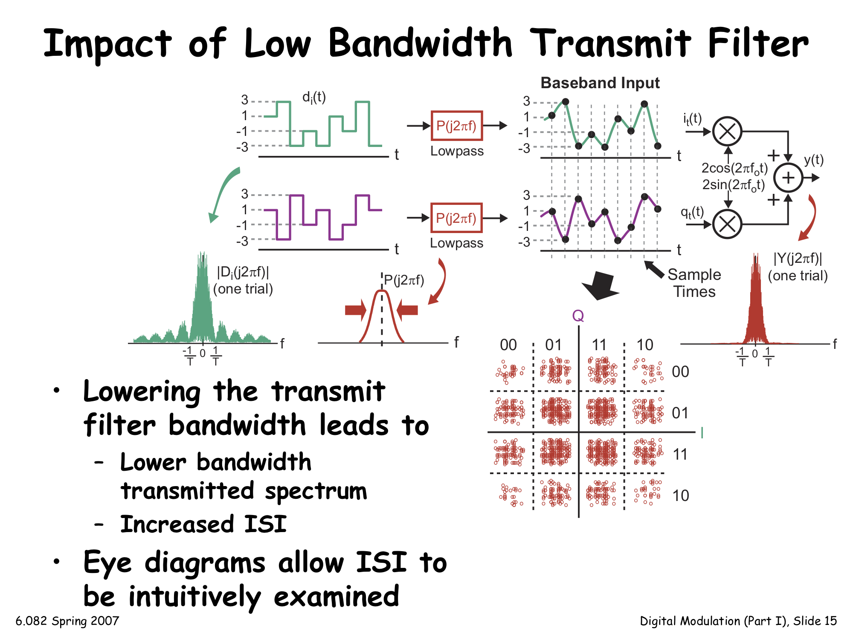
Impact of Low Bandwidth Transmit Filter
Lowering the transmit bandwidth leads to increased bit errors

Slide 51
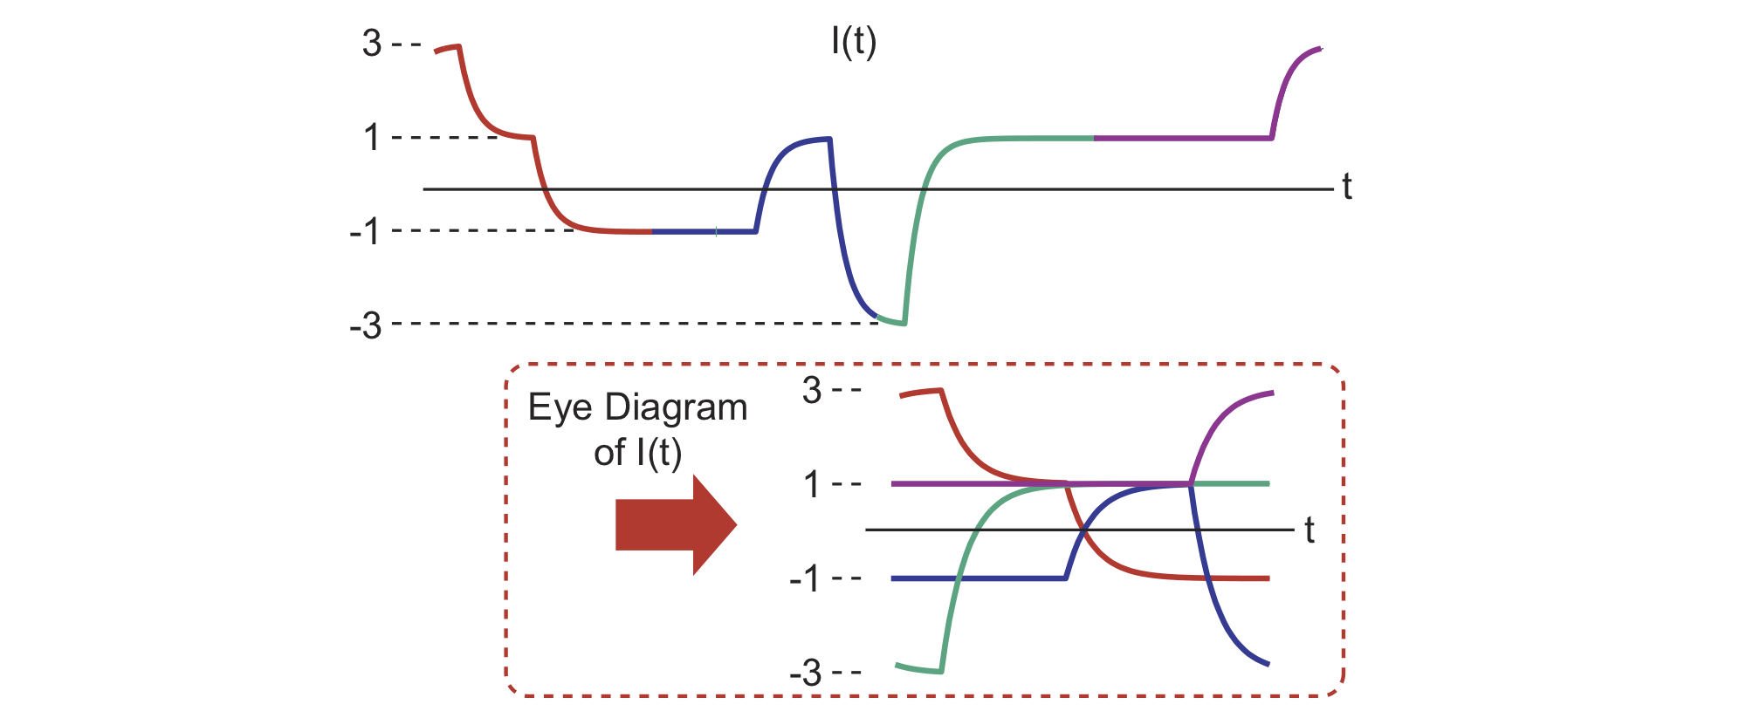
Eye Diagrams
Eye Diagram: Wrap signal back onto itself in periodic time intervals, retaining all “traces”

Slide 52
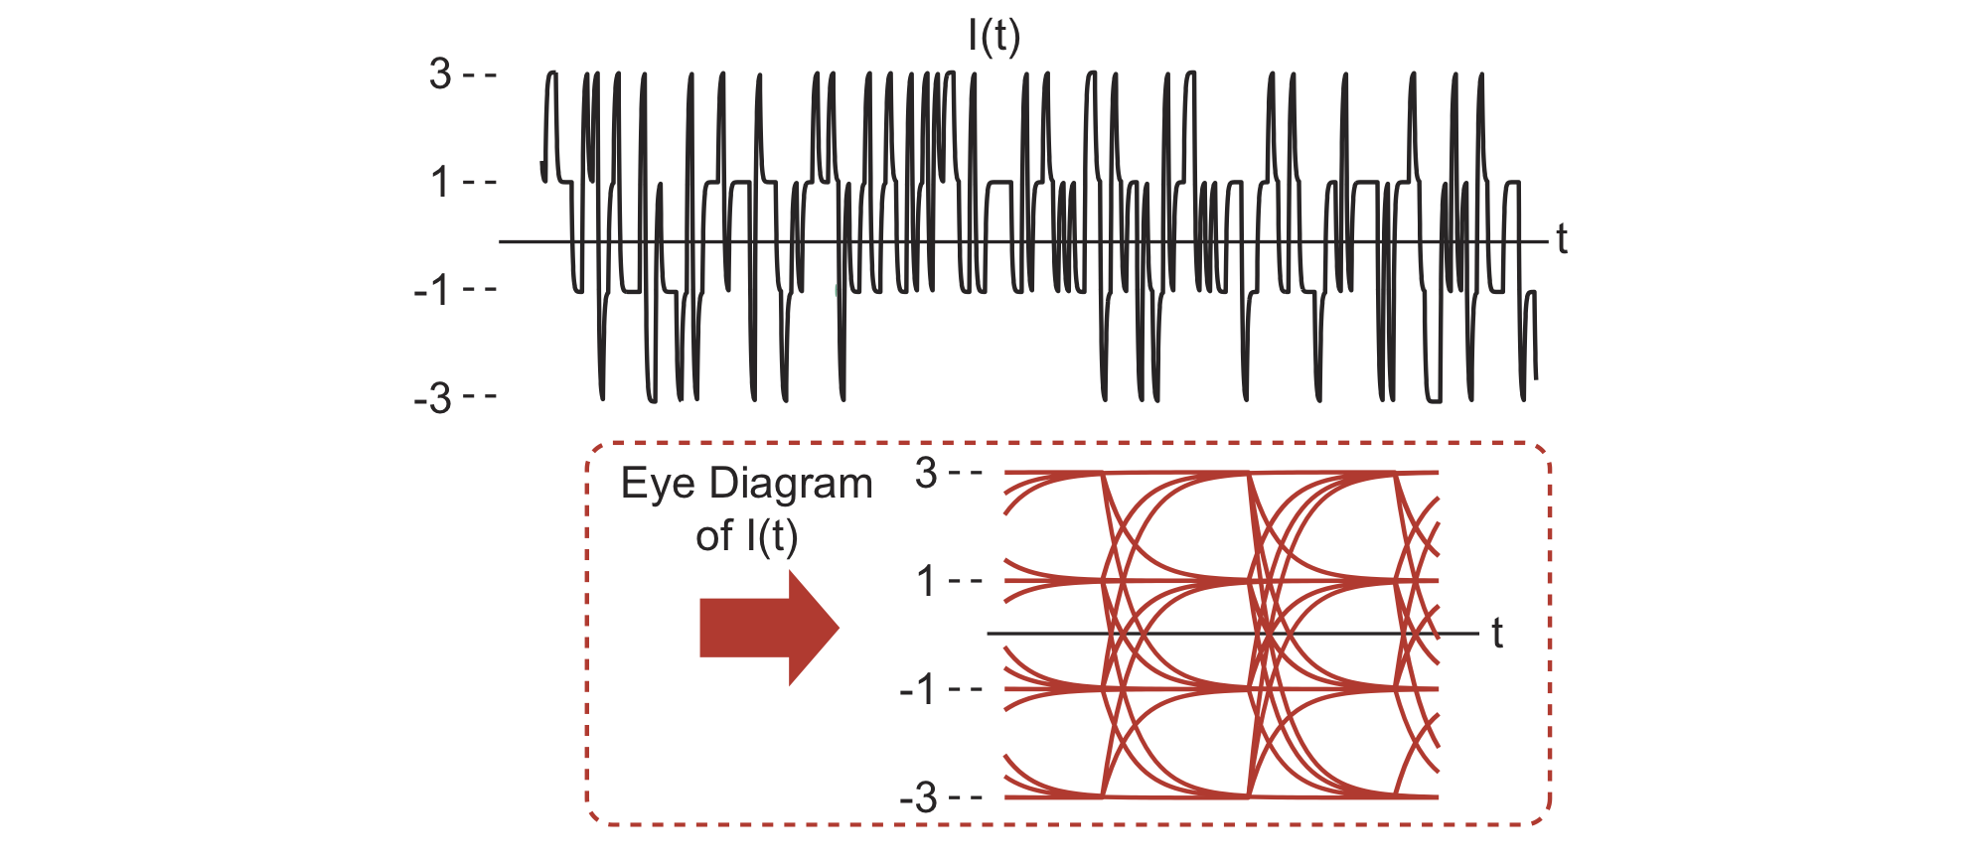
Looking at Many Symbols
Increasing the number of symbols eventually reveals all possible symbol transition trajectories
  Intuitively displays the impact of filtering on transmitted signal

Slide 53
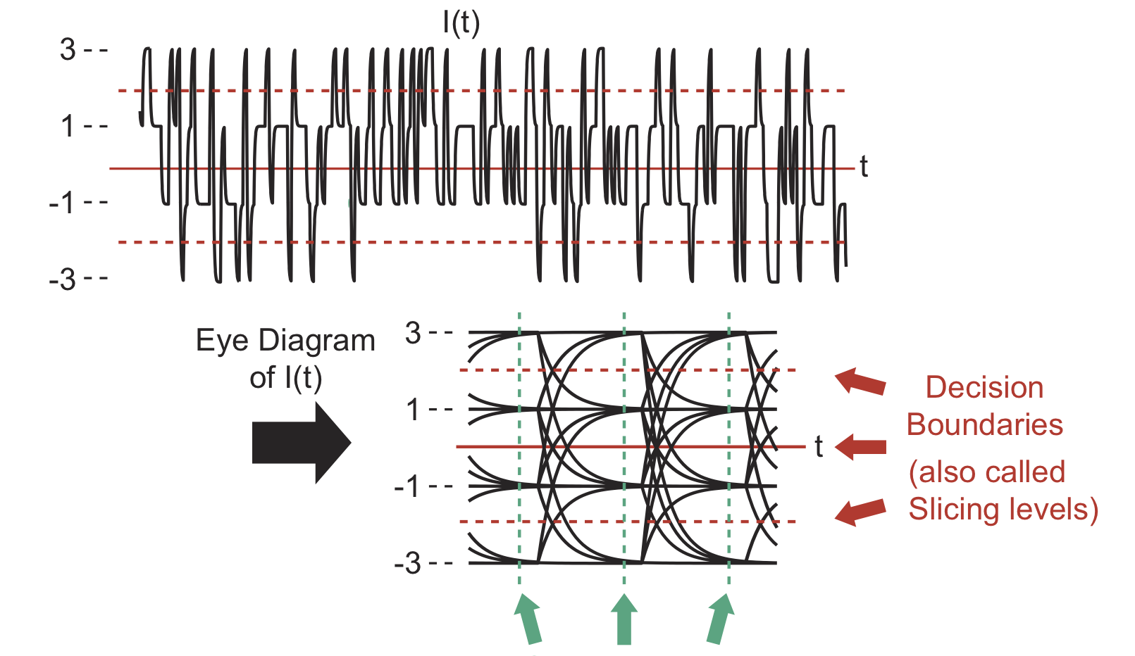
Assessing the Quality of an Eye Diagram
Sample times:
Eye diagram allows visual inspection of the impact of sample time and decision boundary choices
  Large “eye opening” implies less vulnerability to symbol errors

Slide 54
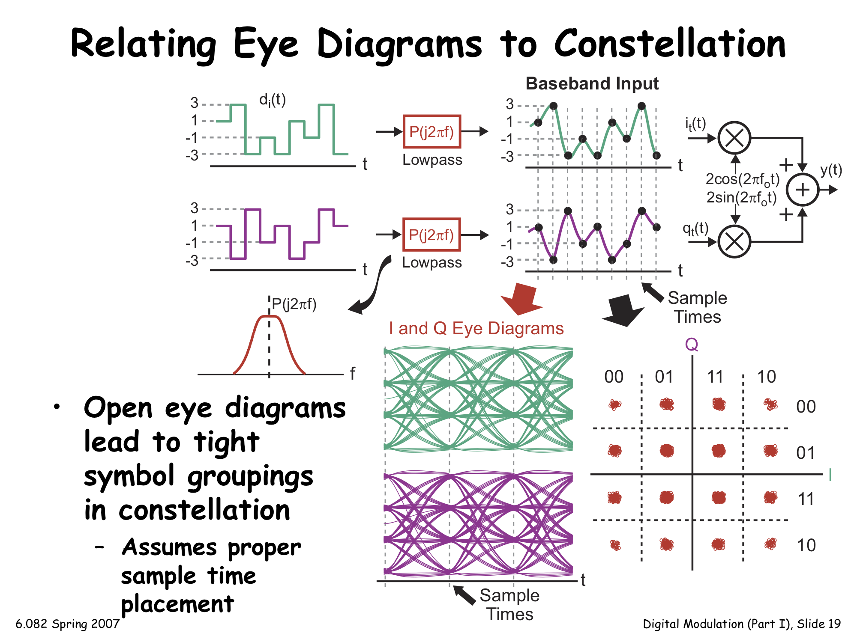
Relating Eye Diagrams to Constellation
Open eye diagrams lead to tight symbol groupings in constellation
  Assumes proper sample time placement

Slide 55
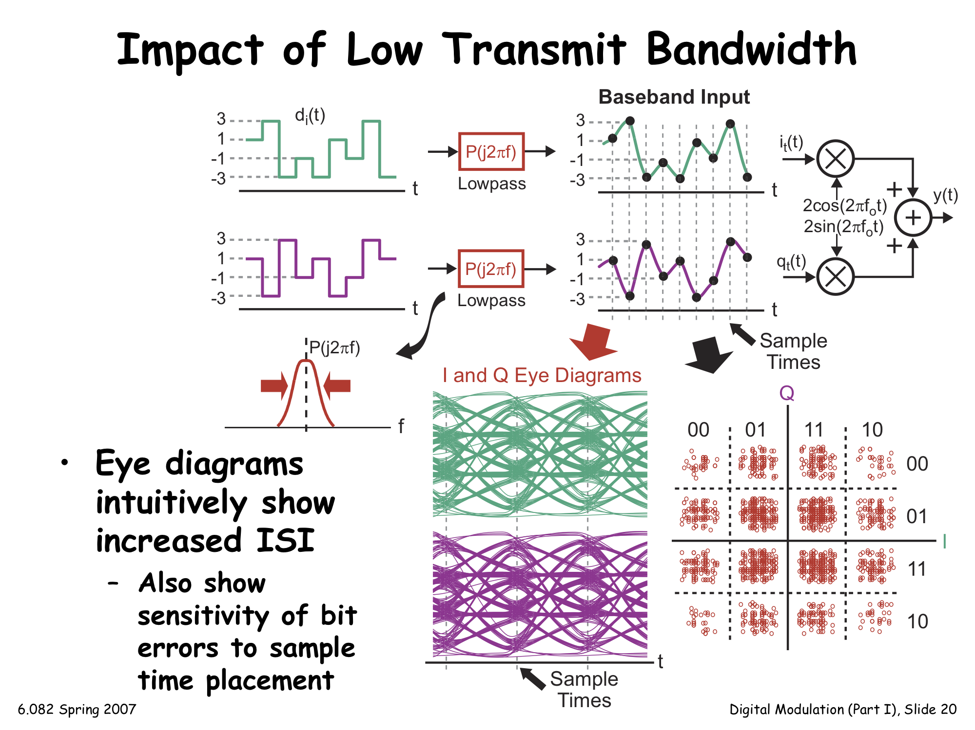
Impact of Low Transmit Bandwidth
Eye diagrams show increased inter-symbol interference (ISI)
  Also show symbol decision sensitivity to sample timing placement

Slide 56
Digital Modulation: Summary
Digital modulation: Sends discrete-valued symbols through an analog communication channel
  Receiver must sample I/Q signals at the appropriate time
  Receiver matches I/Q sample values to corresponding symbols based on decision regions
  Constellation diagrams are a convenient tool to see likelihood of bit errors being made
Choice of transmit filter: Tradeoff between achieving a minimal bandwidth transmitted spectrum and minimal ISI
  Eye diagrams: A convenient tool to see effects of ISI and sensitivity of bit errors to sample time choice

Slide 57
Thursday Topic:
Digital Communications II:
Receiver Processing, Performance

