Slide 1
Part III: Wireless from the Physical Layer, up
Preliminaries: Radio Communication,
Modulation, and Filtering
COS 463: Wireless Networks
Lecture 11
Kyle Jamieson
[Parts adapted from H. Balakrishnan, M. Perrot, C. Sodini , P. Steenkiste]

Slide 2

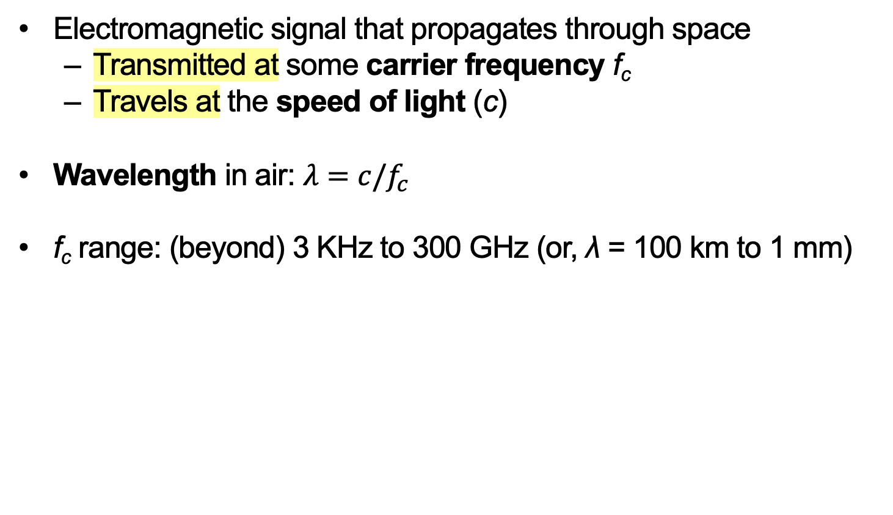
Radio Frequency (RF)
Electromagnetic signal that propagates through space
  Transmitted at some carrier frequency f_{c}
  Travels at the speed of light (c)
Wavelength in air: $λ=c/f_{c}$
f_{c} range: (beyond) 3 KHz to 300 GHz (or, λ = 100 km to 1 mm)

Slide 3
Today
Introduction to Signals: The Frequency Domain
  Modulation and Demodulation
Introduction to Filtering
AM Radio
Signals and Noise

Slide 4
Information Transmission
Goal: Move information (voice, video, data etc.), encoded in signals (e.g., electromagnetic, optical, acoustic)
  Over some channel (physical medium, e.g., free space, fiber, coax)
Transmitter
Channel
Receivers
Input
Output
Information
Signal
Information
Signal

Slide 5

Key Tool: Fourier Series
Suppose x(t) is our information signal
A periodic waveform x(t) can be represented as a sum of weighted (a_{n}) sinusoids of different frequencies ω_{n}:
x(t)
t
= a₀ + a₁ ×
sin(ω₁t)
+ a₂ ×
sin(ω₂t)
+ a₃ ×
sin(ω₃t)
+ ⋯
t

Slide 6
Frequency Domain View
Idea: plot the weights a_{n} versus the frequencies ω_{n}:
x(t)
t
a₂
a₁
a₃
a₀
ω₀
ω₁
ω₂
ω₃
frequency

Slide 7
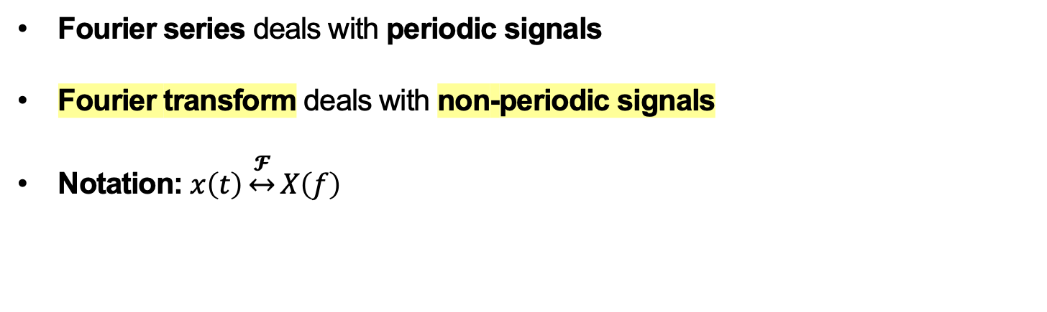
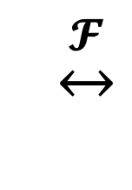
Fourier Transform
Fourier series deals with periodic signals
Fourier transform deals with non-periodic signals
Notation: $x\left(t\right)\underset{↔}{𝓕}X\left(f\right)$
$$\underset{↔}{𝓕}$$
Amplitude
Amplitude
Time
Frequency

Slide 8
Fourier Transform of cosine wave

Slide 9
Key Tool: The Impulse Function
An impulse of area A at time t₀ is denoted:
Defined in terms of its properties when combined with other (information carrying) signals
Aδ(t-t₀)
A
t₀
t

Slide 10
Today
Introduction to Signals: The Frequency Domain
  Modulation and Demodulation
Introduction to Filtering
AM Radio
Signals and Noise

Slide 11
Motivation for Modulation
Physical medium of wireless channel usually free space
Radio wavelength inversely proportional to frequency (1 GHz → 30 cm, while 1 KHz → 30 km wavelength)
Since antenna, component size related to wavelength:
  Want to move signal to higher frequency for smaller devices
Higher frequency signals can send more data, further

Slide 12

Sinusoidal carrier signal
RF signal propagates away from transmitter at light speed c
At an instant in time: signal “looks” sinusoidal in space
At a point in space: signal oscillates sinusoidally in time
c
Transmitter

Slide 13
Goal of Modulation
Given an information signal
Example: Voice signal with 4 KHz bandwidth
Magnitude
Voice
signal
-900 MHz
-4 kHz
0
4 kHz
900 MHz
Frequency
Shift information signal to the carrier frequency
Example: 900 MHz carrier frequency
→ Information signal modulates (changes) the carrier signal

Slide 14
Carrier signal parameters
The information signal modulates the carrier’s parameters:
Wavelength
Amplitude
Phase
t

Slide 15
Goal of Demodulation
Given a transmitted signal,
Example: Voice signal centered at 900 MHz
Magnitude
Voice
signal
-900 MHz
-4 kHz
0
4 kHz
900 MHz
Frequency
Recover the original signal from the transmission.
Example: 4 KHz bandwidth voice signal centered at 0 Hz

Slide 16
Impulse: Sampling Property
Multiplication of a function x(t) with an impulse at time t₀:
Results in scaling the impulse by the value of x(t) at t₀
δ(t-t₀)
A
t₀
t
x(t)
×
t₀
t
=
x(t₀)
t₀
t

Slide 17
Impulse: Convolution in Time
Convolution of a function x(t) with an impulse at time t₀:
Results in a time shift of x(t) by t₀
δ(t-t₀)
A
t₀
t
x(t)
*
t
=
0
t₀
t

Slide 18
Impulse: Convolution in Frequency
Convolve function X(f) with impulse at frequency f₀:
Results in a frequency shift of X(f) by f₀
δ(f−f₀)
A
f₀
f
X(f)
*
f
=
0
f₀
f

Slide 19
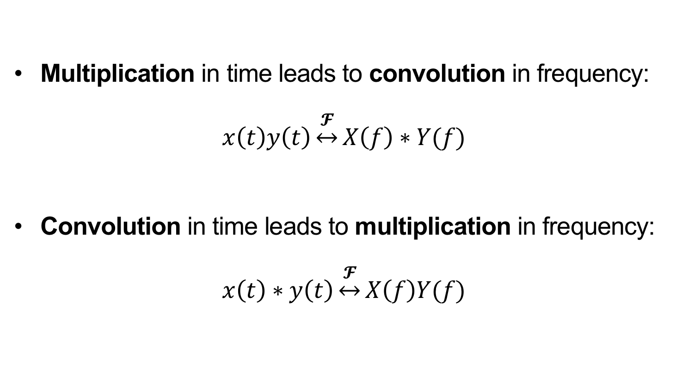
Duality of Convolution and Multiplication
Multiplication in time leads to convolution in frequency:
$$x\left(t\right)y\left(t\right)\underset{↔}{𝓕}X\left(f\right)∗Y(f)$$
Convolution in time leads to multiplication in frequency:
$$x\left(t\right)∗y\left(t\right)\underset{↔}{𝓕}X\left(f\right)Y(f)$$

Slide 20
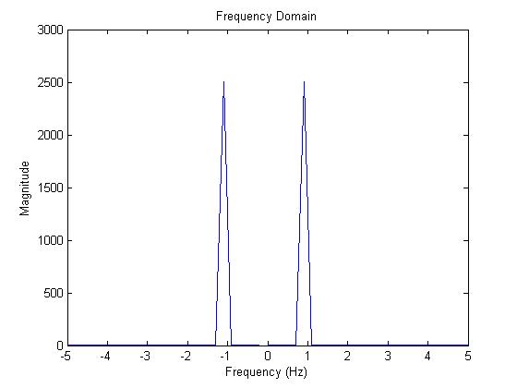
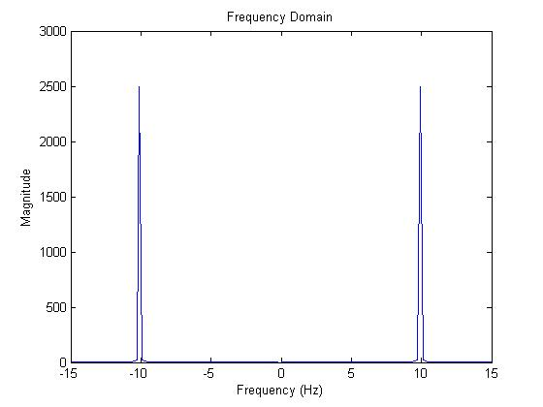
Modulation: Introduction
Given a data signal (e.g. cosine wave) at frequency f₁ (e.g., 1 Hz)
Modulate it with carrier at frequency f₂ (e.g., 10 Hz)
cos(2πt)
cos(2π10t)
Magnitude
Magnitude
frequency (Hz)
frequency (Hz)

Slide 21
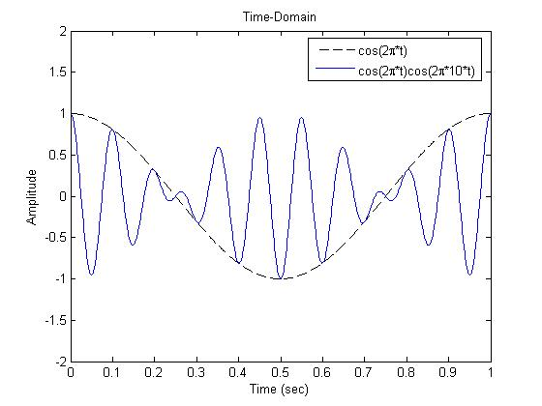
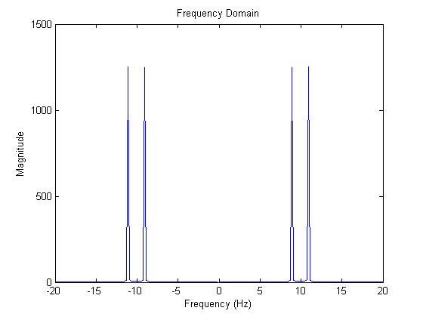
Transmitter: Principle of Modulation
Modulate the carrier with the data: cos(2πt) × cos(2π10t)
Transmitter:
data signal
⨂
modulated
signal
carrier
Time Domain
Frequency Domain
f₁+f₂ = 11 Hz Cosine
Magnitude
Magnitude
f₁−f₂ = 9 Hz Cosine
Time (s)
Frequency (Hz)

Slide 22
Demodulation: Motivation
Receiver wants to recover the original data signal
  Multiplies modulated signal containing f₁−f₂ and f₁ + f₂ by copy of carrier
Receiver:
⨂
???
modulated signal
carrier
Modulated signal:
Carrier:
f₁+f₂ = 11 Hz Cosine
Magnitude
Magnitude
f₁−f₂ = 9 Hz Cosine
Frequency (Hz)
Frequency (Hz)

Slide 23
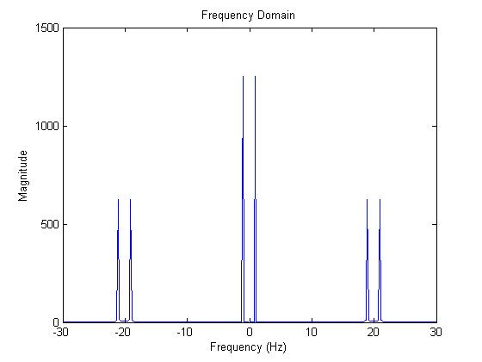
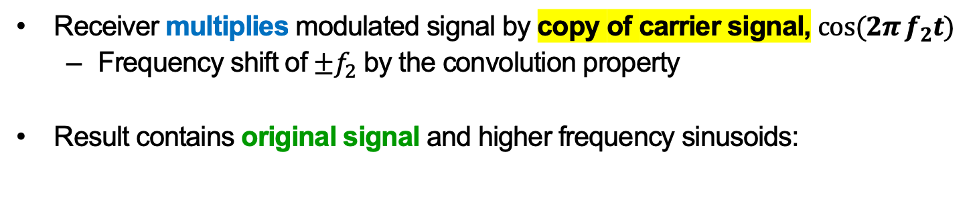
Receiver: Principle of Demodulation
Receiver multiplies modulated signal by copy of carrier signal, $\cos{(2π}f_{2}t)$
  Frequency shift of $±f_{2}$ by the convolution property
Result contains original signal and higher frequency sinusoids:
Frequency Domain
Receiver:
⨂
modulated signal
Magnitude
carrier
Frequency (Hz)
How to remove the higher frequency sinusoids?

Slide 24
Today
Introduction to Signals: The Frequency Domain
Introduction to Filtering
AM Radio
Signals and Noise

Slide 25
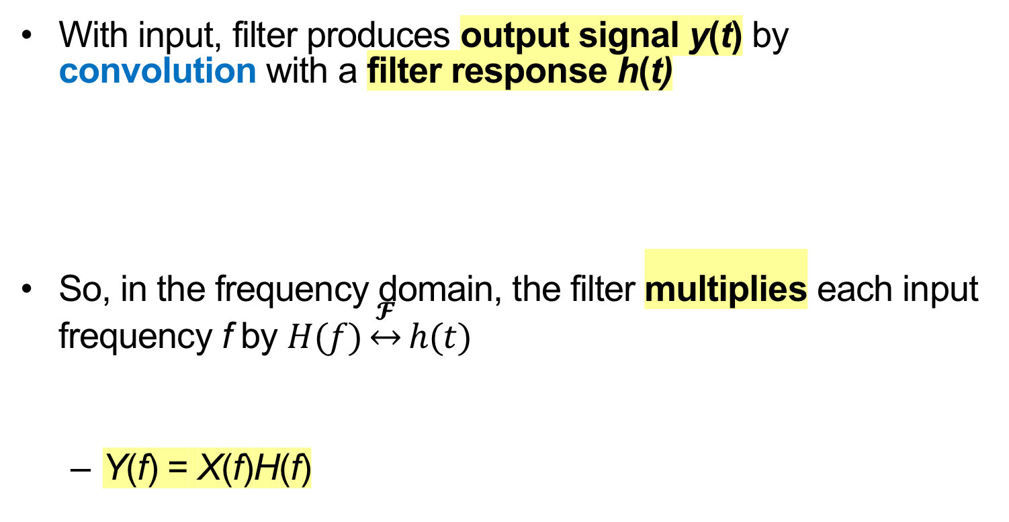
The Concept of Filtering
With input, filter produces output signal y(t) by convolution with a filter response h(t)
So, in the frequency domain, the filter multiplies each input frequency f by $H(f)\underset{↔}{𝓕}h(t)$
  Y(f) = X(f)H(f)
x(t)
h(t)
y(t)
X(f)
H(f)
Y(f)

Slide 26
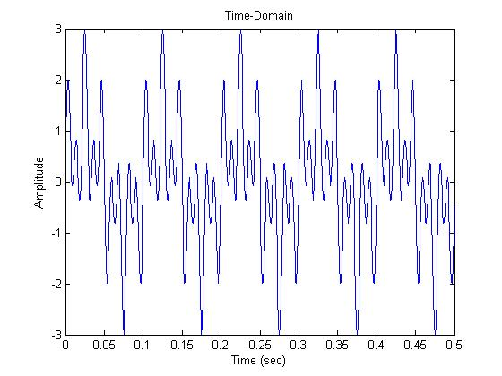
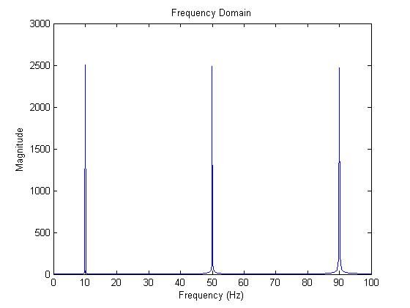
Example Input Signal to Filter
Input signal: Sum of three sinusoids (10, 50, 90 Hz)
h(t)
y(t)
time (s)
↕︎𝓕
10 Hz
50 Hz
90 Hz
f (Hz)

Slide 27
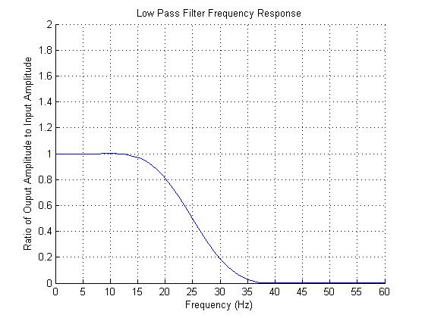
Low Pass Filter Example
H(f) = 1 below 20 Hz, approaches 0 above 20 Hz
h(t)
y(t)
time (s)
↕︎𝓕
H(f)
10 Hz
50 Hz
90 Hz
1
0
20 Hz
f (Hz)
f (Hz)

Slide 28
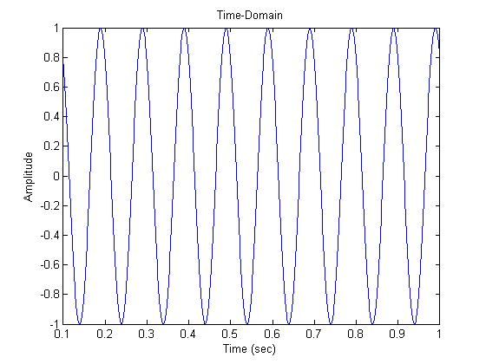
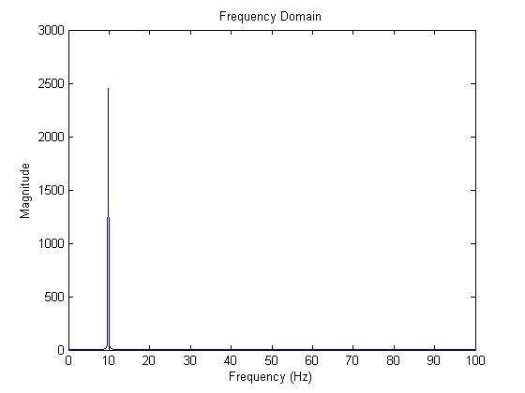
Low Pass Filter Output
H(f) = 1 below 20 Hz, approaches 0 above 20 Hz
h(t)
time (s)
time (s)
↕︎𝓕
H(f)
↕︎𝓕
10 Hz
50 Hz
90 Hz
1
0
20 Hz
f (Hz)
f (Hz)

Slide 29
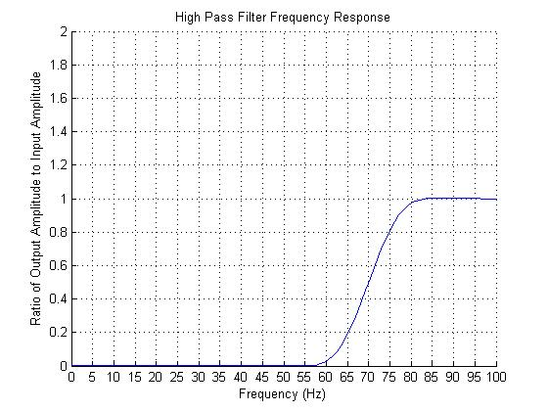
High Pass Filter Example
H(f) = 0 below 70 Hz, approaches 1 above 70 Hz
h(t)
y(t)
time (s)
↕︎𝓕
H(f)
10 Hz
50 Hz
90 Hz
1
70 Hz
0
f (Hz)
f (Hz)

Slide 30
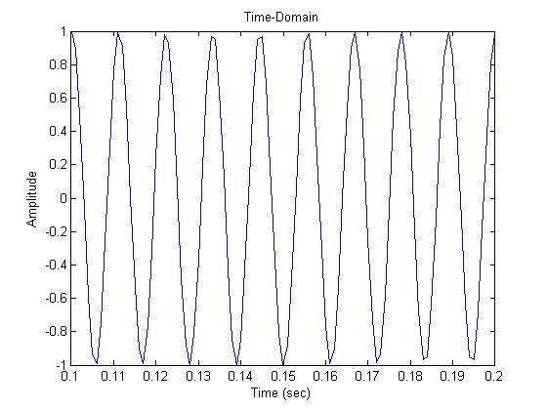
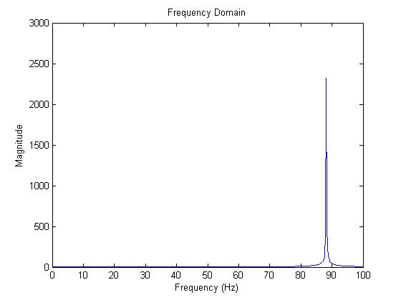
High Pass Filter Output
H(f) = 0 below 70 Hz, approaches 1 above 70 Hz
h(t)
time (s)
time (s)
↕︎𝓕
H(f)
10 Hz
50 Hz
90 Hz
1
70 Hz
0
f (Hz)
f (Hz)
f (Hz)

Slide 31
Bandpass Filter: Motivation
RF Transmitter
RF Receiver
Magnitude
Magnitude
Voice signal
0
4 kHz
900 MHz
0
900 MHz
Frequency
Frequency
Want to receive exclusively a certain frequency band of interest
  In presence of other communication on adjacent channels

Slide 32
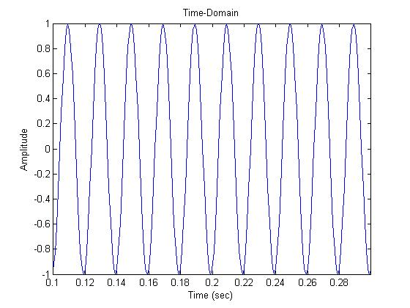
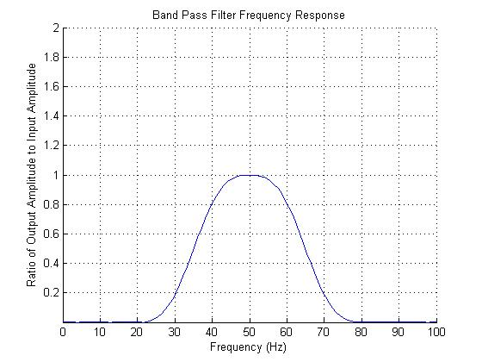
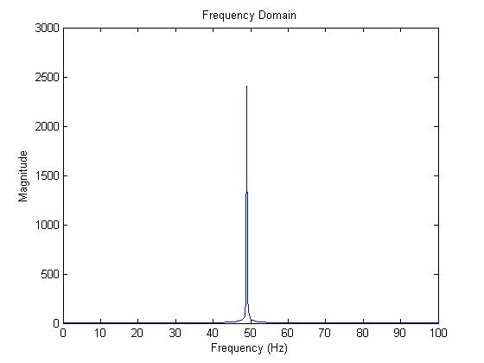
Bandpass Filter Output
H(f) = 0 below 30 Hz, above 70 Hz, approaches 1 elsewhere
h(t)
time (s)
time (s)
↕︎𝓕
H(f)
10 Hz
50 Hz
90 Hz
1
30 Hz
70 Hz
0
f (Hz)
f (Hz)
f (Hz)

Slide 33
Today
Introduction to Signals
Introduction to Filtering
AM Radio
Signals and Noise

Slide 34
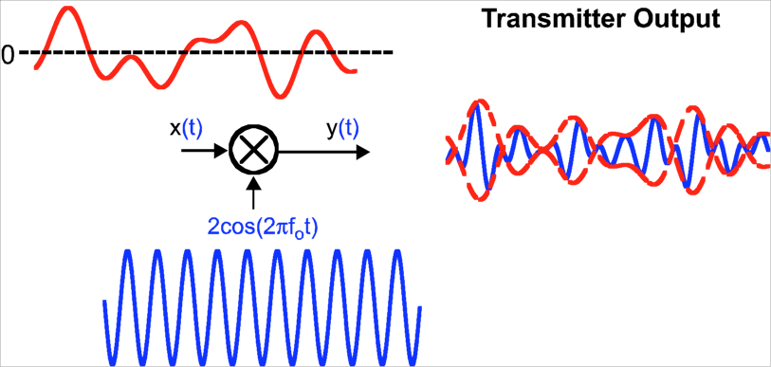
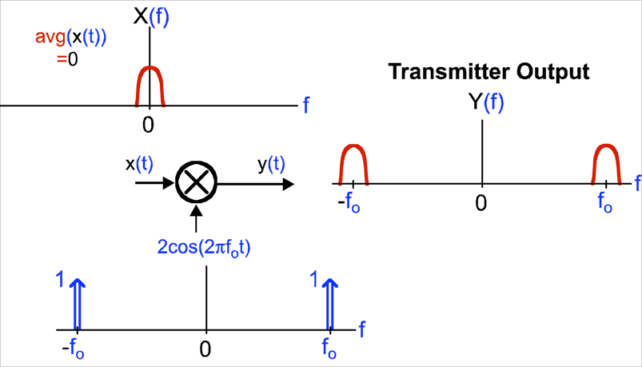
AM Radio Transmitter
x(t)
Time domain view:
Carrier signal (f₀ Hz):
Carrier signal:
Frequency domain view:
Carrier signal (f₀ Hz):

Slide 35
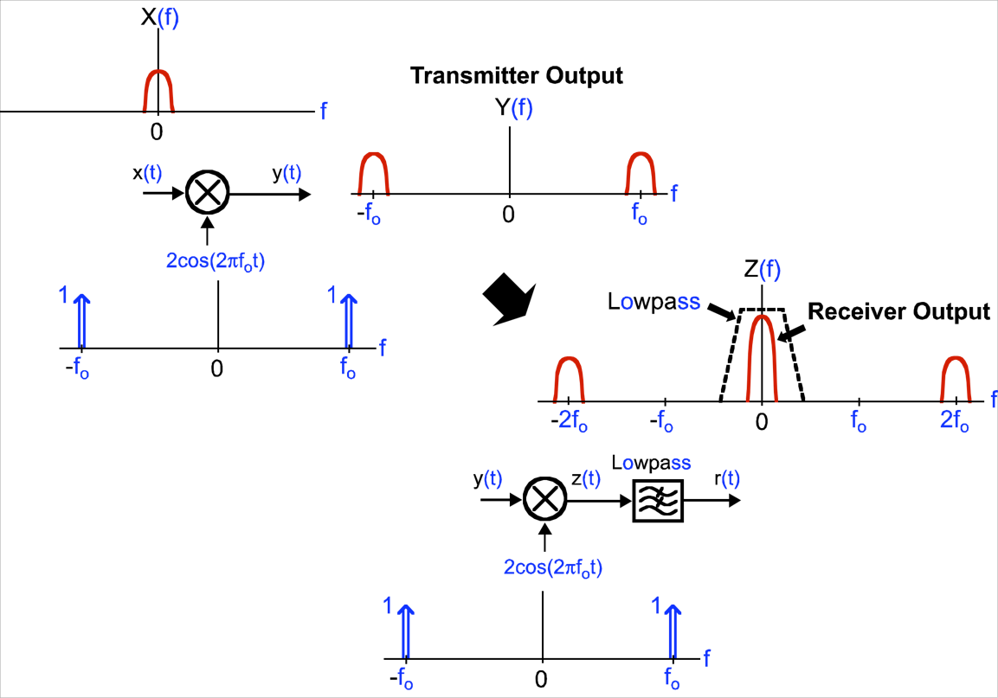
Demodulation: Frequency Domain View
Transmitter:
Receiver:

Slide 36
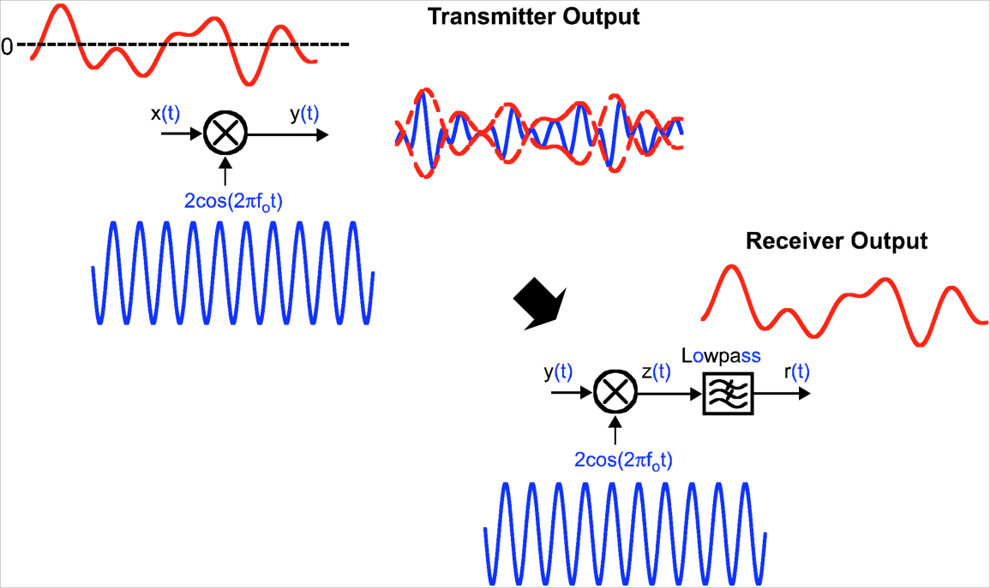
Demodulation: Time Domain View
Transmitter:
Receiver:

Slide 37
Impact of a frequency offset
Frequency offset ε at receiver corrupts the output signal r(t)

Slide 38

Stretch Break and Partner Exercise: FDM-AM
Voice signals:
Signal A
Magnitude
Signal B
Magnitude
Signal C
Magnitude
0
Frequency
0
Frequency
0
Frequency
Using the principle of superposition and the AM radio circuits we’ve just seen:
  Draw a circuit to transmit frequency division-multiplexed amplitude modulation (FDM-AM) of the voice signals A, B, and C at frequencies $f_{A}$, $f_{B}$, and $f_{C}$, respectively
  Plot the radio-frequency spectrum of your circuit’s output (the transmitted FDM-AM signal)
  Describe how a receiver would tune in to and demodulate just Signal B

Slide 39
Today
Introduction to Signals: The Frequency Domain
Introduction to Filtering
AM Radio
Signals and Noise

Slide 40
The Issue of Noise
RF Receiver
Desired signal
Magnitude
Noise
0
900 MHz
Frequency
Noise: Unpredictable, corrupting signal that adds to desired signal
  For RF receiver, mostly comes from analog receiver amplifier circuitry
Undesired signals also add to and corrupt desired signal

Slide 41
Energy Transfer in Wireless Communication
RF Transmitter
RF Receiver
Desired signal
Magnitude
Noise
0
900 MHz
Frequency
Receiver antenna captures a limited amount of desired signal’s energy
  Depending on antenna size, distance, environment

Slide 42
Signal versus Noise
RF Transmitter
RF Receiver
Desired signal
Magnitude
Noise
0
900 MHz
Frequency
Moving transmitter closer to receiver generally increases desired signal energy
Noise from analog receiver circuitry remains unchanged
Next few lectures: How is system performance impacted?

Slide 43
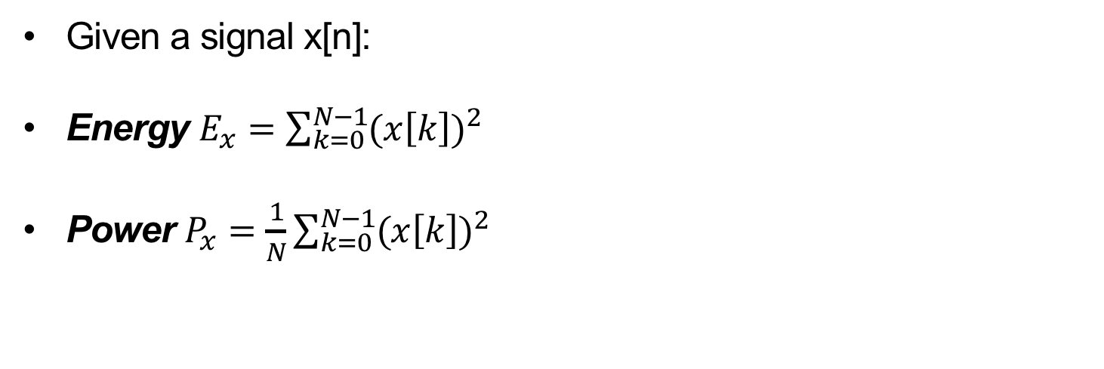
Definition of Power, Energy
Given a signal x[n]:
Energy $E_{x}=\sum_{k=0}^{N−1}{{(x\left[k\right])}^{2}}$
Power $P_{x}=\frac{1}{N}\sum_{k=0}^{N−1}{{(x\left[k\right])}^{2}}$

Slide 44
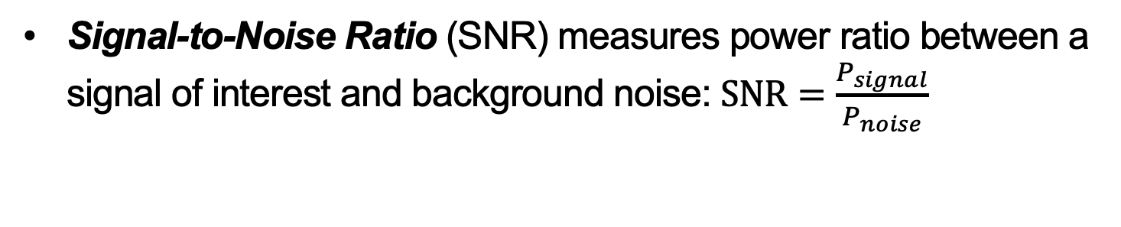
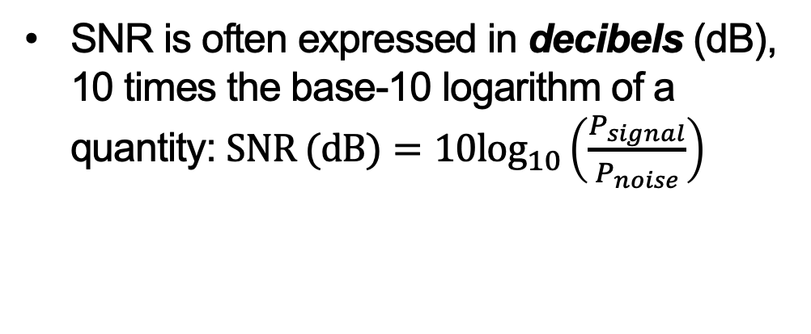
Signal­ to ­Noise Ratio (SNR)
Signal-to-Noise Ratio (SNR) measures power ratio between a signal of interest and background noise: $\text{SNR}=\frac{P_{signal}}{P_{noise}}$
SNR is often expressed in decibels (dB), 10 times the base-10 logarithm of a quantity: $\text{SNR}\text{ (}\text{dB}\text{)}={10log}_{10}\left(\frac{P_{signal}}{P_{noise}}\right)$
SNR (dB) | SNR
30 | 1,000
20 | 100
10 | 10
0 | 1 (equal)
-10 | 0.1
-20 | 0.01
-30 | 0.001

Slide 45
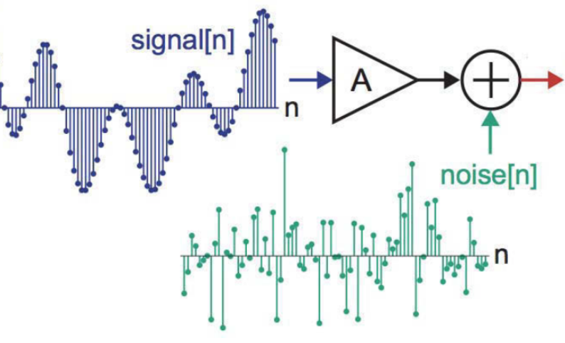
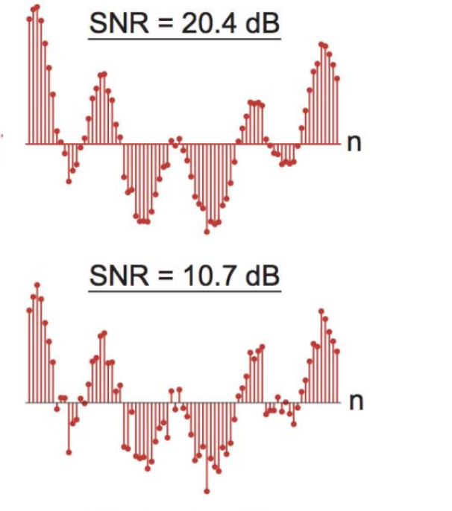
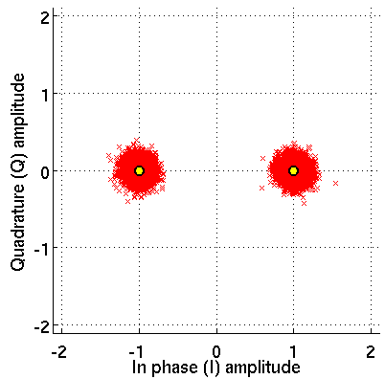
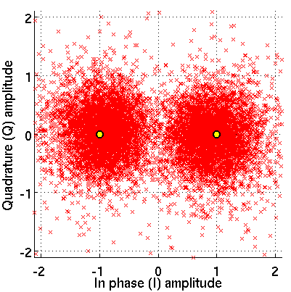
Visualizing Signal to Noise Ratio
Signal view:
Constellation
view:

Slide 46
Summary
Impulse function is an important concept for frequency domain “picture” analysis
  Shifting, sampling properties of impulse explain modulation and demodulation
“Picture analysis” of modulation and filtering
  Modulation shifts in frequency (convolution with impulses)
  Filtering multiplies in frequency

Slide 47
Good luck with the
remainder of your midterms!
Tuesday, March 25 lecture:
From AM Radio to Digital I/Q Modulation

