Slide 1
Bit Rate Adaptation and
Rateless Codes
COS 463: Wireless Networks
Lecture 10
Kyle Jamieson
[Parts adapted from H. Balakrishnan, M. Vutukuru]

Slide 2
Today
Bit Rate Adaptation
  Modulation
  Bit error rate (BER) and signal to noise ratio (SNR)
  Adapting modulation and error control coding
Rateless Codes: Spinal Codes

Slide 3
What is modulation?
Modulate means to change. Change what?
  The amplitude and phase (angle) of a radio carrier signal
Digital modulation: Use only a finite set of choices (i.e., symbols) for how to change the carrier and phase
Quadrature (Q)
symbol
amplitude
phase
In-phase (I)

Slide 4
From information bits to symbols…
Pick two symbols (binary)
  The information bit decides which symbol you transmit
  Phase shift of 180 degrees between the two symbols, so called binary phase shift keying
Q
Input bit=“1”
Input bit=“0”
I

Slide 5
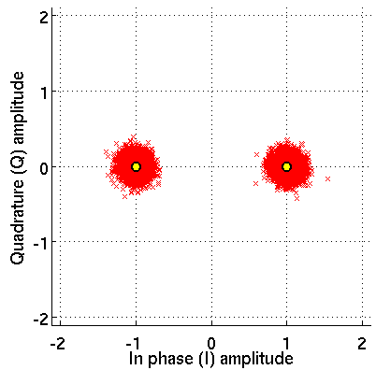
…and back to bits!
Received BPSK constellation
“1”
“0”
Received symbols
Decision boundary
Decision region

Slide 6
From bits to symbols, twice as fast
Quadrature phase shift keying (QPSK)
Input
bits=“10”
Input
bits=“00”
Q
I
Input
bits=“11”
Input
bits=“01”
Sending log₂ 4 = 2 bits/symbol

Slide 7
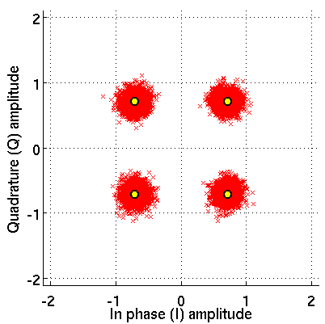
…and back to bits, twice as fast!
Received QPSK constellation
“10”
“00”
“11”
“01”

Slide 8
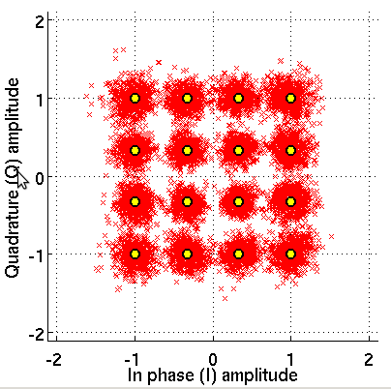
Change modulations, increase bitrate
Binary Phase-Shift
Keying (BPSK)
Quadrature Phase-Shift
Keying (QPSK)
16-Quadrature Amplitude
Modulation (16-QAM)

Slide 9
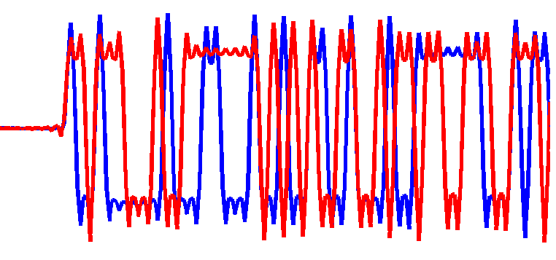
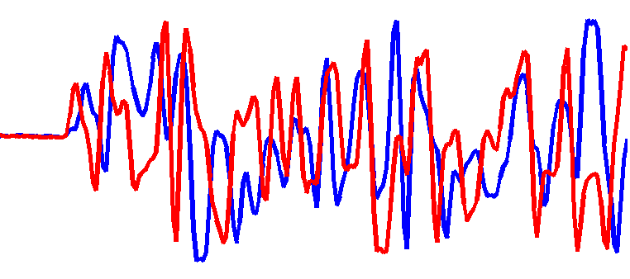
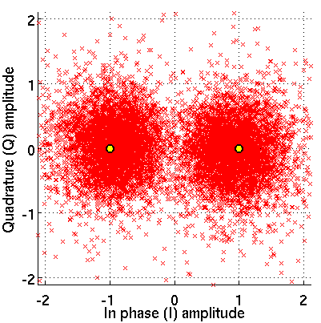
The wireless channel
Transmitted signal: s(t)
Received signal: r(t) = s(t) + noise
Q
Input bit=“1”
Input bit=“0”
I
−1
+1

Slide 10
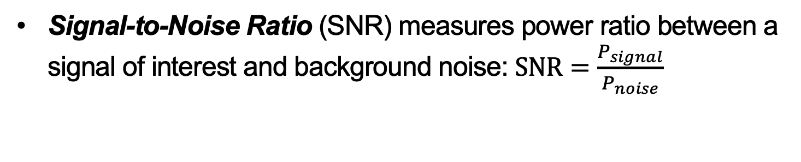
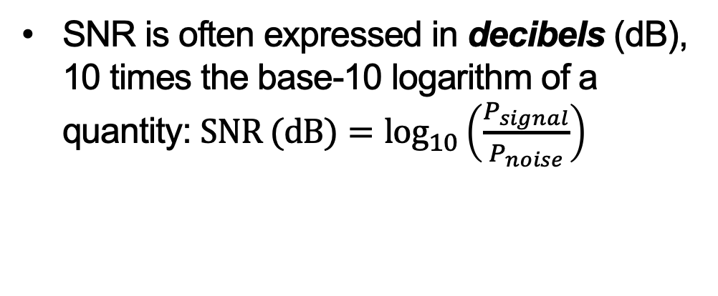
Signal­ to ­Noise Ratio (SNR)
Signal-to-Noise Ratio (SNR) measures power ratio between a signal of interest and background noise: $\text{SNR}=\frac{P_{signal}}{P_{noise}}$
SNR is often expressed in decibels (dB), 10 times the base-10 logarithm of a quantity: $\text{SNR}\text{ (}\text{dB}\text{)}=\log_{10}\left(\frac{P_{signal}}{P_{noise}}\right)$
SNR (dB) | SNR
30 | 1,000
20 | 100
10 | 10
0 | 1 (equal)
-10 | 0.1
-20 | 0.01
-30 | 0.001

Slide 11
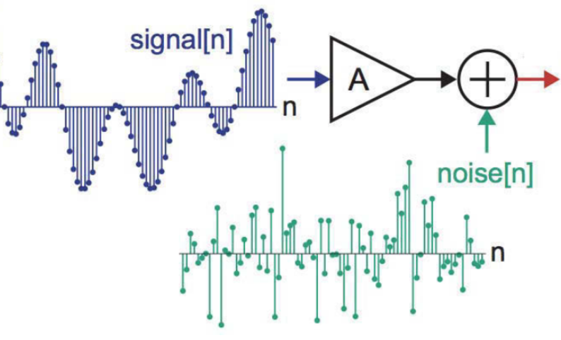
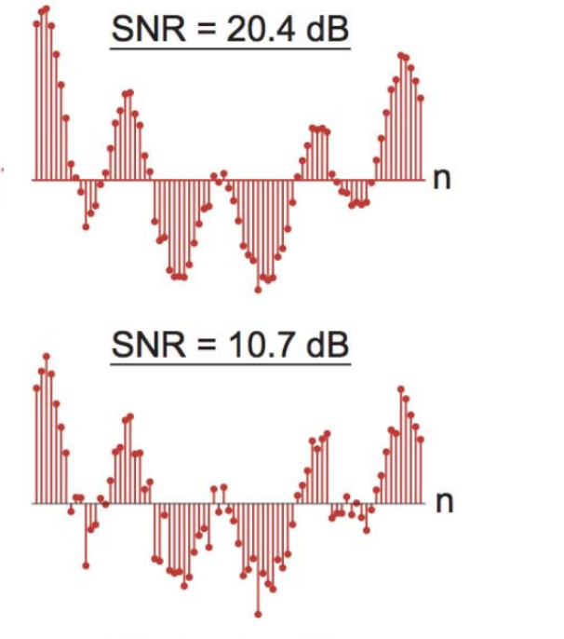
Visualizing Signal to Noise Ratio
Signal view:
Constellation
view:

Slide 12
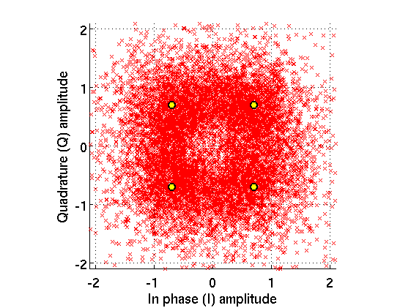

Modulation adaptation

Slide 13
Bit Rate Adaptation in the Physical Layer
source bits
source bits
k bits
k bits
Channel encoder
Channel decoder
n bits
n bits
Modulation (BPSK, QPSK, …)
Demodulation
Code rate: R = k/n

Slide 14
802.11: adapt code rate, modulation

Slide 15
BER vs SNR

Slide 16
Packetized throughput
Throughput = delivery rate × bitrate = (1 − BER)^{n} × bitrate
n = 1500 × 8 bits

Slide 17
Link/PHY checks packet integrity
Throughput = delivery rate × bitrate = (1 − BER)^{n} × bitrate
Network layer
packet
Packet delivery rate = (1−BER)^{n}
Frame checksum: pass only entirely correct frames
Link layer
Physical layer
BER
  Change modulation
  Change coding rate
n = 1500 × 8 bits

Slide 18
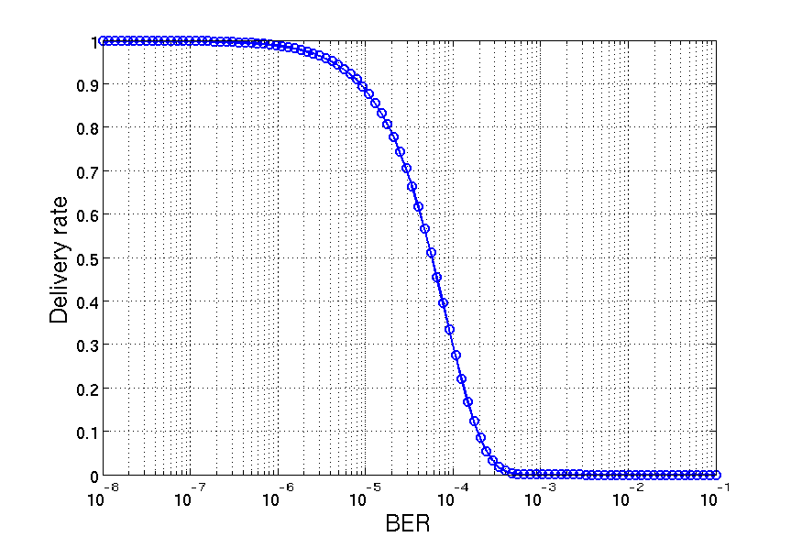
Delivery rate vs BER
Throughput = delivery rate × bitrate = (1 − BER)^{n} × bitrate

Slide 19
BER vs SNR
Let’s go back to the BER vs SNR graph
  For each modulation: What are the SNRs required for BER < 10⁻⁵?
BPSK: 7 dB; QPSK: 12 dB; 16-QAM: 20 dB; 64-QAM: 26 dB

Slide 20
Fixed-rate codes require channel adaptation
Throughput = delivery rate × bitrate = (1 − BER)^{n} × bitrate
7 dB
12 dB
26 dB
n = 1500 × 8 bits

Slide 21
Fixed-rate codes require channel adaptation

Slide 22

Existing rate adaptation algorithms
Frame-based
SNR/BER-based
Data
Data
ACK
SNR using preamble
Estimate frame loss rate
at each bit rate
Lookup table:
SNR/BER → best rate

Slide 23
Today
Bit Rate Adaptation
Rateless Codes: Spinal Codes

Slide 24
Rateless codes: Motivation (1)
Sender transmits information at a rate higher than the channel can sustain
  At first glance, this sounds disastrous!
Receiver extracts information at the rate the channel can sustain at that instant
  No adaptation loop is needed!

Slide 25
Rateless codes: Motivation (2)
Setting: Multicast or unicast links
Sender sends a potentially limitless stream of encoded bits
Receiver(s) collect bits until they are reasonably sure that they can recover the content from the received bits, then send STOP feedback to sender
Automatic adaptation: Receivers with larger loss rate need longer to receive the required information

Slide 26
Today
Bit Rate Adaptation
Rateless Codes: Spinal Codes
  Encoder structure
  Decoder structure

Slide 27
Spinal encoder: Computing the spines
Start with a hash function h and an initial random v-bit state s₀
  Sender and receiver agree on h and s₀ a priori
Sender divides its n-bit message M into k-bit chunks m_{i}
h maps the state and a message chunk into a new state
  The v-bit states s₁, …, s⌈_{n/k}⌉ are the spines

Slide 28
Spinal encoder: Information flow
Observe: State s_{i} contains information about chunks m₁, …, m_{i}
  A stage’s state depends on the message bits up to that stage
So only state s_{⌈n/k⌉} has information about entire message

Slide 29
Spinal encoder: Computing the spines
Each spine seeds a pseudorandom number generator RNG
RNG generates a sequence of c-bit numbers x_{i,l} called symbols
Encoder output is a series of passes, each of ⌈n/k⌉ symbols

Slide 30
Spinal encoder: RNG to symbols
A constellation mapping function translates c-bit numbers x_{i,l} from the RNG to in-phase (I) and quadrature (Q)
  Generates in-phase (I) and quadrature (Q) components independently from two separate x_{i,l}
Uniform
Truncated Gaussian

Slide 31
Today
Bit Rate Adaptation
Rateless Codes: Spinal Codes
  Encoder structure
  Decoder structure
    “Maximum-likelihood” decoding
    Practical “Bubble” Decoder
    Puncturing for higher rate
    Performance

Slide 32
Decode by replaying the encoder
1
0
Sender transmits “1”, “0”:
s₀
h
h
⬥
⬥
Transmitted symbols
  ○ Replayed symbol
  × Received symbol
Instead of inverting the hash function, the decoder replays all four possibilities:
0
0
1
0
s₀
h
○
h
s₀
h
h
×
○
×
×
×
○
○
0
1
1
1
s₀
h
○
h
s₀
h
h
○
×
×
×
×
○
○

Slide 33
Decode by measuring distance
How to decide between the four possible messages?
Measure total distance between:
  Received symbols, corrupted by noise (×), and
  Replayed symbols ()
Sum across stages: the distance increases at first incorrect symbol
0
0
1
0
s₀
h
○
h
s₀
h
h
×
○
×
×
×
○
○
0
1
1
1
s₀
h
○
h
s₀
h
h
○
×
×
×
×
○
○
  ○ Replayed symbol
  × Received symbol

Slide 34
Adding additional passes
Recall: The encoder sends multiple passes over the same message blocks

Slide 35
Adding additional passes
What’s a reasonable strategy for decoding now?
Take the average distance from the replayed symbol (), across all received symbols (×, ×)
  Intuition: As number of passes increases, noise and bursts of interference average out and impact the metric less
0
0
1
0
s₀
h
○
h
s₀
h
h
×
×
○
×
×
×
×
×
×
○
○
0
1
1
1
s₀
h
○
h
s₀
h
h
○
×
×
×
×
×
×
×
×
○
○
  ○ Replayed symbol
  × Received symbol

Slide 36
The Maximum Likelihood (ML) decoder
Consider all 2^{n} possible messages that could have been sent
  The ML decoder minimizes probability of error
Pick the message M′ that minimizes the vector distance between:
  The vector of all received constellation points y
  The vector of constellation points sent if M′ were the message, x(M′)
In further detail:
  x_{t,l}(M′): t^{th} constellation point sent in the l^{th} pass for M′
  y_{t,l}: t^{th} constellation point received in the l^{th} pass

Slide 37
ML decoding over a tree
Observe: Hypotheses whose initial stages share the same symbol guesses are identical in those stages
0
0
1
0
s₀
h
○
h
s₀
h
h
×
○
×
×
×
○
○
0
1
1
1
s₀
h
○
h
s₀
h
h
○
×
×
×
×
○
○

Slide 38
ML decoding over a tree
Observe: Hypotheses whose initial stages share the same symbol guesses are identical in those stages
Therefore we can merge these initial identical stages:
0
0
0
h
1
h
×
○
×
○
s₀
h
s₀
h
○
1
1
×
×
○
h
h
○
×
×
○

Slide 39
ML decoding over a tree
✔
s₂
0
General tree properties:
  n/k levels, one per spine
  Branching factor 2^{k} (per choice of k-bit message chunk)
Let s′_{t} be the t^{th} spine value associated with all messages that share s′_{t}
We find cost of a particular message by summing costs on path from root to leaf
s₁
0
h
×
○
h
○
1
×
h
×
✔
s₀
0
○
1
h
✔
×
○
h
1
×
○
h
○
×

Slide 40
ML decoding over a tree: Multiple passes
0✔
s₂
Suppose the sender transmits L passes, in a poor channel
Average (sum) metric across passes, and label branches
However, the tree has 2^{n} leaves to compare so this approach is still impracticable (too computationally demanding)
s₁
0
h
×
○
h
○
1
×
h
×
✔
s₀
0
○
1
h
✔
×
○
h
1
×
○
h
○
×

Slide 41
Efficiently exploring the tree
Observation: Suppose the ML message M* and some other message M′ differ only in the i^{th} bit
  Only symbols including and after index ⌈i/k⌉ will disagree
  So the earlier the error in M′, the larger the cost
  Can show that the “runners-up” to M* differ only in the last O(log n) bits
Consider the best 100 leaves in the ML tree:
  Tracing back through the tree, they will have a common ancestor with M* in O(log n) steps
  This suggests a strategy in which we only keep a limited number of ancestors

Slide 42
“Bubble” decoder
Maintain a beam of B tree node possibilities to explore at each stage, each to a certain depth d
Expand each ancestor, score every child, propagate best child score for each ancestor, pick B best survivors
Example: B = d = 2, k = 1 (lighter color = better score)
beam

Slide 43
Adjusting the rate
Spinal codes as described so far uses different numbers of passes to adjust the rate
Two problems in Spinal codes as described so far:
  Must transmit one full pass, so max out at k bits/symbol
    Increase k? No: Decoding cost is exponential in k
  Sending L passes reduces rate to k/L—abrupt drop
    Introduces plateaus in the rate versus SNR curve

Slide 44
Puncturing for higher and finer-grained rates
Idea: Systematically skip some spines
  Sender and receiver agree on the pattern beforehand
  Receiver can now attempt a decode before a pass concludes
Decoder algorithm unchanged, missing symbols get zero score
Max rate of this puncturing: 8∙k bits/symbol

Slide 45
Framing at the link layer
Sender and receiver need to maintain synchronization
  Sender uses a short sequence number protected by a highly redundant code
Unusual property of Spinal codes: Shorter message length n is more efficient
  This is in opposition to the trend most codes follow
  Divide the link-layer frame into shorter checksum-protected code blocks
If half-duplex radio, when should sender wait for feedback?
  For more information, see RateMore (MobiCom ‘12)

Slide 46
Today
Bit Rate Adaptation
Rateless Codes: Spinal Codes
    Encoder structure
    Decoder structure
    Performance

Slide 47
Methodology
Software simulation: Simulated wireless channel (additive white Gaussian noise and Rayleigh fading)
Hardware platform: Airblue (FPGA based platform)
  Real 10, 20 MHz bandwidth channels in 2.4 GHz ISM band
Gap to capacity: How much more noise could a capacity-achieving code tolerate at same rate?
  Smaller gap is better
  e.g.: This code achieves six bits/symbol at 20 dB SNR, for a 2 dB gap to capacity
8
6
2 dB
Rate (bits per symbol)
4
2
0

Slide 48
Spinal codes: Higher rate on AWGN channel
Simulated AWGN channel: no link-layer performance effects here
LDPC envelope: Choose best-performing rated LDPC code at each SNR to mimic the best a rate adaptation strategy could do
Strider+: Strider + puncturing: finer rate control, but significant gap to capacity

Slide 49
Rateless codes can “hedge their bets”
Constant SNR means constant average noise power
  But, noise impacting any particular symbol(s) may be higher or lower
Rated codes must be risk averse (send at lower rate)
Rateless codes can decode with fewer symbols when noise is momentarily lower
But this result requires perfect and instantaneous feedback so the rateless code knows when to stop

Slide 50
Spinal codes: Better at sending short messages
Longer code block means more opportunities to prune correct path
  So Spinal codes achieves better performance (smaller gap to capacity) with smaller code block length n
We can see artifacts due to puncturing at higher SNRs

Slide 51
Spinal Codes: Conclusion
Spinal Codes give performance close to Shannon capacity
Eliminate the need to run a bit rate adaptation algorithm
Simpler design and better performance
Link layer design more open, incurs overhead between transmissions

Slide 52
Midterm format
Timing: 60 minutes in a 90 minute timeslot
Exam is closed book, closed Internet, closed electronic devices; calculators not permitted
True/False/Don’t Know questions
  One point for a correct T/F response
  No effect for a don’t know response or no response
  Minus one point for an incorrect T/F response
  Rescaled as a section with a zero floor
Short answer questions
  One to two, each on a theme

Slide 53
Next week’s precepts:
Lab 2
Tuesday, March 12, 11:00 AM:
In-Class Midterm
Next Thursday:
[Part III: Wireless from the PHY Upwards]
Signals and Systems Preliminaries

