Slide 1
Geographic and Diversity
Routing in Mesh Networks
COS 463: Wireless Networks
Lecture 7
Kyle Jamieson
[Parts adapted from B. Karp, S. Biswas, S. Katti]

Slide 2
Course Contents
Wireless From the Transport Layer Downwards
  Transport over wireless, link layer, medium access, routing
Overcoming Bit Errors
  Error Detection/correction, convolutional & “Rateless” codes
An Introduction to the Wireless Channel
  Noise, Multipath Propagation, radio spectrum
Practical/Advanced Wireless Physical Layer concepts
  OFDM, channel estimation, MIMO etc.
Boutique topics
  Visible light communication, low power, Wi-Fi localization

Slide 3
Today
Geographic (Location-Based) Mesh Routing
  Greedy Perimeter Stateless Routing: GPSR
  Cross-link Detection Protocol: CLDP
Diversity Mesh Routing
  ExOR (Roofnet)
  Network Coding

Slide 4
Context: Ad hoc Routing
1990s: availability of off-the-shelf Wi-Fi cards, laptops
1994: First papers on DSDV and DSR routing spark interest in routing on mobile wireless (ad hoc) networks
2000: GPSR
2000: Estrin et al., and the Berkeley
Smart Dust project sparks interest in
wireless sensor networks (sensornets)
Deborah Estrin

Slide 5
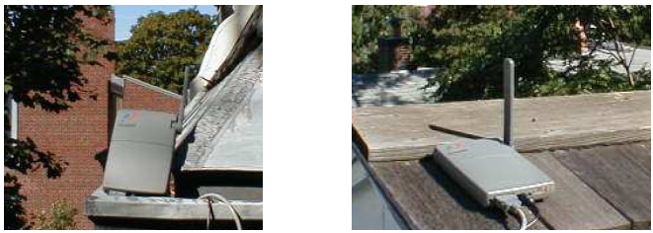
Original Motivation (2000):
Rooftop Networks
Share the broadband access network among many geographically-close households, using a wireless mesh

Slide 6
Motivation (2010+): Sensornets++
Many sensors, widely dispersed
Sensor: radio, transducer(s), small CPU, storage, battery
Multiple wireless hops, forwarding sensor-to-sensor to a base station
Sensornets redux ca. 2015+: Internet of Things
  Related concept, smaller numbers: Edge Computing
What communication primitives will thousand- or million-node sensornets need?

Slide 7
The Routing Problem
Each router has unique ID
Packets stamped with destination ID
  Router must choose next hop for received packet
  Routers communicate to accumulate state for use in forwarding decisions
Evaluation metrics:
  Minimize: Routing protocol message cost
  Maximize: E2E throughput
  Minimize: Per-router state
D
?
?
S

Slide 8
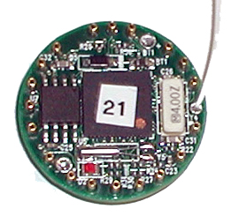
Scalability in Sensor Networks
Resource constraints drive (slightly modified) goals:
State per node: minimize
Energy consumed: minimize
Bandwidth consumed: minimize
System scale in nodes: maximize
Message delivery success rate: maximize

Slide 9
Scaling Routing
Link State: Push full topology map to all routers, O(# links) state
Distance Vector: Push distances across network, O(# nodes) state
Dynamic Source Routing (DSR):
  Flood queries on-demand to learn source routes
  Cache replies, O(# nodes) state
Internet routing scales because of hierarchy & IP prefix aggregation; but not easily applicable in sensornets
Can we achieve per-node routing state independent of # nodes?

Slide 10
Greedy Perimeter Stateless Routing (GPSR)
Central idea: Machines know their geographic locations, route using location
Packet destination field = location of destination
Assume some node location registration/lookup system to support host-centric addressing
Node’s state concerns only one-hop neighbors:
  Low per-node state: O(density)
  Low routing protocol overhead: state pushed only one hop

Slide 11
Assumptions
Nodes all know their own locations
Bi-directional radio links (unidirectional links may be excluded)
Network nodes placed roughly in a plane
Fixed, uniform radio transmitter power
Unit Graph Connectivity: Node connected to all others in a fixed radio range, and none outside this range

Slide 12
Greedy Forwarding
Nodes learn immediate neighbors’ positions from beaconing/piggybacking on data packets
Locally optimal, greedy next hop choice:
  Neighbor geographically nearest to destination
D
x
y
Neighbor must be strictly closer to avoid loops

Slide 13
Greedy Forwarding Failure
Greedy forwarding not always possible! Consider:
D
v
z
void
w
y
x
How can we circumnavigate voids, relying only on one-hop neighborhood information?

Slide 14
Traversing a face
Arriving at node x from node y, along edge (x, y):
  Right-hand rule: depart x from the edge next in the counterclockwise order about x, after edge (x, y)
Traverses the interior of a closed polygon in clockwise edge order
b
c
a

Slide 15
Planar vs. Non-planar Graphs
On graphs with edges that cross (non-planar graphs), right-hand rule may not tour enclosed face boundary
How to remove crossing edges without partitioning graph?
  And using only single-hop neighbors’ positions?

Slide 16
Planarized Graphs
Relative Neighborhood Graph (RNG) and Gabriel Graph (GG)
  Unit graph connectivity assumption
w
w
u
v
u
v
?
?
RNG
GG
RNG ⊆ GG

Slide 17
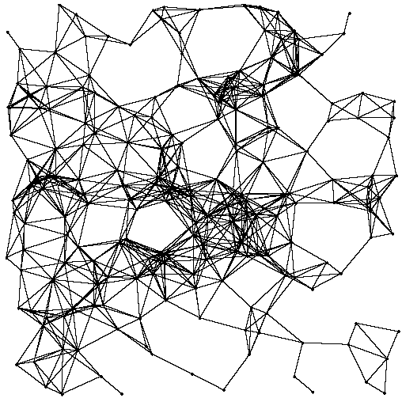
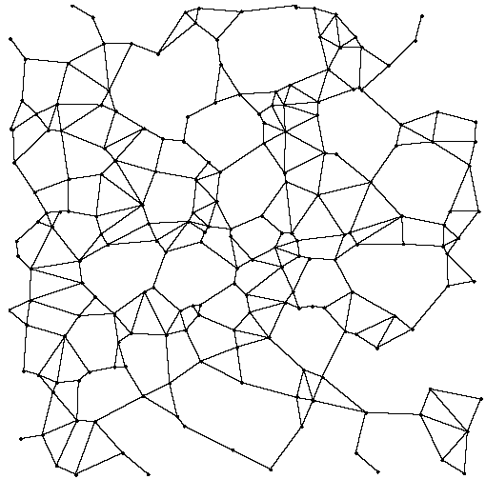
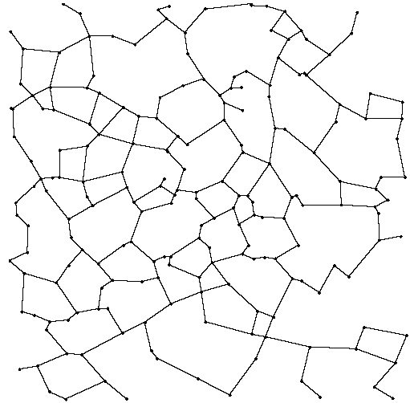
Planarized Graphs
Gabriel Graph Subgraph (GG)
Relative Neighborhood Subgraph (RNG)
Full Graph

Slide 18
Perimeter Mode Forwarding
D
x
x forwards packet to first edge counterclockwise about x from line xD
Traverse face by right-hand rule, until crossing xD at a point that is closer than x to D
Face change: Repeat with next-closer face, and so on

Slide 19
Full Greedy Perimeter Stateless Routing
All packets begin in greedy mode
  Greedy mode uses full graph
  Upon greedy-forwarding failure: (1) node marks its location in packet, (2) marks packet in perimeter mode
Perimeter mode packets follow planar graph traversal:
  Forward along successively closer faces by right-hand rule, until reaching destination
  Packets return to greedy mode upon reaching node closer to destination than perimeter mode entry point

Slide 20
Stretch Break and GPSR question
GPSR/RNG, static network that obeys unit-graph connectivity assumption. Destination D is disconnected from other nodes
A
S
W
D
X
Y
B
Where will greedy mode send the packet, and why?
Where will GPSR send the packet, and why?
Z

Slide 21
GPSR: Making it Real
GPSR for Berkeley mote sensors
  3,750 lines of nesC code
Deployed on Mica 2 “dot” mote testbeds
  23-node, 50-node subsets of 100-node network in office building (office walls; 433 MHz)
Delivery success workload: 50 packets between all node pairs, serially

Slide 22
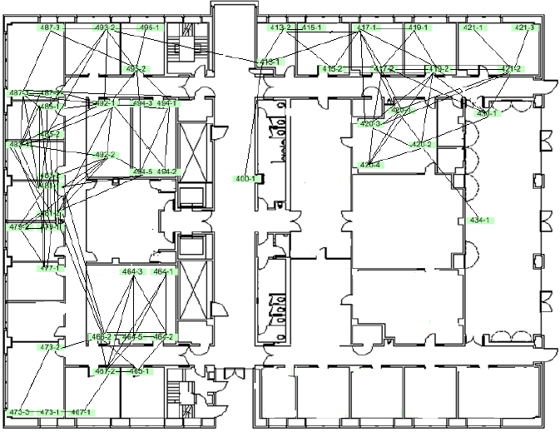
50-Node Indoor Office Testbed
GAME OVER
Only 68.2% of node pairs connected!!
What’s going on here?!

Slide 23
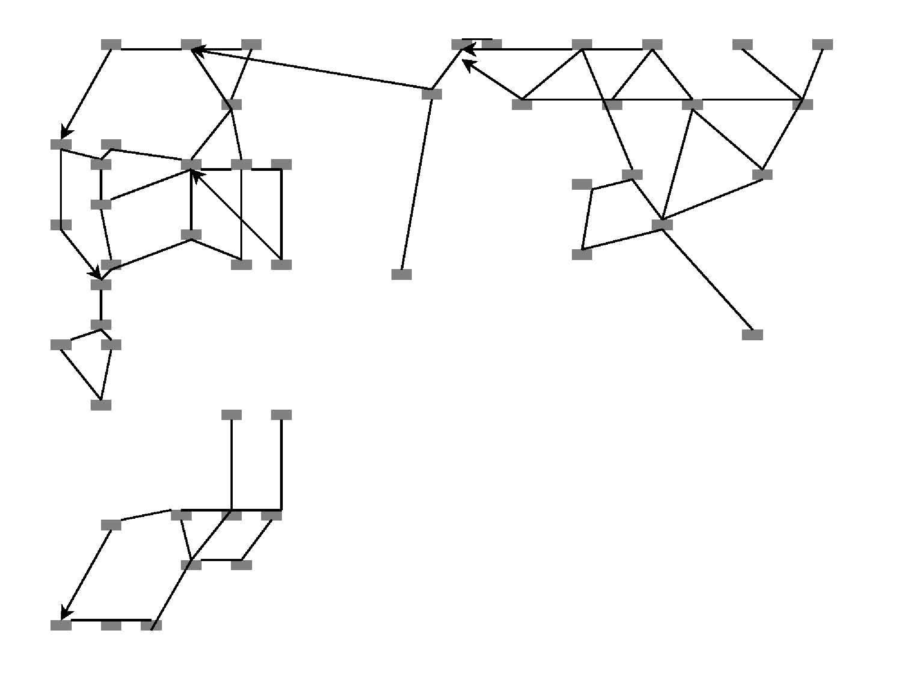
Planar, but Partitioned
Output of GPSR’s Distributed GG
(arrows denote unidirectional links)

Slide 24
Assumptions Redux
Bi-directional radio links (unidirectional links may be excluded)
Network nodes placed roughly in a plane
Unit Graph: Node always connected to all nodes within a fixed radio range, and none outside this range
Fixed, uniform radio transmitter power
Absorption, reflections, interference, antenna orientation differences, lead to non-unit graphs

Slide 25
Planarization Pathologies
w
w
u
v
u
v
?
?
x
Partitioned RNG
RNG w/Unidirectional Link

Slide 26
Face Routing Failure (Non-Planar)
Crossing links may cause face routing to fail

Slide 27
Cross-Link Detection Protocol (CLDP): Assumptions and Goals
Assumptions, revised:
  Nodes know their own positions in 2D coordinate system
  Connected graph
  Bidirectional links
  No assumption whatsoever about structure of graph
Seek a “planarization” algorithm that:
  never partitions graph
  always produces a routable graph; one on which GPSR routing never fails (may contain crossings!)

Slide 28
CLDP Sketch
Nodes explicitly probe each of their own incident candidate links to detect crossings by other links
  Probe packet follows right-hand rule; carries locations of candidate link endpoints
  Probe packet records first crossing link it sees en route
One of two crossing links “eliminated” when probe returns to originator
  Originator may mark candidate link unroutable OR
  Request remote crossing link be marked unroutable
Probe and data packets only traverse routable links

Slide 29
CLDP: A Simple Example
A
B
“(B, C) crosses (D, A)!”
“crossings of (D, A)?”
C
D
All links initially marked “routable”
Detected crossings result in link transition to “unroutable” (by D, or by B or C)
In a dense wireless network, most perimeters short (3 hops); most probes traverse short paths

Slide 30
CLDP and Cul-de-sacs
Cul-de-sacs give rise to links that cannot be eliminated without partitioning graph
Not all {edges, crossings} can be eliminated!
A
B
A
B
“(B, C) crosses
(D, A), but cannot be removed!”
“(B, C) crosses (D, A), but cannot be removed!”
“(B, C), (D, A) cannot be removed!”
C
D
C
D
Routable graphs produced by CLDP may contain crossings, but these crossings never cause GPSR to fail

Slide 31
Summary: CLDP Protocol
Link removable when a probe traverses either the link being probed (or its cross-link) in only one direction
If link L probed, crossing link L’ found:
  both L and L’ removable: remove L
  L removable, L’ not removable: remove L
  L not removable, L’ removable: remove L’
  neither L nor L’ removable: remove no link
Given a static, connected graph, CLDP produces a graph on which GPSR succeeds for all node pairs

Slide 32
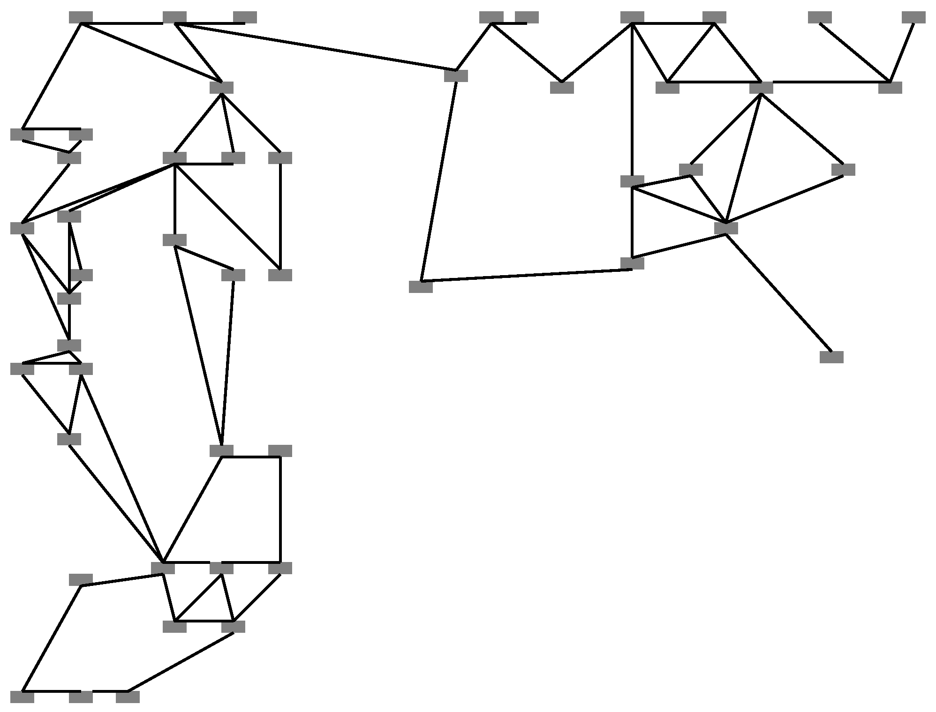
Meanwhile, back in the testbed…
GG
CLDP

Slide 33
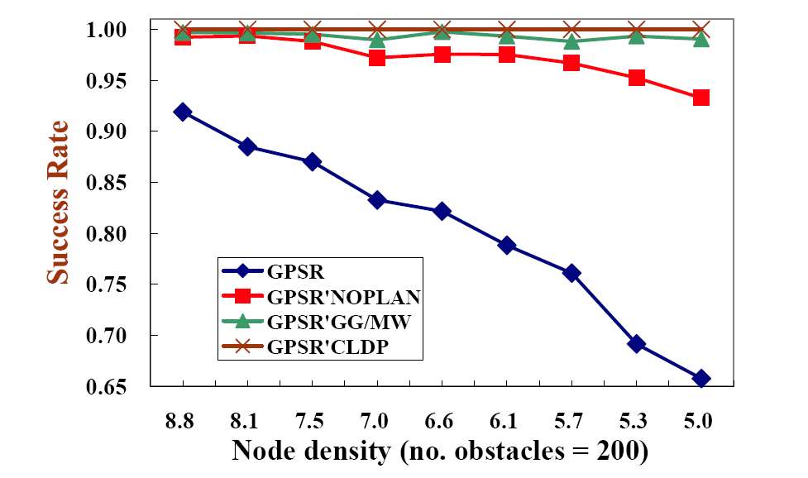
CLDP: Packet Delivery Success Rate
(200 Nodes; 200 Obstacles)

Slide 34
Geographic Routing: Conclusions
Resource constraints, failures, scale of deployment make design of sensornet systems hard
Geography a useful primitive for building sensor network applications (e.g., spatial queries)
Any-to-any routing, with GPSR and CLDP
  O(density) state per node, correct on all networks
Geographic routing an example of the difference between paper designs and building real systems!

Slide 35
Today
Geographic (Location-Based) Mesh Routing
Diversity Mesh Routing
  ExOR (Roofnet)
  Network Coding

Slide 36
Initial approach: Traditional routing
packet
packet
A
B
packet
src
dst
C
Identifies a route, forward over those links
Abstracts radio to look like a wired link

Slide 37
But radios aren’t wires
A
B
1
2
src
dst
2
2
3
3
3
4
4
4
5
5
5
6
6
1
6
1
2
3
4
5
6
1
C
Every packet is broadcast
Reception is probabilistic

Slide 38
ExOR: exploiting probabilistic broadcast
packet
packet
packet
packet
A
B
src
dst
packet
packet
packet
packet
packet
C
Decide who forwards after reception
Goal: only closest receiver should forward
Challenge: agree efficiently, avoiding duplicate xmits

Slide 39
Why ExOR might increase throughput? (1)
src
N1
N2
N3
N4
N5
dst
75%
50%
25%
Throughput ≅ ¹/_{# transmissions}
Best traditional route is over the 50% hops: 3(¹/_{0.5}) = 6 tx
ExOR exploits lucky long receptions
ExOR recovers unlucky short receptions

Slide 40
Why ExOR might increase throughput (2)
N1
25%
100%
N2
25%
100%
src
dst
25%
N3
100%
25%
100%
N4
Traditional routing: ¹/_{0.25} + 1 = 5 tx
ExOR: ¹/(1 – (1 – 0.25)⁴) + 1 ≈ 2.5 transmissions
Diversity of links, paths in mesh networks

Slide 41
ExOR packet batching
rx: 0
rx: 40
rx: 57
rx: 85
tx: 0
N2
N4
tx: 100
tx: 57 -23
≅ 24
rx: 0
tx: ≅ 9
rx: 22
src
dst
rx: 88
rx: 99
rx: 23
N1
N3
rx: 53
tx: ≅ 8
tx: 23
Finding the closest receiver involves coordination overhead
  Want to avoid paying this overhead once per packet
Idea: Send batches of packets to amortize overhead
Node closest to the destination sends first
  Other nodes listen, send just the remaining packets in turn
Repeat schedule until destination has whole batch

Slide 42
The forwarder list establishes transmit order
N2
N4
src
dst
N1
N3
priority:
low medium high
One node sends at a time, highest priority first
Source includes a forwarder list in ExOR header
  The forwarder list is sorted by path ETX metric to dst
    Link ETX: Expected number of transmissions required
    Nodes periodically flood link ETX measurements
    Path ETX is weighted shortest path (Dijkstra’s algorithm)

Slide 43
Batch maps track who received what
tx: {2, 4}
batch map: {1→N3, 2→N2, 4→N2, 6→N3}
batch map: {1→N2, 2→N2, 4→N2}
N2
N4
src
dst
N1
N3
tx: {1, 6}
batch map: {1→N3, 6→N3}
Nodes include a batch map in every data packet header
  For each packet, batch map gives highest priority node known to have received a copy of that packet
  Nodes suppress packets higher priority node received
  Allows source to receive acknowledgement

Slide 44
Completion
If node’s batch map indicates higher priority node has received > 90% of the batch, it remains quiet
Removes excessive overhead due to “straggler” packets that get unlucky due to wireless conditions
ExOR routing itself only guarantees > 90% delivery
Destination requests remaining < 10% packets via traditional routing

Slide 45
Transmission timeline
priority:
high
low
dest
src
src
N17
N5
N20
N24
N13
N11
N8
N18
dest
priority:
low medium high

Slide 46
ExOR uses more links in parallel
Traditional: 3 forwarders, 4 links
ExOR: 7 forwarders, 18 links

Slide 47
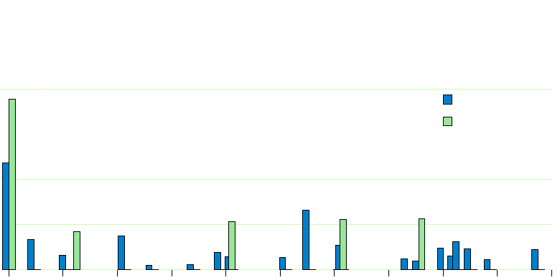
ExOR moves packets farther
58% of Traditional routing transmissions
0.6
ExOR
Traditional Routing
Fraction of Transmissions
0.2
25% of ExOR transmissions
0.1
0
0
100
200
300
400
500
600
700
800
900
1000
Distance (meters)
ExOR average: 422 meters/tx Traditional: 205 meters/tx

Slide 48
Today
Geographic (Location-Based) Mesh Routing
Diversity Mesh Routing
  ExOR (Roofnet)
  Network Coding

Slide 49
Network Coding
ExOR uses a global scheduler
  Requires coordination: Every node knows who received what
  Only one node transmits at a time, others listen
Network Coding Idea: Nodes do not relay received packets verbatim
  Instead combine several packets together to send in one single transmission

Slide 50
Random Linear Codes
P₁
R1
α P₁+ ß P₂
P₂
src
dst
P₁
R2
γ P₁+ δ P₂
P₂
Each router forwards random linear combinations of packets
  Randomness makes duplicates unlikely
  No scheduler; No coordination
    Simple, better exploits spatial reuse

Slide 51
Network Coding: Multicast example
P₁
P₂
src
P₃
P₄
dst1
dst2
dst3
P₁
P1
P1
P₂
P₂
P2
P3
P₃
P₃
P4
P4
P₄
Without coding → source retransmits all 4 packets

Slide 52
Network Coding: Multicast Example
Random combinations
P₁
P₂
8 P₁+5 P₂+ P₃+3 P₄
src
P₃
7 P₁+3 P₂+6 P₃+ P₄
P₄
dst1
dst2
dst3
P₁
P1
P1
P₂
P₂
P2
P3
P₃
P₃
P4
P4
P₄
With random coding → 2 packets are sufficient

Slide 53
Choice of Coding Matters
Goal: P1→A
P2,P3→C
P4→D
P4
P1
B’s Output Queue
C’s Packet Pool
P4
P3
P2
P1
C
P2
A
B
=
P1
+
P2
P4
P3
A’s Packet Pool
D
Bad coding decision:
A & D cannot decode,
C can’t decode P3!
D’s Packet Pool
P3
P1

Slide 54
Choice of Coding Matters
Goal: P1→A
P2,P3→C
P4→D
P4
P1
B’s Output Queue
C’s Packet Pool
P4
P3
P2
P1
C
P3
P1
A
B
=
P1
+
P3
P4
P3
A’s Packet Pool
D
Better coding decision,
A & C can decode.
D’s Packet Pool
P3
P1

Slide 55
Choice of Coding Matters
Goal: P1→A
P2,P3→C
P4→D
P4
P1
B’s Output Queue
C’s Packet Pool
P4
P3
P2
P1
C
P3
P1
A
B
=
P1
+
P3
+
P4
P4
P3
D
P4
A’s Packet Pool
Best coding decision,
A, C & D can decode!
D’s Packet Pool
P3
P1

Slide 56
Network coding: Caveats
Practical throughput gains over ExOR / traditional routing:
  With static nodes
  Traffic quantities need to be large enough
    Delay increases (batching)
  Opposing flows need to exist in some traffic topologies

Slide 57
Thursday Topic:
[463 Part II: Overcoming Bit Errors]
Detecting and Correcting Errors
Next Week’s Precepts:
Lab 2 Introduction

