Slide 1
Link Layer I: Link Establishment,
Medium Access Control
COS 463: Wireless Networks
Lecture 4
Kyle Jamieson

Slide 2
Review: The Data Link Layer (L2)
Enables exchange of atomic messages (frames) between end hosts on the same network
Functions in L2:
  Determine start and end of bits and frames (framing)
  Establish link and deliver information reliably
    Today: How Wi-Fi establishes a link
  Control errors
  If needed, share the medium
    e.g., Shared-wire Ethernet, satellite uplink, Wi-Fi
    Today: Medium access control to share the medium

Slide 3
Motivation: Link-Layer Handoff
TCP Connection
Server
Internet
AP 1
Wired local-area network
AP 2
Client
How to minimize TCP segment loss, TCP timeouts?
Client moves out of AP 1’s coverage, into AP 2’s coverage
Ongoing TCP connections between client and server

Slide 4
Connecting to a Wi-Fi AP
Notion of link-layer network: an Access Point (AP) and a set of connected clients
  Named by the service set identifier (SSID)
  APs generally drop data from clients, APs outside the set
How is the wireless link connection established?
Discovery: Client detects presence of AP
Authentication: Establish identity of AP, client
Association: Establish shared state between AP, client

Slide 5
1. Discovery
How do clients find access points, and vice-versa?
Access Points (APs) send short beacon frames every 100 milliseconds
Clients scan to discover the AP. Two ways:
Passive scan: Switch channels, listen for beacons, wait, repeat on another channel
Active scan: Send packets to probe for the AP’s presence

Slide 6
Discovery: Active scan
Don’t want to wait ca. 100 milliseconds for the next beacon from an AP that may or may not be present
Active scan protocol: On each channel:
Client broadcasts probe request frame
AP responds with probe response frame containing its SSID (network name), data rates supported
  Multiple APs may respond
Clients chooses AP to continue with

Slide 7
2. Authentication
AP establishes its identity to the client, and vice-versa
  A security problem!
Open system authentication: Trivial, client sends authentication frame, AP responds “success”
Shared key authentication: Configure both client and AP with a shared secret key
  Doesn’t scale too well
Enterprise authentication: Use public key certificates, akin to web site authentication

Slide 8
3. Association
The “commit” step that establishes shared AP-client state
Client sends association request frame to AP
AP sends association response frame to client
Data now may flow, both to the AP (uplink) and to the client (downlink)

Slide 9
Initiating The Wi-Fi Handoff
Server
Back to the handoff example:
!!
How is the handoff initiated?
Client tracks received signal strength from AP’s frames
  Client initiates handoff if and when signal strength falls below a threshold

Slide 10
Wi-Fi Handoff Process: High-Level View
Discovery step
  Same as before
Server
Authentication step
  Same as before
Reassociation step
  Replaces association step of the connection process discussed before

Slide 11
Wi-Fi Handoff: Reassociation
Inter-Access Point Protocol (IAPP)
Server
3
2
4
1
Reassociation Request: Client asks new AP to connect
  Supplies old AP identifier
IAPP Move request: New AP asks for old AP’s state
IAPP Move response: Old AP supplies state to new AP
Reassociation Response: “Commit” step, data may flow

Slide 12
Reassociation: Latency
For how long is the client’s link-layer connection interrupted?
  This time duration is the reassociation latency
Beginning: frames get dropped from old AP
  Imprecise: Link-layer retransmissions recover some losses
End: Reassociation protocol completes with new AP
  Precise: Reassociation response message received

Slide 13
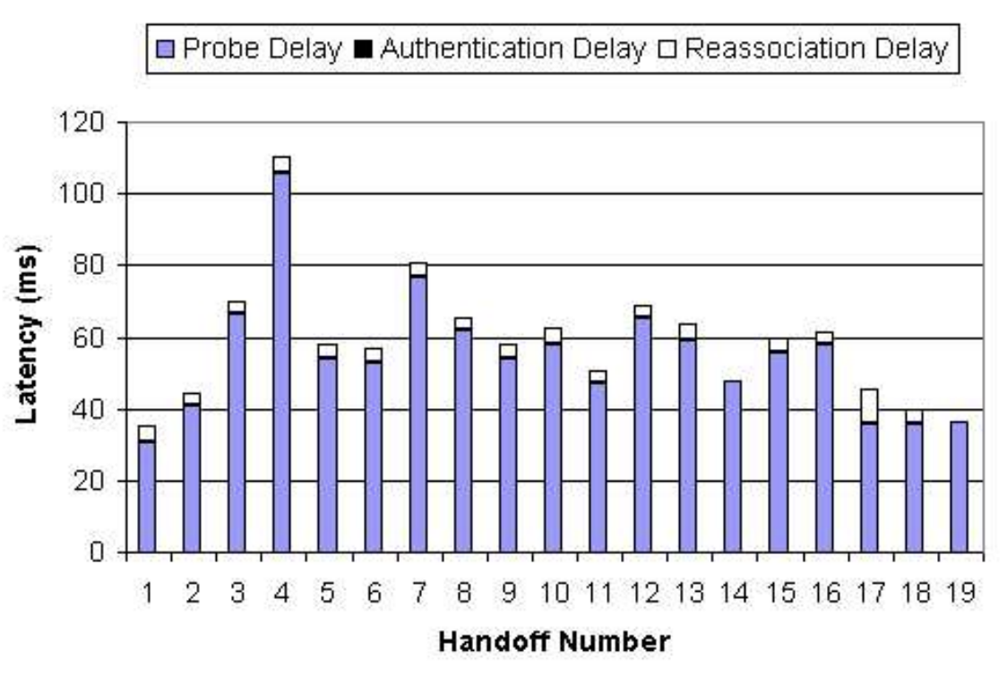
802.11 Reassociation Performance
[Mishra et al., 2003]
Conventional 802.11 reassociation takes ca. 40 to 100 ms
  Long enough to trigger TCP duplicate ACKs, timeouts

Slide 14
Improvements to Wi-Fi Handoff
Wi-Fi standard 802.11r: Fast Roaming
  Store encryption keys on all APs in the network
    So no need for client to perform complete authentication process on reassociation
Wi-Fi Standard 802.11k: Assisted Roaming
  AP tells client a list of nearby other APs and their channels
    So no need for the client to scan

Slide 15
Medium Access Control
Sharing by partitioning the medium
  Introduction, Time and Frequency division
  Code division
Contention-based sharing
  ALOHA
  The Ethernet

Slide 16
Medium access: The Problem
Two questions:
  How should the shared medium be divided?
  Who gets to talk on a shared medium, and when?
A medium access control (MAC) protocol specifies the above

Slide 17
Medium access: Metrics of Success
Efficiency
  High throughput (bits/second successfully received)
    i.e. high utilization (throughput / raw channel rate)
Fairness: All hosts with data to send should get a roughly equal share of the medium over time
Latency: Want to minimize the time a host waits before being granted permission to talk on the shared medium

Slide 18



Physical Limitation: Finite speed of light
From Princeton to...
Geosynchronous Satellite (one way)
100 ms
Yellowstone
Washington,
D.C.
10 ms
1 ms
Mobile
Base station
Trenton
100 μs
1 μs
Wi-Fi AP
10−100 ns
3−30 m
300 m
30 km
300 km
3,000 km
30,000 km

Slide 19
Vastly Different Timescales,
Same Medium Access Protocol!
Satellite Communications
100 ms
Packet Radio
(ALOHA net)
3G/4G Cellular
Data
1 ms
1 μs
Wi-Fi
10−100 ns
3−30 m
300 m
300 km
30,000 km

Slide 20
TDMA: Time Division Multiple Access
Channel time is divided fixed-period, repeating rounds
Each user gets a fixed-length slot (packet time) in each round (unused slots are wasted)
Out-of-band: Mechanism for allocating/de-allocating slots
e.g.: six stations, only 1, 3, and 4 have data to send
6-slot
round
1
3
4
1
3
4
Time

Slide 21
FDMA: Frequency Division Multiple Access
Channel spectrum divided into frequency bands
Each user gets a fixed frequency band (unused frequency slots are wasted)
e.g.: six stations, only 1, 3, and 4 have data to send
time
frequency bands
FDM cable

Slide 22
TDMA and FDMA: Considerations
Advantages
Users are guaranteed to be able to send bits, continuously (FDMA) or periodically (TDMA)
Disadvantages
Unused time slots or frequency bands reduce channel utilization
An out-of-band mechanism is needed to allocate slots or bands (which requires another channel)
Guard bands or guard times reduce channel utilization

Slide 23
Medium Access Control
Sharing by partitioning the medium
  Introduction, Time and Frequency division
  Code division
Contention-based sharing
  ALOHA
  The Ethernet

Slide 24
CDMA: Code Division Multiple Access
All users transmit over the same frequencies, and at the same time:
Allows multiple users to coexist and transmit simultaneously with no interference, in theory
In practice: also performs well
  Some cellular data networks have used CDMA
Okay!
Cathy
Alice
(CDMA)
Bob

Slide 25
Representing bits as binary levels
Let’s represent bits with two (binary) levels as follows:
  0 bit ←→ +1 level 1 bit ←→ −1 level
Scenario: Alice receives data from Bob and Cathy:
  TDMA e.g.: Bob sends bits 101, Cathy sends 001:
Cathy
Alice
Bob
+1
time
−1
TDMA timeslots:
Bob
Cathy
TDMA timeslots:

Slide 26
CDMA: User codes
Cathy
Alice
Bob
Assign each user a unique binary sequence of bits: code
  Call each code bit a chip (convention)
  Call the code length M
CDMA example:
+1
+1
time
−1
−1
Bob’s code c^{bob}
Cathy’s code c^{cathy}

Slide 27
CDMA: Cathy Sending
Cathy
Alice
Bob
Suppose Cathy alone sends message bits 001:
Cathy’s message
Algorithm (CDMA encoding):
For each message bit m:
Send m × c^{user}
+1
time
−1
L data bits → M × L CDMA chips
Bit rate: Factor of M slower
c^{cathy}:
+1
Cathy’s transmitted
CDMA signal:
−1

Slide 28
CDMA: Assumptions
Cathy
Alice
Bob
Let’s assume we have a way of:
  Synchronizing Cathy’s and Bob’s data bits in time
  Synchronizing Cathy’s and Bob’s CDMA chips in time
  Estimating and correcting the effect of the wireless channel between Cathy and Bob to Alice

Slide 29
What Alice Hears
Cathy
Alice
Bob
+1
Bob’s transmitted
CDMA signal:
−1
Cathy’s transmitted
CDMA signal:
+1
−1
+2
+1
What Alice hears:
−1
Result: Neither Bob nor Cathy’s signal – interference!
−2

Slide 30
Tool: Correlation
+1
Algorithm (correlation):
Multiply two signals pointwise, across time
Sum the result across time
Normalize (divide) by the signal length
Bob’s code c^{bob}
−1
Cathy’s code c^{cathy}
+1
−1
Sum: 0
→ Correlation: 0
2. Sum across time
3. Normalize (÷2)
1. Multiply pointwise:
+1
−1

Slide 31
Tool: Correlation
Algorithm (correlation):
Multiply two signals pointwise, across time
Sum the result across time
Normalize (divide) by the signal length
Cathy’s code c^{cathy}
+1
−1
Cathy’s code c^{cathy}
+1
−1
Sum: 2
→ Correlation: 1
2. Sum across time
3. Normalize (÷2)
1. Multiply pointwise:
+1
−1

Slide 32
Correlating Cathy’s Code with
Cathy’s CDMA transmission
Cathy’s transmission
+1
−1
corr
Cathy’s code c^{cathy}
+1
−1
+1
Correlation
−1
Cathy sent: 0 0 1

Slide 33
Listening to Cathy
Cathy
Alice
Bob
Alice hears a mixture
Bob’s transmission
Cathy’s transmission
+2
+1
+1
+1
−1
−1
−1
−2
corr
Cathy’s code c^{cathy}
+1
Zero-correlation with Bob’s code cancels Bob’s transmission from the mixture
−1
+1
Correlation
−1
Cathy sent: 0 0 1

Slide 34

CDMA: How to choose codes?
Let’s generalize the Alice, Bob, Cathy scenario:
  N users, each user n has code $c_{m}^{n}$, n = 1...N
    (m = 1...Code length M)
Goal: Ensure cancellation of all other users when correlating against (each) one
Zero mutual correlation condition: $c_{m}^{n_{1}}$ ★ $c_{m}^{n_{2}}=0, n_{1}≠n_{2}$
User 3
...
User N
User 2
AP
User 1

Slide 35
Example CDMA code: Walsh Codes
Start with the Bob / Cathy code, write as rows in a matrix
$$\left[\begin{matrix}c^{bob} \\ c^{cathy}\end{matrix}\right]=\left[\begin{matrix}1 & 1 \\ 1 & −1\end{matrix}\right]$$
Recursive rule: given matrix M, form $\left[\begin{matrix}M & \text{M} \\ M & −\text{M}\end{matrix}\right]$
e.g. four users:
$$\left[\begin{matrix}\begin{matrix}c^{1} \\ c^{2}\end{matrix} \\ \begin{matrix}c^{3} \\ c^{4}\end{matrix}\end{matrix}\right]=\left[\begin{matrix}1 & 1 & 1 & 1 \\ 1 & −1 & 1 & −1 \\ 1 & 1 & −1 & −1 \\ 1 & −1 & −1 & 1\end{matrix}\right]$$

Slide 36
CDMA: Considerations
CDMA advantages:
  Sending over entire channel frequency bandwidth
    Some parts of frequency band interfered? Okay!
FDMA, TDMA, CDMA disadvantages:
  Rigid allocation of channel resources, requires advance coordination (frequency, time, code)
  Partitioning the channel → reduced rate
Can we have the best of both worlds, perhaps?

Slide 37

Stretch Break with CDMA Calculation!
Recall the two-user Walsh code $\left[\begin{matrix}c^{bob} \\ c^{cathy}\end{matrix}\right]=\left[\begin{matrix}1 & 1 \\ 1 & −1\end{matrix}\right]$, and recursive rule: given matrix M, form $\left[\begin{matrix}M & \text{M} \\ M & −\text{M}\end{matrix}\right]$ to double the number of users in the system.
What’s the second user’s Walsh code
in an eight-user CDMA system?

Slide 38
Medium Access Control
Sharing by partitioning the medium
  Introduction, Time and Frequency division
  Code division
Contention-based sharing
  Unslotted ALOHA, Slotted ALOHA
  The Ethernet

Slide 39
Contention-based sharing
When a station has a frame to send:
  Transmit at full channel data rate B
  No a priori coordination among nodes
Two or more frames overlapping in time: collision
  Both frames lost, resulting in diminished throughput
A random access MAC protocol specifies:
  How to detect collisions
  How to recover from collisions

Slide 40
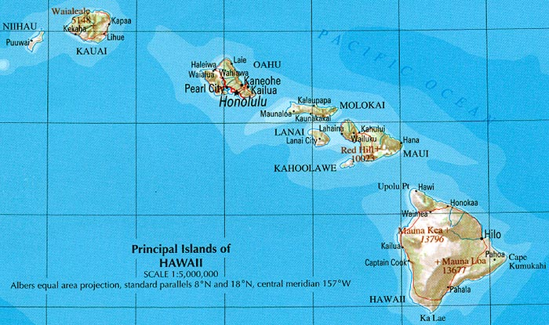
ALOHAnet: Context
Norm Abramson, 1970 at the University of Hawaii
  Seven campuses, on four islands
  Wanted to connect campus terminals and mainframe
  Telephone costs high, so built a packet radio network

Slide 41
Unslotted ALOHA
Simplest possible medium access control: no control at all, anyone can just transmit a packet without delay
Suppose: Chance packet begins in time interval Δt is λ × Δt
  N senders in total, sending frames of time duration 1
λ is the aggregate rate from all N senders
Individual rate λ/N for each sender

Slide 42
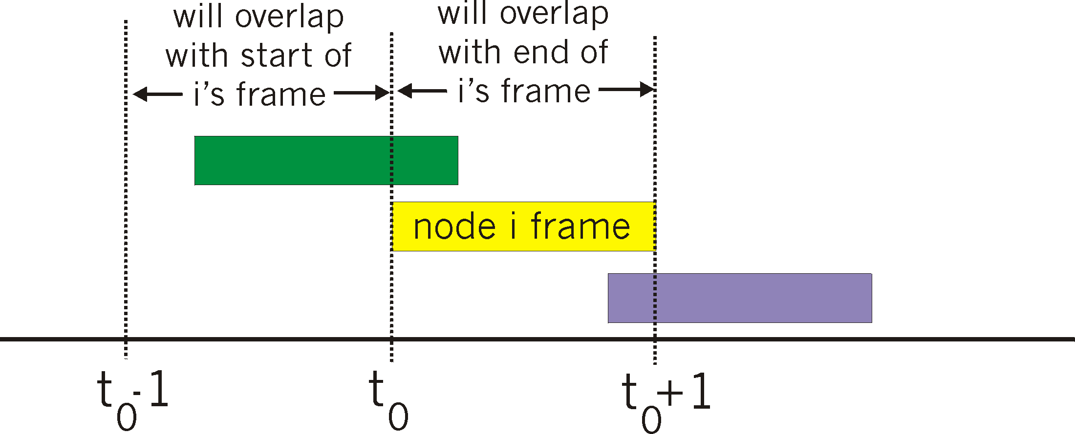
Unslotted ALOHA: Performance
Suppose some node i is transmitting; let’s focus on i ’s frame
Vulnerable period
Others send in [t₀−1, t₀]: overlap i ’s frame start → collision
Others send in [t₀, t₀+1]: overlap i ’s frame end → collision
Otherwise, no collision, node i ’s frame is delivered
Therefore, vulnerable period of length 2 around i ’s frame

Slide 43
Unslotted ALOHA: Performance
Vulnerable period
What’s the chance no one else sends in the vulnerable period (length 2)?

Slide 44
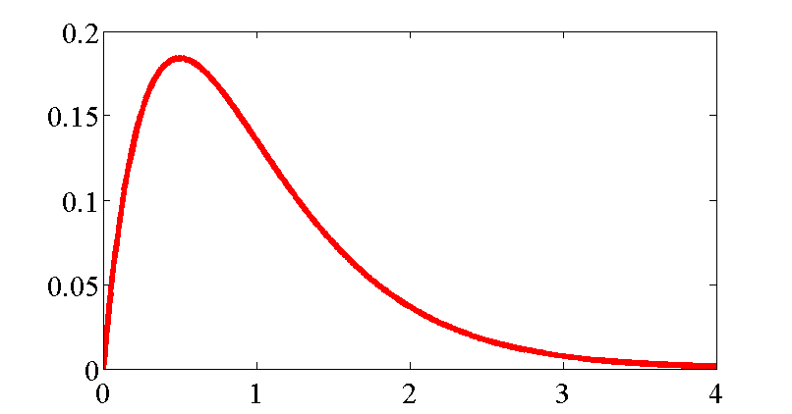
Unslotted ALOHA: Utilization
Utilization
Too many collisions!
1/2e ≈ 18%
Not sending fast enough
λ
Recall λ is the aggregate rate from all senders
  So, utilization = λ × Pr(no other transmission in 2)
= λe^{−2λ}

Slide 45
Slotted ALOHA
Divide time into slots of duration 1, synchronize so that nodes transmit only in a slot
  Each of N nodes transmits with probability p in each slot
  So aggregate transmission rate λ = N × p
As before, if exactly one transmission in slot, can receive; if two or more in slot, no one can receive (collision)
...
Node N

Slide 46
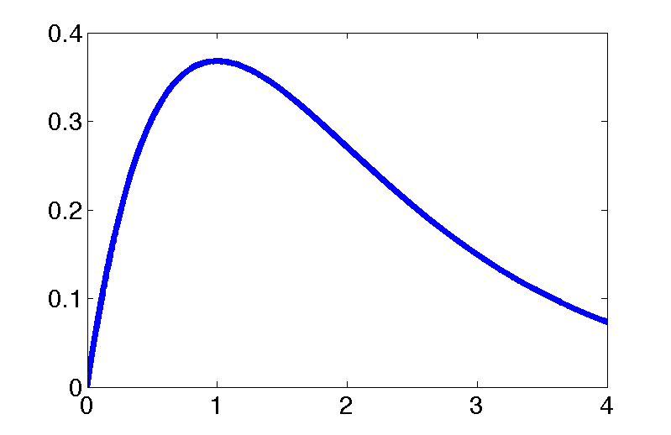
Slotted ALOHA: Utilization
(N nodes, each transmits with probability p in each slot)
What is the utilization as a function of aggregate rate λ = N × p?
Pr[A node is successful in a slot] = p(1−p)^{N−1}
Pr[Success in a slot] = Np(1−p)^{N−1}
Utilization:
λe^{-λ}
1/e ≈ 37%
λ

Slide 47
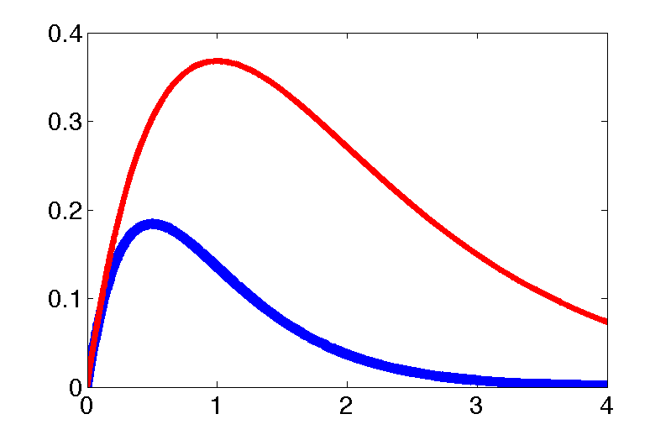
ALOHA throughput: slotted versus unslotted
1/e ≈ 36%
Slotted ALOHA: λe^{−λ}
1/2e ≈ 18%
Unslotted ALOHA: λe^{−2λ}
Just by forcing nodes to transmit on slot boundaries, we double peak medium utilization!

Slide 48
Medium Access Control
Sharing by partitioning the medium
  Introduction, Time and Frequency division
  Code division
Contention-based sharing
  Unslotted ALOHA, Slotted ALOHA
  The Ethernet

Slide 49
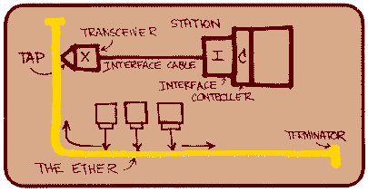
How did the Ethernet get built?
Bob Metcalfe, PhD student at Harvard in early 1970s
  Working on protocols for the ARPAnet
  Intern at Xerox Palo Alto Research Center (PARC), 1973
  Needed a way to network ≈100 Alto workstations in-building
  Adapted ALOHA packet radio
Metcalfe later founds 3Com, acquired by HP in April ’10 for USD $2.7 bn

Slide 50

The Ethernet: Physical design
Coaxial cable, with propagation time τ
  Propagation speed: 3/5 × speed of light
Experimental Ethernet
  Data rate: B = 3 Mbits/s, maximum length: 1000 m
Goal: Any frame a station injects onto the coaxial cable reaches all other stations with high probability
Propagation delay

Slide 51
Collisions on the Ethernet
A
B
C
Z
Propagation delay: τ seconds
Two Problems:
Sender doesn’t know whether frame collided or not
Sender doesn’t know who received a colliding frame
Packet of size N bits: N/B seconds on the wire
Overlapping packets at B means signals sum
  Not time-synchronized: result is bit errors at B
But: C receives OK in this example

Slide 52
Who gets to transmit, and when?
Carrier Sense Multiple Access
with Collision Detection (CSMA/CD)
Begin the transmission procedure at any time
Carrier sensing: defer your transmission if you sense that another station is transmitting
Collision detection: while sending, immediately abort your transmission if you detect another station transmitting

Slide 53
When might a collision happen?
Suppose Station A begins transmitting at time 0
Assume that the packet lasts much longer than τ
All stations sense transmission and defer by time τ
  Don’t begin any new transmissions
A
B
C
Z
Propagation delay: τ seconds

Slide 54
How long does a collision take to detect?
A
B
C
Z
Propagation delay: τ seconds
Suppose Station A begins transmitting at time 0
Worst case: Z begins transmitting just before time τ
Just before time 2τ, A and B hear Z’s transmission (hence detect collision)

Slide 55
Collision detection and packet size
A
B
C
Z
Propagation delay: τ seconds, transmit rate B bits/sec
If packets take time 2τ, A will still be transmitting when Z’s packet arrives at A, so everyone will detect collision
So Ethernet enforces a minimum packet size of 2τB bits
  Experimental Ethernet:
    τ = 5 μs, B = 3 Mbits/s → 2τB = 30 bits

Slide 56
Resolving collisions
Upon abort (carrier detect), station enters the backoff state
Key idea: the colliding stations all wait a random time before carrier sensing and transmitting again
  How to pick the random waiting time? (Should be based on how stations have data to send)
  How to estimate the number of colliding stations?
Goal: Engineer such that nodes will wait different amounts of time, carrier sense, and not collide

Slide 57
Slotted Ethernet backoff
Backoff time is slotted (like slotted ALOHA) and random
  Station’s view of the where the first slot begins is at the end of the busy medium
  Random slot choice in contention window (CW)
Goal: Choose slot time so that different nodes picking different slots CS and defer → don’t collide

Slide 58
Picking the length of a backoff slot
Consider from the perspective of one packet at time t
  Packets before t−τ will cause packet to defer
  Packets after t+τ will not happen (why not?)
Packets beginning within time τ apart will collide
So should we pick a backoff slot length of τ?
OK
Bad
OK
τ
τ
Cause defer
CS fail
(Won’t happen)

Slide 59
The problem of clock skew
No! Slots are timed off the tail-end of the last packet
  Therefore, stations’ clocks differ by at most τ
Suppose we use a backoff slot length of τ
  Different stations picking different slots may collide!
0
1
2
OK
τ
τ
OK
Δ
Station A, slot 1
τ
τ
Station B, slot 0
0
1
2

Slide 60
Picking slot time in presence of clock skew
Want other station’s other slots to all be in “OK” region
  Then, transmissions in different slots won’t collide
  Worst case clock skew: τ
  So, pick a slot time of τ + τ = 2τ
0
1
2
OK
OK
τ
2τ
2τ
0
1
2

Slide 61
Binary Exponential Backoff
Binary exponential backoff (BEB): double CW size on each consecutive collision
Stations wait some number of slots chosen uniformly at random from CW = [0, 2^{m}−1]
  Reset m ← 1 upon a successful transmission
  First retransmit (m = 1): pick from [0, 1]
  Second retransmit (m = 2): pick from [0, 1, 2, 3]
Observe: Stations transmitting new frames don’t take into account recent collisions, might transmit before stations in backoff

Slide 62
Comparing CDMA vs ALOHA random access
CDMA wireless
  No interference between transmitting stations
  Adaptation to varying numbers of users possible by changing codes
  Reduced rate of individual transmissions
  Unused codes waste overall capacity
ALOHA random access
  Stations can transmit using the entire medium, at full rate if alone
  Almost-instant adaptation to varying traffic loads
  Concurrent transmissions result in collisions, reduced throughput

Slide 63
Monday, Tuesday Precepts
Introduction to Lab 1
Tuesday Topic:
Link Layer II: Sharing the Medium,
Wi-Fi Above the PHY

Slide 64
Building the link: Framing bits
Goal: Move bits from one computer to another
  Sender and receiver have independent clocks
  No separate “clock signal” sent on the Ethernet
Problem: Agree on clock tick period
Problem: Agree on clock tick alignment (phase)

Slide 65
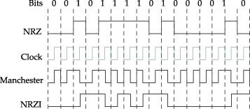
Manchester (phase) encoding
Raw
Manchester encoding = Raw bit signal ⨁ Clock signal
  Result: “0” is a low-to-high transition; “1” is a high-to-low
Transition guaranteed on every bit, so receiver can bit-synchronize based on the encoding alone
Drawback: Halves data rate

Slide 66
Ethernet: Framing and Error Detection
Preamble
Destination
Source
Data
Checksum
8 bits
8 bits
4000 bits
16 bits
Framing individual frames
  Beginning of frame determined by presence of carrier
  End of frame determined by absence of carrier
  Preamble: 101010 produces square wave (receiver sync)
Destination address allows filtering at the link layer
Checksum over whole packet payload
  Protects against errors on coax but not against errors from tap itself (rely on higher layers; E2E argument)

Slide 67
Carrier sensing
Mechanism: measure voltage on the wire
Binary encoding: voltage depends on the data
Manchester coding: constant average voltage

Slide 68
Collision detection
A
B
C
Z
Propagation delay: τ seconds
Paper isn’t clear on this point (authors did have a patent in the filing process)
Mechanism: monitor average voltage on cable
  Manchester encoding means your transmission will have a predictable average voltage V₀; others will increase V₀
  Abort transmission immediately if V_{measured} > V₀

