Slide 1
End-to-End Transport Over Wireless I:
Preliminaries, Split Connection
COS 463: Wireless Networks
Lecture 2
Kyle Jamieson
[Various parts adapted from S. Das, B. Karp, N. Vaidya]

Slide 2
Today
Layering and the End-to-End Argument
Transmission Control Protocol (TCP) primer
Split Connection TCP over wireless

Slide 3
Layering: Motivation
Applications
Web
Skype
SSH
FTP
?
Transmission
media
Coaxial cable
Fiber optic
Wi-Fi
Re-implement every application for every new underlying transmission medium?
  Change every application on any change to an underlying transmission medium (and vice-versa)?
No! But how does the Internet design avoid this?

Slide 4
Internet solution: Intermediate layers
Applications
HTTP
Skype
SSH
FTP
Intermediate layers
Transmission
media
Coaxial cable
Fiber optic
Wi-Fi
Intermediate layers provide a set of abstractions for applications and media
New applications or media need only implement for intermediate layer’s interface

Slide 5
Properties of layers
Application
Service: What a layer does
Service interface: How to access the service
  Interface for the layer above
Transport
Network
Link
Physical
Protocol interface: How peers communicate to implement service
  Set of rules and formats that govern the communication between two Internet hosts

Slide 6
Physical layer (L1)
Service: Move bits between two systems connected by a single physical link
Interface: specifies how to send, receive bits
  e.g., require quantities and timing
Protocols: coding scheme used to represent bits, voltage levels, duration of a bit

Slide 7
Data link layer (L2)
Service: End hosts exchange atomic messages
  Perhaps over multiple physical links
    But using same framing (headers/trailers)
  Arbitrates access to common physical media
  Implements reliable transmission, flow control
Interface: send messages (frames) to other end hosts; receive messages addressed to end host
Protocols: Addressing, routing, medium access control

Slide 8
Network layer (L3)
Service: Deliver datagrams to other networks
  Cross-technology (e.g., Ethernet, 802.11, optical, …)
  Possibly includes packet scheduling/priority
  Possibly includes buffer management
  Best effort service: may drop, delay, duplicate datagrams
Interface:
  Send packets to specified internetwork destination
  Receive packets destined for end host
Protocols:
  Define inter-network addresses (globally unique)
  Construct routing tables and forward datagrams

Slide 9
Transport layer (L4)
Service: Provide end-to-end communication between processes on different hosts
  Demultiplex communication between hosts
  Possibly reliability in the presence of errors
  Rate adaptation (flow control, congestion control)
Interface: send message to specific process at given destination; local process receives messages sent to it
Protocol: perhaps implement reliability, flow control, packetization of large messages, framing

Slide 10
Who does what?
Five layers
  Lower three layers are implemented everywhere
  Top two layers are implemented only at end hosts
    Their protocols are end-to-end
Application
Application
Transport
Transport
Network
Network
Network
Link
Link
Link
Physical
Physical
Physical
Host A
Router
Host B

Slide 11
Logical communication
Each layer on a host interacts with its peer host’s corresponding layer via the protocol interface
Application
Application
Transport
Transport
Network
Network
Network
Link
Link
Link
Physical
Physical
Physical
Host A
Router
Host B

Slide 12
Physical path across the Internet
Communication goes down to physical network
Then from network peer to peer
Then up to the relevant layer
Application
Application
Transport
Transport
Network
Network
Network
Link
Link
Link
Physical
Physical
Physical
Host A
Router
Host B

Slide 13
Protocol multiplexing
Multiplexing: Multiple overlying protocols share use of a single underlying protocol
Problem: How does the underlying protocol decide which overlying protocol messages go to?
Applications
Applications
TCP
UDP
TCP
UDP
???
Network
Network
Host A
Host B

Slide 14
Protocol headers
Each layer attaches its own header (H) to facilitate communication between peer protocols
On reception, layer inspects and removes its own header
  Higher layers don’t see lower layers’ headers
Application
data
data
Application
Transport
H
data
H
data
Transport
Network
H
H
data
H
H
data
Network
Link
H
H
H
data
H
H
H
data
Link
Physical
H
H
H
H
data
H
H
H
H
data
Physical
Host A
Host B

Slide 15

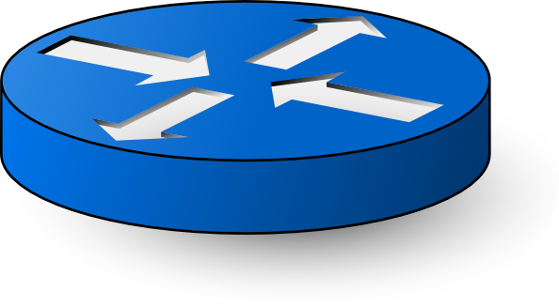
Encapsulation in the Internet
message
data
application
segment
H
data
transport
datagram
H
H
data
Host A
network
frame
H
H
H
data
link
frame
H
H
H
H
data
physical
H
H
H
data
link
H
H
H
data
H
H
H
H
data
physical
data
application
H
data
transport
L2 Switch
Host B
H
H
data
network
H
H
H
data
link
H
H
H
H
data
physical
H
H
data
network
H
H
data
H
H
H
data
link
H
H
H
H
data
physical
L3 Router

Slide 16
Protocol demultiplexing
message
data
application
segment
H
data
transport
datagram
H
H
data
Host A
network
application
H
data
transport
Host B
Applications
H
H
data
network
TCP
UDP
???
Lower-layer header contains demultiplexing information
Network header contains Protocol field specifying overlying protocol
Network
Host B

Slide 17
Drawbacks of layering
Layer n may duplicate lower level functionality
  e.g., error recovery to retransmit lost data
Layers may need same information in headers
  e.g., timestamps, maximum transmission unit size
Layering can hurt performance
  e.g., previous lecture

Slide 18
Layer violations
Two types:
Overlying layer examines underlying layer’s state
  e.g., transport monitors wireless link-layer to see whether packet loss from congestion or corruption
Underlying layer inspecting overlying layer’s state
  e.g., firewalls, NATs (network address translators), “transparent proxies”

Slide 19
Today
Layering and the End-to-End Argument
  Reading: “End-to-End Arguments in System Design” by Saltzer, Reed, Clark
Transmission Control Protocol (TCP) primer
Split Connection TCP over wireless

Slide 20
Motivation: End-to-End Argument
Five layers in the Internet architecture model
Five places to solve many of same problems:
  In-order delivery
  Duplicate-free delivery
  Reliable delivery after corruption, loss
  Encryption
  Authentication
In which layer(s) should a particular function be implemented?

Slide 21

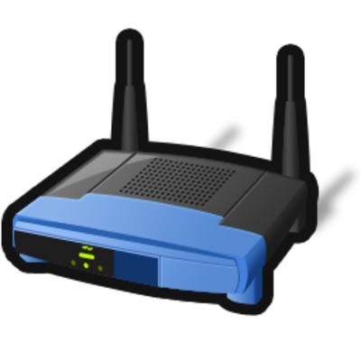
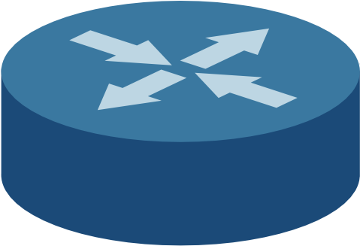

Example: Careful file transfer from A to B
data
A
B
LL ACKs
Goal: Accurately copy file on A’s storage to B’s storage
Straw man design:
  Read file from A’s storage
  A sends packetized file to B
    Link layer resends lost or corrupted packets at each hop
  B writes file data to storage
Does this system meet the design goal? Bit errors on links no issue

Slide 22
Where might errors happen?
On A’s or B’s disk
In A’s or B’s RAM or CPU
In A’s or B’s software
In the RAM, CPU, or software of any router that forwards packet
Why might errors be likely?
  Drive for CPU speed and storage density: pushes hardware to EE limits, engineered to tight tolerances
    e.g., today’s disks return data that are the output of an maximum-likelihood estimation!
  Bugs abound!

Slide 23
Solution: End-to-End verification
A keeps a checksum with the on-disk data
  Why not compute checksum at start of transfer?
B computes checksum over received data, sends to A
A compares the two checksums and resends if not equal
Can we eliminate hop-by-hop error detection?
Is a whole-file checksum, alone, enough?

Slide 24
End-to-End Principle
Only the application at communication endpoints can completely and correctly implement a function
Processing in middle alone cannot provide function
  Processing in middle may, however, be an important performance optimization
Engineering middle hops to provide guaranteed functionality is often wasteful of effort, inefficient

Slide 25
Perils of lower-layer implementation
Entangles application behavior with network internals
Suppose each IP router reliably transmitted to next hop
  Result: Lossless delivery, but variable delay
    ftp: Okay, move huge file reliably (just end-to-end TCP works fine, too, though)
    Skype: Terrible, jitter packets when a few corruptions or drops not a problem anyway
Complicates deployment of innovative applications
  Example: Phone network v. the Internet

Slide 26
Advantages of lower-layer implementation
Can improve end-to-end system performance
Each application author needn’t recode a shared function
Overlapping error checks (e.g., checksums) at all layers invaluable in debugging and fault diagnosis
If end systems not cooperative (increasingly the case), only way to enforce resource allocation!

Slide 27


End-to-end violation: Firewalls
Our network
Internet
Firewall
X
Firewalls clearly violate the e2e principle
  Endpoints are capable of deciding what traffic to ignore
  Firewall is entangled with network, transport, apps, & vice-versa
    e.g.: New header bit to improve congestion control? Many firewalls filter all such packets!
Yet, we probably do need firewalls

Slide 28
Summary: End-to-End principle
Many functions must be implemented at application endpoints to provide desired behavior
  Even if implemented in “middle” of network
End-to-end approach decouples design of components in network interior from design of applications at edges
  Some functions still benefit from implementation in network interior at cost of entangling interior, edges
End-to-end principle is not sacred; it’s just a way to think critically about design choices in communication systems

Slide 29
Five-minute break and Partner Exercises
The end-to-end argument is:
  A guideline for placing functions in computer systems
  A rule for placing functions in a computer system
  A debate on where to place functions in a computer system
  A debate about anonymity in computer networks
Of the following, the best example of an end-to-end argument is:
  If you laid all the web programmers in the world end to end, they would reach from Princeton to CERN
  Every byte going into the write end of a UNIX pipe eventually emerges from the pipe’s read end
  Even if a chain manufacturer tests each link before assembly, they had better test the completed chain
  All important network communication functions should be moved to the Application layer

Slide 30
Today
Layering and the End-to-End Argument
Transmission Control Protocol (TCP) primer
  Over wired networks
  Reading: “Congestion Avoidance and Control” by Jacobson and Karels
TCP over wireless

Slide 31
TCP: Connection-Oriented,
Reliable Byte Stream Transport
Layer-four protocol for reliable transport
  Sending app offers a sequence of bytes: d0, d1, d2, …
  Receiving app sees all bytes arrive in same sequence: d0, d1, d2…
    Result: Reliable byte stream transport between endpoints on the internet
Each such byte stream is called a connection, or flow

Slide 32
TCP’s Many End-to-End Goals
Recover from data loss
Avoid receipt of duplicated data
Preserve data ordering
Provide integrity against corruption
Avoid sending faster than receiver can accept data
Avoid congesting network

Slide 33
Fundamental Problem:
Ensuring At-Least-Once Delivery
Network drops packets, so to ensure delivery:
  Sender attaches sequence number (seqno) to each data packet sent; keeps copy of sent packet
  Receiver returns acknowledgement (ACK) to sender for each data packet received, containing seqno
Sender sets a retransmit timer on each transmission
  If timer expires < ACK returns: retransmit that packet
  If ACK returns, cancel timer, forget that packet
How long should the retransmit timer be?

Slide 34
Fundamental Problem: Estimating RTT
Expected time for ACK to return is round-trip time (RTT)
  End-to-end delay for data to reach receiver, then its ACK to reach sender
Strawman: use fixed timer (e.g., 250 milliseconds)
  What if the route/wireless conditions change?
  What if congestion occurs at one or more routers?
Too small a value: needless retransmissions
Too large a value: needless delay detecting loss
Fixed timer violates E2E argument; details of link behavior should be left to link layer!
Hard-coded timers lead to brittle behavior as technology evolves

Slide 35
Estimating RTT: Exponentially Weighted Moving Average (EWMA)
Measurements of RTT readily available
  Note time t when packet sent, corresponding ACK returns at time t’
  RTT measurement sample: m = t’− t
Single sample too brittle (queuing, routing dynamic)
Adapt over time, using EWMA:
  Measurement samples: m0, m1, m2, …
  fractional weight for new measurement, α
  RTT_{i} = ((1 − α) × RTT_{i-1} + α × mi)
EWMA weights newest samples most
How to choose α? (TCP uses 1/8)
Is mean sufficient to capture RTT behavior over time? (more later)

Slide 36
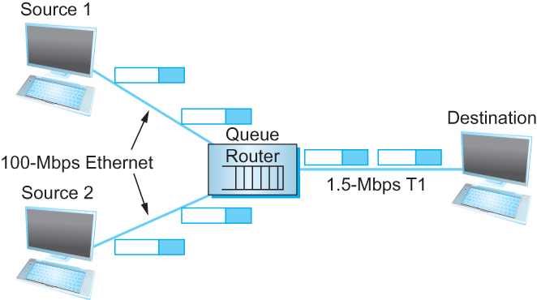
What is Congestion?
Sources may have sufficient proximal link capacity to send
But in the middle of the network may share capacity
Too many packets in the network → queue overflows: congestion

Slide 37
How does TCP know congestion occurred?
How can packets get lost in wired networks?
  Almost exclusively queue buffer overflows
Packet loss is a binary signal
How does a TCP sender know that a packet loss has occurred?
  Lack of receipt of an Acknowledgement → Timeouts

Slide 38
Retransmission and Duplicate Delivery
When sender’s retransmit timer expires, two indistinguishable cases:
  Data packet dropped en route to receiver, or
  ACK dropped en route to sender
In both cases, sender retransmits
In latter case, duplicate data packet reaches receiver!

Slide 39
Eliminating Duplicates:
Exactly-Once Delivery
Sender marks each packet with a monotonically increasing sequence number seqno
Sender includes greatest ACKed seqno in its packets
Receiver remembers only greatest received sequence number, drops received packets with smaller ones
Doesn’t guarantee delivery!
Properties: If delivered, then only once.
If undelivered, sender will not think delivered.
If ACK not seen, data may have been delivered, but sender will not know.

Slide 40
End-to-End Integrity
Achieved by using transport checksum
Protects against things link-layer reliability cannot:
  Router memory corruption, software bugs, &c.
Covers data in packet, transport protocol header
Also should cover layer-3 source and destination!
  Misdelivered packet should not be inserted into data stream at receiver, nor should be acknowledged
  Receiver drops packets w/failed transport checksum

Slide 41
Today
Networking primer/review
Transmission Control Protocol (TCP) primer
TCP over wireless

Slide 42
Running TCP on Wireless Links
Generally, TCP interprets packet loss as queue congestion
  TCP sender reduces congestion window
Wireless links have higher bit error rates, frame loss rates
On wireless links, packet loss can also occur due to random channel errors, or cellular or WLAN handoffs
  Temporary loss not due to congestion
  Reducing window may be too conservative
  Leads to poor throughput

Slide 43
Wireless can also Cause Packet Loss
Dave
Cathy
Alice
Bob
Shared wireless medium leads to a collision of Bob and Cathy’s packets at Alice

Slide 44
Wired & Wireless Mix:
Best TCP sender strategy becomes unclear
Congestion loss
Link loss
Wireless link:
Frequent
(collision)
Frequent
(multipath, interference)
Wired links:
Frequent
(queue drop)
Rare
?
loss
loss
Slow down!
Maintain rate

Slide 45
Fundamental question:
How to differentiate between
Loss due to congestion
Loss due to wireless link itself
Hard to do:
TCP is fundamentally an “end-to-end”
protocol: only sees a loss

Slide 46
Two Broad Approaches
Mask wireless losses from TCP sender
  Then TCP sender will not slow down
  Split Connection Approach
  TCP Snoop
Explicitly notify TCP sender about cause of packet loss

Slide 47
Split Connection Approach
Also called Indirect TCP (I-TCP)
Divide the TCP connection into two parts:
  TCP connection between content server and AP
  Another connection between AP and mobile host
  No real end-to-end connection
No changes to the TCP endpoint at the content server
Access point (AP)
Multi-hop Wired Internet
Mobile
Content server
Wireless
(One hop)

Slide 48
Split Connection: TCP Implementation
Per-TCP connection state
Retransmit
Application
Application
Application
Transport
Transport
Transport
Network
Network
Network
Link
Link
Link
Physical
Physical
Physical
TCP
Reliable transport
Wireless link
Maintain state for both “halves” of each end-to-end “connection” at the AP

Slide 49
Split Connection: Considerations
Connection between AP and mobile need not be TCP
  Could be e.g., Selective Repeat over UDP
Assume that the wireless part is just one hop (traditional cellular or wireless LAN)
Assumes wireless losses not caused by too many packets in the network
  But that’s not always true (e.g. collisions)
    Sender should slow down, but doesn’t

Slide 50
Split Connection: State Migration
Consequence of breaking end-to-end connection:
  On handoff from AP 1 to AP 2, connection state must move from AP 1 to AP 2
AP 1
Content server
Multi-hop Wired Internet
Mobile
Wireless
(One hop)
AP 2

Slide 51
Split Connection: Advantages
No changes needed in wired network or content servers
Transmission errors on the wireless link do not propagate into the fixed network
  Local recovery from errors
Possibility of using custom (optimized) transport protocol for the hop between AP and mobile

Slide 52
Split Connection: Critique
Loss of end-to-end semantics:
  ACK at TCP sender no longer means that receiver must have received that packet
    TCP no longer reliable if crash/bug at AP
Large buffer space may be needed at AP
AP must maintain per-TCP connection state
State must be forwarded to new AP on handoff
  May cause higher handoff latency

Slide 53
Precepts
Python Intro & Programming Exercises
Location: Friend Center, Room 003
Tuesday Lecture
Transport over Wireless II: Snoop
and Explicit Loss Notification

