Slide 1
Class Introduction
COS 463: Wireless Networks
Lecture 1
Kyle Jamieson
[Parts adapted from H. Hassanieh, P. Steenkiste]

Slide 2
Course staff and office hours
Office hours: See website, and also by appointment, synchronized with Lab programming exercise deadlines on Piazza
    Kyle Jamieson
    CS room 306
    Yaxiong Xie
    CS room 103
    Minsung Kim
    CS room 103
    Raymond Sheng
    Lab TA

Slide 3
Wireless is increasingly prevalent
Health and Fitness
Virtual Reality
UAVs
Internet of Things Sensors
Smart Home
Vehicular Networks
Cellular
Networks

Slide 4


Mobile connectivity for people:
Increased wireless demand

Slide 5
Next demand driver:
Billions of Wireless devices

Slide 6
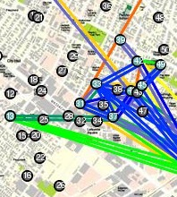
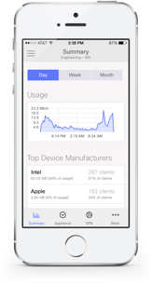
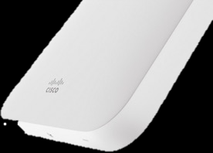
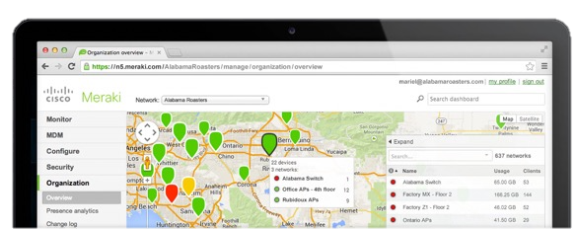
Industrial Impact: Cisco Meraki
Founders Biswas, Bicket, Aguayo, PhD candidates who left program
  Initial products: mesh networking technology from grad school
Pivot three years later
  Focus on cloud-managed Wi-Fi
Roofnet Mesh Network
Cisco acquisition, new Cisco Wi-Fi product line
Takeaway: Wireless technology → industry impact

Slide 7
COS 463: Course Approach
Gain deep knowledge of wireless networks by learning across all layers of the stack
  Some “ELE” content, some “COS” content
Taught from first principles: build up Computer Systems, Signal Processing knowledge
Test that knowledge and cement understanding by hands-on programming lab assignments
  Build something >> “Know” something
  Labs on real software-defined radio hardware
    Real-world “surprises”

Slide 8
Goals of the Class
Understand wireless networks’ design and architecture
  From signals to bits to datagrams
  Understand design choices and tradeoffs
Understand how the design of wireless networks interacts with the rest of the wired Internet
Gain proficiency in building real wireless networks

Slide 9
Course Contents
Wireless From the Transport Layer Downwards
  Transport over wireless, link layer, medium access
Overcoming Bit Errors
  Error Detection/correction, convolutional & “Rateless” codes
An Introduction to the Wireless Channel
  Noise, Multipath Propagation, radio spectrum
Wireless Physical Layer concepts
  OFDM, channel estimation, MIMO etc.
Boutique topics
  Visible light communication, low power, Wi-Fi localization

Slide 10
Prerequisites and Administrivia
Assume basic familiarity with computer networking concepts and programming
  COS 217 required
  Knowledge of C and one other programming language helpful, but not required
  Not open to freshmen
COS 463 is a COS systems-track course

Slide 11
Target audiences
COS 463 is cross-registered with ELE (ELE 463)
COS students who want to extend their networking background to wireless communications
ELE students who want to extend their wireless communications knowledge to networks

Slide 12
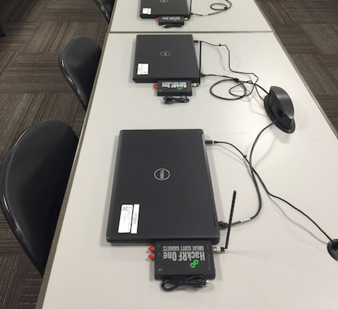
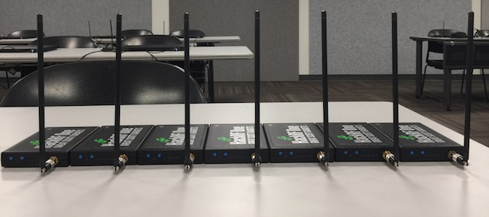
Modes of delivery
Lectures: Introduce concepts, gain background knowledge
  New this year: Break time, quiz time (→ class participation)
Precepts & Lab: hands-on training on wireless systems
  Learning by doing: building wireless systems with a software defined radio platform
  Precepts and labs closely coupled

Slide 13

Lab logistics
Friend Center, Room 003
Enrolled students as of Feb 1 on room access control list
  Visit a hotspot and tap your TigerCard to update
  If you weren’t enrolled Feb 1, send instructors a private Piazza message requesting access

Slide 14
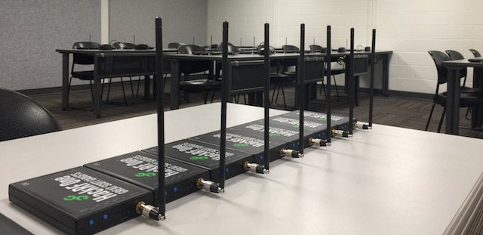
Lab: Building a spectrum analyzer
Introduce you to basic signal processing concepts
  Fast Fourier Transform (FFT)
  Low-pass filtering
Learning how to use the HackRF software-defined radio

Slide 15
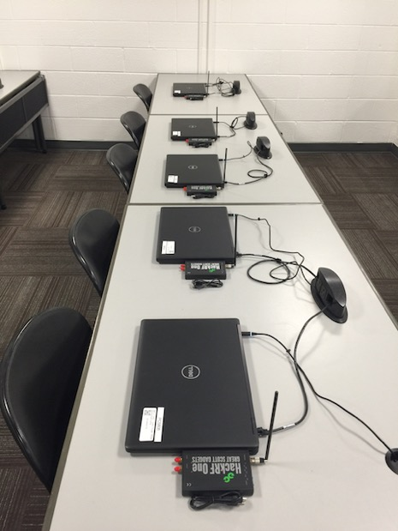
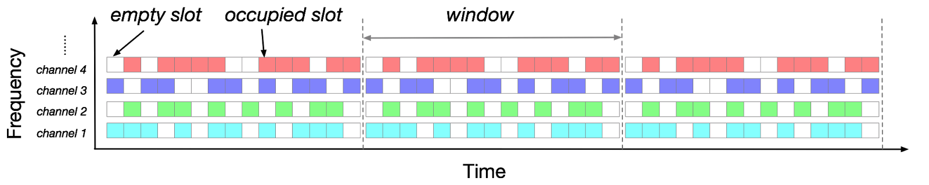
Lab: Sharing the Wireless Medium
We set up a transmitter in the room
You listen for an empty time or frequency slot and send in that slot
We show the result in a live “scoreboard”

Slide 16
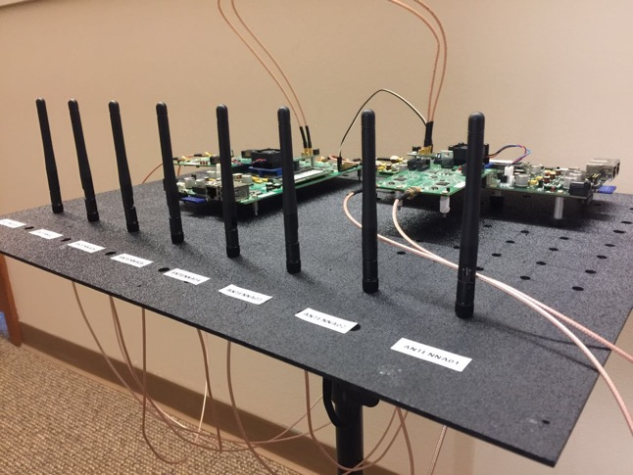
Lab: Array Signal Processing
Angle-of-arrival estimation using multiple antennas
Transmit beamforming using multiple antennas
User 1
User 2

Slide 17
Optional Readings, for reference
Text book: Cory Beard and William Stallings,Wireless Communication Networks and Systems
Reference material: Eldad Perahia, Robert Stacey, Next Generation Wireless LANs

Slide 18
Class Grading
Midterm exam: 20%
Final exam: 30%
Five lab programming assignments: 40%
Class participation: 10%
  Precept attendance and participation
  Activity on Piazza, in-class exercises
Midterm and final exam coverage: Everything mentioned in lecture and precept, all readings, all labs
  Emphasis on the concepts discussed in lecture & precepts, and lab content

Slide 19
Today
How do wireless and wired networks differ?
What makes wireless interesting?
What new services does wireless enable?

Slide 20
Wireless is less reliable
Alice
Bob
In wired networks, link bit error rate is 10⁻¹² and less
Wireless networks are far from that target
  Bit error rates of 10⁻⁶ and above are common!
Why?

Slide 21
Today
How do wireless and wired networks differ?
  A shared wireless medium
  Less reliable links
  Mobility
What makes wireless interesting?
What new services does wireless enable?

Slide 22
Wireless is a shared medium
Cathy
Wired networks:
Alice and Bob’s conversation is independent of Cathy and Eve’s conversation
Wireless networks:
Close by wireless conversations share the same wireless medium
Alice
Bob
Eve

Slide 23
Why is a point-to-point link the
wrong abstraction for building
wireless networks?

Slide 24
Reason #1: Interference
Cathy
Noise is naturally present in the environment from many sources
Interference can be from other users of the same technology, other technologies altogether
Impacts the throughput users can achieve
Alice
Bob
Cathy

Slide 25

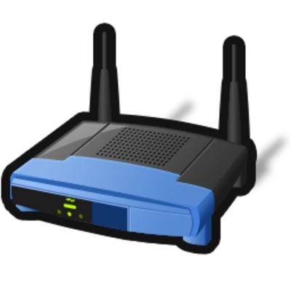
Reason #2: Can leverage broadcast
Router
Alice
Bob
Want to exchange packets, but out of direct range

Slide 26
Solution using wired abstraction
1
2
Router
Alice
3
4
Bob
Requires four transmissions in total

Slide 27
Idea: Router combines the packets
1
2
Router
Alice
Bob
=
⊕

Slide 28
Router broadcasts the combination
1
2
Router
Alice
3
Bob
Requires just three transmissions in total

Slide 29
Sumary: Shared medium is very different
Wireless’ shared medium is very different than point-to-point wired links
So need to think about wireless networks differently
Interference is a major problem
But also can leverage broadcast nature of wireless
  Four to three transmissions increases throughput
  Serve more users or increase app performance
    Better Skype calls

Slide 30
Break time and (Not Graded) Partner Quiz: Butterfly Network
Two top source nodes have A and B, respectively
Two destination nodes at bottom each want both A and B
Each edge can carry just one value
Label each edge with a value to deliver A and B to both destination nodes

Slide 31
Today
How do wireless and wired networks differ?
  A shared wireless medium
  Less reliable links
  Mobility
What makes wireless interesting?
What new services does wireless enable?

Slide 32
Less reliable links:
Multipath propagation
Ceiling
S
R
Floor
Signal bounces off surface and interferes with itself
Can be constructive or destructive, depending on the respective path lengths
Can be more than two paths

Slide 33
Today
How do wireless and wired networks differ?
  A shared wireless medium
  Less reliable links
  Mobility
What makes wireless interesting?
What new services does wireless enable?

Slide 34
Mobility affects link throughput
Quality of transmission depends on distance, other factors
Affects the throughput mobile users achieve
Worst case: Outages, periods with no connectivity!
Alice
Throughput,
Alice to Bob
Bob
time

Slide 35
Mobility matters, even if stationary!
Mobile people, devices affect wireless channel of stationary nodes!
Alice
Throughput,
Alice to Bob
time
Bob
Cathy

Slide 36
Mobility matters, still!
Cathy
Impact of mobility on transmission is complex:
  Multipath effects
Alice
Throughput,
Alice to Bob
Bob
time

Slide 37
Today
How do wireless and wired networks differ?
What makes wireless interesting?
  Deep intellectual challenges
  Cross-layer design
What new services does wireless enable?

Slide 38

Some things are well understood…
Q: What’s the capacity of a point-to-point link?
  Bits/second can ”reliably” communicate
Before Shannon:
  Only way to make probability of bit error arbitrarily small is to reduce the rate of communication.
After Shannon (with some assumptions):
  Up to some rate C (Shannon Capacity), coding can make chance of bit error arbitrary small!

Slide 39



…others aren’t understood well at all!
Q: What’s the capacity of a wireless network?
A [Information Theory]: “ ”
A [Computer Networks]: “Let’s build a better medium access control protocol!”

Slide 40
Today
How do wireless and wired networks differ?
What makes wireless interesting?
  Deep Intellectual challenges
  Cross-layer design
What new services does wireless enable?

Slide 41
The argument for cross-layer design
Traditional approach: Optimize within layers
New Approach: Design and optimize across layers
Applications
Cross-layer designs
Applications
Transport Layer
End-to-End (including Transport)
Network Layer
Communications and Coding
Physical Layer
Radio Hardware, Antennas

Slide 42
why is point-to-point
Why is layer separation sub-optimal?

Slide 43

Scenario: Laptop in a “dead spot”
01010110111
01010110111
With layer separation: A few bit errors → persistent loss
But two access points unlikely to experience error in the same bit

Slide 44
Solution: A cross-layer Approach
High-speed Ethernet
01010110111
01010110111
Physical layer delivers partially-correct packets
Link/network layers combine correct bits across different access points to correct errors

Slide 45
A challenge for bit combining
High-speed Ethernet
“First bit is 1”
“First bit is 0”
Which access point should we believe?

Slide 46
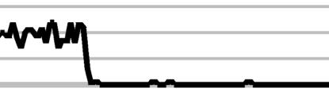
Idea: Network cooperates with PHY layer
Physical layer already estimates probability of correctness (confidence) in each 0/1 bit decision
Idea: Expose confidence to the higher layers
Confidence
1
0
01010110111
Physical Layer

Slide 47
Solution: Use confidences across layers
High-speed Ethernet
“First bit is 1 with 0.8 confidence”
“First bit is 0 with 0.5 confidence”
Believe the access point with higher confidence

Slide 48
Experiment: Packet delivery v. poor coverage
Average Bit Error Rate

Slide 49
Experiment: Packet delivery v. poor coverage
Average Bit Error Rate

Slide 50
Experiment: Packet delivery v. poor coverage
Average Bit Error Rate

Slide 51
Fundamental change in network architecture
Traditional approach: Optimize within layers
New Approach: Design and optimize across layers
Applications
Cross-layer designs
Applications
Transport Layer
End-to-End (including Transport)
Network Layer
Communications and Coding
Physical Layer
Radio Hardware, Antennas

Slide 52
Today
How do wireless and wired networks differ?
What makes wireless interesting?
What new services does wireless enable?

Slide 53
New Services: Wireless localization
GPS does not work indoors → use Wi-Fi to localize

Slide 54
How do we get virtual touch screens?

Slide 55
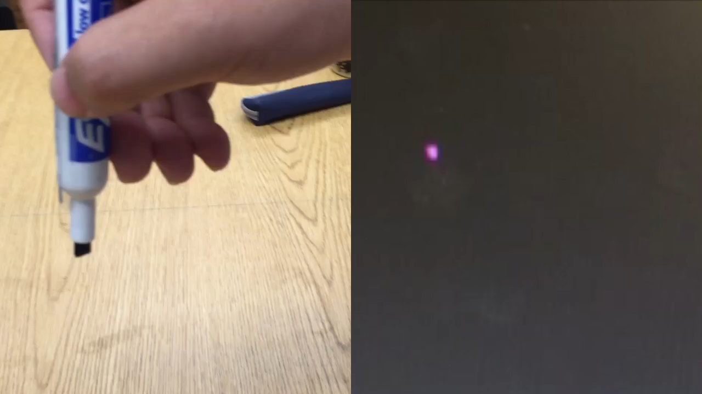
RFID motion tracking in the air

Slide 56
RFID technology: Smart homes
Localize everything and anything in the home
RFID: Battery-free stickers to tag any and every object

Slide 57
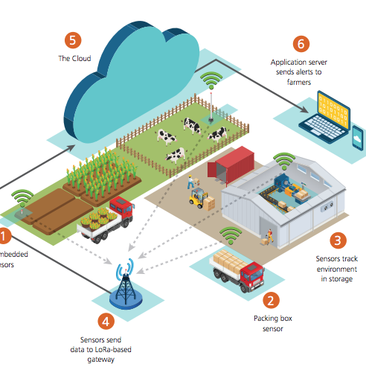
Low Power, Wide Area Networks
Wireless, battery operated sensors and devices
Long Range: Kilometers
Long lifetime: 10-20 years
Low cost
Applications:
  Smart electricity, water, utility meters
  Asset tracking: e.g. Vehicle fleet monitoring
  Agriculture monitoring
[semtech.com]

Slide 58
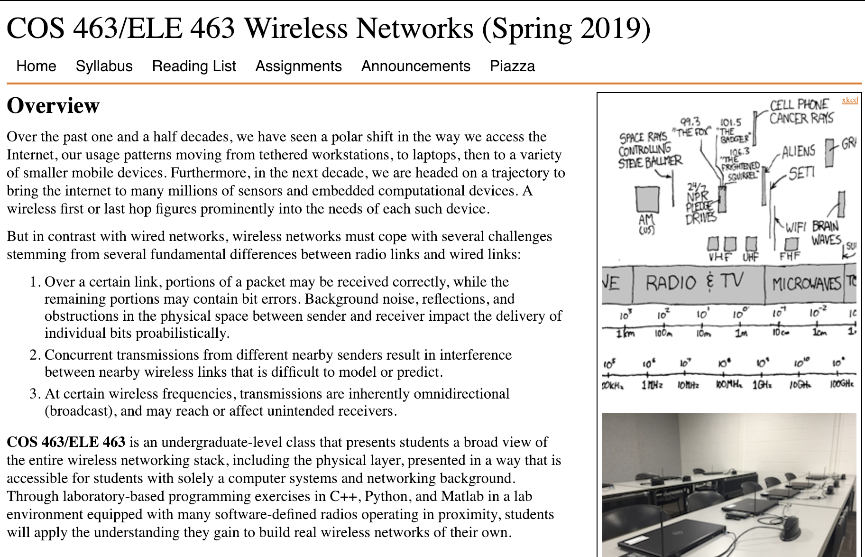
Class Website
www.cs.princeton.edu/courses/archive/spring19/cos463

Slide 59
Thursday Topic
Systems & Networking Concepts: Layering,
End-to-End Arguments
Transport over Wireless I: TCP Split Connection
Monday/Tuesday Precepts
Python Intro and Signal Processing Primer
Location: Friend Center, Room 003

