Slide 1
Multiuser Communication and Capacity
COS 463 Wireless Networks
Lecture 19
Kyle Jamieson
Notes:
Today we’ll go back to single-antenna systems and revisit questions of Capacity and communication.
2018 Notes:

Slide 2
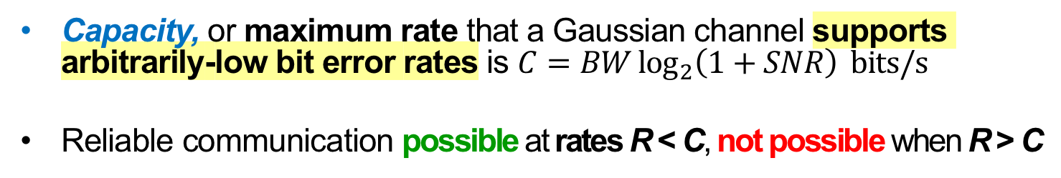
Review: Shannon Capacity
Capacity, or maximum rate that a Gaussian channel supports arbitrarily-low bit error rates is $C=BW\log_{2}\left(1+SNR\right) bits/s$
Reliable communication possible at rates R < C, not possible when R > C
Notes:
Today we’re going to GENERALIZE this to beyond simple links.

Slide 3
Review: Sharing the Wireless Medium
Uplink to Alice, Cathy and Bob both want to deliver information
Contention-based: Unstructured, taking turns in time
TDMA: Scheduled turns in time
FDMA: Sharing via Different Frequency Bands
CDMA: Sharing via Different Codes
What’s the best we can do?
Cathy
Alice
Bob

Slide 4
Today: Multiuser Capacity
Building atop Shannon capacity of a single link:
What’s the best we can do in the multiuser uplink channel?
What’s the best we can do in the multiuser downlink channel?
Notes:
Building on Shannon Capacity of a single link

Slide 5
Two-User Interference Channel
Sender 1
AP
Sender 2
On the same frequency channel at the same time:
  Sender 1 sends signal x₁ with power P₁
  Sender 2 sends signal x₂ with power P₂
AP receives: y[m] = x₁[m] + x₂[m] + w[m]
  w[m] is background Gaussian Noise with variance σ²
Notes:
Two concurrent sender radios; one receiver radio.
Note: No radio channel, but we can model that as different powers transmitted.

Slide 6
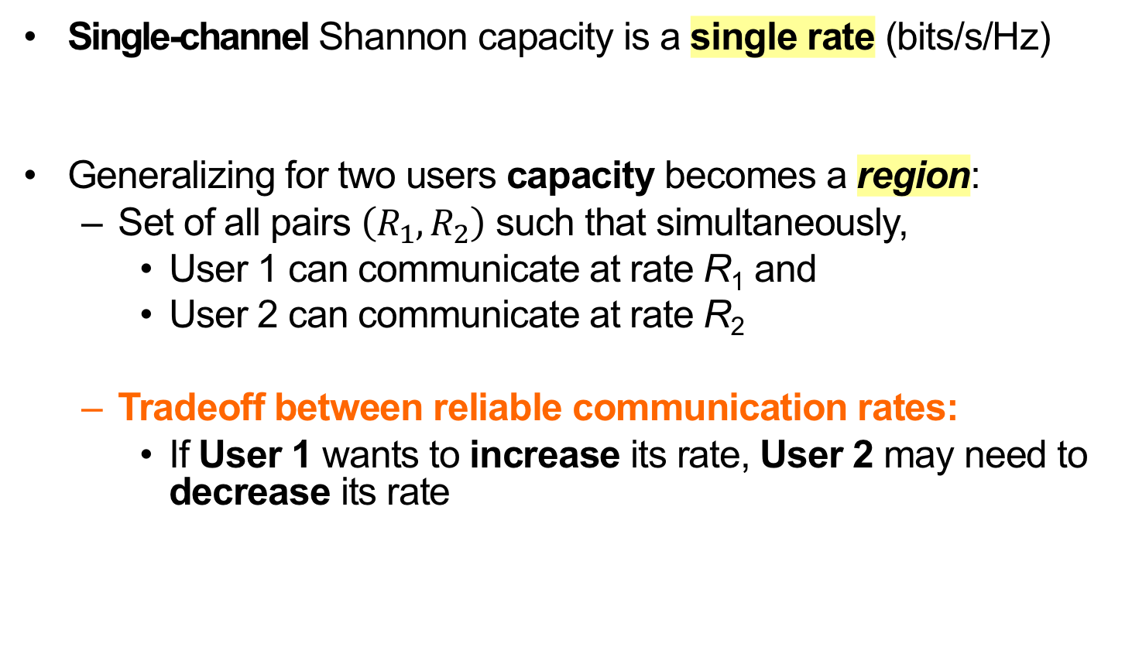
Extension of Capacity to Multiple Users
Single-channel Shannon capacity is a single rate (bits/s/Hz)
Generalizing for two users capacity becomes a region:
  Set of all pairs $\left(R_{1}, R_{2}\right)$ such that simultaneously,
    User 1 can communicate at rate R₁ and
    User 2 can communicate at rate R₂
  Tradeoff between reliable communication rates:
    If User 1 wants to increase its rate, User 2 may need to decrease its rate
Notes:
TRADEOFF E.G.: in OFDM you vary the number of subcarriers you give to each user. TDMA, vary timeslots.

Slide 7

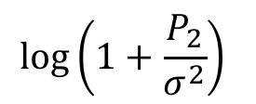
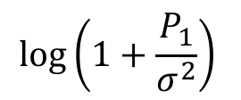

Two-User Interference Channel:
Single-User Bounds
User 2’s rate $R_{2}$
User 2 sending alone
$$\log\left(1+\frac{P_{2}}{σ^{2}}\right)$$
User 1 sending alone
$$\log\left(1+\frac{P_{1}}{σ^{2}}\right)$$
User 1’s rate $R_{2}$
Notes:
Plotting rates on both axes: rate region
>>> R1 less than p2p link w/o other user
>>> R2 less than p2p link w/o other user

Slide 8
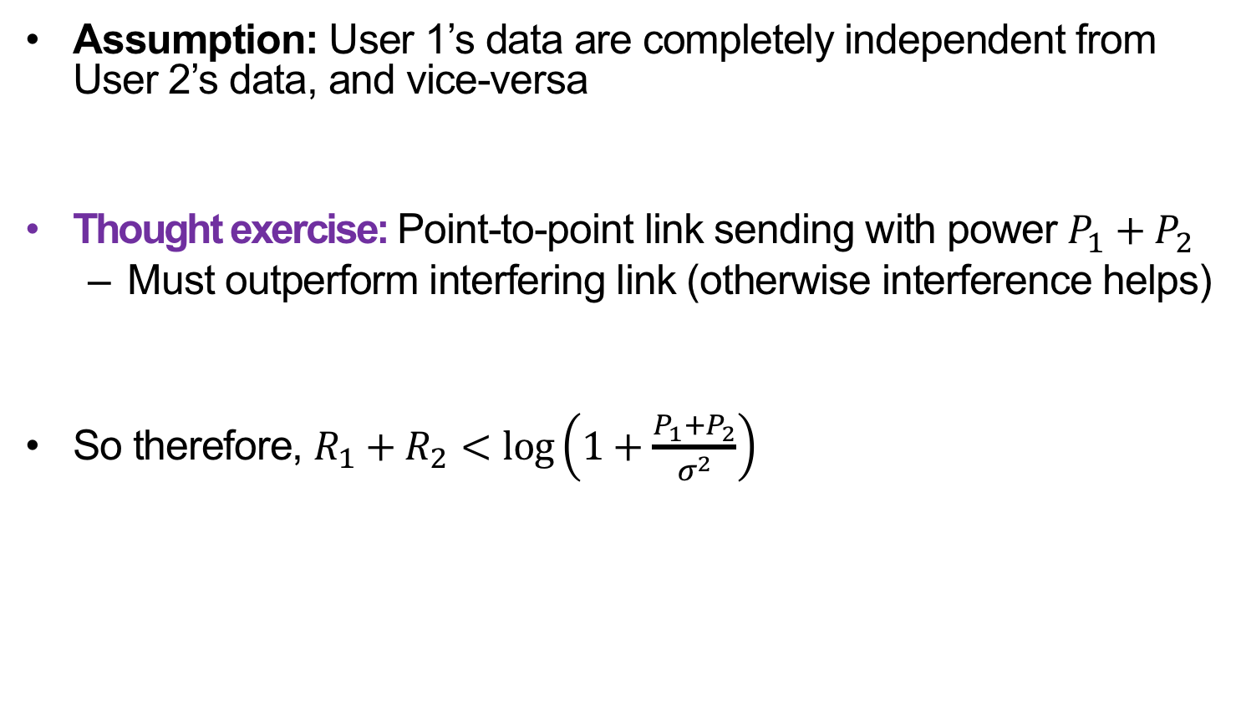
Interference Doesn’t Help
Assumption: User 1’s data are completely independent from User 2’s data, and vice-versa
Thought exercise: Point-to-point link sending with power $P_{1}+P_{2}$
  Must outperform interfering link (otherwise interference helps)
So therefore, $R_{1}+R_{2}<\log\left(1+\frac{P_{1}+P_{2}}{σ^{2}}\right)$
Notes:
>>> R1 + R2 cannot exceed capacity of a p2p link with sum of the two users’ power.
(Otherwise, an interfering user would increase capacity).

Slide 9
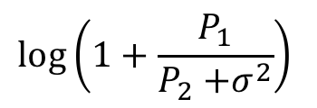
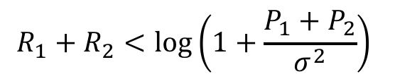
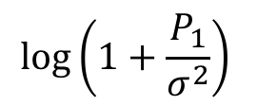

Two-User Interference Channel:
Capacity Region
User 2’s rate $R_{2}$
$$\log\left(1+\frac{P_{2}}{σ^{2}}\right)$$
$$R_{1}+R_{2}<\log\left(1+\frac{P_{1}+P_{2}}{σ^{2}}\right)$$
$$\log\left(1+\frac{P_{1}}{P_{2}{+σ}^{2}}\right)$$
User 1’s rate $R_{1}$
$$\log\left(1+\frac{P_{1}}{σ^{2}}\right)$$
Notes:
So the capacity region looks like this.
>>> Surprising part is we can operate HERE.
MAX RATE for USER 1, good rate for USER 2.
DECODE USER 2, treating USER 1 like interference.

Slide 10
Successive Interference Cancellation (SIC)
Receiver decodes information from both senders in three stages:
Decode data of user 2, treating signal from user 1 as noise
Reconstruct user 2’s signal (x’₂[m]) from decoded data and subtract from aggregate received signal y[m], cancelling it:
  y’ [m] = y [m] − x’₂[m]
  = x₁[m] + (x₂[m] – x’₂[m]) + w[m]
Decode user 1’s signal from y’[m]

Slide 11
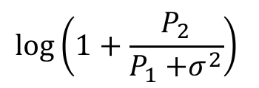
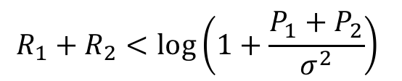
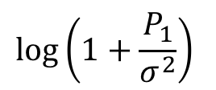
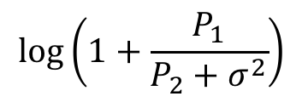
SIC: Choice of User Order
User 2’s rate $R_{2}$
$$\log\left(1+\frac{P_{2}}{σ^{2}}\right)$$
$$\log\left(1+\frac{P_{2}}{P_{1}{+σ}^{2}}\right)$$
$$R_{1}+R_{2}<\log\left(1+\frac{P_{1}+P_{2}}{σ^{2}}\right)$$
$$\log\left(1+\frac{P_{1}}{P_{2}+σ^{2}}\right)$$
User 1’s rate $R_{1}$
$$\log\left(1+\frac{P_{1}}{σ^{2}}\right)$$
Notes:
P2 stronger than P1
Choosing stronger user first is more practical for implementation
Choosing weaker user first gives better rate fairness

Slide 12
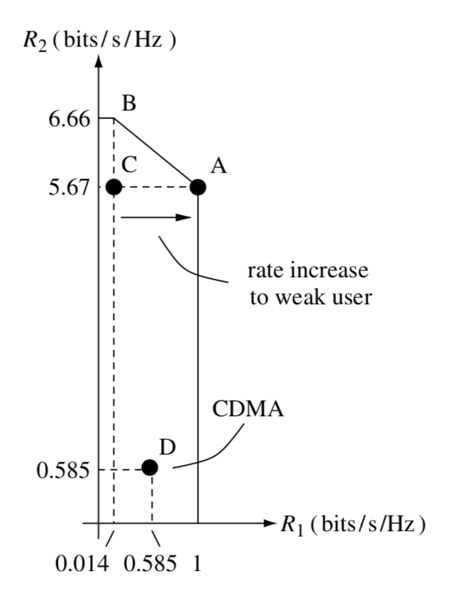
Comparison with CDMA
CDMA: Every user decoded treating the other users as noise
  Achieves Point C
    But, User 1 starves
CDMA power control: Reduce power of the strong user
  Achieves Point D

Slide 13
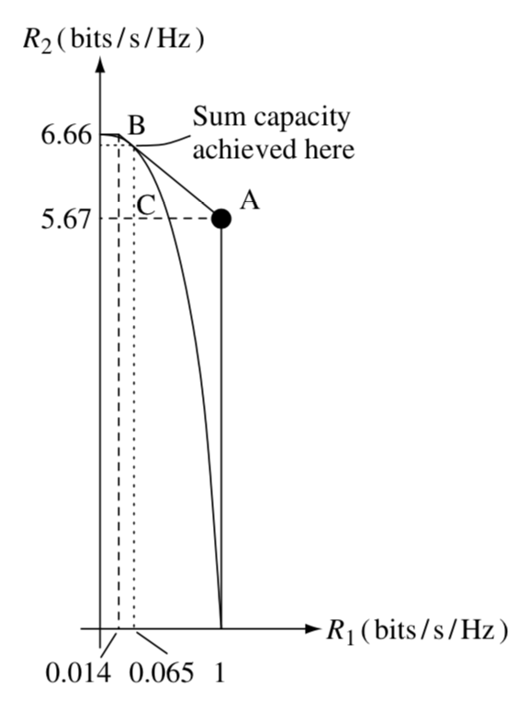
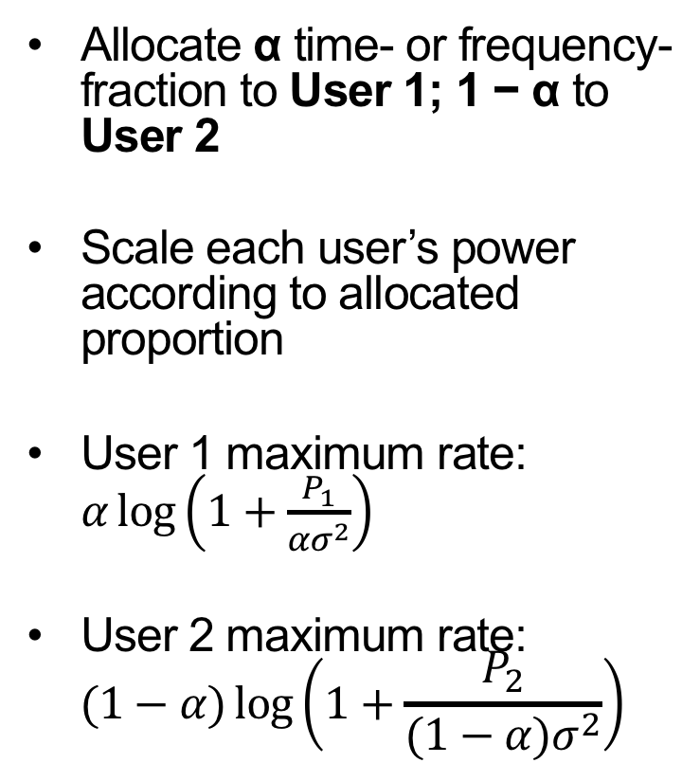
Comparison with TDMA/FDMA
Allocate α time- or frequency-fraction to User 1; 1 − α to User 2
Scale each user’s power according to allocated proportion
User 1 maximum rate: $α\log\left(1+\frac{P_{1}}{ασ^{2}}\right)$
User 2 maximum rate:
$$(1−α)\log\left(1+\frac{P_{2}}{(1−α)σ^{2}}\right)$$

Slide 14
Comparison with TDMA/FDMA
Allocate as follows:
  α time- or frequency-fraction to User 1;
  1 − α to User 2
Tuning α (time/frequency and power) to P₁, P₂ can achieve a point on the A-B curve (optimal)

Slide 15
Today: Multiuser Capacity
Building atop Shannon capacity of a single link:
What’s the best we can do in the multiuser uplink channel?
What’s the best we can do in the multiuser downlink channel?
  Unknown information streams
  Taking content of the data into account
Notes:
Building on Shannon Capacity of a single link

Slide 16
Two-User Downlink Channel
User 1
AP
User 2
On the same frequency channel at the same time:
  User 1 receives signal x₁ with power P₁
  User 2 receives signal x₂ with power P₂
AP receives: y[m] = x₁[m] + x₂[m] + w[m]
  w[m] is background Gaussian Noise with variance σ²

Slide 17
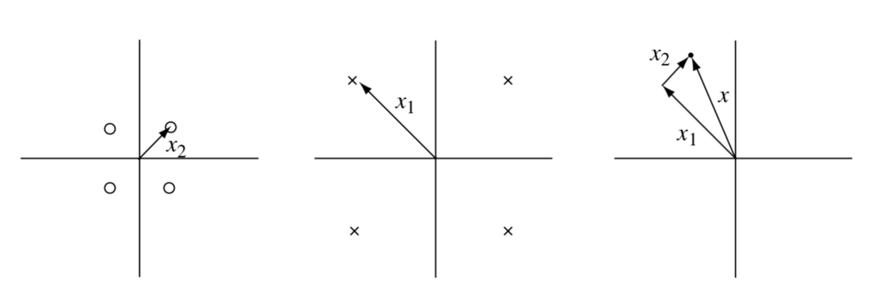
Superposition Coding
User 2 alone
QPSK signal
User 1 alone
QPSK signal
User 1 and 2 Superposition

Slide 18
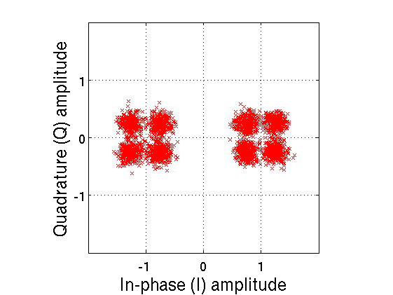
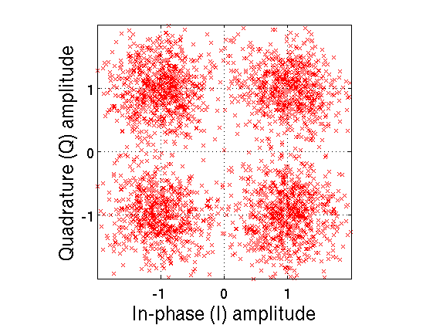
Decoding Strong BPSK with weak QPSK
“1”
“0”
BPSK decoding
BPSK
symbol
decisions
Received r(t)
BPSK model
Interference-cancelled QPSK
−
=
Q
“10”
“00”
Input bit=“1”
Input bit=“0”
−
I
=
−1
+1
“11”
“01”

Slide 19
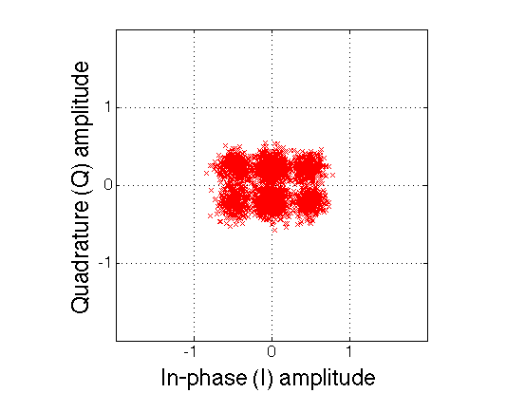
Power Difference Helps Superposition Coding
Q
Input bit=“1”
Input bit=“0”
−
I
−1
+1
Notes:
explain on board X’s and O’s

Slide 20
Today: Multiuser Capacity
Building atop Shannon capacity of a single link:
What’s the best we can do in the multiuser uplink channel?
What’s the best we can do in the multiuser downlink channel?
  Unknown information streams
  Taking content of the data into account
Notes:
Building on Shannon Capacity of a single link

Slide 21
Precoding for Known Interference
TV receiver
AP
TV broadcast
Receives:
y = x + s + w
Scenario: Hide digital data in an analog TV broadcast
AP transmitting on downlink to user overhears broadcast
  Sends digital data x intended for User 1
  s is the stronger analog TV broadcast signal
Background noise w

Slide 22
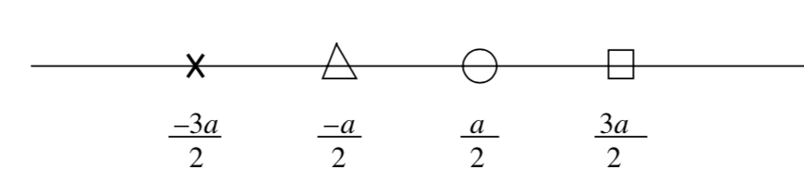
Precoding for Known Interference
TV receiver
AP
TV broadcast
Receives:
y = x + s + w
Want to distort TV broadcast signal s minimally
Suppose we want to send one of four in-phase symbols (no Q):
In-Phase

Slide 23
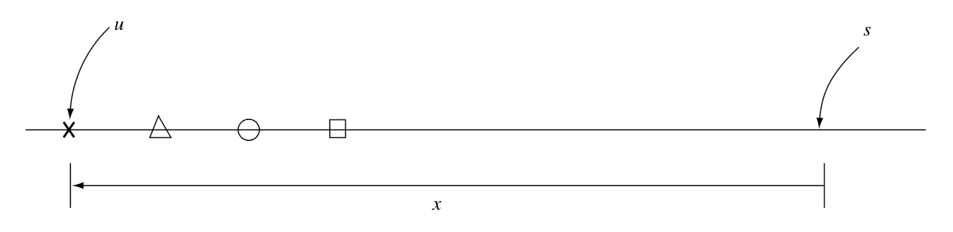
Precoding for Known Interference
Want to distort TV broadcast s minimally
Suppose we want to send one of four in-phase symbols (no Q):
Large distortion

Slide 24
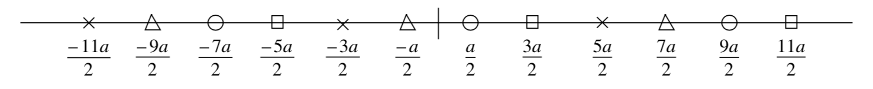
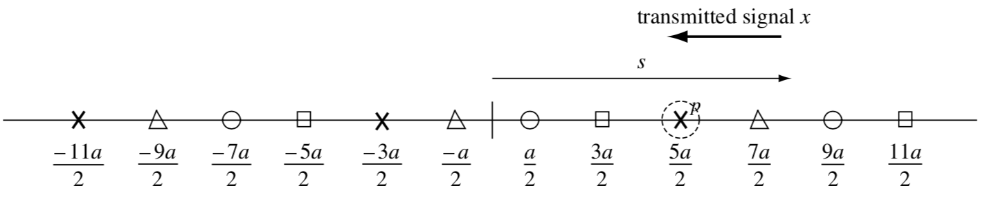
Tomlinson-Harashima Precoding
Suppose we want to send one of four in-phase symbols (no Q):
Idea: Replicate constellation across amplitudes:
Transmit closest replicated constellation point:

Slide 25
Tomlinson-Harashima: Summary
Effect is like superposition coding
Choosing closest replicated constellation group minimizes power
  Transmitted signal depends on the interfering signal
Result: Hide digital information in the analog transmission

Slide 26
Friday Precept:
Lab 4 Hackathon
Tuesday Topic:
Low-Power Wireless Communication

