Slide 1
MIMO III: Channel Capacity,
Interference Alignment
COS 463: Wireless Networks
Lecture 18
Kyle Jamieson
[Parts adapted from D. Tse]

Slide 2
Today
MIMO Channel Degrees of Freedom
MIMO Channel Capacity
Interference Alignment

Slide 3

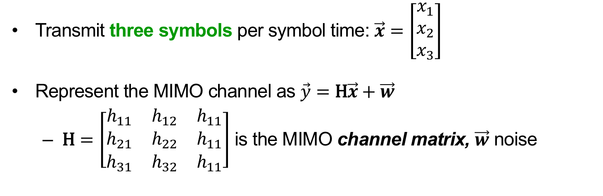


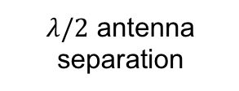

Review: The MIMO Channel
Send x₁, x₂, x₃
$$φ$$
$$λ/2$$
1
1
2
2
$λ/2$ antenna separation
3
3
$$θ$$
$$d≫λ$$
Receive y₁, y₂, y₃
Transmit three symbols per symbol time: $\vec{x}=\left[\begin{matrix}x_{1} \\ x_{2} \\ x_{3}\end{matrix}\right]$
Represent the MIMO channel as $\vec{y}=\text{H}\vec{x}+\vec{w}$
  $\text{H}=\left[\begin{matrix}h_{11} & h_{12} & h_{11} \\ h_{21} & h_{22} & h_{11} \\ h_{31} & h_{32} & h_{11}\end{matrix}\right]$ is the MIMO channel matrix, $\vec{w}$ noise

Slide 4
Recap: MIMO Radio Channel
MIMO link with n_{t} transmit, n_{r} receive antennas
MIMO radio channel itself:

Slide 5
Recap: Zero-Forcing MIMO
Sender
Receiver
Transmitter does not know H (CSI)
Each symbol time:
  Sends n_{t} symbols (original Data), one per transmit antenna
Data arrives mixed together at receiver antennas y

Slide 6
Recap: Zero-Forcing MIMO
Receiver knows H (CSI)
Each symbol time:
  Receive n_{r} mixed-up signals y
  For each of the n_{t} transmitted symbols:
    Zero-Forcing Receiver nulls all but that symbol

Slide 7
How Many Streams are Possible?
Received signals live in an n_{r}-dimensional vector space
  e.g. n_{r} = 3 receive antennas → 3-D vector space:
Cancel by projection. Therefore, at most n_{r} streams possible

Slide 8
How Many Streams are Possible?
One spatial signature per transmit antenna
  e.g. n_{r} = 3 receive, n_{t} = 2 transmit antennas:
Therefore, at most n_{t} streams possible
h₂
h₁

Slide 9
How Many Streams are Possible?
Need enough strong physical paths in the wireless channel
  e.g. n_{r} = 3, n_{t} = 3 but two physical paths confines { h_{i} } to a plane
At most # physical paths possible streams
h₂
h₁
h₃

Slide 10

How Many Streams are Possible?
Need enough strong physical paths in the wireless channel
  e.g. n_{r} = 3, n_{t} = 3 and three physical paths
At most # physical paths possible streams
h₁
$${\text{Proj}}_{⊥\left\langle h_{2}, h_{3}\right\rangle }h_{1}$$
h₂
h₁
h₃

Slide 11
Degrees of Freedom
Figure of merit that summarizes number of streams possible is called degrees of freedom of H
Degrees of freedom = min { n_{t}, n_{r}, # strong paths }
h₁
h₂
h₃

Slide 12
Today
MIMO Channel Degrees of Freedom
MIMO Channel Capacity
  Vector Space Intuition
  Eigenmode Forcing via Singular Value Decomposition
Interference Alignment

Slide 13
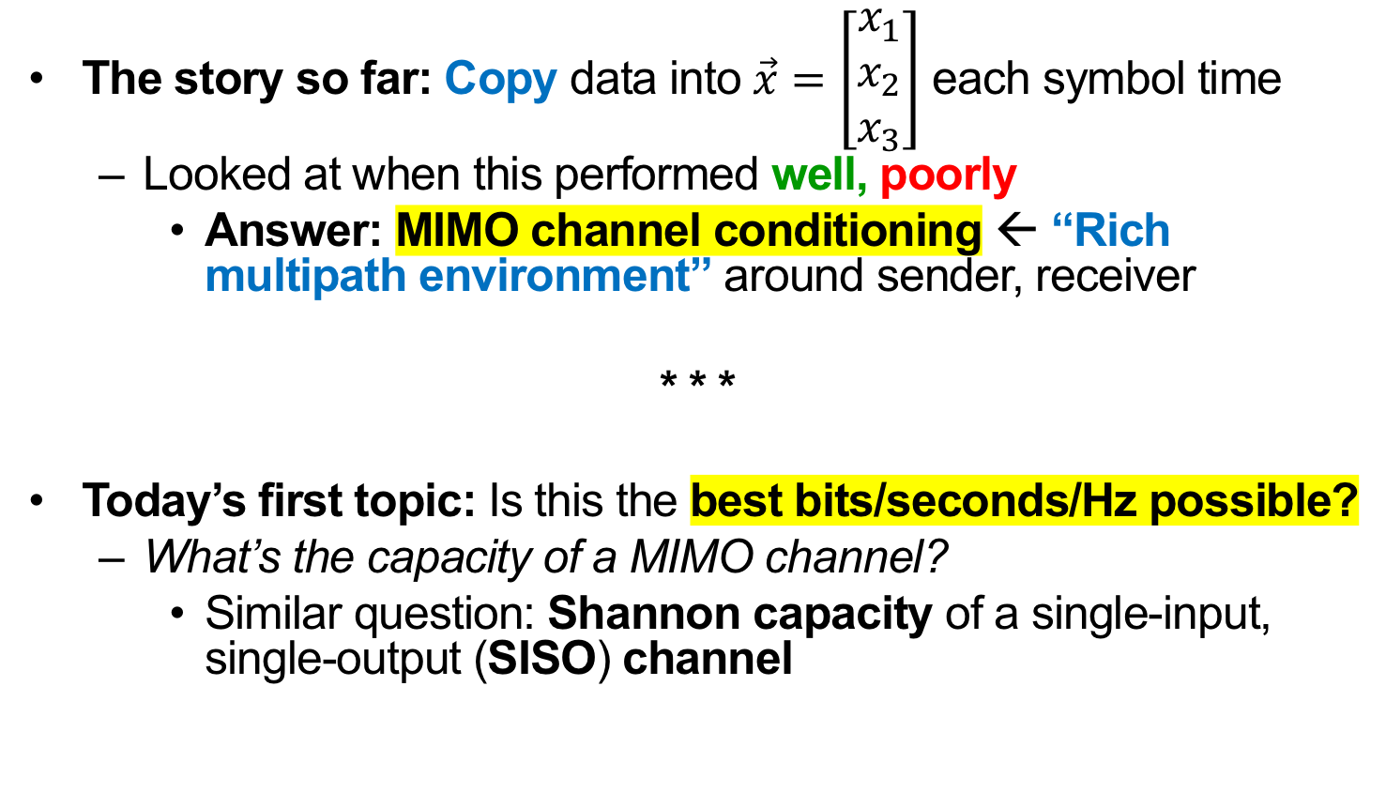
MIMO Channel Capacity: Motivation
The story so far: Copy data into $\vec{x}=\left[\begin{matrix}x_{1} \\ x_{2} \\ x_{3}\end{matrix}\right]$ each symbol time
  Looked at when this performed well, poorly
    Answer: MIMO channel conditioning ← “Rich multipath environment” around sender, receiver
* * *
Today’s first topic: Is this the best bits/seconds/Hz possible?
  What’s the capacity of a MIMO channel?
    Similar question: Shannon capacity of a single-input, single-output (SISO) channel

Slide 14
Where’s the Room for Improvement?
Suppose the transmitter knows H (CSI)
Zero-forcing receiver heard h₁, h₂, h₃
  Power loss at receiver (due to Proj⟘) for h₃
Idea: Use transmit antennas 2 and 3 to send the ideal direction
  No longer simply one symbol, one transmit antenna
h₁
h₂
h₃
Send this instead of h₃

Slide 15
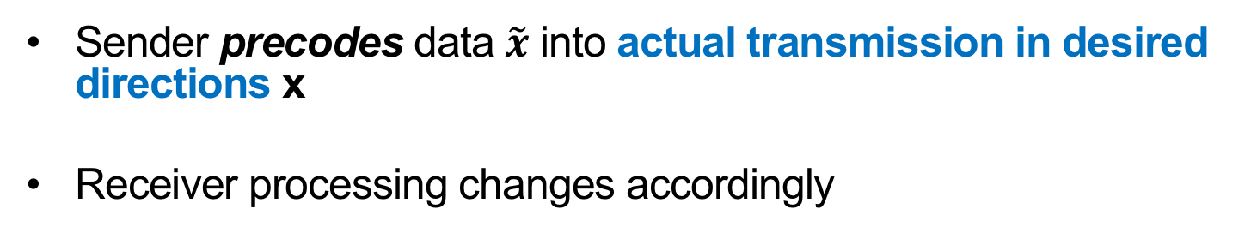
How Might We Control Directions?
Sender precodes data $\tilde{x}$ into actual transmission in desired directions x
Receiver processing changes accordingly
Sender
Receiver

Slide 16
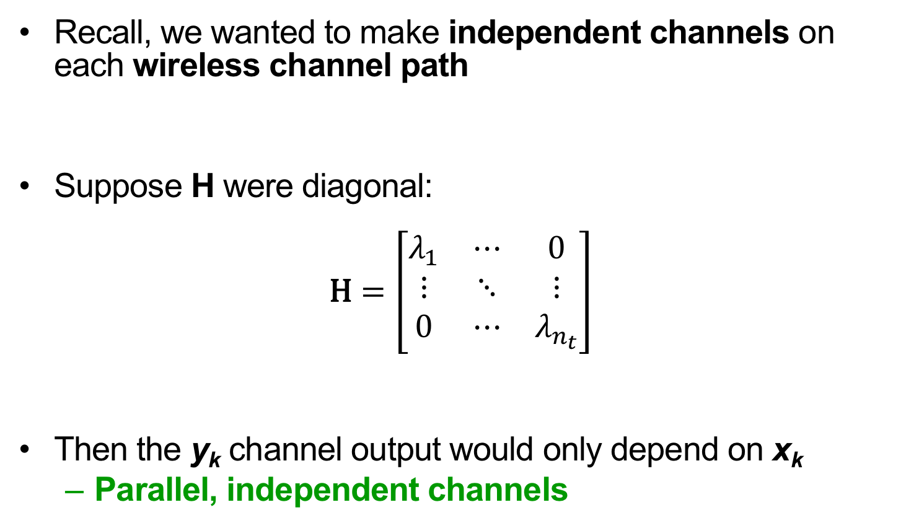
What Kind of Precoding?
Recall, we wanted to make independent channels on each wireless channel path
Suppose H were diagonal:
$$\text{H}=\left[\begin{matrix}λ_{1} & ⋯ & 0 \\ ⋮ & ⋱ & ⋮ \\ 0 & ⋯ & λ_{n_{t}}\end{matrix}\right]$$
Then the y_{k} channel output would only depend on x_{k}
  Parallel, independent channels

Slide 17
Today
MIMO Channel Degrees of Freedom
MIMO Channel Capacity
  Vector Space Intuition
  Eigenmode Transmission
Interference Alignment

Slide 18
Singular Value Decomposition (SVD)
The insight lies in a special way of “factoring” matrix H
Any matrix H has an SVD: H → UΛV*
  Λ is a diagonal matrix (contains zeroes off-diagonal)
  U and V are unitary (UU* = U*U = VV* = V*V = I)
n_{t}
n_{r}
n_{t}
n_{t}
H
U
Λ
V*
n_{r}
=
n_{r}
×
×
n_{t}
n_{r}

Slide 19
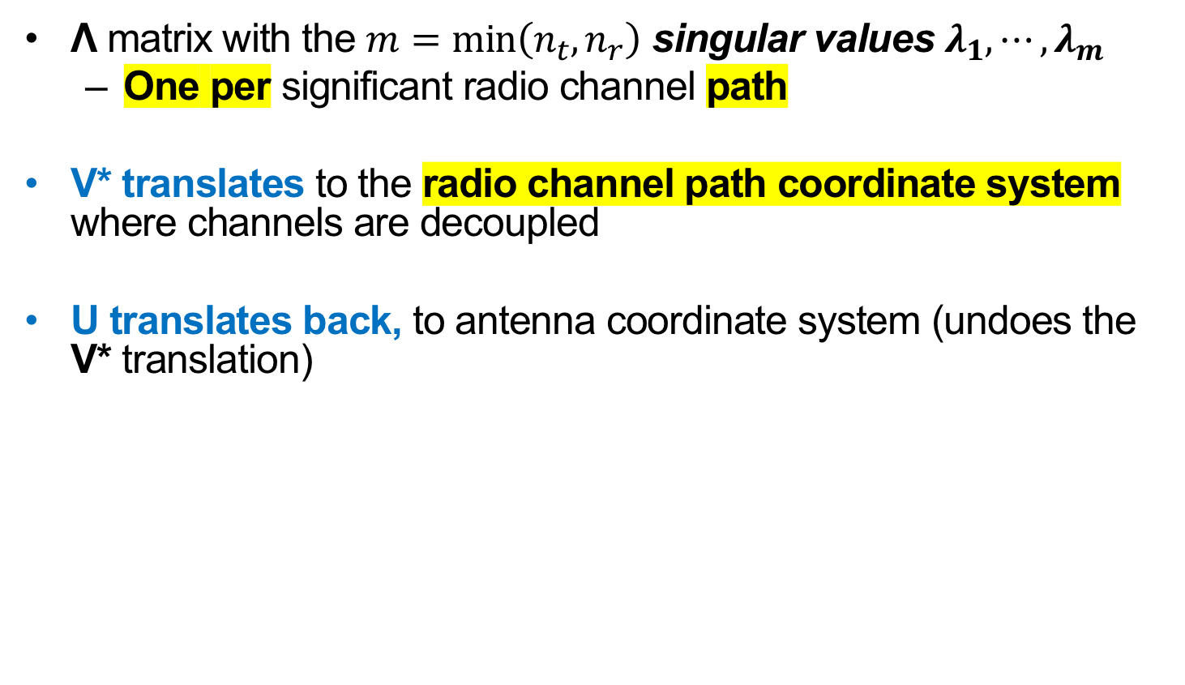
Interpreting the SVD Steps
Λ matrix with the $m=\min\left(n_{t}, n_{r}\right)$ singular values $λ_{1}, ⋯, λ_{m}$
  One per significant radio channel path
V* translates to the radio channel path coordinate system where channels are decoupled
U translates back, to antenna coordinate system (undoes the V* translation)
n_{t}
n_{r}
n_{t}
n_{t}
H
U
Λ
V*
n_{r}
=
n_{r}
×
×
n_{t}
n_{r}

Slide 20

Leveraging the SVD in a Practical System
  Alone, SVD does nothing (just analyzes what H does)
  Want to put data into the radio channel coordinate system
Insight: VV* = I (Unitary property)
Want $\tilde{x}$ here →

Slide 21
Leveraging the SVD in a Practical System
  Sender precodes with V, receiver “post-codes” with U*
    V is unitary, so V*V = I (same for U)
      So data sees independent channels
  This is called MIMO eigenmode transmission
No effect
Sender
Receiver

Slide 22
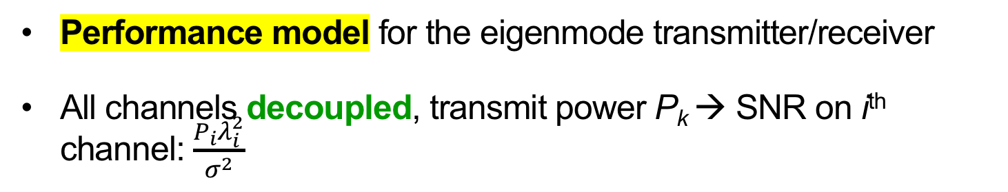
A Model for Eigenmode Transmission
Performance model for the eigenmode transmitter/receiver
All channels decoupled, transmit power P_{k} → SNR on i^{th} channel: $\frac{P_{i}λ_{i}^{2}}{σ^{2}}$
Sender
Receiver

Slide 23
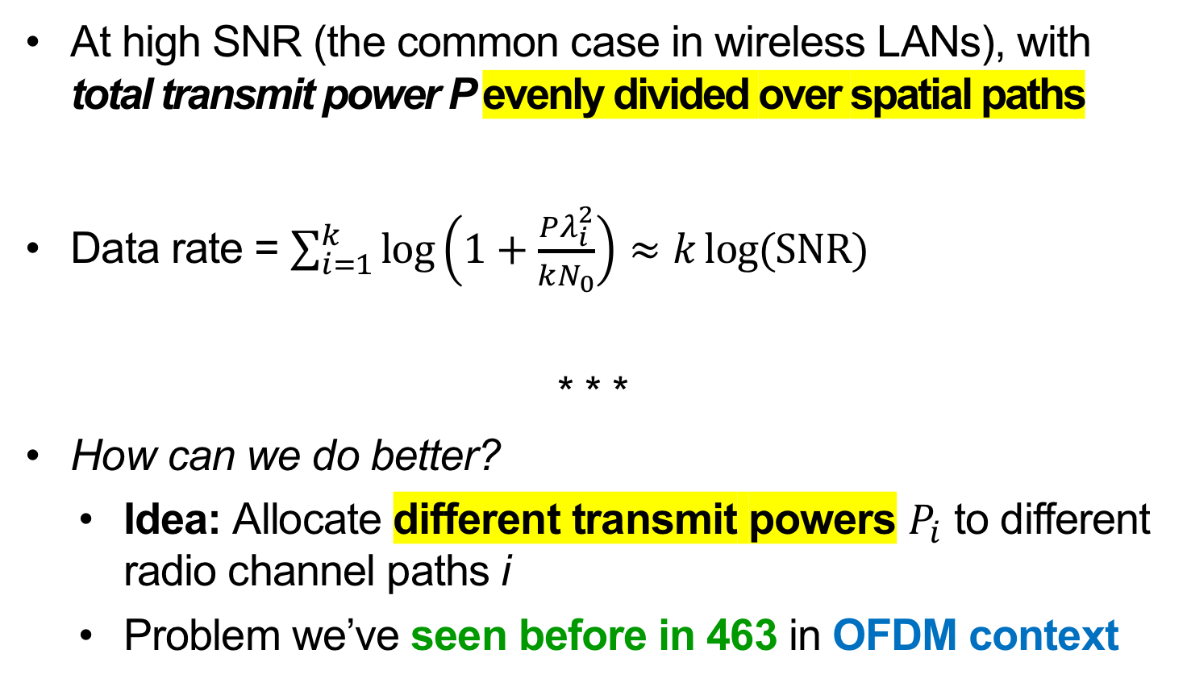
Performance: Uniform Power Division
  At high SNR (the common case in wireless LANs), with total transmit power P evenly divided over spatial paths
  Data rate = $\sum_{i=1}^{k}{\log\left(1+\frac{Pλ_{i}^{2}}{kN_{0}}\right)}≈k\log{(\text{SNR})}$
  * * *
  How can we do better?
    Idea: Allocate different transmit powers $P_{i}$ to different radio channel paths i
    Problem we’ve seen before in 463 in OFDM context

Slide 24
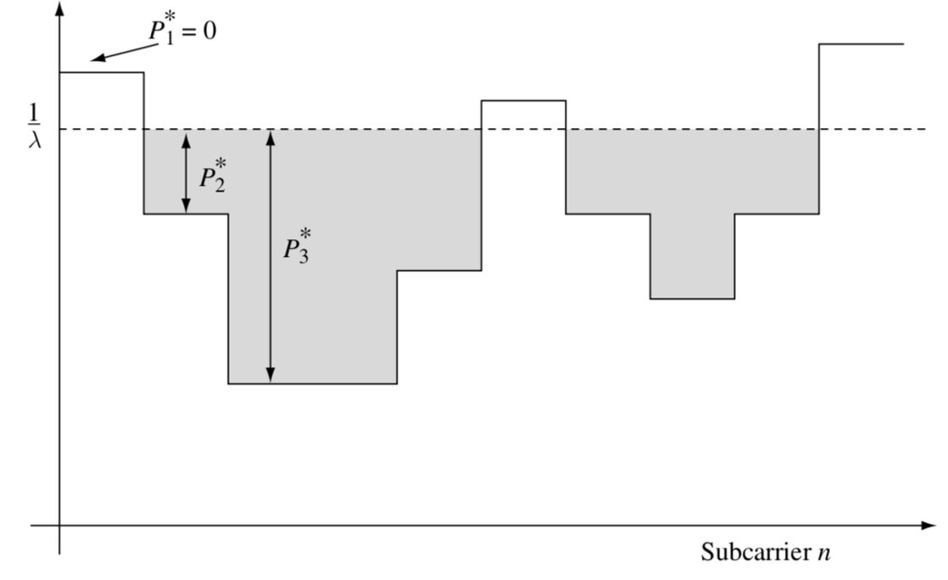

Waterfilling for MIMO Power Allocation
Allocated transmit power P_{i}
μ
$$\frac{σ^{2}}{λ_{i}^{2}}$$
Physical Channel Path / Eigenmode i

Slide 25
MIMO Capacity: Takeaways
OFDM – MIMO analogy:
  A transformation (OFDM: FFT, MIMO: SVD)
  renders interfering channels in
  (OFDM: frequency, MIMO: space) independent
MIMO Eigenmode transmission:
  Transmitter sends directionally, along spatial paths of the radio channel
  Receiver listens directionally, along same spatial paths
  Achieves the MIMO channel capacity

Slide 26
Today
MIMO Channel Degrees of Freedom
MIMO Channel Capacity
Interference Alignment

Slide 27
Interference Alignment (IA)
Number of concurrent MIMO streams a client can send is limited by the number of antennas
  Sending more streams results in interference between streams
  Also limited by the amount of multipath in the environment
New Idea: Use MIMO precoding techniques to align interference at receivers to advantage
Requires APs cooperating via a wired backhaul
  e.g. APs owned by one organization

Slide 28
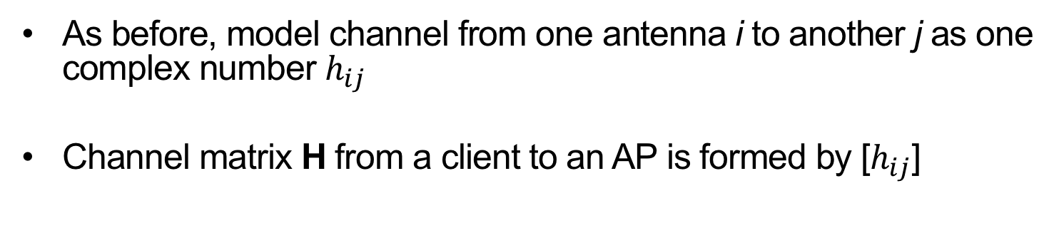
MIMO channel representation
As before, model channel from one antenna i to another j as one complex number $h_{ij}$
Channel matrix H from a client to an AP is formed by [$h_{ij}$]

Slide 29
Uplink: Interference Between Networks
Client 1 has 2 packets for AP 1; Client 2 has a packet for AP 2
  Two-antenna APs, so each decoding in a 2-D space
Three packets form three vectors in the 2-D space at each AP
  Therefore, the APs can’t decode these 3 packets
1
1
2
2

Slide 30
Interference alignment: Basic idea (1)
Clients transmit p₂ and p₃ aligned at access point (AP) 1
  They add up in their one direction
AP 1 zero-forces to decode p₁, sends it over backhaul to AP 2
AP 2 subtracts p₁ from the signal it receives, cancelling it
1
1
2
2

Slide 31
Interference alignment: Basic idea (2)
AP 2 uses zero-forcing receiver to decode p₂, p₃
AP 2 sends p₂ to AP 1 (or onward on behalf of client 1)
1
1
2
2

Slide 32
Uplink: Sketching a Practical Protocol
Transmit precoding: client multiplies packet by vector v
  Changes alignment at receiver
Client 1 picks random precoding vectors v₁ and v₂
Client 1 begins transmission
1
1
2
2
Client 2 chooses v₃ so that H₁₁v₂ = H₂₁v₃
  How does client 2 know H₁₁ and H₂₁?
    Client 1 can include in its packet header

Slide 33
Uplink: Four Concurrent Packets?
All packets but one (p₁) must align at AP 1, so AP 1 can decode
Subtract p₁ from the four packets at AP 2, leaving three packets
AP 2 can only decode two packets at a time (2-d space)
  Can’t decode p₃ and p₄ at AP 2: Can only decode p₁ and p₂
1
2

Slide 34
Downlink Interference Alignment
Clients can’t exchange frames over backhaul
Instead, align neighboring APs’ interference at each client
p₂, p₃ aligned:
p₁, p₃ aligned:
p₁, p₂ aligned:

Slide 35
Thursday Topic:
Multiuser Channel Capacity

