Slide 1
MIMO I: Spatial Diversity
COS 463: Wireless Networks
Lecture 16
Kyle Jamieson
[Parts adapted from D. Halperin et al., T. Rappaport]

Slide 2
What is MIMO, and why?
Multiple-Input, Multiple-Output (MIMO) communications
  Sends and receive more than one signal on different transmit and receive antennas
We’ve already seen frequency, time, spatial multiplexing in 463:
  MIMO is a more powerful way to multiplex wireless medium in space
  Transforms multipath propagation from an impediment to an advantage

Slide 3
Many Uses of MIMO
At least three different ways to leverage space:
Spatial diversity: Send or receive redundant streams of information in parallel along multiple spatial paths
  Increases reliability and range (unlikely that all paths will be degraded simultaneously)
Spatial multiplexing: Send independent streams of information in parallel along multiple spatial paths
  Increases rate, if we can avoid interference
Interference alignment: “Align” two streams of interference at a remote receiver, resulting in the impact of just one interference stream

Slide 4
MIMO-OFDM
subcarriers
Symbols
Multipath fading: different effects on different frequencies
  OFDM: Orthogonal Frequency Domain Multiplexing
  Different subcarriers are independent of each other
Channel model for OFDM: y = h∙x + w
  A single complex number h captures the effect of the channel on data in a particular subcarrier
For MIMO: Think about each subcarrier, independent of other subcarriers

Slide 5
Plan
Today: Diversity in Space
  Receive Diversity
  Transmit Diversity
Next time: Multiplexing in Space
Next time: Interference Alignment

Slide 6
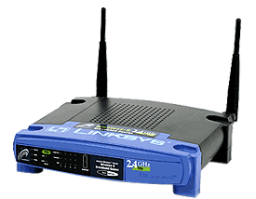
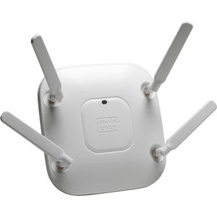
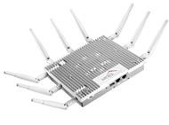
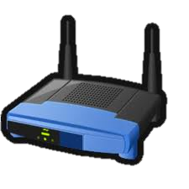
Path Diversity: Motivation
Multi-Antenna Access Points (APs), especially 802.11n,ac:
Multiple APs cooperating with each other:
Distributed Antenna systems, separating antenna from AP:
Wired backhaul

Slide 7
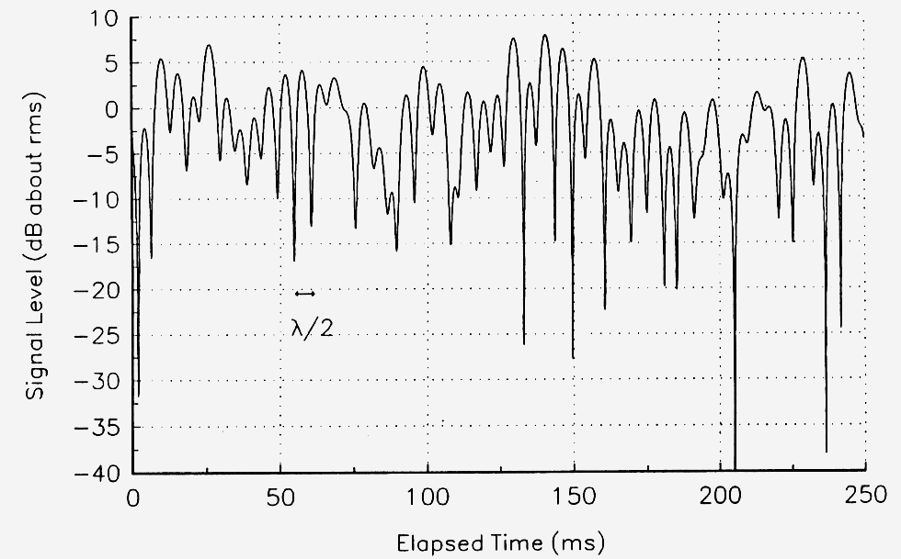

Review: Fast Fading
Typical outdoor multipath propagation environment, channel h
On one link each subcarrier’s power level experiences Rayleigh fading:
$${\left|h\right|}^{2}$$

Slide 8
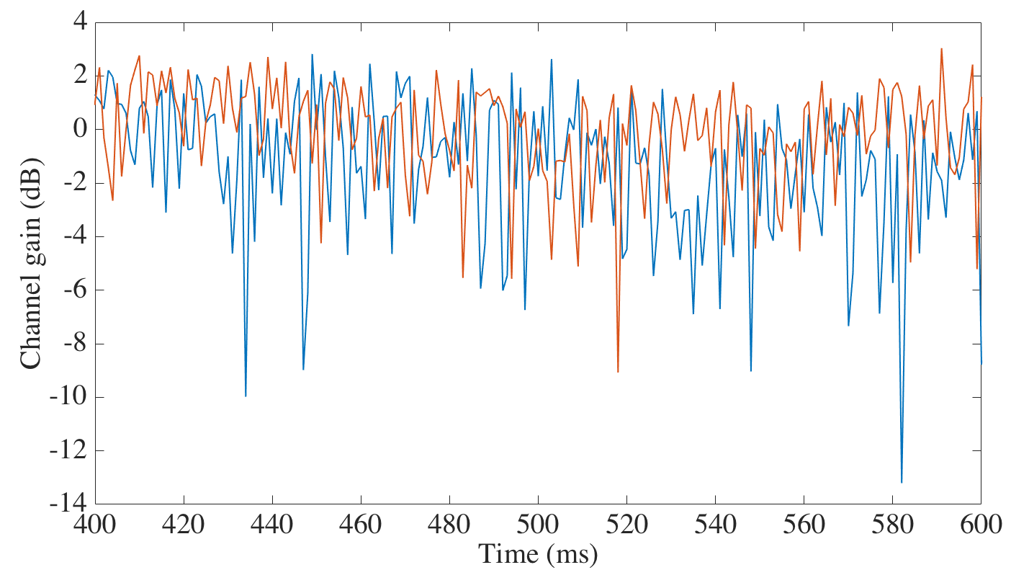

Uncorrelated Rayleigh Fading
Suppose two antennas, separated by distance d₁₂
Channels from each to a distant third antenna (h₁₃, h₂₃) can be uncorrelated
  Fading happens at different times with no bias for a simultaneous fade
$${\left|h_{1}\right|}^{2},{\left|h_{2}\right|}^{2}$$

Slide 9
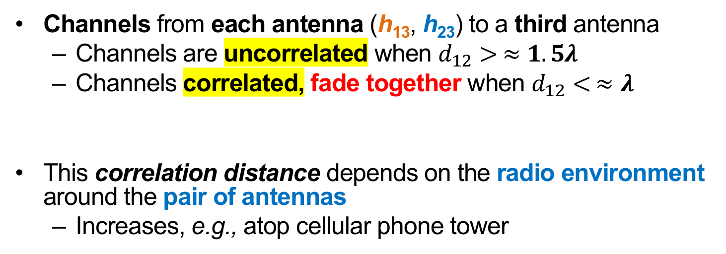


When is Fading Uncorrelated, and Why?
$$≫λ$$
$$d_{12}$$
Channels from each antenna (h₁₃, h₂₃) to a third antenna
  Channels are uncorrelated when $d_{12}> ≈1.5λ$
  Channels correlated, fade together when $d_{12}< ≈λ$
This correlation distance depends on the radio environment around the pair of antennas
  Increases, e.g., atop cellular phone tower

Slide 10
Plan
Today: Diversity in Space
  Receive Diversity
    Selection Diversity
    Maximal Ratio Combining
  Transmit Diversity
Next time: Multiplexing in Space
Next time: Interference Alignment

Slide 11
Channel Model for Receive Diversity
One transmit antenna sends a symbol to two receive antennas
  Receive diversity, or Single-Input, Multi-Output (SIMO)
Each receive antenna gets own copy of transmitted signal via
  Different path
  Potentially different channel
h₁
Receive antenna 1
x
h₂
Receive antenna 2

Slide 12
Selection Diversity
h₁
Rx 1
x
Select stronger
h₂
Radio
Rx 2
Two receive antennas share one receiving radio
Chooses the antenna with stronger signal, sends that to the radio
  Helps reliability (both unlikely bad)
  Wastes received signal from other antenna(s)

Slide 13
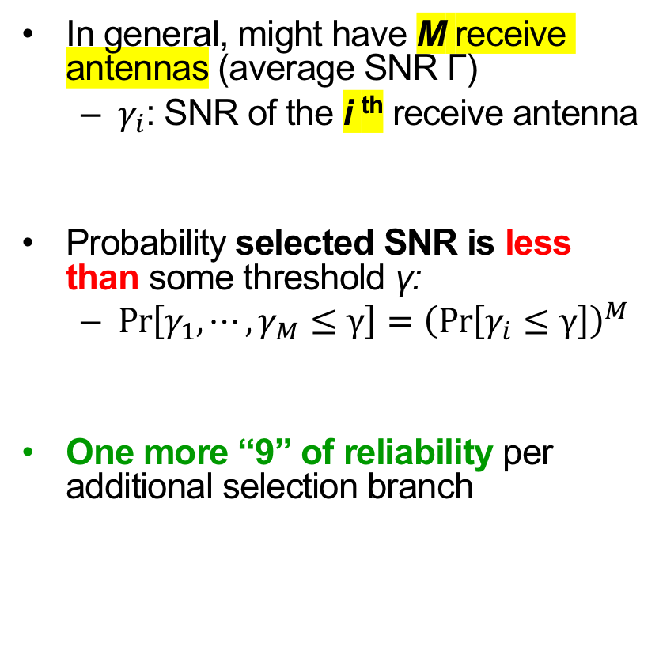
Selection Diversity:
Performance Improvement
In general, might have M receive antennas (average SNR Γ)
  $γ_{i}$: SNR of the i ^{th} receive antenna
Probability selected SNR is less than some threshold γ:
  $\operatorname{Pr}\left[γ_{1}, ⋯,γ_{M}≤γ\right]={\left(\operatorname{Pr}\left[γ_{i}≤γ\right]\right)}^{M}$
One more “9” of reliability per additional selection branch
Probability (%) that Selected Antenna’s SNR Exceeds Threshold γ
Higher probability (better) ↓
← lower threshold SNR

Slide 14
Leveraging All Receive Antennas
h₁
Rx 1
x
h₂
Rx 2
Want to just add the two received signals together
  But if we did the signals would often cancel out
Solution: Receive M radios, align signal phases, then add
  Requires M receive radios, in general

Slide 15
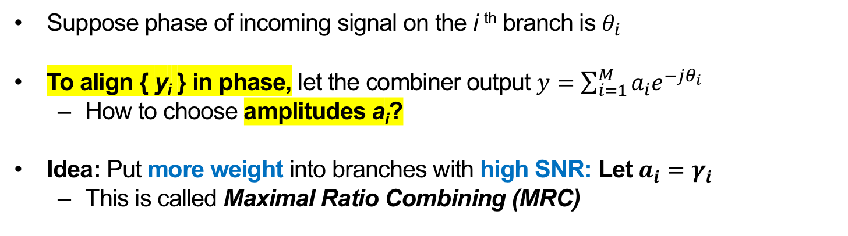
How to Choose Weights?
h₁
Rx 1
x
h₂
y
Rx 2
Suppose phase of incoming signal on the i ^{th} branch is $θ_{i}$
To align { y_{i} } in phase, let the combiner output $y=\sum_{i=1}^{M}{a_{i}e^{−jθ_{i}}}$
  How to choose amplitudes a_{i}?
Idea: Put more weight into branches with high SNR: Let $a_{i}=γ_{i}$
  This is called Maximal Ratio Combining (MRC)

Slide 16

MRC: Performance Improvement
Probability that MRC’s SNR is Under Threshold γ₀
Lower probability (better) ↓
$$10{\text{log}}_{10}\left(Γ/γ_{0}\right)$$
Lower threshold SNR →
Two “9”s of reliability improvement between one (i.e., no MRC) and two MRC branches

Slide 17
Selection Diversity, in Frequency
Antennas A and C experience different fades on different subcarriers
Selection Combining (“SEL”) improves but certain subcarriers still experience fading
MRC increases power and flattens nulls, leading to fewer bit errors

Slide 18

MRC’s Capacity Increase
MRC with M branches increases SNR
  Increased Shannon capacity
Sub-linear (logarithmic) capacity increase in M:
  $C_{MRC}=BW∙log⁡\left(1+M∙SNR\right)$ bits/second/Hz

Slide 19
Plan
Today: Diversity in Space
  Receive Diversity
  Transmit Diversity
    Channel reciprocity
    Transmit beamforming
    Introduction to Space-Time Coding: Alamouti’s Scheme
Next time: Multiplexing in Space
Next time: Interference Alignment

Slide 20
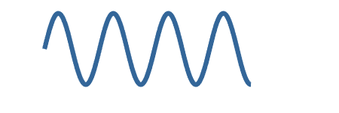

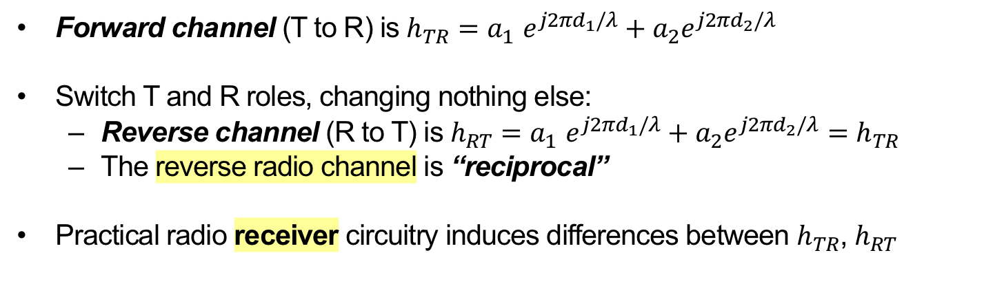
An Aside: Radio Channels are “Reciprocal”
a₂,d₂,τ₂
Transmitter T
a₁,d₁,τ₁
Receiver R
Forward channel (T to R) is $h_{TR}{=a}_{1}e^{j2πd_{1}/λ}+a_{2}e^{j2πd_{2}/λ}$
Switch T and R roles, changing nothing else:
  Reverse channel (R to T) is $h_{RT}{=a}_{1}e^{j2πd_{1}/λ}+a_{2}e^{j2πd_{2}/λ}=h_{TR}$
  The reverse radio channel is “reciprocal”
Practical radio receiver circuitry induces differences between $h_{TR}$, $h_{RT}$

Slide 21
Transmit Diversity: Motivation
More space, power, processing capability available at the transmitter?
  Yes, likely! e.g. Cellular base station, Wi-Fi AP transmitting downlink traffic to mobile
But, a (possible) requirement: May need to know the radio channel at the transmitter before the transmission commences
  cf. receive diversity: channel from preamble reception
Then, a tension: Separate transmit antennas for path diversity
  Antenna 1, Antenna 2, transmit radio non co-located
    Then, harder to move transmit signals, radio channel measurements i.e. channel state information (CSI) between the three locations

Slide 22
Transmit Beamforming: Motivation
“receiver”
Suppose the transmitter knows the CSI to receivers
Transmitters align their signals so that constructive interference occurs at the single receive antenna
  Align before transmission, not after reception (receive beamforming)

Slide 23
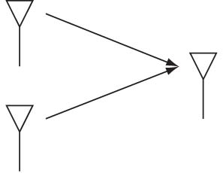


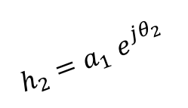
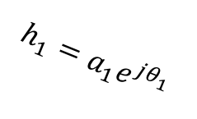
Transmit Beamforming
Leverage channel reciprocity, receive beamforming “in reverse”
Send one data symbol x from two antennas
$$a_{1}e^{−jθ_{1}}$$
$$h_{1}=a_{1}e^{jθ_{1}}$$
Tx 1
Receive
$$h_{2}{=a}_{1}e^{jθ_{2}}$$
Tx 2
$$a_{2}e^{−jθ_{2}}$$
Multiply (pre-code) x by the complex conjugate of each channel

Slide 24
Plan
Today: Diversity in Space
  Receive Diversity
  Transmit Diversity
    Channel reciprocity
    Transmit beamforming
    Introduction to Space-Time Coding: Alamouti’s Scheme
Next time: Multiplexing in Space
Next time: Interference Alignment

Slide 25
Alamouti Scheme: Motivation
Suppose transmitters don’t know CSI information to receiver: what to do?
Naïve beamforming (just send same signals)
  Signals would often cancel out
Repetition
  Each antenna takes turns transmitting same symbol
    Receiver combines coherently
  Use M symbol times
    Increases diversity (“SNR” term in Shannon capacity)
    Cuts Shannon rate by 1/M factor

Slide 26
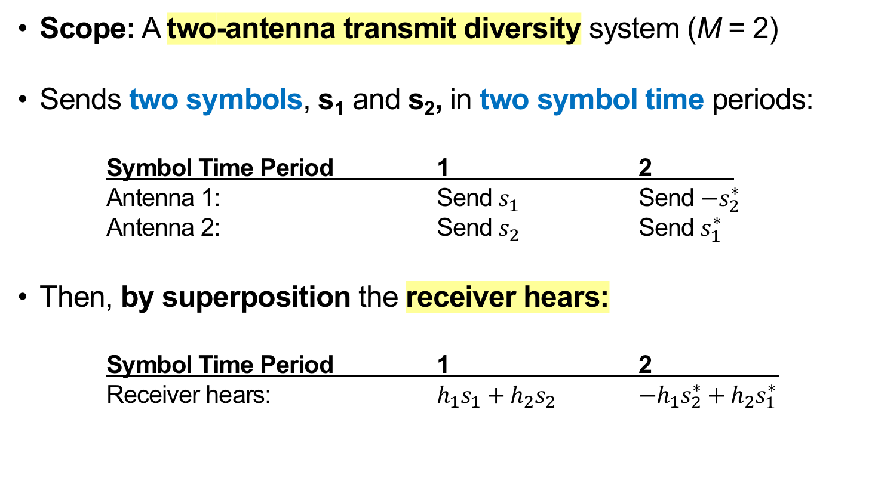
Alamouti Scheme
Scope: A two-antenna transmit diversity system (M = 2)
Sends two symbols, s₁ and s₂, in two symbol time periods:
Symbol Time Period 1 2
Antenna 1: Send $s_{1}$ Send $−s_{2}^{∗}$
Antenna 2: Send $s_{2}$ Send $s_{1}^{∗}$
Then, by superposition the receiver hears:
Symbol Time Period 1 2
Receiver hears: $h_{1}s_{1}+h_{2}s_{2}$ $−h_{1}s_{2}^{∗}+h_{2}s_{1}^{∗}$

Slide 27
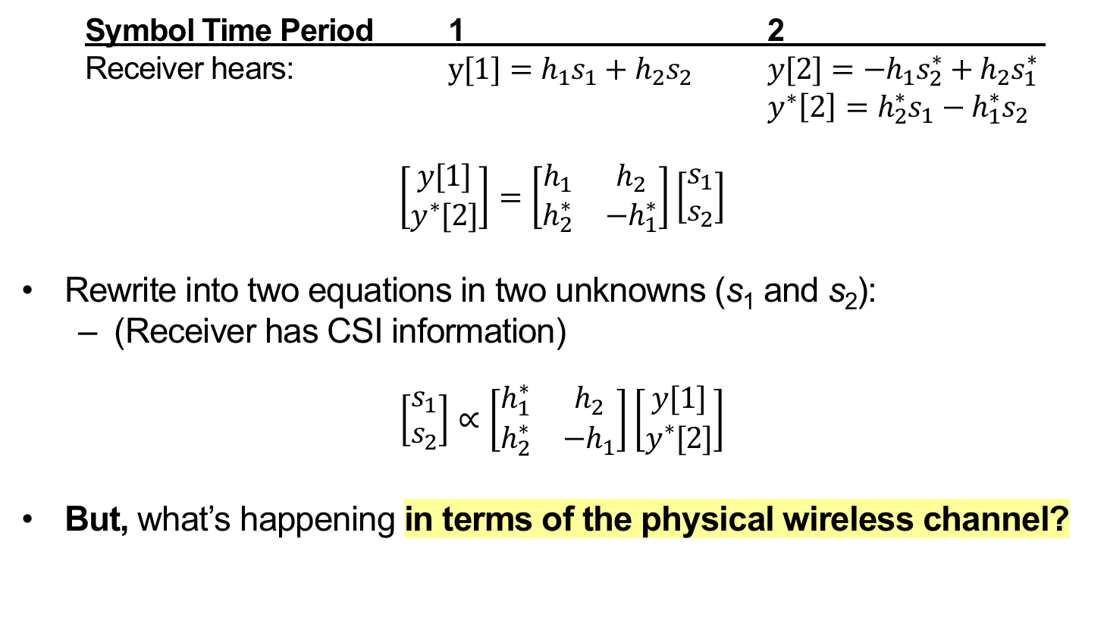
Alamouti Receiver Processing
Symbol Time Period 1 2
Receiver hears: $y[1]=h_{1}s_{1}+h_{2}s_{2}$ $y[2]=−h_{1}s_{2}^{∗}+h_{2}s_{1}^{∗}$
$y^{∗}\left[2\right]=h_{2}^{∗}s_{1}−h_{1}^{∗}s_{2}$
$$\left[\begin{matrix}y[1] \\ y^{∗}[2]\end{matrix}\right]=\left[\begin{matrix}h_{1} & h_{2} \\ h_{2}^{∗} & −h_{1}^{∗}\end{matrix}\right]\left[\begin{matrix}s_{1} \\ s_{2}\end{matrix}\right]$$
Rewrite into two equations in two unknowns (s₁ and s₂):
  (Receiver has CSI information)
$$\left[\begin{matrix}s_{1} \\ s_{2}\end{matrix}\right]∝\left[\begin{matrix}h_{1}^{∗} & h_{2} \\ h_{2}^{∗} & −h_{1}\end{matrix}\right]\left[\begin{matrix}y[1] \\ y^{∗}[2]\end{matrix}\right]$$
But, what’s happening in terms of the physical wireless channel?

Slide 28
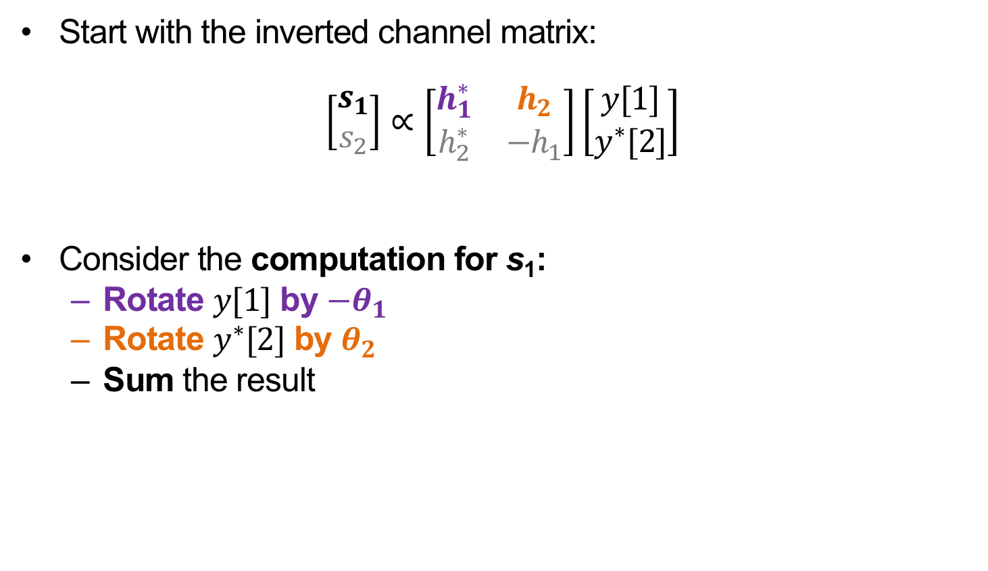
Intuition for Alamouti Receiver Processing
Start with the inverted channel matrix:
$$\left[\begin{matrix}s_{1} \\ s_{2}\end{matrix}\right]∝\left[\begin{matrix}h_{1}^{∗} & h_{2} \\ h_{2}^{∗} & −h_{1}\end{matrix}\right]\left[\begin{matrix}y[1] \\ y^{∗}[2]\end{matrix}\right]$$
Consider the computation for s₁:
  Rotate $y[1]$ by $−θ_{1}$
  Rotate $y^{∗}[2]$ by $θ_{2}$
  Sum the result

Slide 29
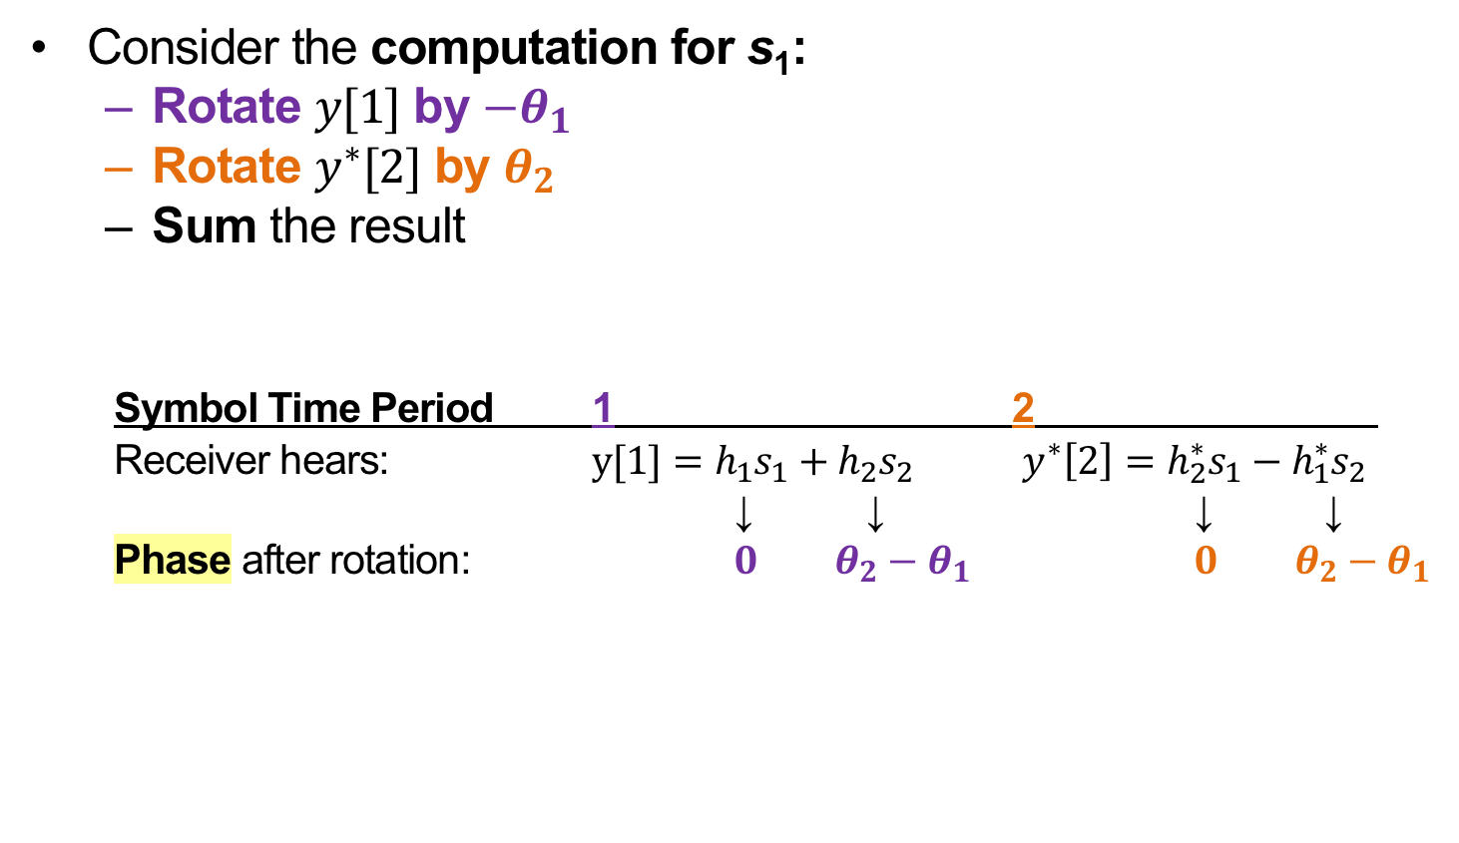
Alamouti: Impact of Phase Rotations
Consider the computation for s₁:
  Rotate $y[1]$ by $−θ_{1}$
  Rotate $y^{∗}[2]$ by $θ_{2}$
  Sum the result
Symbol Time Period 1 2
Receiver hears: $y[1]=h_{1}s_{1}+h_{2}s_{2}$ $y^{∗}\left[2\right]=h_{2}^{∗}s_{1}−h_{1}^{∗}s_{2}$
↓ ↓ ↓ ↓
Phase after rotation: $0$ $θ_{2}−θ_{1}$ $0$ $θ_{2}−θ_{1}$

Slide 30
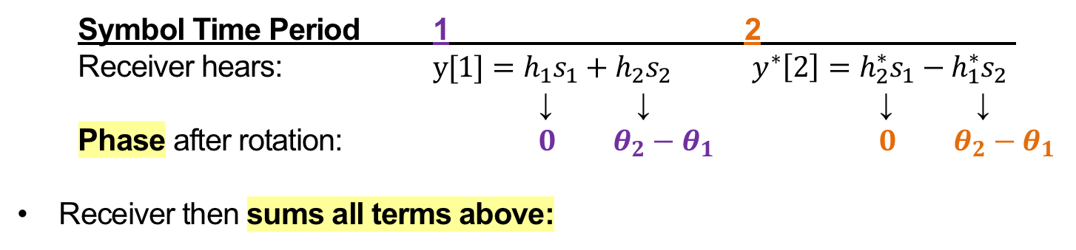

Alamouti: Receiver-Side Picture
Symbol Time Period 1 2
Receiver hears: $y[1]=h_{1}s_{1}+h_{2}s_{2}$ $y^{∗}\left[2\right]=h_{2}^{∗}s_{1}−h_{1}^{∗}s_{2}$
↓ ↓ ↓ ↓
Phase after rotation: $0$ $θ_{2}−θ_{1}$ $0$ $θ_{2}−θ_{1}$
Receiver then sums all terms above:
Received signal:
Q
$$∡θ_{2}−θ_{1}$$
s₂
s₂
s₁
s₁
I

Slide 31
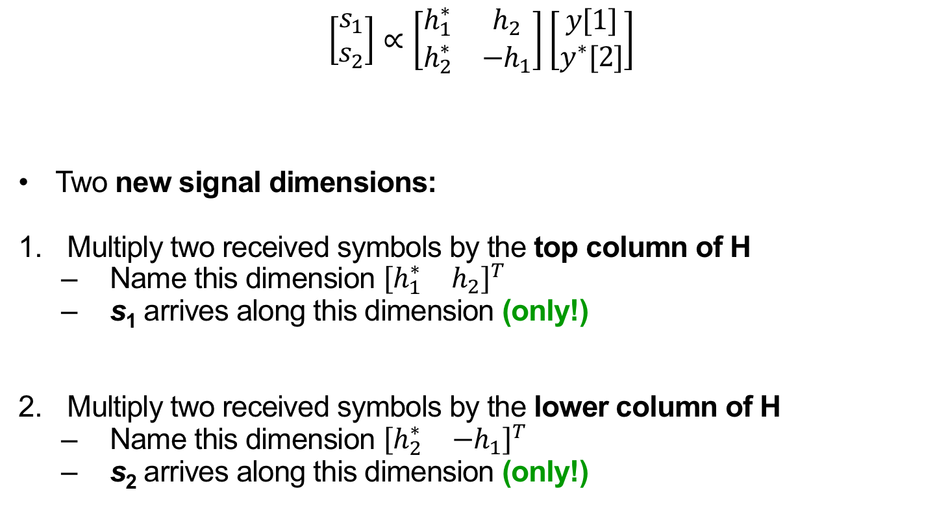
Alamouti: Interpretation
$$\left[\begin{matrix}s_{1} \\ s_{2}\end{matrix}\right]∝\left[\begin{matrix}h_{1}^{∗} & h_{2} \\ h_{2}^{∗} & −h_{1}\end{matrix}\right]\left[\begin{matrix}y[1] \\ y^{∗}[2]\end{matrix}\right]$$
Two new signal dimensions:
Multiply two received symbols by the top column of H
  Name this dimension ${\left[\begin{matrix}h_{1}^{∗} & h_{2}\end{matrix}\right]}^{T}$
  s₁ arrives along this dimension (only!)
Multiply two received symbols by the lower column of H
  Name this dimension ${\left[\begin{matrix}h_{2}^{∗} & {−h}_{1}\end{matrix}\right]}^{T}$
  s₂ arrives along this dimension (only!)
H

Slide 32
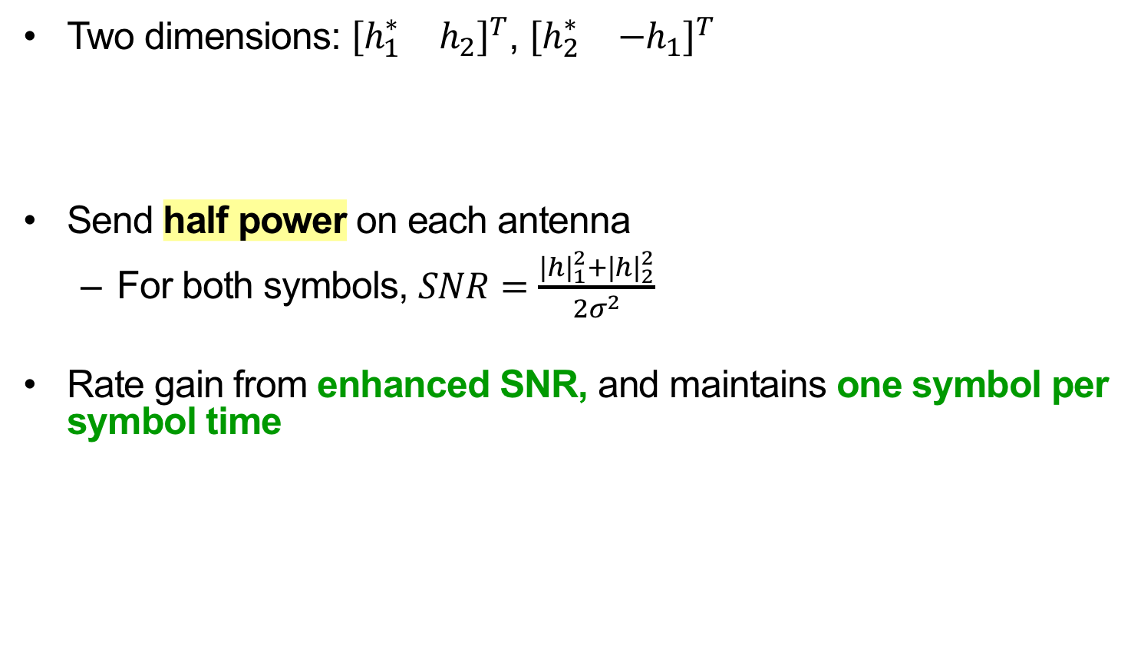
Alamouti: Performance
Two dimensions: ${\left[\begin{matrix}h_{1}^{∗} & h_{2}\end{matrix}\right]}^{T}$, ${\left[\begin{matrix}h_{2}^{∗} & {−h}_{1}\end{matrix}\right]}^{T}$
Send half power on each antenna
  For both symbols, $SNR=\frac{{|h|}_{1}^{2}+{|h|}_{2}^{2}}{2σ^{2}}$
Rate gain from enhanced SNR, and maintains one symbol per symbol time
Received
signal:
Q
s₁
s₁
I

Slide 33
Multi-Antenna Diversity: Summary
Leverage path diversity
  Decrease probability of “falling into” to deep Rayleigh fade on a single link
Defined new “dimensions” of independent communication channels based on space

Slide 34
Thursday Topic:
MIMO II: Spatial Multiplexing
Friday Precept:
Exploiting Doppler

