Slide 1
Receiver Designs for the
Radio Channel
COS 463: Wireless Networks
Lecture 15
Kyle Jamieson
[Parts adapted from C. Sodini, W. Ozan, J. Tan]

Slide 2
Today
Delay Spread and Frequency-Selective Fading
Time-Domain Equalization
Orthogonal Frequency Division Multiplexing

Slide 3
Last Time: Power Delay Profile,
Delay Spread, Excess Delay
a₂,d₂,τ₂
Transmitter
a₁,d₁,τ₁
Receiver
a₁
Power Delay Profile P(t)
a₁
a₂
RMS delay spread
τ₁
τ₂
t

Slide 4
Last Time: Multipath causes
Frequency Selectivity
Interference between reflected and line-of-sight radio waves results in frequency dependent fading

Slide 5
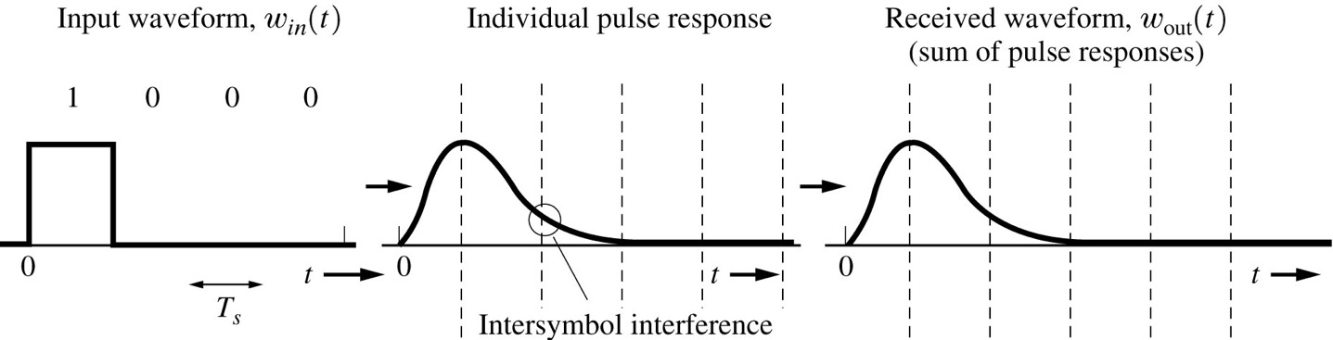
Problem: Inter-symbol interference (ISI)
Transmitted signal
Received signal with ISI

Slide 6
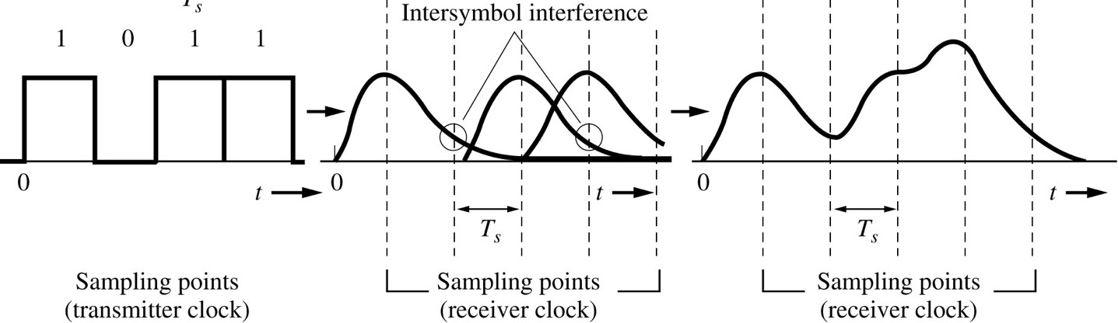
Problem: Inter-symbol interference (ISI)
Transmitted signal
Received signal with ISI
ISI at one symbol depends on the value of other symbols

Slide 7
Today
Delay Spread and Frequency-Selective Fading
Time-Domain Equalization
Orthogonal Frequency Division Multiplexing

Slide 8


Wideband System Design
Transmitter
Data d_{k}
p(t)
Transmit filter
Channel
h(t)
Receiver
y_{t}
y[n]
p*(−t)
h_{eq}(t)
$$\hat{dk}$$
Matched filter
Equalizer
$$f\left(t\right)=\left(p∗h\right)\left(t\right)∗p^{∗}(−t)$$
Composite channel f (made up of pulse shape, radio channel, and matched filter)

Slide 9
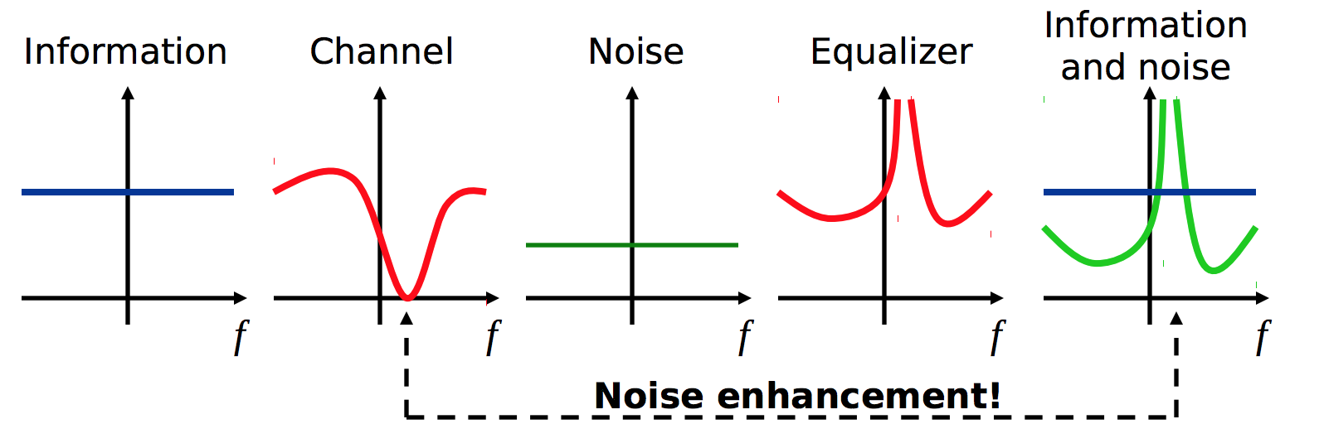
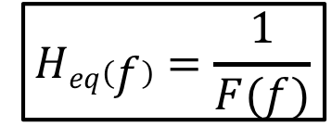

Zero-Forcing Equalizer
Receiver:
Receiver front-end noise: n_{k}
y_{t}
y[n]
+
p*(−t)
h_{eq}(t)
$$\hat{dk}$$
Matched filter
Equalizer
$$Heq\left(f\right)=\frac{1}{F(f)}$$

Slide 10
Physical Layer Preamble
Preamble
Packet body
Sequence of symbols known to both transmitter & receiver

Slide 11
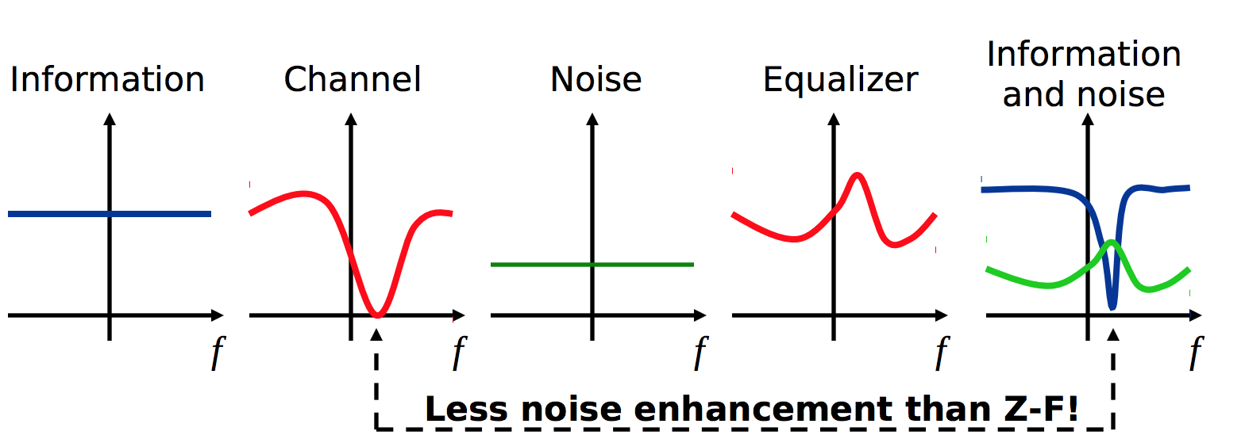
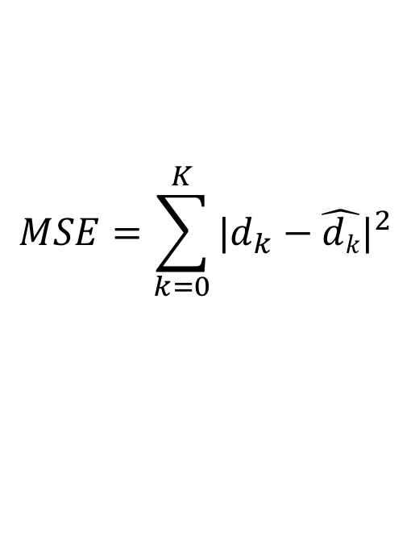
Minimal Mean-Squared Error Equalizer
Goal: h_{eq} that minimizes mean-squared error (MSE) between received and transmitted symbols from preamble
Assumes packet has a preamble, channel stays same over a packet time
$$MSE=\sum_{k=0}^{K}{{|d_{k}−\hat{dk}|}^{2}}$$

Slide 12
Decision-feedback Equalizer
Idea: Subtract the interference caused by already detected data (symbols)
Noise: n_{k}
Decision device
y_{t}
y[n]
+
+
p*(-t)
w (t)
+
$$\hat{dk}$$
-
Matched filter
Forward filter
d(t)
This part shapes the signal to work well with the decision feedback.
Feedback filter
This part removes ISI on future symbols from the currently detected symbols.

Slide 13
Decision-feedback Equalizer
Forward filter w(t) is a linear equalizer
  e.g., zero-forcing, MSE
The DFE has access to the symbol decisions, computes error signal to update feedback filter (complex!)
error
-
+
Noise: n_{k}
Decision device
y_{t}
y[n]
+
+
p*(-t)
w (t)
+
$$\hat{dk}$$
-
Matched filter
Forward filter
d(t)
Feedback filter

Slide 14
Today
The Culprits: Delay Spread and Frequency-Selective Fading
Time-Domain Equalization
Orthogonal Frequency Division Multiplexing

Slide 15
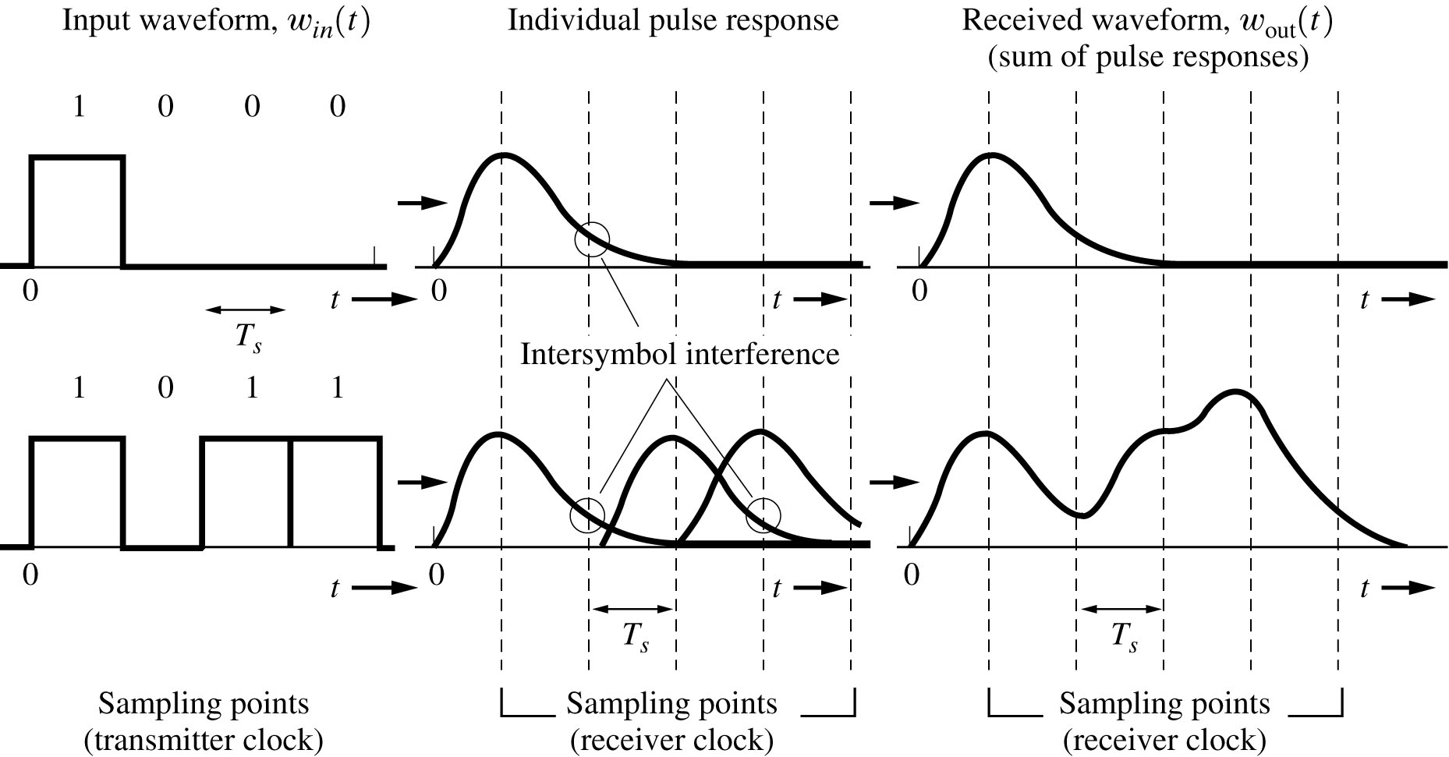
Problem: Inter-symbol interference (ISI)
Transmitted signal
Received signal with ISI

Slide 16
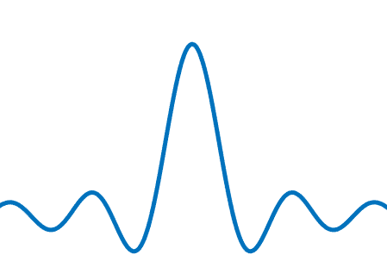
Symbol time determines frequency bandwidth
Symbol time
T
W
t
f
2T
W/2
t
f
Slowing down by a factor of two halves the frequency bandwidth of the sender’s signal

Slide 17

A narrowband signal “fits into” the coherence bandwidth
Over what frequency range is the channel approximately the same? This is the coherence bandwidth$W_{c}≈\frac{1}{2T_{d}}$
Coherence bandwidth W_{c}

Slide 18
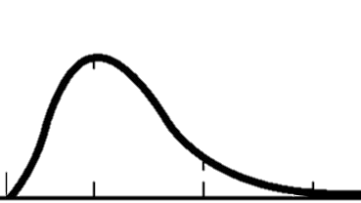
Simple Solution: Slow down
1
(double) T_{s}
No ISI
Transmitted signal
Received signal

Slide 19
Wideband versus OFDM
Wideband Signal
Frequency
Frequency selective fading
distorts wide-band signals
Multipath causes ISI
Time
Frequency
OFDM Signal
Narrowband
signals
Longer OFDM symbol time
Time

Slide 20
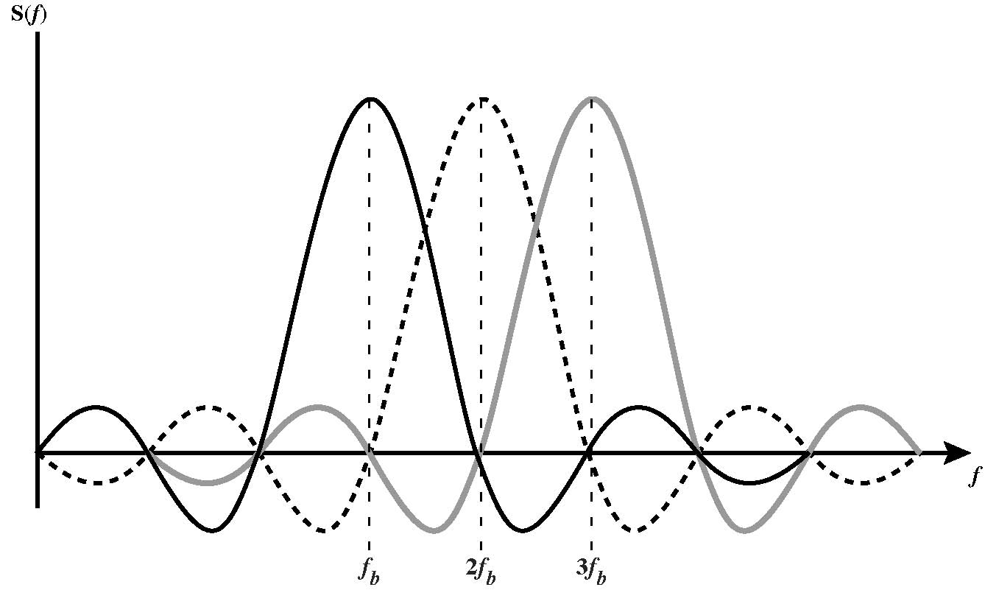
Subcarriers are “Orthogonal”
Peaks of each subcarrier coincide in frequency with zeros of other subcarriers
  Carriers can be packed very densely with minimal interference
  Requires very good control over frequencies

Slide 21
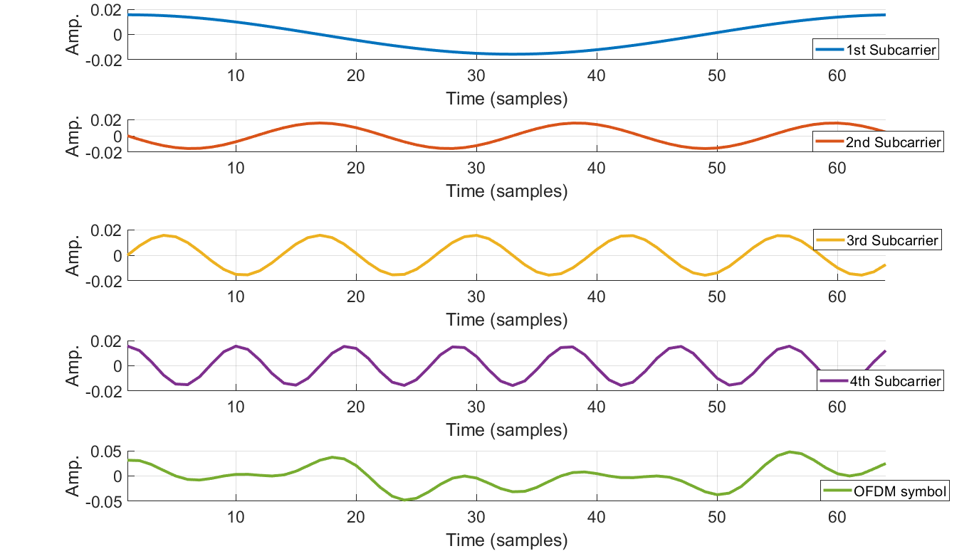
One OFDM symbol in time
New OFDM symbol time T_{s}

Slide 22
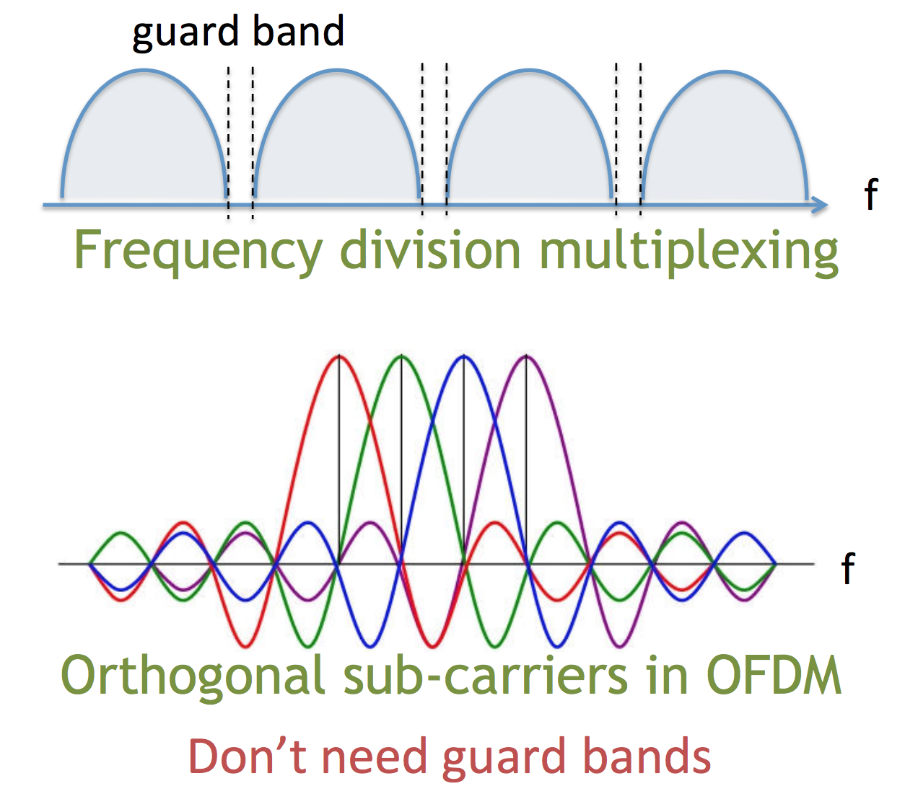
Difference between FDM and OFDM

Slide 23
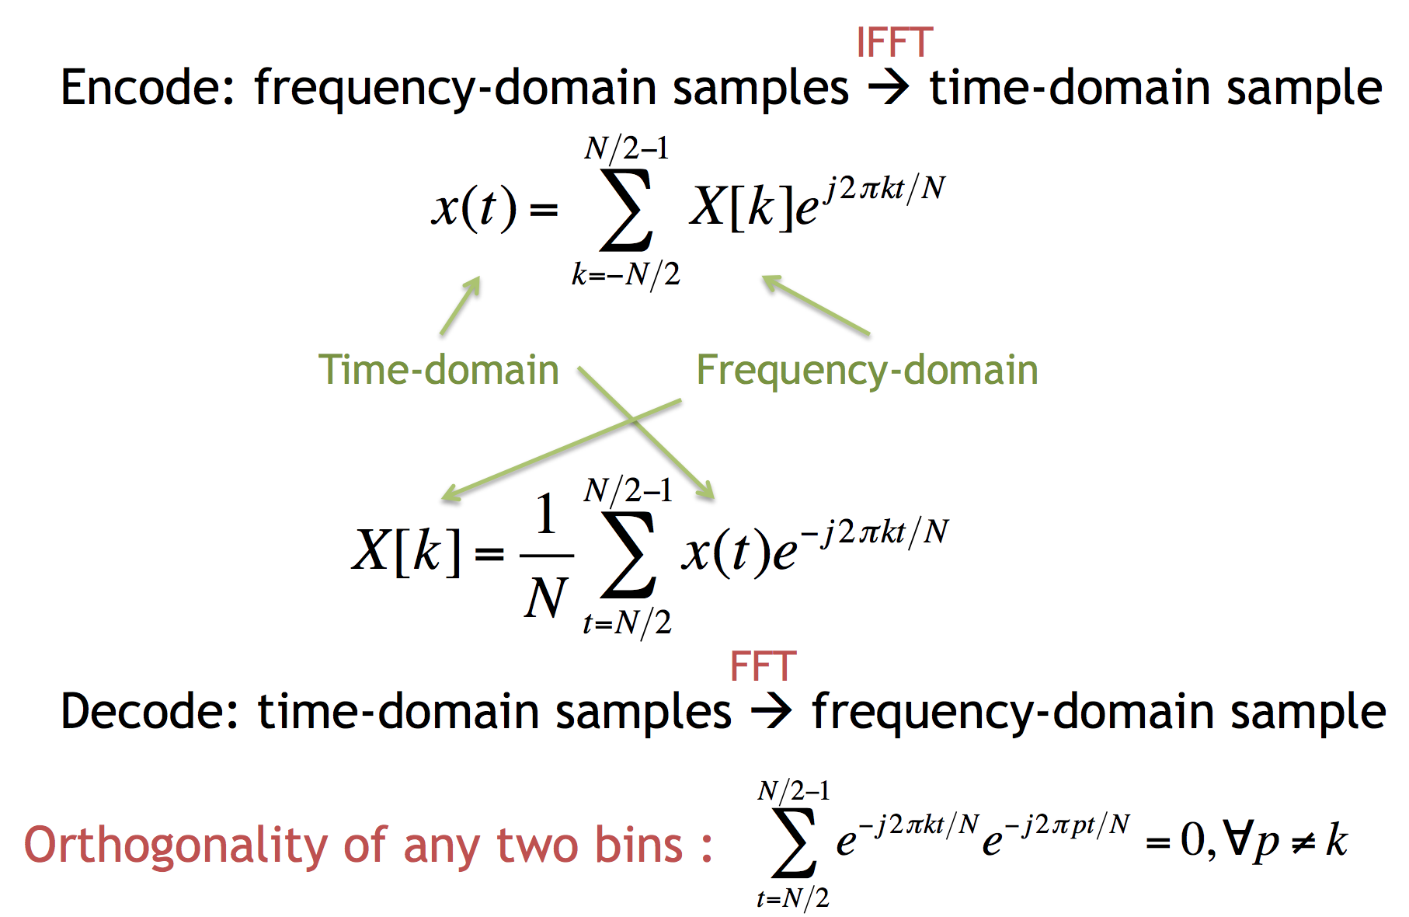
Orthogonality of Subcarriers

Slide 24
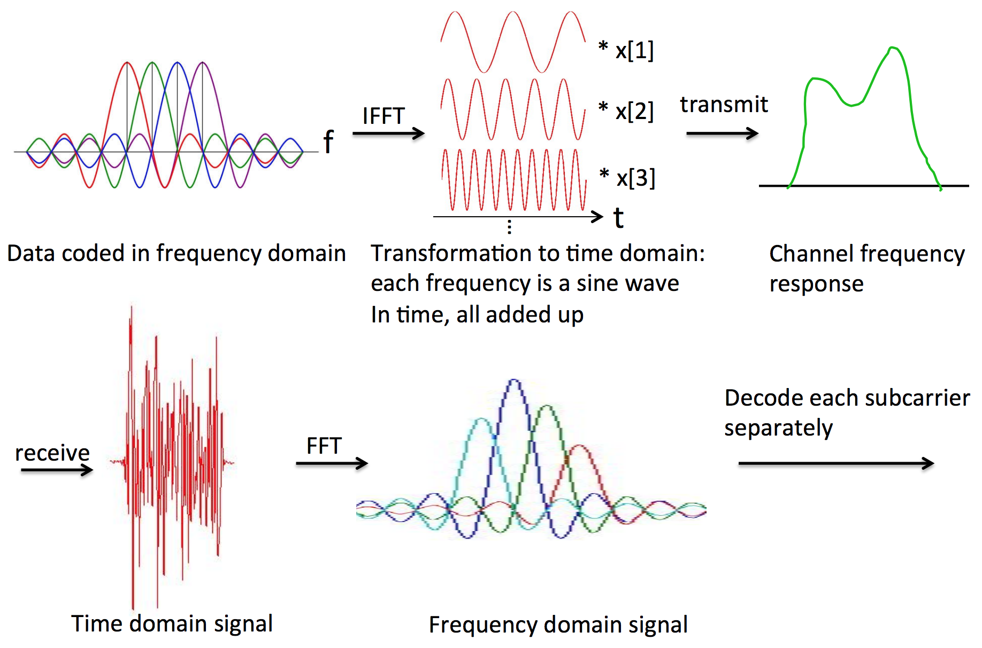
OFDM: System Design
Transmitter:
Receiver:

Slide 25
Problem: Inter-OFDM Symbol Interference

Slide 26
Problem: Receiver synchronization
1
2
3
Receiver:
1
2
3
Receiver’s view of Symbol 1 contains actual Symbols 1 and 2

Slide 27
Interference solution:
Inter-symbol guard interval
Guard interval between adjacent symbols mitigates adjacent symbol interference

Slide 28
Synchronization solution: Cyclic prefix
N_{fft}, T_{fft}
N_{s}, T_{s}
Receiver:
Symbol OK!

Slide 29
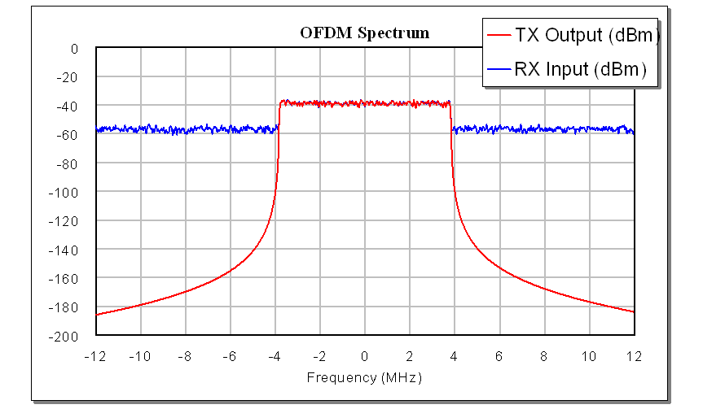
OFDM signal: Frequency-Domain view
Uniform power in the frequency domain over the OFDM signal bandwidth

Slide 30
OFDM signal: Time Domain View
Many low-frequency sinusoids in the time domain
Occasionally in time, many will all constructively interfere
  Result: High ratio of peak power / average power

Slide 31
Peak to Average Power & Transmit Amplifiers
Transmit power amplifier sits just before the transmit antenna
Peak power in non-linear region causes signal distortion
  So lower input signal level so that peak input power falls in linear region
Typical Transmit Power Amplifier Response (V_{out} / V_{in})
Put peak power here
High peak to average power ratio (PAPR) →
  Low average power level →
    Signal mostly uses fewer levels in discrete representation, so high quantization error (another form of distortion)

Slide 32
An OFDM Modem
N complex samples
N subchannels
S/P
quadrature amplitude modulation (QAM) encoder
N-IFFT
add cyclic prefix
P/S
D/A +
transmit filter
Bits
00110
TRANSMITTER
multipath channel
RECEIVER
N complex samples
N subchannels
P/S
QAM
decoder
invert channel
=
frequency
domain
equalizer
N-FFT
S/P
remove cyclic prefix
Receive filter
+
A/D

Slide 33
Estimating the Channel
Transmit known OFDM preamble symbol x
  In frequency domain on frequency i, denote preamble X_{i}
After FFT, hears frequency domain value Y_{i}

Slide 34
Packet detection
OFDM uses two identical, repeated symbols s₁, s₂ in the preamble for packet detection:
Receiver radio is always listening, receiving samples
  Call this received sample stream r[n]
s₁
s₂
Preamble
Packet body

Slide 35
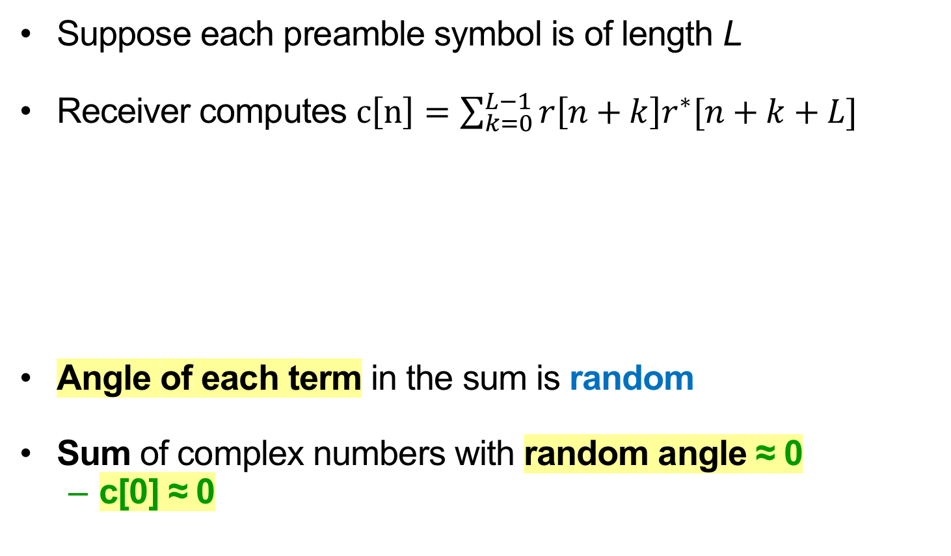
Searching for the preamble in noise
Suppose each preamble symbol is of length L
Receiver computes $c\left[n\right]=\sum_{k=0}^{L−1}{r\left[n+k\right]r^{∗}[n+k+L]}$
Angle of each term in the sum is random
Sum of complex numbers with random angle ≈ 0
  c[0] ≈ 0
Computing c[0]:
L
r[n]:
background noise
s₁
s₂
Packet body

Slide 36
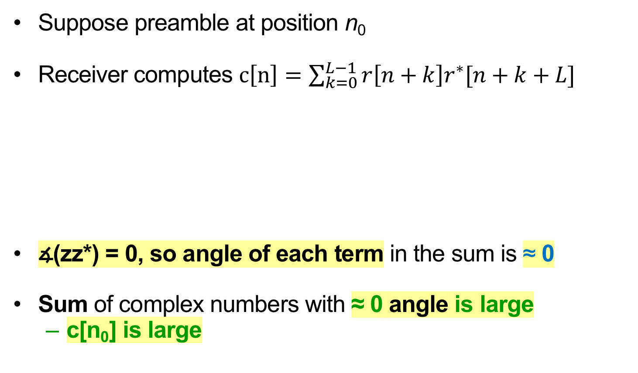
Search window encounters preamble
Suppose preamble at position n₀
Receiver computes $c\left[n\right]=\sum_{k=0}^{L−1}{r\left[n+k\right]r^{∗}[n+k+L]}$
∡(zz*) = 0, so angle of each term in the sum is ≈ 0
Sum of complex numbers with ≈ 0 angle is large
  c[n₀] is large
Computing c[n₀]:
L
r[n]:
background noise
s₁
s₂
Packet body
n₀

Slide 37
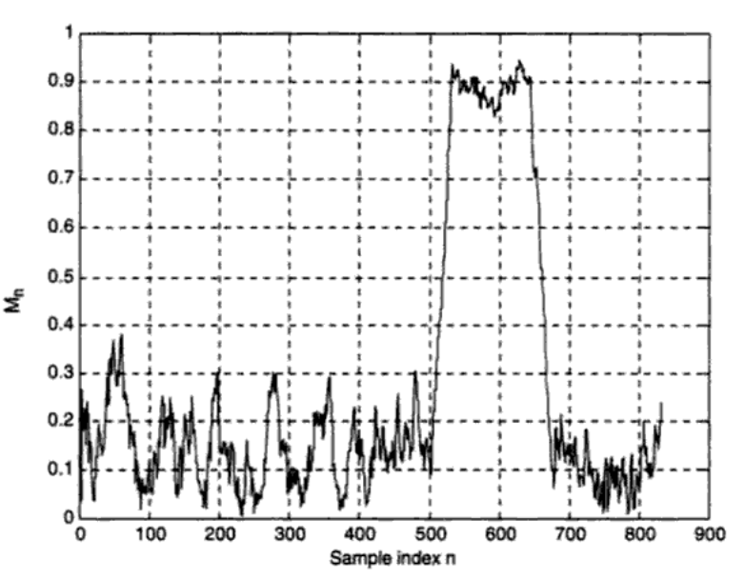
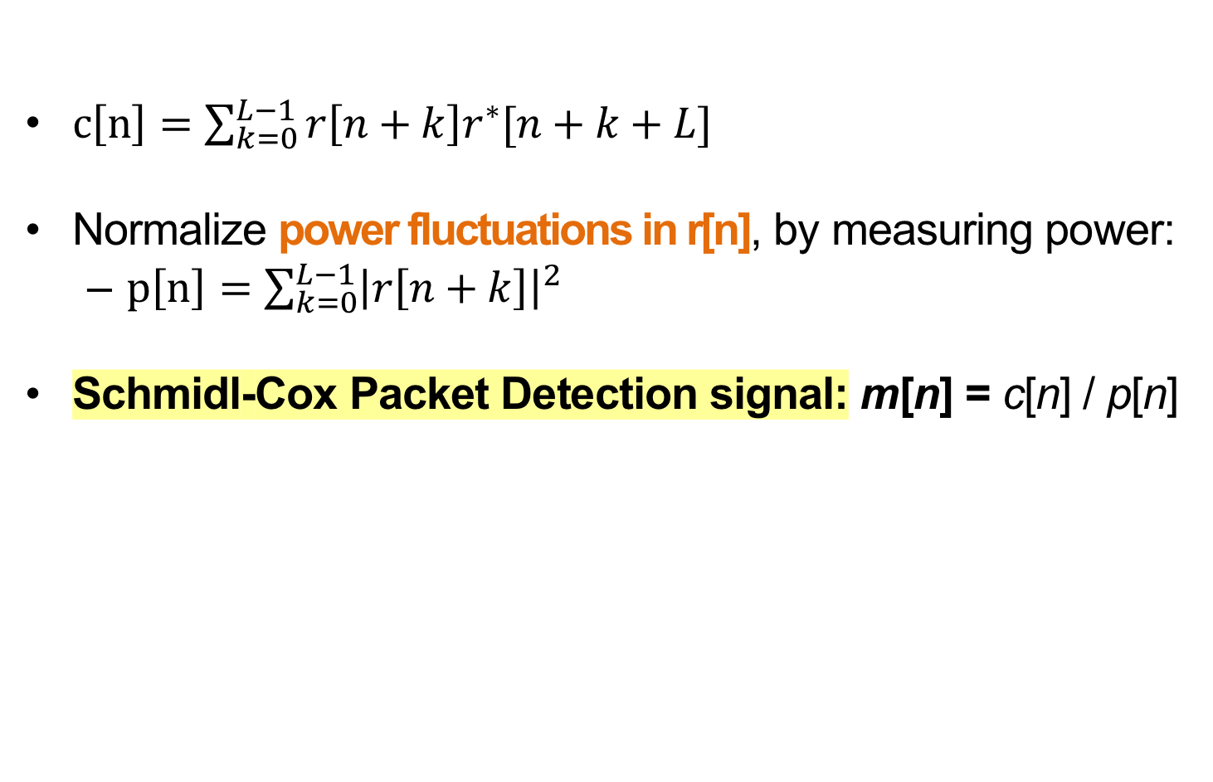
Schmidl-Cox Packet Detection
$c\left[n\right]=\sum_{k=0}^{L−1}{r\left[n+k\right]r^{∗}[n+k+L]}$
Normalize power fluctuations in r[n], by measuring power:
  $p\left[n\right]=\sum_{k=0}^{L−1}{{\left|r\left[n+k\right]\right|}^{2}}$
Schmidl-Cox Packet Detection signal: m[n] = c[n] / p[n]
Packet detection metric m[n]
Time samples n

Slide 38
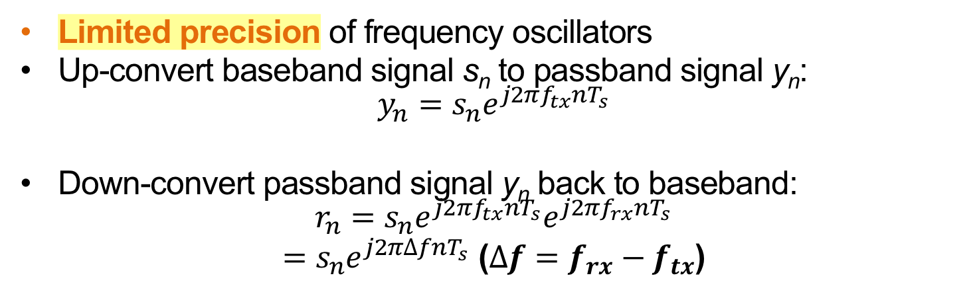
A Closer Look at Carrier Frequency Offset
Limited precision of frequency oscillators
Up-convert baseband signal s_{n} to passband signal y_{n}:
$$y_{n}=s_{n}e^{j2πf_{tx}nT_{s}}$$
Down-convert passband signal y_{n} back to baseband:
$$r_{n}=s_{n}e^{j2πf_{tx}nT_{s}}e^{j2πf_{rx}nT_{s}}$$
$=s_{n}e^{j2π∆fnT_{s}}$ ($∆f=f_{rx}−f_{tx}$)

Slide 39
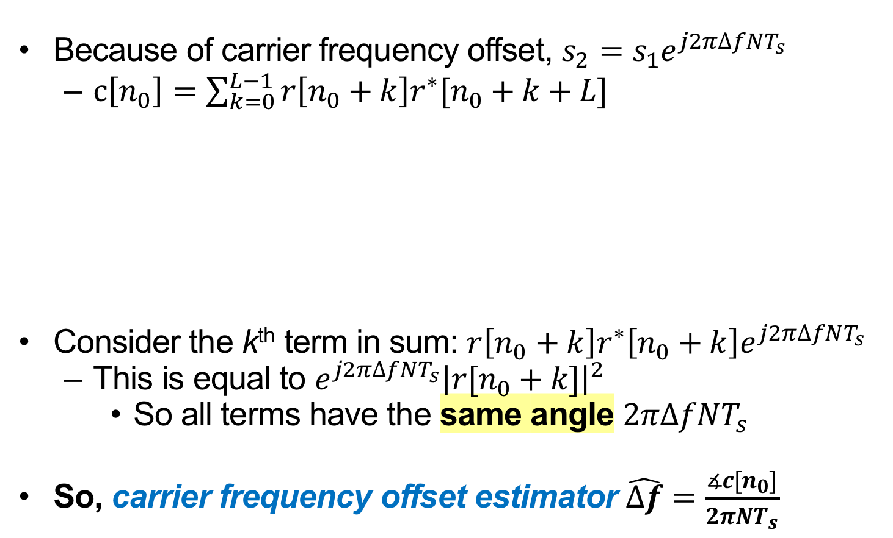
Estimating Carrier Frequency Offset
Because of carrier frequency offset, $s_{2}=s_{1}e^{j2π∆fNT_{s}}$
  $c\left[n_{0}\right]=\sum_{k=0}^{L−1}{r\left[n_{0}+k\right]r^{∗}[n_{0}+k+L]}$
Consider the k^{th} term in sum: $r\left[n_{0}+k\right]r^{∗}\left[n_{0}+k\right]e^{j2π∆fNT_{s}}$
  This is equal to $e^{j2π∆fNT_{s}}{\left|r[n_{0}+k]\right|}^{2}$
    So all terms have the same angle $2π∆fNT_{s}$
So, carrier frequency offset estimator $\hat{∆f}=\frac{∡c[n_{0}]}{2πNT_{s}}$
Computing c[n₀]:
L
r[n]:
background noise
s₁
s₂
Packet body
n₀

Slide 40
Sample Clock Offset
The transmitter and receiver may sample the signal at slightly different rates, leading to a sample time offset ζ
All subcarriers experience the same sampling delay, but travel over different frequencies

Slide 41
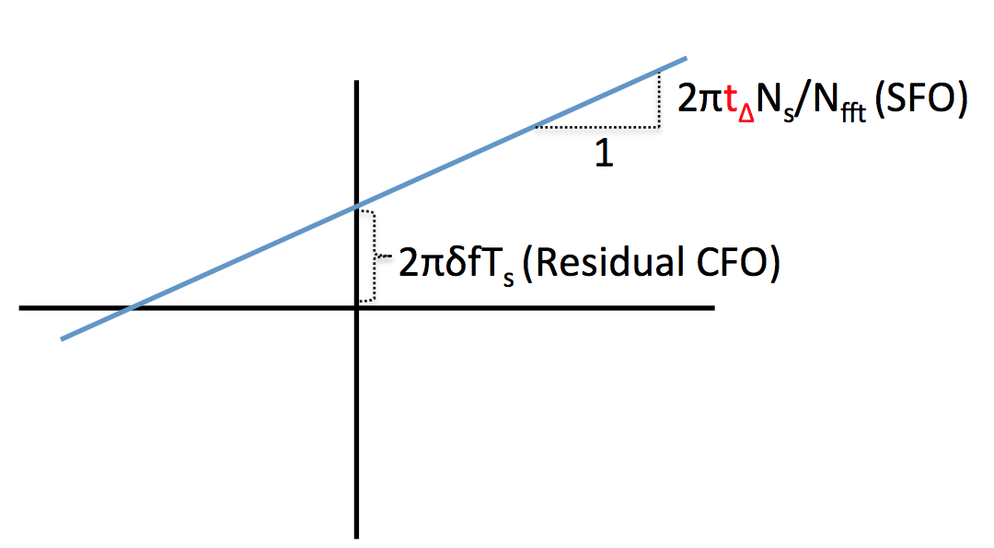

Correcting Sample Clock Offset in the Frequency Domain
$$2πζ\left(\frac{N_{s}}{N_{FFT}}\right)$$
⦟ H
f
Sample clock offset : slope
Residual CFO: intersection with y-axis

Slide 42
Per-subcarrier Bit Rate Choice

Slide 43
Example: IEEE 802.11a, 802.11g
OFDM with up to 48 subcarriers
  Subcarrier spacing is 312.5 KHz
  Subcarriers modulated: BPSK, QPSK, 16-QAM, or 64-QAM
Uses a convolutional code at a rate of ½, 2/3, ¾ , or 5/6 to provide forward error correction
Results in data rates of 6, 9, 12, 18, 24, 36, 48, and 54 MBps
Cyclic prefix is 25% of a symbol time (16 vs 64)

Slide 44
Friday Precept:
Lab 4: Single-carrier transceiver
on the HackRF hardware

