Slide 1
The Radio Channel
COS 463: Wireless Networks
Lecture 14
Kyle Jamieson
[Parts adapted from I. Darwazeh, A. Goldsmith, T. Rappaport, P. Steenkiste]

Slide 2
Motivation
The radio channel is what limits most radio systems – the main challenge!
  Understanding its properties is therefore key to understanding radio systems’ design
There is no single radio channel, but instead variation in many different properties
  Carrier frequency, environment (e.g. indoors, outdoors, satellite, space)
Many different models covering many different scenarios

Slide 3
Channel and Propagation Models
A channel model describes what happens
  Gives channel output power for a particular input power
  “Black Box” – no explanation of mechanism
  Requires appropriate statistical parameters (e.g. loss, fading)
A propagation model describes how it happens
  How signal gets from transmitter to receiver
  How energy is redistributed in time and frequency
  Can inform channel model parameters

Slide 4
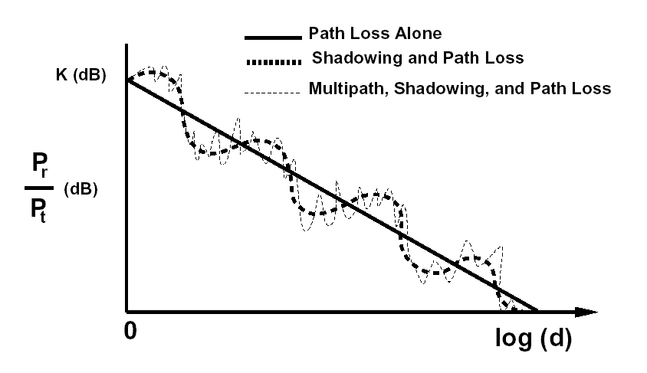

Modeling (from a high-level perspective)
$$\text{log}(\text{distance})$$

Slide 5
Today
Large scale channel models
  Free space model
  Two-ray ground model
Small-scale channel models
Equalization: Coping with the channel

Slide 6
The dBm unit
If we take one milliwatt as a reference then we have a unit of absolute power called dBm:
Where P₁ is the power we want to express in dBm, in Watts
Power (linear) | Power (dBm)
10 W | 40 dBm
1 W | 30 dBm
100 mW | 20 dBm
10 mW | 10 dBm
1 mW | 0 dBm
10 µW | -20 dBm
1 µW | -30 dBm
1 nW | -60 dBm
1 pW | -90 dBm

Slide 7
Goal: Power Budget
Tx Radio
Rx Radio
P_{RX} (dBm) = P_{TX} (dBm) + Gains (dB) – Losses (dB)
Receiver needs a certain SINR to be able to decode the signal
Factors reducing power budget:
  Noise, attenuation (multiple sources), longer range, fading
Factors improving power budget:
  Antenna gain, transmit power

Slide 8
Large-Scale Channel Models
Goal: Predict average received signal strength given a transmitter-receiver separation distance

Slide 9
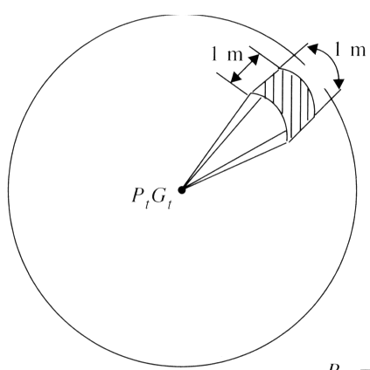
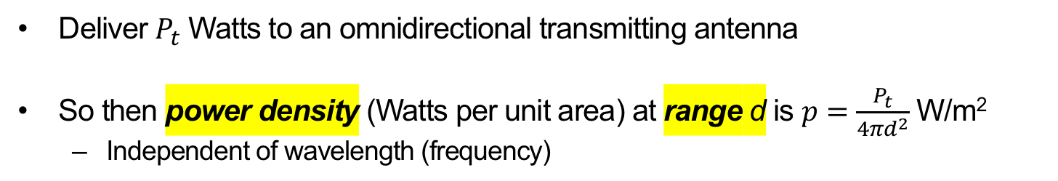



Transmitting in Free Space
unit area
$$P_{t}$$
$$d$$
Total spherical surface area: $4πd^{2}$
Deliver $P_{t}$ Watts to an omnidirectional transmitting antenna
So then power density (Watts per unit area) at range d is $p=\frac{P_{t}}{4πd^{2}}$ W/m²
  Independent of wavelength (frequency)

Slide 10
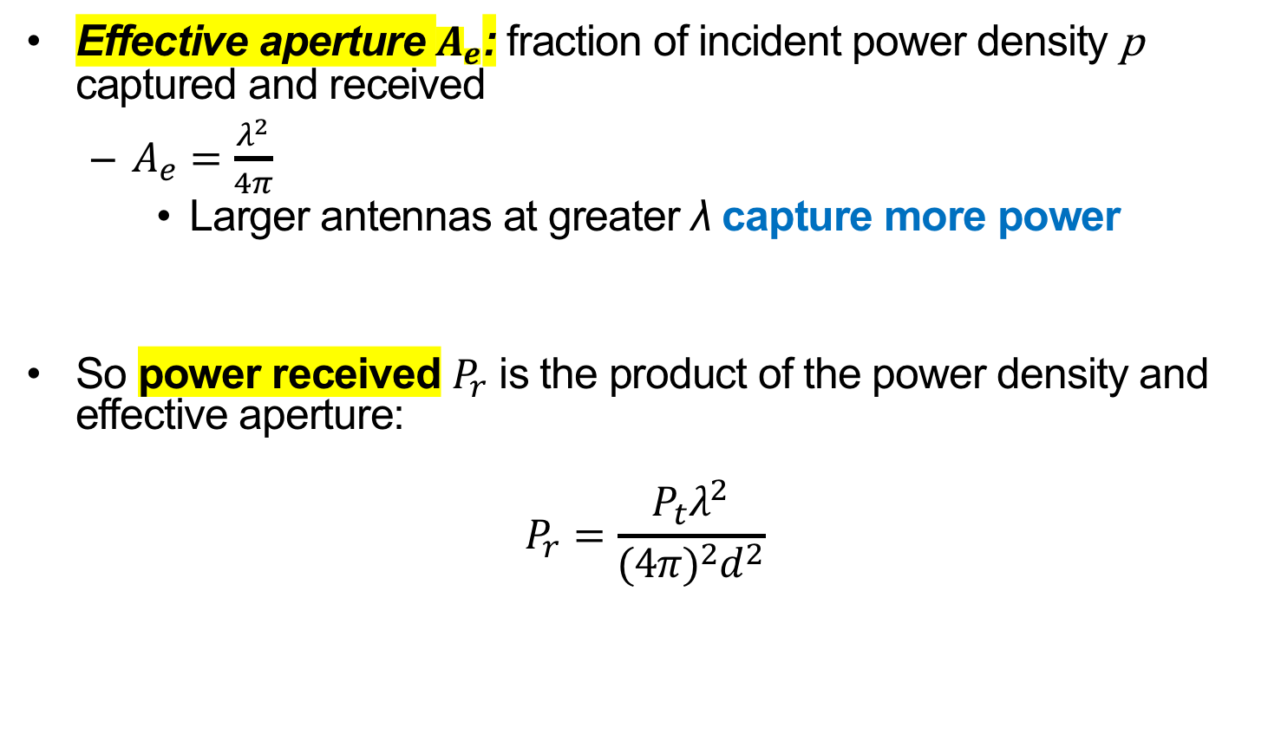
Idealized Receive Antenna
Effective aperture $A_{e}$: fraction of incident power density p captured and received
  $A_{e}=\frac{λ^{2}}{4π}$
    Larger antennas at greater λ capture more power
So power received $P_{r}$ is the product of the power density and effective aperture:
$$P_{r}=\frac{P_{t}λ^{2}}{{(4π)}^{2}d^{2}}$$

Slide 11
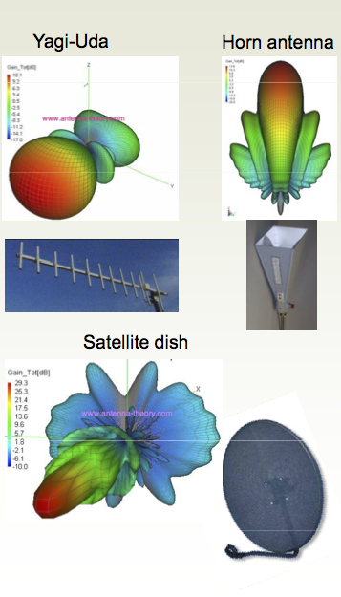
Antenna Gain
Antennas don’t radiate power equally in all directions
  Specific to the antenna design
Model these gains in the directions of interest between transmitter, receiver:
  Transmit antenna gain G_{t}
  Receive antenna gain G_{r}

Slide 12

Friis Free Space Channel Model
Power received $P_{r}$ is the product of the power received by idealized antennas, times transmit and receive antenna gains:
$$P_{r}=\frac{P_{t}G_{t}G_{r}λ^{2}}{{(4π)}^{2}d^{2}}$$

Slide 13
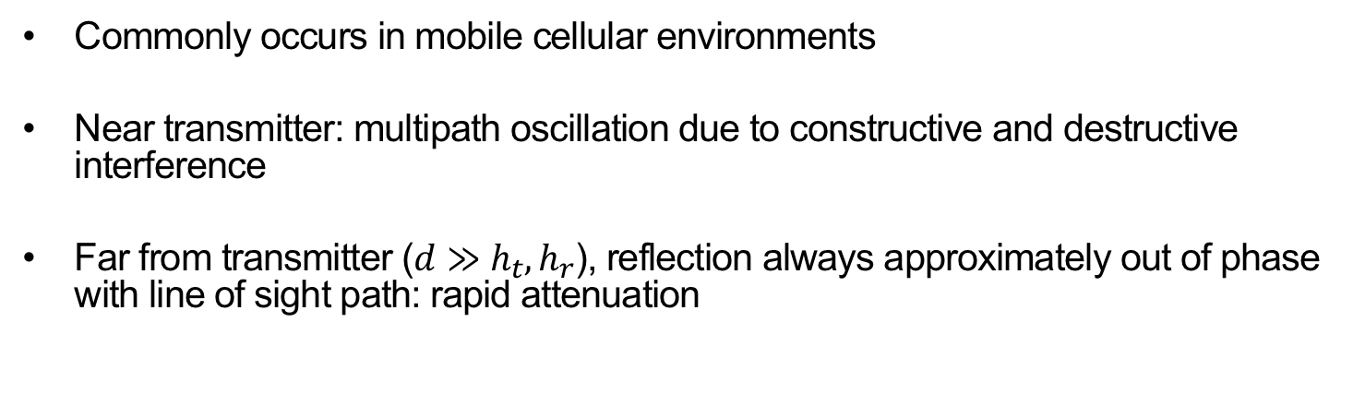



Ground Reflection (Two-Ray)
Propagation Model
Transmitter
Receiver
$$h_{t}$$
$$h_{r}$$
$$d$$
Commonly occurs in mobile cellular environments
Near transmitter: multipath oscillation due to constructive and destructive interference
Far from transmitter ($d≫h_{t}, h_{r}$), reflection always approximately out of phase with line of sight path: rapid attenuation

Slide 14
Today
Large scale channel models
Small-scale channel models
Equalization: Coping with the channel

Slide 15
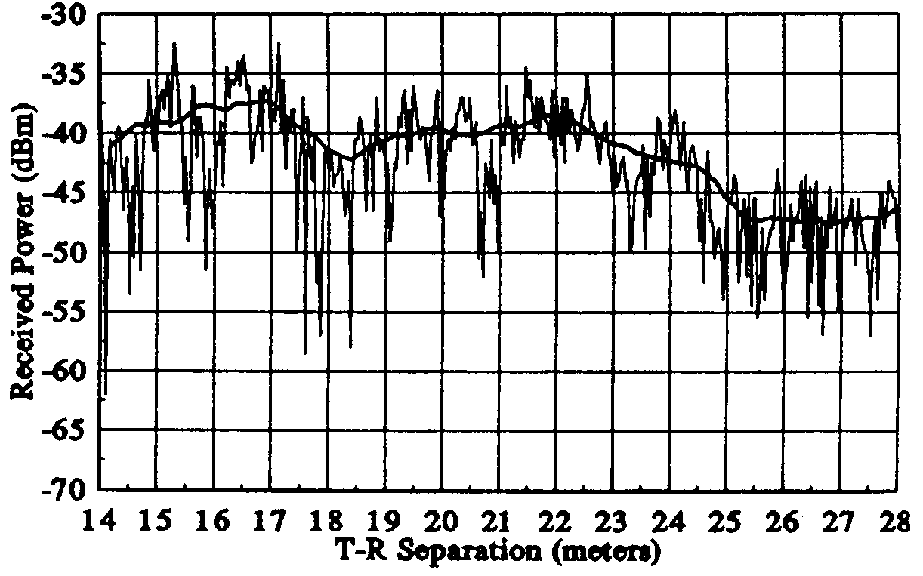
Small-scale versus large-scale modeling
Small-scale models: Characterize the channel over at most a few wavelengths or a few seconds

Slide 16
Radio Propagation Mechanisms
reflection
scattering
diffraction
Reflection
  Propagation wave impinges on object large compared to λ
    e.g. the surface of the Earth, buildings, walls, etc.
Diffraction
  Path from transmitter to receiver obstructed by surface with sharp irregular edges
  Waves bend around obstacle, even when LOS (line of sight) does not exist
Scattering
  Objects smaller than radio wavelength (i.e. foliage, street signs etc.)

Slide 17
Multipath Radio Propagation
Receiver gets multiple copies of signal
  Each copy follows different path, with different path length
  Copies can either strengthen or weaken each other
    Depends on whether they are in or out of phase
Enables communication even when transmitter and receiver are not in “line of sight”
  Allows radio waves effectively to propagate around obstacles, thereby increasing the radio coverage area
Transmitter, receiver, or environment object movement on the order of λ significantly affects the outcome
  e.g. 2.4 GHz → λ = 12 cm, 900 MHz → ≈ 1 ft

Slide 18

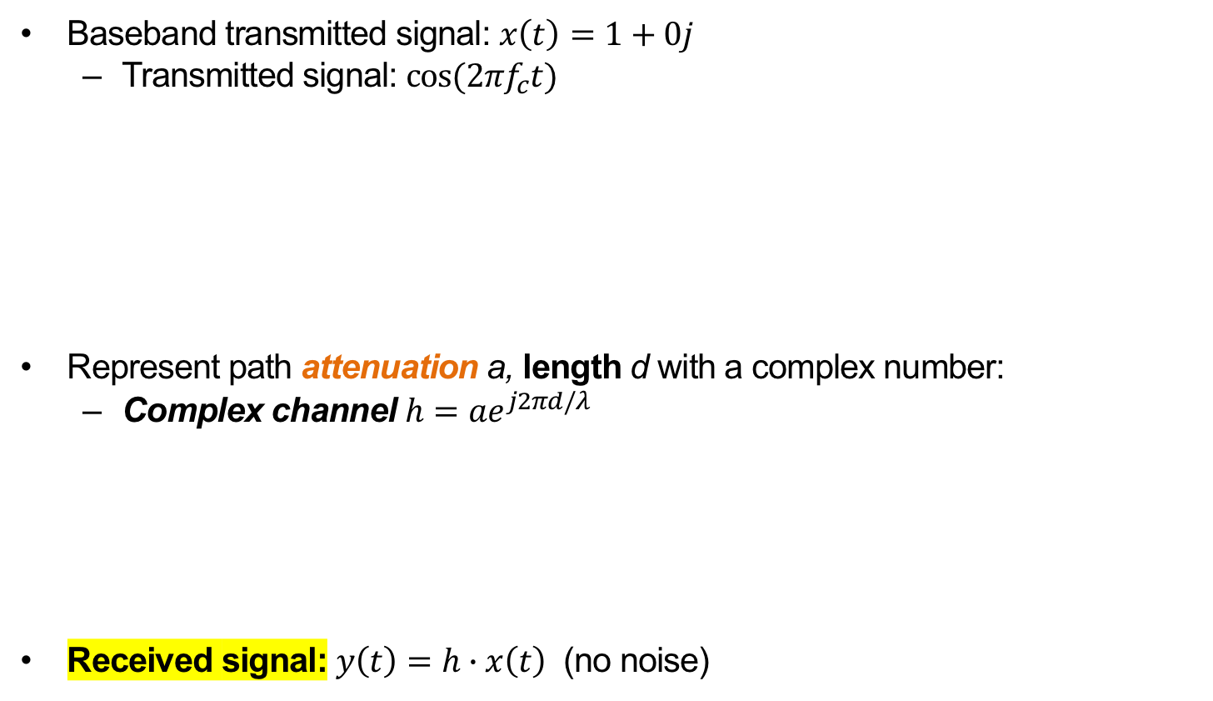


Sinusoidal carrier, line of sight only
Baseband transmitted signal: $x\left(t\right)=1+0j$
  Transmitted signal: $\cos{(2πf_{c}t)}$
Represent path attenuation a, length d with a complex number:
  Complex channel $h=ae^{j2πd/λ}$
Received signal: $y\left(t\right)=h∙x\left(t\right)$ (no noise)
Transmitter
a, d, τ
Receiver
$$a$$
$$2π(d \text{mod} λ)$$

Slide 19
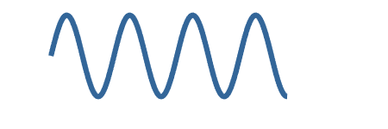
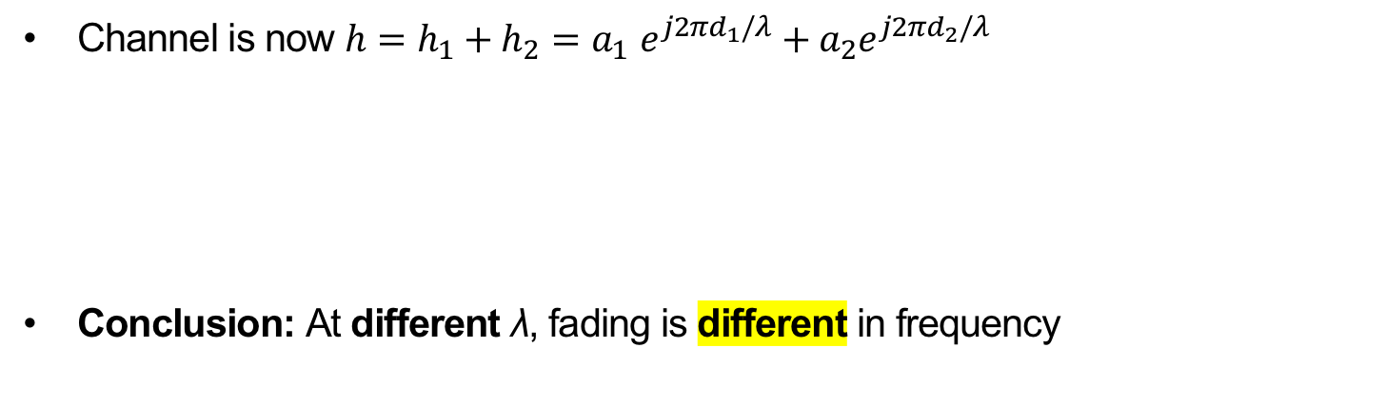
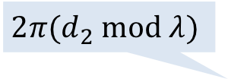
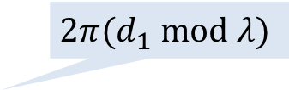
Adding a reflecting path
h₂ (a₂,d₂,τ₂)
Transmitter
h₁ (a₁=1,d₁,τ₁)
Receiver
Channel is now $h=h_{1}+h_{2}{=a}_{1}e^{j2πd_{1}/λ}+a_{2}e^{j2πd_{2}/λ}$
Conclusion: At different λ, fading is different in frequency
$$2π(d_{2} \text{mod} λ)$$
h₁
$$2π(d_{1} \text{mod} λ)$$
h₂

Slide 20
Reflections cause frequency selectivity
Interference between reflected and line-of-sight radio waves results in frequency dependent fading
Coherence bandwidth B_{c}: Frequency range over which the channel is roughly the same (“flat”)

Slide 21
How does frequency selectivity arise?
(Another look)
Path 2
Transmitter
Path 1
Receiver

Slide 22
How does frequency selectivity arise?
(Another look)
Receive antenna
d₂−d₁
Path 1
(shorter):
← Distance from receive antenna
Path 2
(longer):
Sum:

Slide 23
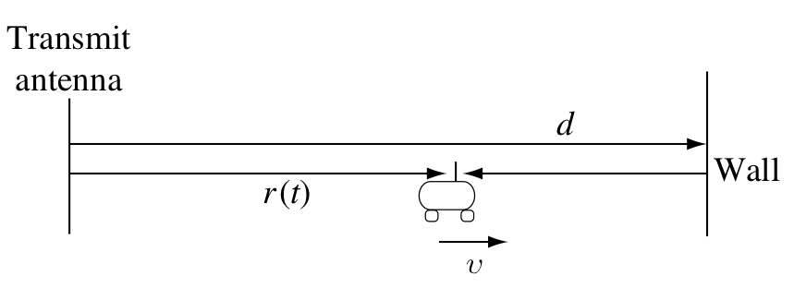
Stationary transmitter, moving receiver
Receiver
antenna
Suppose reflecting wall, fixed transmit antenna, no other objects
  Receive antenna moving rightwards at velocity v
Two arriving signals at receiver antenna with path length difference 2(d − r(t))

Slide 24
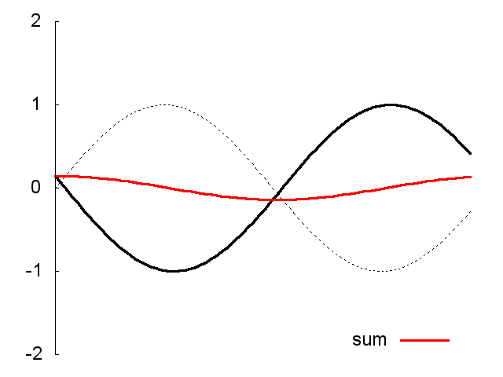
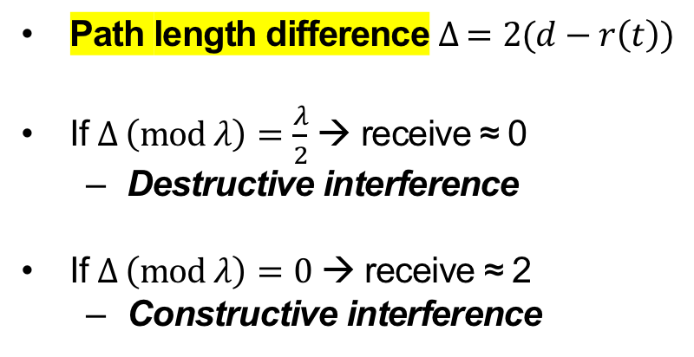
How does fading in time arise?
Receiver
antenna
Path length difference $∆ =2(d−r\left(t\right))$
If $∆ \left(\text{mod} λ\right)=\frac{λ}{2}$ → receive ≈ 0
  Destructive interference
If $∆ \left(\text{mod} λ\right)=0$ → receive ≈ 2
  Constructive interference
λ/2
λ
sum

Slide 25
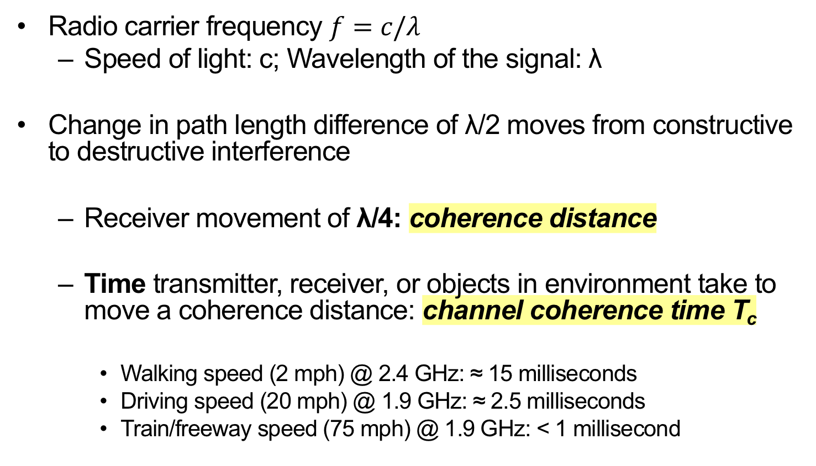
Channel Coherence Time
Radio carrier frequency $f=c/λ$
  Speed of light: c; Wavelength of the signal: λ
Change in path length difference of λ/2 moves from constructive to destructive interference
  Receiver movement of λ/4: coherence distance
  Time transmitter, receiver, or objects in environment take to move a coherence distance: channel coherence time T_{c}
    Walking speed (2 mph) @ 2.4 GHz: ≈ 15 milliseconds
    Driving speed (20 mph) @ 1.9 GHz: ≈ 2.5 milliseconds
    Train/freeway speed (75 mph) @ 1.9 GHz: < 1 millisecond

Slide 26
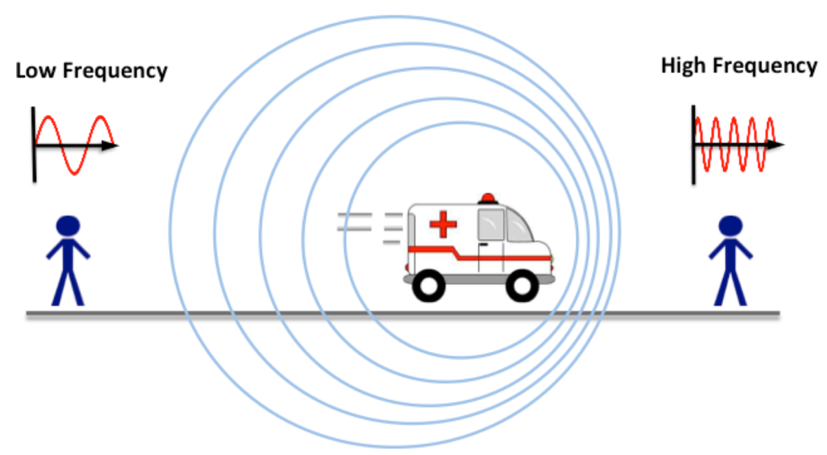

Another perspective: Doppler Effect
Movement by the transmitter, receiver, or objects in the environment creates a Doppler Shift
$$∆f=\left(\frac{v}{c}\right)f$$
v →

Slide 27
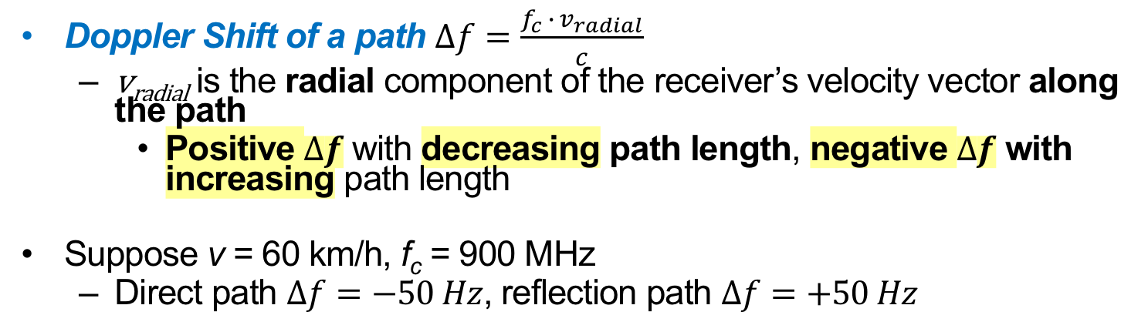
Stationary transmitter, moving receiver:
From a Doppler Perspective
Receiver
antenna
Doppler Shift of a path $∆f=\frac{f_{c}{ ∙ v}_{radial}}{c}$
  v_{radial} is the radial component of the receiver’s velocity vector along the path
    Positive $∆f$ with decreasing path length, negative $∆f$ with increasing path length
Suppose v = 60 km/h, f_{c} = 900 MHz
  Direct path $∆f=−50 Hz$, reflection path $∆f=+50 Hz$

Slide 28
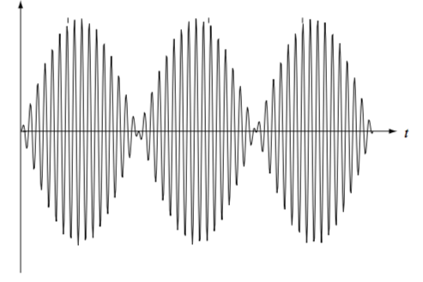
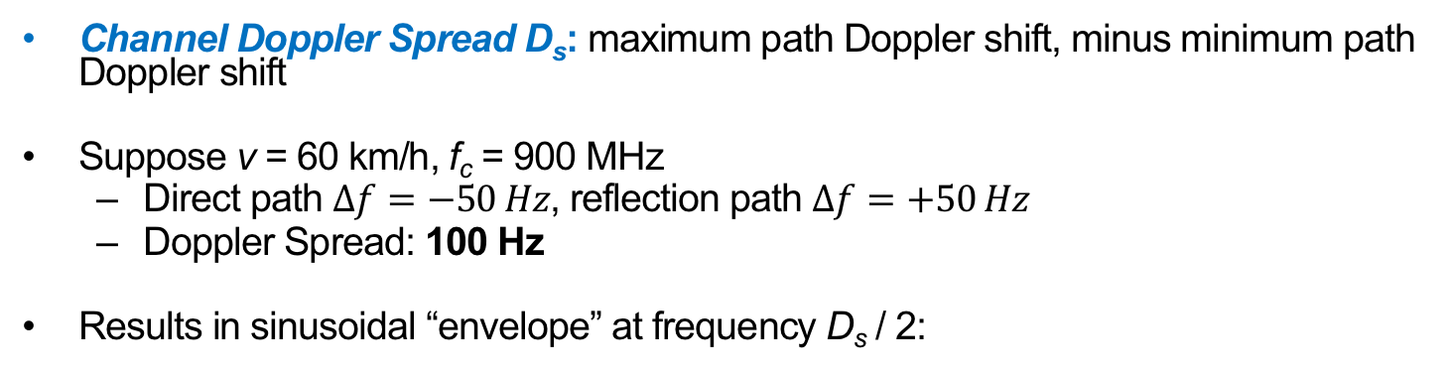
Stationary transmitter, moving receiver:
From a Doppler Perspective
Channel Doppler Spread D_{s}: maximum path Doppler shift, minus minimum path Doppler shift
Suppose v = 60 km/h, f_{c} = 900 MHz
  Direct path $∆f=−50 Hz$, reflection path $∆f=+50 Hz$
  Doppler Spread: 100 Hz
Results in sinusoidal “envelope” at frequency D_{s} / 2:
Received signal
5 ms
Receiver
antenna

Slide 29


Channel Coherence Time:
From a Doppler Perspective
Sinusoidal “envelope” at frequency $\frac{D_{s}}{2}$:
Transition from 0 to peak in $\frac{1}{2D_{s}}$
  So qualitatively significant change in time $T_{c}=\frac{1}{4D_{s}}$
    Alternate definition of channel coherence time
Received signal
$$\frac{D_{s}}{2}$$

Slide 30
What does the channel look like in time?
a₂,d₂,τ₂
Transmitter
a₁,d₁,τ₁
Receiver
a₁
Channel impulse response h(t)
a₁
a₂
Delay spread T_{d}
τ₁
τ₂
t

Slide 31

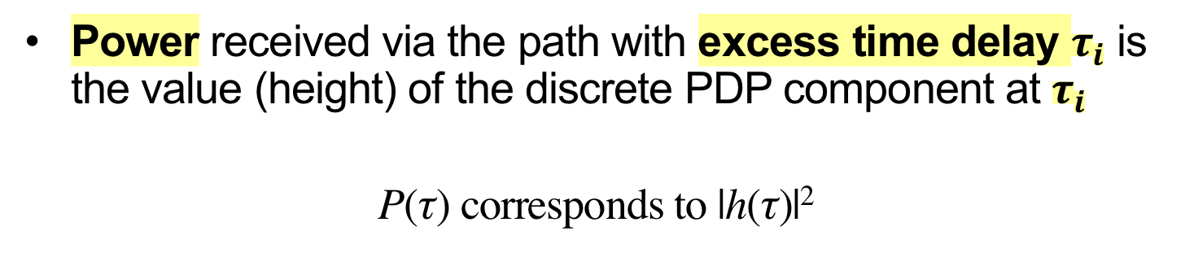




Power delay profile (PDP)
Power received via the path with excess time delay $τ_{i}$ is the value (height) of the discrete PDP component at $τ_{i}$
P(τ) corresponds to |h(τ)|²
P(τ)
τ
0
$$τ_{1}$$
$$τ_{2}$$
$$τ_{3}$$
$$τ_{4}$$
$$τ_{5}$$

Slide 32
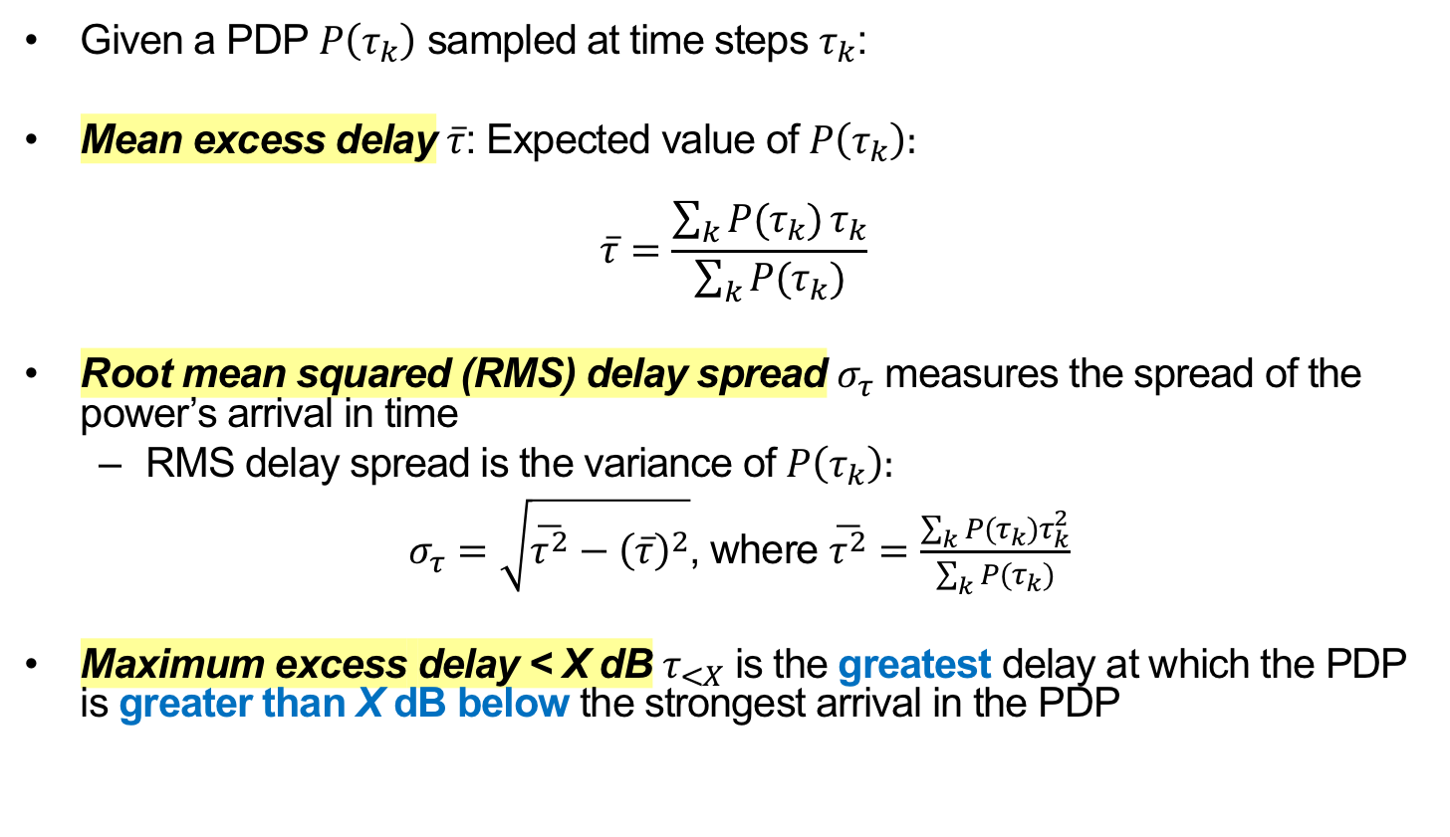
Characterizing a power delay profile
Given a PDP $P\left(τ_{k}\right)$ sampled at time steps $τ_{k}$:
Mean excess delay $\overline{τ}$: Expected value of $P\left(τ_{k}\right):$
$$\overline{τ}=\frac{\sum_{k}{P(τ_{k})}τ_{k}}{\sum_{k}{P(τ_{k})}}$$
Root mean squared (RMS) delay spread $σ_{τ}$ measures the spread of the power’s arrival in time
  RMS delay spread is the variance of $P\left(τ_{k}\right):$
$σ_{τ}=\sqrt{\overline{τ^{2}}−{\left(\overline{τ}\right)}^{2}}$, where $\overline{τ^{2}}=\frac{\sum_{k}{P(τ_{k})τ_{k}^{2}}}{\sum_{k}{P(τ_{k})}}$
Maximum excess delay < X dB $τ_{<X}$ is the greatest delay at which the PDP is greater than X dB below the strongest arrival in the PDP

Slide 33
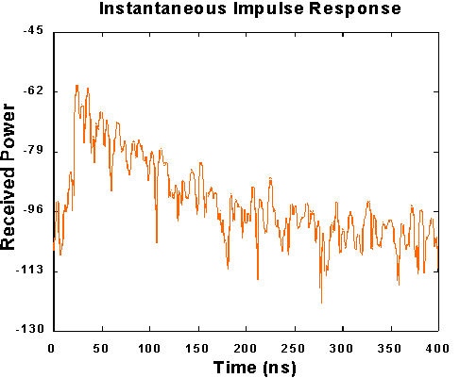
Example Indoor PDP Estimation
Typical RMS delay spreads
Environment | RMS delay spread
Indoor cell | 10 – 50 ns
Satellite mobile | 40 – 50 ns
Open area (rural) | < 0.2 𝛍s
Suburban macrocell | < 1 𝛍s
Urban macrocell | 1 – 3 𝛍s
Hilly macrocell | 3 – 10 𝛍s
Finite bandwidth of measurement normally results in continuous PDP
PDP typically has a decaying exponential form

Slide 34
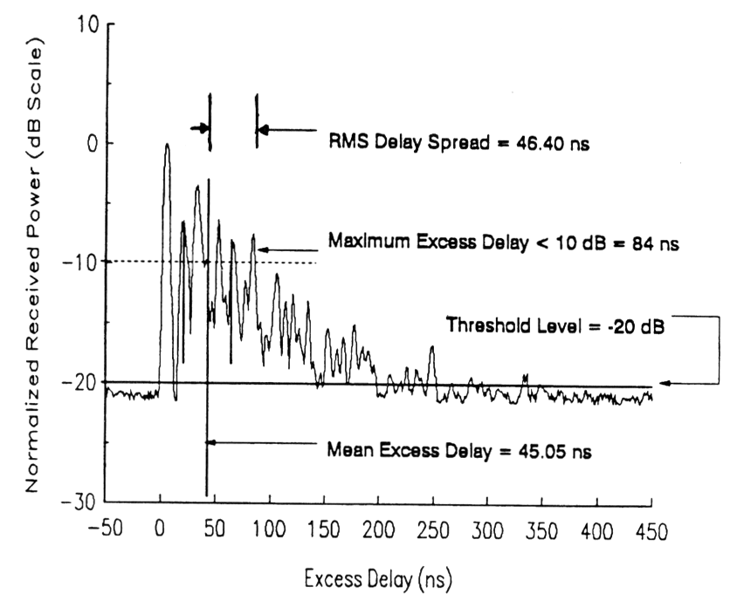
Indoor power delay profile

Slide 35
Flat Fading
Channel
Not shown above!
Slow down → sending data over a narrow bandwidth channel
  Channel is constant over its bandwidth
  Multipath is still present, so channel strength fluctuates over time
    How to model this fluctuation?

Slide 36
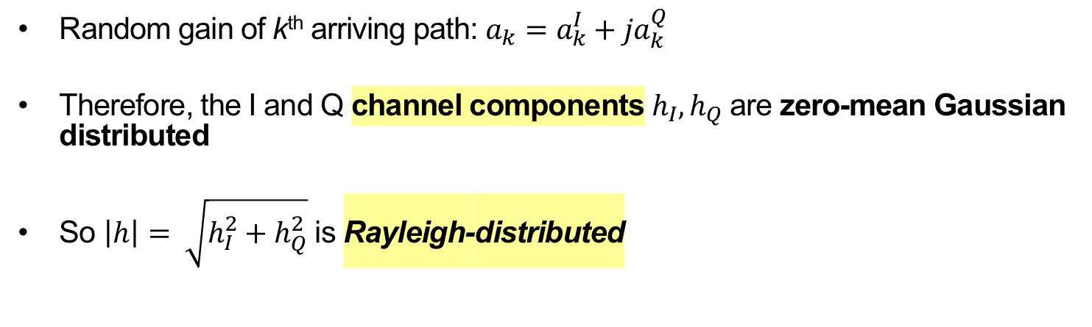

Rayleigh Fading Model
Channel impulse response h(t)
a₁
a₂
a₃
τ₁
τ₂
τ₃
t
Random gain of k^{th} arriving path: $a_{k}=a_{k}^{I}+ja_{k}^{Q}$
Therefore, the I and Q channel components $h_{I}, h_{Q}$ are zero-mean Gaussian distributed
So $\left|h\right|= \sqrt{h_{I}^{2}+h_{Q}^{2}}$ is Rayleigh-distributed
Rayleigh PDF
$$σ$$

Slide 37
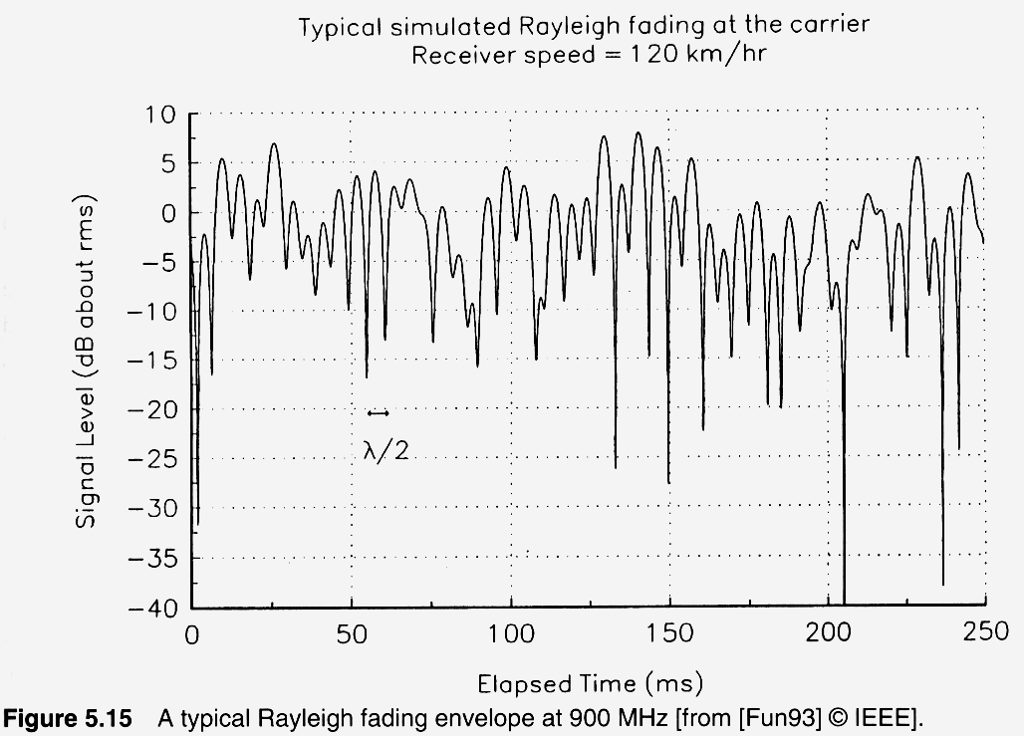
Rayleigh fading example

Slide 38
Putting it all Together: Ray Tracing
Approximate solutions to Maxwell’s electromagnetic equations by instead representing wavefronts as particles, traveling along rays
  Apply geometric reflection, diffraction, scattering rules
    Compute angle of reflection, angle of diffraction
Error is smallest when receiver is many λ from nearest scatterer, and all scatterers are large relative to λ
Good match to empirical data in rural areas, along city streets (radios close to ground), and indoors
Completely site-specific
  Changes to site may invalidate model

Slide 39
Today
Large scale channel models
Small-scale channel models
Equalization: Coping with the channel

Slide 40
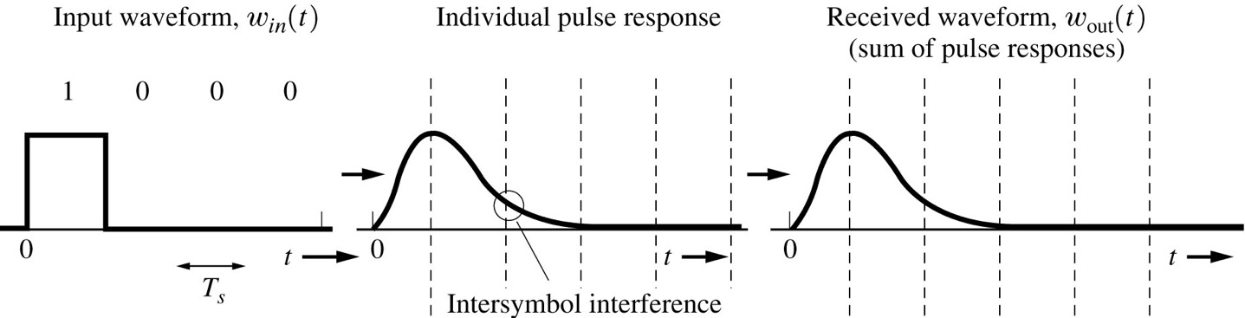
Problem: Inter-symbol interference (ISI)
Transmitted signal
Received signal with ISI

Slide 41
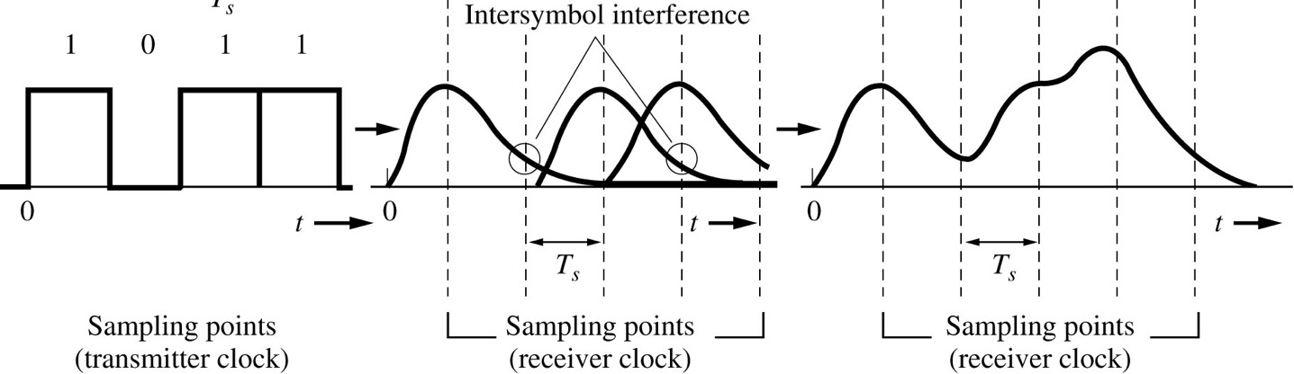
Problem: Inter-symbol interference (ISI)
Transmitted signal
Received signal with ISI
ISI at one symbol depends on the value of other symbols

Slide 42
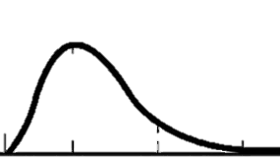
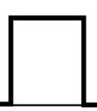
One Solution: Slow down
1
No ISI
Transmitted signal
Received signal

Slide 43


Channel Model
Transmitter
d_{k}
p(t)
Transmit filter
Wireless Channel
h(t)
Receiver
y_{t}
y[n]
h*(-t)
h_{eq}(t)
$$\hat{dk}$$
Matched filter
Equalizer
$$f\left(t\right)=\left(p∗h\right)\left(t\right)∗h^{∗}(−t)$$
Composite channel (made up of pulse shape, radio channel, and matched filter)

Slide 44
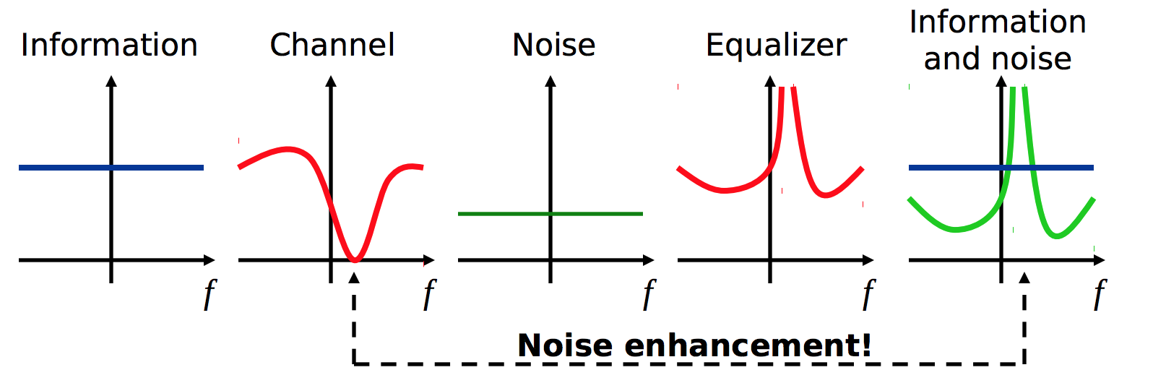
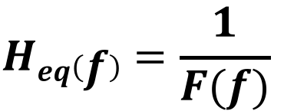
Another Solution I:
Zero-forcing Equalizer
Receiver
Noise: n_{k}
y_{t}
y[n]
+
h*(-t)
h_{eq}(t)
$$\hat{dk}$$
Matched filter
Equalizer
$$Heq\left(f\right)=\frac{1}{F(f)}$$

Slide 45
Preamble
Preamble
Packet body
Sequence of symbols known to both transmitter & receiver

Slide 46
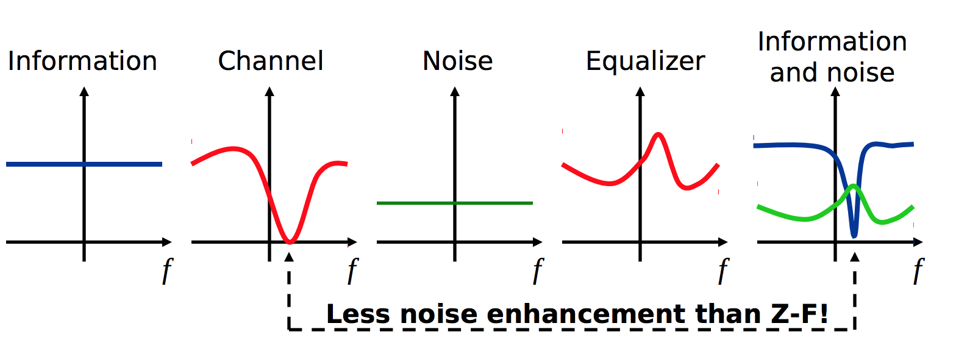
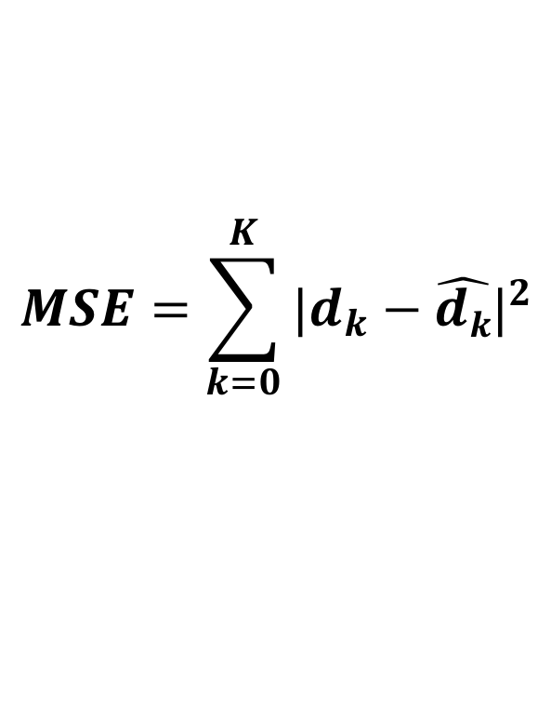
Another Solution II: MSE Equalizer
Goal: Minimizing mean-squared error (MSE) between received symbols & transmitted symbols
Assumes Receiver has a preamble
$$MSE=\sum_{k=0}^{K}{{|d_{k}−\hat{dk}|}^{2}}$$

Slide 47
Another Solution III: Decision-feedback Equalizer
Idea: Subtract the interference caused by already detected data (symbols)
Noise: n_{k}
Decision device
y_{t}
y[n]
+
+
h*(-t)
w (t)
+
$$\hat{dk}$$
-
Matched filter
Forward filter
d(t)
This part shapes the signal to work well with the decision feedback.
Feedback filter
This part removes ISI on “future” symbols from the currently detected symbols.

Slide 48

Another Solution III: Decision-feedback Equalizer
The forward filter w(t) here uses a linear equalizer
  e.g., zero-forcing, MSE
$F（f）W\left(f\right)−D\left(f\right)=1$
The DFE has access to the symbol decisions
Noise: n_{k}
Decision device
y_{t}
y[n]
+
+
h*(-t)
w (t)
+
$$\hat{dk}$$
-
Matched filter
Forward filter
d(t)
Feedback filter

Slide 49
Thursday Topic:
OFDM
Friday Precept:
Lab 4: BPSK Radio

