Slide 1
Preliminaries: Radio Communication,
Modulation, and Filtering
COS 463: Wireless Networks
Lecture 11
Kyle Jamieson
[Parts adapted from I. Darwazeh, H. Balakrishnan, M. Perrot, C. Sodini , P. Steenkiste]

Slide 2
Today
Radio fundamentals
  Radio Frequency (RF) Spectrum
  Energy and Noise
Introduction to Modulation
Introduction to Filtering

Slide 3

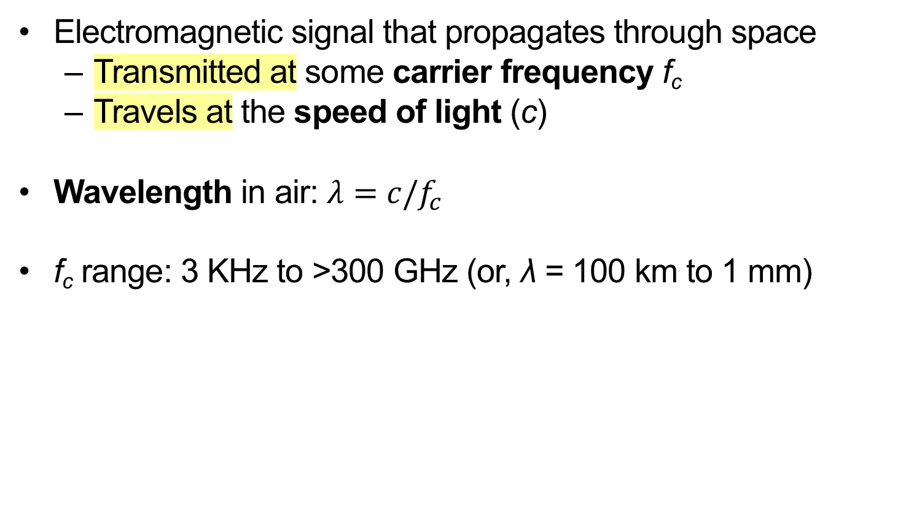
Radio Frequency (RF)
Electromagnetic signal that propagates through space
  Transmitted at some carrier frequency f_{c}
  Travels at the speed of light (c)
Wavelength in air: $λ=c/f_{c}$
f_{c} range: 3 KHz to >300 GHz (or, λ = 100 km to 1 mm)

Slide 4
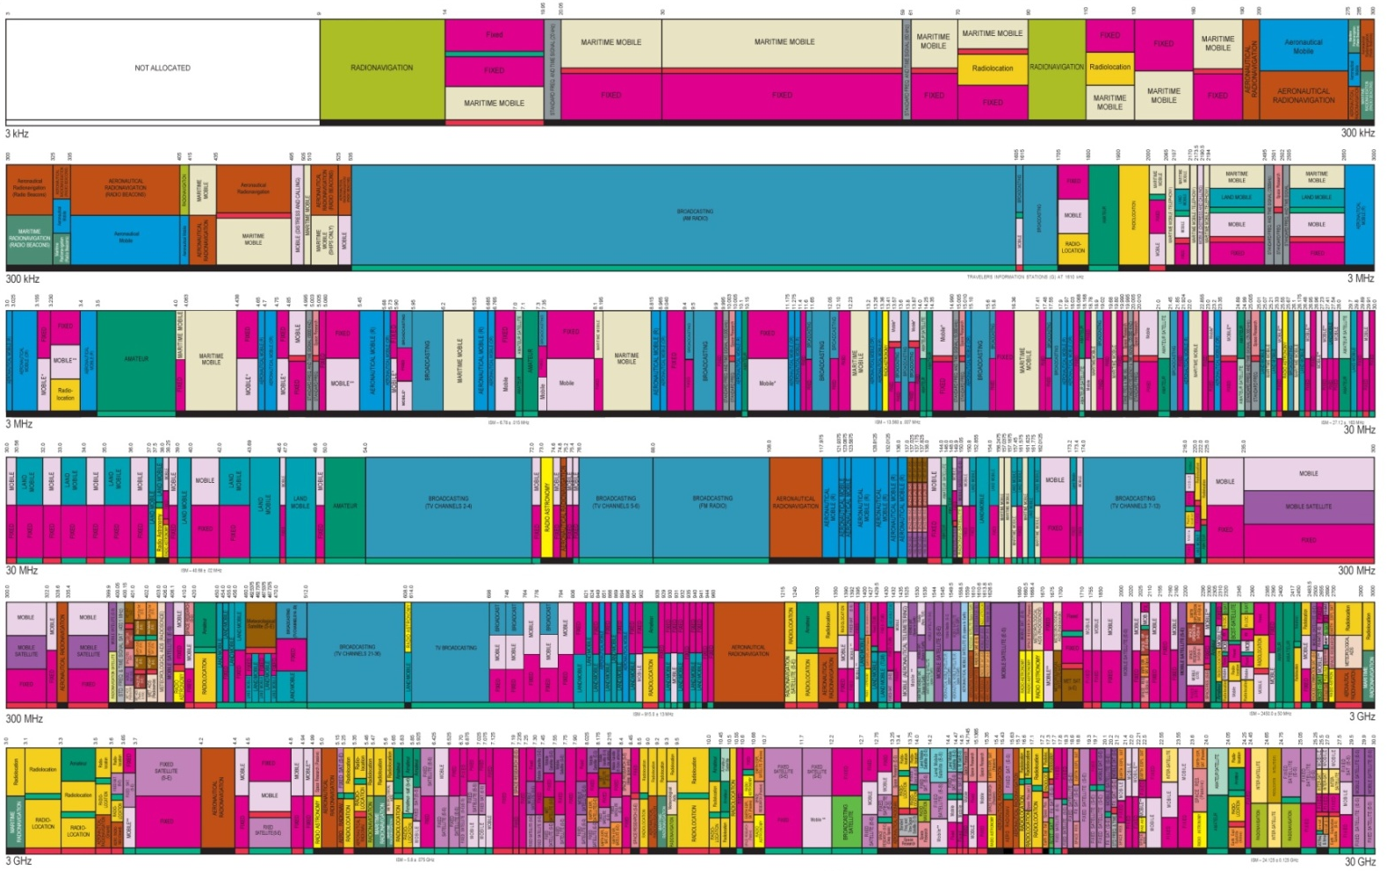
Spectrum allocation in the US

Slide 5
Information Transmission
Information (voice, video, data etc.)
Coded in signals (electromagnetic, optical, acoustic)
Transmitted over a channel (physical medium such as free space, fiber, wire etc.)
Transmitter
Channel
Receivers
Input
Output
Information
Signal
Information
Signal

Slide 6
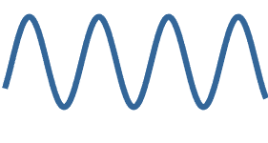
Key Tool: Fourier Series
Motivation: x(t) is our information waveform
A periodic waveform x(t) can be represented as a sum of weighted (a_{n}) sinusoids of different frequencies ω_{n}
x(t)
sin(ω₁t)
t
= a₀ + a₁ ×
sin(ω₂t)
+ a₂ ×
sin(ω₃t)
+ a₃ ×
+ ⋯
t

Slide 7
Frequency Domain View
Plot the weights a_{n} versus the frequencies ω_{n}:
x(t)
t
a₂
a₁
a₃
a₀
ω₀
ω₁
ω₂
ω₃
frequency

Slide 8
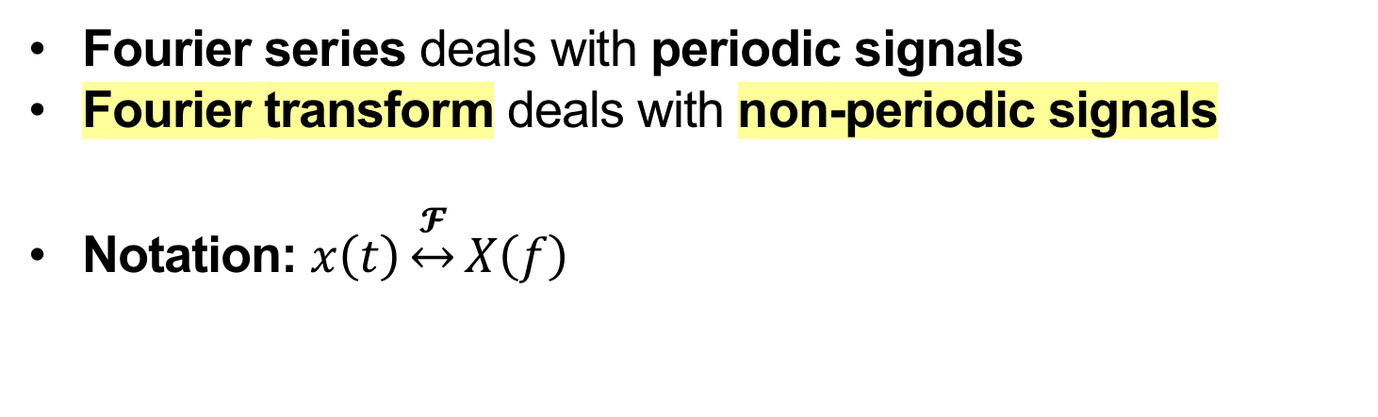
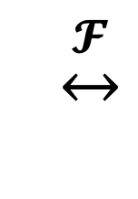
Fourier Transform
Fourier series deals with periodic signals
Fourier transform deals with non-periodic signals
Notation: $x\left(t\right)\underset{↔}{𝓕}X\left(f\right)$
$$\underset{↔}{𝓕}$$
Amplitude
Amplitude
Time
Frequency

Slide 9
Key Tool: The Impulse Function
An impulse of area A at time t₀ is denoted:
Defined in terms of its properties when combined with other (information carrying) signals
Aδ(t-t₀)
A
t₀
t

Slide 10
Fourier Transform of cosine wave

Slide 11
Today
Radio fundamentals
  Radio Frequency (RF) Spectrum
  Energy and Noise
Introduction to Modulation and Demodulation
Introduction to Filtering

Slide 12
Wireless Transmission
Physical medium of wireless channel usually free space
Radio wavelength inversely proportional to frequency (1 GHz → 30 cm, while 1 KHz → 30 km wavelength)
Since antenna and component size is related to wavelength we want to move the information signal to a higher frequency for smaller devices

Slide 13

Sinusoidal carrier signal
RF signal propagates away from transmitter at light speed c
At an instant in time: signal “looks” sinusoidal in space
At a point in space: signal oscillates sinusoidally in time
c
Transmitter

Slide 14
Goal of Modulation
Given an information signal
Example: Voice signal with 4 KHz bandwidth
Magnitude
Voice
signal
-900 MHz
-4 kHz
0
4 kHz
900 MHz
Frequency
Shift information signal to the carrier frequency
Example: 900 MHz carrier frequency
→ Information signal modulates (changes) the carrier signal

Slide 15
Carrier signal parameters
The information signal modulates the carrier’s parameters:
Wavelength
Amplitude
Phase
t

Slide 16
Goal of Demodulation
Given a transmitted signal,
Example: Voice signal centered at 900 MHz
Magnitude
Voice
signal
-900 MHz
-4 kHz
0
4 kHz
900 MHz
Frequency
Recover the original signal from the transmission.
Example: 4 KHz bandwidth voice signal centered at 0 Hz

Slide 17
Impulse: Sampling Property
Multiplication of a function x(t) with an impulse at time t₀:
Results in scaling the impulse by the value of x(t) at t₀
δ(t-t₀)
A
t₀
t
x(t)
×
t₀
t
=
x(t₀)
t₀
t

Slide 18
Impulse: Convolution Property
Convolution of a function x(t) with an impulse at time t₀:
Results in a time shift of x(t) by t₀
δ(t-t₀)
A
t₀
t
x(t)
*
t
=
0
t₀
t

Slide 19
Impulse: Convolution in Frequency
Convolve function X(f) with impulse at frequency f₀:
Results in a frequency shift of X(f) by f₀
δ(f−f₀)
A
f₀
f
X(f)
*
f
=
0
f₀
f

Slide 20
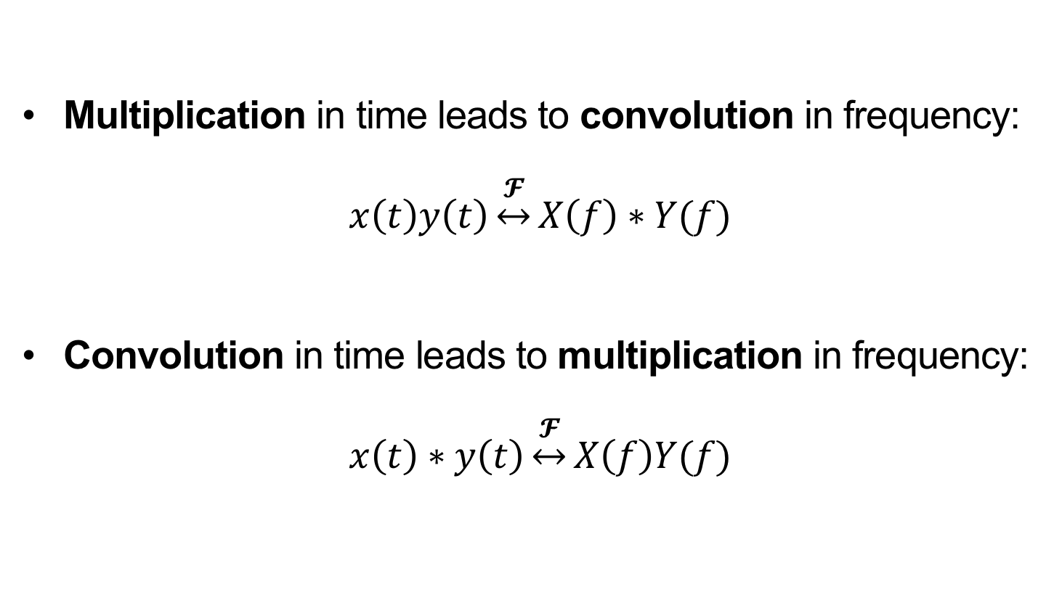
Duality of Convolution and Multiplication
Multiplication in time leads to convolution in frequency:
$$x\left(t\right)y\left(t\right)\underset{↔}{𝓕}X\left(f\right)∗Y(f)$$
Convolution in time leads to multiplication in frequency:
$$x\left(t\right)∗y\left(t\right)\underset{↔}{𝓕}X\left(f\right)Y(f)$$

Slide 21
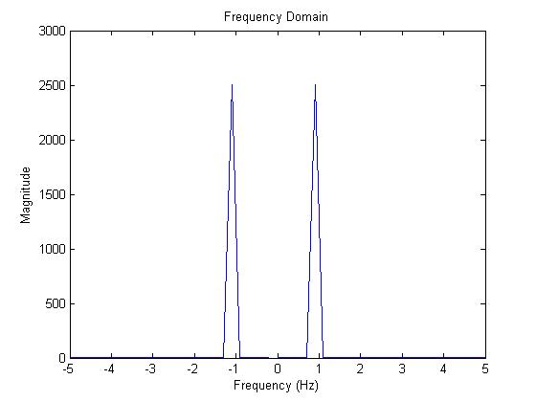
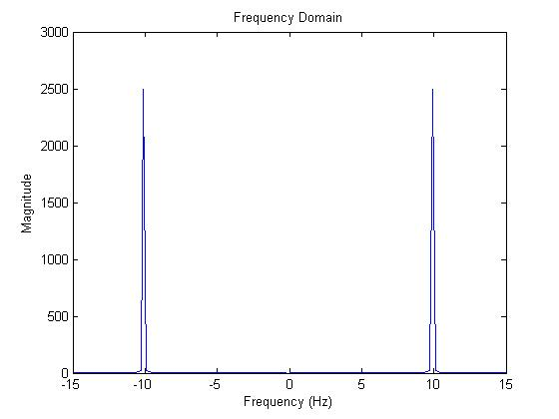
Principle of Modulation
Given a cosine wave at frequency f₁ (1 Hz)
Modulate it with carrier at frequency f₂ (10 Hz) by multiplication
cos(2πt)
cos(2π10t)
Magnitude
Magnitude
frequency (Hz)
frequency (Hz)
Modulate the two cosines: cos(2πt) × cos(2π10t)

Slide 22
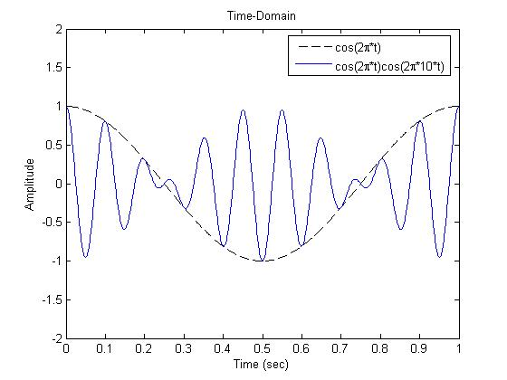
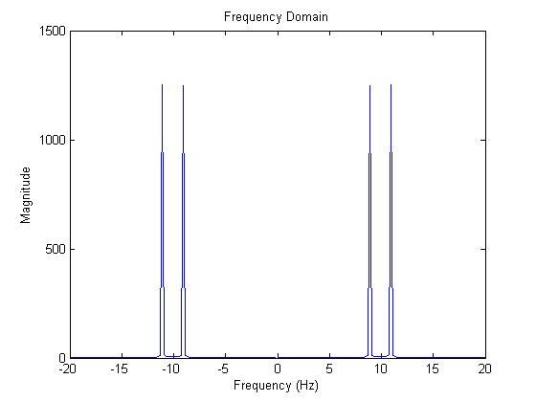
Time Domain and Frequency Domain
Views of Modulation
Time Domain
Frequency Domain
f₁+f₂ = 11 Hz Cosine
Magnitude
Magnitude
f₁−f₂ = 9 Hz Cosine
Time (s)
frequency (Hz)

Slide 23
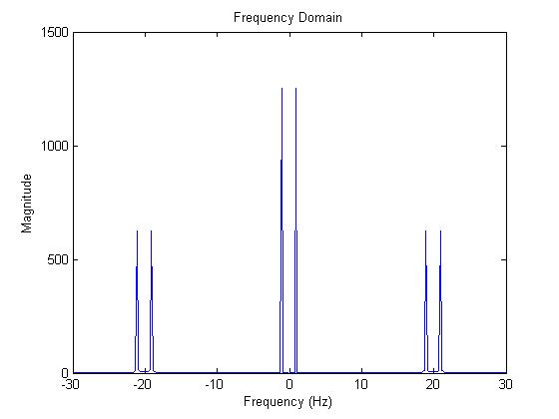
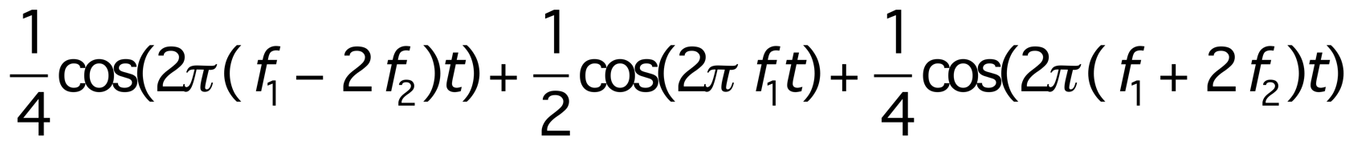
Principle of Demodulation
Receiver multiplies the modulated signal containing f₁−f₂ and f₁ + f₂ by a copy of the carrier signal: cos(2πf₂t)
Result contains original signal and higher frequency sinusoids:
Frequency Domain
Original signal
How to remove the higher frequency sinusoids?
Magnitude
Frequency (Hz)

Slide 24
Today
Radio fundamentals
Introduction to Modulation and Demodulation
Introduction to Filtering

Slide 25
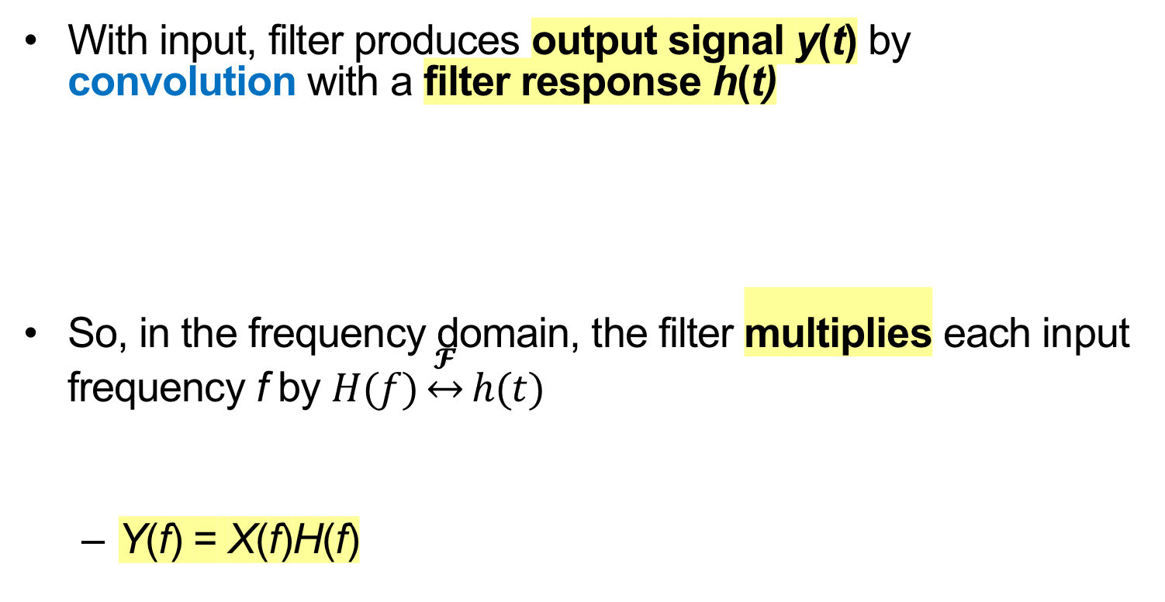
The Concept of Filtering
With input, filter produces output signal y(t) by convolution with a filter response h(t)
So, in the frequency domain, the filter multiplies each input frequency f by $H(f)\underset{↔}{𝓕}h(t)$
  Y(f) = X(f)H(f)
x(t)
h(t)
y(t)
X(f)
H(f)
Y(f)

Slide 26
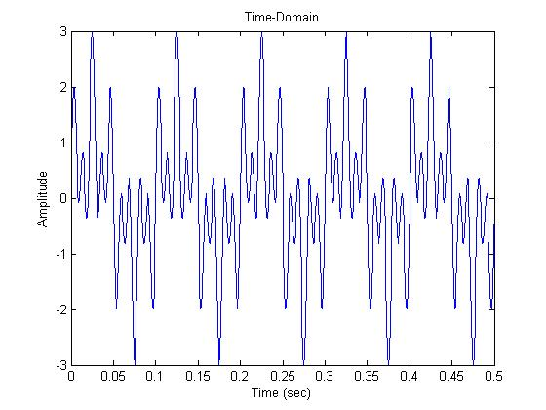
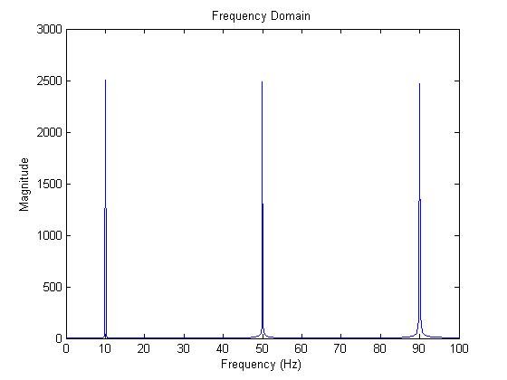
Example Input Signal to Filter
Input signal: Sum of three sinusoids (10, 50, 90 Hz)
h(t)
y(t)
time (s)
↕︎𝓕
10 Hz
50 Hz
90 Hz
f (Hz)

Slide 27
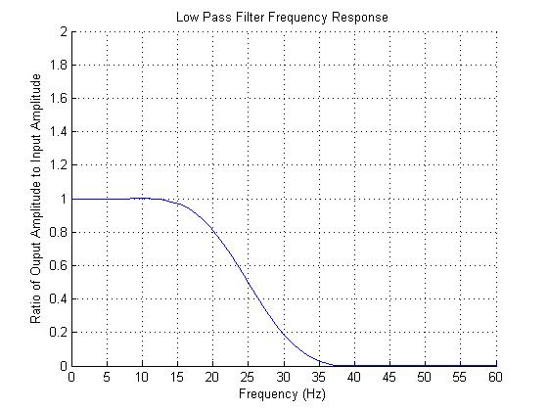
Low Pass Filter Example
H(f) = 1 below 20 Hz, approaches 0 above 20 Hz
h(t)
y(t)
time (s)
↕︎𝓕
H(f)
10 Hz
50 Hz
90 Hz
1
0
20 Hz
f (Hz)
f (Hz)

Slide 28
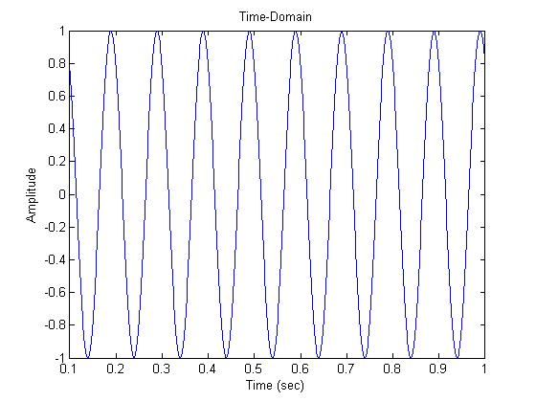
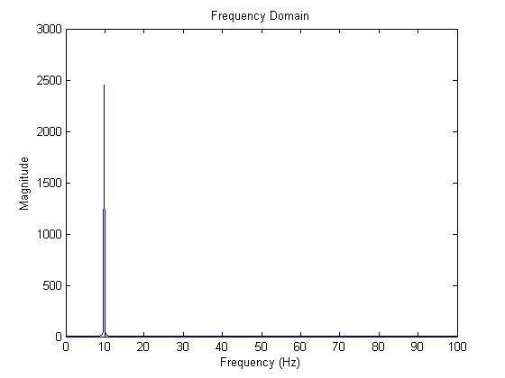
Low Pass Filter Output
H(f) = 1 below 20 Hz, approaches 0 above 20 Hz
h(t)
time (s)
time (s)
↕︎𝓕
H(f)
↕︎𝓕
10 Hz
50 Hz
90 Hz
1
0
20 Hz
f (Hz)
f (Hz)

Slide 29
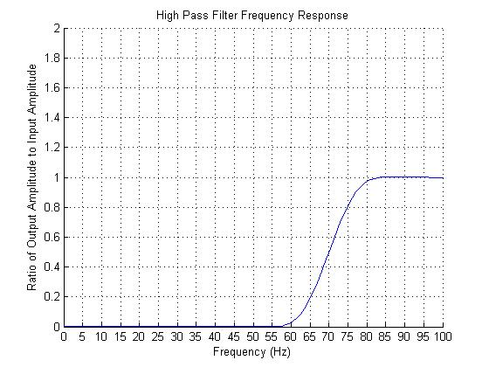
High Pass Filter Example
H(f) = 0 below 70 Hz, approaches 1 above 70 Hz
h(t)
y(t)
time (s)
↕︎𝓕
H(f)
10 Hz
50 Hz
90 Hz
1
70 Hz
0
f (Hz)
f (Hz)

Slide 30
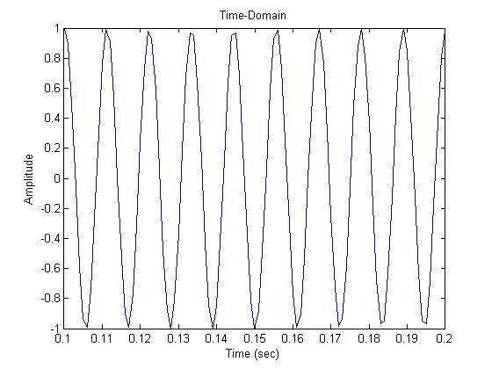
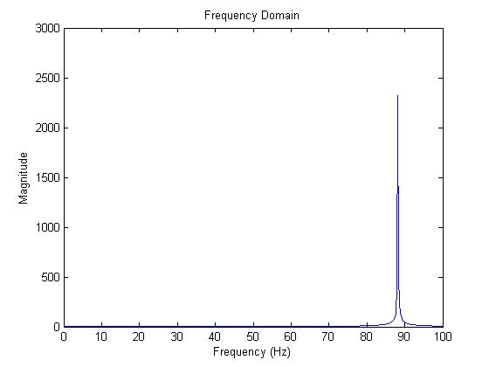
High Pass Filter Output
H(f) = 0 below 70 Hz, approaches 1 above 70 Hz
h(t)
time (s)
time (s)
↕︎𝓕
H(f)
10 Hz
50 Hz
90 Hz
1
70 Hz
0
f (Hz)
f (Hz)
f (Hz)

Slide 31
Bandpass Filter: Motivation
RF Transmitter
RF Receiver
Magnitude
Magnitude
Voice signal
0
4 kHz
900 MHz
0
900 MHz
Frequency
Frequency
Want to receive exclusively a certain frequency band of interest
  In presence of other communication on adjacent channels

Slide 32
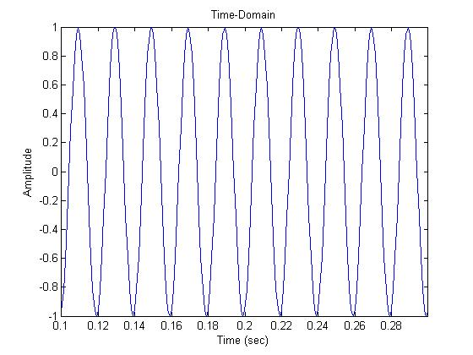
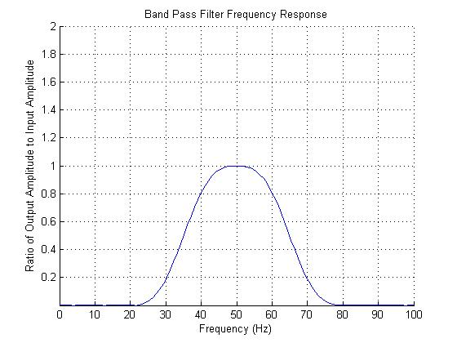
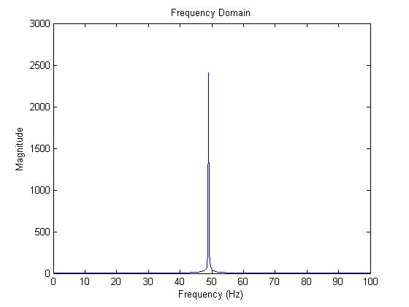
Bandpass Filter Output
H(f) = 0 below 30 Hz, above 70 Hz, approaches 1 elsewhere
h(t)
time (s)
time (s)
↕︎𝓕
H(f)
10 Hz
50 Hz
90 Hz
1
30 Hz
70 Hz
0
f (Hz)
f (Hz)
f (Hz)

Slide 33
Today
Radio fundamentals
Introduction to Modulation and Demodulation
  AM Radio
  Performance metrics
Introduction to Filtering

Slide 34
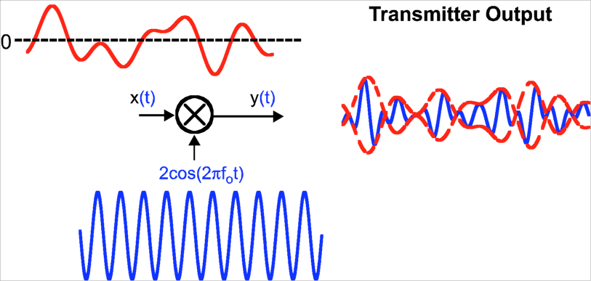
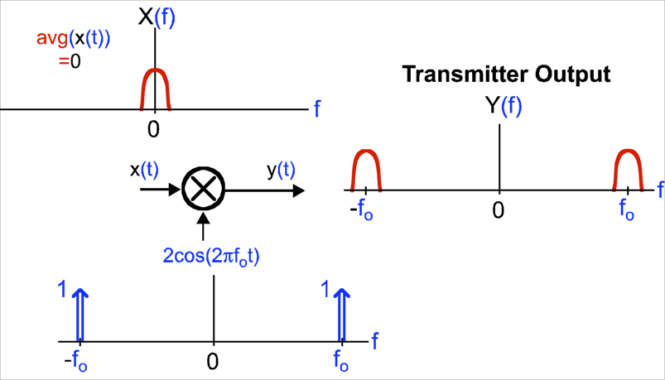
AM Radio Transmitter
x(t)
Time domain view:
Carrier signal (f₀ Hz):
Carrier signal:
Frequency domain view:
Carrier signal (f₀ Hz):

Slide 35
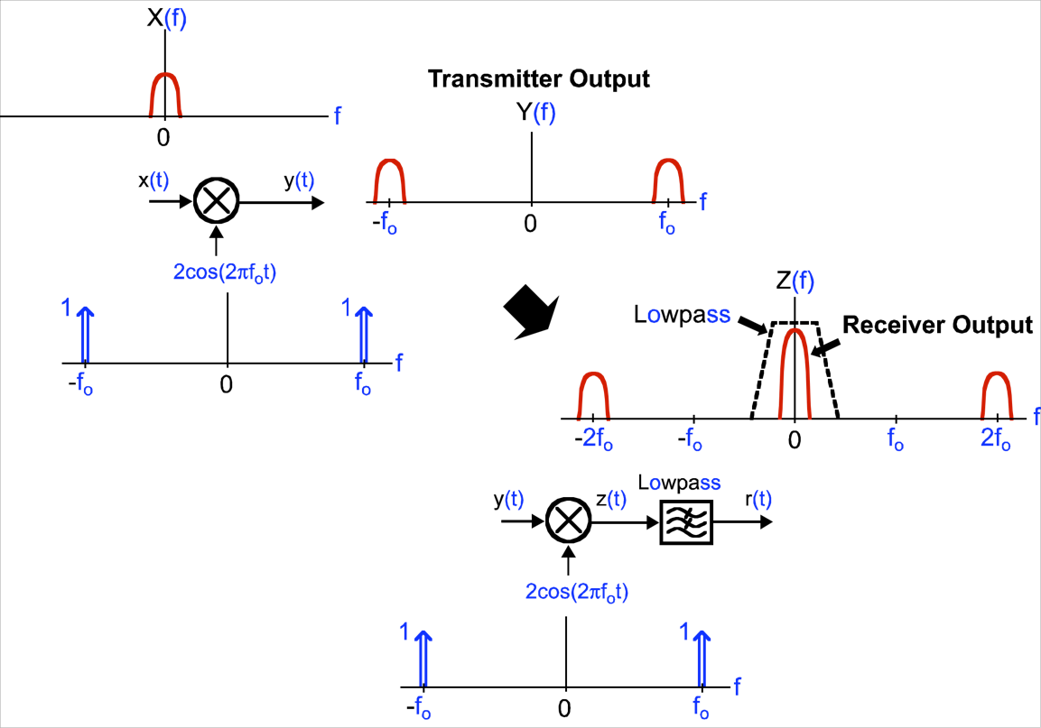
Demodulation: Frequency Domain View
Transmitter:
Receiver:

Slide 36
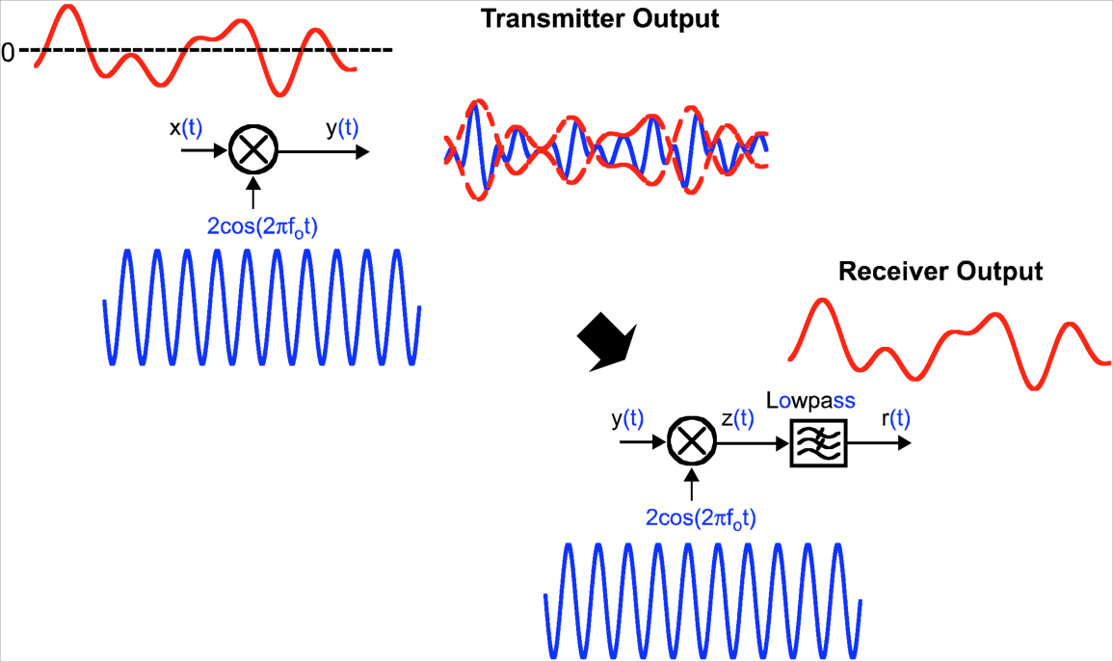
Demodulation: Time Domain View
Transmitter:
Receiver:

Slide 37
Impact of a frequency offset
Frequency offset ε at receiver corrupts the output signal r(t)

Slide 38
Today
Radio fundamentals
  Radio Frequency (RF) Spectrum
  Energy and Noise
Introduction to Modulation
Introduction to Filtering

Slide 39
The Issue of Noise
RF Receiver
Desired signal
Magnitude
Noise
0
900 MHz
Frequency
Noise: Unpredictable, corrupting signal that adds to desired signal
  For RF receiver, mostly comes from analog receiver amplifier circuitry
Undesired signals also add to and corrupt desired signal

Slide 40
Energy Transfer in Wireless Communication
RF Transmitter
RF Receiver
Desired signal
Magnitude
Noise
0
900 MHz
Frequency
Receiver antenna captures a limited amount of desired signal’s energy
  Depending on antenna size, distance, environment

Slide 41
Signal versus Noise
RF Transmitter
RF Receiver
Desired signal
Magnitude
Noise
0
900 MHz
Frequency
Moving transmitter closer to receiver generally increases desired signal energy
Noise from analog receiver circuitry remains unchanged
Next few lectures: How is system performance impacted?

Slide 42
Today
Radio fundamentals
Introduction to Modulation and Demodulation
  AM Radio
  Performance metrics
Introduction to Filtering

Slide 43
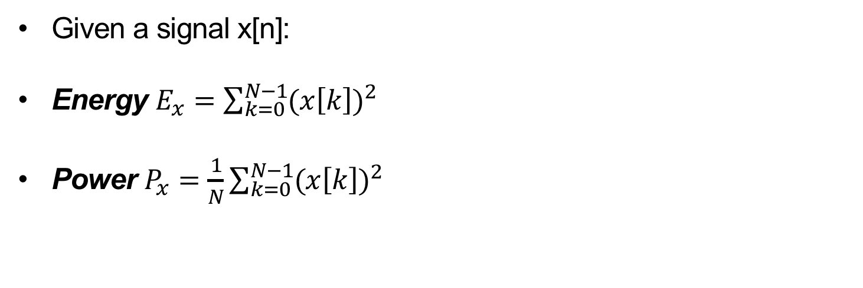
Definition of Power, Energy
Given a signal x[n]:
Energy $E_{x}=\sum_{k=0}^{N−1}{{(x\left[k\right])}^{2}}$
Power $P_{x}=\frac{1}{N}\sum_{k=0}^{N−1}{{(x\left[k\right])}^{2}}$

Slide 44
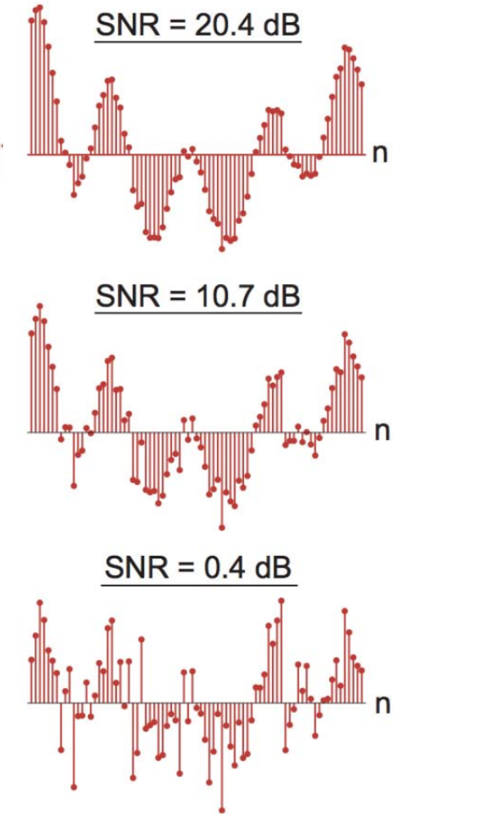
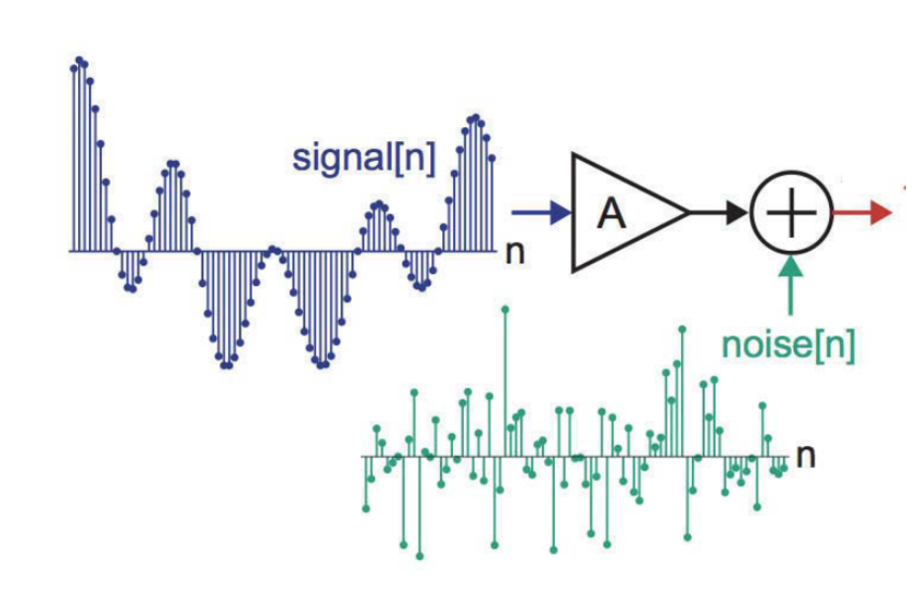
SNR Example

Slide 45
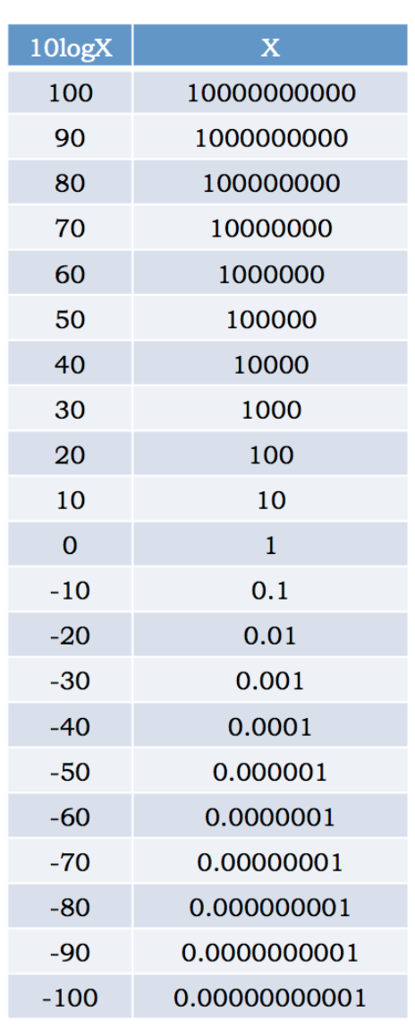
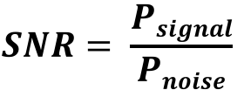
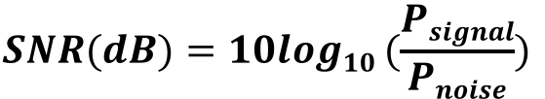
Signal­ to ­Noise Ratio (SNR)
The Signal-to-Noise ratio (SNR) is useful in judging the impact of noise on system performance
SNR is often measured in decibels (dB):
$$SNR= \frac{Psignal}{Pnoise}$$
$$SNR(dB)=10log10 (\frac{Psignal}{Pnoise})$$

Slide 46
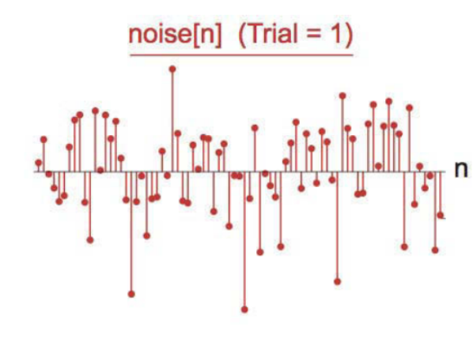
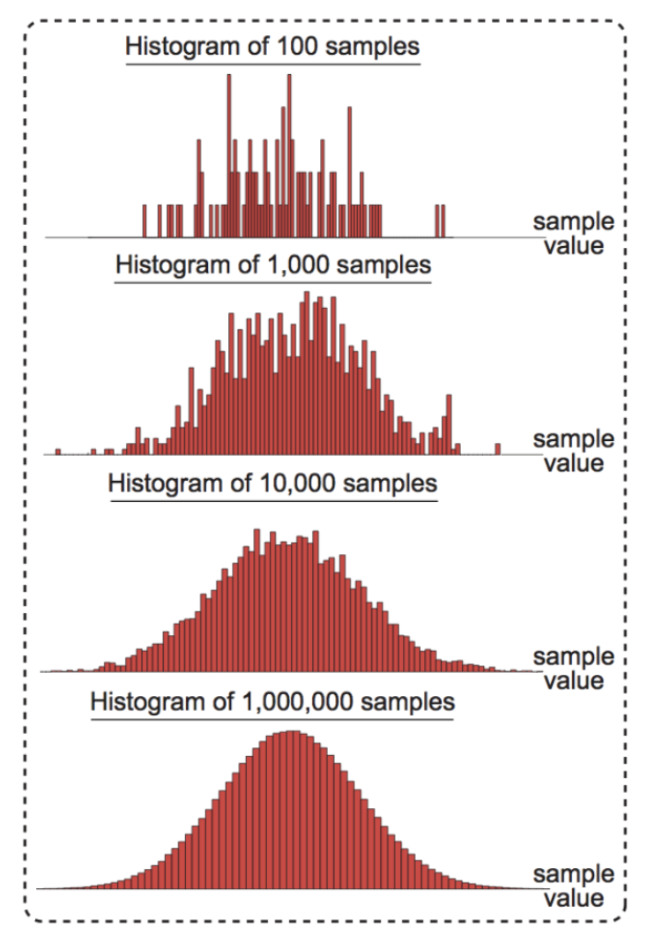
Noise Characterization: From Samples to Histogram
Experiment: create histograms of sample values from signals of increasing lengths
Typically converge to a shape called probability density function (PDF)

Slide 47
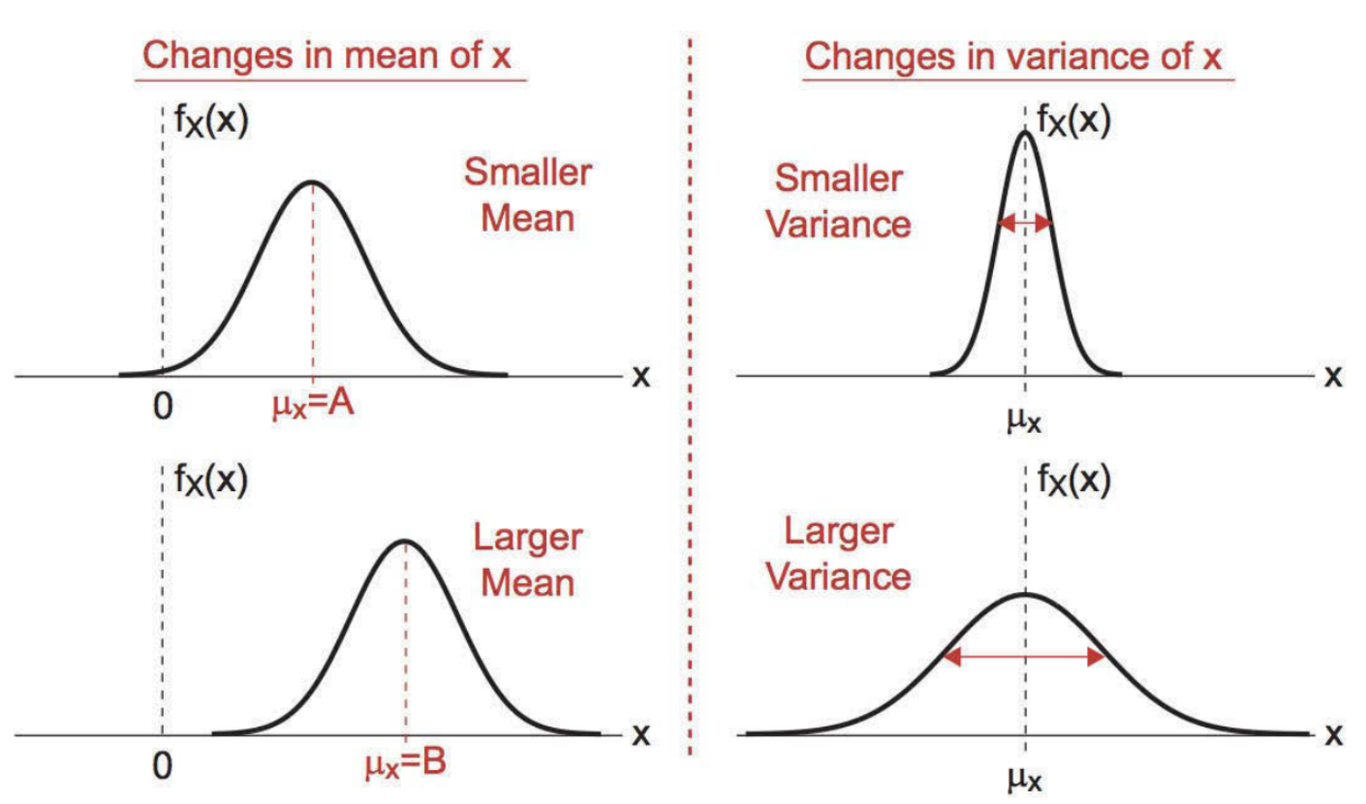
Visualizing Mean and Variance
Changes in mean shift the center of mass of PDF
Changes in variance narrow or broaden the PDF

Slide 48
Summary
Impulse function is an important concept for frequency domain “picture” analysis
  Shifting, sampling properties of impulse explain modulation and demodulation
“Picture analysis” of modulation and filtering
  Modulation shifts in frequency (convolution with impulses)
  Filtering multiplies in frequency

Slide 49
Thursday:
In-Class Midterm (90 minutes)

